Slide 1
CPE 323 Introduction to Embedded Computer Systems: The MSP430 Clock System
Instructor: Dr Aleksandar Milenkovic Lecture Notes

Slide 2
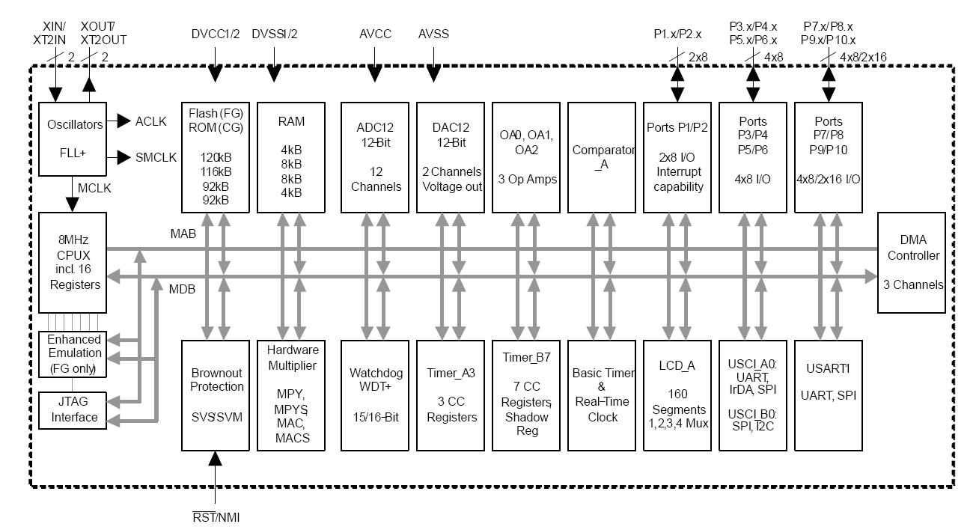
MSP430xG461x Microcontroller

Slide 3
Clock System: An Introduction
Clock – square wave whose edges trigger hardware
Traditional clocks: a crystal with frequency of a few MHz is connected to two μC pins; internally the clock may be divided by 2 or 4.
Typical application cycle in embedded systems
μC stays in a low-power mode until
An event wakes up μC to handle it
Often need multiple clocks (fast for CPU, slow for peripherals)
Power consumption: P ~ CV²f

Slide 4
Clock System: An Introduction
Crystal clocks
Accurate (the frequency is typically within 11 part in 100,000), stable (do not change with time or temperature)
High-frequency (a few MHz) or low-frequency (32,768 Hz) for a real-time clock
Expensive, delicate, draw a relatively large current, require additional components (capacitors), take long time to start up and stabilize
Resistor and capacitor (RC) clocks
Cheap, quick to start
Poor accuracy and stability
Can be external or integrated into a chip

Slide 5
MS430 Clock System
Flexible to address conflicting demands for high-performance, low-power, and a precise frequency
3 internal clocks from 4 possible sources: MCLK, SMCLK, ACLK
Master clock, MCLK: used by the CPU and a few peripherals (e.g., ADC12, DMA, ...)
Subsystem master clock, SMCLK: distributed to peripherals
Auxiliary clock, ACLK: distributed to peripherals
Typical configuration: MCLK and SMCLK are in the megahertz range, ACLK is 32 KHz

Slide 6
MS430 Clock System
Digitally controlled Oscillator, DCO: available in all devices; highly-controllable oscillator
Generated on-chip RC-type frequency controlled by SW + HW
Low- or high-frequency crystal oscillator, LFXT1
LF: 32768Hz
XT: 450kHz .... 8MHz
High-frequency crystal oscillator, XT2
Internal very low-power, low-frequency oscillator, VLO: available in more recent MSP430F2xx devices; provides an alternative to LFXT1 when accuracy is not needed

Slide 7
FLL+ Clock Module (MSP430x4xx)
FLL+ clock module: frequency-locked loop clock module
Characteristics
Low system cost
Ultra-low power consumption
Can operate with no external components
Supports one or two external crystals or resonators (LFXT1 and XT2)
Internal digitally-controlled oscillator with stabilization to a multiple of the LFXT1 watch crystal frequency
Full software control over 4 output clocks: ACLK, ACLK/n, MCLK, and SMCLK

Slide 8
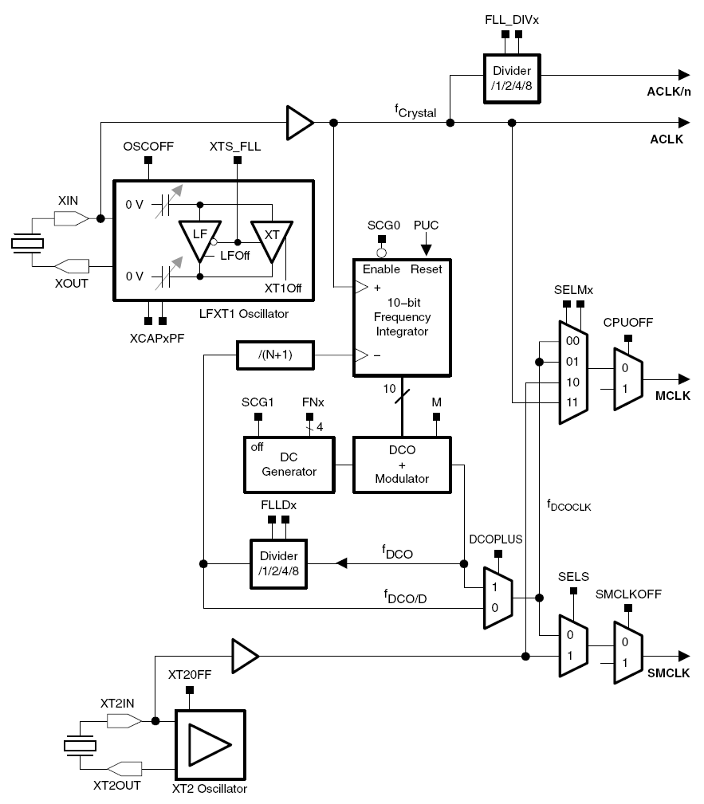
MSP430x461x Frequency- Locked Loop: Block Diagram

Slide 9
FLL+ Clock Module
LFXT1CLK: Low-frequency/high-frequency oscillator that can be used
either with low-frequency 32768-Hz watch crystals, or
standard crystals or resonators in the 450-kHz to 8-MHz range
XT2CLK: Optional high-frequency oscillator that can be used with standard crystals, resonators, or external clock sources in the 450-kHz to 8-MHz range
DCOCLK: Internal digitally controlled oscillator (DCO) with RC-type characteristics, stabilized by the FLL.

Slide 10
FLL+ Clock Module (cont’d)
Four clock signals are available from the FLL+ module
ACLK: Auxiliary clock
The ACLK is the LFXT1CLK clock source. ACLK is software selectable for individual peripheral modules
ACLK/n: Buffered output of the ACLK
The ACLK/n is ACLK divided by 1,2,4 or 8 and only used externally
MCLK: Master clock used by the CPU and system
Software selectable as LFXT1CLK, XT2CLK (if available), or DCOCLK
MCLK can be divided by 1, 2, 4, or 8 within the FLL block
SMCLK: Sub-main clock, used by peripheral modules
Software selectable as XT2CLK (if available), or DCOCLK

Slide 11
FLL+ Clock Module Operation
After a PUC, MCLK and SMCLK are sourced from DCOCLK at 32 times the ACLK frequency
When a 32,768-Hz crystal is used for ACLK, MCLK and SMCLK will stabilize to 1.048576 MHz
Status register control bits SCG0, SCG1, OSCOFF, and CPUOFF configure the MSP430 operating modes and enable or disable components of the FLL+ clock module
SCFQCTL, SCFI0, SCFI1, FLL_CTL0, and FLL_CTL1 registers configure the FLL+ clock module
FLL+ can be configured or reconfigured by software at any time during program execution.
Example, MCLK = 64 × ACLK = 2097152
BIC #GIE,SR ; Disable interrupts
MOV.B #(64−1),&SCFQTL ; MCLK = 64 * ACLK, DCOPLUS=0
MOV.B #FN_2,&SCFIO ; Select DCO range
BIS #GIE,SR ; Enable interrupts

Slide 12
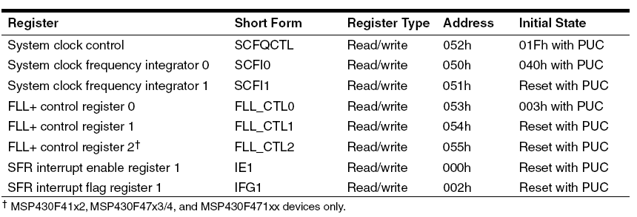
FLL+ Clock Module Registers

Slide 13
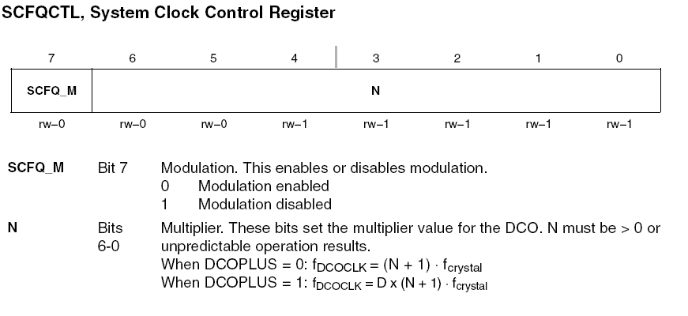
SCFQCTL

Slide 14
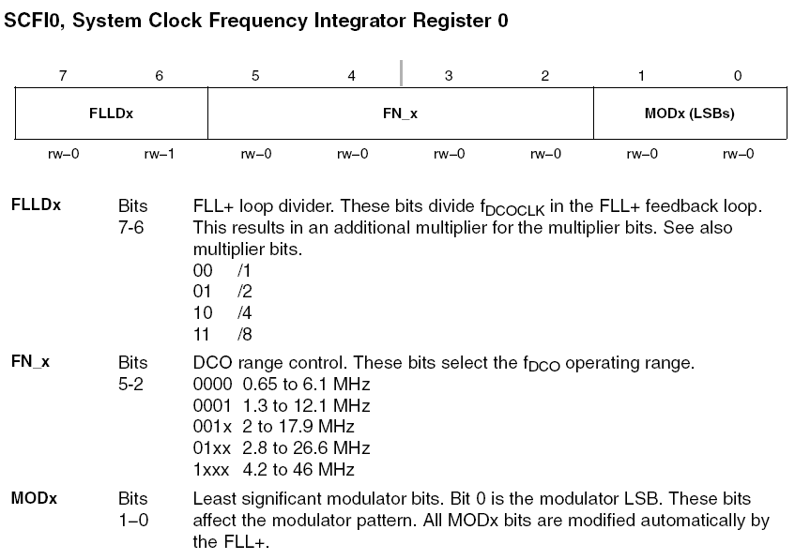
SCFI0

Slide 15
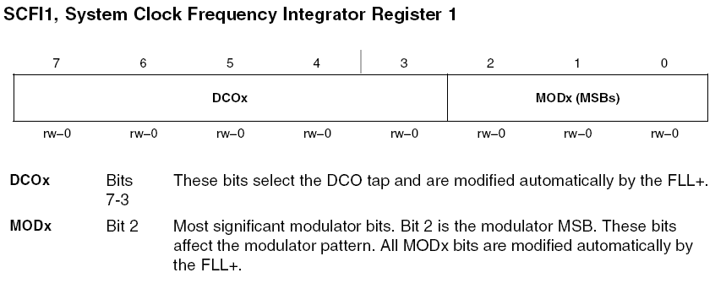
SCFI1

Slide 16
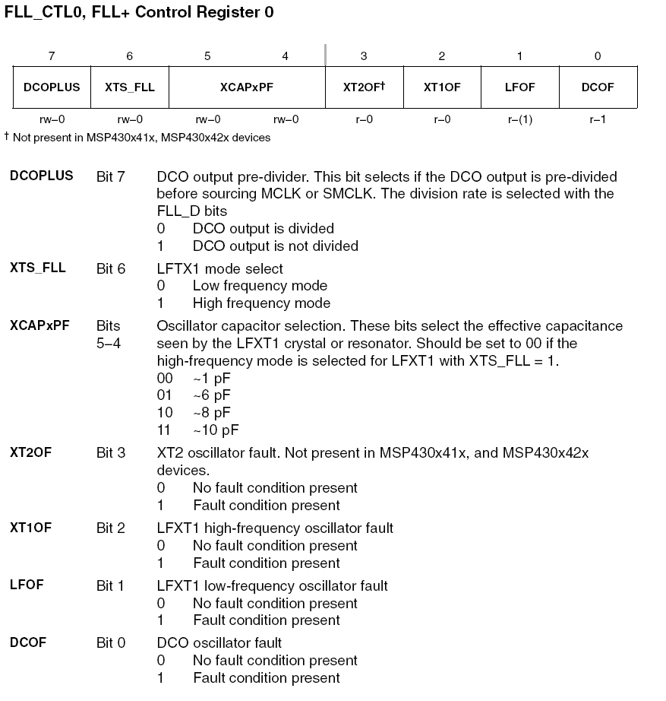
FLL-CTL0

Slide 17
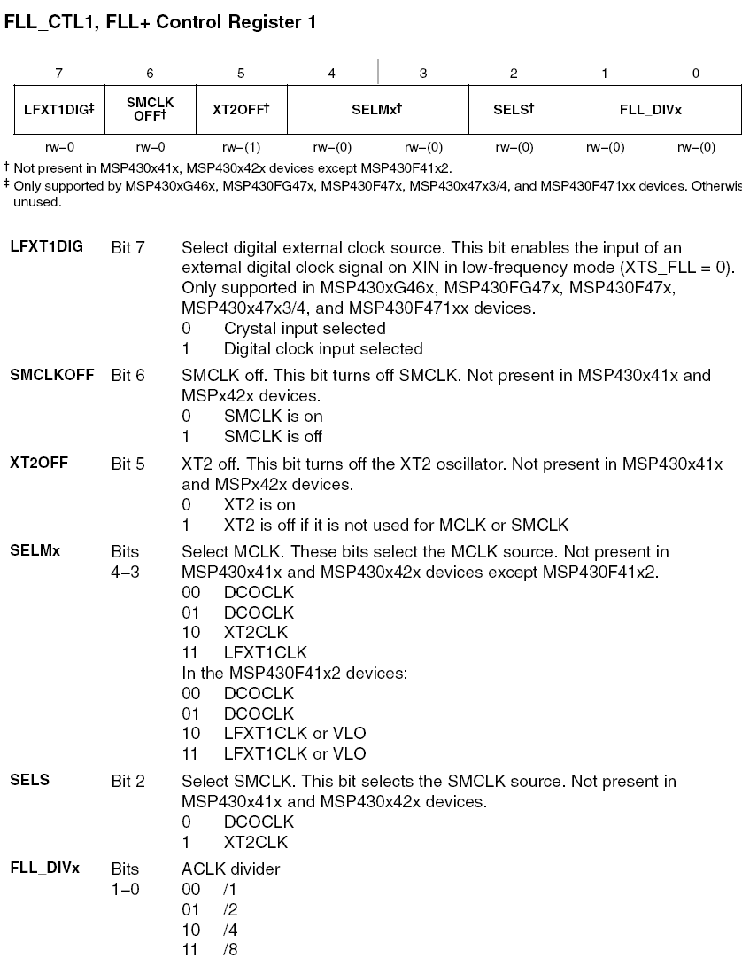
FLL-CTL1

Slide 18
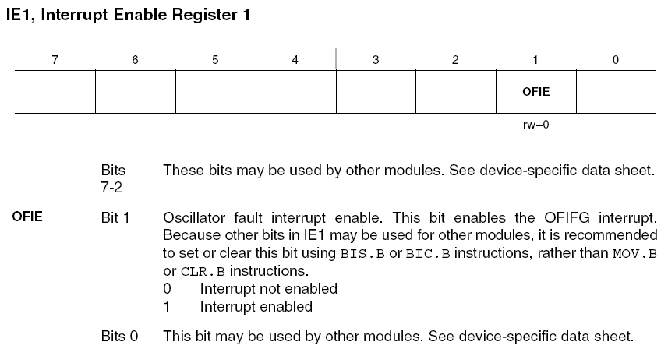
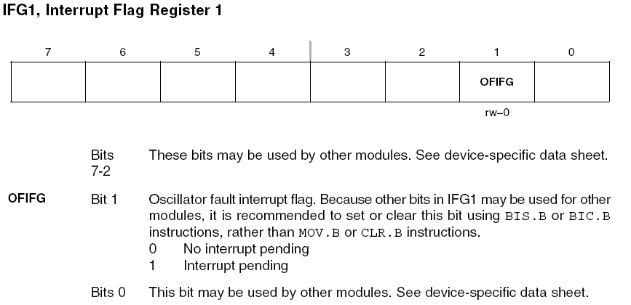
IE1, IFG1

Slide 19
LFXT1 Oscillator
Low-frequency (LF) mode (XTS_FLL=0) with 32,768 Hz watch crystal connected to XIN and XOUT
High-frequency (HF) mode (XTS_FLL=1) with high-frequency crystals or resonators connected to XIN and XOUT (~450 KHz to 8 MHz)
XCPxPF bits configure the internally provided load capacitance for the LFXT1 crystal (1, 6, 8, or 10 pF)
OSCOFF bit can be set to disable LFXT1

Slide 20
XT2 Oscillator
XT2 sources XT2CLK and its characteristics are identical to LFXT1 in HF mode, except it does not have internal load capacitors (must be provided externally)
XT2OFF bit disables the XT2 oscillator if XT2CLK is not used for MCLK and SMCLK

Slide 21
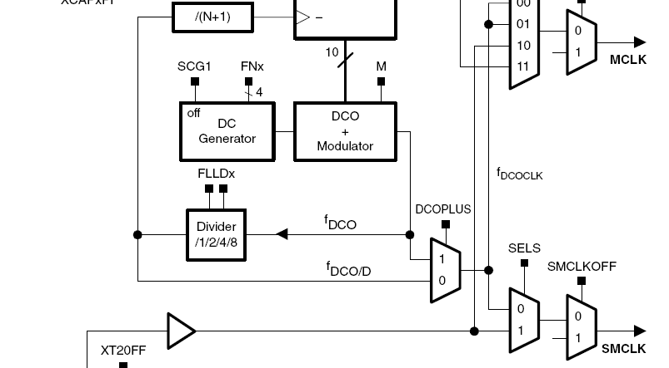
DCO
Integrated ring oscillator with RC-type characteristics
DCO frequency is stabilized by the FLL to a multiple of ACLK as defined by N (the lowest 7 bits of the SCFQCTL register)
DCOPLUS bit sets the f_{DCOCLK} to f_{DCO} or f_{DCO/D} (divider)
FLLDx bits define the divider D to 1, 2, 4 or 8
By default DCOPLUS=0 and D=2 (providing f_{DCOCLK}= f_{DCO/2})
DCOPLUS = 0: f_{DCOCLK} = (N + 1) x f_{ACLK}
DCOPLUS = 1: f_{DCOCLK} = D x (N + 1) x f_{ACLK}

Slide 22
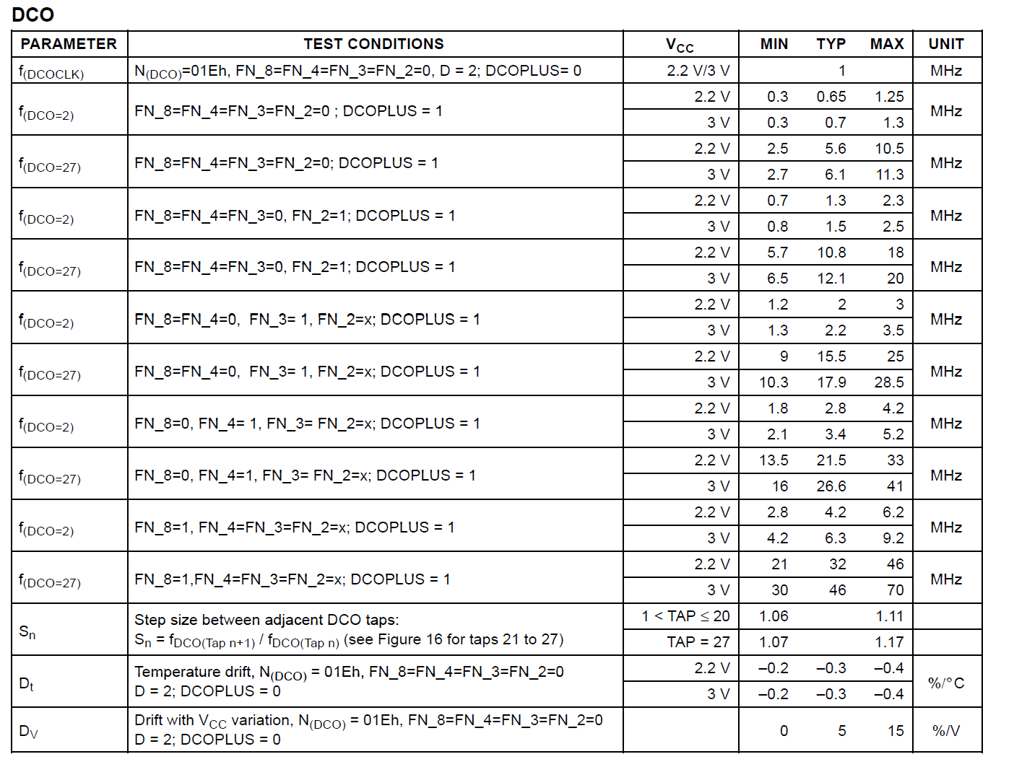
DCO Frequency Range

Slide 23
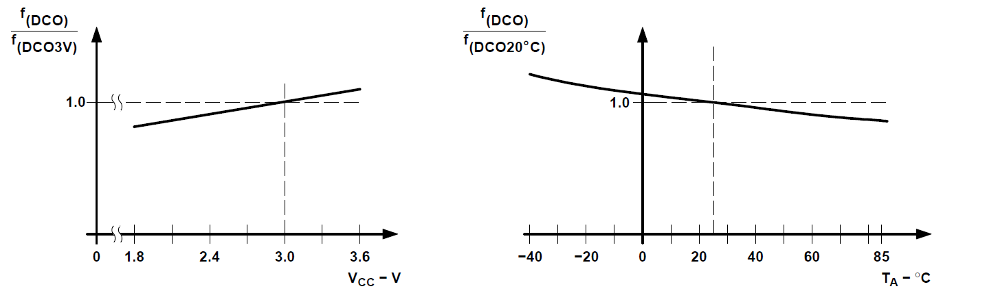
DCO Frequency as f(V_{CC}, T_{A})

Slide 24
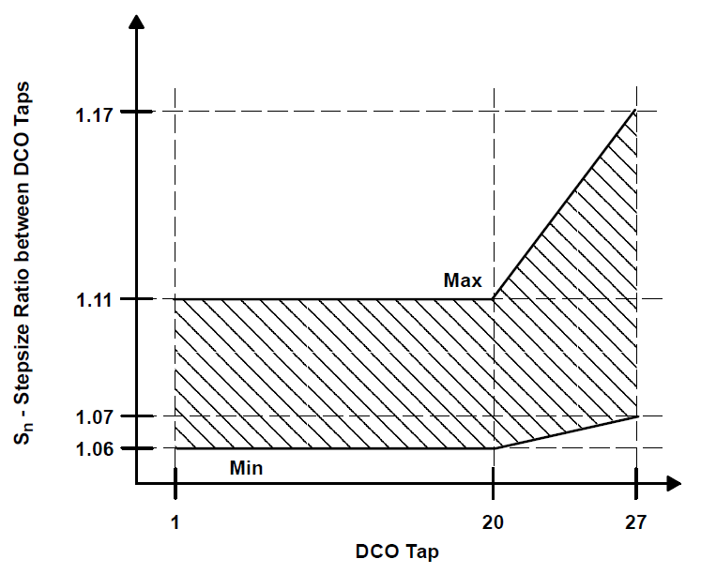
DCO Stepsize Ratio (Sn)

Slide 25
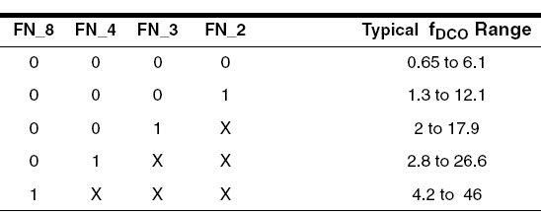
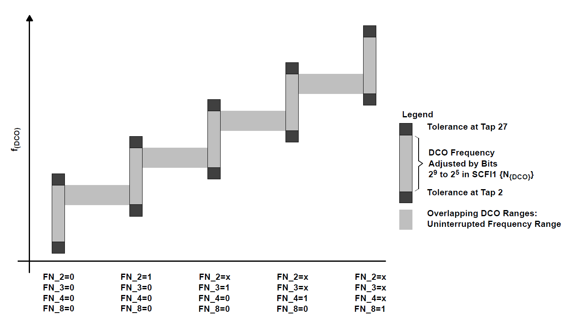
DCO Ranges Controlled by FN bits

Slide 26
Frequency Locked Loop
FLL continuously counts up or down a 10-bit frequency integrator
The output of the frequency integrator that drives the DCO can be read in SCFI1 and SCFI0. The count is adjusted +1 or −1 with each ACLK crystal period.
Five of the integrator bits, SCFI1 bits 7-3, set the DCO frequency tap
Twenty-nine taps are implemented for the DCO (28, 29, 30, and 31 are equivalent), and each is approximately 10% higher than the previous
The modulator mixes two adjacent DCO frequencies to produce fractional taps
SCFI1 bits 2-0 and SCFI0 bits 1-0 are used for the modulator
The DCO starts at the lowest tap after a PUC or when SCFI0 and SCFI1 are cleared
Time must be allowed for the DCO to settle on the proper tap for normal operation. 32 ACLK cycles are required between taps requiring a worst case of 28 x 32 ACLK cycles for the DCO to settle

Slide 27
DCO Modulator
Mixes two adjacent DCO frequencies to produce an intermediate effective frequency and spread the clock energy, reducing electromagnetic interference (EMI)
Mixes the two adjacent frequencies across 32 DCOCLK clock cycles
The error of the effective frequency is zero every 32 DCOCLK cycles and does not accumulate
Modulator settings and DCO control are automatically controlled by the FLL hardware

Slide 28
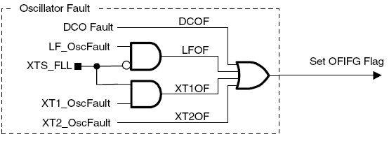
FLL+ Fail-Safe Operation
Incorporates an oscillator-fault fail-safe feature
Detects an oscillator fault for LFXT1, DCO and XT2
Available fault conditions are:
Low-frequency oscillator fault (LFOF) for LFXT1 in LF mode
High-frequency oscillator fault (XT1OF) for LFXT1 in HF mode
High-frequency oscillator fault (XT2OF) for XT2
DCO fault flag (DCOF) for the DCO

Slide 29
Example #1 (DCO on 2.45 MHz)
//******************************************************************************
// MSP430xG46x Demo - FLL+, Runs Internal DCO at 2.45MHz
// Description: This program demonstrates setting the internal DCO to run at
// 2.45MHz with auto-calibration by the FLL+ circuitry.
// ACLK = LFXT1 = 32768Hz, MCLK = SMCLK = DCO = (74+1) x ACLK = 2457600Hz
// MSP430xG461x
// -----------------
// /|\| XIN|-
// | | | 32kHz
// --|RST XOUT|-
// | |
// | P1.1|--> MCLK = 2.45MHz
// | |
// | P1.5|--> ACLK = 32kHz
// | |
//*****************************************************************************
#include <msp430xG46x.h>
void main(void)
{
WDTCTL = WDTPW + WDTHOLD; // Stop watchdog timer
FLL_CTL0 |= XCAP18PF; // Set load capacitance for xtal
SCFI0 |= FN_2; // x2 DCO, 4MHz nominal DCO
SCFQCTL = 74; // (74+1) x 32768 = 2.45Mhz
P1DIR = 0x22; // P1.1 & P1.5 to output direction
P1SEL = 0x22; // P1.1 & P1.5 to output MCLK & ACLK
while(1); // Loop in place
}

Slide 30
Example #2 (DCO at 8 MHz)
//******************************************************************************
// MSP430xG46x Demo - FLL+, Runs Internal DCO at 8MHz
// Description: This program demonstrates setting the internal DCO to run at
// 8MHz with auto-calibration by the FLL+.
// ACLK = LFXT1 = 32768Hz, MCLK = SMCLK = DCO = (121+1) x 2 x ACLK = 7995392Hz
// MSP430xG461x
// -----------------
// /|\| XIN|-
// | | | 32kHz
// --|RST XOUT|-
// | |
// | P1.1|--> MCLK = 8MHz
// | |
// | P1.5|--> ACLK = 32kHz
//
//*****************************************************************************
#include <msp430xG46x.h>
void main(void)
{
WDTCTL = WDTPW + WDTHOLD; // Stop watchdog timer
FLL_CTL0 |= DCOPLUS + XCAP18PF; // DCO+ set, freq = xtal x D x N+1
SCFI0 |= FN_4; // x2 DCO freq, 8MHz nominal DCO
SCFQCTL = 121; // (121+1) x 32768 x 2 = 7.99 MHz
P1DIR = 0x22; // P1.1 & P1.5 to output direction
P1SEL = 0x22; // P1.1 & P1.5 to output MCLK & ACLK
while(1); // Loop in place
}

Slide 31
Example #3 (XT2 HF)
#include <msp430xG46x.h>
void main(void) {
volatile unsigned int i;
WDTCTL = WDTPW+WDTHOLD; // Stop WDT
// Disable LFXT1 xtal osc & FLL loop
_BIS_SR(OSCOFF + SCG0 + GIE);
// Activate XT2 high freq xtal
FLL_CTL1 &= ~XT2OFF;
// Wait for xtal to stabilize
do
{
IFG1 &= ~OFIFG; // Clear OSCFault flag
for (i = 5; i > 0; i--); // Time to set flag
}
// OSCFault flag still set?
while ((IFG1 & OFIFG));
FLL_CTL1 |= SELM1; // MCLK = XT2
P1DIR |= 0x002; // P1.1 output direction
P1SEL |= 0x002; // P1.1 option select
while(1);
}
//******************************************************************************
// MSP430xG46x Demo - FLL+, MCLK Configured to Operate from XT2 HF XTAL
// Description: Proper selection of an external HF XTAL for MCLK is
// demonstrated using HF XT2 OSC. OFIFG is polled until the HF XTAL
// is stable - only then is MCLK sourced by XT2. MCLK is buffered on P1.1.
// MSP430xG46x
// -----------------
// /|\| XIN|-
// | | |
// --|RST XOUT|-
// | |
// | XT2IN|-
// | | HF XTAL (455kHz - 8MHz)
// | XT2OUT|-
// | |
// | P1.1/MCLK|-->MCLK = HF XTAL
//******************************************************************************

