Slide 1
Message Passing in
Synchronous Computations

Slide 2
Synchronous Computations
In a (fully) synchronous application, all the processes synchronized at regular points.
Barrier
A basic mechanism for synchronizing processes - inserted at the point in each process where it must wait.
All processes can continue from this point when all the processes have reached it (or, in some implementations, when a stated number of processes have reached this point).

Slide 3
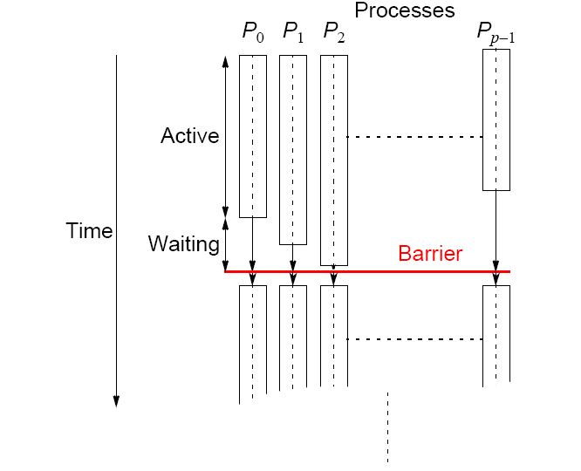
Processes reaching barrier
at different times

Slide 4
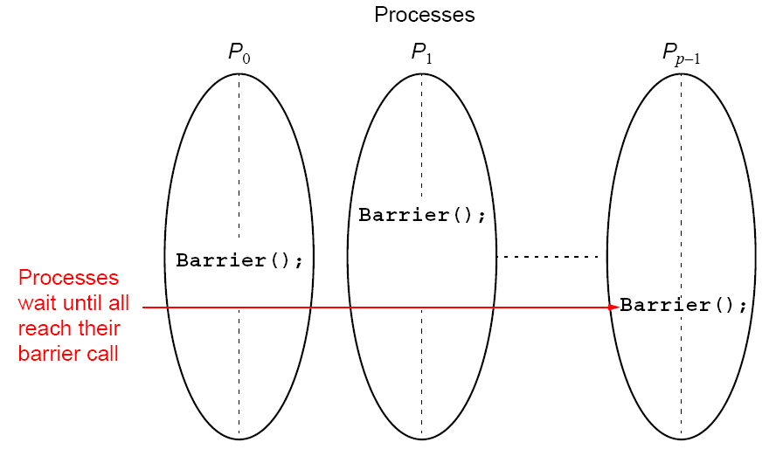
In message-passing systems, barriers provided with library
routines:
64

Slide 5
MPI
MPI_Barrier()
Barrier with a named communicator being the only parameter.
Called by each process in the group, blocking until all members of the group have reached the barrier call and only returning then.

Slide 6
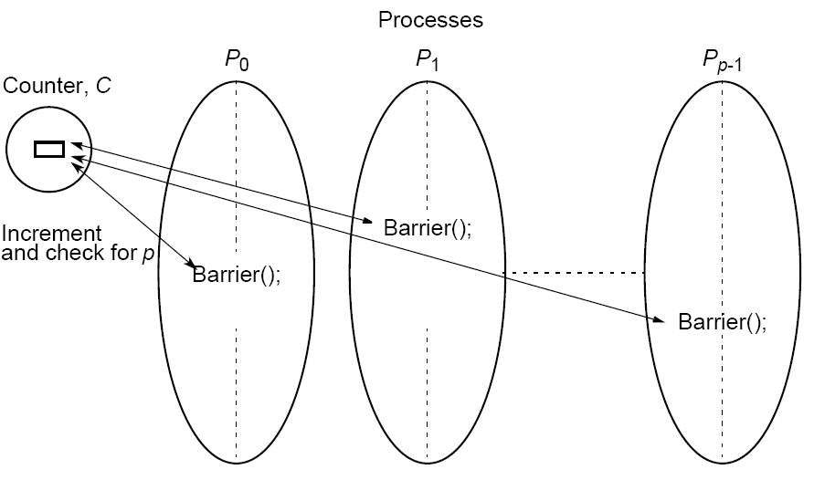
Barrier Implementation
Centralized counter implementation (a linear barrier):

Slide 7
Good barrier implementations must take into account that a barrier might be used more than once in a process.
Might be possible for a process to enter the barrier for a second time before previous processes have left the barrier for the first time.

Slide 8
Counter-based barriers often have two phases:
• A process enters arrival phase and does not leave this
phase until all processes have arrived in this phase.
• Then processes move to departure phase and are released.
Two-phase handles the reentrant scenario.

Slide 9
Example code:
Master:
for (i = 0; i < n; i++) /*count slaves as they reach barrier*/
recv(Pany);
for (i = 0; i < n; i++) /* release slaves */
send(Pi);
Slave processes:
send(Pmaster);
recv(Pmaster);

Slide 10
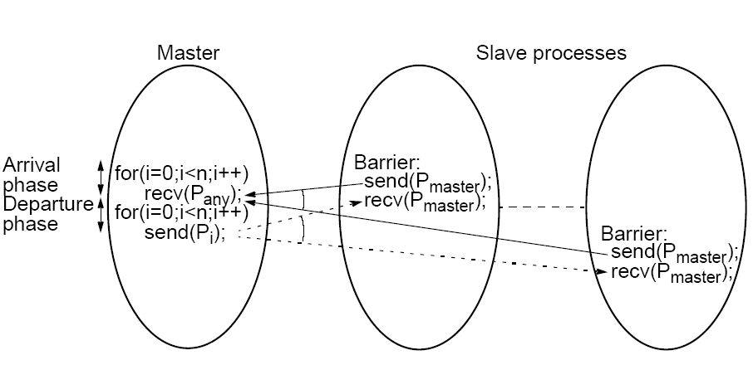
Barrier implementation in
a message-passing system

Slide 11
Tree Implementation
More efficient. O(log p) steps
Suppose 8 processes, P0, P1, P2, P3, P4, P5, P6, P7:
1st stage: P1 sends message to P0; (when P1 reaches its barrier)
P3 sends message to P2; (when P3 reaches its barrier)
P5 sends message to P4; (when P5 reaches its barrier)
P7 sends message to P6; (when P7 reaches its barrier)
2nd stage: P2 sends message to P0; (P2 & P3 reached their barrier)
P6 sends message to P4; (P6 & P7 reached their barrier)
3rd stage: P4 sends message to P0; (P4, P5, P6, & P7 reached barrier)
P0 terminates arrival phase;
(when P0 reaches barrier & received message from P4)
Release with a reverse tree construction.

Slide 12
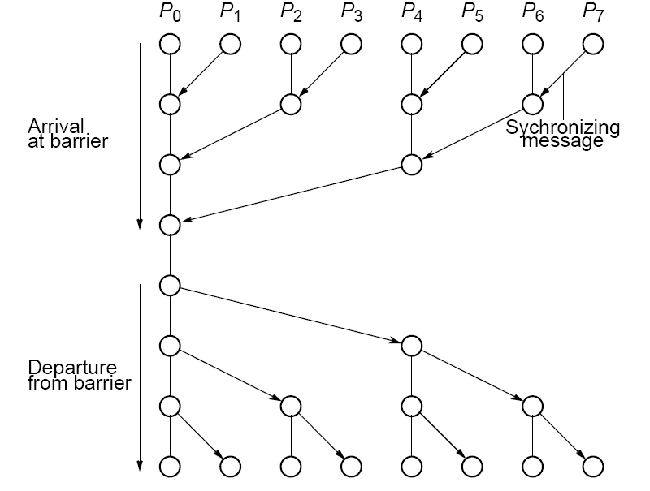
Tree barrier

Slide 13
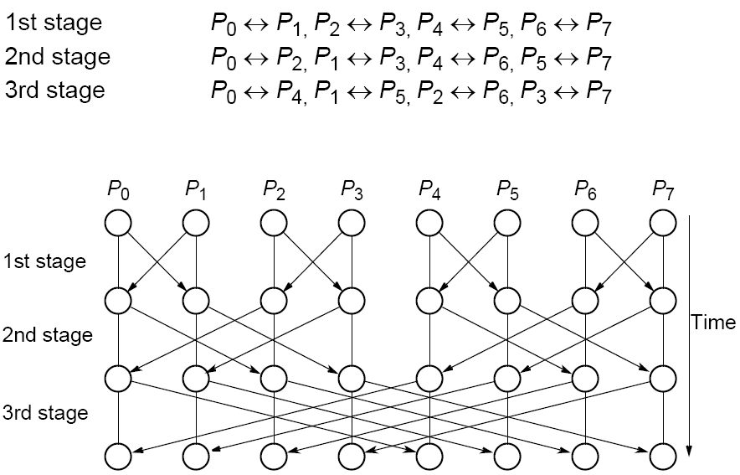
Butterfly Barrier

Slide 14
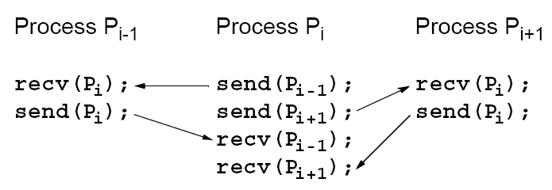
Local Synchronization
Suppose a process Pi needs to be synchronized and to exchange data with process Pi-1 and process Pi+1 before continuing:
Not a perfect three-process barrier because process Pi-1 will only synchronize with Pi and continue as soon as Pi allows. Similarly, process Pi+1 only synchronizes with Pi.

Slide 15
Deadlock
When a pair of processes each send and receive from each other, deadlock may occur.
Deadlock will occur if both processes perform the send, using synchronous routines first (or blocking routines without sufficient buffering). This is because neither will return; they will wait for matching receives that are never reached.

Slide 16
A Solution
Arrange for one process to receive first and then send and the other process to send first and then receive.
Example
Linear pipeline, deadlock can be avoided by arranging so the even-numbered processes perform their sends first and the odd-numbered processes perform their receives first.

Slide 17
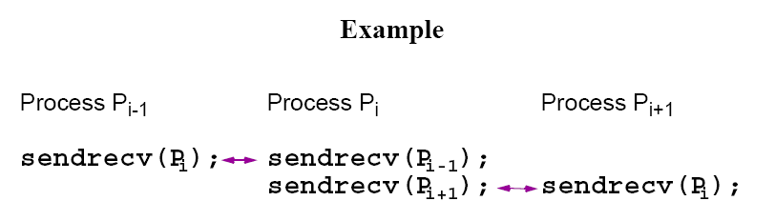
Combined deadlock-free blocking
sendrecv() routines
MPI provides MPI_Sendrecv() and MPI_Sendrecv_replace().
MPI sendrev()s actually has 12 parameters!

Slide 18
Synchronized Computations
Can be classififed as:
• Fully synchronous
or
• Locally synchronous
In fully synchronous, all processes involved in the computation must be synchronized.
In locally synchronous, processes only need to synchronize with a set of logically nearby processes, not all processes involved in the computation

Slide 19
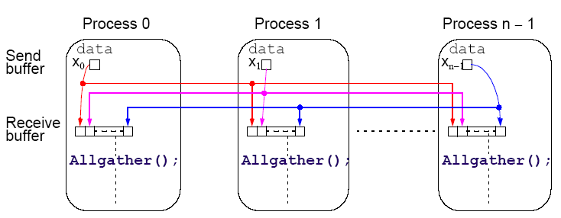
Introduce a new message-passing operation - Allgather.
Allgather
Broadcast and gather values in one composite construction.

Slide 20
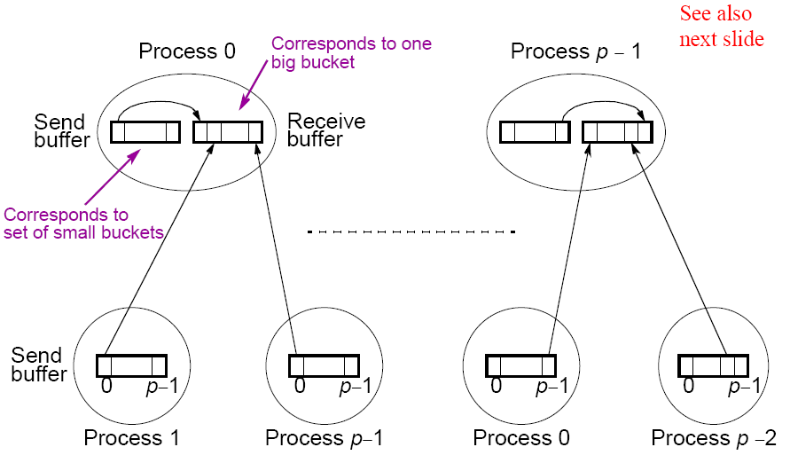
“all-to-all” broadcast routine
Sends data from each process to every other process
4.13

Slide 21
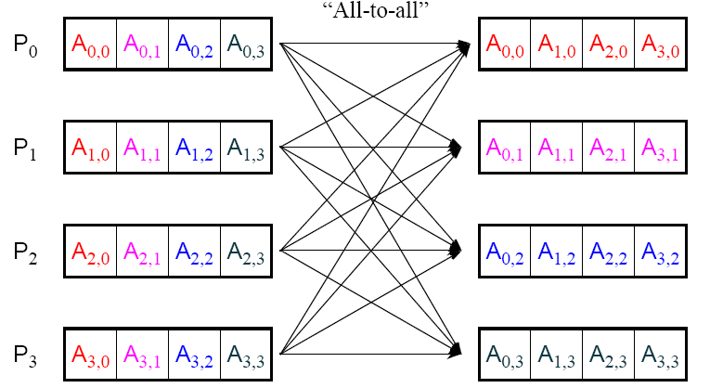
“all-to-all” routine actually transfers rows of an array to columns:
Transposes a matrix.

Slide 22
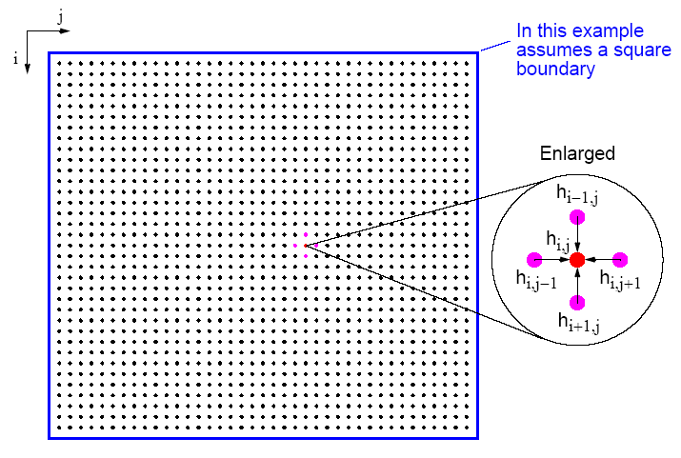
Heat Distribution Problem

Slide 23
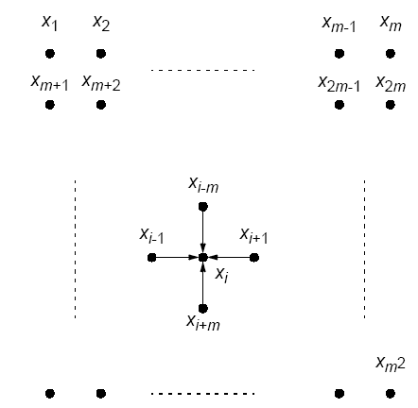
Natural ordering of heat distribution problem

Slide 24


Number points from 1 for convenience and include those representing the edges. Each point will then use the equation
Could be written as a linear equation containing the unknowns xi-m, xi-1, xi+1, and xi+m:
Notice: solving a (sparse) system
Also solving Laplace’s equation.

Slide 25
Sequential Code
Using a fixed number of iterations
for (iteration = 0; iteration < limit; iteration++) {
for (i = 1; i < n; i++)
for (j = 1; j < n; j++)
g[i][j] = 0.25*(h[i-1][j]+h[i+1][j]+h[i][j-1]+h[i][j+1]);
for (i = 1; i < n; i++) /* update points */
for (j = 1; j < n; j++)
h[i][j] = g[i][j];
}
using original numbering system (n x n array).

Slide 26
To stop at some precision:
do {
for (i = 1; i < n; i++)
for (j = 1; j < n; j++)
g[i][j] = 0.25*(h[i-1][j]+h[i+1][j]+h[i][j-1]+h[i][j+1]);
for (i = 1; i < n; i++) /* update points */
for (j = 1; j < n; j++)
h[i][j] = g[i][j];
continue = FALSE; /* indicates whether to continue */
for (i = 1; i < n; i++)/* check each pt for convergence */
for (j = 1; j < n; j++)
if (!converged(i,j) {/* point found not converged */
continue = TRUE;
break;
}
} while (continue == TRUE);

Slide 27
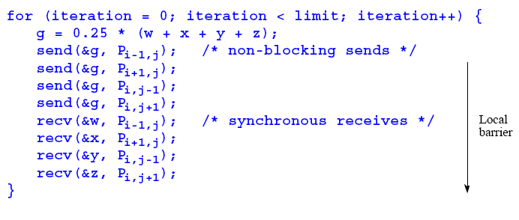
Parallel Code
With fixed number of iterations, P_{i,j}
(except for the boundary points):
Important to use send()s that do not block while waiting for recv()s; otherwise processes would deadlock, each waiting for a recv() before moving on - recv()s must be synchronous and wait for send()s.

Slide 28
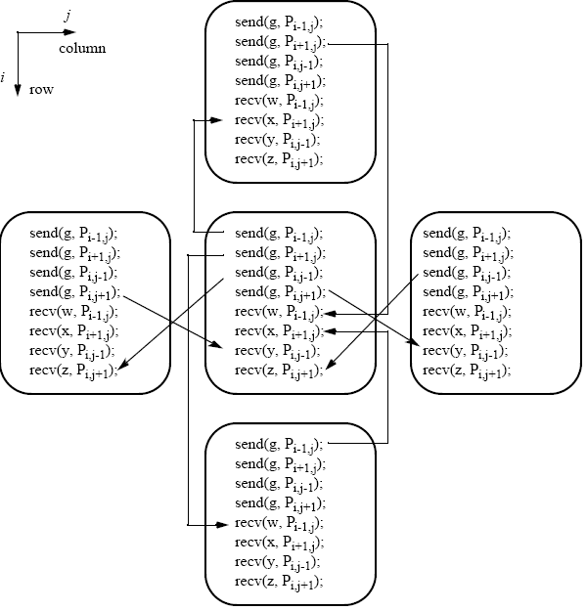
Message passing for heat distribution problem

Slide 29
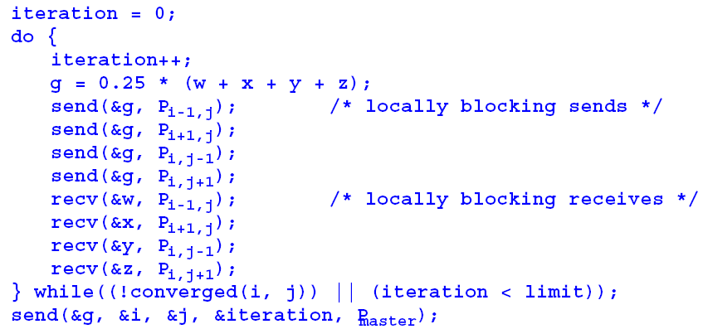
Version where processes stop when they reach their required precision:

Slide 30
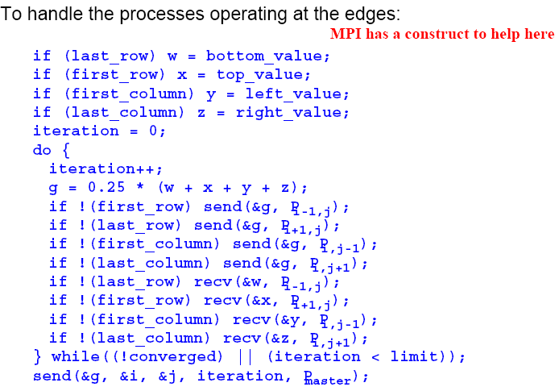

Slide 31
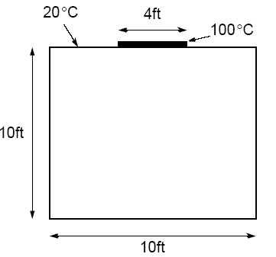
Example
A room has four walls and a fireplace. Temperature of wall is 20°C, and temperature of fireplace is 100°C. Write a parallel program using Jacobi iteration to compute the temperature inside the room and plot (preferably in color) temperature contours at 10°C intervals using Xlib calls or similar graphics calls as available on your system.

Slide 32
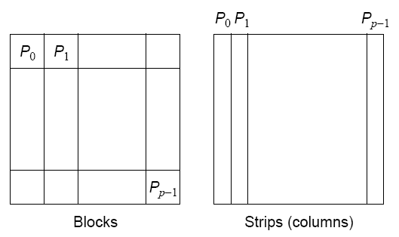
Partitioning
Normally allocate more than one point to each processor, because many more points than processors.
Points could be partitioned into square blocks or strips:

Slide 33
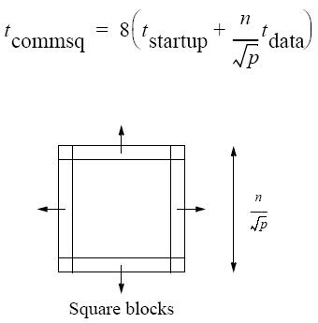
Block partition
Four edges where data points exchanged.
Communication time given by

Slide 34
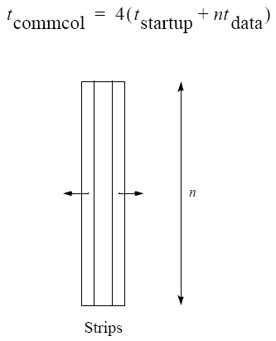
Strip partition
Two edges where data points are exchanged.
Communication time is given by

Slide 35
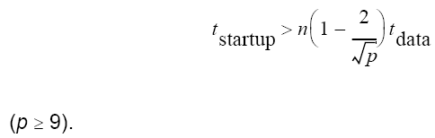
Optimum
In general, strip partition best for large startup time, and block
partition best for small startup time.
With the previous equations, block partition has a larger communication time than strip partition if

Slide 36
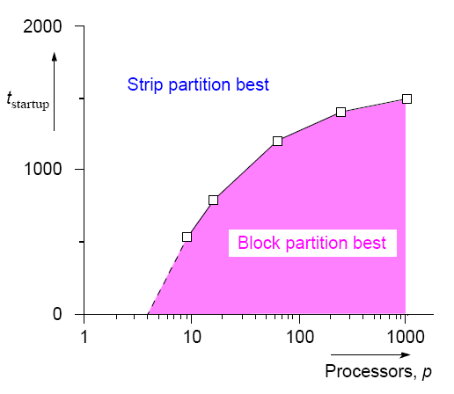
Startup times for block and
strip partitions

Slide 37
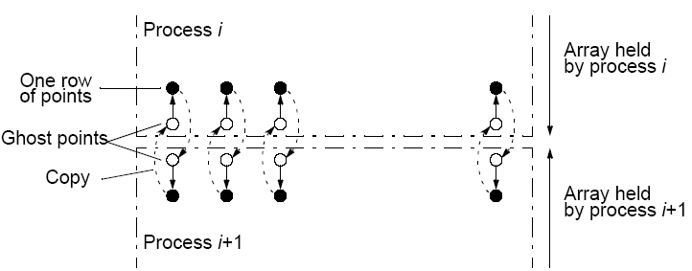
Ghost Points
Additional row of points at each edge that hold values from adjacent edge. Each array of points increased to accommodate ghost rows.

Slide 38
Safety and Deadlock
When all processes send their messages first and then receive all of their messages is “unsafe” because it relies upon buffering in the send()s. The amount of buffering is not specified in MPI.
If insufficient storage available, send routine may be delayed from returning until storage becomes available or until the message can be sent without buffering.
Then, a locally blocking send() could behave as a synchronous send(), only returning when the matching recv() is executed. Since a matching recv() would never be executed if all the send()s are synchronous, deadlock would occur.

Slide 39
Making the code safe
Alternate the order of the send()s and recv()s in adjacent
processes so that only one process performs the send()s first.
Then even synchronous send()s would not cause deadlock.
Good way you can test for safety is to replace message-passing routines in a program with synchronous versions.
6.61

Slide 40
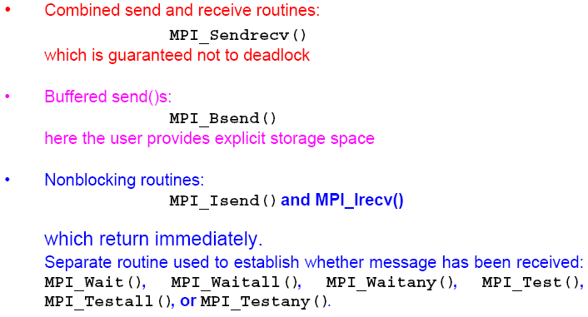
MPI Safe Message Passing Routines
MPI offers several methods for safe communication:

