Slide 1
Chapter 4
Shared-Memory Programming with Pthreads

Slide 2
Shared memory multiprocessor system
Any memory location can be accessible by any of the processors.
A single address space exists, meaning that each memory location is given a unique address within a single range of addresses.
Generally, shared memory programming more convenient although it does require access to shared data to be controlled by the programmer (using critical sections etc.)

Slide 3
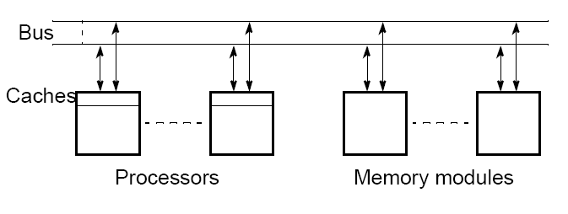
Shared memory multiprocessor
using a single bus

Slide 4
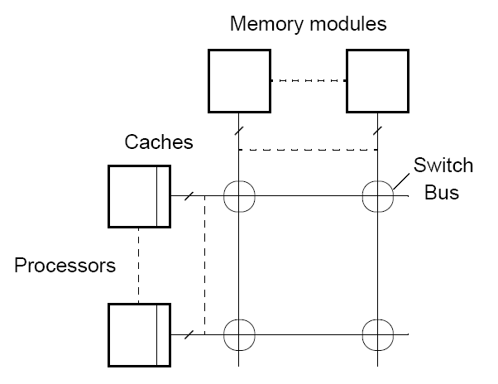
Shared memory multiprocessor
using a crossbar switch

Slide 5
Alternatives for Programming Shared
Memory Multiprocessors:
• Using heavy weight processes.
• Using threads. Example Pthreads
• Using a completely new programming language for
parallel programming - not popular. Example Ada.
• Using library routines with an existing sequential
programming language.
• Modifying the syntax of an existing sequential
programming language to create a parallel programing
language. Example UPC
• Using an existing sequential programming language
supplemented with compiler directives for specifying
parallelism. Example OpenMP

Slide 6
Using Heavyweight Processes
Operating systems often based upon notion of a process.
Processor time shares between processes, switching from one process to another. Might occur at regular intervals or when an active process becomes delayed.
Offers opportunity to de-schedule processes blocked from proceeding for some reason, e.g. waiting for an I/O operation to complete.
Concept could be used for parallel programming but traditionally incurs high process creation overhead.

Slide 7
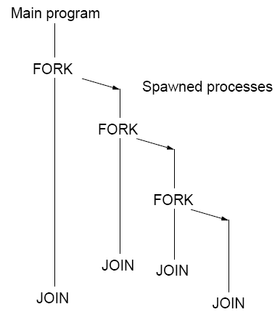
FORK-JOIN construct
Heavy weight processes first to use fork-join idea.
Also dynamic process creation is supported.

Slide 8
UNIX/Linux Style Fork/JoinSystem Calls
fork() -- creates a new process by duplicating the calling process. The new process, referred to as the child, almost an exact replica of the parent process.
Child process has its own unique process ID.
Returns:
On success, the process id, pid, of the child process is returned in the parent, and 0 is returned in the child.
On failure, -1 is returned in the parent, no child process is created, and errno is set appropriately.

Slide 9
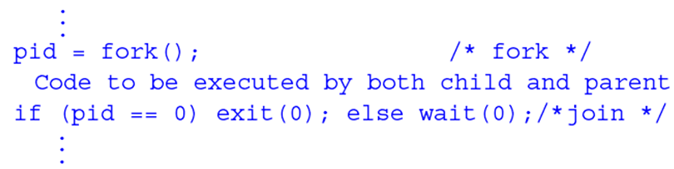
UNIX/Linux Style Fork/Join System Calls
wait(pid) -- suspends execution of the calling process until one of its children terminates
pid == 0 means wait for any child process whose process group ID is equal to the value of pid
exit(status) -- function causes normal process termination and the value of status is returned to the parent

Slide 10
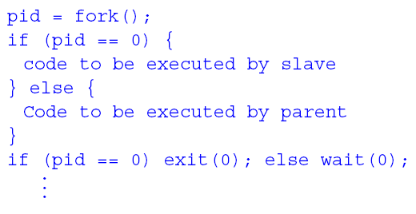
UNIX/Linux Style Fork/Join System Calls
SPMD model with different code for master process and forked slave process.

Slide 11
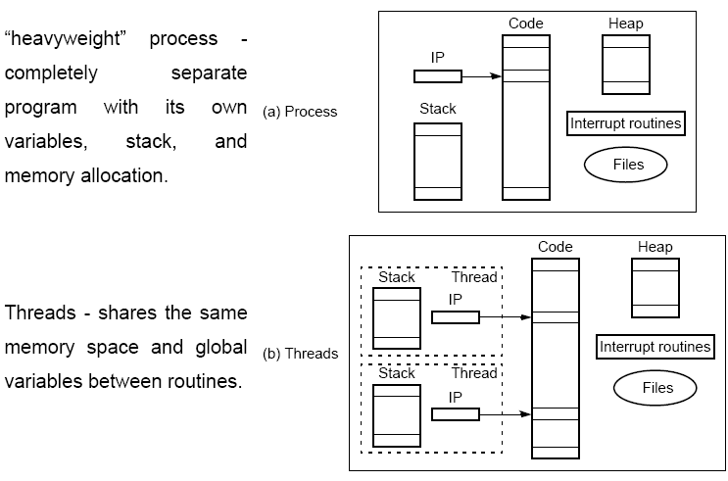
Differences between a process and threads

Slide 12
What is a thread?
process:
an address space with 1 or more threads executing within that address space, and the required system resources for those threads
a program that is running
thread:
a sequence of control within a process
shares the resources in that process

Slide 13
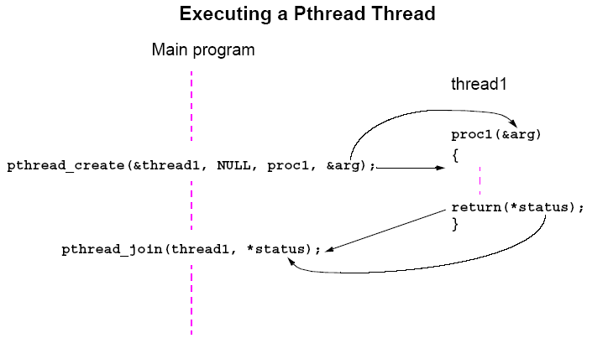
Pthreads
IEEE Portable Operating System Interface, POSIX, sec. 1003.1 standard

Slide 14
Detached Threads
In some cases there is no need for a join.
Threads not joined are called detached threads.
When detached threads terminate, they are destroyed and their resource released.

Slide 15
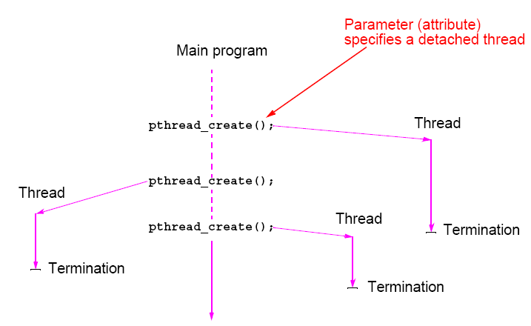
Pthreads Detached Threads

Slide 16
Thread-Safe Routines
Thread safe if they can be called from multiple threads
simultaneously and always produce correct results.
Many standard I/O functions are thread safe (prints messages without interleaving the characters).
System routines that return time may not be thread safe.
Routines that access shared data may require special care to be made thread safe.

Slide 17
Statement Execution Order
Single processor: Processes/threads typically executed until blocked.
Multiprocessor: Instructions of processes/threads interleaved in time.
Example
Process 1 Process 2
Instruction 1.1 Instruction 2.1
Instruction 1.2 Instruction 2.2
Instruction 1.3 Instruction 2.3
Several possible orderings, including
Instruction 1.1
Instruction 1.2
Instruction 2.1
Instruction 1.3
Instruction 2.2
Instruction 2.3
assuming instructions cannot be divided into smaller steps.

Slide 18
If two processes were to print messages, for example, the messages could appear in different orders depending upon the scheduling of processes calling the print routine.
Worse, the individual characters of each message could be interleaved if the machine instructions of instances of the print routine could be interleaved.

Slide 19
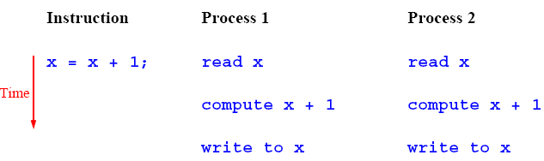
Accessing Shared Data
Accessing shared data needs careful control.
Consider two processes each of which is to add one to a shared data item, x. Necessary for the contents of the location x to be read, x + 1 computed, and the result written back to the location:

Slide 20
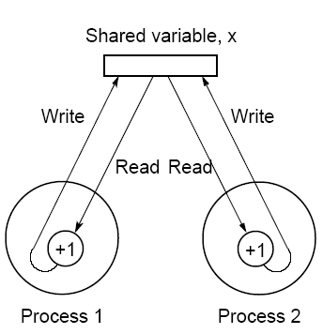
Conflict in accessing shared variable

Slide 21
Critical Section
A mechanism for ensuring that only one process accesses a particular resource at a time is to establish sections of code involving the resource as so-called critical sections and arrange that only one such critical section is executed at a time
This mechanism is known as mutual exclusion.
This concept also appears in an operating systems.

Slide 22
Locks
Simplest mechanism for ensuring mutual exclusion of critical
sections.
A lock is a 1-bit variable that is a 1 to indicate that a process has entered the critical section and a 0 to indicate that no process is in the critical section.
Operates much like that of a door lock:
A process coming to the “door” of a critical section and finding it open may enter the critical section, locking the door behind it to prevent other processes from entering. Once the process has finished the critical section, it unlocks the door and leaves.

Slide 23
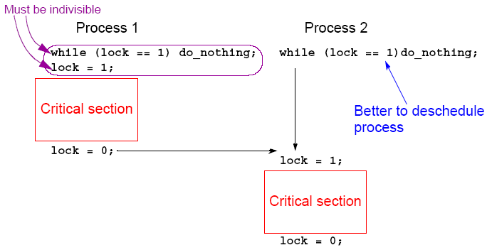
Control of critical sections through busy waiting

Slide 24
Pthread Lock Routines
Locks are implemented in Pthreads with mutually exclusive lock variables, or “mutex” variables:
.
pthread_mutex_lock(&mutex1);
critical section
pthread_mutex_unlock(&mutex1);
.
If a thread reaches a mutex lock and finds it locked, it will wait for the lock to open. If more than one thread is waiting for the lock to open when it opens, the system will select one thread to be allowed to proceed. Only the thread that locks a mutex can unlock it.

Slide 25
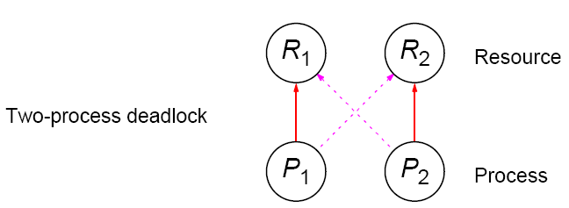
Deadlock
Can occur with two processes when one requires a resource held by the other, and this process requires a resource held by the first process.

Slide 26
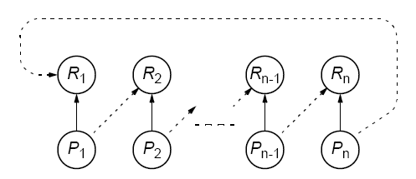
Deadlock (deadly embrace)
Deadlock can also occur in a circular fashion with several processes having a resource wanted by another.

Slide 27
Pthreads
Offers one routine that can test whether a lock is actually closed without blocking the thread:
pthread_mutex_trylock()
Will lock an unlocked mutex and return 0 or will return with EBUSY if the mutex is already locked – might find a use in overcoming deadlock.

Slide 28
Semaphores
P and V operations are performed indivisibly.
Mechanism for activating waiting processes is also implicit in P and V operations. Though exact algorithm not specified, algorithm expected to be fair. Processes delayed by P(s) are kept in abeyance until released by a V(s) on the same semaphore.
Devised by Dijkstra in 1968. Letter P is from the Dutch word passeren, meaning “to pass,” and letter V is from the Dutch word vrijgeven, meaning “to release.”)

Slide 29
Semaphores
A positive integer (including zero) operated upon by two operations:
P (sem_wait) operation on semaphore s
Waits until s is greater than zero and then decrements s by one and allows the process to continue.
V (sem_post) operation on semaphore s
Increments s by one and releases one of the waiting processes (if any).

Slide 30
Mutual exclusion of critical sections can be achieved with one
semaphore having the value 0 or 1 (a binary semaphore), which
acts as a lock variable, but the P and V operations include a process
scheduling mechanism:
Process 1 Process 2 Process 3
Noncritical section Noncritical section Noncritical section
. . .
. . .
. . .
P(s) P(s) P(s)
Critical section Critical section Critical section
V(s) V(s) V(s)
. . .
. . .
. . .
Noncritical section Noncritical section Noncritical section

Slide 31
General semaphore
(or counting semaphore)
Can take on positive values other than zero and one.
Provide, for example, a means of recording the number of “resource units” available or used and can be used to solve producer/ consumer problems. - more on that in operating system courses.
Semaphore routines exist for UNIX processes.
Not exist in Pthreads as such, though they can be written
Do exist in real-time extension to Pthreads.

Slide 32
Monitor
Suite of procedures that provides only way to access shared resource. Only one process can use a monitor procedure at any instant.
Could be implemented using a semaphore or lock to protect entry, i.e.,
monitor_proc1()
{
lock(x);
.
monitor body
.
unlock(x);
return;
}

Slide 33
Condition Variables
Often, a critical section is to be executed if a specific global
condition exists; for example, if a certain value of a variable has been reached.
With locks, the global variable would need to be examined at
frequent intervals (“polled”) within a critical section.
Very time-consuming and unproductive exercise.
Can be overcome by introducing so-called condition variables.

Slide 34
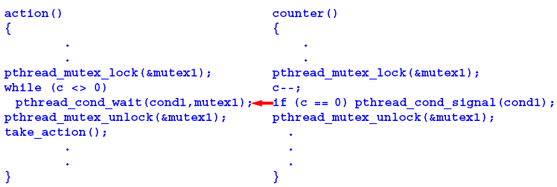
Pthread Condition Variables
Pthreads arrangement for signal and wait:
Signals not remembered - threads must already be waiting for a signal to receive it.

Slide 35
Language Constructs for Parallelism
Shared Data
Shared memory variables might be declared as shared with, say,
shared int x;

Slide 36
par Construct
For specifying concurrent statements:
par {
S1;
S2;
.
.
Sn;
}

Slide 37
forall Construct
To start multiple similar processes together:
forall (i = 0; i < n; i++) {
S1;
S2;
.
.
Sm;
}
which generates n processes each consisting of the statements forming the body of the for loop, S1, S2, …, Sm. Each process uses a different value of i.

Slide 38
Example
forall (i = 0; i < 5; i++)
a[i] = 0;
clears a[0], a[1], a[2], a[3], and a[4] to zero concurrently.

Slide 39
Compiler/Processor Optimizations
Compiler and processor reorder instructions for optimization.
Example
The statements
a = b + 5;
x = y + 4;
could be compiled to execute in reverse order:
x = y + 4;
a = b + 5;
and still be logically correct.
May be advantageous to delay statement a = b + 5 because a
previous instruction currently being executed in processor needs
more time to produce the value for b. Very common for processors to execute machines instructions out of order for increased speed .

Slide 40
Dependency Analysis
To identify which processes could be executed together.
Example
Can see immediately in the code
forall (i = 0; i < 5; i++)
a[i] = 0;
that every instance of the body is independent of other instances and all instances can be executed simultaneously.
However, it may not be that obvious. Need algorithmic way of recognizing dependencies, for a parallelizing compiler.

Slide 41
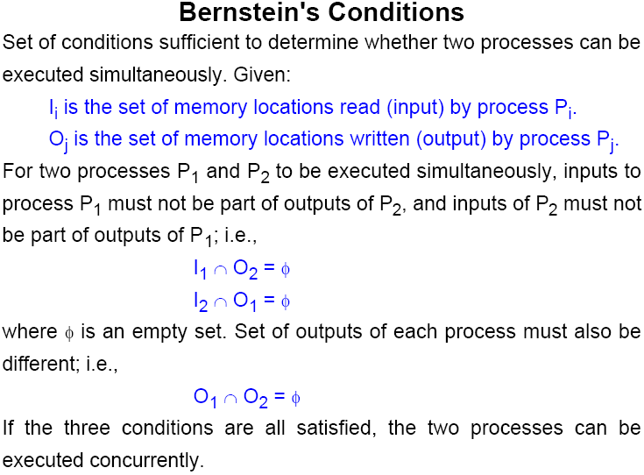

Slide 42
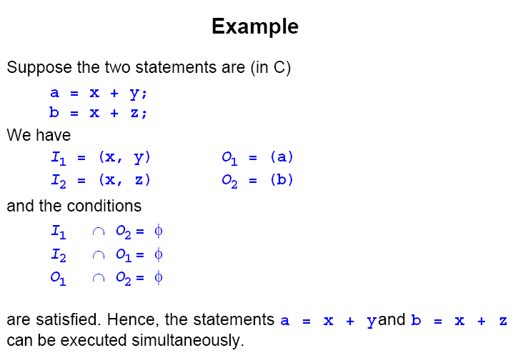

Slide 43
What is a thread?
process:
an address space with 1 or more threads executing within that address space, and the required system resources for those threads
a program that is running
thread:
a sequence of control within a process
shares the resources in that process

Slide 44
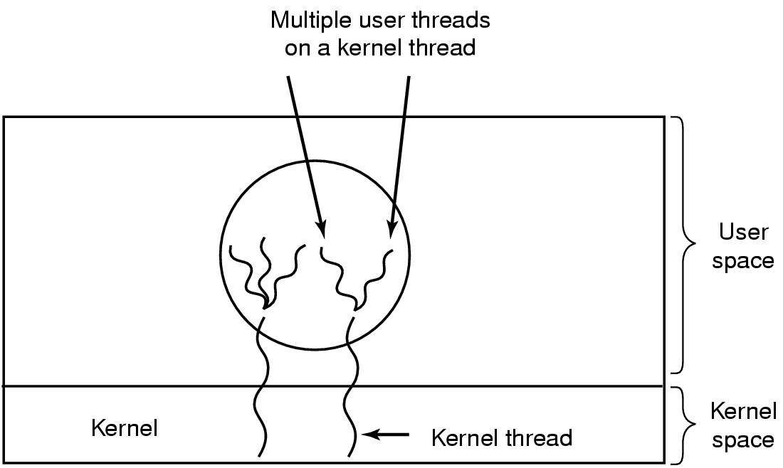
Hybrid Implementations
Multiplexing user-level threads onto kernel-level threads

Slide 45
Advantages and Drawbacks of Threads
Advantages:
the overhead for creating a thread is significantly less than that for creating a process (~ 2 milliseconds for threads)
multitasking, i.e., one process serves multiple clients
switching between threads requires the OS to do much less work than switching between processes

Slide 46
Drawbacks:
not as widely available as longer established features
writing multithreaded programs require more careful thought
more difficult to debug than single threaded programs
for single processor machines, creating several threads in a program may not necessarily produce an increase in performance (only so many CPU cycles to be had)

Slide 47
POSIX Threads (pthreads)
IEEE's POSIX Threads Model:
programming models for threads in a UNIX platform
pthreads are included in the international standards ISO/IEC9945-1
pthreads programming model:
creation of threads
managing thread execution
managing the shared resources of the process

Slide 48
Pthread Operations
POSIX function | description
pthread_cancel | terminate another thread
pthread_create | create a thread
pthread_detach | set thread to release resources
pthread_equal | test two thread IDs for equality
pthread_exit | exit a thread without exiting process
pthread_kill | send a signal to a thread
pthread_join | wait for a thread
pthread_self | find out own thread ID

Slide 49
main thread:
initial thread created when main() (in C++) are invoked by the process loader
once in the main(), the application has the ability to create daughter threads
if the main thread returns, the process terminates even if there are running threads in that process, unless special precautions are taken
to explicitly avoid terminating the entire process, use pthread_exit()

Slide 50
thread termination methods:
implicit termination:
thread function execution is completed
explicit termination:
calling pthread_exit() within the thread
calling pthread_cancel() to terminate other threads
for numerically intensive routines, it is suggested that the application creates p threads if there are p available processor cores

Slide 51
Exiting and Cancellation
A process can terminate when:
it calls exit directly
one of its threads calls exit()
it returns from main()
it receives a termination signal
In any of these cases, all threads of the process terminate.

Slide 52
Thread Exit
When a thread is done, it can return from its first function (the one used by pthread_create) or it can call pthread_exit
void pthread_exit(void *value_ptr);
Common uses:
Return value is often a pointer to the original struct or a malloc’d struct (memory must be free’d by joining thread)
Use the heap not the stack!!!

Slide 53
Canceling a thread!
One thread can request that another exit by using pthread_cancel
int pthread_cancel(pthread_t thread);
The pthread_cancel returns after making the request.

Slide 54
Sample Pthreads Program in C++
The program in C++ calls the pthread.h header file. Pthreads related statements are preceded by the pthread_ prefix (except for semaphores).
In Pthreads knowing how to manipulate pointers is very important!

Slide 55
/*
Pthreads Example - Hello World - C/C++ Version
File: hello_world_PTH2.cpp
Compilation on altix.asc.edu
to compile the program
icc hello_world_PTH2.cpp -o hello_world_PTH2 -lpthread
to run type
./hello_world_PTH2
*/
using namespace std;
#include <iostream>
#include <fstream>
#include <pthread.h>
#define NTHREADS 8 /* set number of threads to 8 */
pthread_mutex_t MUTEX; // globaly defined lock variable used to insure
// uninterrupted print operations from each thread
ofstream filestr("file_nm"); // filestr: file stream common to all threads
// This is the worker thread code
void *hello(void * arg) {
int myid=*(int *) arg;
sleep(1);
// enter critical region
pthread_mutex_lock(&MUTEX);
filestr << "Hello World, from PThread " << myid << endl;
// exit critical region
pthread_mutex_unlock(&MUTEX);
return arg; // could use pthread_exit(NULL) function as well
}

Slide 56
Thread Synchronization Mechanisms
Mutual exclusion (mutex):
guard against multiple threads modifying the same shared data simultaneously
provides locking/unlocking critical code sections where shared data is modified
each thread waits for the mutex to be unlocked (by the thread who locked it) before performing the code section

Slide 57
Basic Mutex Functions:
int pthread_mutex_init(pthread_mutex_t *mutex, const pthread_mutexattr_t *mutexattr);
int pthread_mutex_lock(pthread_mutex_t *mutex);
int pthread_mutex_unlock(pthread_mutex_t *mutex);
int pthread_mutex_destroy(pthread_mutex_t *mutex);
a new data type named pthread_mutex_t is designated for mutexes
a mutex is like a key (to access the code section) that is handed to only one thread at a time
the attribute of a mutex can be controlled by using the pthread_mutex_init() function
the lock/unlock functions work in tandem

Slide 58
#include <pthread.h>
...
pthread_mutex_t my_mutex; // should be of global scope
...
int main()
{
int tmp;
...
// initialize the mutex
tmp = pthread_mutex_init( &my_mutex, NULL );
...
// create threads
...
pthread_mutex_lock( &my_mutex );
do_something_private();
pthread_mutex_unlock( &my_mutex );
...
return 0;
}
Whenever a thread reaches the lock/unlock block, it first determines if the mutex is locked. If so, it waits until it is unlocked. Otherwise, it takes the mutex, locks the succeeding code, then frees the mutex and unlocks the code when it's done.

Slide 59
/*
Pthreads Example - Hello World - C/C++ Version
File: hello_world_PTH2.cpp
Compilation on altix.asc.edu
to compile the program
icc hello_world_PTH2.cpp -o hello_world_PTH2 -lpthread
to run type
./hello_world_PTH2
*/
using namespace std;
#include <iostream>
#include <fstream>
#include <pthread.h>
#define NTHREADS 8 /* set number of threads to 8 */
pthread_mutex_t MUTEX; // globaly defined lock variable used to insure
// uninterrupted print operations from each thread
ofstream filestr("file_nm"); // filestr: file stream common to all threads

Slide 60
// This is the worker thread code
void *hello(void * arg) {
int myid=*(int *) arg;
// enter critical region
pthread_mutex_lock(&MUTEX);
filestr << "Hello World, from PThread " << myid << endl;
// exit critical region
pthread_mutex_unlock(&MUTEX);
return arg; // could use pthread_exit(NULL) function as well
}

Slide 61
// this is the main thread's code -- it spawns the worker threads and
// then waits for all the worker threads to return before it exits
int main(int argc,char *argv[])
{
int tid; // tid thread number
pthread_t threads[NTHREADS]; // holds various thread info
int ids[NTHREADS]; // holds thread args
int errcode; // pthread error code
pthread_attr_t tattr; // pthread attribute object
// the following code sets up the Pthread attribute object
// not really necessary if you like the defaults
if (errcode = pthread_attr_init(&tattr)) {
cerr << "Failed to create attribute object: " << strerror(errcode) << endl;
}
// make threads joinable (for detatched threads use PTHREAD_CREATE_DETACHED)
else if (errcode = pthread_attr_setdetachstate(&tattr,PTHREAD_CREATE_JOINABLE)) {
cerr << "Failed to set attribute state: " << strerror(errcode) << endl;
}
// allow threads to be scheduled system wise not just process wise
else if (errcode = pthread_attr_setscope(&tattr,PTHREAD_SCOPE_SYSTEM)) {
cerr << "Failed to set attribute scope: " << strerror(errcode) << endl;
}
// initialize mutex variable -- this variable is used to insure that
// all couts are automic meaning that they are not interrupted
pthread_mutex_init(&MUTEX,NULL);

Slide 62
Settable Properties of Thread Attributes
property | function
attribute objects | pthread_attr_destroy
 | pthread_attr_init
detach state | pthread_attr_getdetachstate
 | pthread_attr_setdetachstate
stack | pthread_attr_getguardsize
 | pthread_attr_setguardsize
 | pthread_attr_getstack
 | pthread_attr_setstack
scheduling | pthread_attr_getinheritsched
 | pthread_attr_setinheritsched
 | pthread_attr_getschedparam
 | pthread_attr_setschedparam
 | pthread_attr_getschedpolicy
 | pthread_attr_setschedpolicy
 | pthread_attr_getscope
 | pthread_attr_setscope

Slide 63
Thread Attributes
detach state attribute:
int pthread_attr_setdetachstate(pthread_attr_t *attr, int detachstate);
detached – main thread continues working without waiting for the daughter threads to terminate
joinable – main thread waits for the daughter threads to terminate before continuing further

Slide 64
Detaching a Thread
int pthread_detach(pthread_t threadid);
Indicate that system resources for the specified thread should be reclaimed when the thread ends
If the thread is already ended, resources are reclaimed immediately
This routine does not cause the thread to end
A detached thread’s thread ID is undetermined
Threads are detached
after a pthread_detach() call
after a pthread_join() call
if a thread terminates and the PTHREAD_CREATE_DETACHED attribute was set on creation

Slide 65
contention scope attribute:
int pthread_attr_setscope(pthread_attr_t *attr, int *scope);
system scope – threads are mapped one-to-one on the OS's kernel threads (kernel threads are entities that scheduled onto processors by the OS)
process scope – threads share a kernel thread with other process scoped threads

Slide 66
Threads Programming Model
pipeline model – threads are run one after the other
master-slave model – master (main) thread doesn't do any work, it just waits for the slave threads to finish working
equal-worker model – all threads work

Slide 67
/* create the threads */
for (tid=0; tid<NTHREADS; tid++) {
ids[tid]=tid;
errcode=pthread_create(
&threads[tid],// thread information structure
&tattr, // thread attributes -- NULL means assume defaults
hello, // function name that is to represent thread
&ids[tid]); // pthread created thread id for the created thread
// check for error during thread creation
if (errcode) {
cerr << "Pthread Creation Error: " << strerror(errcode) << endl;
exit(1);
}
}

Slide 68
Creating a thread:
int pthread_create( pthread_t *thread, pthread_attr_t *attr, void *(*thread_function)(void *), void *arg );
first argument – pointer to the identifier of the created thread
second argument – thread attributes
third argument – pointer to the function the thread will execute
fourth argument – the argument of the executed function (usually a struct)
returns 0 for success

Slide 69
// output number of threads
pthread_mutex_lock(&MUTEX); // enter critical region
filestr << "Number of threads = " << NTHREADS << endl;
pthread_mutex_unlock(&MUTEX); // exit critical region
// wait for all threads to return before exiting main program (process)
for (tid=0; tid<NTHREADS; tid++) {
// wait for each thread to terminate
errcode=pthread_join(
threads[tid], //thread scheduler id information of selected thread
NULL); //thread return value -- not used in this case
if (errcode) {
cerr << "Pthread Join Error: " << strerror(errcode) << endl;
exit(1);
}
}
filestr.close(); // close open file
}

Slide 70
Waiting for the threads to finish:
int pthread_join( pthread_t thread, void **thread_return )
main thread will wait for daughter thread thread to finish
first argument – the thread to wait for
second argument – pointer to a pointer to the return value from the thread
returns 0 for success
threads should always be joined; otherwise, a thread might keep on running even when the main thread has already terminated

Slide 71
Counting Semaphores:
permit a limited number of threads to execute a section of the code
similar to mutexes
should include the semaphore.h header file
semaphore functions do not have pthread_ prefixes; instead, they have sem_ prefixes

Slide 72
Basic Semaphore Functions:
creating a semaphore:
int sem_init(sem_t *sem, int pshared, unsigned int value);
initializes a semaphore object pointed to by sem
pshared is a sharing option; a value of 0 means the semaphore is local to the calling process
gives an initial value value to the semaphore
terminating a semaphore:
int sem_destroy(sem_t *sem);
frees the resources allocated to the semaphore sem
usually called after pthread_join()
an error will occur if a semaphore is destroyed for which a thread is waiting

Slide 73
semaphore control:
int sem_post(sem_t *sem);
int sem_wait(sem_t *sem);
sem_post atomically increases the value of a semaphore by 1, i.e., when 2 threads call sem_post simultaneously, the semaphore's value will also be increased by 2 (there are 2 atoms calling)
sem_wait atomically decreases the value of a semaphore by 1; but always waits until the semaphore has a non-zero value first

Slide 74
#include <pthread.h>
#include <semaphore.h>
...
void *thread_function( void *arg );
...
sem_t semaphore; // also a global variable just like mutexes
...
int main()
{
int tmp;
...
// initialize the semaphore
tmp = sem_init( &semaphore, 0, 0 );
...
// create threads
pthread_create( &thread[i], NULL, thread_function, NULL );
...
while ( still_has_something_to_do() )
{
sem_post( &semaphore );
...
}
...
pthread_join( thread[i], NULL );
sem_destroy( &semaphore );
return 0;
}

Slide 75
void *thread_function( void *arg )
{
sem_wait( &semaphore );
perform_task_when_sem_open();
...
pthread_exit( NULL );
}
the main thread increments the semaphore's count value in the while loop
the threads wait until the semaphore's count value is non-zero before performing perform_task_when_sem_open() and further
daughter thread activities stop only when pthread_join() is called

Slide 76
Condition Variables:
used for communicating information about the state of shared data
can make the execution of sections of a codes by a thread depend on the state of a data structure or another running thread
condition variables are for signaling, not for mutual exclusion; a mutex is needed to synchronize access to shared data

Slide 77
Condition Variables
Often, a critical section is to be executed if a specific global
condition exists; for example, if a certain value of a variable has been reached.
With locks, the global variable would need to be examined at
frequent intervals (“polled”) within a critical section.
Very time-consuming and unproductive exercise.
Can be overcome by introducing so-called condition variables.

Slide 78
Pthread Condition Variables
Pthreads arrangement for signal and wait:
Signals not remembered - threads must already be waiting for a signal to receive it.

Slide 79
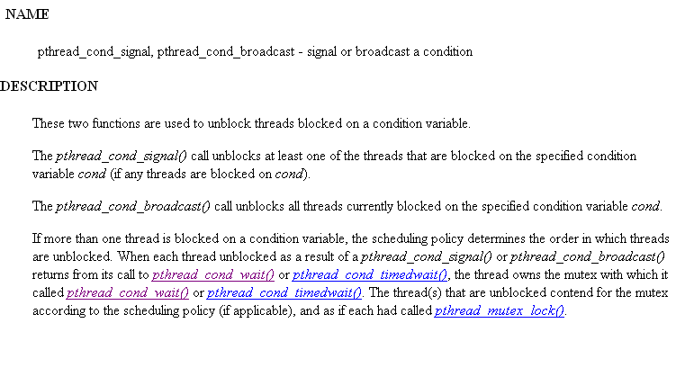

Slide 80
