Slide 1
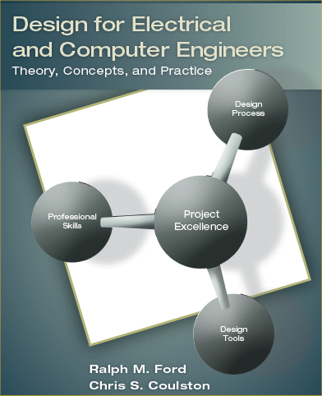
Chapter 1 – The Engineering Design Process

Slide 2
ABET Definition of Engineering Design
Engineering design is the process of devising a system, component, or process to meet desired needs.
It is a decision-making process (often iterative), in which the basic sciences, mathematics, and engineering sciences are applied to convert resources optimally to meet a stated objective.
Among the fundamental elements of the design process are the establishment of objectives and criteria, synthesis, analysis, construction, testing, and evaluation. [ABET]

Slide 3
Engineering Design Processes
Design process – the process by which an idea is taken from concept to realization of the final system.
Many potential solutions may be generated
Goal is to find best solution given the constraints and available resources
Aim is to develop a system that best meets the needs of the customer within the given constraints

Slide 4
Engineering Design Processes
Engineering design is an iterative process
Design problems are open-ended with many potential solutions
Design processes represent best practices for realizing a system
Design processes may be prescriptive or descriptive

Slide 5
A Prescriptive Process
Systematic recipe for realizing a new system.

Slide 6
A Descriptive Process
Less formal overview of activities needed to realize a design

Slide 7
VLSI Design Process
Design Flow in a VLSI system – often strictly enforced by the CAD tool

Slide 8
Embedded Systems Design Process

Slide 9
Waterfall Software Development

Slide 10
Design Processes – WHO CARES?
What is the value of the design process?
it formalizes the thought process to ensure that good design practices are followed and no steps are skipped.
Allows for better integration between team members allowing them to contribute in a coordinated matter on the same portion of the design problem.
How much does it cost to correct problems as process proceeds?

Slide 11
Cost to Implement Changes

Slide 12
The World-Class Engineer
12
Aware of the World
Solidly Grounded
Technically Broad
Effective in Group Operations
Versatile
Customer Oriented

Slide 13
Design Process – this book
Problem ID & customer needs (Ch 2)
Research/Problem Analysis (Ch 2)
Requirements Specification (Ch 3)
Concept Generation & Evaluation (Ch 4)
Design Phase (Ch 5, 6, & 8)
Prototype, Construct, & Test (Ch 7)

