Slide 1
The Quality Function Deployment (QDF) Process
House of Quality Analysis
A method of transforming the customers needs into design requirements

Slide 2
Quality Function Development
QFD is a method of incorporating
Customer’s Desires & Needs
“Voice of the Customer”
Market research
Relevant Technical Benchmark Data
To produce a prioritized set of engineering design requirements

Slide 3
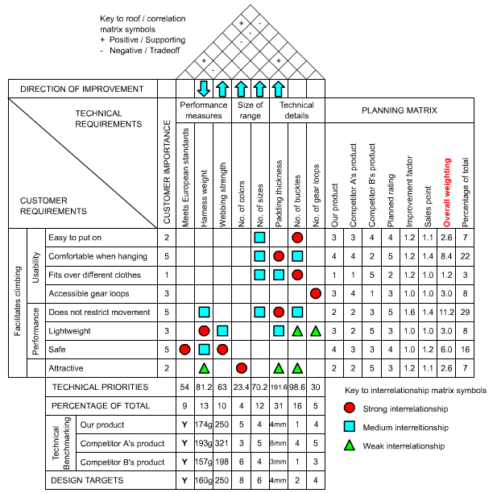
QDF House of Quality (HOQ)

Slide 4
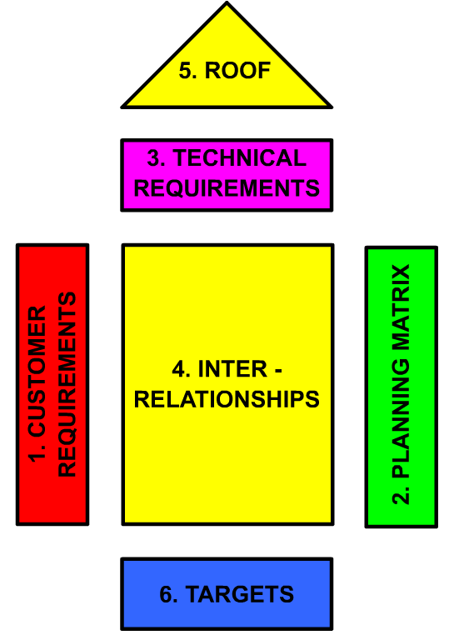

QDF House of Quality (HOQ)

Slide 5

Structured list of customers needs, problems and desires using terminology familiar to the customer (“the Voice of the Customer”)
Often gathered through direct conversations with customer
These requirements are each recorded separately
They are then put in a structured form
Affinity and/or Tree Diagrams are often used

Slide 6
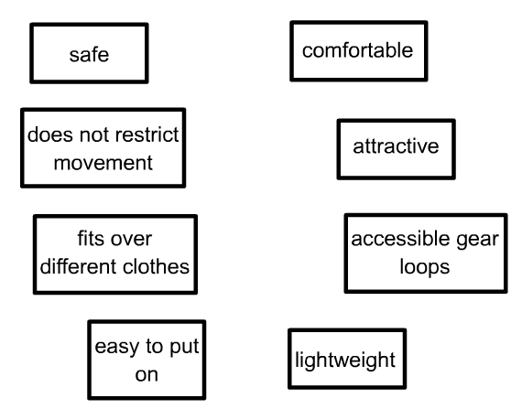
Example

Slide 7
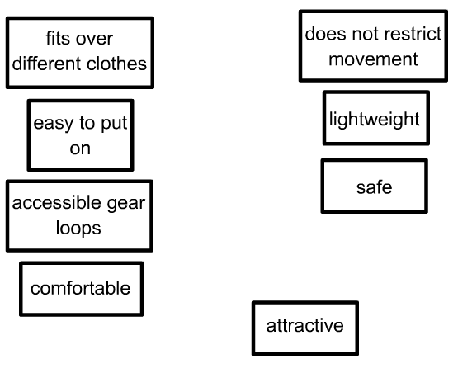
Example – Affinity Groupings

Slide 8
For each group a formal title is chosen that expresses the general theme of the group.
The group titles themselves can be further grouped into higher level associations.
This forms the basis of the Affinity Diagram.

Slide 9
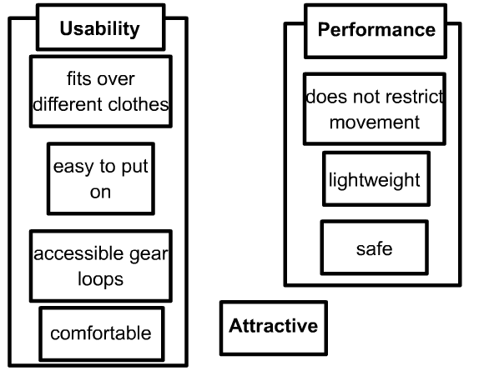
Example – Affinity Groupings with Chosen Titles

Slide 10
Example – Affinity Diagram

Slide 11
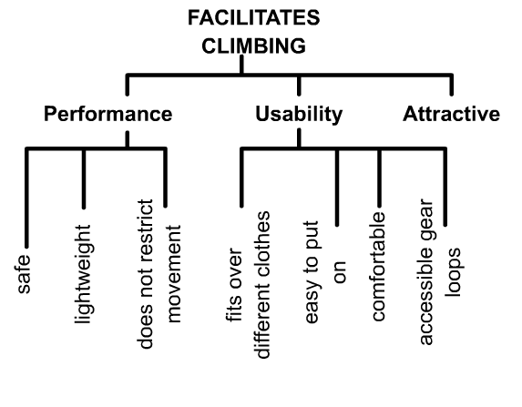
Example – Corresponding Tree Diagram
Hierarchical
Constructed like a family tree
Constructed top down with each level being examined for errors and omissions

Slide 12
Example – Corresponding Tree Diagram

Slide 13
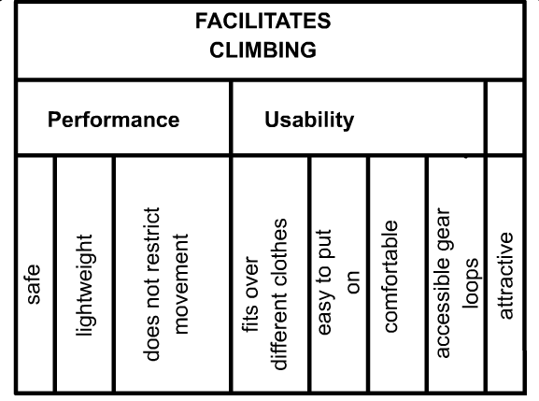
Example – Customer Requirement portion of HOQ

Slide 14
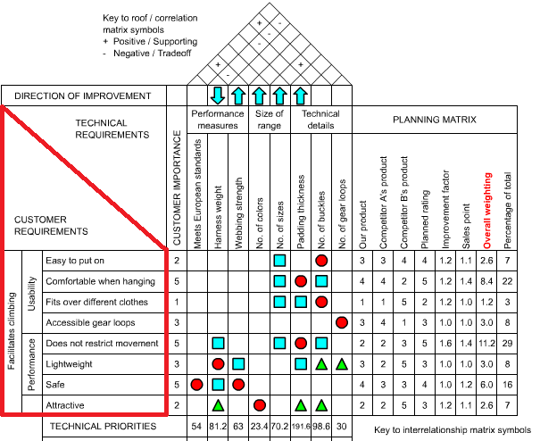
Example – Customer Requirement portion of HOQ

Slide 15
QDF House of Quality

Slide 16

Purpose
To quantify the customers’ requirement priorities and their perceptions of the performance of existing products
Allows these priorities to be adjusted to reflect the issues that concern the design team
Measures obtained in this portion of the HOQ should come directly from the customer
A questionnaire may be used

Slide 17
Importance Weighting (IW)
A quantitative measure of the relative importance of each of the customers requirements
Often shown on the left (customer’s requirement) section of the HOQ
Note: a questionnaire is often used to obtain these weightings from the customer
Can use a pre-defined scale (such as from 0 to 10)
Can use the Analytical Hierarchy Process (AHP) Customers give input on pair-wise requirement weightings basis

Slide 18
Existing Product Satisfaction Metric
A quantitative measure of the performance of existing products in fulfilling each of the customer requirements
Usually placed on the RHS of the HOQ – in the Planning Matrix section
Note: a questionnaire is also often used here to obtain these weightings from the customer
Can use a pre-defined scale
Analytical Hierarchy Process (AHP) can also be used
Customers give input by comparing competitors products on a pair-wise basis

Slide 19
Other Metrics (supplied by design team)
Existing Satisfaction Rating (ESR)
The performance rating of the existing product
Planned Satisfaction Rating (PSR)
The expected performance rating of the new product
Improvement Factor (IF)
Indicates the relative amount of improvement the planned Satisfaction Rating will give
IF = (PSR-ESR)/(Rating Range)+1
where IF >1 new product is better, IF <1 old product is better, IF = 1 neither product is better

Slide 20
Other Metrics (supplied by design team)
Sales Point (SP)
A metric which is used to add a positive weighting to customer requirements which add market value to the product (usually between 1 and 1.5)
Overall Weighting (OW)
A metric which can be used to obtain the effective importance of each of the customer’s requirements when taking into account additional external considerations.
OW = IW*IF*SP
Often put in normalized form

Slide 21
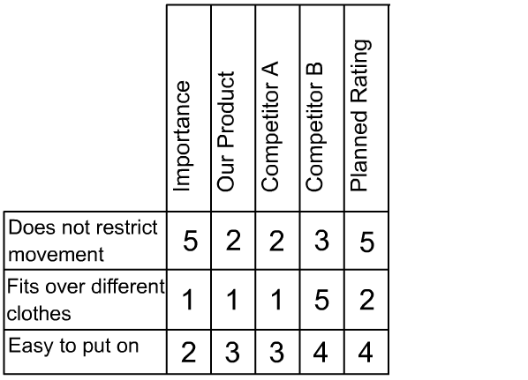

Slide 22
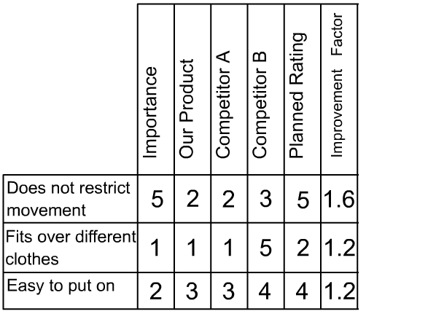

Slide 23
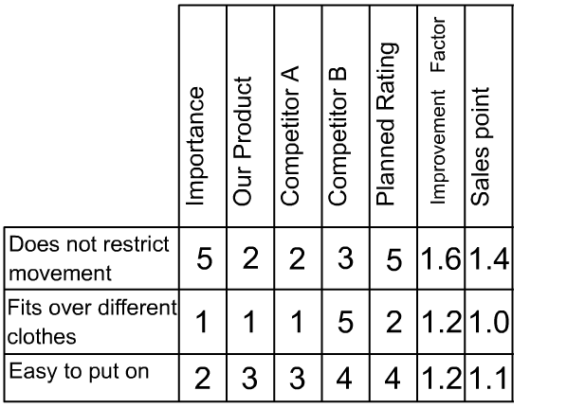

Slide 24
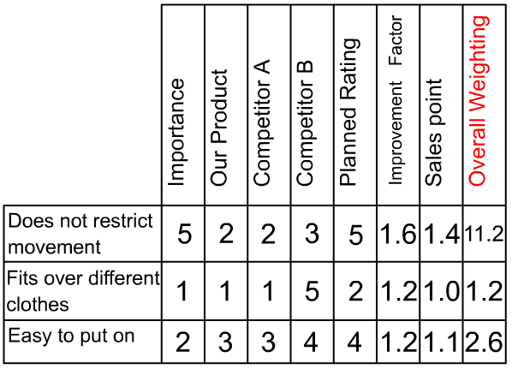

Slide 25
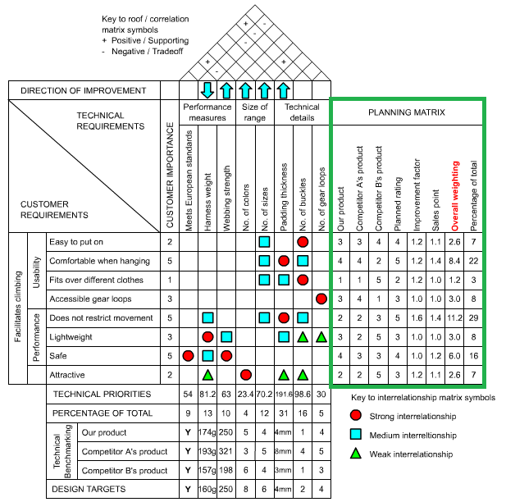

Slide 26
QDF House of Quality

Slide 27

Structured list of characteristics of the product which the design team believes are important in order to meet the specified customer requirements (“the Voice of the Company”)
Generated by the QFD design team
Characteristics are quantitative in nature (i.e. they are measurable)
Affinity and/or Tree Diagrams are often used in this analysis as they were in the customer requirement analysis

Slide 28
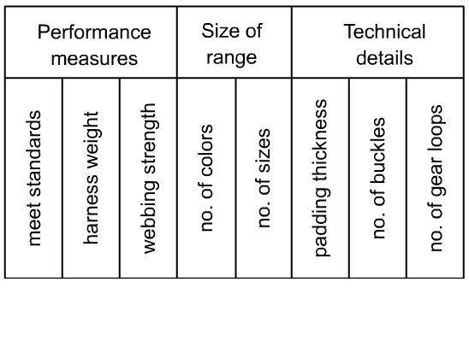
An additional row is often included here to indicate the direction of change needed to improve overall product performance

Slide 29
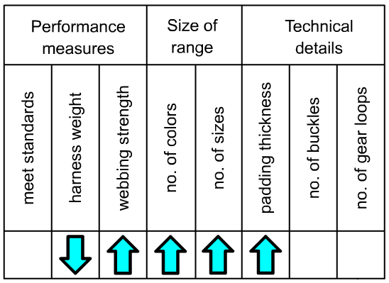

Slide 30
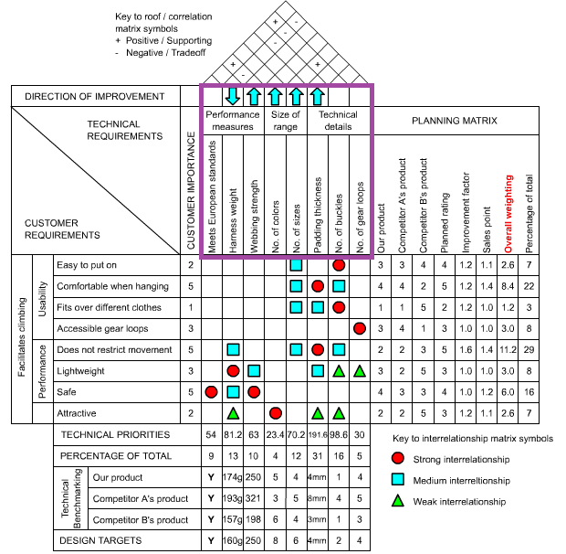

Slide 31
QDF House of Quality

Slide 32

Interrelationship Matrix
Identifies and quantifies the interrelationships between the customer requirements and technical requirements
Can be the most time consuming portion of the process to complete
The level of interrelationship discerned is often weighted on a four point scale (high, medium, low, or none)
Question is posed in the following way “how significant is specific technical requirement in satisfying the specific customer requirement?”

Slide 33
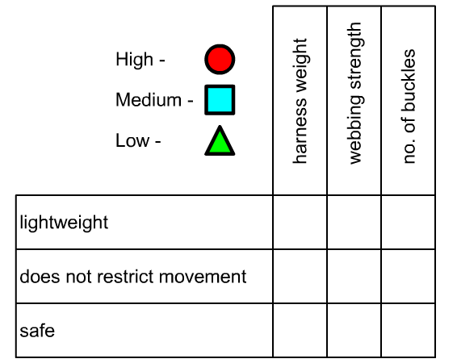

Slide 34
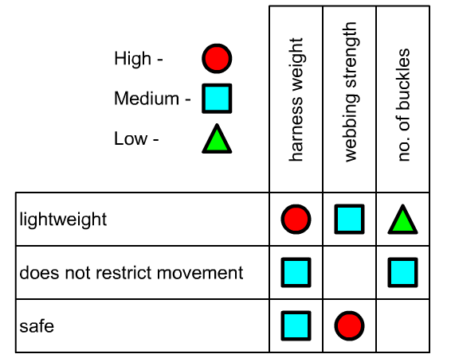

Slide 35
Interrelationship Matrix
Each level of interrelationship weighting is assigned a score which that suits the needs of the individual design project
(e.g. High-9, Medium-3, Low-1, and None-0)
These weightings are relative and may be varied later to study their impact on the final conclusions.

Slide 36
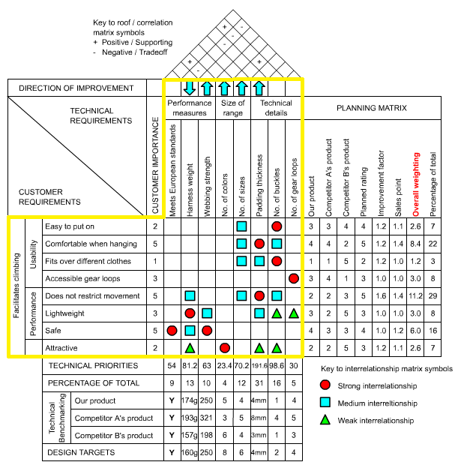

Slide 37
QDF House of Quality

Slide 38


Slide 39
The “Roof” matrix
Identifies where the technical requirements either support or impede one another
For each cell the question is asked “Does improving one technical requirement cause a deterioration or improvement in the other requirement?”
When the answer is a deterioration – an engineering trade-off exists ( - symbol).
When the answer is an improvement these requirements support one another (+ symbol)

Slide 40
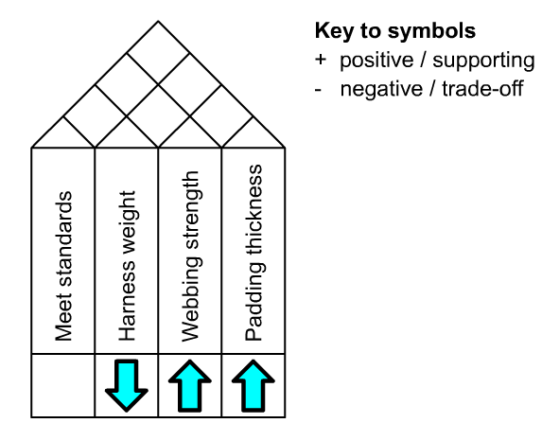

Slide 41
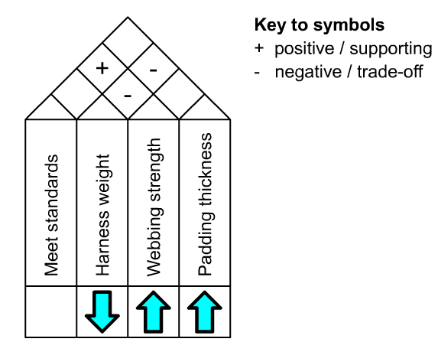

Slide 42
The “Roof” matrix
Supportive relationships --highlight where a focused design improvement could lead to a range of benefits to the product.
Trade-offs – highlight where innovative solutions need to be developed to avoid costly compromises

Slide 43
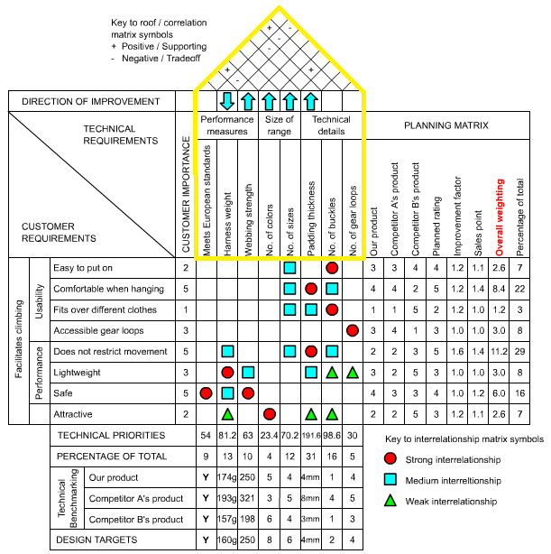

Slide 44
QDF House of Quality

Slide 45

The Targets matrix
Summaries the conclusions drawn from the data contained in the entire HOQ
General made up of three parts
Technical Priorities
Competitive Benchmarks
Targets

Slide 46
Technical Priorities
Represent the relative importance of each technical requirement of the product in meeting the customer’s specified needs
Calculated from the weightings contained in the planning and interrelationship matrix sections.
(Each interrelationship weighting is multiplied by the overall weighting from the planning matrix)
(These values are then summed down the columns to give a priority score for each technical requirement)

Slide 47
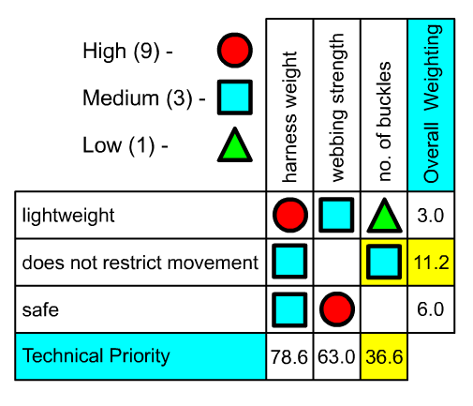

Slide 48
Competitive Benchmarking
Quantitative Measurement of the important characteristics of each technical requirement on the existing set of competitive products
This helps identify the target levels of performance to be achieved in the new product

Slide 49
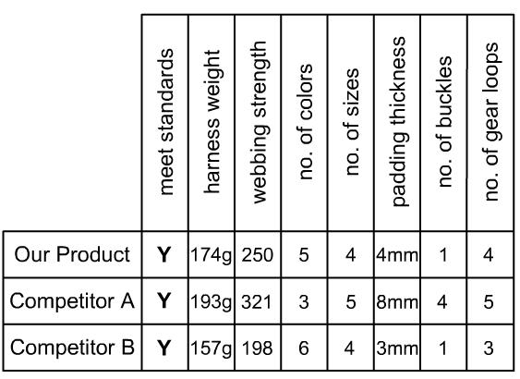

Slide 50
Targets
The set of engineering target values to be met for each technical requirement by the new product design
These targets are set based upon customers needs, competition’s performance, and the team’s performance.

Slide 51
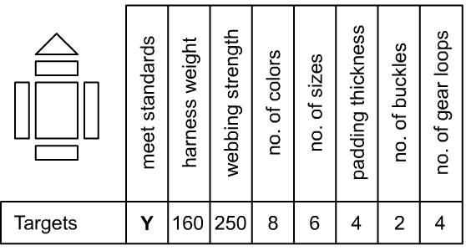

Slide 52
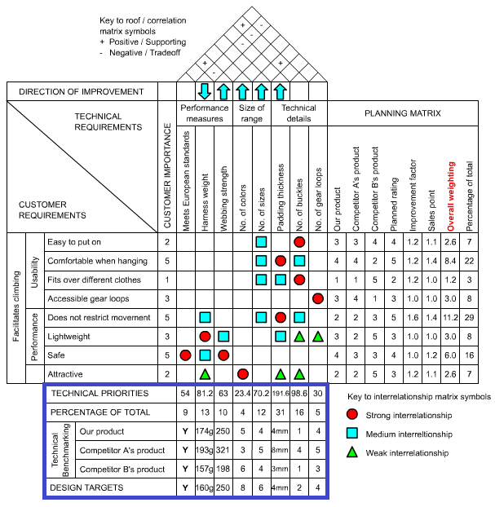

Slide 53
QDF House of Quality

