Slide 1
CPE 323 Introduction to Embedded Computer Systems: DMA Controller
Instructor: Dr Aleksandar Milenkovic Lecture Notes

Slide 2
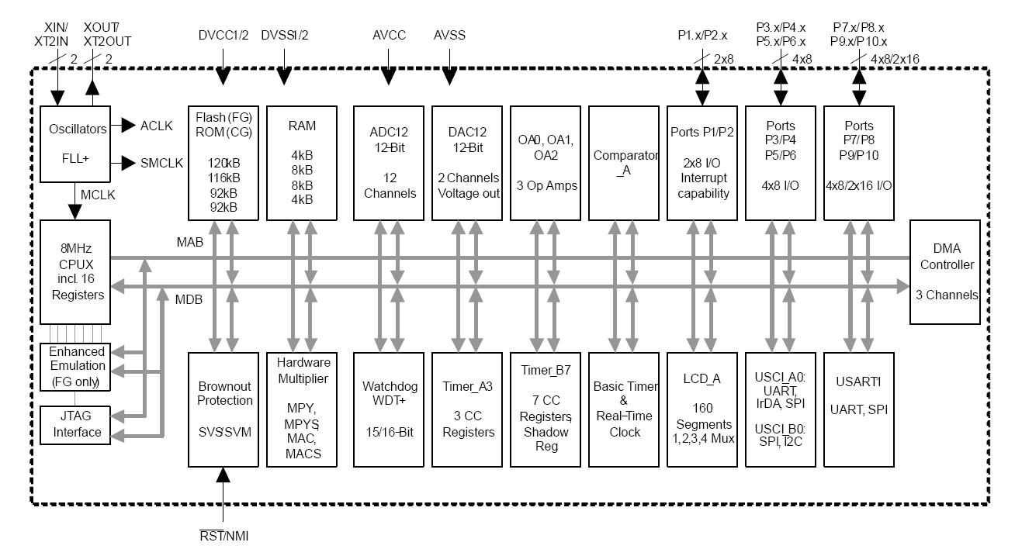
MSP430xG461x Microcontroller

Slide 3
DMA Controller Introduction
Direct memory access (DMA) controller transfers data from one address to another without CPU intervention, across the entire address range
Move data from the ADC12 conversion memory to RAM
Move data from RAM to DAC12
Devices that contain a DMA controller may have one, two, or three DMA channels available
Using the DMA controller
Can increase the throughput of peripheral modules
Can reduce system power consumption by allowing the CPU to remain in a low-power mode without having to awaken to move data to or from a peripheral

Slide 4
MSP430 DMA Features
Up to three independent transfer channels
Configurable DMA channel priorities
Requires only two MCLK clock cycles per transfer
Byte or word and mixed byte/word transfer capability
Block sizes up to 65535 bytes or words
Configurable transfer trigger selections
Selectable edge or level-triggered transfer
Four addressing modes
Single, block, or burst-block transfer modes
Configured from software

Slide 5
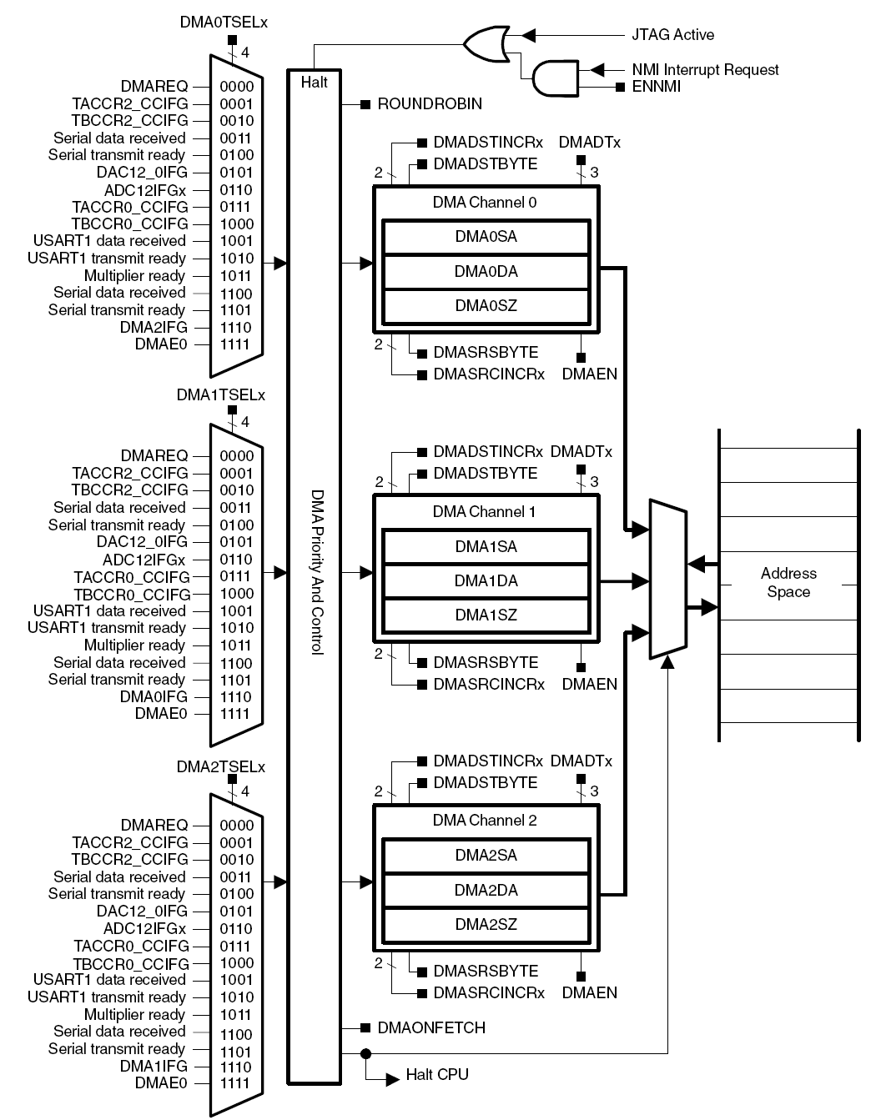
DMA Block Diagram

Slide 6
DMA Operation
3 Channels (DMA0, DMA1, DMA2) for independent transfers
Initialize block software from software, carry it out in hardware
DMA Registers
Starting Address (SA)
Destination Address (DA)
Block Size (SZ)

Slide 7
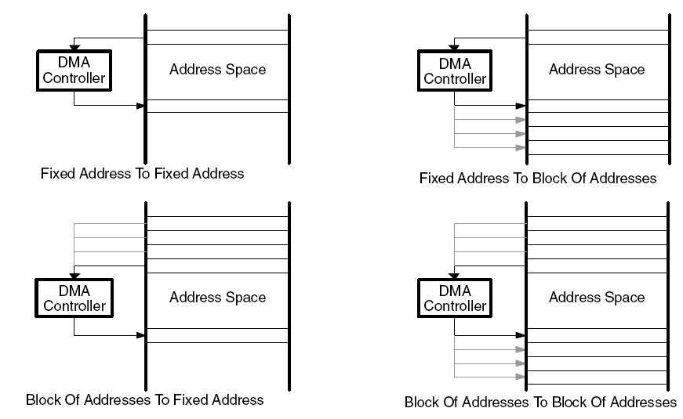
DMA Addressing Modes
Configured with the DMASRCINCRx and DMADSTINCRx control bits
DMASRCINCRx/ DMADSTINCRx bits select if the source/destination address is incremented, decremented, or unchanged after each transfer
Transfers may be byte-to-byte, word-to-word, byte-to-word, or word-to-byte
Word-to-byte: only the lower byte of the source-word is transferred
Byte-to-word: the upper byte of the destination-word is cleared when the transfer occurs

Slide 8
DMA Addressing Modes
Configured with the DMASRCINCRx and DMADSTINCRx control bits
Select if the source/destination address is incremented, decremented, or unchanged after each transfer
Four transfer modes
Fixed address to fixed address (e.g., comm2comm)
Fixed address to block of addresses (e.g. comm2mem)
Block of addresses to fixed address (e.g., mem2comm)
Block of addresses to block of addresses (mem2mem)
Transfers may be byte-to-byte, word-to-word, byte-to-word, or word-to-byte
Word-to-byte: only the lower byte of the source-word is transferred
Byte-to-word: the upper byte of the destination-word is cleared when the transfer occurs

Slide 9
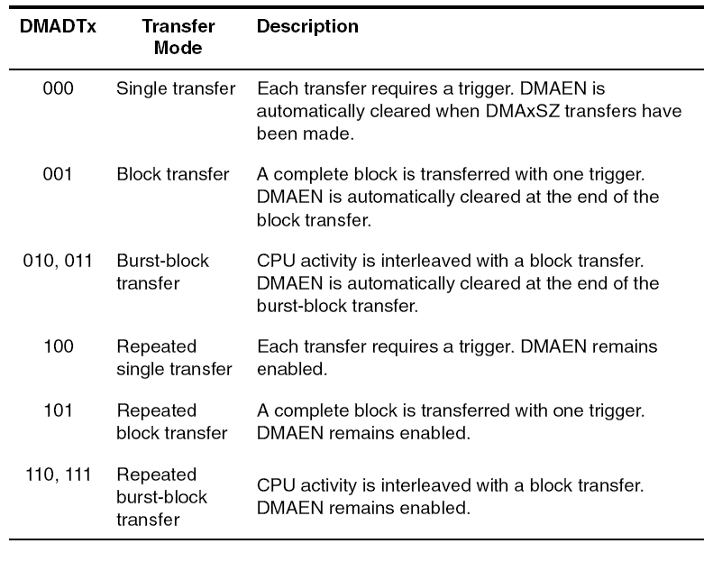
DMA Transfer Modes
Single/Repeated single modes: each byte/word transfer requires a separate trigger
Block/Repeated block modes: a transfer of a complete block of data occurs after one trigger
CPU is halted until the complete block has been transferred
Burst-block/Repeated burst-block modes: transfers are block transfers with CPU activity interleaved.
CPU executes 2 MCLK cycles after every four byte/word transfers of the block resulting in 20% CPU execution capacity

Slide 10
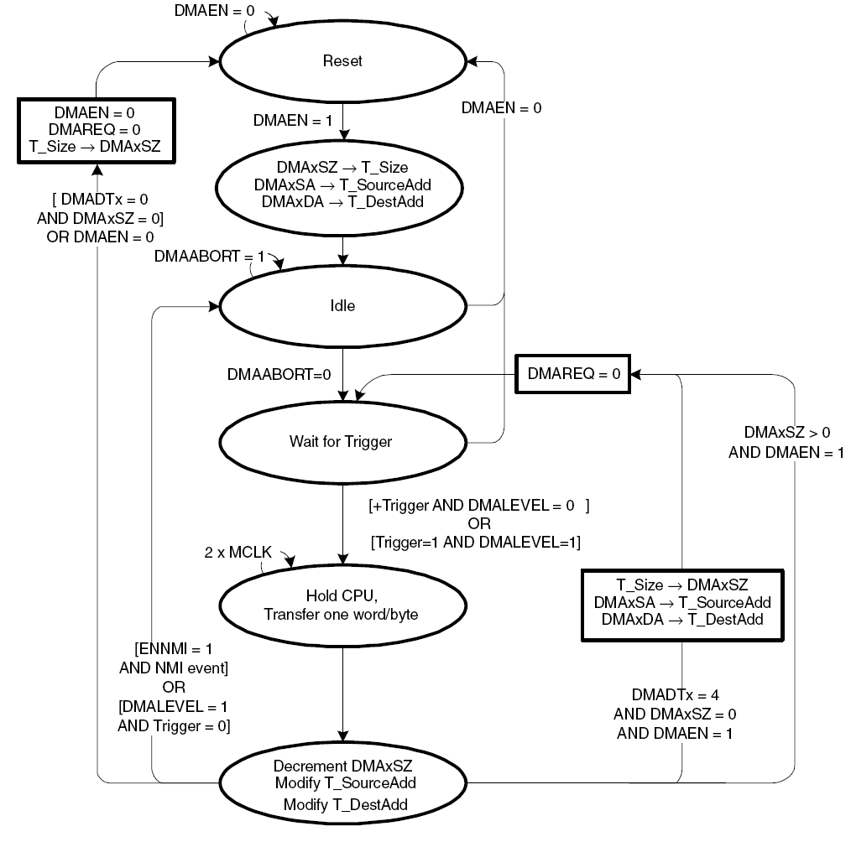
DMA Single Transfer

Slide 11
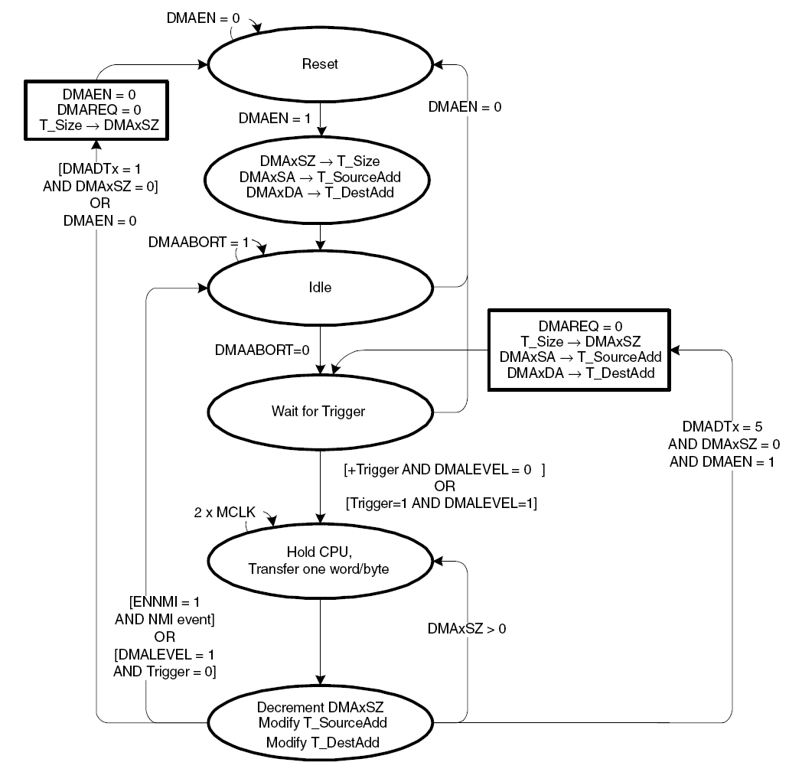
DMA Block Transfer

Slide 12
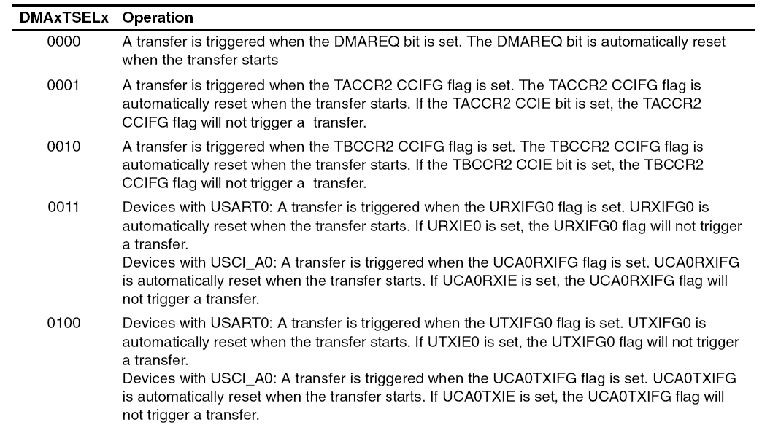
DMA Trigger Operation
DMAxTSELx bits select trigger
Edge-sensitive or level-sensitive

Slide 13
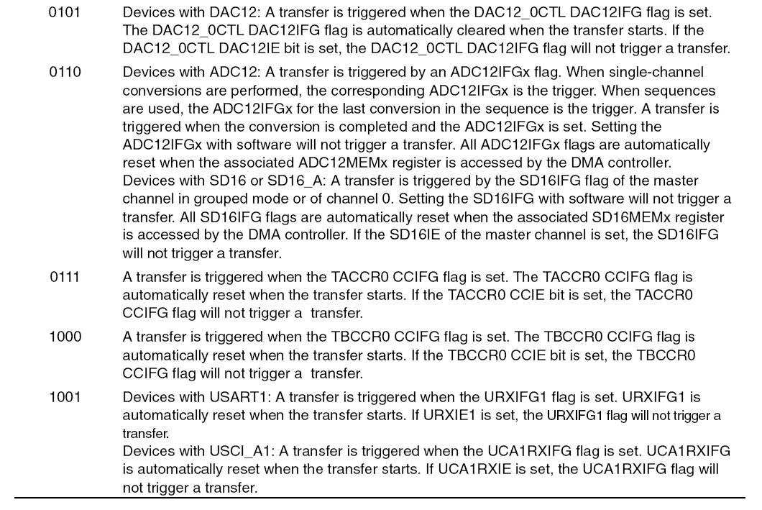
DMA Trigger Operation (cont’d)

Slide 14
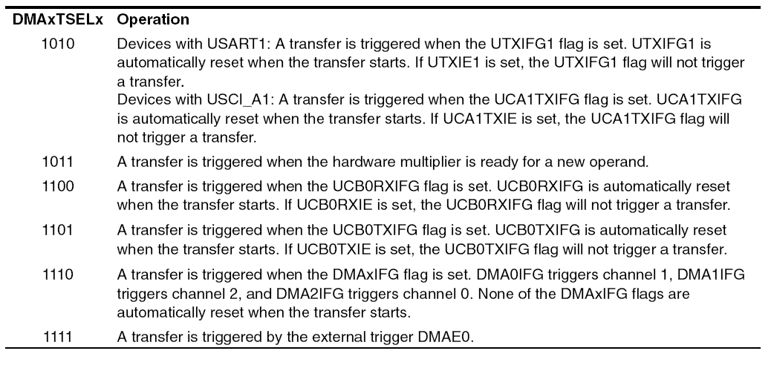
DMA Trigger Operation (cont’d)

Slide 15
Stopping DMA Transfers
Two ways to stop DMA transfers in progress:
A single, block, or burst-block transfer may be stopped with an NMI interrupt, if the ENNMI bit is set in register DMACTL1
A burst-block transfer may be stopped by clearing the DMAEN bit

Slide 16
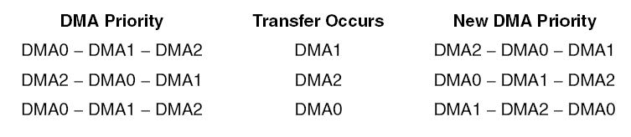
DMA Channel Priorities
Default DMA channel priorities are DMA0−DMA1−DMA2
If two or three triggers happen simultaneously or are pending, the channel with the highest priority completes its transfer (single, block or burst-block transfer) first, then the second priority channel, then the third priority channel.
Transfers in progress are not halted if a higher priority channel is triggered
The higher priority channel waits until the transfer in progress completes before starting
DMA channel priorities are configurable with the ROUNDROBIN bit (see below)

Slide 17
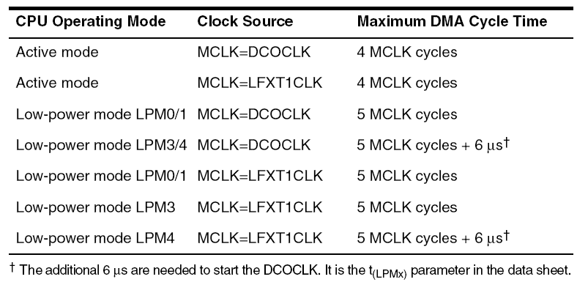
DMA Transfer Cycle Times
DMA requires 1 or 2 MCLK cc to synchronize before each single transfer or complete block or burst-block transfer
Each byte/word transfer requires 2 MCLK after synchronization, and one cycle of wait time after the transfer
DMA cycle time is dependent on the MSP430 operating mode and clock system setup (use MCLK)
If the MCLK source is active, but the CPU is off, the DMA controller will use the MCLK source for each transfer, without re-enabling the CPU.
If the MCLK source is off, the DMA controller will temporarily restart MCLK, sourced with DCOCLK, for the single transfer or complete block or burst-block transfer
The CPU remains off, and after the transfer completes, MCLK is turned off.

Slide 18
DMA and Interrupts
DMA transfers are not interruptible by system interrupts
System interrupts remain pending until the completion of the transfer
NMI interrupts can interrupt the DMA controller if the ENNMI bit is set
System interrupt service routines are interrupted by DMA transfers
If an interrupt service routine or other routine must execute with no interruptions, the DMA controller should be disabled prior to executing the routine

Slide 19
DMA Interrupts
Each DMA channel has its own DMAIFG flag
Each DMAIFG flag is set in any mode, when the corresponding DMAxSZ register counts to zero. If the corresponding DMAIE and GIE bits are set, an interrupt request is generated
All DMAIFG flags source only one DMA controller interrupt vector and the interrupt vector may be shared with the other modules
software must check the DMAIFG and other flags to determine the source of the interrupt
The DMAIFG flags are not reset automatically and must be reset by software

Slide 20
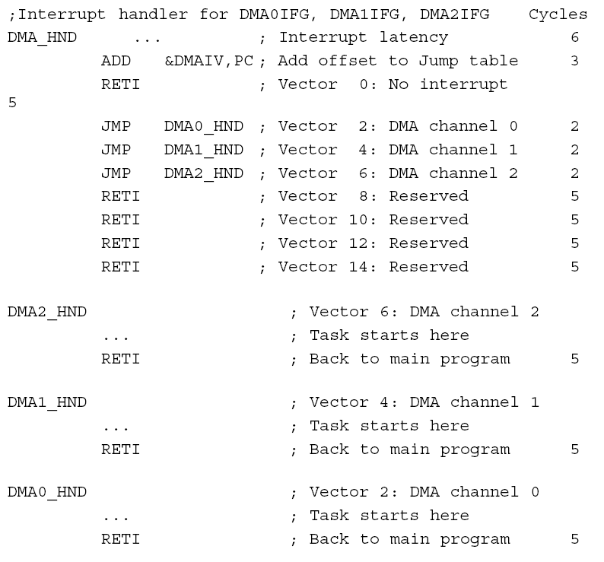
DMAIV Register

Slide 21
DMA and ADC12
DMA can automatically move data from any ADC12MEMx register to another location
No CPU intervention, independently from LPMs
=> increases throughput of the ADC12 module, and saves energy
DMA transfers can be triggered from any ADC12IFGx flag
When CONSEQx = {0,2} the ADC12IFGx flag for the ADC12MEMx used for the conversion can trigger a DMA transfer
When CONSEQx = {1,3}, the ADC12IFGx flag for the last ADC12MEMx in the sequence can trigger a DMA transfer
Any ADC12IFGx flag is automatically cleared when the DMA controller accesses the corresponding ADC12MEMx

Slide 22
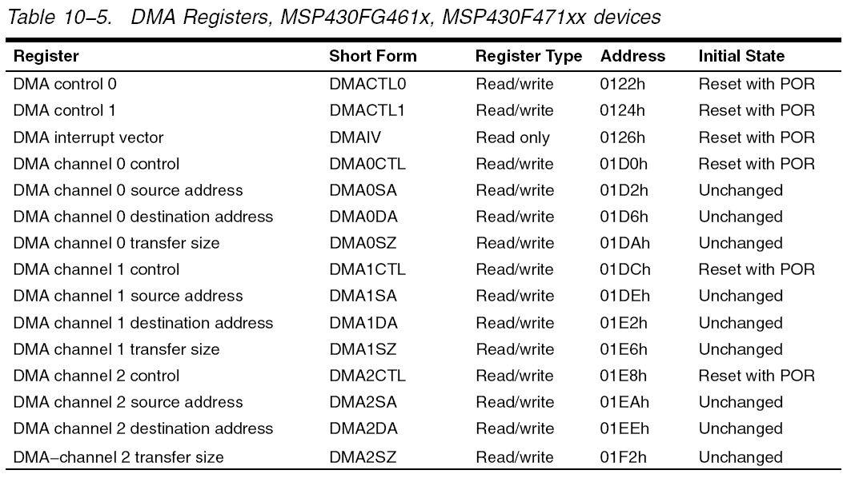
DMA Registers

Slide 23
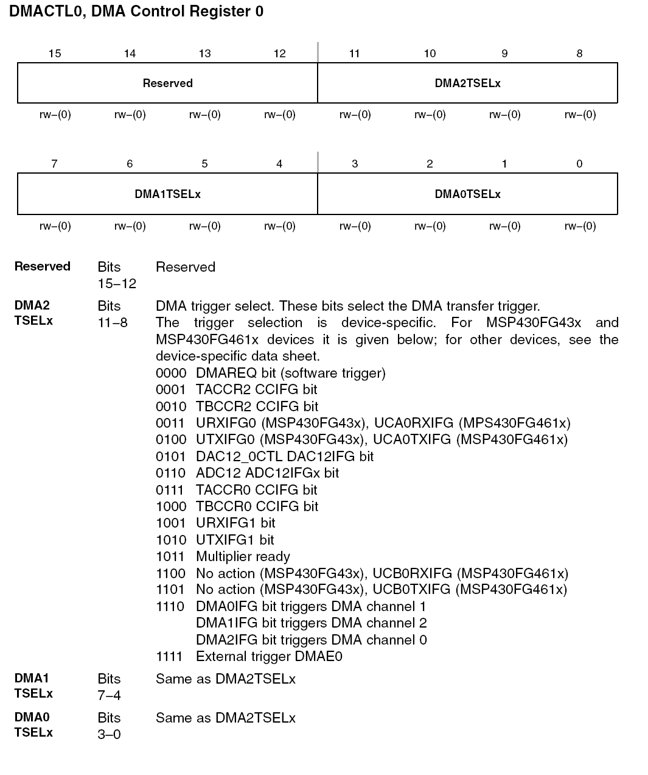
DMACTL0

Slide 24
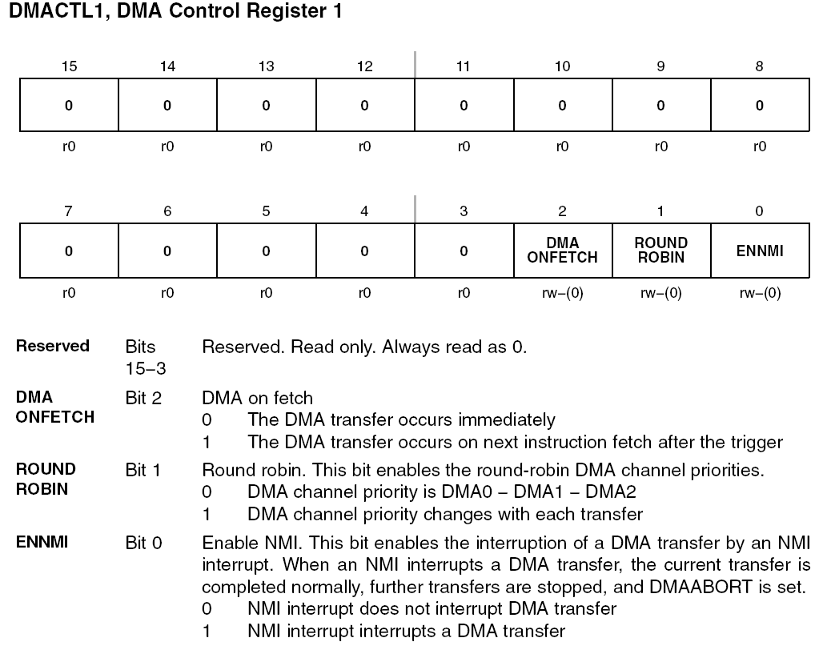
DMACTL1

Slide 25
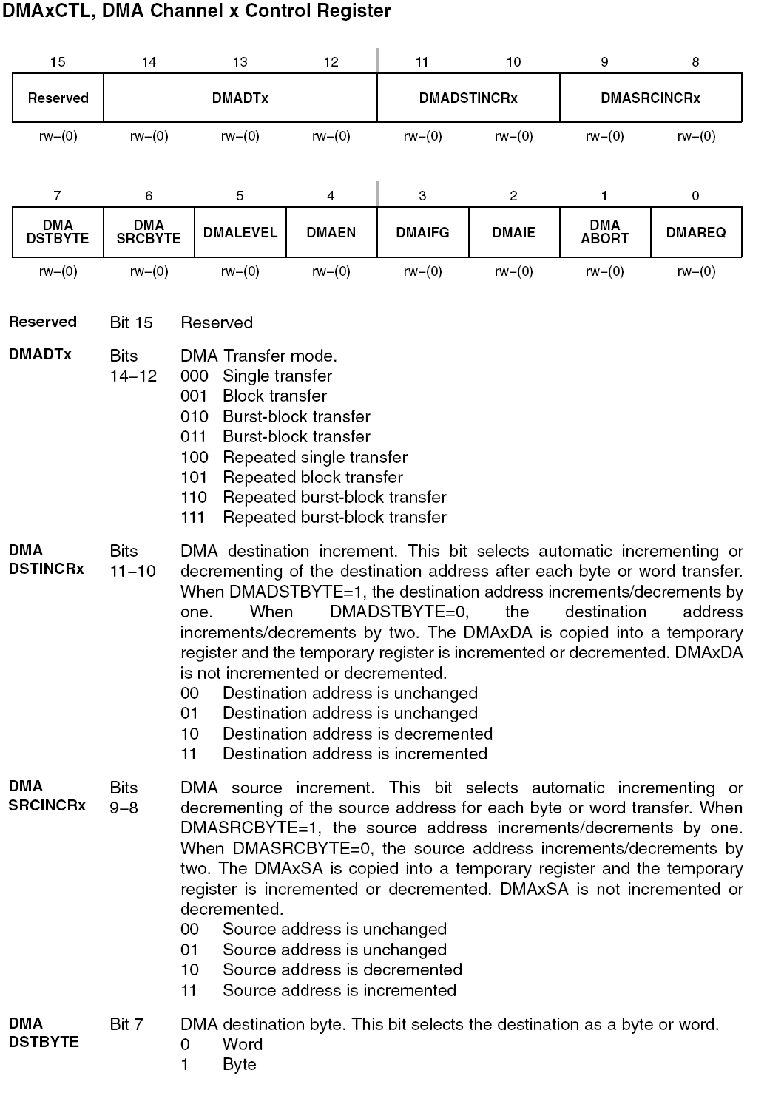
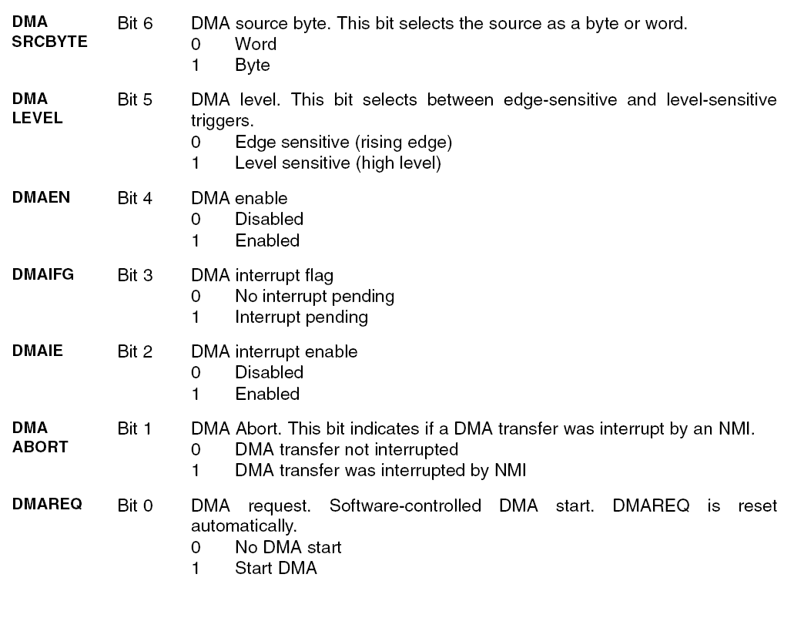
DMAxCTL

Slide 26
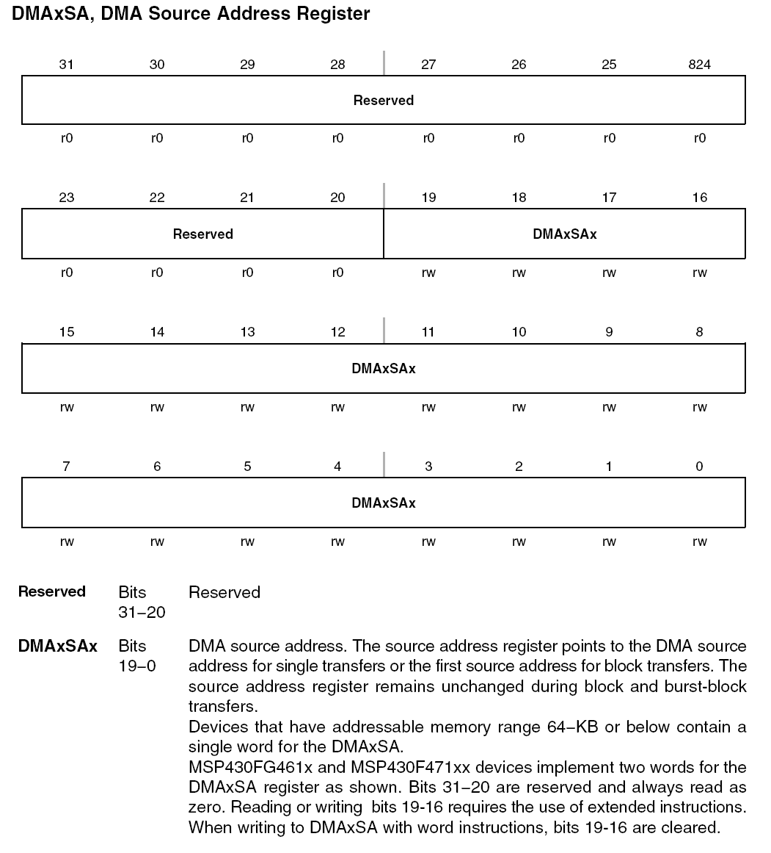
DMAxSA

Slide 27
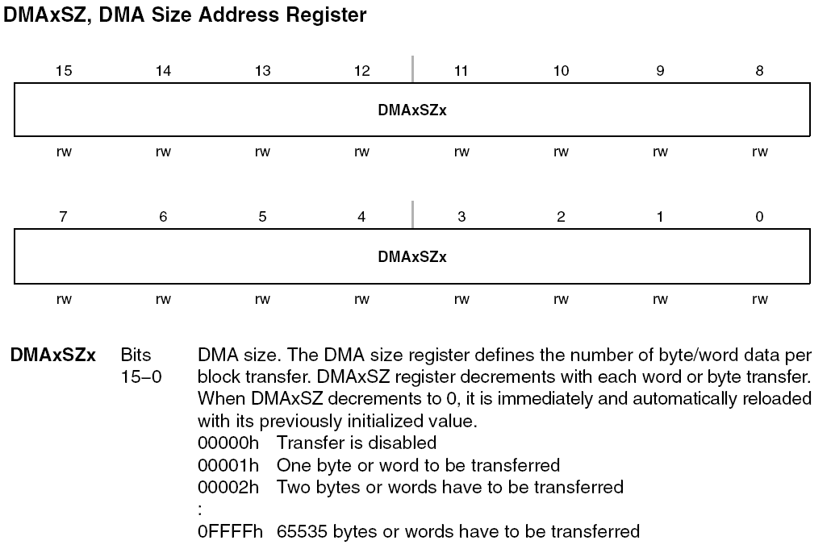
DMAxSZ

Slide 28
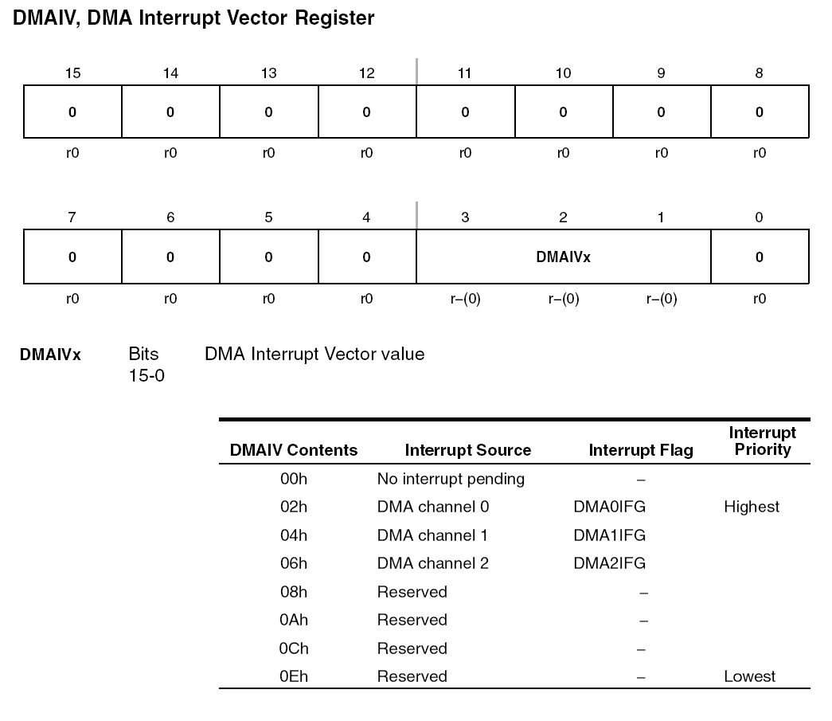
DMAIV

Slide 29
An Example (Mem2Mem)
//*************************************************************************
// MSP430xG461x Demo - DMA0, Repeated Burst to-from RAM, Software Trigger
//
// Description: A 16 word block from 1400-141fh is transfered to 1420h-143fh
// using DMA0 in a burst block using software DMAREQ trigger.
// After each transfer, source, destination and DMA size are
// reset to inital software setting because DMA transfer mode 5 is used.
// P5.1 is toggled durring DMA transfer only for demonstration purposes.
// ** RAM location 0x1400 - 0x143f used - make sure no compiler conflict **
// ACLK = 32kHz, MCLK = SMCLK = default DCO 1048576Hz
//
// MSP430xG461x
// -----------------
// /|\| XIN|-
// | | | 32kHz
// --|RST XOUT|-
// | |
// | P5.1|-->LED
//
// A. Dannenberg/ M. Mitchell
// Texas Instruments Inc.
// October 2006
// Built with IAR Embedded Workbench Version: 3.41A
//****************************************************************************
#include "msp430xG46x.h"
void main(void)
{
WDTCTL = WDTPW + WDTHOLD; // Stop WDT
P5DIR |= 0x002; // P1.0 output
DMA0SA = 0x1400; // Start block address
DMA0DA = 0x1420; // Destination block address
DMA0SZ = 0x0010; // Block size
DMA0CTL = DMADT_5 + DMASRCINCR_3 + DMADSTINCR_3 + DMAEN; // Rpt, inc
DMA0CTL |= DMAEN; // Enable DMA0
while(1)
{
P5OUT |= 0x02; // P5.1 = 1, LED on
DMA0CTL |= DMAREQ; // Trigger block transfer
P5OUT &= ~0x02; // P5.1 = 0, LED off
}
}

Slide 30
An Example (Mem2Comm)
#include "msp430xG46x.h"
const char String1[13] = "\nHello World";
void main(void)
{
WDTCTL = WDT_ADLY_1000; // WDT 1000ms, ACLK, int
IE1 |= WDTIE; // Enable WDT interrupt
P4SEL |= 0x03; // P4.0,1 = USART1 TXD/RXD
ME2 |= UTXE1 + URXE1; // Enable USART1 TXD/RXD
UCTL1 |= CHAR; // 8-bit characters
UTCTL1 = SSEL0; // BRCLK = ACLK
UBR01 = 0x03; // 32k/9600=3.41
UBR11 = 0x00;
UMCTL1 = 0x04A; // Modulation
UCTL1 &= ~SWRST; // Release USART state machine
DMACTL0 = DMA0TSEL_10; // UTXIFG1 trigger
DMA0SA = (int)String1; // Source block address
DMA0DA = TXBUF1_; // Destination single address
DMA0SZ = 0014; // Block size
DMA0CTL = DMASRCINCR_3 + DMASBDB + DMALEVEL; // Repeat, inc src
__bis_SR_register(LPM3_bits + GIE); // Enter LPM3 w/ interrupts
}
#pragma vector = WDT_VECTOR // Trigger transfer
__interrupt void WDT_ISR(void)
{
DMA0CTL |= DMAEN; // Enable
}
//****************************************************************************
// MSP430xG461x Demo - DMA0, Block Mode UART1 9600, ACLK
//
// Description: DMA0 is used to transfer a string as a block to U1TXBUF.
// UTXIFG1 WILL trigger DMA0. "Hello World" is TX'd via 9600 baud on UART1.
// Watchdog in interval mode triggers block transfer every 1000ms.
// Level senstive trigger used for UTXIFG1 to prevent loss of inital edge
// sensitive triggers - UTXIFG1 which is set at POR.
// ACLK = UCLK 32768Hz, MCLK = SMCLK = default DCO 1048576Hz
// Baud rate divider with 32768hz XTAL @9600 = 32768Hz/9600 = 3.41 (000Dh 4Ah)
//
// MSP430xG461x
// -----------------
// /|\| XIN|-
// | | | 32768Hz
// --|RST XOUT|-
// | |
// | P4.0|------------> "Hello World"
// | | 9600 - 8N1
//
// A. Dannenberg/ M. Mitchell
// Texas Instruments Inc.
// October 2006
// Built with IAR Embedded Workbench Version: 3.41A
//***************************************************************************

