Slide 1
CPE 323 Introduction to Embedded Computer Systems: LCD_A Controller
Instructor: Dr Aleksandar Milenkovic Lecture Notes

Slide 2
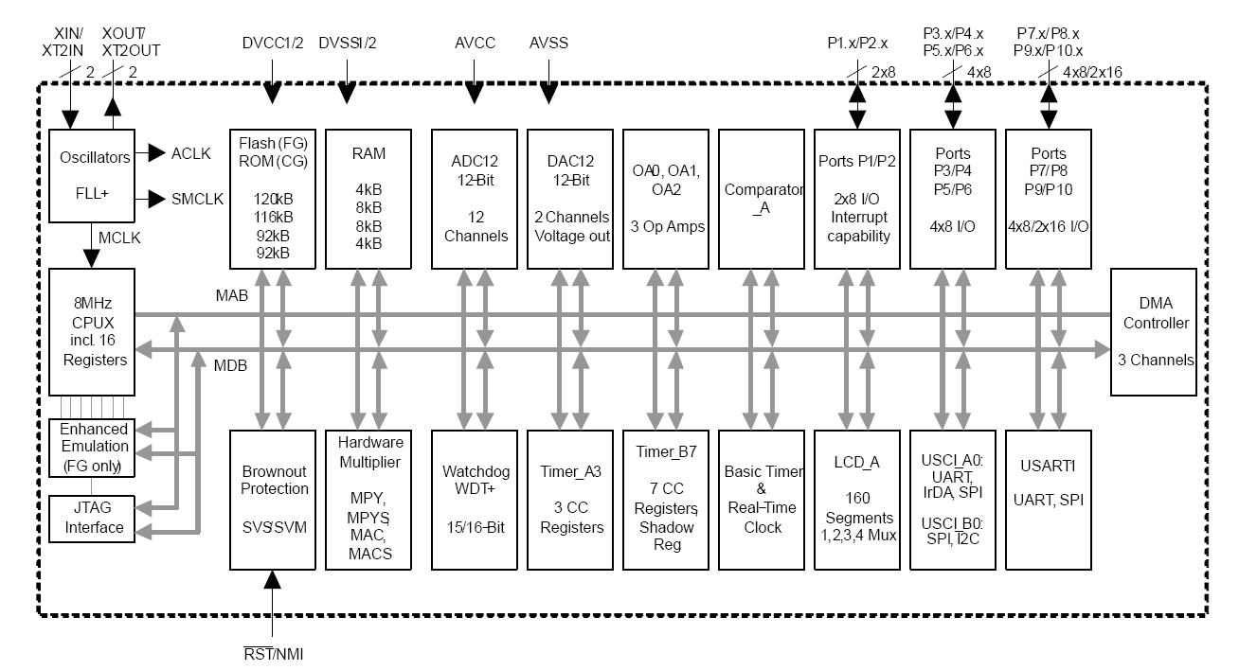
MSP430xG461x Microcontroller

Slide 3
LCD Displays
LCD - Liquid crystal display
Use much less power than LEDs
Does not emit light itself but controls the intensity of reflected or transmitted light
Backlight must be provided for a display to be used in dark surroundings
Three classes
Segmented LCDs
Character-based LCDs
Fully graphical LCDs

Slide 4
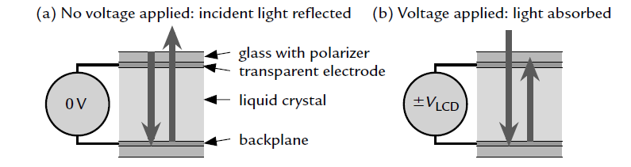
Reflective LCD: Operation Basics
Construction:
Two glass plates carry transparent electrodes on their opposing faces and there is a mirror below the lower plate
The gap between is filled with a liquid crystal
Bias voltage between electrodes = 0 => Incident light is reflected and the display appears clear
Sufficiently large bias voltage changes the optical properties of the liquid crystal so that reflected light is no longer transmitted through the upper glass and the segment appears dark
Electrically the display is similar to a capacitor, albeit rather lossy

Slide 5
Reflective LCD: Operation Basics (cont’d)
Complication: LCDs must be driven with AC, not DC
A steady voltage of only a few tens of millivolts leads to electrolysis of the liquid crystal, which eventually destroys the display
Approach: The two electrodes of a segment are therefore driven with square waves in antiphase to produce an alternating voltage with zero mean
The frequency is low, typically around 100 Hz, but must not be close to multiples of the AC mains (line) frequency (50 or 60 Hz)
The output of many lights fluctuates at twice the frequency of the mains and the LCD appears to flicker if it is updated at a similar rate

Slide 6
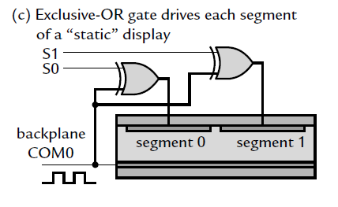
Driving Multiple Segments in LCDs
Common backplane: COM0
A square wave provides a clock to bias the display
Each segment on the front has a separate connection: S0, S1
An exclusive-OR gate with a control signal to each segment:
Si=0 => XOR gate transmits clock on COM0 unchanged => there is no potential difference between the electrodes, and the segment remains clear
Si=1 => XOR inverts the clock so that an alternating bias is applied to the segment, which turns dark
XOR gates could be real devices but it is straightforward to implement this inside the MCU by toggling the outputs periodically.

Slide 7
Driving Multiple Segments in LCDs
Common backplane: COM0
A square wave provides a clock to bias the display
Each segment on the front has a separate connection: S0, S1
An exclusive-OR gate with a control signal to each segment:
Si=0 => XOR gate transmits clock on COM0 unchanged => there is no potential difference between the electrodes, and the segment remains clear
Si=1 => XOR inverts the clock so that an alternating bias is applied to the segment, which turns dark
XOR gates could be real devices but it is straightforward to implement this inside the MCU by toggling the outputs periodically.

Slide 8
Driving Multiple Segments in LCDs (cont’d)
Static approach:
One pin for each segment on display + one pin for backplane
Problem: Large number of pins
Solution:
Multiplexed displays require fewer pins (multiple segments share a single pin)
Drawback: more trickier to multiplex LCDs because of the requirement for AC drive

Slide 9
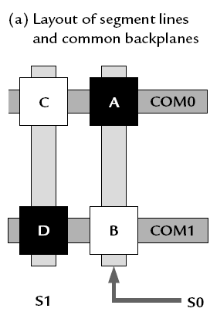
Two-way Multiplexing
Example
4 segments (A, B, C, and D)
1 backplane
Static: 5 pins
Multiplexed: 4 pins
2 common backplanes (COM0, COM1)
2 signals (S0, S1)

Slide 10
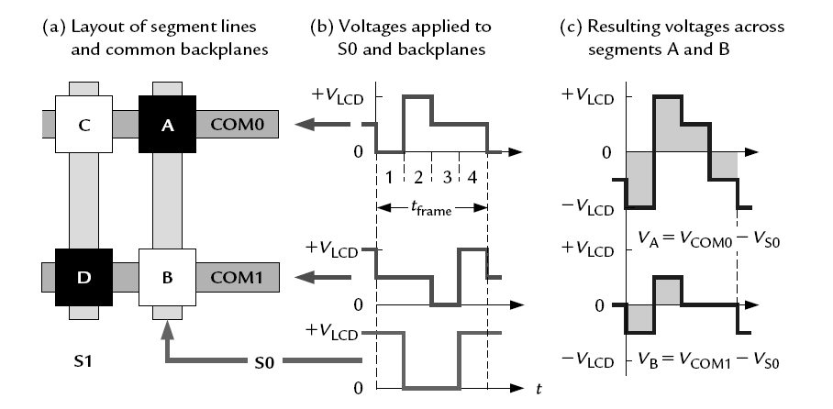
Two-way Multiplexing
Segment A: V_{COM0} – V_{S0}; Segment B: V_{COM1} – V_{S0}
Segment C: V_{COM0} –V_{S1}; Segment D: V_{COM1} – V_{S1}

Slide 11
Two-way Multiplexing
Each period of the waveforms, called a frame, is divided into four phases:
1. The segments on COM0 are addressed in the first phase by pulling COM0 to ground (0 V).
Segment A should be on and S0 is therefore driven to its maximum value, V_{LCD}
V_{A} = V_{COM0}−V_{S0} =−V_{LCD}
The segments on COM1 should be inactive during this phase and it is therefore put at a “neutral” voltage of 1/2V_{LCD}
V_{B} = V_{COM1} – V_{S0}= − 1/2V_{LCD}
2. The voltages in the second phase are the opposite of those in the first to ensure a pure AC signal with zero mean
V_{COM0} = V_{LCD} and V_{S0} = 0 to give V_{A}=+V_{LCD}
The backplane that is not being addressed, COM1, remains at its neutral voltage of 1/2V_{LCD} so that V_{B} =+1/2V_{LCD}
3. Now it is the turn of COM1 to be addressed so it is pulled to ground and COM0 is set to neutral 1/2V_{LCD}
Segment B should be off and S0 is therefore pulled to ground as well
4. This is the opposite of phase 3 to ensure that the mean voltage remains 0.

Slide 12
Two-way Multiplexing
It is not possible to apply either the maximum voltage ±V_{LCD} at all times to segments that should be on nor a constant value of 0 to those that should be off
Response of a segment depends on the root mean square (rms) value of the bias across it
Suppose that V_{LCD} = 3.0 V. Then the values here are
Vrms A = √5/8 V_{LCD} ≈ 2.4V
Vrms B = √1/8 V_{LCD} ≈ 1.1 V
The rms voltages have a ratio of √5 and are sufficiently large and small to make the segments dark and clear, respectively
The drive is no longer purely “digital” because a voltage of 1/2 V_{LCD} is needed

Slide 13
LCD_A Display Clock
Refresh rate: 30 Hz or faster to avoid flicker
Higher frequencies give a clearer display but consume more current
2-way multiplexed: 2x2, 4 clocks per frame
4-way multiplexed display needs eight clock cycles per frame (4x2)
f_{LCD} must be at least 240 Hz
ACLK is at the usual 32 KHz => 32 K/240 = 136 or less, so a factor of 128 would probably be chosen

Slide 14
LCD_A Bias Voltage
LCD_A has an internal chain of resistors
No external components are needed other than the display itself
An external resistor chain can be used to reduce the current required. A variable resistor can be attached as a contrast control

Slide 15
LCD_A Bias Voltage
LCD_A offers three choices for the voltage to drive the display:
1) Internal AVCC
2) An external voltage, which may be used with either the internal or an external divider
3) An internal charge pump, which provides an adjustable, regulated output in the range 2.60–3.44V, which can be controlled from software
A reservoir capacitor CLCD of at least 4.7F for the charge pump must be connected to the LCDCAP pin
Note: CPU may operate on low voltages

Slide 16
LCD_A Controller
Liquid Crystal Display (LCD) controller
Included in several devices of the MSP430 families (’3xx and ’4xx)
Allows a rapid and simple way to interface with the program
LCD controller commands the LCD panels generating voltage signals to the segments. It supports static, and multiplex rates up to 4 (2 mux, 3 mux and 4 mux) LCD panels
Features
Display memory
Automatic signal generation
Configurable frame frequency
Blinking capability
Support for 4 types of LCDs:
Static
2-mux, 1/2 bias
3-mux, 1/3 bias
4-mux, 1/3 bias

Slide 17
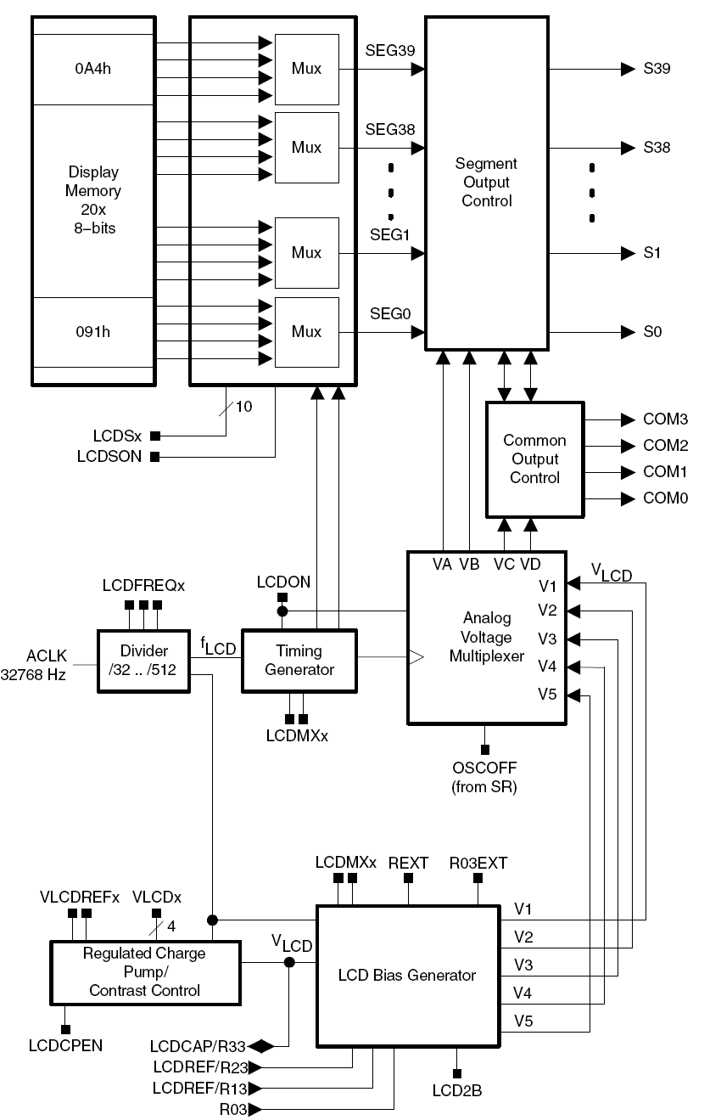
LCD_A Controller Block Diagram

Slide 18
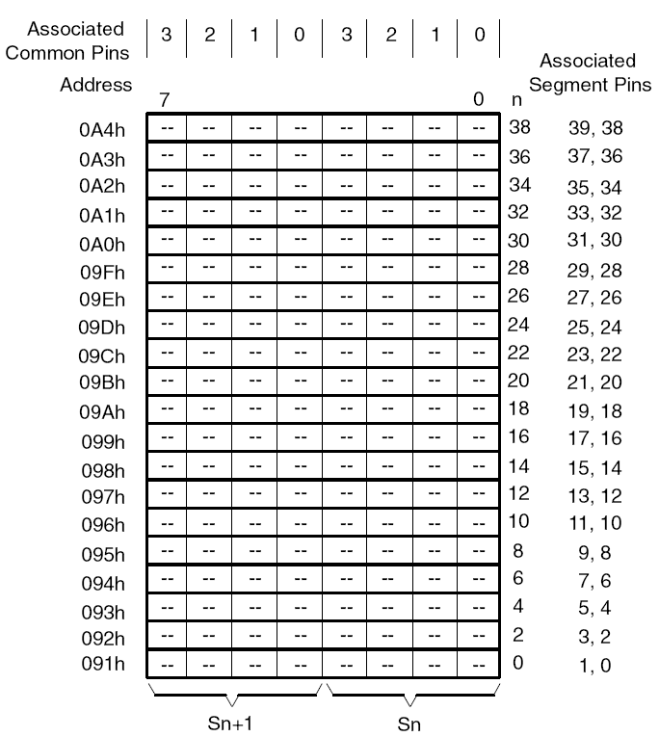
LCD Memory Map
Each memory bit corresponds to one LCD segment, or is not used, depending on the mode
To turn on an LCD segment, its corresponding memory bit is set

Slide 19
LCD Controller Operation
LCD controller supports blinking
The LCDSON bit is ANDed with each segment’s memory bit.
When LCDSON = 1, each segment is on or off according to its bit value
When LCDSON = 0, each LCD segment is off
Timing generation
Uses the f_{LCD} signal to generate the timing for common and segment lines
Proper frequency f_{LCD} depends on the LCD’s requirement for framing frequency and LCD multiplex rate

Slide 20
LCD_A Voltage Generation
Allows selectable sources for the peak output waveform voltage, V1, as well as the fractional LCD biasing voltages V2 − V5
V_{LCD} may be sourced from AVCC, an internal charge pump, or externally
All internal voltage generation is disabled if the oscillator sourcing ACLK is turned off (OSCOFF = 1) or the LCD_A module is disabled (LCDON = 0)

Slide 21
LCD_A Voltage Selection
Sourced from
AVCC when VLCDEXT = 0, VLCDx = 0, and VREFx = 0.
the internal charge pump when VLCDEXT = 0, VLCDPEN = 1, and VLCDx > 0
The charge pump is always sourced from DVCC
The VLCDx bits provide a software selectable LCD voltage from 2.6 V to 3.44 V (typical) independent of DVCC
The internal charge pump may use an external reference voltage when VLCDREFx = 01. In this case, the charge pump voltage will be 3x the voltage applied externally to the LCDREF pin and the VLCDx bits are ignored.
When VLCDEXT = 1, VLCD is sourced externally from the LCDCAP pin and the internal charge pump is disabled.

Slide 22
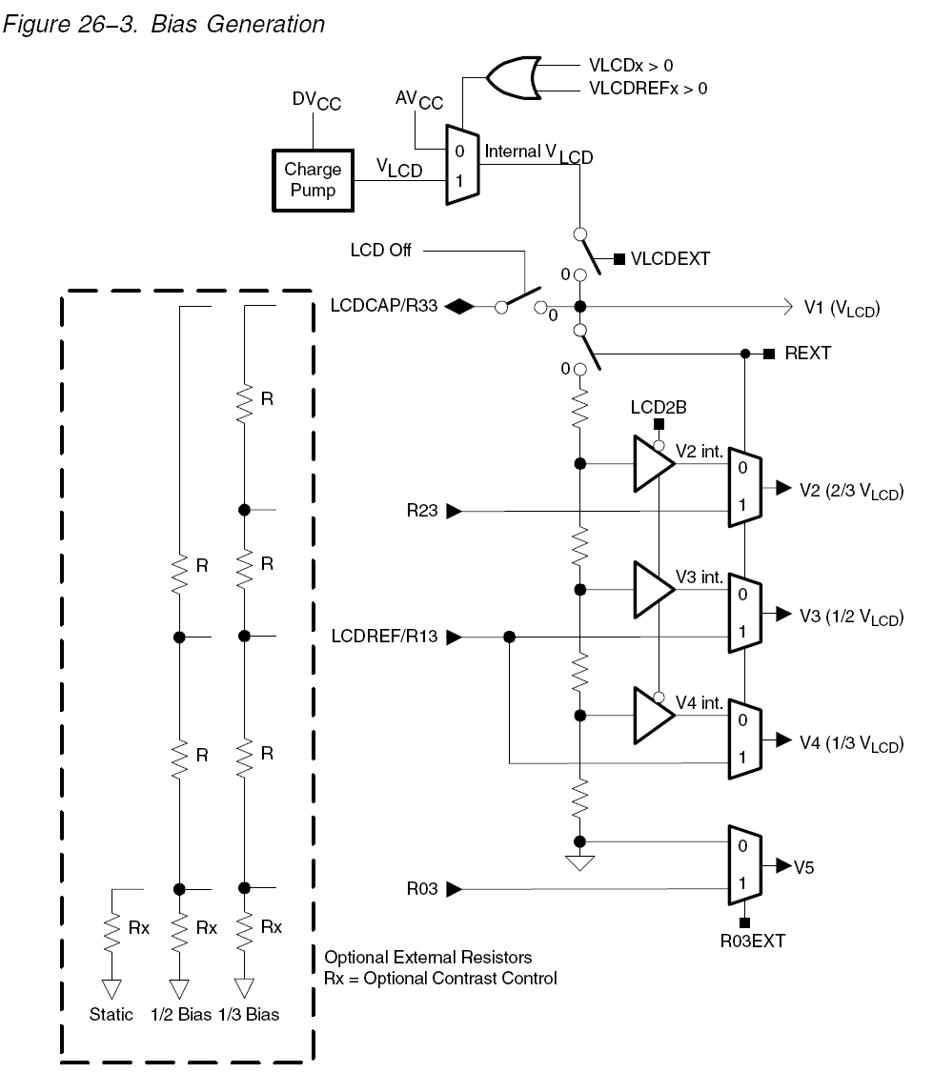
Bias Generation
The fractional LCD biasing voltages, V2 − V5 can be generated internally or externally, independent of the source for VLCD
REXT bit

Slide 23
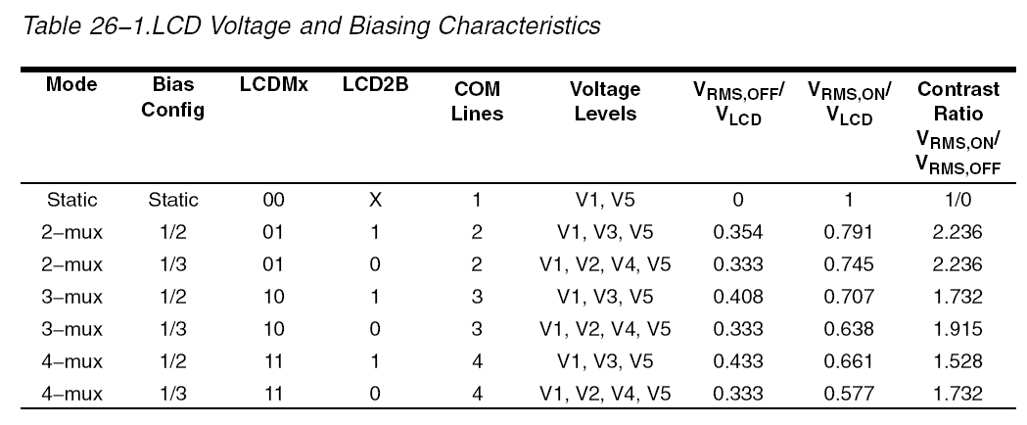
LCD_A Voltage Generation
The contrast ratio depends on the used LCD display and the selected biasing scheme
Table 26−1 shows the biasing configurations that apply to the different modes together with the RMS voltages for the segments turned on (VRMS,ON) and turned off (VRMS,OFF) as functions of VLCD. It also shows the resulting contrast ratios between the on and off states

Slide 24
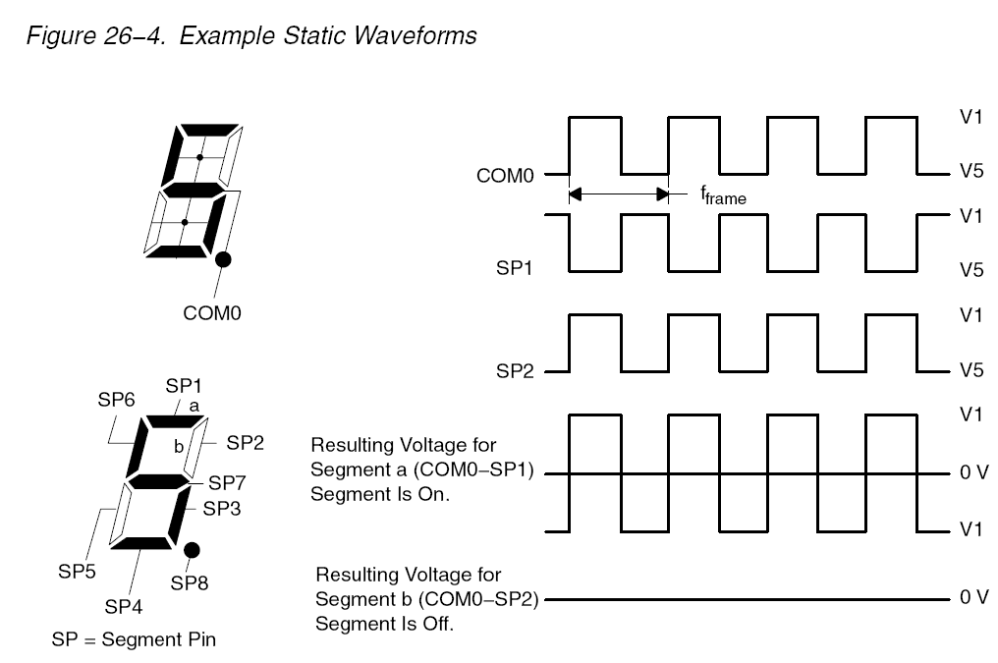
Static Mode
Each MSP430 segment pin drives one LCD segment
One common line, COM0, is used

Slide 25
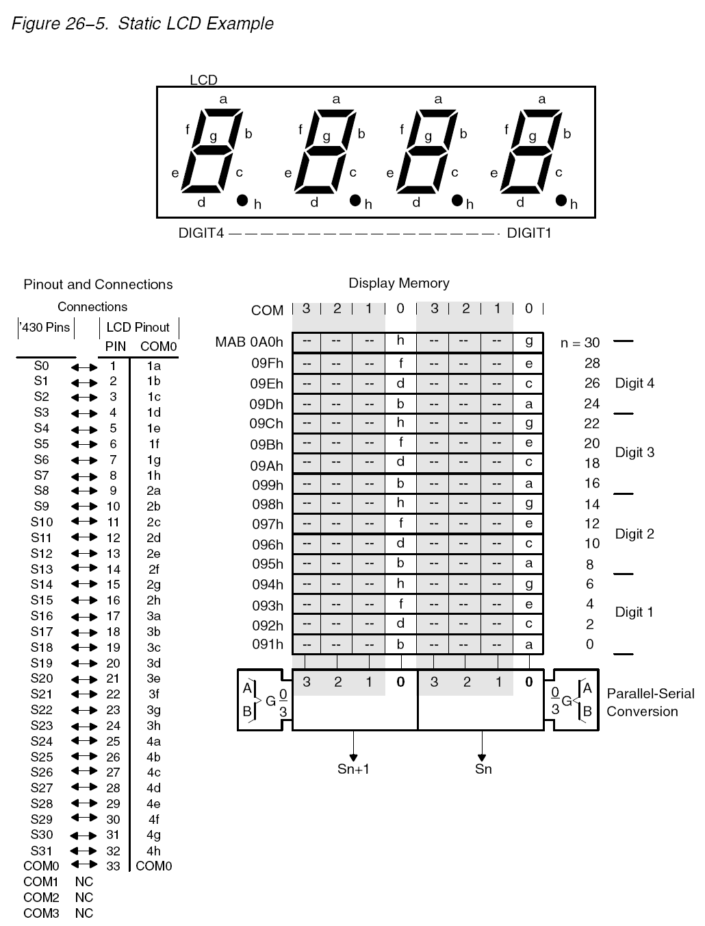
Static LCD Example

Slide 26
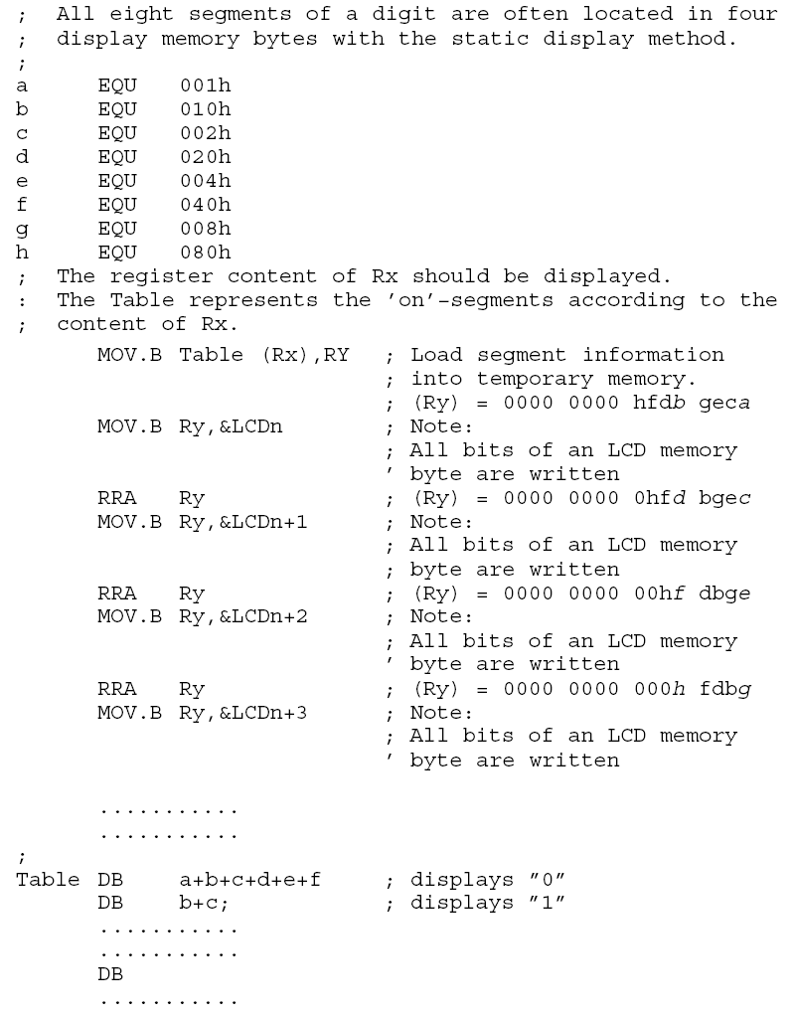
Static Mode Software Example
h | f | d | b | g | e | c | a
h | f | d | b | g | e | c | a
0 | h | f | d | b | g | e | c
0 | 0 | h | f | d | b | g | e
0 | 0 | 0 | h | f | d | b | g

Slide 27
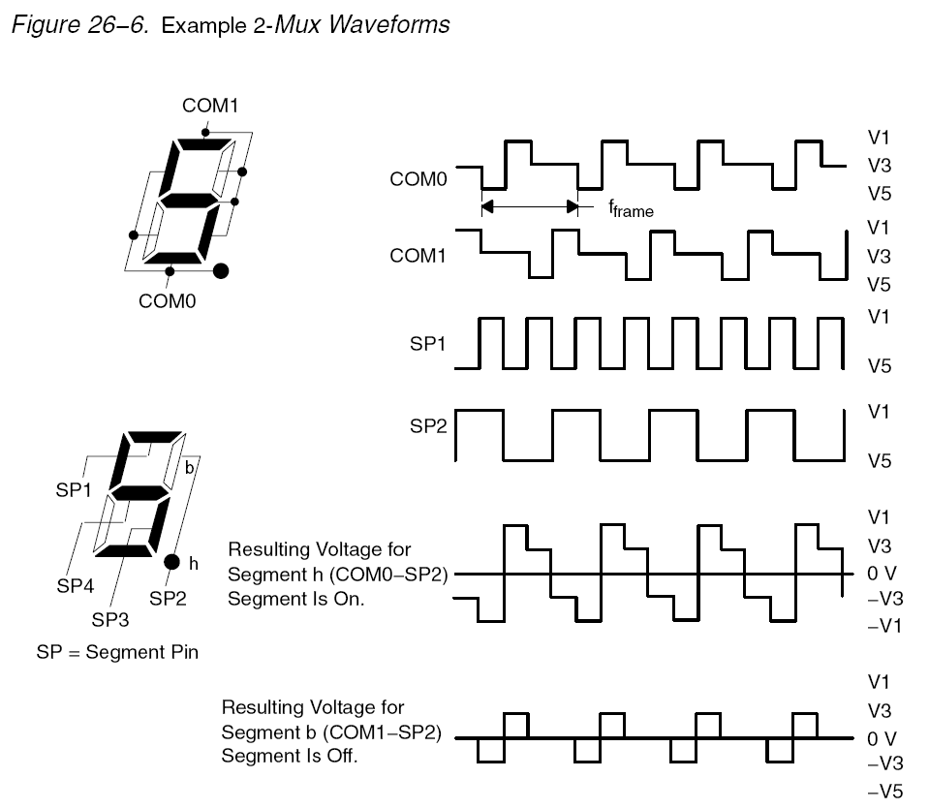
2-MUX Mode
Each MSP430 segment pin drives two LCD segments
Two common lines, COM0 and COM1, are used
2-mux example waverforms
a=COM1-SP1
b=COM1-SP2
c=COM1-SP3
d=COM0-SP3
e=COM0-SP4
f=COM0-SP1
g=COM1-SP4
h=COM0-SP2

Slide 28
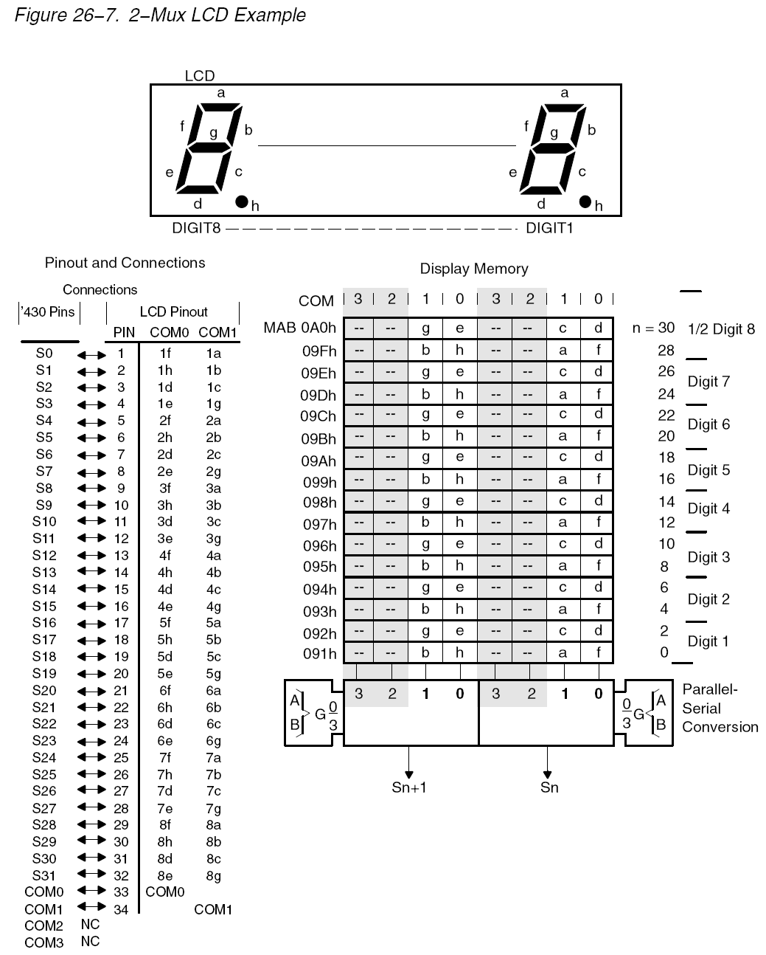
2-MUX LCD Example

Slide 29
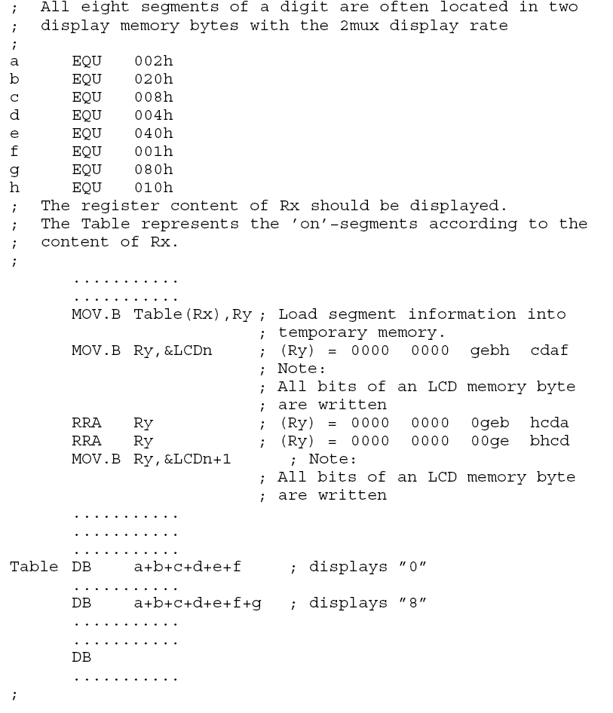
2-MUX Software Example

Slide 30
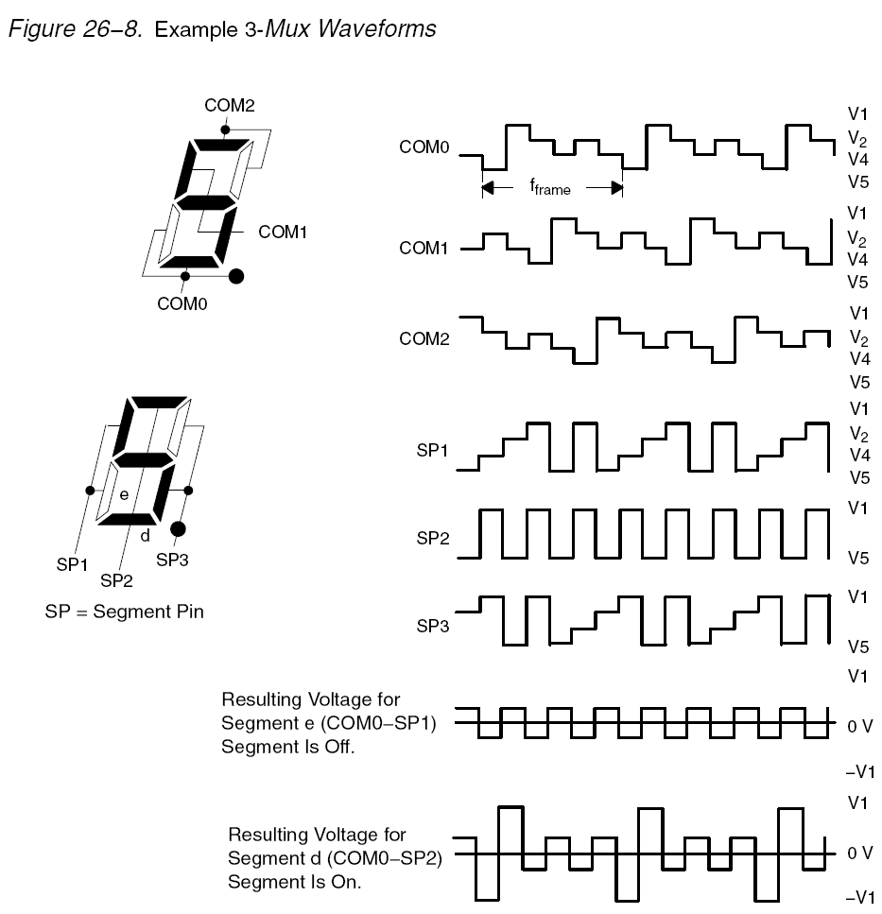
3-MUX Mode Waverforms
Each MSP430 segment pin drives three LCD segments
Three common lines, COM0 and COM1, and COM2 are used
3-mux example waverforms

Slide 31
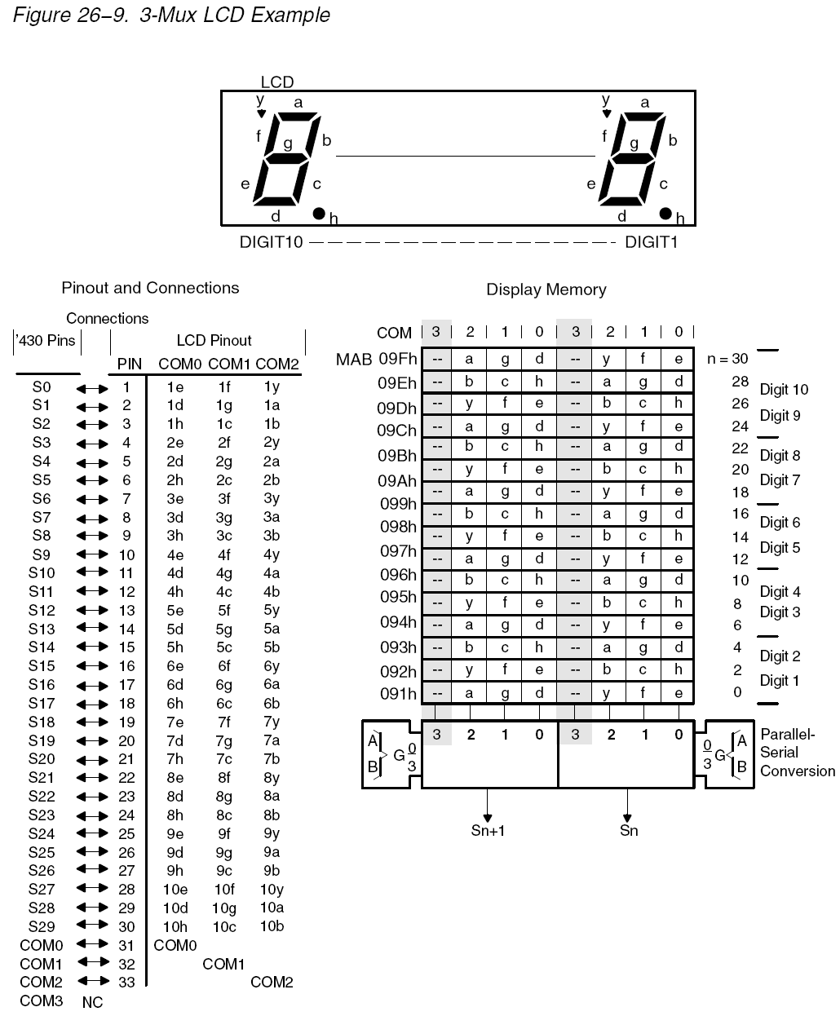
3-MUX LCD Example

Slide 32
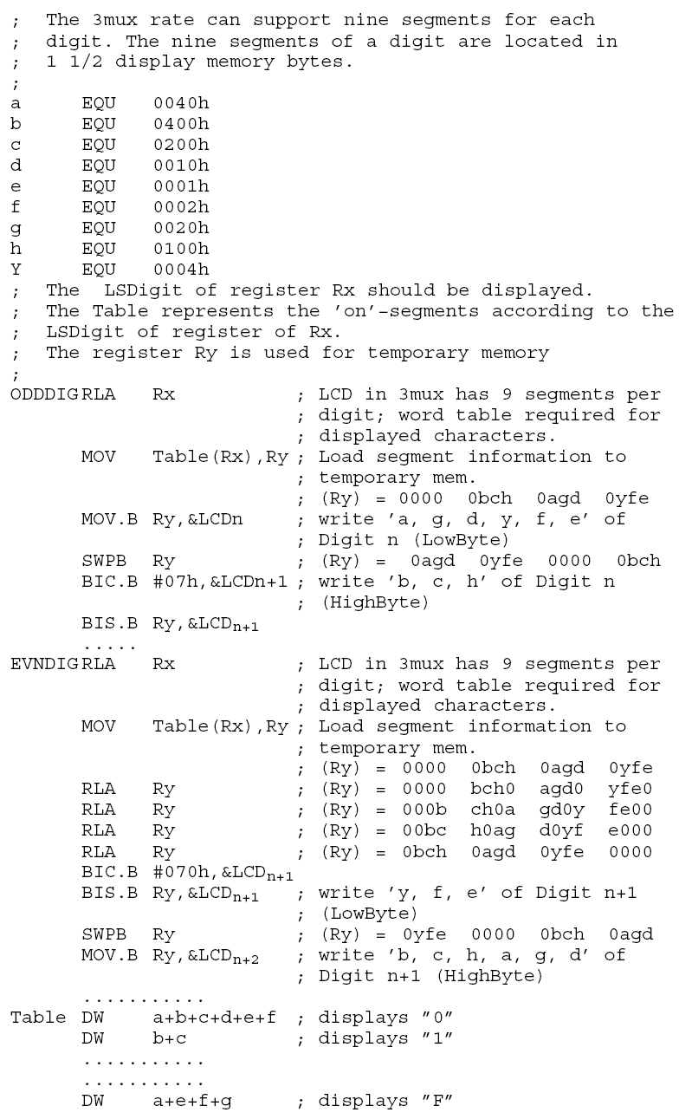
3-MUX Software Example

Slide 33
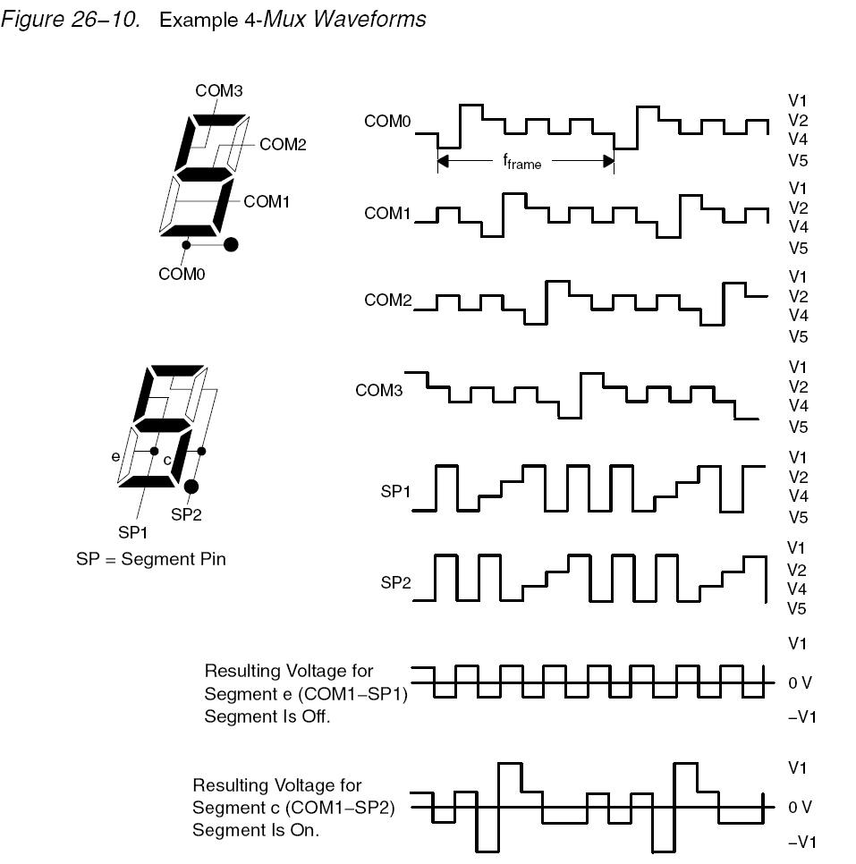
4-MUX Mode Waverforms
Each MSP430 segment pin drives four LCD segments
Four common lines, COM0, COM1, COM2, and COM3 are used
4-mux example waverforms

Slide 34
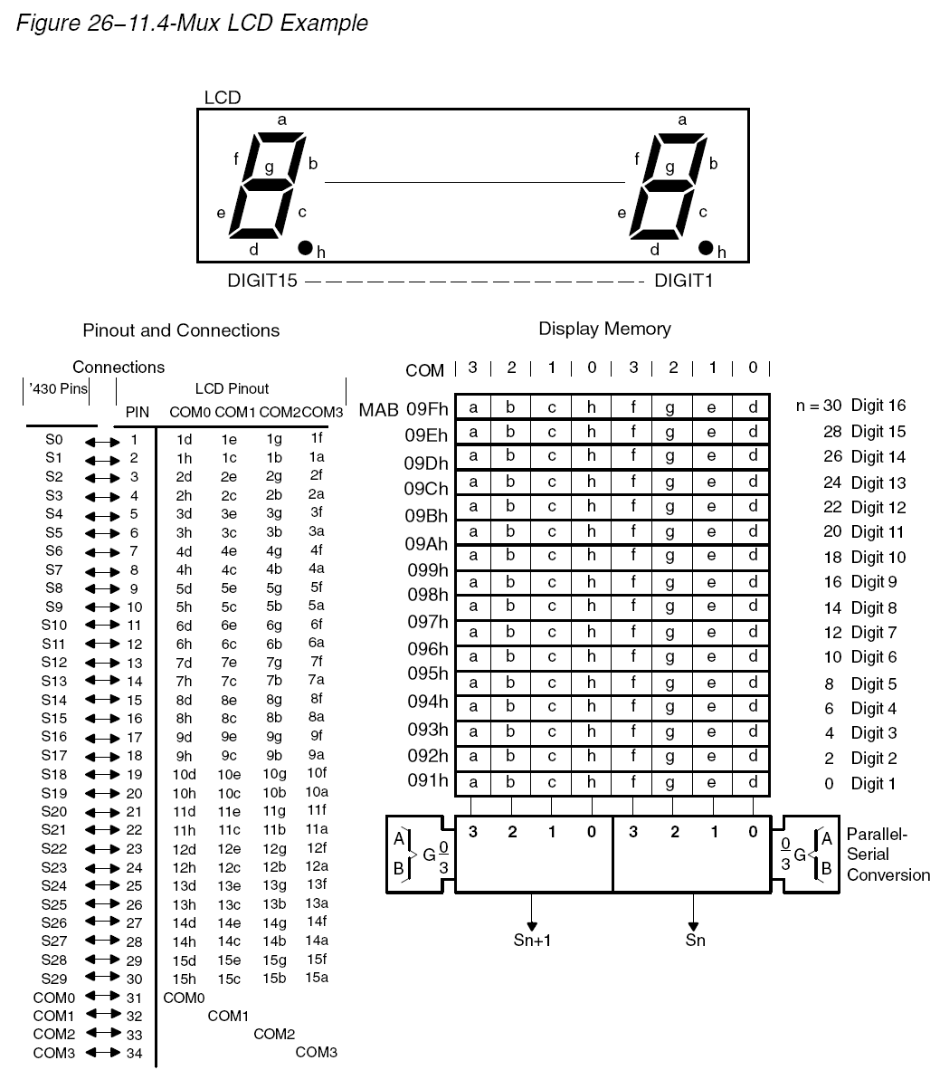
4-MUX LCD Example

Slide 35
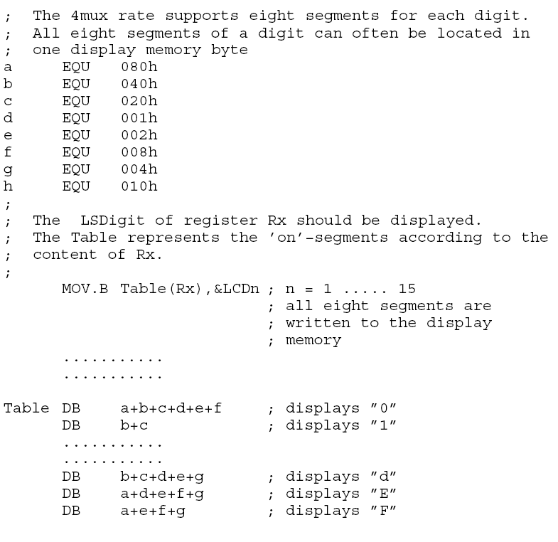
4-MUX Software Example

Slide 36
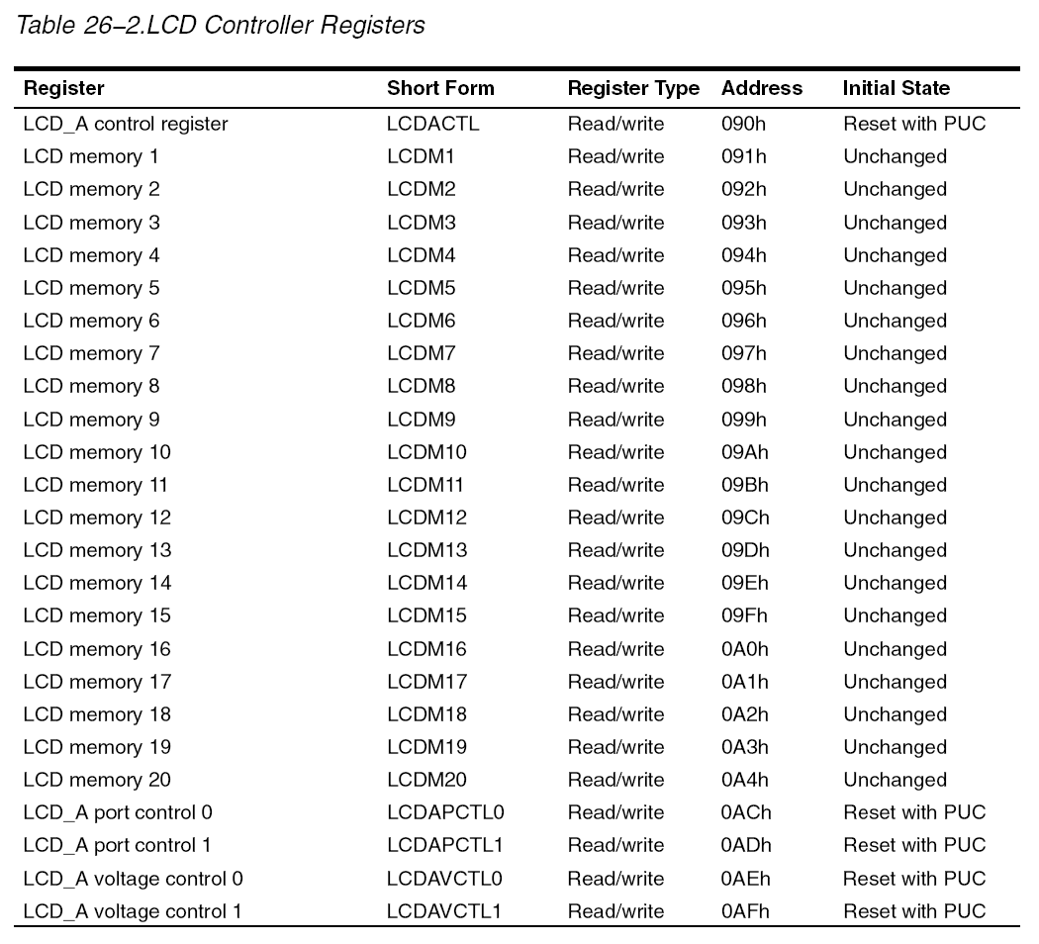
LCD Control Registers

Slide 37
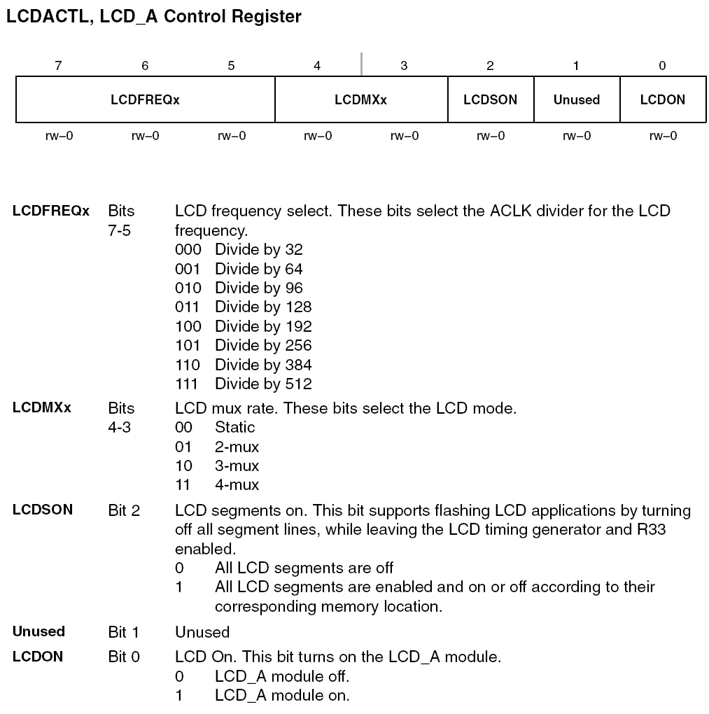
LCD_A Control Register

Slide 38
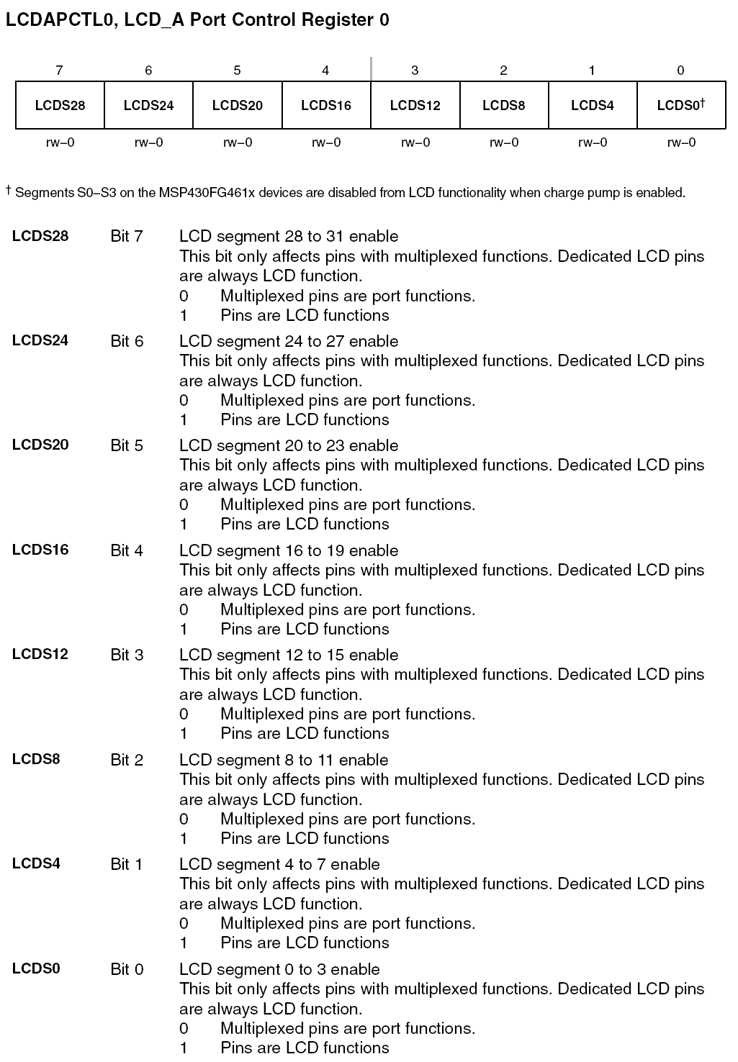
LCD_A Port Control Register

Slide 39
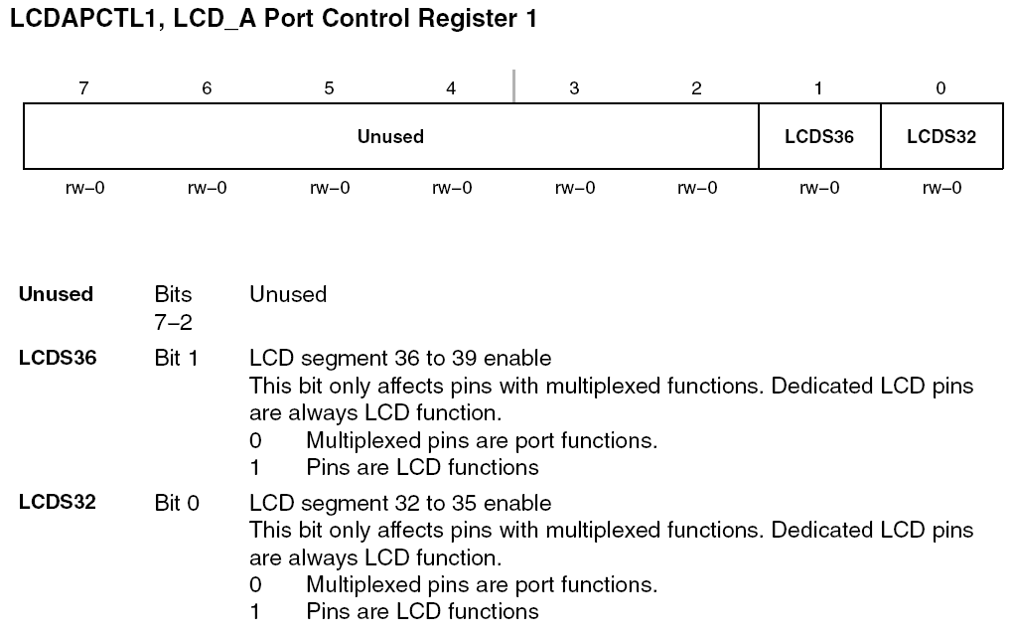
LCD_A Port Control Register (1)

Slide 40
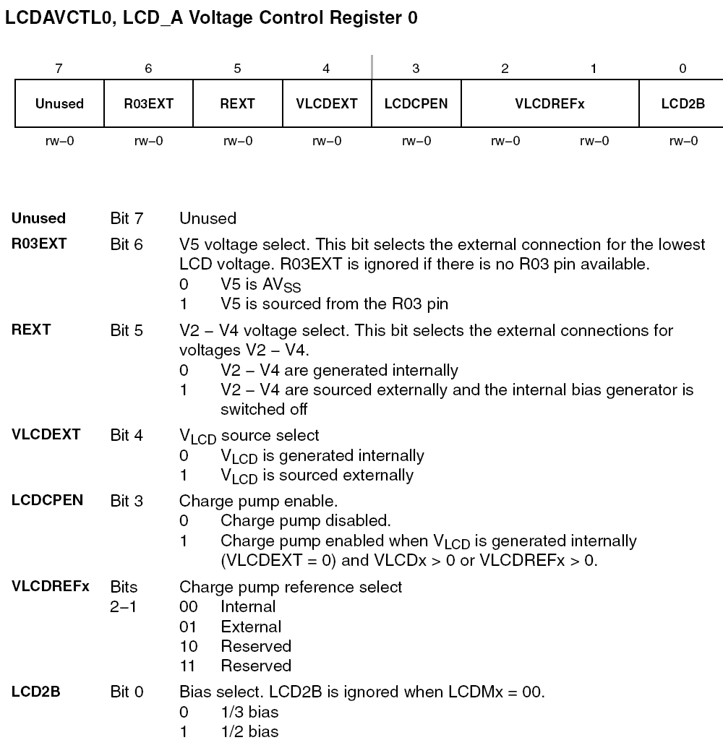
LCD_A Voltage Control Register (0)

Slide 41
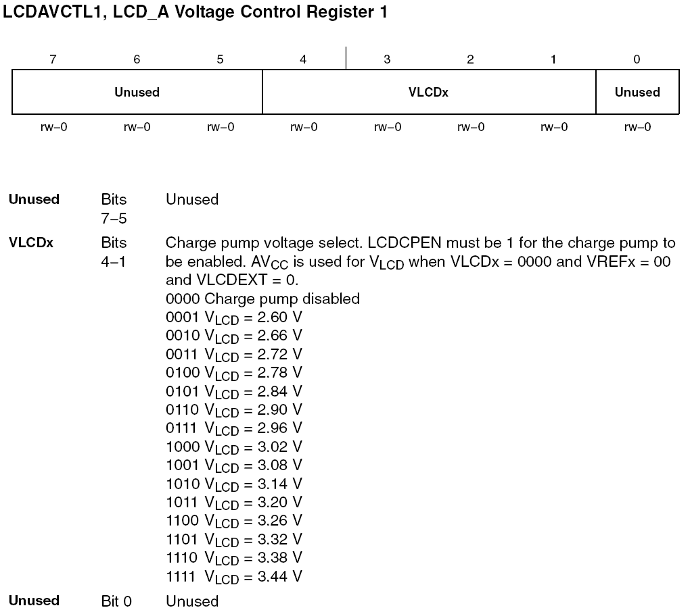
LCD_A Voltage Control Register (1)

Slide 42
DRFG4618 LCD Interface

Slide 43
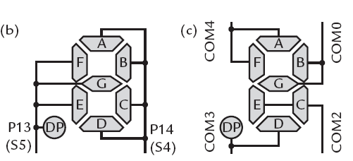
Softbaugh LCD SBLCDA4: Segment Description
SBLCDA4 Display

Slide 44
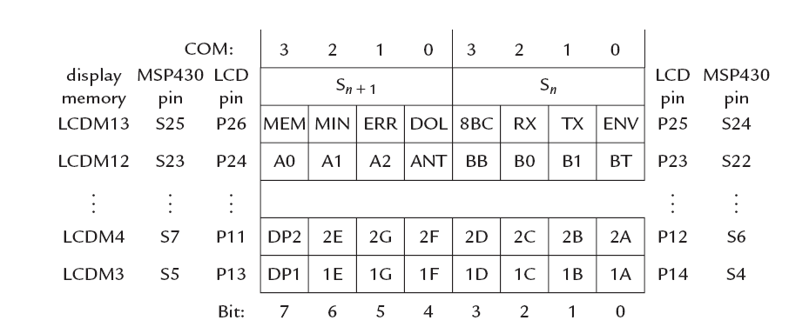
Mapping SBCDA4 segments to MSP430 pins (TI Experimenter board)

