Slide 1
CPE 323 Introduction to Embedded Computer Systems: Digital I/O
Instructor: Dr Aleksandar Milenkovic Lecture Notes

Slide 2
MSP430: Digital I/O (Chapter 7 in textbook)

Slide 3
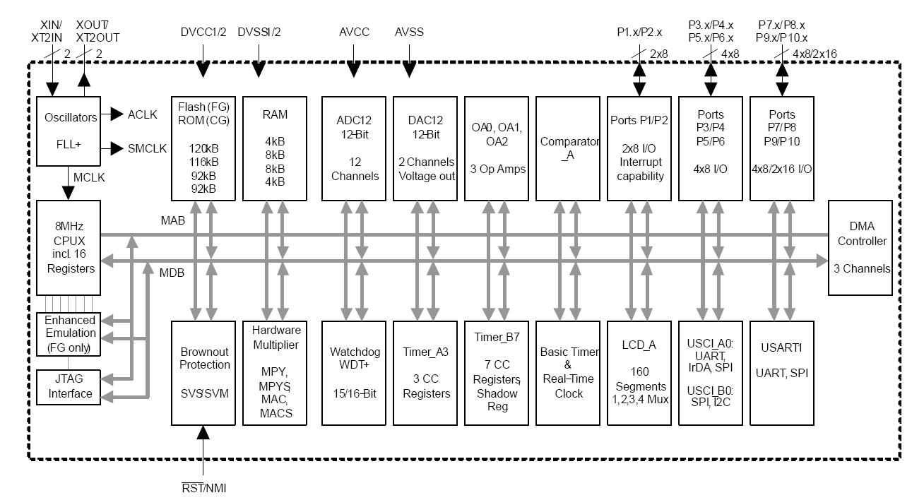
MSP430xG461x Microcontroller

Slide 4
Digital Input, Output
Digital inputs – they are either on or off
Inputs from humans or sensors
E.g., switches, sensors (e.g., door is locked, button is pressed, ...)
Digital outputs – set them on or off
Light-emitting diodes (LEDs), seven segment displays, liquid-crystal displays (LCDs)
MSP430 can supply these directly if they work from the same voltage and draw a sufficiently small current
Digital input/output ports (P1 – Pn), n=2 ... 10
Almost all pins can be used either for digital I/O or for other (special) functions
Their operation must be configured on start up

Slide 5
Digital Input, Output (cont’d)
Ports P1 and P2 have interrupt capability
Each interrupt for the P1 and P2 input lines can be individually enabled and configured to provide an interrupt on a rising edge or falling edge of an input signal.
The digital I/O features include:
Independently programmable individual I/Os
Any combination of input or output
Individually configurable P1 and P2 interrupts
Independent input and output data registers
The digital I/O is configured with user software

Slide 6
Parallel Ports
Port1
Port3
Port2
…
Port10
Function Select Register PxSEL
yes
yes
Interrupt Edge Select Register PxIES
yes
no
Interrupt Enable Register PxIE
yes
no
Interrupt Flag Register PxIFG
yes
no
Direction Register PxDIR
yes
yes
Output Register PxOUT
yes
yes
Input Register PxIN
yes
yes
P1.
P2.
P3.
7
6
5
4
3
2
1
0
P4.
…
P10.
Notes:
Digital I/O

Slide 7
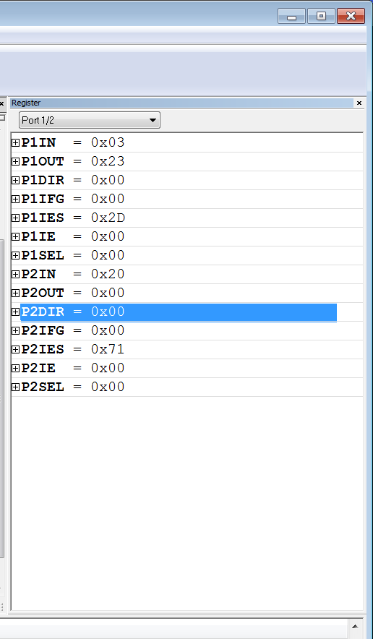
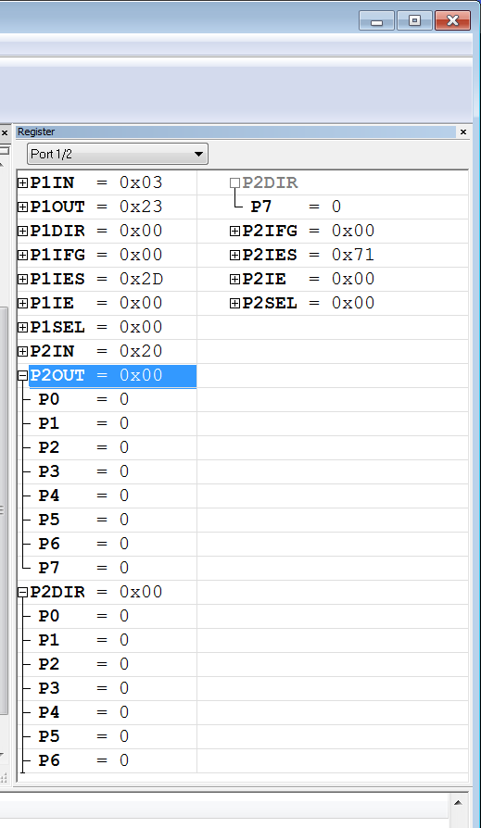
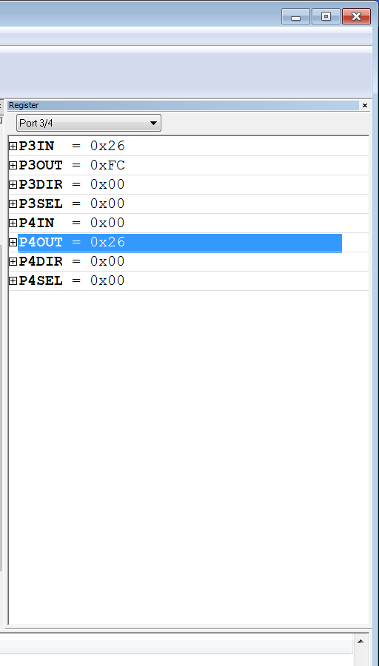
IAR View of Digital I/O Ports
P1, P2, Expanded view
P3, P4, Expanded view
P1, P2

Slide 8
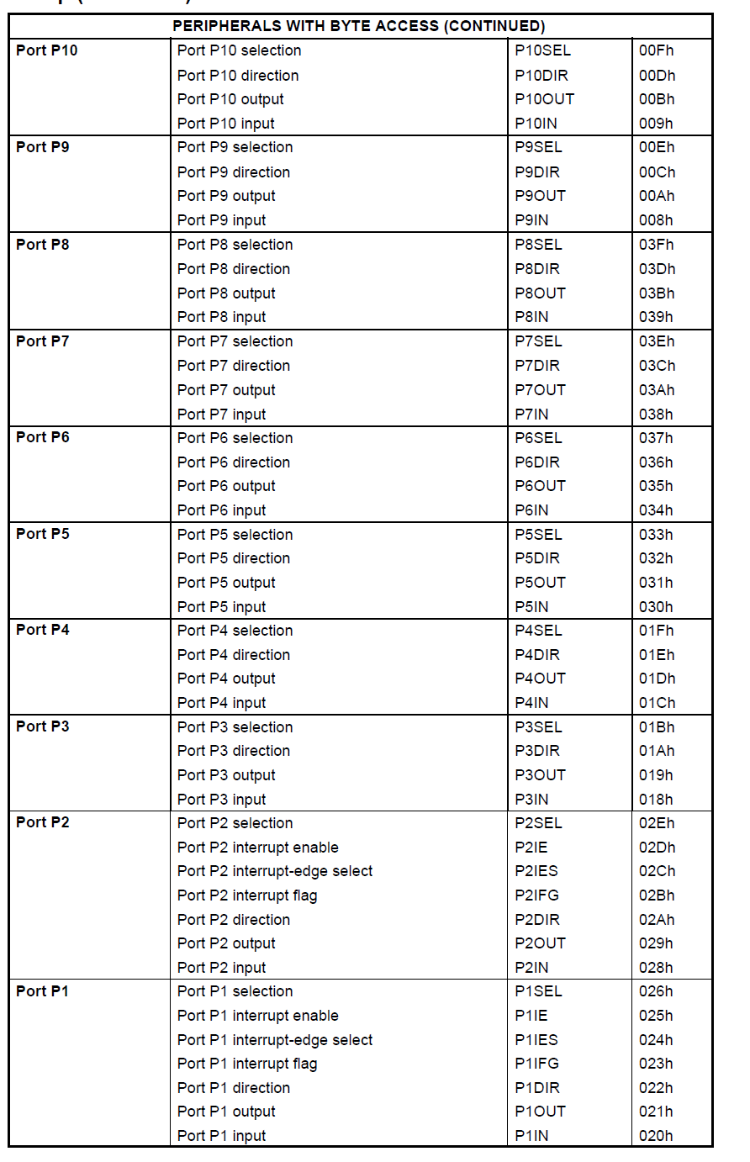
Digital I/O: MSP430FG4618
Port peripheral address mapping

Slide 9
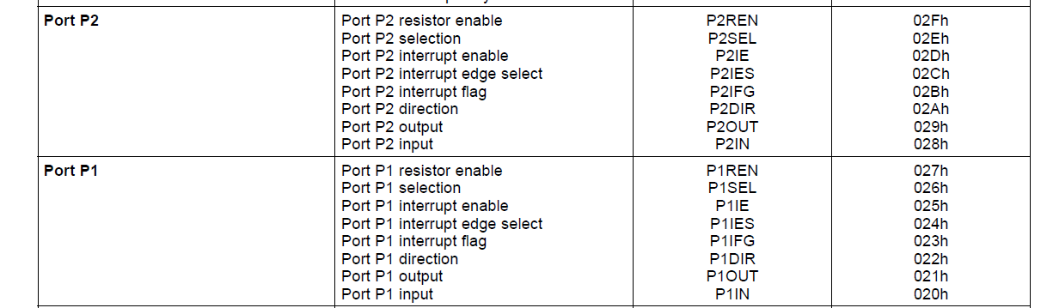
MSP430F2013
There is one 8-bit I/O port implemented—port P1—and two bits of I/O port P2
Each I/O has an individually programmable pullup/pulldown resistor
Port peripheral address mapping

Slide 10
Digital I/O Registers: Operation
Input Register PnIN
Each bit in each PnIN register reflects the value of the input signal at the corresponding I/O pin when the pin is configured as I/O function.
Bit = 0: The input is low
Bit = 1: The input is high
Output Registers PnOUT
Each bit in each PnOUT register is the value to be output on the corresponding I/O pin when the pin is configured as I/O function and output direction.
Bit = 0: The output is low
Bit = 1: The output is high
Do not write to PxIN. It will result in increased current consumption

Slide 11
Digital I/O Registers: Operation
Direction Registers PnDIR
Bit = 0: The port pin is switched to input direction
Bit = 1: The port pin is switched to output direction
Function Select Registers PnSEL
Port pins are often multiplexed with other peripheral module functions.
Bit = 0: I/O Function is selected for the pin
Bit = 1: Peripheral module function is selected for the pin

Slide 12
Digital I/O Registers: Operation
Interrupt Flag Registers P1IFG, P2IFG (only for P1 and P2)
Bit = 0: No interrupt is pending
Bit = 1: An interrupt is pending
Only transitions, not static levels, cause interrupts
Interrupt Edge Select Registers P1IES, P2IES
Each PnIES bit selects the interrupt edge for the corresponding I/O pin (n=1, 2).
Bit = 0: The PnIFGx flag is set with a low-to-high transition
Bit = 1: The PnIFGx flag is set with a high-to-low transition

Slide 13
Digital I/O Registers: Operation (Specific for MSP430F2xxx)
Pullup/Pulldown Resistor Enable Registers PxREN
Each bit in each PxREN register enables or disables the pullup/pulldown resistor of the corresponding I/O pin
The corresponding bit in the PxOUT register selects if the pin is pulled up or pulled down
Bit = 0: Pullup/pulldown resistor disabled
Bit = 1: Pullup/pulldown resistor enabled

Slide 14
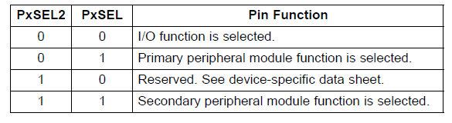
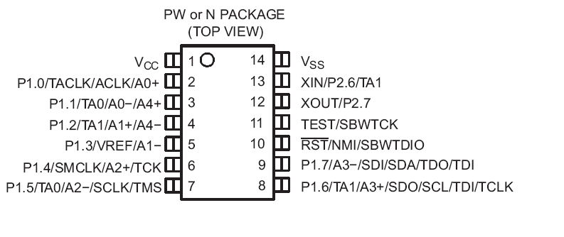
Digital I/O Registers: Operation (Specific for MSP430F2xxx)
Two select registers PxSEL and PxSEL2

Slide 15
Configuring Unused Pins
Unused pins must never be left unconnected in their default state as inputs
Floating (unconnected) input – both pull-up and pull-down may be causing shoot-through current => deplete your power source
What should you do?
Wire unused pins externally to V_{GND} or V_{DD} and configure them as inputs (Warning: if you accidentally configure them as outputs you may damage the chip)
Leave the pins unconnected externally, but connect them internally to V_{GND} or V_{DD} (applicable only to MSP430F2xx devices)
Leave the pins unconnected and configure them as outputs (Warning: do not short circuit them with the probe)

