Slide 1
Assemble the parts

Slide 2
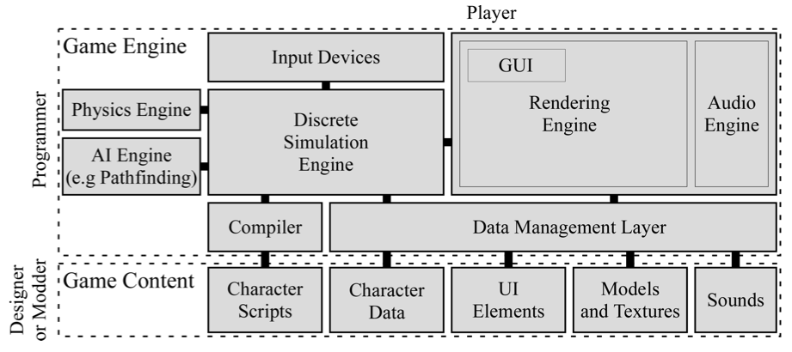
Simplified view
Credit: Walker White

Slide 3
The big picture
Game engine architecture by Jason Gregory
http://www.gameenginebook.com/

Slide 4
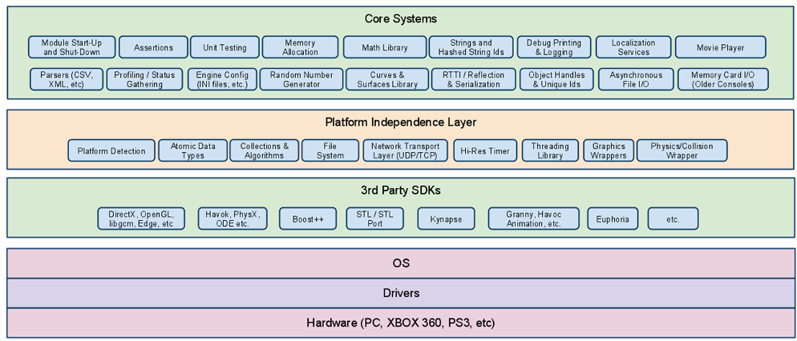

Slide 5
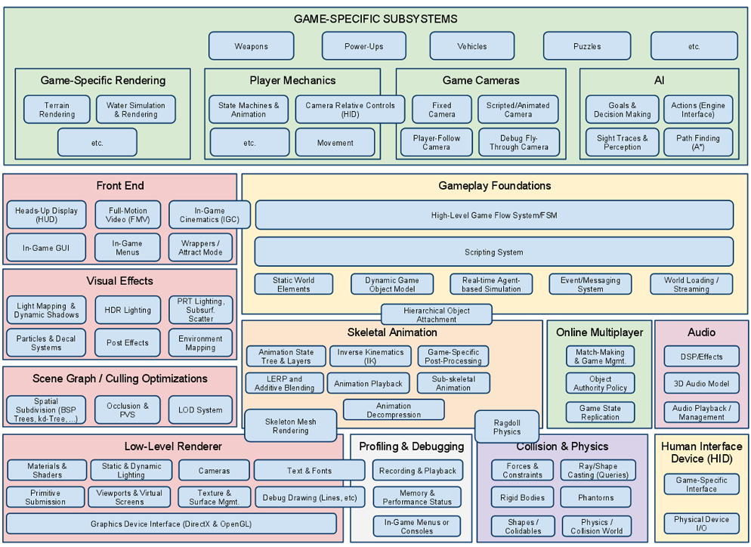

Slide 6
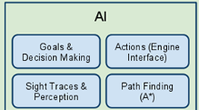
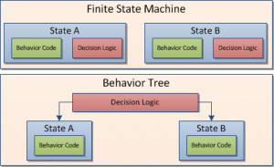
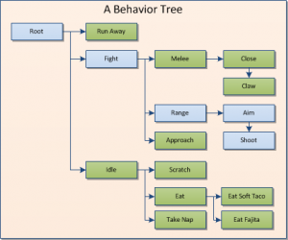
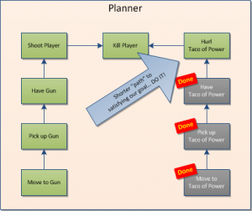
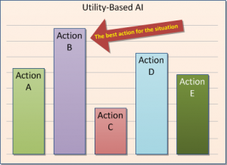
The Basic AI part
http://intrinsicalgorithm.com/IAonAI/2012/11/ai-architectures-a-culinary-guide-gdmag-article/

Slide 7
What needs to be done
1 - AI receives processor time
Execution Management
Wait until it is your turn
Sense the state of the world
Think about what action to perform
Act in the world
Movement (Character AI)
Decision Making (Char AI)
Strategy (Group AI)
3
2 - AI obtains world information
World Interface
Animation
Physics
...
4 - AI output is turned into action

Slide 8
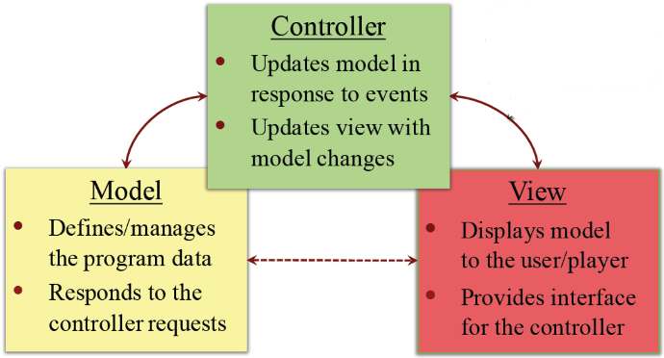
Waiting for what?

Slide 9
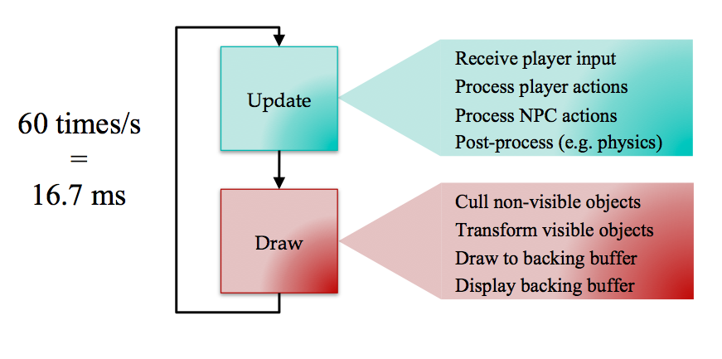
How long is the wait?
Sensing: Determine state of the world
All world changes are messages sent to agents
Agent examines the world for information
Thinking: Given the goal and the state of the world determine what should be done.
Determined by strict rule or state changes
Selection from options
Acting: Tell animation system what to do
Low level instructions for speed, angles, orientations
High level instructions for moving, picking, using

Slide 10
So how do we put all of this together?
First, get some basics. This is what we are doing.
Second see what has been done. See Game AI Pro. The first volume is available on line for free. http://www.gameaipro.com/
Third, find appropriate libraries to begin to understand how to put the parts together or concentrate on a particular authoring environment. You will need to explore the net for this.
Fourth, record what you learn and look for new things. Promweek can be informative https://promweek.soe.ucsc.edu/about/

