Slide 1
Gaming and Games

Slide 2
Response curves
“… need to introduce a new method of dealing with functional data. To solve the problem of customizability, we need a way to store the results of a function, tweaking those results at will, and extract what we need out of it. To solve the problem of extracting a random number x , y % of the time as determined by a continuous probability distribution function, we need to do something very similar: store the results in a data structure that allows for retrieval in the appropriate proportion of occurrences. Response curves handle both of these situations admirably.”

Slide 3
Starting point
We want to make a choice from specified options according to a distribution. Not just a random guess.
getChoiceType()
{
Roll a die to get a value. Here the whole set of options take up all of the space, or the sum of the percentages = 100
Call the value of the dice roll as index
Now break out the pieces
From 1..4 = 4
if ( index <= 4 ) return CHOICE_A;
From 5..7 = 3
if ( index <= 7 ) return CHOICE _B;
From 8..37 = 30
if ( index <= 37 ) return CHOICE _C;
From 38..100 = 63
return CHOICE _D;
}

Slide 4
That works!
Clean, simple and fast, but not very flexible. Need greater abstraction and generality to be effective. A partial solution to this problem is to define some enumerated type or develop a special class.
CHOICE_TYPE enum {
CHOICE _A,
CHOICE _B,
CHOICE _C,
CHOICE _D,
}
Amend as needed for more choices or get and set methods or functions

Slide 5
Add more!
Build a structure (class or struct) for a CHOICE_BUCKET
CHOICE_BUCKET
{
width is the actual width of the bucket
edge is the calculated edge of the bucket
choiceType is the choice type this bucket represents
}
Assemble an ordered collection (list) of buckets
CHOICE_TYPE_LIST is a list of CHOICE_BUCKET;
This CHOICE_TYPE_LIST is held in the variable choiceTypeList;

Slide 6
Putting things together
Build the buckets!
addBucket(CHOICE_TYPE choiceType, int width)
{
currentBucket as a CHOICE_BUCKET;
maxIndex += width;
currentBucket.choiceType = choiceType;
currentBucket.width = width;
currentBucket.edge =maxIndex;
choiceTypeList.append( currentBucket );
}

Slide 7
Initialize
Initialize the buckets with some values. Note that these are hard coded values. Think of alternatives for flexibility.
initBuckets()
{
addBucket( CHOICE_A, 4 );
addBucket(CHOICE_B, 3 );
addBucket(CHOICE_C, 30 );
addBucket(CHOICE_D, 63 );
}

Slide 8
Get a choice
Now to get a choice from the defined response curve
getChoiceType()
{
Generate a random number between 1 and maxIndex
Roll the die. The index = rolls of the die for 1 to maxInt
Count the number of buckets
numBuckets is the size of choiceTypeList;
Loop through all the buckets while less than numBuckets
Loop to see if index fits in the bucket
if ( index <= choiceTypeList[loop_index].edge ) {
return choiceTypeList[loop_index].choiceType;
If the index didn't land in a bucket, do something to indicate index is out of range! As a default, you might select one of the choices.
}

Slide 9
Building a response curve
Fill an ordered structure, list, by some equation.
CURVE_LIST is a list of appropriate values;
This CURVE_LIST is held in the variable equationResults;
fillList( int size )
{
double y;
for ( int x = 0; x <= size; x++ ) {
Put the equation for y here. Text uses y = ( -2 * x ) + 100;
equationResults.append( y );
}

Slide 10
Getting a result
A bit of effort but in the grand scheme allows for the manipulation of the results of the equation.
More flexibility. Don’t use the straight list index: store the x and y in a structure. There will be a list of these elements. Define ELEMENT. Make a list of these called elementList.
But now how do you get the value out? Brute force is fine for a small number of values. It can be better to use an offset. It provides improvement but it is not abstract or flexible. Having run into this sort of scenario many times, you know the answer! Binary search.

Slide 11
Binary search
getYbyBinarySearch( int x )
{
Get number of elements in the list. iCount is elementList.size();
Set the boundaries of the search range to the first and last elements. So let iLow = 0 iHigh = iCount - 1 and found = false;
initialize i = 0; // the list index
while ( !found ) {
Use the mid-way point as the index guess i = iLow + ( ( iHigh - iLow ) / 2 );
if ( x = elementList[i].x ) {
The guess is correct, so found is true and return elementList[i].y; }
if ( x < elementList[i].x ) { Need to lower the high boundary to the current guess so iHigh = i - 1;
} else { raise the low boundary to the current guess so iLow = i + 1; }
}
return elementList[i].y;
}

Slide 12
More considerations
So far so good but notice that what is really at stake is some sort of choice and not the actual value.
Build another data structure that maps the choices to the numbers via the size of the bucket and the edge. Size is the surrogate for the probability of the choice. Need to modify the add bucket notion to automatically take care of the edge by way of the size.
Note also the application to utility rather than raw numbers.

Slide 13
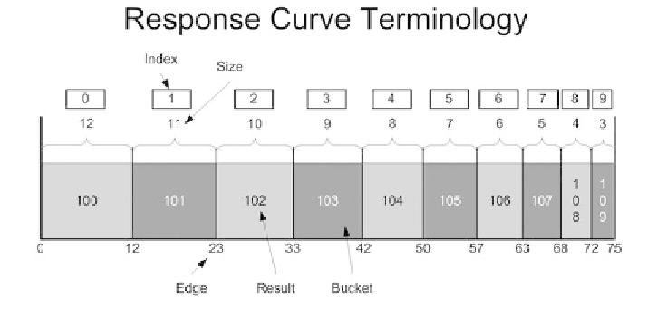
The big picture

Slide 14
More can be done
Modify the function or method to get result as needed so that it looks at a range rather than a point.
For more fun build methods that allow the adjustment of the sizes and edges.
This approach allows dynamic changes to the response curve. Abstraction really is your friend. Does it really matter whether your boss tells you to adjust the curve or the situational awareness does?
Make sure that we can uses utility as well as raw numbers.

Slide 15
Factor weighting
Need to analyze “the approach that we use to generate our utility scores. To do that, we need to take into account a number of different components. We need to delve into what makes a score not only relevant, but usable. With that in mind, we can tailor our system to make it useable and meaningful without opening ourselves to pitfalls..”

Slide 16
Data come in many forms
CATEGORICAL vs. NUMERICAL (quantitative vs. qualitative) Data that represent categories, such as dichotomous (two categories) and nominal (more than two categories) observations, are collectively called categorical (qualitative). Data that are counted or measured using a numerically defined method are called numerical (quantitative).
DISCRETE vs. ORDERED CATEGORICAL Discrete data arise from observations that can only take certain numerical values, usually counts such as the number things. Ordered categorical data should not be treated as discrete data for statistical analysis. Discrete data may be treated as ordered categorical data in statistical analysis, but some information is lost in doing so.
CONTINUOUS Continuous data are numerical data that can theoretically be measured in infinitely small units. The interval measurement scale is intended for continuous data. Sometimes continuous data are given discrete values at certain thresholds. Information is lost when continuous data are recorded only in ranges (ordered categories), and the statistical analysis of continuous data is more powerful than that of categorical data.
PERCENTAGES and RATIOS Percentages or ratios summarize two pieces of information. Simple ratios (0 to 1, i.e. the denominator is the maximum possible value that the numerator can take) can be treated as continuous data. More difficult to analyze data arise when the ratio represents a change, and the value can be negative. Ratios of observations compared with reference values, are difficult to handle as values may fall either side of 1 (100%).

Slide 17
And scales too.
Properties of scales
Identity. Each value on the measurement scale has a unique meaning.
Magnitude. Values on the measurement scale have an ordered relationship to one another. That is, some values are larger and some are smaller.
Equal intervals. Scale units along the scale are equal to one another.
A minimum value of zero. The scale has a true zero point, below which no values exist.
Four scales
The nominal scale of measurement only satisfies the identity property of measurement. Values assigned to variables represent a descriptive category, but have no inherent numerical value with respect to magnitude.
The ordinal scale has the property of both identity and magnitude. Each value has a unique meaning, and has an ordered relationship to every other value.
The interval scale of measurement has the properties of identity, magnitude, and equal intervals.
The ratio scale of measurement satisfies all four of the properties of measurement.

Slide 18
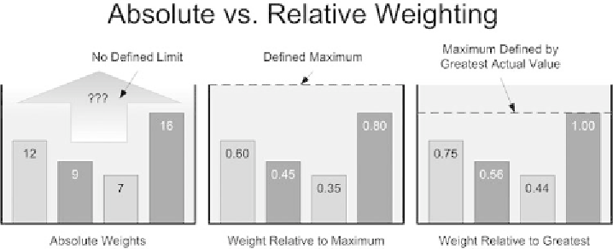
A slightly different approach

Slide 19
Weighting
Absolute Weights
Assign a concrete value to each bar but no context in which to judge a given score.
Weights Relative to a Maximum
Assign values to a score in order to compare the absolute weight of what is being measured to a different value that is specified as the maximum possible value.
Weights Relative to Each Other
Compare all the scores to whichever score is the greatest. The maximum is not a specified value. This provides for automatic scaling where the relative differences between scores yield important information.

Slide 20
Issues
Granularity
When scaling weight scores, granularity is important. Think of it in terms of the accuracy to which we need to either calculate or keep track of something.
Accuracy
A main considerations for establishing a correct level of granularity is the accuracy of differentiation. This is the level at which differences between adjacent measurements can be concerned. Too many or not enough?

Slide 21
Issues
Concrete numbers
One can count and measure plenty of things in games: units, buildings, numbers of bullets in a gun, damage dealt over time, health, and how much money items cost.
These concrete numbers can be used in making a decision and provide the data for decision making. But how can these be compared?
Abstract ratings
Concrete counts and measurements don't necessarily correspond equally to utility, and by themselves do not deliver the notions of value and importance.
The abstract concept of utility is different from the concrete count.

Slide 22
Combining criteria
If the only concern is a single criterion, there is ample flexibility in how to decide on the range and, by association, the granularity. It is also easy to score the criterion. However, when using one utility score in conjunction with others, the whole picture must be kept in mind.
Normalizing
One way to make the comparing, contrasting, and combining of disparate numbers meaningful (and easier) is to use the same scale for all of them.
By normalizing utility values, it is easier to use the resulting value in a variety of comparisons and calculations that are not directly dependent on the potentially variable components that make up the utility.

Slide 23
Weighted sums
Weighted sums
Most of the time, a single criterion is not enough to make a meaningful and interesting decision.
Most decisions result from a combination of criteria. Except for rare circumstances, the weights that factors have in the decision are not equal. One factor is typically more important than another. As the number of factors to consider in a decision increase, the likelihood that they all have the same importance decreases.
The most common method of balancing the significance of each factor is through the process known as weighted sums . Weighted sums, allow for the construction of a single value from multiple factors - each with their own value. To do this pair each component value with a coefficient that represents its weight in the overall decision.

Slide 24
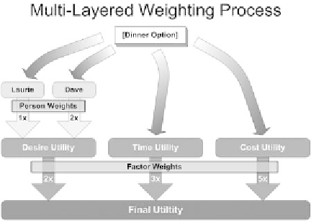
Layering
Even after calculating and combining factors to arrive at a utility function, there still may not be enough information to process a decision. Weighted sums allow the combination and normalization of similar information. This allows the decision process to take disparate pieces of information into account. It is usually simpler to combine similar items together first to arrive at an aggregate value.
For example, in the text the author combined the two sets of dinner preferences into one combined dinner preference value.
Once there are these combined values, they can be combined with other values in another step of the process. This creates a layered weighting model. In essence, the decision is built in tiers.

