Slide 1
Games and gaming - 3

Slide 2
Rationality and irrationality
The point about traditional game theory is that it is based on all players being rational. The good side of this is that one can say what a player ought to do. It is normative.
On the other hand we don’t believe that players are rational all of the time. This is so much so that we can build general patterns for irrational activity. This is descriptive of what people actually do.

Slide 3
The pirates’ game
Five pirates find 100 gold coins and trying to decide how to distribute. The rules of pirate distribution are:
The most senior pirate proposes a distribution
The pirates vote on whether to accept it.
The proposer can vote
The proposer has the casting vote if there is a tie
If the proposal is approved, the proposal goes into effect.
If the vote fails, the proposer is thrown overboard and dies.
The next most senior pirate becomes the proposer and the process begins again.

Slide 4
The pirates’ game
There are four pirate characteristics. Each pirate:
Is entirely rational
Wants to survive
Wants to maximize the amount of gold he receives.
Would prefer to throw another overboard, if all other results would otherwise be equal.

Slide 5
The pirates’ game
Take a moment to discuss the game and then tell me your decision about what the senior proposing pirate should do.

Slide 6
Pirates and their reasoning
The senior pirate should be generous to the others (minimize his share) since the other would throw him off the ship otherwise.
If the other pirates think that he is taking too much, they would throw the senior pirate off the ship. This would be to their advantage since there would now be only four pirates to share the 100 coins.

Slide 7
Pirates can reason backwards!
The two last pirates, D and E. D is senior proposer.
D proposes 100 for himself!
Since D has the deciding vote then by 3, 4 and 5 he wins and E can do nothing.

Slide 8
Pirates can reason backwards!
Now suppose that there are three pirates left, C, D and E. C is the senior pirate.
By characteristic A, pirate C knows what pirate D would do if there were only two pirates. Of course E would also know what D would do if it was down to two pirates.
So pirate C propose that pirate E gets one coin, pirate D gets no coins and he keeps the rest!
Why? By characteristic C pirate E would vote with pirate C and by rules 2, 3, and 5, C wins.

Slide 9
Pirates can reason backwards!
So now for four: B, C, D, E. B is senior.
Now B, being perfectly rational, would know the three pirate solution. Now B would know that things don’t go well for D.
So B offers D one coin (better than nothing and characteristic C). B offers nothing to C and nothing to E. B keeps the rest for himself.
B wins since the vote would be a tie and under the rules of voting his vote is the deciding vote.

Slide 10
Pirates can reason backwards!
But why not be nice and give E a coin? E would vote for this since even if B is thrown overboard he can’t get more than one coin.
But pirates are nasty! Remember characteristic D. So E would not go for it since he could both get a coin and cause B to be thrown overboard. A two-fer!

Slide 11
Pirates can reason backwards!
So now we come to pirate A. Being perfectly rational he know the previous possibilities.
If B were in charge C an E would get nothing and A needs their votes. So if each gets a pice of gold they would be satisfied by getting something and C would not risk being thrown overboard.
The proposal then is that C and E each get one piece of gold and A gets the rest! The proposal wins!

Slide 12
How did this happen?
A had to take into account what the other rational pirates (playing by the rules) would do. In particular what D, C and B would do.
This is a normative account of what pirates should/ought to do. So the initial proposal is really very wrong

Slide 13
Super-rationality
It is not just that we are perfectly rational but all players are perfectly rational.
Now this connects rather nicely to the four requirements for normative decision theory. Each individual
Has all of the relevant information
Is able to accurately perceive the information
Is able to perfectly perform all relevant calculations
Is perfectly rational

Slide 14
But what would a survey say?
Survey all of the pirate population or sample the pirate population.
Do this even if you are perfectly rational.
Maybe the key is to model pirate behavior.
So maybe the first proposal was ‘correct’ in the actual world but ‘wrong’ in the normative world. (That may take a bit of mental digestion.)

Slide 15
Two thirds of the average game
Rules:
1. Every player must write a whole number between 0 and 100 on this sheet.
2. The winner of the game will be the player whose number is closet to 2/3 of the average of all the numbers written by all the players.
http://twothirdsofaverage.creativitygames.net/

Slide 16
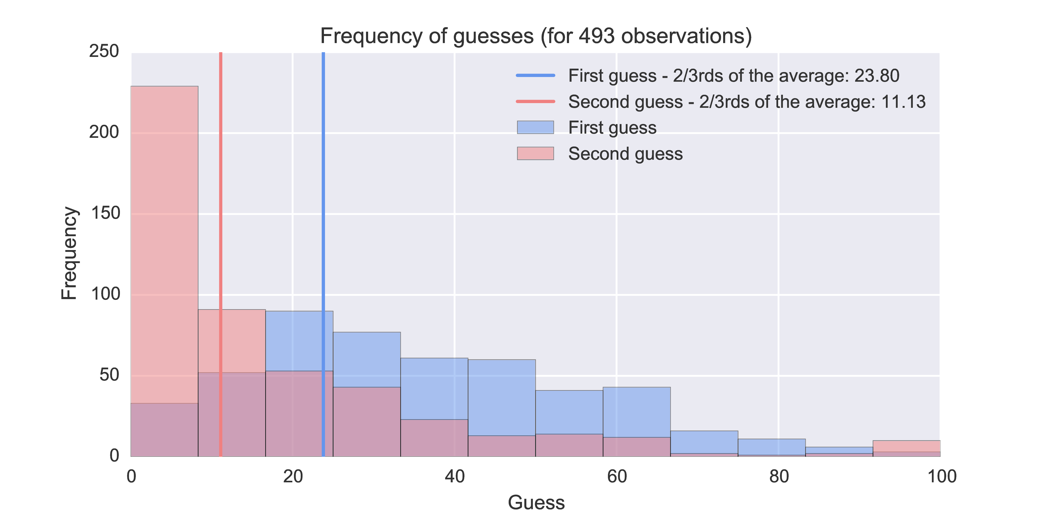
A fun result
http://vknight.org/unpeudemath/pedagogy/2015/07/23/Using-the-two-thirds-of-the-average-game-in-class/

Slide 17
But wait!
Intuitively, the winning answer will not be 100. Why? Because the average of numbers no greater than 100 cannot be greater than 100. Now, 2/3 of the average of numbers no greater than 100 cannot be greater than 66.666… Therefore, it is irrational to select a number higher than 66.666…
If you are rational, you will not select a number greater than 66.666…. If you assume everyone else is rational, then all of them will also eliminate numbers above 66.666… . This reduces the puzzle to selecting a number between 1 and 66.666… trying to get closest to 2/3 of the average.
The same reasoning applies to the compressed range [0, 66.666…]. If all players are rational, then it is clear that nobody would select a number greater than 44.444… because it is impossible for 2/3 of the average of numbers between 1 and 66.666… to be any larger than 44.444…
Uh OH!
Doing this an infinite number of times, every player ought to select zero.

Slide 18
So?
Perfect Rationality Is Flawed: While acting under perfect rationality leads to decisions that are “right” in a theoretical sense, this often fail to yield realistic-looking decisions.
Not Everyone Is Rational: The reason acting perfectly rational often does not yield good results is that we cannot expect super-rationality — the perfect rationality of all other players.

Slide 19
So?
Not Everyone Is Irrational: We cannot expect super-rationality, but we can expect that at least some players will act in a rational fashion at least some of the time.
Pursuing Rationality Has Limits: When people are attempting to be rational, they are often limited in their ability or desire to do so. This results in varying degrees of partially rationally behavior.
Acting Irrationally Can Be Logical: Since we cannot expect everyone to act either perfectly or even partially rationally, it is sometimes logical to act in a fashion that is not perfectly rational.

Slide 20
So?
People Exhibit Bounded Rationality: People are not perfectly rational because they often fail in their abilities to perceive and calculate the information correctly.
Pursuing Rationality Can Be Prohibitive: The costs of attempting perfect rationality can be so high compared to the benefits that we can justify remaining in rational ignorance of the information.

