Slide 1
Games and Gaming -5

Slide 2
Marginal utility
Same item may have a different utility to the same person at a different time.
Context matters? How does one represent context? Or is it just time?
Consider the case of the utility of getting the next unit of something you want.
The first unit has the highest utility and the last the least.

Slide 3
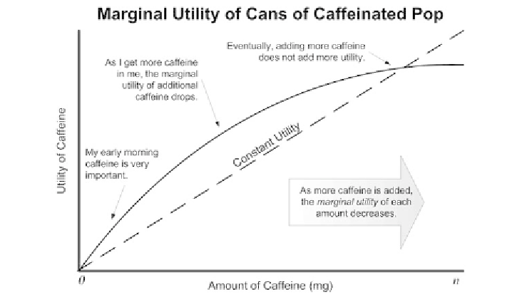
Marginal utility

Slide 4
Marginal utility
In the case the marginal utility of the first consumption is high. As more acquisitions are made the amount of utility for the next consumption decreases.
In some sense the value of the object to be consumed is not based on you. 4mg of caffeine, 0.8 lethality, 20 health_units
In that same sense the marginal utility of the consumption of the object depends on you. My caffeine level is low so the utility of the consumption of the next caffeine unit is high although since my health_units are high the utility of the consumption of my next helath_pack is lower.
Note that each item in this same sense has a utility and it may even be the case that the utilities can be compared for some purposes.
For many purposes it is assumed that marginal utility is continuously changing. Each additional consumption has a utility and that consumption changes the utility of the next consumption.

Slide 5
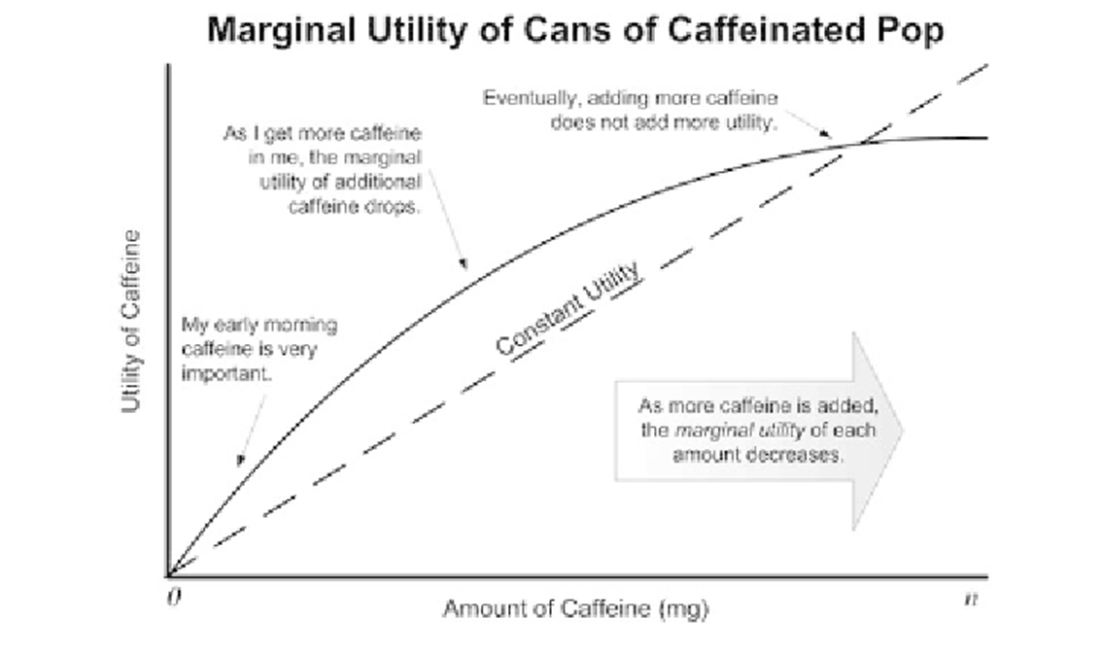
Decreasing marginal utility
The caffeine example in the text illustrates decreasing marginal utility.

Slide 6
Decreasing marginal utility
The slope of the line between two points on the curve is an effective measure of the marginal utility.
Allows that total utility can be increasing as marginal utility is deceasing.

Slide 7
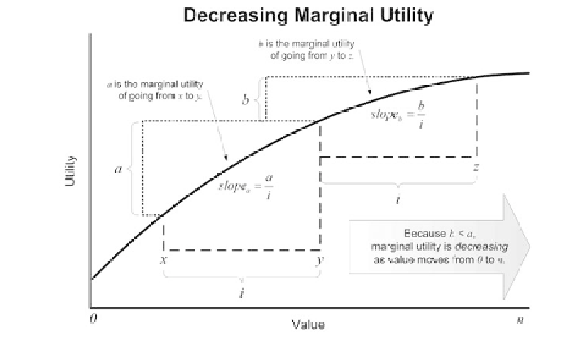
Decreasing marginal utility

Slide 8
Strategy
Strategy game where ‘building’ is done by a NPIC.
A military unit has a value. Building the first unit may have a utility greater than its value. Building more units adds to the total utility but the marginal utility is decreasing.

Slide 9
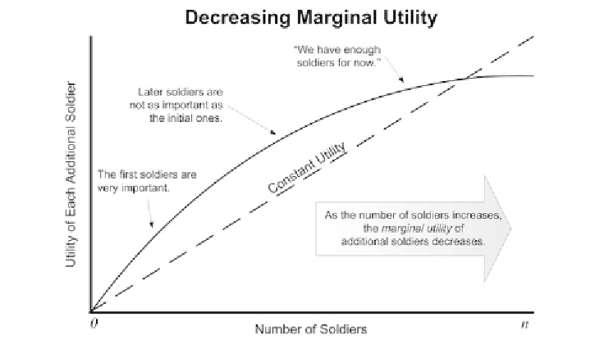
Building soldiers may be like drinking caffeine drinks.

Slide 10
Strategy and civilization
Consider a Civilization-like strategy game
http://www.civilization.com/en/home/
“A game is a series of interesting choices. “
Highest-level manager for responsible for development of the computer player’s economy
Responsible for coordination between the build, unit, resource, and research managers, as well as setting spending limits
Handles computer player expansion, upgrading of buildings and units, and epoch advancement

Slide 11
Strategy and civilization
There is a build unit
Responsible for placement of the structures and towns
Receives requests from the unit manager for training buildings and from the civilization manager for support buildings
All site evaluation occurs here
Most buildings have requirements on where they can and cannot be placed

Slide 12
Now it depends on that curve.
That brings us to marginal utility.
And now our decisions seem to be ‘controlled’ by the curve.
The need is to construct a formula to express the changing marginal utility for building soldiers. Typically this would be handed to a build manager for production.
What is the formula?

Slide 13
Formulas
Linear is straightforward
Where S_{n} is the nth soldier an U(S_{n}) is the utility of the nth soldier
U(S_{n}) = ((11 – n) X 10)
Being a bit more positive
U(S_{n}) = 100 / n
Let’s be real
U(S_{n}) = 100 (0.95^{3(n-)})

Slide 14
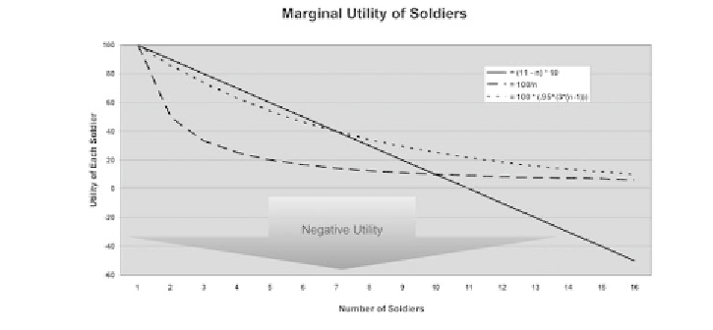
The results

Slide 15
Health is different
Health is a different notion.
When you have it, consuming a bit is not all that important.
When you are low on it, getting a unit of health makes a very large difference.
Note that the rate of consumption is also important. Also go back and take a look at the Heath_Kit and Armor example beginning on page 156

Slide 16
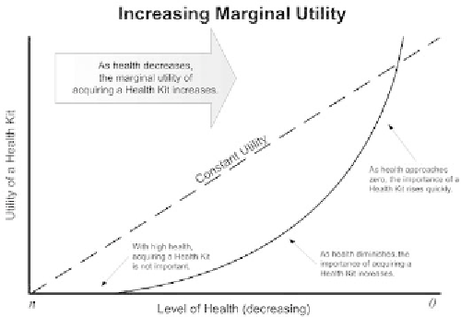
Increasing marginal utility

Slide 17
St. Petersburgh paradox
The St. Petersburg game is played by flipping a fair coin until it comes up tails, and the total number of flips, n, determines the prize, which equals $2^{n}. Thus if the coin comes up tails the first time, the prize is $2¹ = $2, and the game ends. If the coin comes up heads the first time, it is flipped again. If it comes up tails the second time, the prize is $2² = $4, and the game ends. If it comes up heads the second time, it is flipped again. And so on. There are an infinite number of possible ‘consequences’ (runs of heads followed by one tail) possible. The probability of a consequence of n flips (P(n)) is 1 divided by 2^{n}, and the ‘expected payoff’ of each consequence is the prize times its probability. The table on the next slide lists these figures for the consequences where n = 1 … 10:

Slide 18
St. Petersburgh paradox
n | P(n) | Prize | Expected payoff
1 | 1/2 | $2 | $1
2 | 1/4 | $4 | $1
3 | 1/8 | $8 | $1
4 | 1/16 | $16 | $1
5 | 1/32 | $32 | $1
6 | 1/64 | $64 | $1
7 | 1/128 | $128 | $1
8 | 1/256 | $256 | $1
9 | 1/512 | $512 | $1
10 | 1/1024 | $1024 | $1

Slide 19
Wow an infinite reward
You can earn a infinite amount of money?
But
How much are you willing to put up for that chance?
To see what the problem may be think about replacing the doubling with some fixed amount, say $100
Reward and risk with a dash of marginal utility, please.

Slide 20
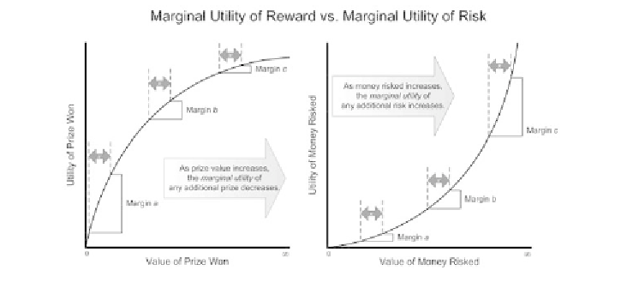
Marginal utility of risk and reward.

Slide 21
Reward and risk
Note that on left side graph, the marginal utility of reward, as the value of the prize won increases the marginal utility of the additional prize won decreases.
Note on the right side graph, the marginal utility of risk, as the value of the money risked increases the marginal utility of the additional risk increases.
What to do?

Slide 22
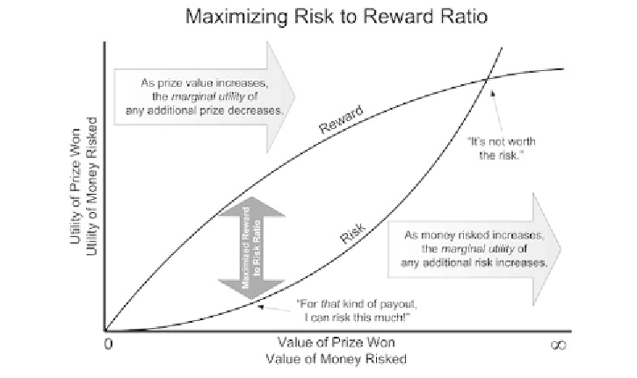
Risk and reward

Slide 23
More details
This may suggest that there are thresholds and steps.
This is probably going to be the case.
There will be tradeoffs
Soldiers or walls
Farms or soldiers
Wealth or territory
Builders or priests
Priests or farms
Rock, paper, scissors?
Deal or no Deal? Who wants to be a millionaire?
And it might be part of a story line: crisis, climax, resolution.

