Slide 1
CPE 323 Introduction to Embedded Computer Systems: Hardware Multiplier
Instructor: Dr Aleksandar Milenkovic Lecture Notes

Slide 2
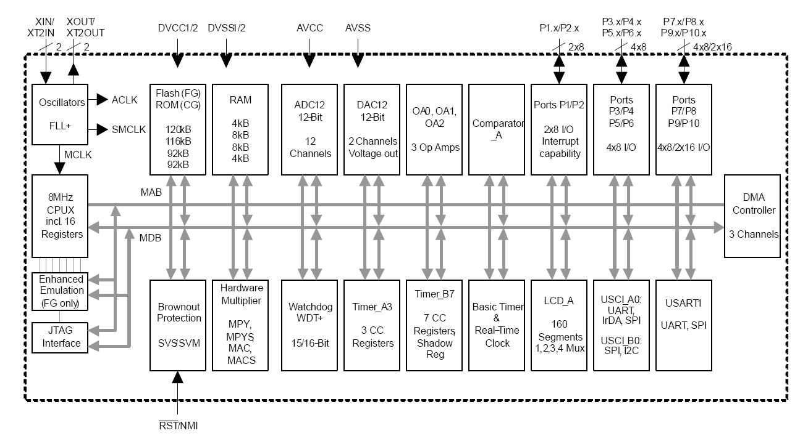
MSP430xG461x Microcontroller

Slide 3
Hardware Multiplier (16x16)
No ISA support for multiplication
Multiplication is supported by a dedicated peripheral module that performs
16x16, 16x8, 8x16, and 8x8 bit operations
Signed and unsigned multiplication
Signed and unsigned multiply and accumulate operations
How that works?
Load operands and read the result
No additional clock cycles are required

Slide 4
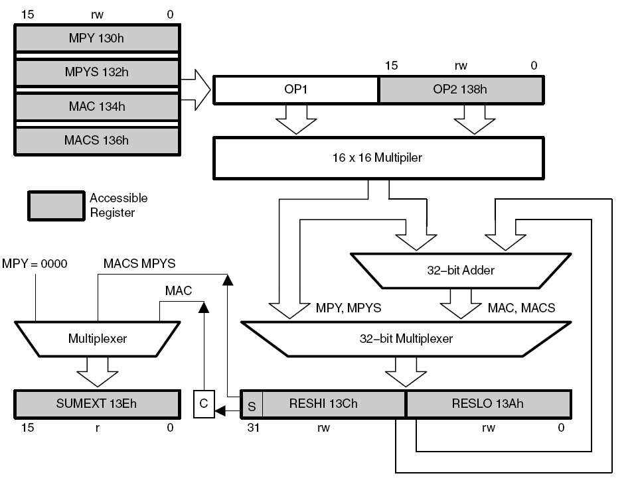
Multiplier Block Diagram

Slide 5
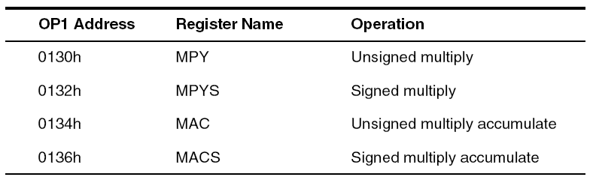
Multiplier Operation
How do we select type of operation?
By the address the first operand is written to
When does multiplication start?
When the second operand is written to the operand two register OP2
Where is the result?
Written into the three result registers RESLO,RESHI, and SUMEXT

Slide 6
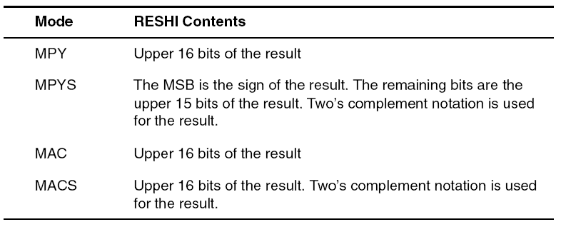
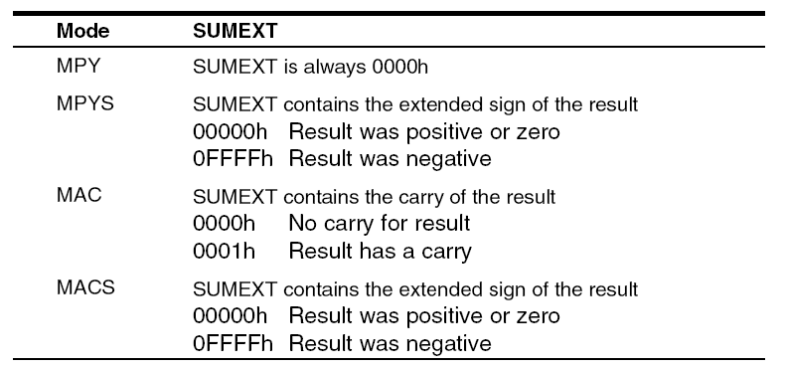
Result Registers
RESLO
Holds the lower 16-bits of the calculation result
RESHI
SXT

Slide 7
Software Examples
; 16x16 Unsigned Multiply
MOV #01234h,&MPY ; Load first operand
MOV #05678h,&OP2 ; Load second operand
; ... ; Process results
; 8x8 Unsigned Multiply. Absolute addressing.
MOV.B #012h,&0130h ; Load first operand
MOV.B #034h,&0138h ; Load 2nd operand
; ... ; Process results
; 16x16 Signed Multiply
MOV #01234h,&MPYS ; Load first operand
MOV #05678h,&OP2 ; Load 2nd operand
; ... ; Process results

Slide 8
Software Examples
; 8x8 Signed Multiply. Absolute addressing.
MOV.B #012h,&0132h ; Load first operand
SXT &MPYS ; Sign extend first operand
MOV.B #034h,&0138h ; Load 2nd operand
SXT &OP2 ; Sign extend 2nd operand
; (triggers 2nd multiplication)
; ... ; Process results
; 16x16 Unsigned Multiply Accumulate
MOV #01234h,&MAC ; Load first operand
MOV #05678h,&OP2 ; Load 2nd operand
; ... ; Process results

Slide 9
Software Examples
; 16x16 Signed Multiply Accumulate
MOV #01234h,&MACS ; Load first operand
MOV #05678h,&OP2 ; Load 2nd operand
; ... ; Process results
; 8x8 Signed Multiply Accumulate. Absolute addressing
MOV.B #012h,&0136h ; Load first operand
SXT &MACS ; Sign extend first operand
MOV.B #034h,R5 ; Temp. location for 2nd operand
SXT R5 ; Sign extend 2nd operand
MOV R5,&OP2 ; Load 2nd operand
; ... ; Process results

Slide 10
Indirect Addressing of RESLO
Note: if using indirect or indirect autoincrement addressing mode to access the results registers, at least one instruction is needed between loading the second operand and accessing one of the result registers
; Access multiplier results with indirect addressing
MOV #RESLO,R5 ; RESLO address in R5 for indirect
MOV &OPER1,&MPY ; Load 1st operand
MOV &OPER2,&OP2 ; Load 2nd operand
NOP ; Need one cycle
MOV @R5+,&xxx ; Move RESLO
MOV @R5,&xxx ; Move RESHI

Slide 11
Multiplication and Interrupts
If an interrupt occurs after writing OP1 but before writing OP2, and the multiplier is used in servicing that interrupt, the original multiplier mode selection is lost and the results are unpredictable
To avoid this, disable interrupts before using the hardware multiplier or do not use the multiplier in interrupt service routines.
; Disable interrupts before using the hardware multiplier
DINT ; Disable interrupts
NOP ; Required for DINT
MOV #xxh,&MPY ; Load 1st operand
MOV #xxh,&OP2 ; Load 2nd operand
EINT ; Interrupts may be enable before
; Process results

