Slide 1
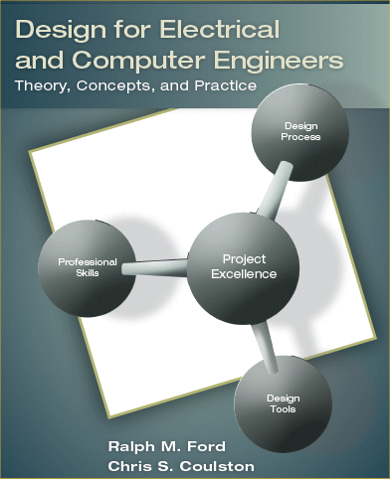
Chapter 4 – Concept Generation & Evaluation

Slide 2
Motivation
Creativity is part of being an engineer.
We often start with a single solution to a problem and then pursue it as the only possibility.
Need to be creative and generate a variety possible designs.
Need to be able to evaluate different designs.
Systematic generation
BE ABLE TO DEFEND YOUR DESIGN!
Companies want to employ innovative engineers.
Develop your engineering judgment.

Slide 3
Learning Objectives
By the end of this chapter, you should:
Understand the importance of creativity, innovation, concept generation, and critical evaluation in engineering design.
Be familiar with barriers that hinder creativity.
Be able to apply strategies and formal methods to generate concepts.
Be able to apply techniques for the evaluation of design concepts.

Slide 4

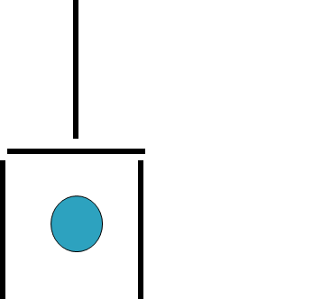
Think of this as a shovel with a coin on the shovel. The problem is to move two of the “toothpicks” so that the coin is no longer in the shovel, but you still have a shovel.
Notes:
| |
|_____|
|
* |
Slide the top of the shovel over by half. People tend to put an artificial constraint and only want to move a toothpick completely. In this case, you only slide it to the right.

Slide 5
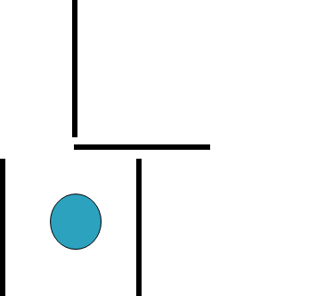
Think of this as a shovel with a coin on the shovel. The problem is to move two of the “toothpicks” so that the coin is no longer in the shovel, but you still have a shovel.
Notes:
| |
|_____|
|
* |
Slide the top of the shovel over by half. People tend to put an artificial constraint and only want to move a toothpick completely. In this case, you only slide it to the right.

Slide 6
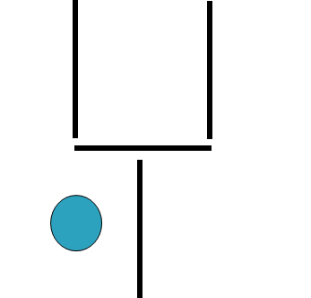
Think of this as a shovel with a coin on the shovel. The problem is to move two of the “toothpicks” so that the coin is no longer in the shovel, but you still have a shovel.
Notes:
| |
|_____|
|
* |
Slide the top of the shovel over by half. People tend to put an artificial constraint and only want to move a toothpick completely. In this case, you only slide it to the right.

Slide 7
Barriers to Creativity
Perceptual
Emotional
Cultural and Environmental
Intellectual and Expressive
Notes:
Perceptual blocks
Emotional blocks
Cultural blocks
Intellectual and expressive blocks

Slide 8
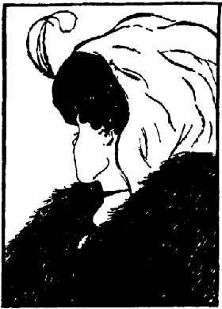

Perceptual Blocks

Slide 9
Vertical and Lateral Thinking
“A body is discovered in a park in Chicago in the middle of summer. It has a fractured skull and many other broken bones, but the cause of death was hypothermia.”
Think of the TV show CSI – Crime Scene Investigation. Generate as many solutions as possible to the following scenarios. The idea is to see the problem from a variety of different viewpoints and generate plausible scenarios. You have insufficient information and should examine your assumptions.

Slide 10
Vertical and Lateral Thinking
Vertical thinking is
Solving problems using an analytical, sequential and well known sequential methodology.
Lateral thinking is
Solving problems through an indirect and creative approach.
using reasoning that is not easily obtained using step-by-step logic

Slide 11
Strategies for Creativity
Have a questioning attitude
Practice being creative
Suspend judgment
All incubation time
Think like a beginner

Slide 12
SCAMPER
Substitute
Can new elements be substituted for those that already exist in the system?
Combine
Can existing entities be combined in a novel way that has not been done before?
Adapt
Can parts of the whole be adapted to operate differently?
Modify
Can part or all of the system be modified in some way? (size, shape, functionality)

Slide 13
SCAMPER
Put to other use
Are there other application domains where the product or system can be put to use?
Eliminate
Can parts of the whole be eliminated? Or should the whole itself be eliminated?
Rearrange or Reverse
If the elements are not themselves to be changed can they be rearranged differently to work better?
Are there any roles or objectives that can be reversed?

Slide 14

Search Externally
Literature review
Search and review existing products
Benchmark similar products
Interview experts
Search Internally
Brainstorming/brainwriting
Nominal Group Technique
Concept Table/Fans

Slide 15
Brainstorming
Rules for group brainstorming
No evaluation or judgment of ideas permitted.
Encourage wild ideas.
Focus on quantity, not quality (can always toss later!)
Build upon, combine, or modify the ideas of others (SCAMPER).
Record all ideas.

Slide 16
Morphology: Personal Computing
User Interface | Display | Connectivity & Expansion | Power | Size
Keyboard | CRT | Serial & parallel | Battery | Hand-held, Fits in pocket
Touchpad | Flat Panel | USB | AC Power | Notebook size
Handwriting Recognition | Plasma | Wireless Ethernet | Solar Power | Wearable
Video | Heads-up display | Wired Ethernet | Fuel Cell | Credit card size
Voice | LCD | PCMCIA | Thermal transfer | Flexible in shape
 |  | Modem / Telephone

Slide 17
Concept Fan

Slide 18

Decision Methods (some of them)
Strength & Weakness Analysis
Analytical Hierarchy Process (Decision Matrix)
Pugh Concept Selection

Slide 19
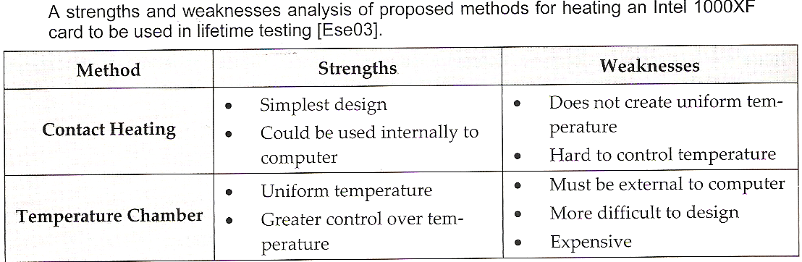
Strength & Weakness Analysis
Identify and list strengths and weaknesses of each concept.
To make more analytical, assign subjective weights to strengths and weaknesses (plus and minus factors) and sum them.

Slide 20
AHP (Decision Matrix)
 |  | Design Option 1 | Design Option 2 |  | Design Option n
Criteria 1 |  | α₁₁ | α₁₂ |  | α_{1n}
Criteria 2 |  | α₂₁ | α₂₂ |  | α_{2n}
Criteria m |  | α_{m1} | α_{m2} |  | α_{mn}
Score

Slide 21
Decision Matrix: Steps
Step 1: Determine the selection criteria
Step 2: Select the criteria weightings
Step 3: Identify and rate alternatives relative to the criteria
Step 4: Compute the scores
Step 5: Review the decision
You can use all the quantitative data you can get, but you still have to distrust it and use your own intelligence and judgment.—Alvin Toffler

Slide 22
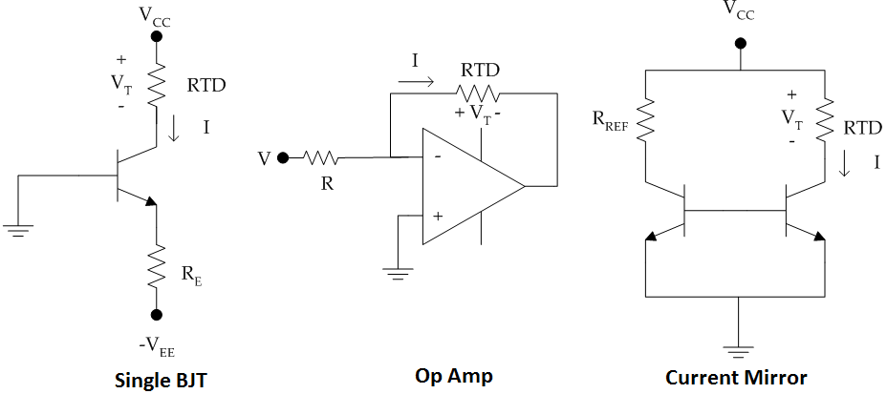
Example: Quantitative Decision
Select a current source circuit for current measurement

Slide 23
Step 1: Select the Criteria
In this case they are given as
Accuracy
Cost
Size
Availability

Slide 24
Step 2: Select the Weighting Factors
These are computed based upon the results of the pairwise comparison – given in the problem.
Be sure to normalize the final values.

Slide 25
Step 3: Compute Design Ratings
They need to be computed for the following
Accuracy
Cost
Size
Availability

Slide 26
Step 4: Compute the Scores
 |  | Single BJT | Op Amp | Current Mirror
Accuracy | 0.42 | 0.08 | 0.55 | 0.37
Cost | 0.12 | 0.41 | 0.28 | 0.31
Size | 0.12 | 0.48 | 0.31 | 0.21
Availability | 0.34 | 0.35 | 0.40 | 0.25
Score |  | 0.26 | 0.44 | 0.30

Slide 27
Pugh Concept Selection
Select the comparison criteria
Determine weights for the criteria
Determine the concepts
Select baseline concept, initially believed best
Compare other concepts to baseline:
+1 better than, 0 equal to, -1 worse than.
Compute weighted score for concepts, not including the baseline.
Examine concepts: retain, update, or drop. Synthesize best elements of others where possible.
Update table & iterate until best concept emerges.

Slide 28
Pugh Concept Table
 |  | Option 1 (Reference) | Option 2 | Option 3 | Option 4
Criteria 1 | 4 | - | 0 | 0 | +1
Criteria 2 | 5 | - | +1 | -1 | 0
Criteria 3 | 2 | - | -1 | 0 | +1
Criteria 4 | 1 | - | +1 | +1 | -1
Score |  | - | 4 | -4 | 5
Continue? |  | Combine | Yes | No | Combine

Slide 29

Identify different design alternatives Search externally
Brainstorming sessions.
Nominal Group Technique
Morphology (Concept Tables and Fans)
SCAMPER
Identify leading concept and justify
Strength & Weaknesses Analysis
Decision Matrices
Pugh Concept Selection

