Slide 1
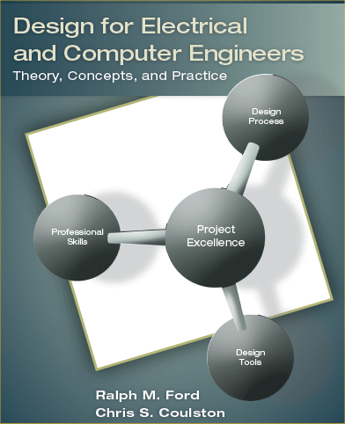
Chapter 8 – System Reliability

Slide 2
Motivation
How do you know how long your design is going to last?
Is there any way we can predict how long it will work?

Slide 3
Learning Objectives
By the end of this chapter, you should:
Have a familiarity with the basic principles of probability and understand how they apply to reliability theory.
Understand the mathematical definition and meaning of failure rate, reliability, and mean time to failure.
Understand how to determine the reliability of a component.
Understand how to derate the power of electronic components for use under different operating temperatures.
Understand how to determine the reliability of different system configurations.

Slide 4
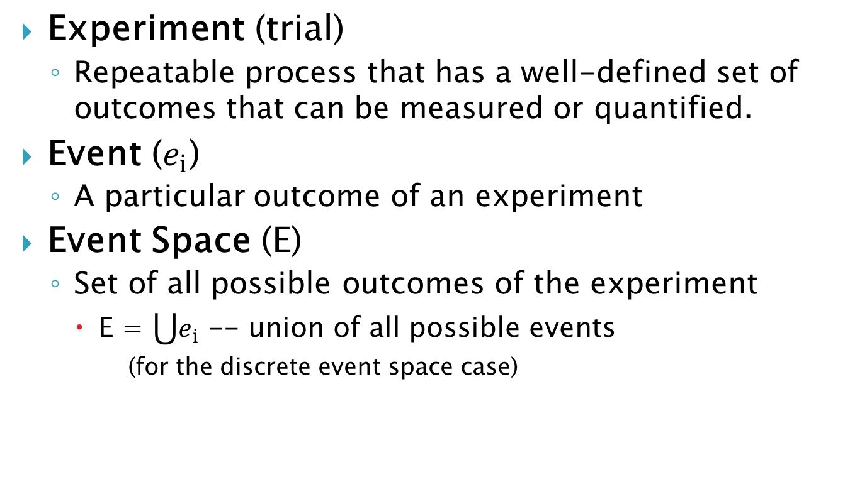
Probability Theory Review
Experiment (trial)
Repeatable process that has a well-defined set of outcomes that can be measured or quantified.
Event ($e_{i}$)
A particular outcome of an experiment
Event Space (E)
Set of all possible outcomes of the experiment
E = $\bigcup{e_{i}}$ -- union of all possible events
(for the discrete event space case)

Slide 5
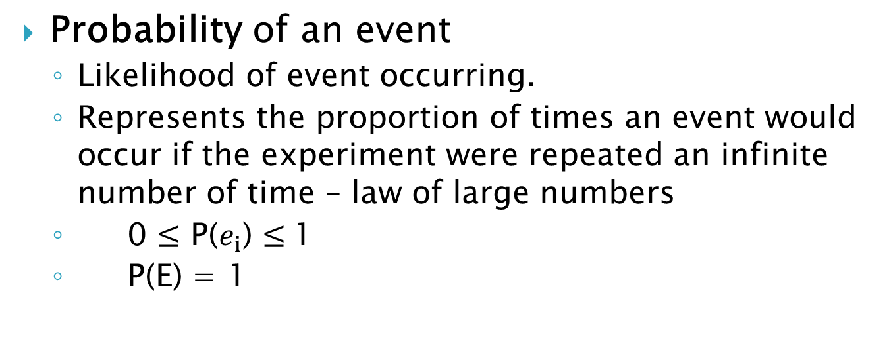
Probability Theory Review
Probability of an event
Likelihood of event occurring.
Represents the proportion of times an event would occur if the experiment were repeated an infinite number of time – law of large numbers
0 $≤$ P($e_{i}$) $≤$1
P(E) = 1

Slide 6
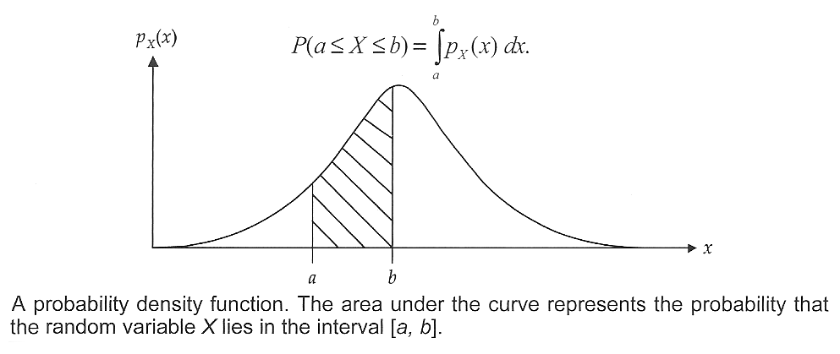



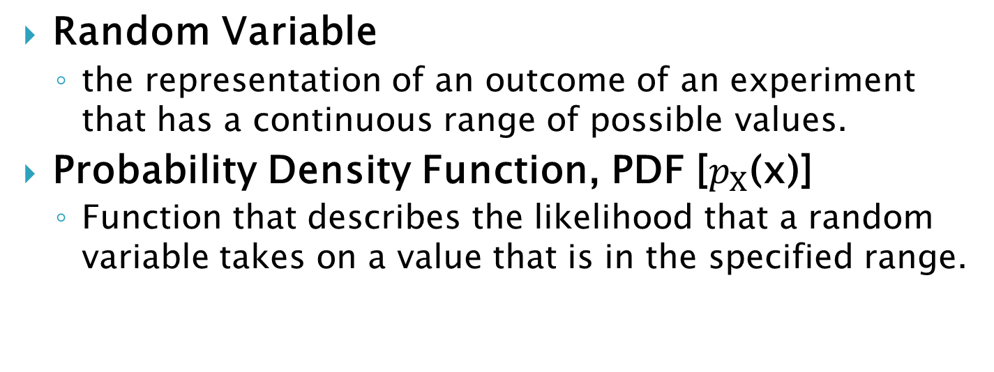
Probability Theory Review
Random Variable
the representation of an outcome of an experiment that has a continuous range of possible values.
Probability Density Function, PDF [$p_{X}$(x)]
Function that describes the likelihood that a random variable takes on a value that is in the specified range.

Slide 7

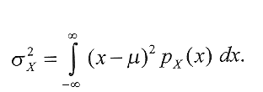
Probability Theory Review
Population Mean, μ
the center of mass of the PDF, -the arithmetic average
Population Variance, σ²
the center of mass of the PDF, -the arithmetic average
Average of the squared difference of the random variable from the mean
Square root of the Variance is called the standard deviation, σ

Slide 8
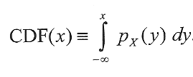
Probability Theory Review
Cumulative Distribution Function, CDF(x)
Probability that a random variable X that as a given PDF will have a value is less or equal to x.

Slide 9
Common PDFs
Normal (Gaussian) Density

Slide 10
Common PDFs
Uniform Density

Slide 11
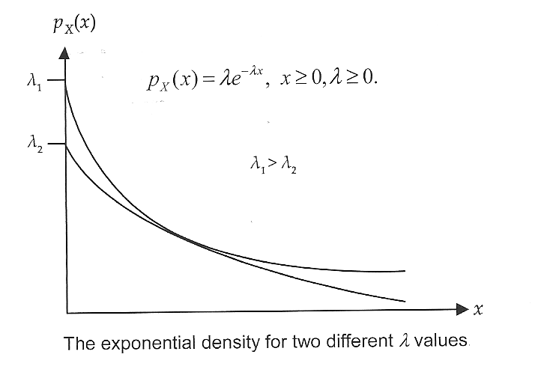
Common PDFs
Exponential Density
Used to model time dependent functions such as:
inter-arrival time data packets in a com system
component failures as a function of time

Slide 12
Reliability Prediction
Reliability (survival) function
Reliability function, R(t), is the probability that a device is functioning properly (has not failed) at time t.
Failure function (defn)
Failure function, F(t), probability that the device has failed by time t.
F(t) = 1-R(t)
Failure Rate
Failure Rate λ(t), is the expected number of failures per unit time
it is the average rate that a collection of identical devices will fail at a given time t.

Slide 13
Reliability Prediction
Failure Time function (defn)
Failure Time, F_{T}(t), PDF used to determine the probability that a given device will fail within a specified time.

Slide 14
The Bathtub Curve

Slide 15
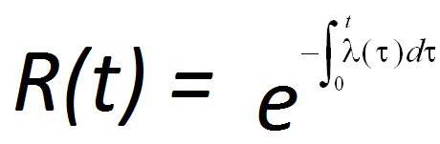
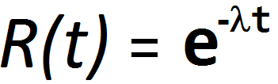
Calculating Reliability from failure rates
In general – when failure rates vary
when failure rates are considered constant over time over the region of interest

Slide 16
Consider a transistor with a failure rate of
λ = 10⁻⁶ (failures) per hour
What is the probability that the transistor will be operable in 5 years?
R(t)=e^{-λt}
t = 5 years * 365 days/year * 24 hours/day * 10⁻⁶ /hour
R(t) = e^{-λt} = e^{-0.0438} = 0.957.

Slide 17


Mean Time to Failure

Slide 18
Failure Rate Estimates
Factors that influence the failure rates of devices are
Subjecting Devices to Conditions outside their normal bounds of operation
Excessive current, power, heat, vibration, etc.
Subjecting Devices to Conditions within their normal bounds of operation
Power voltages, temperatures, etc.

Slide 19
Failure rate estimates
Low Frequency FET, Appendix C.
How would you find each of these?

Slide 20
Series Systems
Def’n (Series System) =
A system in which the failure of a single component (or subsystem) leads to the failure of the overall system
We model this as

Slide 21

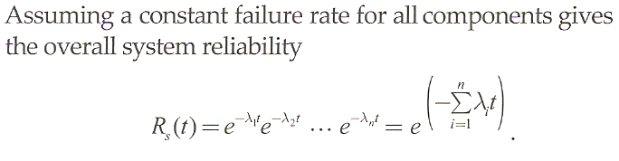
Series Systems
We model this as

Slide 22
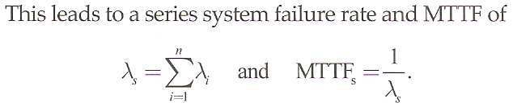
Series Systems
We model this as

Slide 23
Parallel Systems
Definition: Redundancy
design that has multiple modules that perform the same function where a single module would suffice.
Definition: Parallel System
design that employs two or more redundantly functioning modules

Slide 24
Parallel System Model

Slide 25


Parallel System Model

Slide 26
Combination Systems

Slide 27
Combination Systems

Slide 28
Summary
Probability Review
Random Variables
PDFs and CDFs
Mean and Variance
Reliability Estimation
Failure rate and the bathtub curve
Reliability & MTTF
Application to single components (MIL-SPEC)
System Reliability
Series systems
Parallel systems
Combination systems

