Slide 1
CS 5600 Computer Systems
Lecture 11: Virtual Machine Monitors
Notes:
<number>
8/22/2012
Defense
Christo Wilson

Slide 2
History
In the ‘70s, there were dozens of OSes
Unlike today, where Windows and Android dominate
This created many problems
Upgrading hardware or switching hardware vendors meant changing OS
However, apps are typically bound to a particular OS
Virtual machines were used to solve this problem
Pioneered by IBM
Run multiple OSes concurrently on the same hardware
Heavyweight mechanism for maintaining app compatibility
<number>

Slide 3
Terminology
“Virtual machine” is a loaded term
E.g. Java Virtual Machine refers to a runtime environment (software) that can execute Java bytecode
“VM” is a loaded abbreviation
JVM (Java Virtual Machine), Virtual Memory
For our purposes, we will talk about Virtual Machine Monitors (VMM)
VMM is software that allows multiple guest OSes to run concurrent on one physical machine
Each guest runs on a virtual machine
VMM is sometimes called a hypervisor
<number>

Slide 4
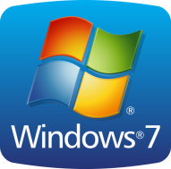
OS Fundamentals
OS multiplexes resources between apps
OS enforces isolation & protection between apps (ring 3)
App
App
App
App
OS
Physical Machine
CPU
RAM
Disks
The OS manages physical resources
The OS expects to have privileged access (ring 0)
<number>

Slide 5

VMM Organization and Functions
Map operations on virtual hw. to physical hw.
Multiplex resources between guest OSes
Enforce protection & isolation between guest OSes
App
App
App
App
Guest OS
Guest OS
Virtual Machine
Virtual Machine
CPU
RAM
Disk
VMM
Host OS
Physical Machine
CPU
RAM
Disks
<number>
Notes:
Christo Wilson
8/22/2012
Defense
<number>

Slide 6
Goals of Virtualization
Popek and Goldberg, 1974
Fidelity: software on the VMM executes identically to its execution on hardware
Except for timing effects
Performance: An overwhelming majority of guest instructions are executed by the hardware without VMM intervention
Counterexample: the JVM
Safety: the VMM manages all hardware resources
Guests cannot impact each other
<number>

Slide 7
Advantages of Virtualization (1)
Compatibility and functionality
Guests are oblivious to low-level hardware changes
Windows apps on Linux or vice-versa
Consolidation
Multiple machines can be combined into one by running the OSes as guests
Checkpointing and migration
A guest OS can be written to disk or sent across the network, reloaded later or on a different machine
<number>

Slide 8
Advantages of Virtualization (2)
Security
If a guest OS is hacked, the others are safe (unless the hacker can escape the guest by exploiting the VMM)
Multiplatform debugging
App writers often target multiple platforms
E.g. OS X, Windows, and Linux
Would you rather debug on three separate machines, or one machine with two guests?
<number>

Slide 9
Technical Challenges
x86 is not designed with virtualization in mind
Some privileged instructions don’t except properly
MMU only supports one layer of virtualization
These hardware issues violate goal 1 (fidelity)
As we will discuss, sophisticated techniques are needed to virtualize x86
These techniques work, but they reduce performance
Modern x86 hardware supports virtualization
AMD-V and VT-x for hypervisor context switching
RVI (AMD) and EPT (Intel) for MMU virtualization
<number>

Slide 10
Performance Challenges
Memory overhead
VMM data structures for virtualized hardware may require lots of memory
CPU overhead
Context switching between VMM and each guest is costly
Some instructions and functions (e.g. page allocation) must be virtualized; slower than direct operations
I/O performance
Devices must be shared between guests
Virtualized devices (e.g. disks, network) may be slower than the underlying physical devices
<number>

Slide 11
Full Virtualization (VMWare)
Hardware Support
Paravirtualization (Xen)
<number>

Slide 12
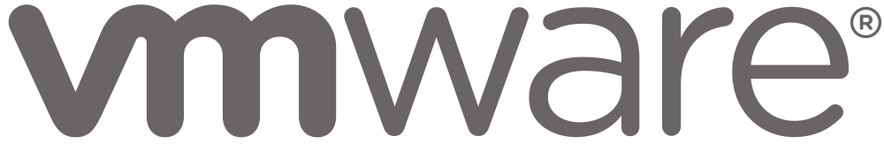
Full Virtualization
VMWare implements full virtualization
Full → guest OSes do not need to be modified
Goals:
Run unmodified OSes as guests
Isolate the guest from the host (safety/security)
Share physical devices and resources with the guest
CPU, RAM, disk, network, GPU, etc…
Other full virtualization VMMs:
Parallels on OS X
Hyper-v on Windows
<number>

Slide 13
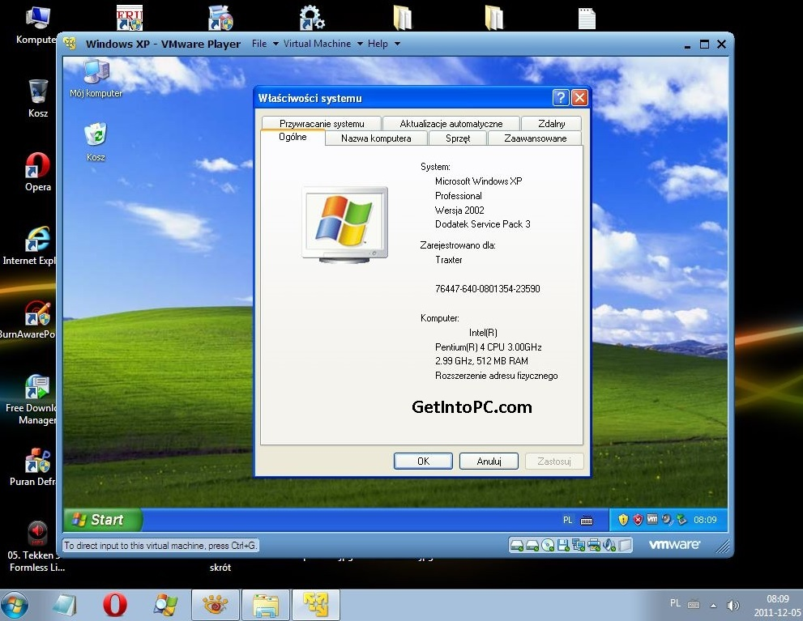
<number>

Slide 14
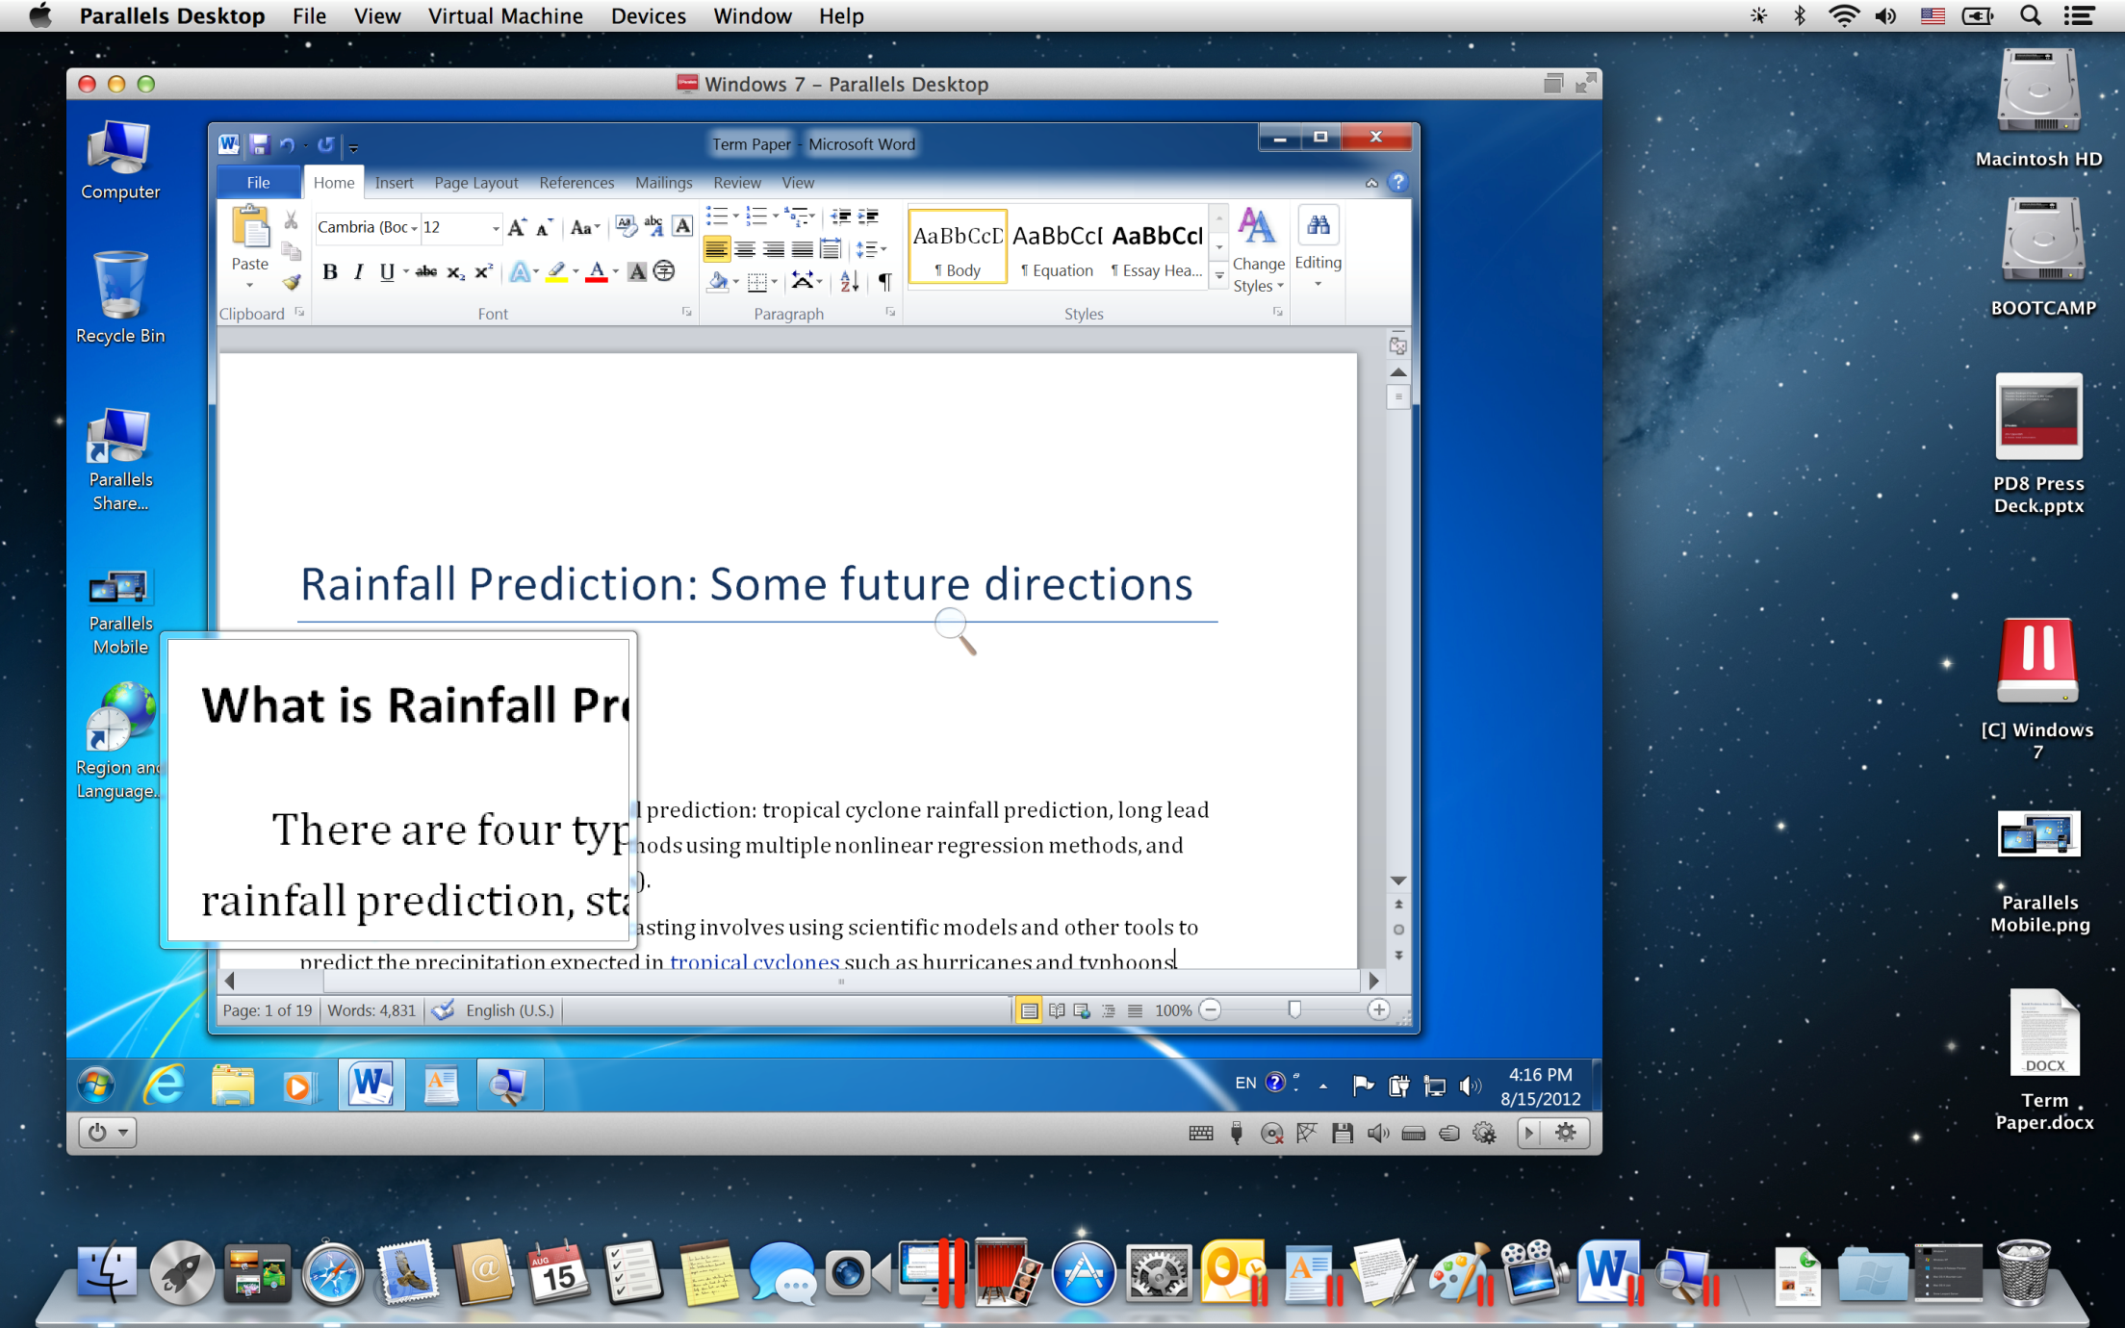
<number>

Slide 15
Before We Virtualize…
The VMM is an application
Like any app, it runs on top of a host OS
VMMs exist for most OSes
VMWare works on Windows and Linux
Parallels on OS X
Hyper-V on Windows
Some lightweight OSes are designed to run VMMs
VMWare ESX
The host OS manages underlying physical resources
VMM
Host OS
Physical Machine
<number>

Slide 16
Booting a Guest
When an OS boots, it expects to do so on physical hardware
To boot a guest, the VMM provides virtual hardware
A fake BIOS
CPU: typically matches the underlying CPU (e.g. x86 on x86)
RAM: subset of physical RAM
Disks: map to subsets of the physical disk(s)
Network, etc…
Guest OS is totally isolated
Executes in userland (ring 3)
Memory is contained in an x86 segment
Guest boots exactly like any other OS
Starts at the MBR, looks for the bootloader, etc…
Guest OS
Virtual Machine
VMM
<number>

Slide 17
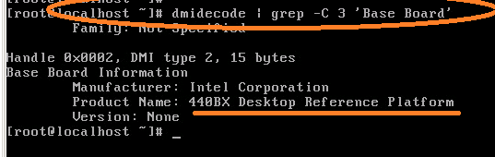
Virtual Machine Hardware
VMMs try to emulate hardware that is:
Simple
Emulating advanced features is hard to do in software
Widely supported by device drivers
Guests should already include support for the virtual hardware
Example: VMWare virtual motherboard is always an Intel 440BX reference board
This motherboard was released in 1998
Widely supported by many OSes
All VMWare guests run on this virtual hardware to this day
<number>

Slide 18
Virtual Hardware Examples
Write to the disk
Send a packet
VMM exports a simple disk interface
Reads/writes are translated to a virtual filesystem on the real disk
Just like Pintos on QEMU
Simple network interface
VMM acts like a NAT, multiplexing packets to and from multiple guests
App
App
App
Guest OS
VM
VM
NIC
Disk
NIC
VMM
Host OS
PM
Disks
NIC
Receive a packet
<number>

Slide 19
Sharing CPU and RAM
0xFFFFFFFF
VMM allocates subsets of RAM for guests
Each guest’s memory is contained in an x86 segment
Segments enforce strong isolation
VMM divides CPU time between guests
Timer interrupts jump to the host OS
VMM schedules time for each guest
Guests are free to schedule apps as they
In a multicore system, each guest may be assigned 1 or more CPUs
Guest App
Guest only sees a subset of RAM
Guest App
Guest OS
Guest App
Guest OS
Host OS manages all RAM
VMM
Host OS
EIP
0x00000000

Slide 20
Virtual and Physical CPU
Install new page table
Each guest has a virtual CPU created by the VMM
However, the virtual CPU is only used to store state
E.g. if a guest updates cr3 or eflags, the new value is stored in the virtual CPU
Guest code executes on the physical CPU
Keeps guest performance high
Guests run in userland, so security is maintained
App
App
Guest OS
VM
CPU
Update cr3
VMM
Host OS
PM
CPU
Update cr3
<number>

Slide 21
Handling Interrupts
thread_yield()
0xFFFFFFFF
Every OS installs handlers to deal with interrupts
incoming I/O, timer, system call traps
When a guest boots, the VMM records the addresses of guest handlers
When the VMM context switches to a guest, some of its handlers are installed in the physical CPU
Host traps are reinstalled when the guest loses context
EIP
Guest App
Guest OS
int 0x80 handler
No need to jump to the host or the VMM
VMM
Host OS
0x00000000
<number>

Slide 22
Challenges With Virtual Hardware
Dealing with privileged instructions
OSes expect to run with high privilege (ring 0)
How can the VMM enable guest OSes to run in userland (ring 3)?
Managing virtual memory
OSes expect to manage their own page tables
This requires modifying cr3 (high privilege) as well as updated page tables in RAM
How can the VMM translate between a guest’s page tables and the hosts page tables?
<number>

Slide 23
Protected Mode
Most modern CPUs support protected mode
x86 CPUs support three rings with different privileges
Ring 0: OS kernel
Ring 1, 2: device drivers
Ring 3: userland
Most OSes only use rings 0 and 3
Ring 3
Ring 2
Ring 1
Ring 0
Kernel
Device Drivers
Device Drivers
Applications

Slide 24
Privileged Instructions
OSes rely on many privileges of ring 0
cri, sti, popf – Enable/disable interrupts
hlt – Halt the CPU until the next interrupt
mov cr3, 0x00FA546C – install a page table
Install interrupt and trap handlers
Etc…
However, guests run in userland (ring 3)
VMM must somehow virtualize privileged operations
<number>

Slide 25
Using Exceptions for Virtualization
Ideally, when a guest executes a privileged instruction in ring 3, the CPU should generate an exception
Example: suppose the guest executes hlt
The CPU generates a protection exception
The exception gets passed to the VMM
The VMM can emulate the privileged instruction
If guest 1 runs hlt, then it wants to go to sleep
VMM can do guest1.yield(), then schedule guest 2
<number>

Slide 26
Problem: x86 Doesn’t Except Properly
On x86, interrupts can be enabled/disabled by setting bit 9 of the eflags register
popf pops the top value off the stack and writes it into eflags
Problem: the behavior of popf varies based on privilege
In ring 0, all bits of eflags are overwritten
In ring 3, all bits are overwritten except bit 9
If a guest OS uses popf to alter bit 9, then:
The update will fail, and the guest’s state will be inconsistent (the guest OS may crash)
No CPU exception is generated, so the VMM has no idea that the guest tried to enable/disable interrupts
<number>

Slide 27
Binary Translation
x86 assembly cannot be virtualized because some privileged instructions don’t generate exceptions
Workaround: translate the unsafe assembly from the guest to safe assembly
Known as binary translation
Performed by the VMM
Privileged instructions are changed to function calls to code in VMM
<number>

Slide 28
Binary Translation Example
Guest OS Assembly
Translated Assembly
do_atomic_operation:
cli
mov eax, 1
xchg eax, [lock_addr]
test eax, eax
jnz spinlock
…
…
mov [lock_addr], 0
sti
ret
do_atomic_operation:
call [vmm_disable_interrupts]
mov eax, 1
xchg eax, [lock_addr]
test eax, eax
jnz spinlock
…
…
mov [lock_addr], 0
call [vmm_enable_interrupts]
ret
<number>

Slide 29
Pros and Cons
Advantages of binary translation
It makes it safe to virtualize x86 assembly code
Translation occurs dynamically, on demand
No need to translate the entire guest OS
App code running in the guest does not need to be translated
Disadvantages
Translation is slow
Wastes memory (duplicate copies of code in memory)
Translation may cause code to be expanded or shortened
Thus, jmp and call addresses may also need to be patched
<number>

Slide 30
Caching Translated Code
Typically, VMMs maintain a cache of translated code blocks
LRU replacement
Thus, frequently used code will only be translated once
The first execution of this code will be slow
Other invocations occur at native speed
<number>

Slide 31
Problem: How to Virtualize the MMU?
On x86, each OS expects that it can create page tables and install them in the cr3 register
The OS believes that it can access physical memory
However, virtualized guests do not have access to physical memory
Using binary translation, the VMM can replace writes to cr3
Store the guest’s root page in the virtual CPU cr3
The VMM can now walk to guest’s page tables
However, the guest’s page tables cannot be installed in the physical CPU…
<number>

Slide 32
Two Layers of Virtual Memory
Physical address → machine address
Host OS’s
View of RAM
Virtual address → physical address
0xFFFFFFFF
Guest OS’s
View of RAM
Guest App’s
View of RAM
0xFFFF
Page 2
0xFF
Page 0
Page 0
Page 3
Page 2
Page 1
Page 1
Page 3
Page 0
Page 3
Page 1
0x00
Page 2
Unknown to the guest OS
Known to the guest OS
0x0000
0x00000000

Slide 33
Guest’s Page Tables Are Invalid
Guest OS page tables map virtual page numbers (VPNs) to physical frame numbers (PFNs)
Problem: the guest is virtualized, doesn’t actually know the true PFNs
The true location is the machine frame number (MFN)
MFNs are known to the VMM and the host OS
Guest page tables cannot be installed in cr3
Map VPNs to PFNs, but the PFNs are incorrect
How can the MMU translate addresses used by the guest (VPNs) to MFNs?
<number>

Slide 34
Shadow Page Tables
Solution: VMM creates shadow page tables that map VPN → MFN (as opposed to VPN→PFN)
Guest Page Table
Physical Memory
VPN | PFN
00 (0) | 01 (1)
01 (1) | 10 (2)
10 (2) | 11 (3)
11 (3) | 00 (0)
64
Maintained by the guest OS
Invalid for the MMU
Page 3
48
Page 2
32
Virtual Memory
Page 1
16
64
Page 0
Page 3
0
48
Page 2
32
Shadow Page Table
Machine Memory
Page 1
16
VPN | MFN
00 (0) | 10 (2)
01 (1) | 11 (3)
10 (2) | 00 (0)
11 (3) | 01 (1)
64
Maintained by the VMM
Valid for the MMU
Page 0
Page 3
0
48
Page 2
32
Page 1
16
Page 0
0
<number>
Notes:
Christo Wilson
8/22/2012
Defense
<number>

Slide 35
Building Shadow Tables
Problem: how can the VMM maintain consistent shadow pages tables?
The guest OS may modify its page tables at any time
Modifying the tables is a simple memory write, not a privileged instruction
Thus, no helpful CPU exceptions :(
Solution: mark the hardware pages containing the guest’s tables as read-only
If the guest updates a table, an exception is generated
VMM catches the exception, examines the faulting write, updates the shadow table
<number>

Slide 36
Dealing With Page Faults
It is possible that the shadow table may be inconsistent
If a guest page faults, this could be a:
True miss: actual page fault, guest OS/app should crash
Hidden miss: the shadow table is inconsistent; there is a valid VPN→PFN mapping in the guest’s page tables
VMM must disambiguate true and hidden misses
On each page fault, the VMM must walk the guest’s tables to see if a valid VPN→PFN mapping exists
If so, this is a hidden miss
Update the shadow table and retry the instruction
Otherwise, forward the page fault to the guest OS’s handler
Tracing
<number>

Slide 37
Pros and Cons
The good: shadow tables allow the MMU to directly translate guest VPNs to hardware pages
Thus, guest OS code and guest apps can execute directly on the CPU
The bad:
Double the amount of memory used for page tables
i.e. the guest’s tables and the shadow tables
Context switch from the guest to the VMM every time a page table is created or updated
Very high CPU overhead for memory intensive workloads
<number>

Slide 38
More VMM Tricks
The VMM can play tricks with virtual memory just like an OS can
Paging:
The VMM can page parts of a guest, or even an entire guest, to disk
A guest can be written to disk and brought back online on a different machine!
Shared pages:
The VMM can share read-only pages between guests
Example: two guests both running Windows XP
<number>

Slide 39
Full Virtualization (VMWare)
Hardware Support
Paravirtualization (Xen)
<number>

Slide 40
The Story So Far…
We have discussed how systems like VMWare implement full virtualization
Key challenges solved by VMWare:
Binary translation rewrites guest OS assembly to not use privileged instructions
Shadow page tables maintained by the VMM allow the MMU to translate addresses for guest code
So what’s the problem?
Performance
<number>

Slide 41
Virtualization Performance
Guest code executes on the physical CPU
However, that doesn’t mean its as fast as the host OS or native applications
Guest code must be binary translated
Shadow page tables must be maintained
Page table updates cause expensive context switches from guest to VMM
Page faults are at least twice as costly to handle
<number>

Slide 42
Hardware Techniques
Modern x86 chips support hardware extensions designed to improve virtualization performance
Reliable exceptions during privileged instructions
Known as AMD-V and VT-x (Intel)
Released in 2006
Adds vmrun/vmexit instructions (like sysenter/sysret)
Extended page tables for guests
Known as RVI (AMD) and EPT (Intel)
Adds another layer onto existing page table to map PFN→MFN
<number>

Slide 43
AMD-V and VT-x
Annoyingly, AMD and Intel offer different implementations
However, both offer similar functionality
vmenter: instruction used by the hypervisor to context switch into a guest
Downgrade CPU privilege to ring 3
vmexit: exception thrown by the CPU if the guest executes a privileged instruction
Saves the running state of the guest’s CPU
Context switches back to the VMM
<number>

Slide 44
Configuring vmenter/vmexit
The VMM tells the CPU what actions should trigger vmexit using a VM Control Block (VMCB)
VMCB is a structure defined by the x86 hardware
Fields in the struct tell the CPU what events to trap
Examples: page fault, TLB flush, mov cr3, I/O instructions, access of memory mapped devices, etc.
The CPU saves the state of the guest to the VMCB before vmexit
Example: suppose the guest exits due to device I/O
The port, data width, and direction (in/out) of the operation get stored in the VMCB
<number>

Slide 45
Benefits of AMD-V and VT-x
Greatly simplifies VMM implementation
No need for binary translation
Simplifies implementation of shadow page tables
Warning: the VMM runs in userland, but use of AMD-V and VT-x requires ring 0 access
Host OS must offer APIs that allow VMMs to configure VMCB and setup callbacks for guest OS exceptions
Example: KVM on Linux
<number>

Slide 46
Problem with AMD-V and VT-x
Some operations are much slower when using vmexit vs. binary translation
Guest OS Assembly
Translated Assembly
do_atomic_operation:
cli
mov eax, 1
…
do_atomic_operation:
call [vmm_disable_interrupts]
mov eax, 1
…
This code is okay because cli is trapped by vmexit
However, each vmexit causes an expensive context switch
The VMM must generate this code via binary translation
But, this direct call is very fast, no context switch needed
<number>

Slide 47
Benefits of AMD-V and VT-x
Greatly simplifies VMM implementation
No need for binary translation
Simplifies implementation of shadow page tables
… however, sophisticated VMMs still use binary translation in addition to vmenter/vmexit
VMM observes guest code that causes frequent vmexits
Hot spots may be binary translated or dynamically patched to improve performance
Similar to Just-In-Time (JIT) compilation
<number>

Slide 48
Second Level Address Translation
AMD-V and VT-x help the VMM control guests
… but, they don’t address the need for shadow page tables
Second level address translation (SLAT) allows the MMU to directly support guest page tables
Intel: Extended Page Tables (EPT)
AMD: Rapid Virtualization Indexing (RVI)
Also known as Two Dimensional Paging (TDP)
Introduced in 2008
<number>

Slide 49
SLAT Implementation
VMM installs first and second level tables in the MMU
Context switch to the guest via vmenter
Steps to translate an address:
MMU queries the level 1 (guest) table
MMU queries the level 2 (VMM) table
If any step yields an invalid PTE than page fault to the VMM (vmexit)
Guest Page Table
VPN | PFN
00 (0) | 01 (1)
01 (1) | 10 (2)
10 (2) | 11 (3)
11 (3) | 00 (0)
Maintained by the guest OS
Extended
Page Table
PFN | MFN
01 (1) | 10 (2)
10 (2) | 11 (3)
11 (3) | 00 (0)
00 (0) | 01 (1)
Maintained by the VMM
vmcr3
CPU
cr3
<number>

Slide 50
Advantages of SLAT
Huge performance advantages vs. shadow page tables
When guests mov cr3, the CPU updates vmcr3 register
No need to vmexit when guest OS switches context
EPT can be filled on-demand or pre-initialized with PFN→MFN entries
On-demand:
Slower, since many address translations will trigger hidden misses
… but hardware pages for the guest can be allocated when needed
And, the EPT will be smaller
Preallocation:
No need to vmexit when the guest OS creates or modifies it’s page tables
… but hardware pages need to be reserved for the guest
And, the EPT table will be larger
<number>

Slide 51
Pre-initialized EPT
Host OS’s
View of RAM
PFN→MFN pre-initialized by the VMM
VPN→PFN managed on-demand by the guest OS
Guest OS’s
View of RAM
Guest App 1’s
View of RAM
Guest App 2’s
View of RAM
Pages reserved for the guest OS

Slide 52
Disadvantages of SLAT
Memory overhead for EPT
… but not as much as shadow page tables
TLB misses are twice as costly
SLAT makes page tables twice as deep, hence it takes twice as long to resolve PTEs
<number>

Slide 53
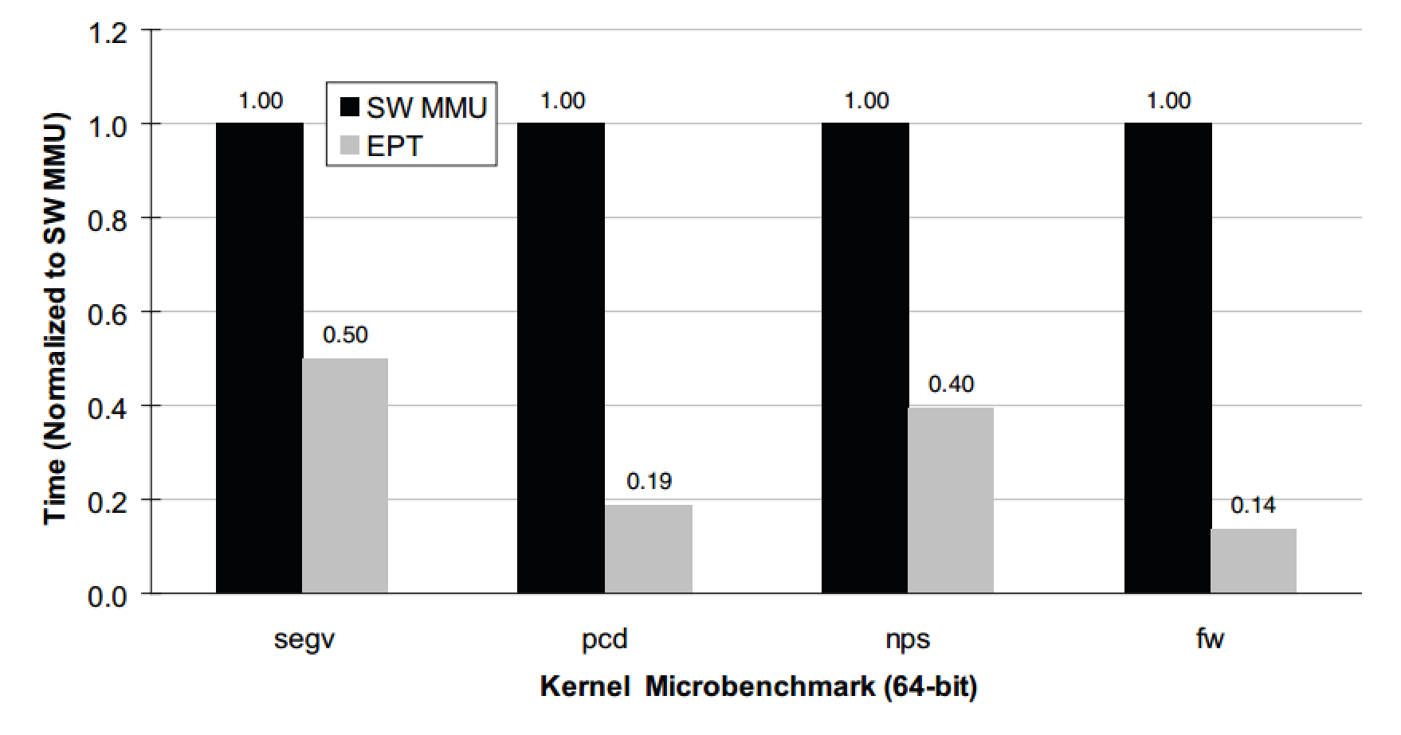
EPT Performance Evaluation
Microbenchmarks by the VMWare team
Normalized to shadow page table speeds (1.0)
Lower times are better
<number>

Slide 54
Configuring Your VMM
Advanced VMMs like VMWare give you three options
Binary translation + shadow page tables
AMD-V/VT-x + shadow page tables
AMD-V/VT-x + RVI/EPT
Which is best?
Choosing between 1 and 2 is more difficult
For some workloads, 2 is much slower than 1
Run benchmarks with your workload before decided on 1 or 2
Fastest by far
But, requires very recent, expensive CPUs
<number>

Slide 55
Full Virtualization (VMWare)
Hardware Support
Paravirtualization (Xen)
<number>

Slide 56
The Story so Far…
We have discussed full virtualization by looking at the implementation of VMWare
We have discussed how recent advances in x86 hardware can speed up virtualization
Thus far, we have abided by virtualization rule #1:
Fidelity: software on the VMM executes identically to its execution on hardware
What if we relax this assumption?
<number>

Slide 57
Relaxing Assumptions
Problem: it takes a lot of work to virtualize an arbitrary guest OS
VMM implementation is very complicated
Even with hardware support, performance issues remain
What if we require that guests be modified to run in the VMM
How much work is it to modify guests to “cooperate” with the VMM?
Will VMM implementation be simpler?
Can we get improved performance?
<number>

Slide 58
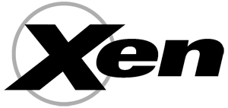
Paravirtualization
Denali and Xen pioneered the idea of paravirtualization
Require that guests be modified to run on the VMM
Replace privileged operations with hypercalls to the hypervisor
Defer most memory management to the VMM
Our discussion will focus on Xen
Commercial product owned by Citrix (i.e. GoToMeeting)
Robust, mature hypervisor
<number>

Slide 59
Hypercalls
The Xen VMM exports a hypercall API
Methods replace privileged instructions offered by the hardware
E.g halt CPU, enable/disable interrupts, install page table
Guest OS can detect if it’s running directly on hardware or on Xen
In the former case, typical ring 0 behavior is used
In the latter case, hypercalls are used
If a guest executes a privileged instruction, crash it
Xen VMM makes no attempt to emulate privileged instructions
Simplifies Xen VMM implementation
<number>

Slide 60
Handling Interrupts and Exceptions
Guests register callbacks with the Xen VMM to receive interrupts and exceptions
Timer interrupts
Page faults
I/O interrupts
Xen buffers many events and passes them to the guest in batches
Improves performance by reducing the number of VMM→guest context switches
In some cases, interrupts are forwarded directly to the guest without Xen’s intervention
Example: int 0x80 system calls
<number>

Slide 61
Managing Virtual Memory
All guest memory is managed by Xen
Guests allocate empty page tables, registers them with Xen via a hypercall
Guest may read but not write page tables
All updates to pages must be made via hypercalls
Advantages:
No extra memory needed for extended page tables
No need to implement shadow page tables
No additional overhead for TLB misses
No hidden misses
Disadvantages:
Each updates to page tables cause a guest→VMM context switch
<number>

Slide 62
Virtual Time in Xen
Keeping track of time is hard in the guest
Guest cannot observe CPU ticks directly
VMM may context switch a guest out for an arbitrary amount of time
Xen provides multiple times to guests
Real time: ticks since bootup
Virtual time: ticks during which the guest is active
Wall clock time, adjusted by timezone
Why are real time and wall clock time separate?
The host OS may change the time (e.g. daylight savings)
Changing the clock can cause weird anomalies
<number>

Slide 63
Virtual Devices in Xen
Xen exports simple, idealized virtual devices to guests
Guest needs to be modified to include drivers for these devices
Thankfully, the drivers are simply to write
This is essentially the same approach used by other hypervisors (VMWare, etc.)
<number>

Slide 64
Modifying Guests
How much work does it take to modify a guest OS to run on Xen?
Linux: 3000 lines (1.36% of the kernel)
Including device drivers
Windows XP: 4620 lines (0.04% of the kernel)
Device drivers add another few hundred lines of code
Modification isn’t trivial, but its certainly doable
<number>

Slide 65
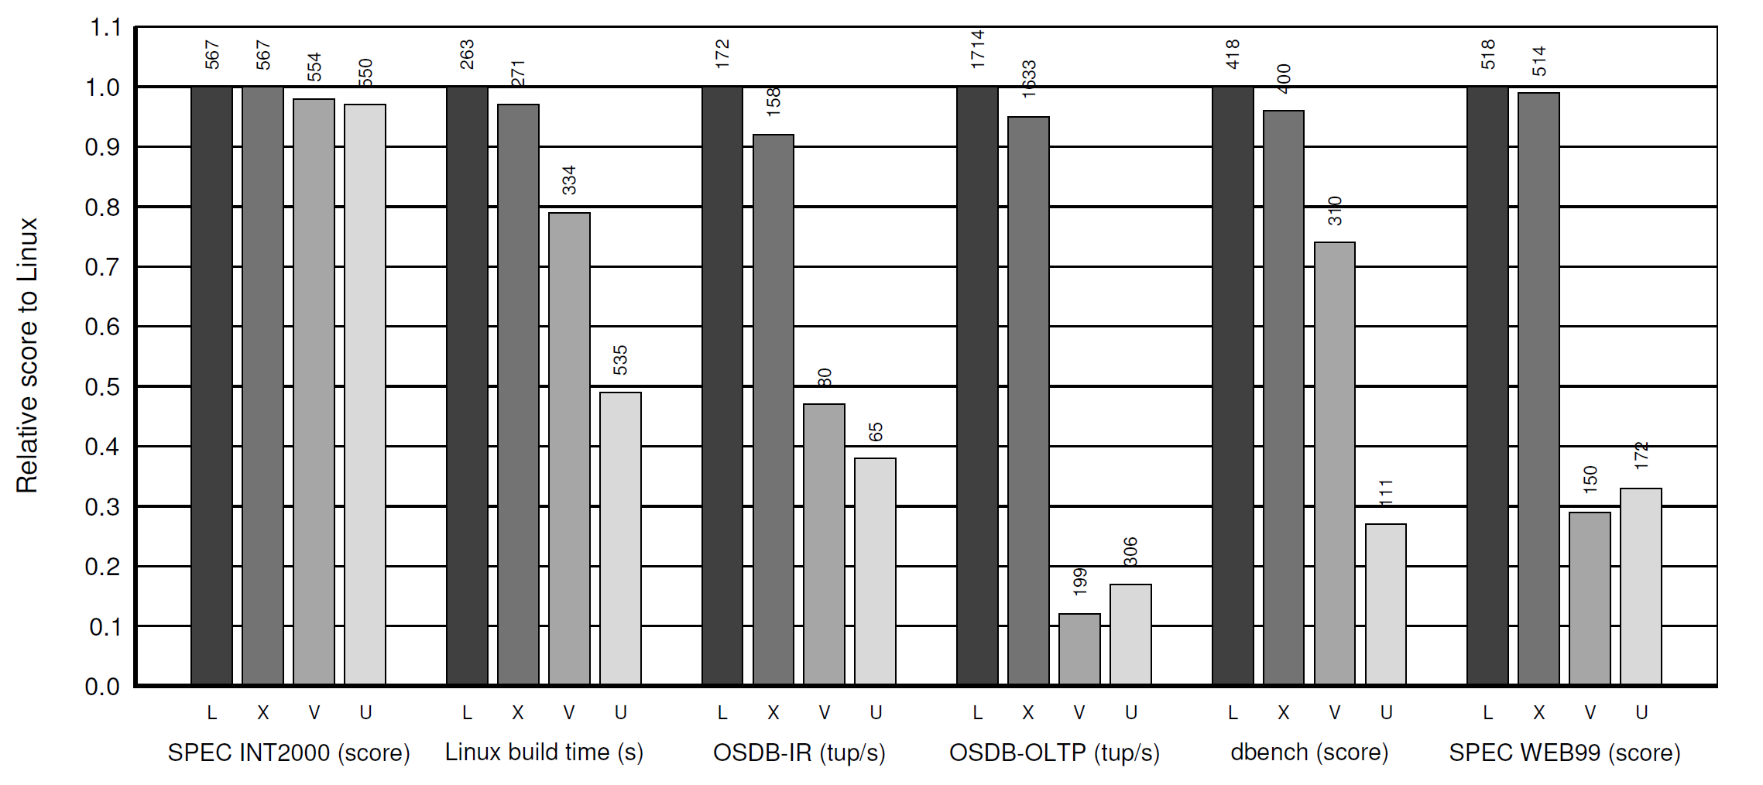
Xen Performance
Warning: this comparison is Xen vs. VMWare 3.2 in 2003
AMD-V/VT-x and RVI/EPT did not exist in 2003
Today, VMWare is much faster due to x86 hardware extension
Relative performance of native Linux (L), Linux on Xen (X), Linux on VMWare 3.2 (V), and User-Mode Linux (U)
Normalized to native Linux
<number>

Slide 66
Wrap-Up
Virtualization has made a huge resurgence in the last 15 years
Today, all OSes and most CPUs have direct support for hosting virtual machines, or becoming virtualized
Virtualization underpins the cloud
E.g. Amazon EC2 rents virtual machines at low costs
Hugely important for innovation
<number>

Slide 67
Bibliography
Software and Hardware Techniques for x86 Virtualization
http://www.vmware.com/files/pdf/software_hardware_tech_x86_virt.pdf
A Comparison of Software and Hardware Techniques for x86 Virtualization
http://dl.acm.org/citation.cfm?id=1168860
Performance Evaluation of Intel EPT Hardware Assist
http://www.vmware.com/pdf/Perf_ESX_Intel-EPT-eval.pdf
Xen and the Art of Virtualization
http://dl.acm.org/citation.cfm?id=945462
<number>

