Slide 1
Chapter 5
Shared-Memory Programming with OpenMP

Slide 2

OpenMP
An accepted standard developed in the late 1990s by a group of industry specialists.
Consists of a small set of compiler directives, augmented with a small set of library routines and environment variables using the base language C/C++ and Fortran.
The compiler directives can specify such things as the par and forall operations described previously.

Slide 3
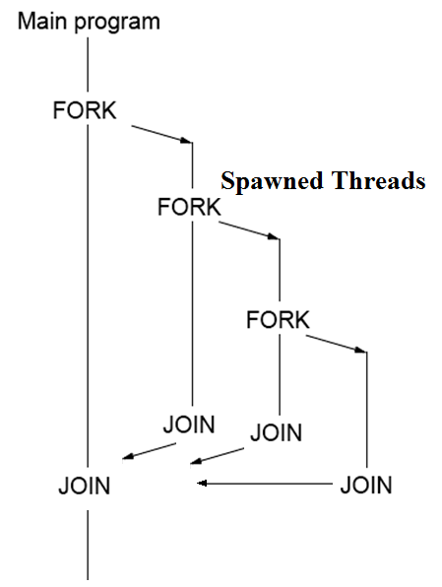
Employs Fork-Join Parallelism

Slide 4
Master thread spawns a team of threads as needed
Parallelism can be added incrementally
sequential program evolves into a parallel program
Master Thread
Parallel Regions

Slide 5
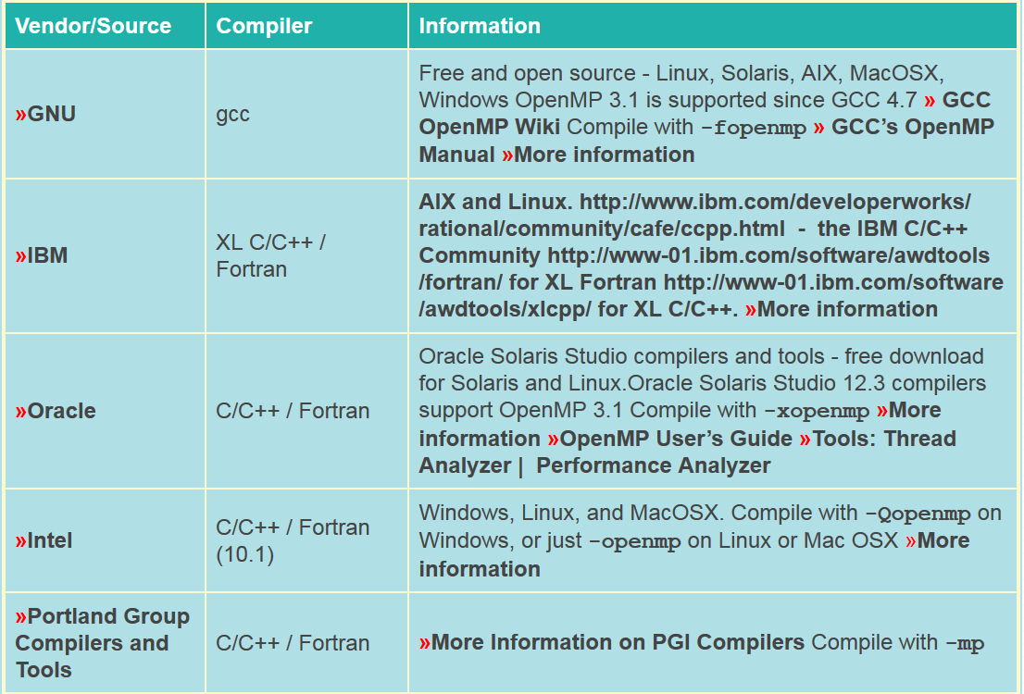
Most of the constructs in OpenMP are compiler directives or pragmas

Slide 6
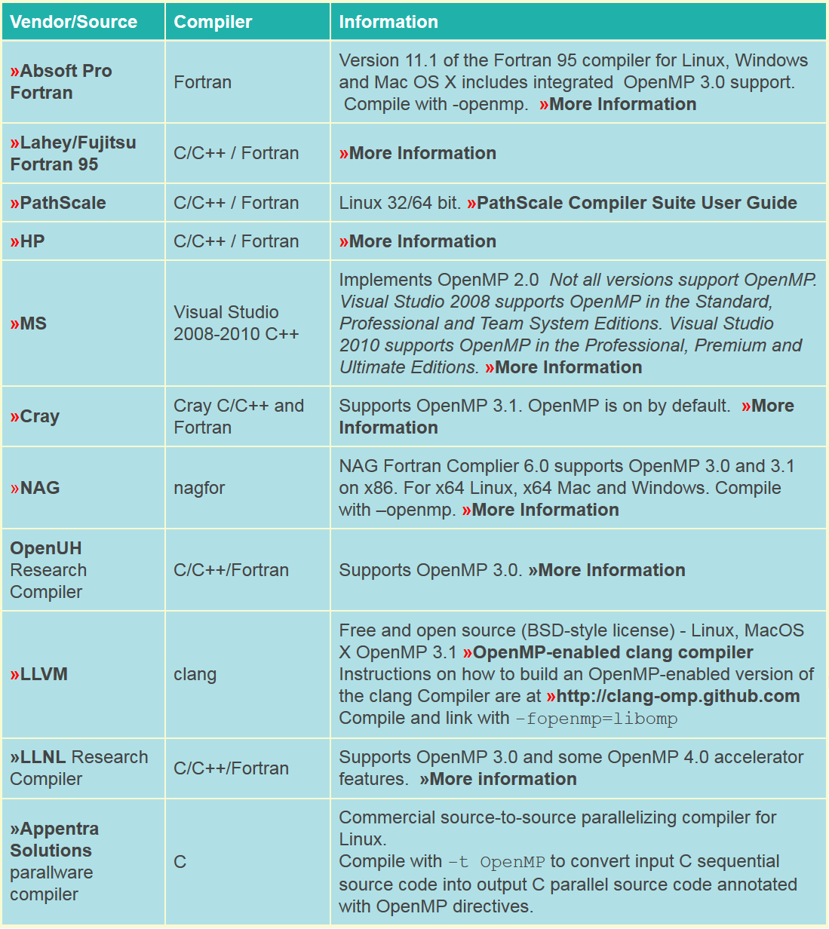

Slide 7
For C and C++, the OpenMP pragmas take the form:
Usually must also include <omp.h> if using OpenMP API functions
Needed for use in most compilers such as icc, gcc, and g++
May also require additional parameters (clauses) after the construct for different options.
#pragma omp construct [clause [clause]…]

Slide 8
#pragma omp construct [clause [clause]…]
Many OpenMP constructs apply to code segments that are specified as a Structured Block.
Structured Blocks are a single program statement or set of statements that act as a unit.
In C/C++ for cases where there is more than one programming statement the { and } brackets are used to indicate the beginning and ending of the Structured Block
There must be only one control entry point and only one control exit point
Structured Blocks generally follow the OpenMP pragma

Slide 9
Parallel Region & Structured Blocks (C/C++)
OpenMP constructs apply to structured blocks
Structured block: a block with one point of entry at the top and one point of exit at the bottom
#pragma omp parallel
{
int id = random() % N;
more: res[id] = do_big_job (id);
if (conv(res[id])) goto more;
}
printf (“All done\n”);
if (go_now()) goto more;
#pragma omp parallel
{
int id = random() % N;
more: res[id] = do_big_job(id);
if (!conv(res[id])) goto done;
goto more;
}
done: if (!really_done()) goto more;
A structured block
Not a structured block
9

Slide 10
The parallel construct creates a team of threads with a specified Structured Block being executed by the multiple threads in parallel.
The exact number of threads in the team determined by one of several ways.
(clause in the construct, environment variable, or API function call)
Other directives used within a parallel construct to specify parallel for loops and different blocks of code for threads.

Slide 11
Parallel Construct
#pragma omp parallel
structured_block
creates multiple threads, each one executing the specified structured_block,
either a single statement or multiple statements using { ...} with a single entry point and a single exit point.
There is an implicit barrier at the end of the construct.
This construct corresponds to the general forall construct.

Slide 12
Setting the Number of threads
Established by either:
num_threads clause after the parallel construct, or
omp_set_num_threads() library routine being previously
the environment variable OMP_NUM_THREADS is defined in the order given or is system dependent if none of the above.
Number of threads available can also be altered automatically to achieve best use of system resources by a “dynamic adjustment” mechanism.
Master Thread
Parallel Regions

Slide 13
Data Scoping – What’s shared
OpenMP uses a shared-memory programming model
Shared variable - a variable whose name provides access to a the same block of storage for each thread
The OpenMP shared clause can be used to make items explicitly shared
Global variables are shared among tasks
C/C++: File scope variables, namespace scope variables, static variables, Variables with const-qualified type having no mutable member are shared.
Static variables which are declared in a scope inside the construct are also shared.
13

Slide 14
Data Scoping – What’s private
Not everything is shared...
Examples of implicitly determined private variables include:
Stack (local) variables in functions called from parallel regions are PRIVATE
Automatic variables within a statement block are PRIVATE
Loop iteration variables on worksharing construct are PRIVATE
Implicitly declared private variables within tasks will be treated as firstprivate
14

Slide 15
private Clause
Reproduces the variable for each task
Variables are un-initialized; C++ object is default constructed
Any value external to the parallel region is undefined
void* work(float* c, int N) {
float x, y;
int i, j;
#pragma omp parallel for private(x, y, j)
for (i = 0; i < N; i++) {
x = a[i];
for (j = 0; j < N; j += (i+1)) {
y = b[j];
c[i] = x + y;
}
}
}
15

Slide 16
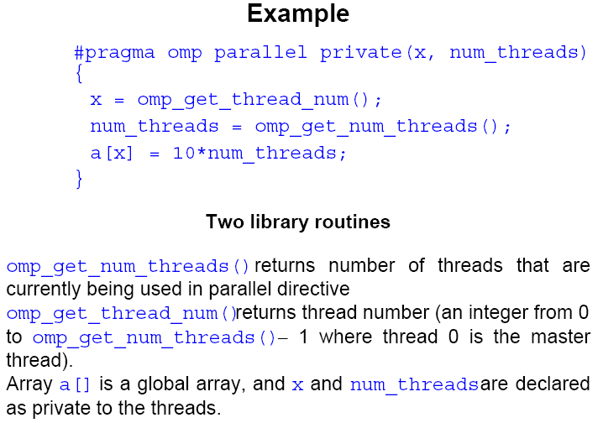

Slide 17
Work-Sharing
Worksharing is the general term used in OpenMP to describe distribution of work across threads.
Three examples in this classification:
omp sections construct
omp for construct
omp single construct
omp task construct {to be discussed later}
In all cases, there is an implicit barrier at the end of the construct unless a nowait clause is included.
Note that these constructs do not start a new team of threads. That done by an enclosing parallel construct.

Slide 18
Sections
The construct
#pragma omp sections
{
#pragma omp section
structured_block
#pragma omp section
structured_block
.
.
.
}
cause the structured blocks to be shared among threads in team.
#pragma omp sections precedes the set of structured blocks.
#pragma omp section prefixes each structured block.
Note: main thread will not leave it until all sections have been executed: -- The first section construct is optional.

Slide 19
For Loop
#pragma omp for
for_loop
causes the for loop to be divided into parts and parts shared among threads in the team. The for loop must be of a simple form.
Way that for loop divided can be specified by an additional “schedule” clause.
Example: the clause schedule (static, chunk_size) cause the for loop be divided into sizes specified by chunk_size and allocated to threads in a round robin fashion.

Slide 20
schedule Clause
The schedule clause affects how loop iterations are mapped onto threads
Blocks of iterations of size “chunk” to threads
Round robin distribution
Low overhead, may cause load imbalance
schedule(static [,chunk])
20

Slide 21
schedule Clause Example
#pragma omp parallel for schedule (static, 8)
for( int i = 3; i <= end; i += 2 )
{
if ( TestForPrime(i) ) gPrimesFound++;
}
Iterations are divided into chunks of 8
Since the first value assigned to i is 3, the first chunk is
{3,5,7,9,11,13,15,17}
21

Slide 22
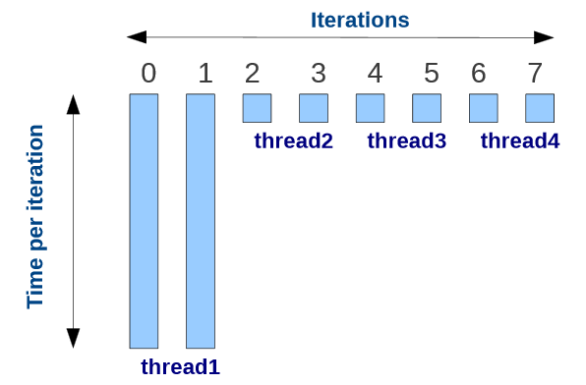
Issues with Static schedule Clause
Having the number of iterations distributed as evenly as possible among all OpenMP threads is not always the best way to partition the problem!
Example:
Note the load imbalance!
Threads 2, 3, and 4 will have to wait for thread 1 to finish!
22

Slide 23
schedule Clause
The schedule clause affects how loop iterations are mapped onto threads
Blocks of iterations of size “chunk” to threads
Round robin distribution
Low overhead, may cause load imbalance
Threads grab “chunk” iterations
When done with iterations, thread requests next set
Can reduce load imbalance, Significant Overhead involved compared to static scheduling.
Similar to dynamic but chunk size is relative to number of iterations that remain to be executed
Dynamic schedule starting with large block
Size of the blocks shrink; no smaller than “chunk”
schedule(static [,chunk])
schedule(dynamic[,chunk])
schedule(guided[,chunk])
23

Slide 24
Ordered
Used in conjunction with for and parallel for construct to cause an iteration to be executed in the order that it would have occurred if written as a sequential loop.
Usage:
The omp ordered directive must be used as follows:
It must appear within the extent of a omp for or omp parallel for construct containing an ordered clause.
It applies to the statement block immediately following it. Statements in that block are executed in the same order in which iterations are executed in a sequential loop.
An iteration of a loop must not execute the same omp ordered directive more than once.
An iteration of a loop must not execute more than one distinct omp ordered directive.

Slide 25
Ordered
#pragma omp for ordered
for (i=0; i<n; i++)
{
...
if (i <= 10)
{
...
#pragma omp ordered
{ ... }
}
...
(i > 10)
{
...
#pragma omp ordered
{ ... }
}
...
}

Slide 26
Single
The directive
#pragma omp single
structured block
cause the structured block to be executed by one thread only.
Notes:
The thread that executes the block is not necessarily the master.
Other threads will wait
Useful to fix sections of thread-unsafe code
Useful for I/O operations

Slide 27
Combined Parallel Work-sharing Constructs
If a parallel construct followed by a single for construct, it can be combined into:
#pragma omp parallel for
for_loop
with similar effects, i.e. it has the effect of each thread executing the same for loop.

Slide 28
Combining constructs
These two code segments are equivalent
#pragma omp parallel
{
#pragma omp for
for (i = 0;i < MAX; i++) { res[i] = huge();
}
}
#pragma omp parallel for
for (i = 0;i < MAX; i++) {
res[i] = huge();
}
28

Slide 29
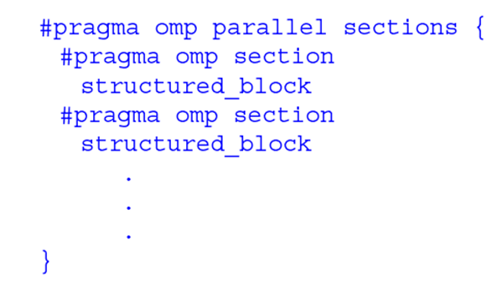
If a parallel construct is followed by a single sections construct they can be combined into
Note: in both cases, the nowait clause is not allowed.

Slide 30
Master Construct
#pragma omp master
structured_block
causes the master thread to execute the structured block.
Different to those in the work sharing group in that there is no implied barrier at the end of the construct (nor the beginning). Other threads encountering this directive will ignore it and the associated structured block, and will move on.
#pragma omp parallel
{
DoManyThings();
#pragma omp master
{ // if not master skip to next stmt
ExchangeBoundaries();
}
DoManyMoreThings();
}

Slide 31
Synchronization Constructs
Critical
The critical construct will only allow one thread execute the
associated structured block.
#pragma omp critical name
structured_block
When one or more threads reach the critical construct:
They will wait until no other thread is executing the same critical section (one with the same name),
Then one thread will proceed to execute the structured block. name is optional.
All critical sections with no name map to one undefined name.

Slide 32
critical Construct
Defines a critical region on a structured block
#pragma omp critical [(lock_name)]
Threads wait their turn
Only one thread at a time calls Consum() and updates RES (preventing race condition)
Naming the critical construct RES_lock is optional
float RES;
#pragma omp parallel
{ float B;
#pragma omp for for(int i = 0; i < niters; i++){
B = Big_Job(i);
#pragma omp critical (RES_lock) RES += Consum(B);
} }
Good Practice – Name all critical sections

Slide 33
reduction Clause
The variables in “list” must be shared in the enclosing parallel region
Inside parallel or work-sharing region:
A PRIVATE copy of each list variable is created and initialized depending on the “op”
These copies are updated locally by threads
At end of construct, local copies are combined through “op” into a single value and combined with the value in the original SHARED variable
reduction (op : list)

Slide 34
Example – Dot Product
Private copy of sum for each thread is created
Initialized to zero
At end of parallel region, all private copies of sum added together and result stored in shared variable
#pragma omp parallel for reduction(+:sum)
for(i = 0; i < N; i++) {
sum += a[i] * b[i];
}

Slide 35
C/C++ Reduction Operations
A range of associative operands can be used with reduction
Initial values are the ones that make sense mathematically
Typically identity element of operation
Operand | Initial Value
+ | 0
* | 1
- | 0
^ | 0
Operand | Initial Value
& | ~0
| | 0
&& | 1
|| | 0

Slide 36
Barrier
#pragma omp barrier
When a thread reaches the barrier it waits until all threads have reached the barrier and then they all proceed together.
There are restrictions on the placement of barrier directive in a program.
i.e. all threads must be able to reach the barrier.

Slide 37
barrier directive
Explicit barrier synchronization
Each thread waits until all threads arrive
#pragma omp parallel shared (A, B, C) { DoSomeWork(A,B); cout << “Processed A into B” << endl; #pragma omp barrier DoSomeWork(B,C); cout << “Processed B into C” << endl; }

Slide 38
Implicit Barriers
Several OpenMP constructs have implicit barriers
Parallel region – necessary barrier – cannot be removed
Loop worksharing (parallel for) construct
single construct
Unnecessary barriers hurt performance and can be removed with the nowait clause
The nowait clause is applicable to:
Loop worksharing (parallel for) construct
single construct

Slide 39
nowait Clause
Use when threads unnecessarily wait between independent computations
#pragma omp for nowait
for(...)
{...};
#pragma single nowait
{ [...] }
#pragma omp for schedule(dynamic,1) nowait
for(int i=0; i<n; i++)
a[i] = bigFunc1(i);
#pragma omp for schedule(dynamic,1)
for(int j=0; j<m; j++)
b[j] = bigFunc2(j);

Slide 40
Atomic
#pragma omp atomic
expression_statement
The atomic construct implements a critical section efficiently when the critical section simply updates a variable (adds one, subtracts one, or does some other simple arithmetic operation as defined by expression_statement).

Slide 41
atomic directive
Applies only to simple update of memory location
#pragma omp parallel for shared(x, y, index, n)
for (i = 0; i < n; i++) {
#pragma omp atomic
x[index[i]] += Work1(i);
y[i] += work2(i);
}
#pragma omp parallel for shared(x, y, index, n)
for (i = 0; i < n; i++) {
#pragma omp critical
x[index[i]] += Work1(i);
y[i] += work2(i);
}

Slide 42
Flush Directive
A synchronization point which causes thread to have a “consistent” view of certain or all shared variables in memory.
All current read and write operations on the variables allowed to complete and values written back to memory but any memory operations in the code after flush are not started, thereby creating a “memory fence”.
Format:
#pragma omp flush (variable_list)
Only applied to thread executing flush, not to all threads in the team.
Flush occurs automatically at the entry and exit of parallel and critical constructs (and combined parallel for and parallel sections constructs), and at the exit of for, sections, and single (if a no-wait clause is not present).

Slide 43
Flush Directive
Format:
#pragma omp flush (variable_list)
Flush occurs automatically at the entry and exit of parallel and critical constructs (and combined parallel for and parallel sections constructs), and at the exit of for, sections, and single (if a no-wait clause is not present).
In order to see a consistent value for a variable between two threads, this order must happen:
The value is written to the variable by the first thread
The variable is flushed by the first thread
The variable is flushed by the second thread
The value is read from the variable by the second thread

Slide 44
Nested Parallel Regions
If not supported or disabled, a parallel region nested within another parallel region results in the creation of a new team, consisting of one thread, by default.
Use the omp_get_nested() library function to determine if nested parallel regions are enabled.
The two methods available for enabling nested parallel regions (if supported) are:
1. The omp_set_nested() library routine
2. Setting of the OMP_NESTED environment variable to TRUE

Slide 45
Locks in OpenMP
OpenMP also does include locks as well as critical and atomic sections.
critical sections are the most common way to handle mutual exclusion issues.
Locks provide greater flexibility
Possible to implement asynchronous behavior
Can apply to sub-elements of a structured block
OpenMP API calls must be used to access and manipulate locks.
Behavior of uninitialized locks undefined

Slide 46
Locks in OpenMP
Simple locks: Locks that can not be locked if already in a locked state
Nestable locks: Locks that can be locked multiple times by the same thread before being unlocked.
Lock variable types:
Simple Locks: omp_lock_t
Nestable Locks: omp_nest_lock_t
Simple Locks
Nestable Locks
omp_init_lock
omp_destroy_lock
omp_set_lock
omp_unset_lock
omp_test_lock
omp_init_nest_lock
omp_destroy_nest_lock
omp_set_nest_lock
omp_unset_nest_lock
omp_test_nest_lock

Slide 47
New Addition to OpenMP
Tasks – Main change for OpenMP 3.0
Allows parallelization of irregular problems
unbounded loops
recursive algorithms
producer/consumer algorithms

Slide 48
What are tasks?
Tasks are independent units of work
Threads are assigned to perform the work of each task
Tasks may be deferred or executed immediately
The OpenMP runtime system decides
Tasks are composed of:
code to execute
data environment
internal control variables (ICV)
Serial
Parallel

Slide 49
Task Construct – Explicit Task View
(Linked List Example)
A Team of threads is created within a parallel region
A single thread, T0, is chosen
T0 executes the while loop, creates tasks, and fetches next pointers
Each task runs in its own thread
Threads wait at single barrier; proceed when all tasks done
#pragma omp parallel
{
#pragma omp single
{ // block 1
node * p = head;
while (p) {
#pragma omp task firstprivate(p)
process(p); // block 2
p = p->next; // block 3
}
} // tasks done
}
49

Slide 50
Why are tasks useful?
Single Threaded
T0 T1 T2 T3
Potential to parallelize irregular patterns and recursive function calls
Block 1
Block 1
Block 2 Task 1
Block 3
Block 2 Task 1
Block 3
Block 2 Task 2
#pragma omp parallel
{
#pragma omp single
{ // block 1
node * p = head;
while (p) {
#pragma omp task firstprivate(p)
process(p); // block 2
p = p->next; // block 3
}
} // tasks done
}
Block 3
Block 2 Task 3
Idle
Idle
Block 2 Task 2
Time
Block 3
Time Saved
Block 2 Task 3
50

Slide 51
When are tasks complete?
At thread or task barriers
At implicit barrier of single thread spawning tasks
At the directive: #pragma omp barrier
#pragma omp parallel
{
#pragma omp single nowait // implied barrier removed by nowait
{ // block 1
node * p = head;
while (p) {
#pragma omp task firstprivate(p)
process(p); // block 2
p = p->next; // block 3
}
} // tasks done
} // End of parallel region – implied barrier still present
At the directive: #pragma omp taskwait
Explicitly wait on the completion of child tasks

Slide 52
OpenMP 4.0 Main Tasking Extensions
The depend clause to support task dependences
Forces additional constraints on task scheduling
Expressed through: list item(s) + dependence type
Dependence types are: in, out and inout
The taskgroup construct
Specifies to wait on completion of child tasks and their descendant tasks
Note: taskwait only joins direct child tasks

