Slide 1
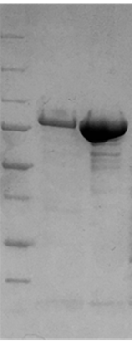
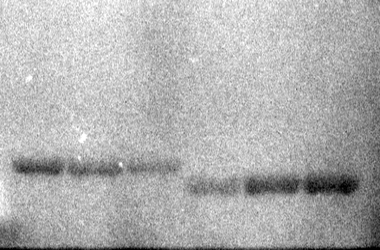
a
b
250
150
CheA
iLOV-CheA
100
75
50
25
20

