Slide 1
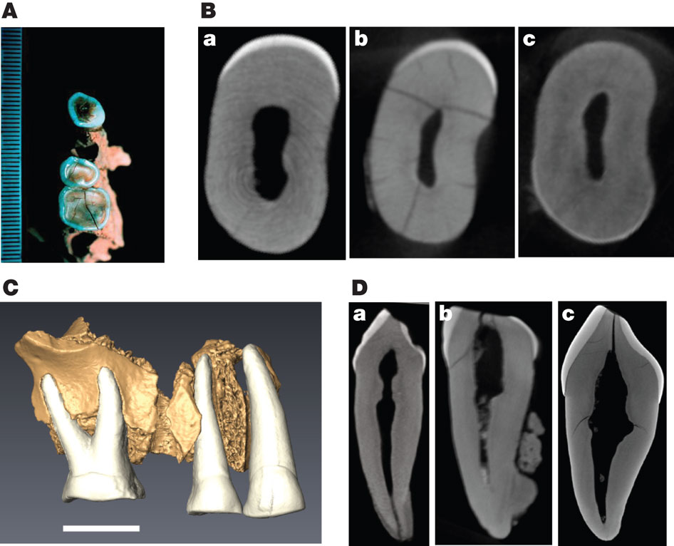

Morphology of the KC4 maxilla.
T Higham et al. Nature 000, 1-4 (2011) doi:10.1038/nature10484

