Slide 1
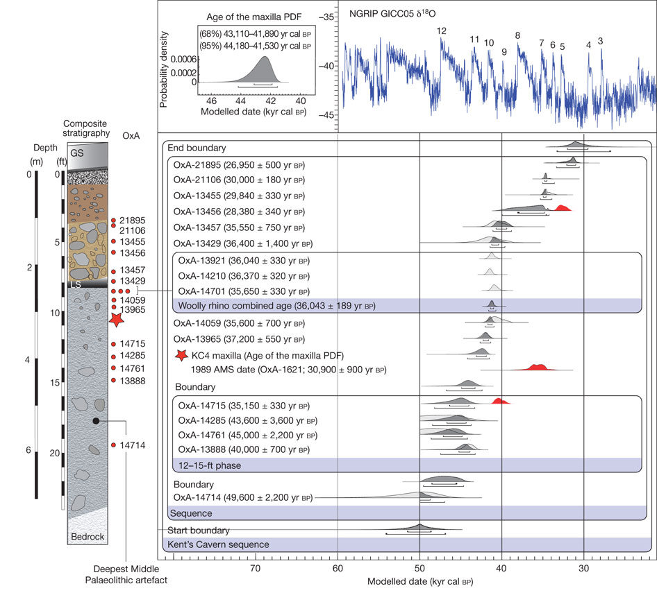

Bayesian age model for Kent’s Cavern.
T Higham et al. Nature 000, 1-4 (2011) doi:10.1038/nature10484

