Slide 1
2. Software Architecture Style （软件体系结构风格）

Slide 2
Agenda
Taxonomy of styles
Data Flow
Call/Return
Data-centered
Virtual Machine
Independent Component
Other styles

Slide 3
软件体系结构的定义
SA = {Components, Connectors, Constraints}
构件（Components）是功能单元，执行预定义的服务并且与其他构件交互。
连接器（ Connectors ）定义交互协议与策略。
约束（Constraints） 定义了系统必须服从的规则。
------------- Garlan and Shaw

Slide 4

Coupling（耦合） and Cohesion（内聚）
Architectural Building blocks:

Slide 5
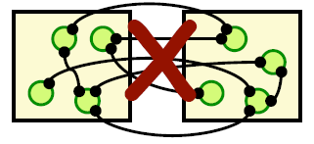
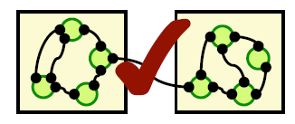
Coupling（耦合） and Cohesion（内聚）
A good architecture:
Minimizes coupling between modules
Goal: modules don’t to know much about one another to interact
Low coupling makes future change easier
Maximizes the cohesion of each module
Goal: the contents of each module are strongly inter-related
High cohesion makes a module easier to understand

Slide 6
Architectural Styles
A style
describes a class of architectures（描述一类体系结构）
is independent on the problems（独立于实际问题，强调了软件系统中通用的组织结构）
is found repeatedly in practice（在实践中被多次设计、应用）
is a package of design decisions（是若干设计思想的综合）
has known properties that permit reuse（具有已经被熟知的特性，并且可以复用）
Notes:
体系结构风格反映了领域中众多系统所共有的结构和语义特性，并指导如何将各个模块和子系统有效地组织成一个完整的系统。按这种方式理解，软件体系结构风格定义了用于描述系统的术语表和一组指导构件系统的规则。
对软件体系结构风格的研究和实践促进对设计的重用，一些经过实践证实的解决方案也可以可靠地解决新的问题。体系结构风格的不变部分使不同的系统可以共享同一个实现代码。
是软件工程成熟的标志
软件体系结构风格style，模式pattern和习语idiom

Slide 7
软件体系结构风格的概念
软件体系结构风格（Architectural Style）
一种体系结构风格以结构组织模式定义了一个系统家族
关于构件和连接件类型的术语；一组约束对它们组合方式的规定；一个或多个语义模型，规定了如何从各成分的特性决定系统整体特性
概括地说，一种软件体系结构风格刻画一个具有共享结构和语义的系统家族

Slide 8
Benefits of Using Styles
Design reuse
Well-understood solutions applied to new problems
Code reuse
Shared implementations of invariant aspects of a style
Understandability of system organization
A phrase such as “client-server” conveys a lot of information
Interoperability（互操作）
Supported by style standardization
Style-specific analyses
Enabled by the constrained design space
Visualizations
Style-specific depictions matching engineers’ mental models

Slide 9
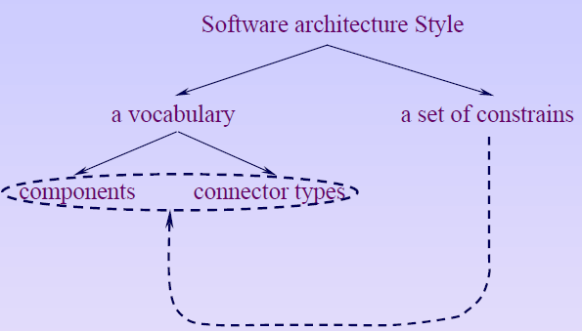
Software Architectural Style
软件体系结构风格（Software architecture style）是描述某一特定应用领域中系统组织方式的惯用模式（idiomatic paradigm）。
软件体系结构风格定义了用于描述系统的术语表和一组指导构建系统的规则。

Slide 10
Style Analysis Dimensions
What is the design vocabulary（设计词汇表）?
Component and connector types
What are the allowable structural pattern?
What is the underlying computational model?
What are the essential invariants（基本不变性） of the style?
What are some common examples of its use?
What are the advantages and disadvantages of using that style?
What are some of the common specializations?
Notes:
讨论体系结构风格时要回答的问题是：
（１）设计词汇表是什么？
（２）构件和连接件的类型是什么？
（３）可容许的结构模式是什么？
（４）基本的计算模型是什么？
（５）风格的基本不变性是什么？
（６）其使用的常见例子是什么？
（７）使用此风格的优缺点是什么？
（８）其常见的特例是什么？
The description of each pattern includes notes on (Mary Shaw)
• Problem: What problem the pattern addresses. That is, what
characteristics of the application requirements lead the designer to select
this pattern?
• Context: What aspects of the setting (computation environment or
other constraints on the implementation) constrain the designer in the use
of this pattern?
• Solution: The system model captured by the pattern, together with the
components, connectors, and control structure that make up the pattern.
• Diagram: A figure showing a typical pattern, annotated to show the
components and connectors.
• Significant Variants: For some patterns, notes some major variants
of the basic pattern.
• Examples: References to examples or more extensive overviews of
systems that apply this pattern

Slide 11
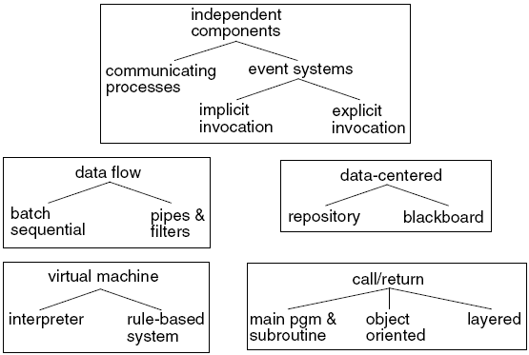
Taxonomy of Styles
Garlan和Shaw给出了通用体系结构风格的分类（a list of common architectural styles）

Slide 12
Notes about Architecture Styles
特别注意：体系结构风格不是堆软件进行分类的标准，它仅仅是描述软件的不同角度而已
例如，一个系统采用了分层风格，但这并不妨碍它用面向对象的方法来实现。
There is no complete list（没有完备的列表）
Styles overlap（风格是彼此重叠的）
Systems exhibit multiple styles at once（一个系统通常表现出多种风格）
同一个系统采用多种风格形成了所谓体系结构风格的异构组合。

Slide 13
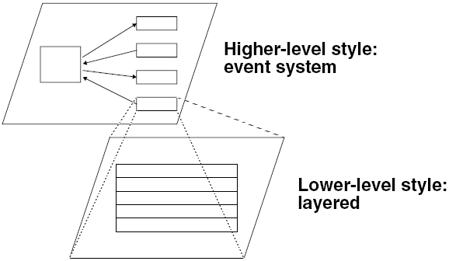
Heterogeneous(异构) Styles
A system need not be comprised of only one style
A single (part of a) system may be viewed as several style concurrently.
Notes:
heterogeneous：异构的

Slide 14
Agenda
Taxonomy of style
Data Flow
Call/Return
Data-centered
Virtual Machine
Independent Component
Other styles

Slide 15
Data Flow Style
A data flow system is one in which
the availability of data controls the computation（由数据控制计算）
the structure of the design is dominated by orderly motion of data from process to process（系统结构由数据在处理之间的有序移动决定）
the pattern of data flow is explicit（数据流系统的结构是显而易见的）
In a pure data flow system, there is no other interaction between processes（在纯数据流系统中，处理之间除了数据交换，没有任何其他的交互）
Notes:
数据流样式的目标是实现可重用性和可更改性。数据流样式的特点是把系统看做是对相继输入数据的一系列变换。

Slide 16
Data Flow Style
There are variety of variations on this genera theme:
how control is exerted (e.g., push versus pull)（如何施加控制（比如：推还是拉））
degree of concurrency between processes（处理之间并行的程度）
topology（拓扑结构）
Notes:
exert: 运用，发挥

Slide 17
Data Flow Styles
Components: Data Flow Components
Interfaces are input ports and output ports（组件接口是输入端口和输出端口）
Computational model: read data from input ports, compute, write data to output ports（计算模型：从输入端读数据，计算，将计算结果写到输出端）
Connectors: Data Streams
Uni-directional（单向）
usually asynchronous, buffered （通常是异步的，有缓冲）
Interfaces are reader and writer roles
Systems
Arbitrary graphs（任意拓扑结构）
Computational model: functional composition

Slide 18
Patterns of Data Flow in Systems
In general, data can flow in arbitrary patterns（一般情况，数据的流向无序）
Often we are primarily interested in nearly linear data flow systems（我们主要研究近似线性数据流）
or in very simple, highly constrained cyclic structures（或者是在限度内的循环数据流）
Notes:
第一个体系结构可用吗？
如果数据流如此混乱，说明我们选择的体系结构不对

Slide 19
Control Flow vs. Data Flow
Control Flow (typical case in procedural systems)
Dominant question is how locus of control moves through the program（主要问题是控制点怎样在程序或系统之间移动）
Data may accompany the control but is not the driving force（数据可能跟着控制走，但是并不起推动系统运转的作用）
Primary reasoning is about order of computation（关注的核心是计算顺序）
Data Flow
Dominant question is how data moves through a collection of (atomic) computations（主要问题是数据怎样在运算单元之间流动）
As data moves, control is “activated”（数据到了，控制（计算）单元便开始工作）
We reason about data availability, transformations, latency, …（我们关心数据是否可用，转换，延时……）

Slide 20
Three Examples of Data Flow
Batch Sequential（批处理）
Pipe-and-Filter（管道-过滤器）
Process Control（过程控制）

Slide 21
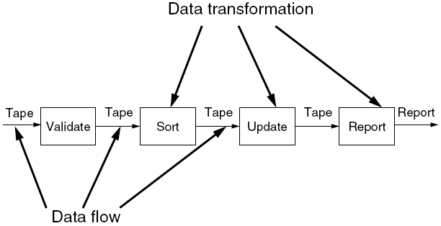
Batch Sequential
Notes:
处理步骤或组件是独立的程序，并且假定要等到一个步骤全部完成后才能开始下一个步骤。在各个步骤之间，每一批数据都作为一个整体传送。

Slide 22
Batch Sequential: Model
Processing steps are independent programs（每个处理步骤是一个独立的程序）
Each step runs to completion before next step starts（每一步必须在前一步结束后才能开始）
Data transmitted as a whole between steps（数据必须是完整的，以整体的方式传递）
Typical applications:
classical data processing（传统的数据处理）
program compilation（程序编译）/computer aided software engineering

Slide 23
Pipe-and-Filter
在管道-过滤器风格下，每个功能模块都有一组输入和输出。功能模块称作过滤器（filter）；功能模块间的连接可以看作输入、输出数据流之间的通路，称作管道（pipe）。
管道-过滤器风格的特性之一在于过滤器的相对独立性，即过滤器独立完成自身功能，相互之间无需进行状态交互。

Slide 24
Pipe-and-Filter
过滤器是独立运行的构件
非邻近的过滤器之间不共享状态
过滤器自身无状态
过滤器对其处理上下连接的过滤器“无知”
对相邻的过滤器不施加任何限制
结果的正确性不依赖于各个过滤器运行的先后次序
各过滤器在输入具备后完成自己的计算。
完整的计算过程包含在过滤器之间的拓扑结构中。

Slide 25
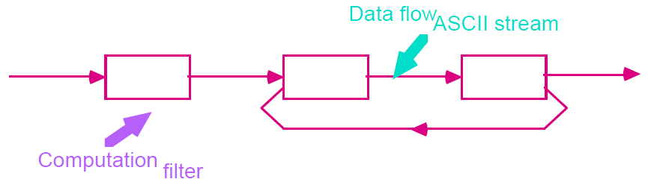
Pipe-and-Filter
Notes:
管道过滤器样式强调相继组件对数据的渐进转换。在UNIX系列的操作系统中采用了这种样式。

Slide 26
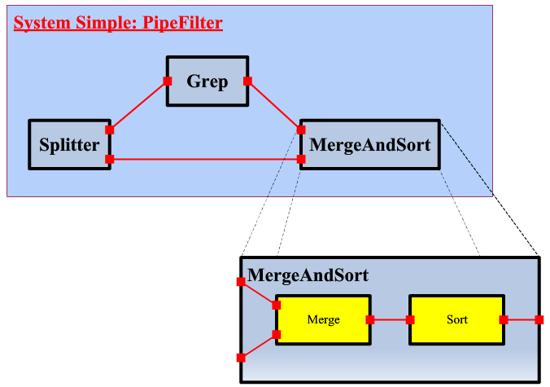
Pipe-and-Filter
一个采用了嵌套的管道过滤器的系统示例：

Slide 27
Pipe-and-Filter: Examples
Unix系统中的管道过滤器结构
ls -al | grep my
DOS中的管道命令
DOS允许在命令中出现用“|”分开的多个命令，将“|”之前的命令的输出，作为“|”之后命令的输入，这就是“管道功能”，“|”是管道操作符。

Slide 28
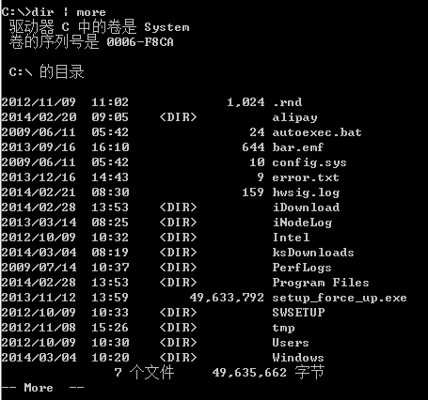
Pipe-and-Filter: Examples
dir | more
Notes:
dir | more使得当前目录列表在屏幕上逐屏显示。Dir的输出是整个目录列表，它不出现在屏幕上是由于符号“|”的规定，成为下一个命令more的输入，more命令将其输入一屏一屏的显示，成为命令行的输出。

Slide 29
Pipe-and-Filter: Advantages
使得软件构件具有良好的隐蔽性和高内聚、低耦合的特点
设计者可以将整个系统的输入输出特性理解为各个过滤器功能的简单合成
支持功能模块的重用：任意两个过滤器只要相互间所传输的数据格式上达成一致，就可以连接在一起
系统容易维护和扩展：新的过滤器容易加入到系统中，旧的过滤器也可被改进的过滤器替换
支持某些特定属性的分析，如吞吐量和死锁检测
支持并发执行，每个过滤器既可以独立运行，也可以与其他过滤器并发执行（并行？并发？）

Slide 30
Pipe-and-Filter: Disadvantages
由于过滤器的传输特性，这种模式通常不适合于交互性很强的应用。
因为在数据传输上没有通用的标准，每个过滤器都增加了解析和合成数据的工作，这会导致系统性能的下降，也会增加编写过滤器的复杂性（数据格式转换与映射）。

Slide 31
Batch Sequential vs Pipe & Filter
Both decompose task into fixed sequence of computations, interact only through data passed from one to another.（把任务分解成为一系列固定顺序的计算单元(组件)，组件间只通过数据传递交互。）
Batch Sequential | Pipe/Filter
total | incremental
High latency (real-time is hard) | Results start immediately
Random access to input ok | Processing localized in input
No concurrency | Feedback loops possible
Non-interactive | Often interactive, awkwardly
Notes:
Awkwardly:笨拙的

Slide 32
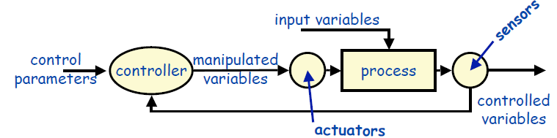
Process Control
Examples
Aircraft/spacecraft flight control systems
Controllers for industrial production lines, power stations
Chemical engineering
Interesting properties
Separates control policy from the controlled process
Handles real-time, reactive computations
Disadvantages
Difficult to specify the timing characteristics and response to disturbances

Slide 33
Agenda
Taxonomy of styles
Data Flow
Call/Return
Data-centered
Virtual Machine
Independent Component
Other styles

Slide 34
Call/Return
Main program and subroutines
Classical programming paradigm-functional decomposition
Object-Oriented/Abstract Data Types
Information (representation, access method) hiding
Layered hierarchies
Each level only communicates with its immediate neighbors
Other
Client-server
……

Slide 35
History
Main program and subroutines
Decomposition into processing steps with single-threaded control（单线程控制，划分为若干处理步骤）
Functional modules
Aggregation of processing steps into modules（把处理步骤集成到模块内）
Abstract Data Types
Bundle operations and data, hide representations and other secrets（操作和数据捆绑在一起，隐藏实现和其他秘密）

Slide 36
History
Objects
Methods (bound dynamically), polymorphism (subtypes), reuse (through inheritance)（方法（动态绑定），多态（子类），重用（继承））
OO Architectures
Objects as separate processes/threads（对象作为不同的进程/线程）
Client-server, tiered styles
Components
Multiple interfaces, binary compatibility, advanced middleware （多个接口，二进制兼容，高级中间件）

Slide 37
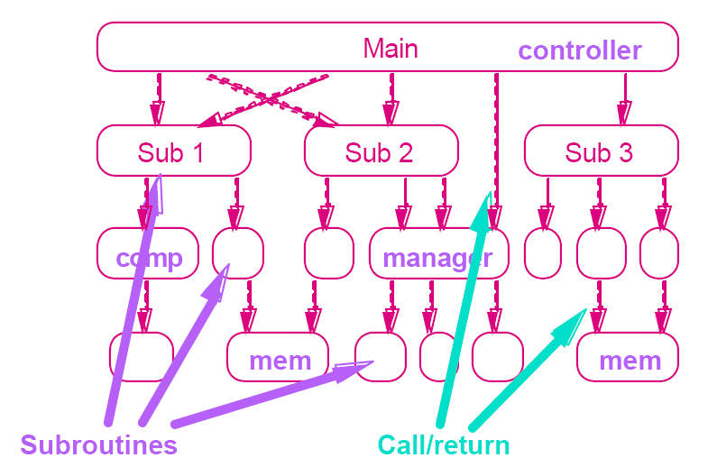
Main Program and Subroutine

Slide 38
Main Program and Subroutine
Problem:
This pattern is suitable for applications in which the computation can appropriately be defined via a hierarchy of procedure definitions.
Context:
Many programming languages provide natural support for defining nested collections of procedures and for calling them hierarchically. These languages often allow collections of procedures to be grouped into modules, thereby introducing name-space locality. The execution environment usually provides a single thread of control in a single name space.
Notes:
Significant Variants: The model of procedure call as the organizing principle is preserved across processes through the Remote Procedure Call (RPC). Although RPC is typically implemented by communication messages, the abstraction it presents is of single-threaded procedure call.

Slide 39
Main Program and Subroutine
Solution:
System model: call and definition hierarchy, subsystems often defined via modularity
Components: procedures and explicitly visible data
Connectors: procedure calls and explicit data sharing
Control structure: single thread
Notes:
Significant Variants: The model of procedure call as the organizing principle is preserved across processes through the Remote Procedure Call (RPC). Although RPC is typically implemented by communication messages, the abstraction it presents is of single-threaded procedure call.

Slide 40
Main Program and Subroutine: Model
Hierarchical decomposition:
Based on definition-use relationship
Uses procedure call as interaction mechanism
Single thread of control:
Supported directly by programming languages
Hierarchical reasoning:
Correctness of a subroutine depends on the correctness of the subroutines it calls
Subsystem structure implicit:
Subroutines typically aggregated into modules

Slide 41
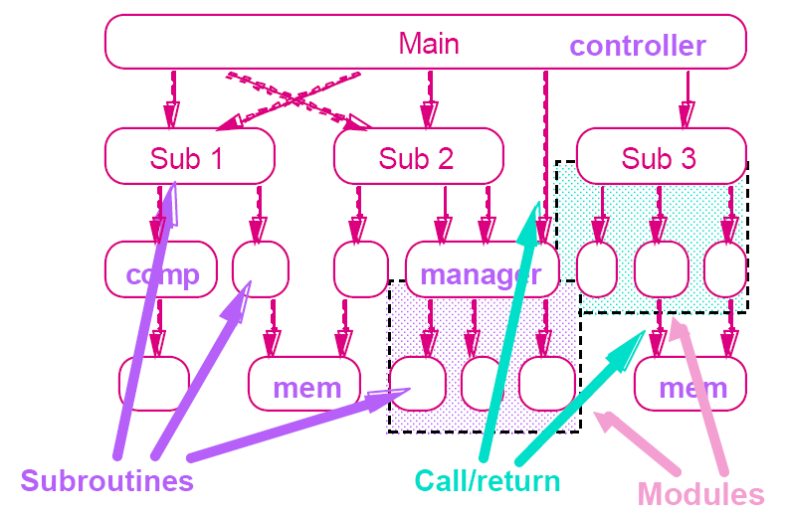
Main Program and Subroutine

Slide 42
Pipes vs Procedures
 | Pipes | Procedures
Control | Asynchronous, data-driven | Synchronous, blocking
Semantics | Functional | Hierarchical
Data | Streamed | Parameter / return value
Variations | Buffering, end-of-file behavior | Binding time, exception handling, polymorphism

Slide 43
Criteria for Modularization
What is a module?
Common view: a piece of code. But too limited.
Compilation unit, including related declarations and interface
Parnas: a unit of work.
Why modularize a system, anyway?
Management: Partition the overall development effort
divide and conquer （分而治之）
Evolution: Decouple parts of a system so that changes to one part are isolated from changes to other parts
Understanding: Permit system to be understood as composition of mind-sized chunks
Key issue: what criteria to use for modularization
Notes:
David L Parnas

Slide 44
Module Decomposition
Parnas
Hide secrets. OK, what’s a “secret”?
Representation of data
Properties of a device, other than required properties
Mechanisms that support policies
Try to localize future change
Hide system details likely to change independently
Expose in interfaces assumptions unlikely to change
Use functions to allow for change
They’re easier to change than visible representation

Slide 45
Encapsulation/Information Hiding
Parnas: Hide secrets (not just representations)
Booch: Object’s behavior is characterized by actions that it suffers and that it requires
Practically speaking:
Object has state and operations, but also has responsibility for the integrity of its state
Object is known by its interface
Object is probably instantiated from a template
Object has operations to access and alter state and perhaps generator
There are different kinds of objects (e.g., actor, agent, server)

Slide 46
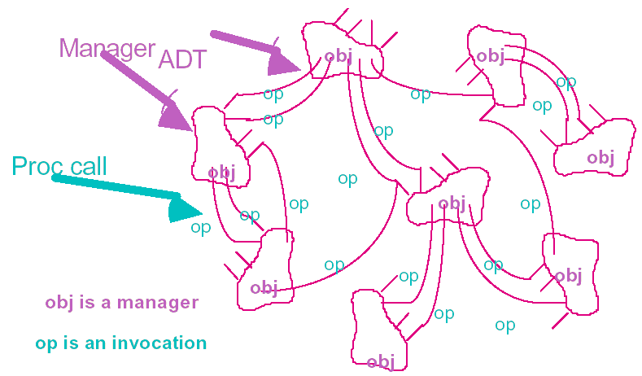
Data Abstraction or Object-Oriented

Slide 47
Data Abstraction or Object-Oriented
Problem: This pattern is suitable for applications in which a central issue is identifying and protecting related bodies of information, especially representation information.
Context: Numerous design methods provide strategies for identifying natural objects. Newer programming languages support various variations on the theme, so if the language choice or the methodology is fixed, that will strongly influence the flavor of the decomposition.
Solution:
System model: localized state maintenance
Components: managers (e.g., servers, objects, abstract data types)
Connectors: procedure call
Control structure: decentralized, usually single thread

Slide 48
Elements of Object Architectures
Encapsulation: Restrict access to certain information（封装：限制对某些信息的访问）
Interaction: Via procedure calls or similar protocol（交互：通过过程调用或类似的协议）
Polymorphism: Choose the method at run-time（多态：在运行时选择具体的操作）
Inheritance: Shared definitions of functionality （继承：对共享的功能保持唯一的接口）
Reuse and maintenance: Exploit encapsulation and locality to increase productivity（重用和维护：利用封装和聚合提高生产力）

Slide 49
Problems with Object Approaches
Managing many objects
vast sea of objects requires additional structuring（对象的海洋需要额外的结构来容纳）
hierarchical design suggested by Booch and Parnas
Managing many interactions
single interface can be limiting & unwieldy (hence, “friends”)（单一的接口能力有限并且笨拙（于是，“友元”））
some languages/systems permit multiple interfaces (inner class, interface, multiple inheritance)
Distributed responsibility for behavior
makes system hard to understand
interaction diagrams now used in design
Capturing families of related designs
types/classes are often not enough
design patterns as an emerging off-shoot

Slide 50
Managing Large Object Sets
Pure O-O design leads to large flat systems with many objects
Same old problems can reappear
Hundreds of modules => hard to find things
Need a way to impose structure
Need additional structure and discipline
Structuring options
Layers (which are not necessarily objects)
Supplemental index
Hierarchical decomposition: big objects and little objects

Slide 51
Next Class
Architecture Style
Call/Return
Data centered
Virtual machine
Independent component

