Slide 1
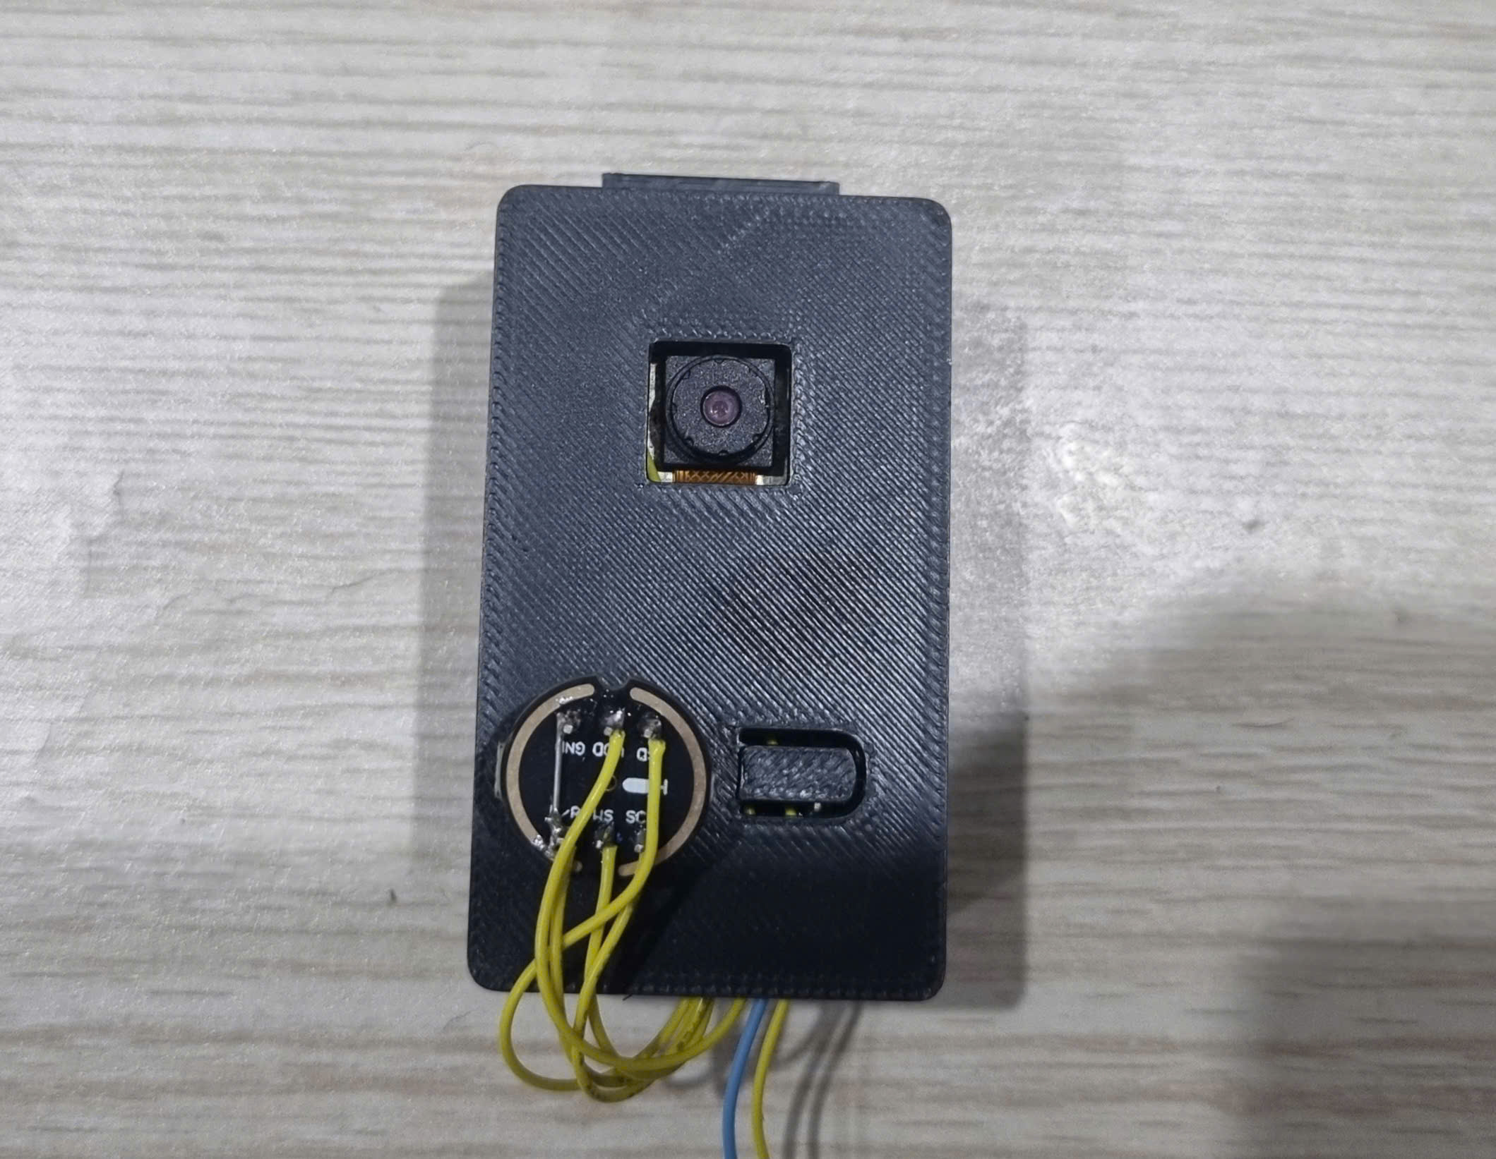
NODE EDGE-AI
ESP32-S3 N16R8
Micro INMP441

Slide 2
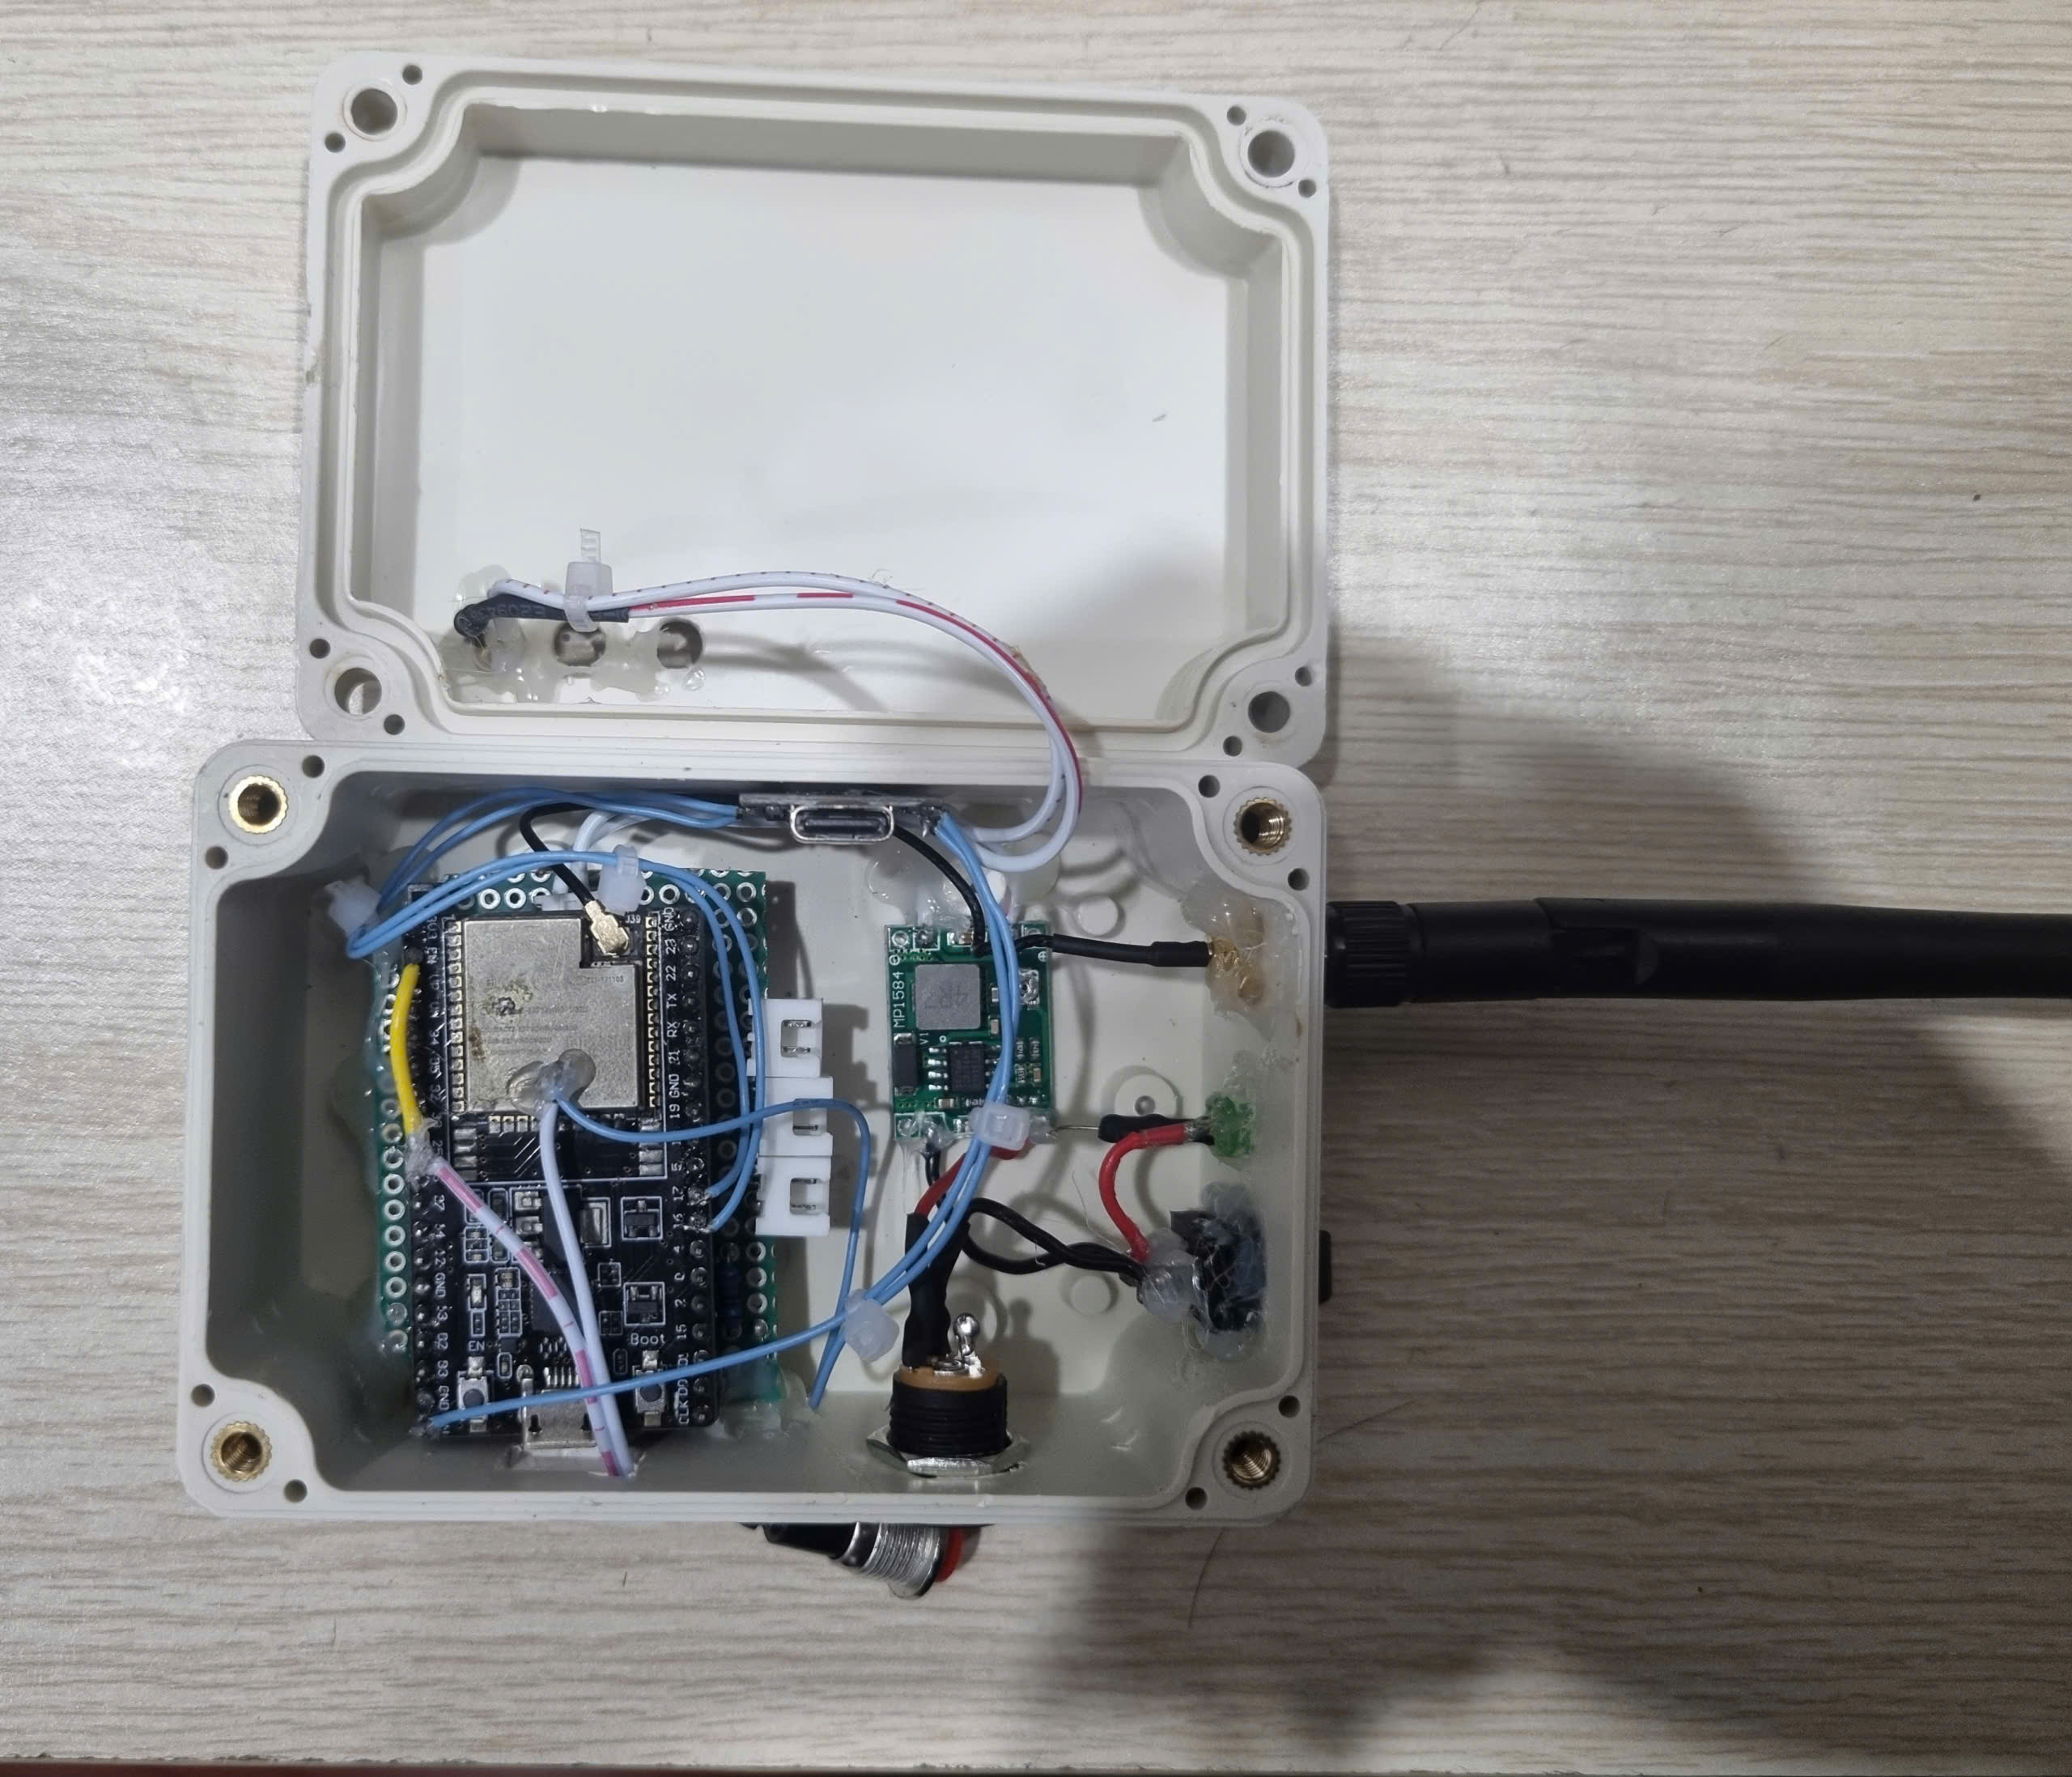
GateWays
ESP32-WROOM

Slide 3
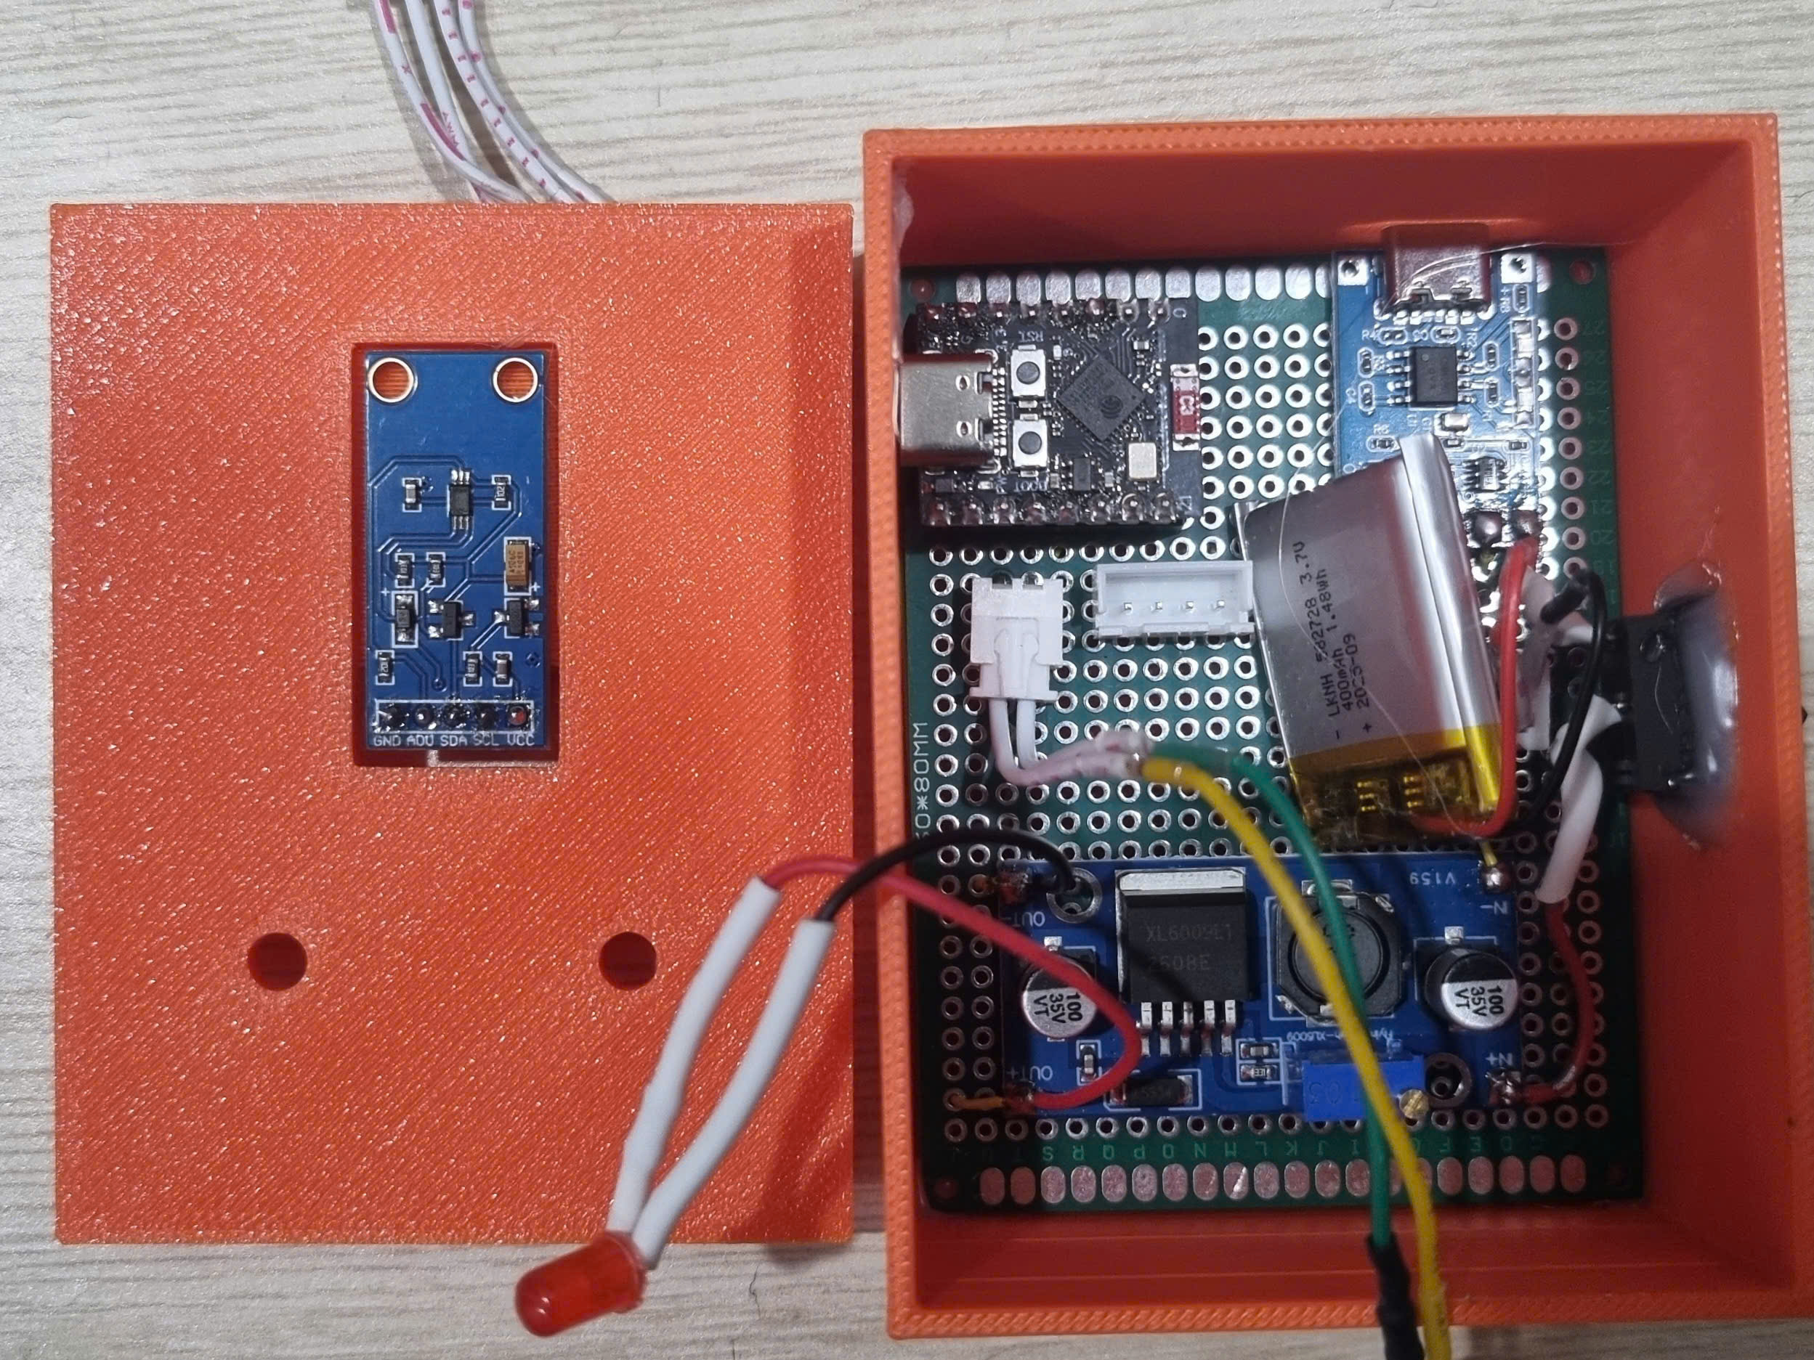
Node Sensor
ESP32-C3
BH1750

