Slide 1
MOVIE STREAMING
WEB

Slide 2
Lê Võ Thanh Duy ITITIU15030
Lưu Minh Quân ITITIU15033
Đặng Quốc Cường ITITIU15005
ABOUT US

Slide 3
Introduction

Slide 4
Introduction
Nowadays, movie and TV series are essential and irreplaceable parts of the people’s everyday entertainment. With the rapid development of the entertainment industry, there are various ways of watching movie and TV series. One of the fastest developing methods is video streaming with plenty of services such as Netflix, Amazon Prime, phimmoi and so on. But the problem is that some charge a very high subscription fee, some don’t but are embedded with annoying ads. With this in mind, we have decided to develop our own movie streaming service which is free, fast and convenient for users.

Slide 5
Use case diagram and its description

Slide 6
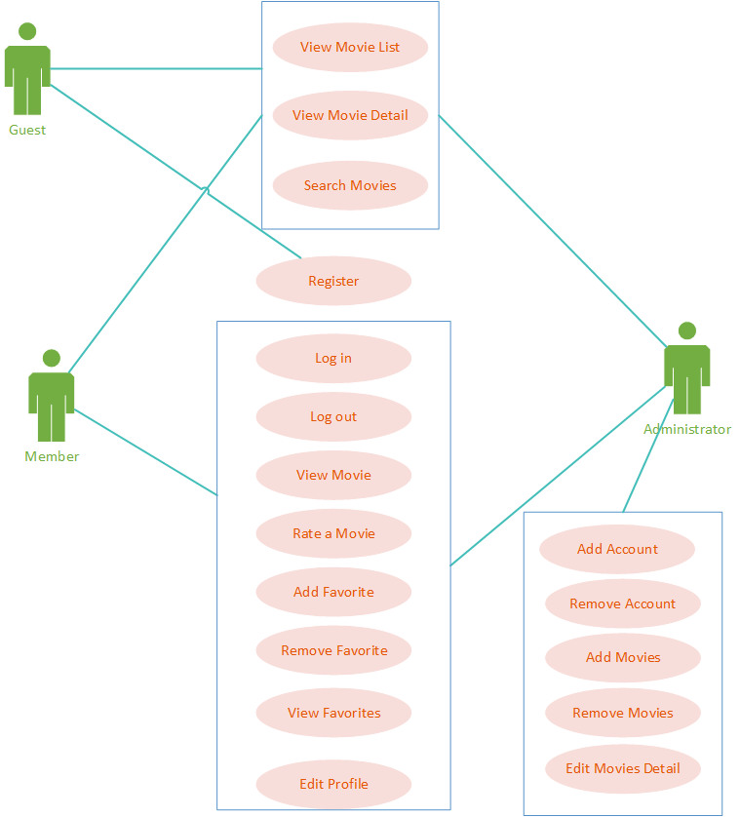
Use case diagram

Slide 7
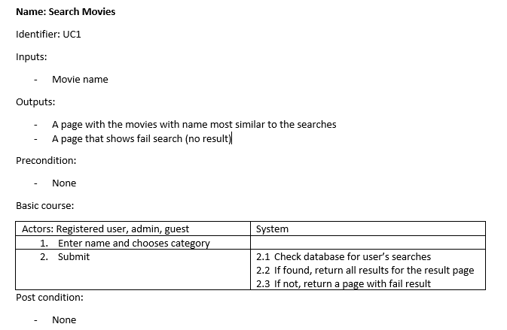
Use case diagram detail

Slide 8
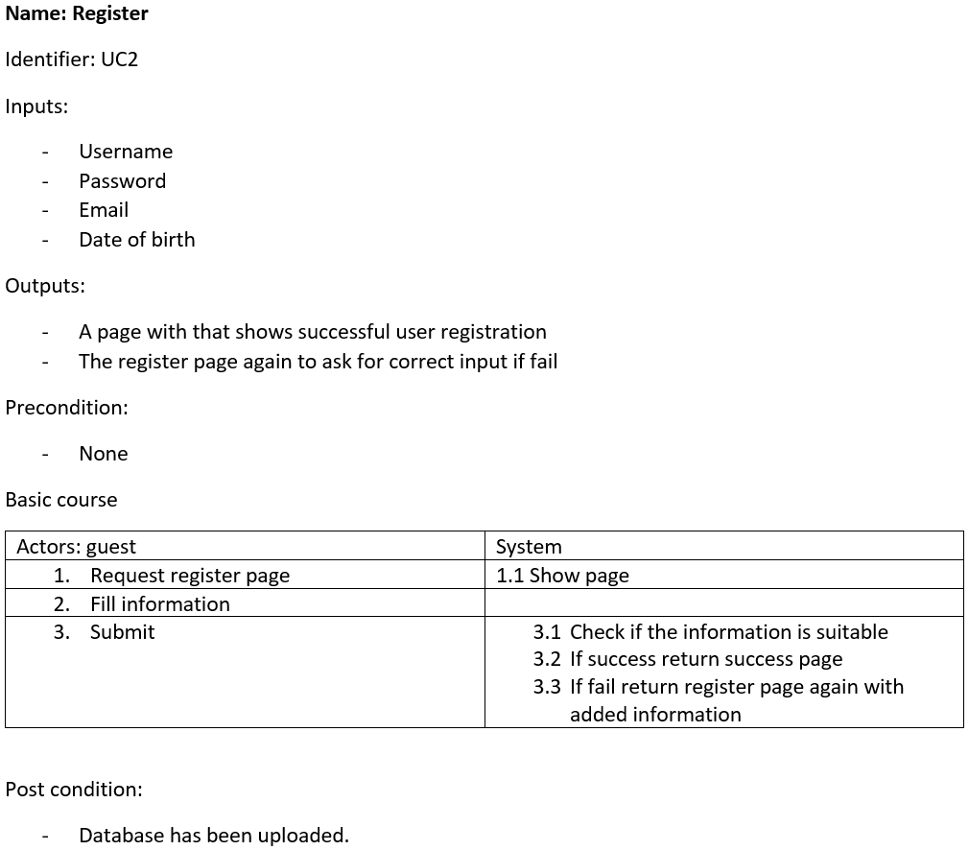
Use case diagram detail

Slide 9
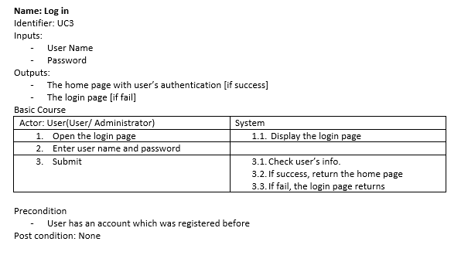
Use case diagram detail

Slide 10
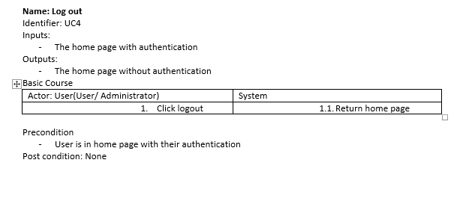
Use case diagram detail

Slide 11
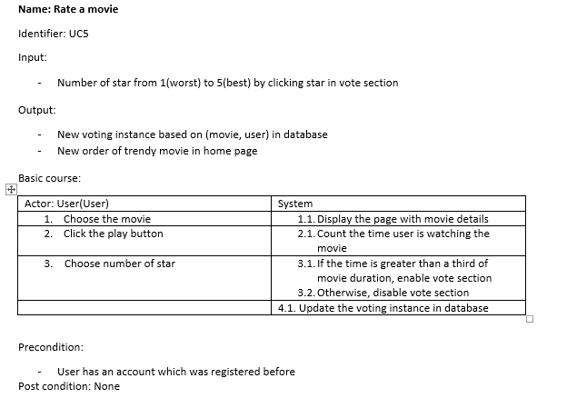
Use case diagram detail

Slide 12
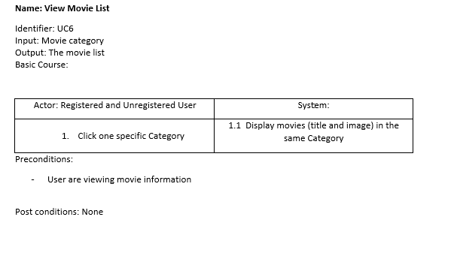
Use case diagram detail

Slide 13
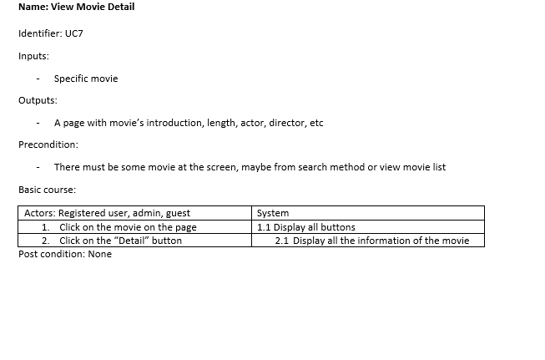
Use case diagram detail

Slide 14
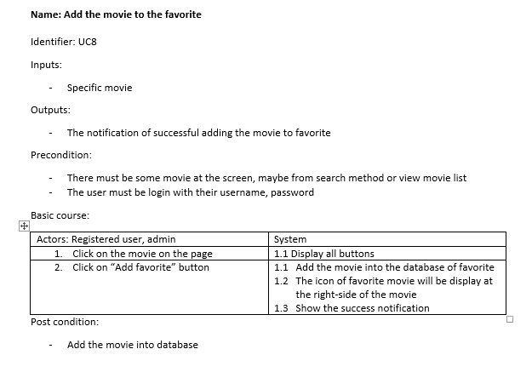
Use case diagram detail

Slide 15
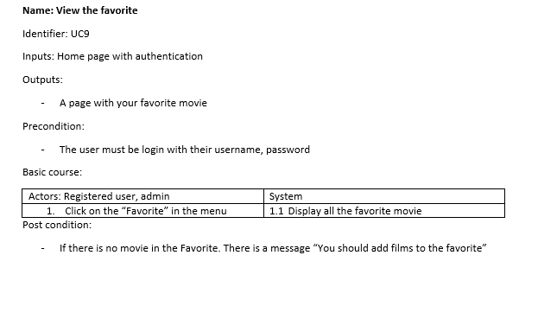
Use case diagram detail

Slide 16
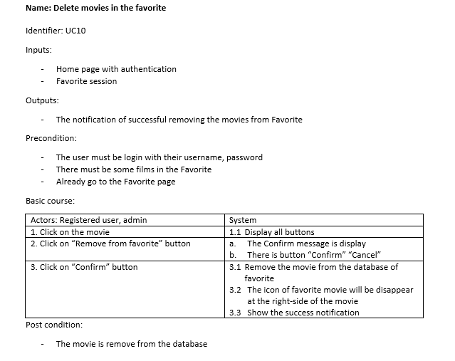
Use case diagram detail

Slide 17
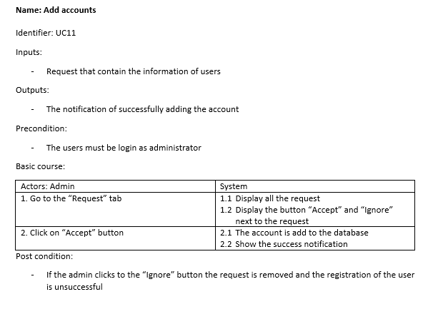
Use case diagram detail

Slide 18
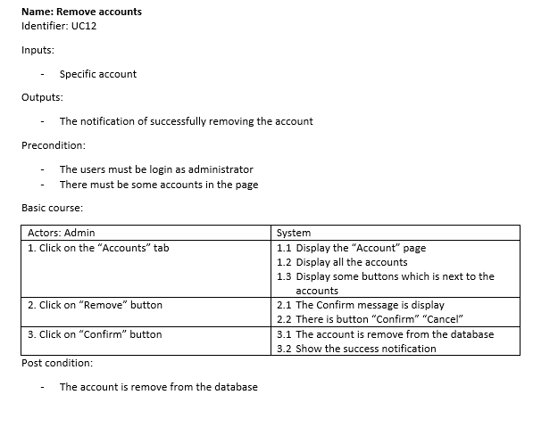
Use case diagram detail

Slide 19
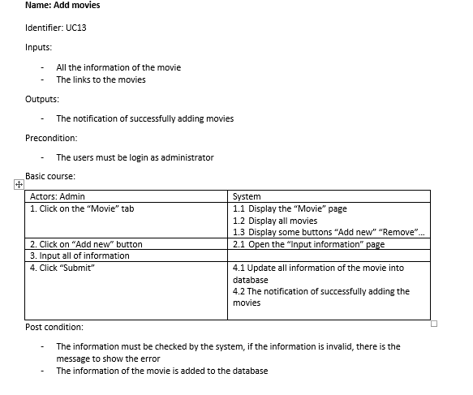
Use case diagram detail

Slide 20
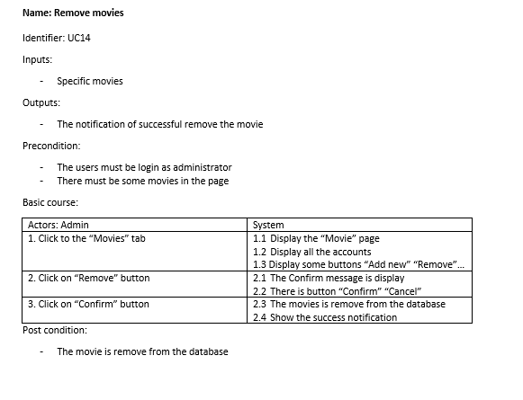
Use case diagram detail

Slide 21
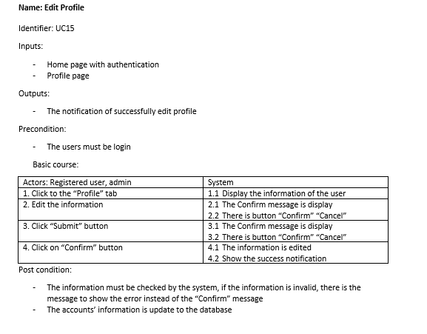
Use case diagram detail

Slide 22
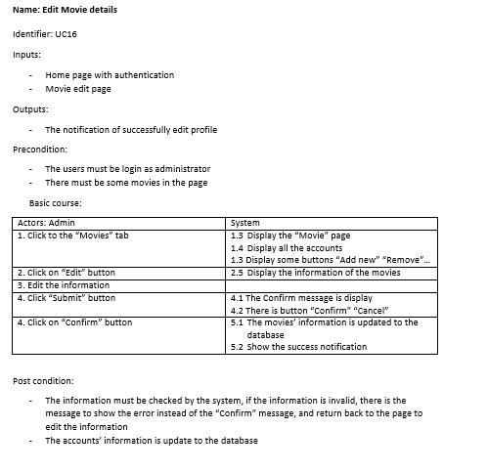
Use case diagram detail

Slide 23
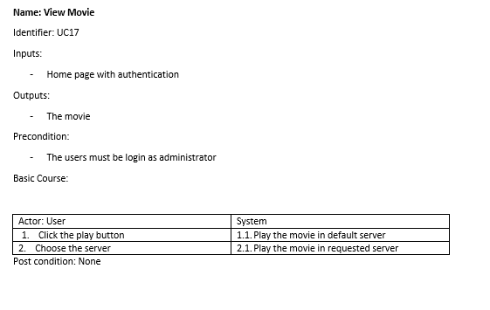
Use case diagram detail

Slide 24
Database design

Slide 25
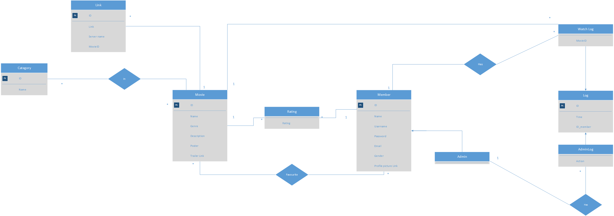
ERD

Slide 26
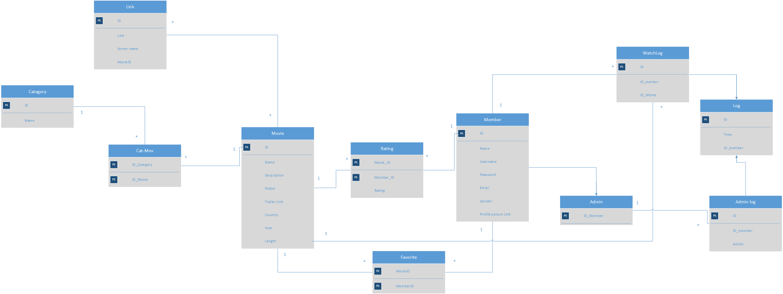
Database Schema

Slide 27
Sequence diagram

Slide 28
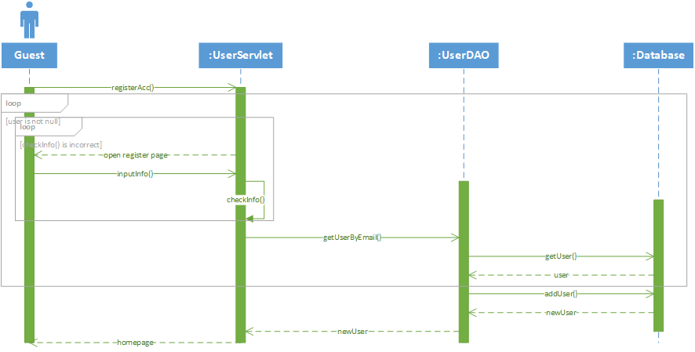
Register sequence diagram

Slide 29
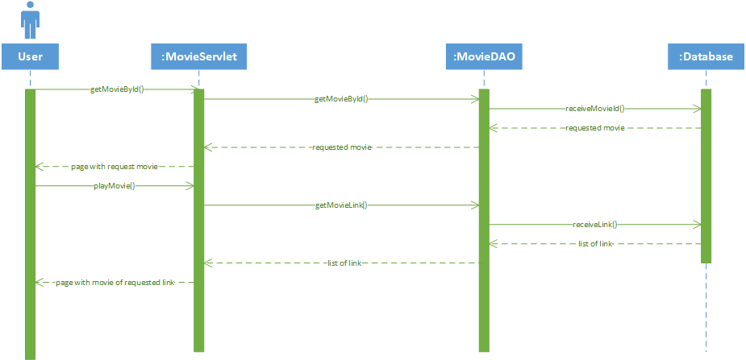
View movie sequence diagram

Slide 30
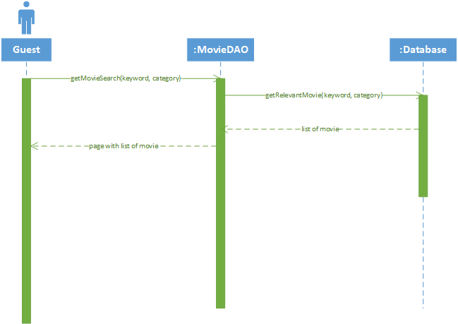
Search movie sequence diagram

Slide 31
Class diagram

Slide 32
