Slide 1
Let’s Git Gud
Sai Prashanth Chandramouli
M.S. in Computer Science
irc: saipc
Github: TDA
E-mail: thatsenough@youstalker.com

Slide 2
Disclaimer
All details on these slides are purely fictitious based on fact.
No Animals were harmed in the making of this slideshow (unless you count me).
I make obscure references to filmography and some computer fields. Ask if it is unclear.
All photos/images used here were taken from(sometimes of) free-to-get sources like xkcd. Any copyright infringement claim will fall flat on its face, so don’t even think about it.
Any references, messages, images bearing resemblance to any real life object, person or animal were probably NOT coincidental, and any that are found to be offensive were probably meant to be offensive.
So quit whining and let’s move on to the next slide.

Slide 3
What do you need to follow this?
A Text Editor (Eg: SublimeText3 <3 or if you are a masochist, notepad++ or gedit).
A Terminal (Git Bash or Powershell if you are on Windows, iTerm2 if on Mac OSX, and … well, terminal on linux).
A GitHub Account.
Ability to put up with my rambling for an hour or so without getting bored/angry/irritated or whatever.

Slide 4
What’s all the fuss about?
So what is Git?
According to Wikipedia, “Git (/ɡɪt/) is a widely used version control system for software development. It is a distributed revision control system with an emphasis on speed, data integrity, and support for distributed, non-linear workflows”
Uhm.. Say that in English?
All right. Git is “an unpleasant or contemptible person.”
Oh, wait, nvm.

Slide 5
Stop kidding! I hate jokes.
Ok, Calm down.
Git is a tool that can help you with software development.
It helps you track how your project changes over time, and in case you screw up, lets you fix stuff everytime. Well, almost everytime.
GitHub on the other hand is, well, a website?

Slide 6
What does Git do?
Allows you to add files to be tracked, and saves snapshots of these files at a given time
Allows you to go back to a particular snapshot of a file which was saved in the past.
Allows you to see who made what changes, and save or rollback changes made by others.
Gives a clean mechanism to organize changes in a software project and bring harmony to the pandemonium.

Slide 7
What does Git NOT do?
Make you a better programmer or coder, or whatever you call yourself.
Guarantee that you will never lose work/code. (Not kidding, if you are interested, I can show at least 3 ways of losing all your data or getting stuck in limbo using git).
Force best practices →There’s a reason it’s called practice.

Slide 8
Some terminology
Remote: Fancy term for ‘Server’.
Branch: Set of snapshots in a particular sequence.
Master: Fancy term for ‘main branch’.
Fork: Fancy term for ‘copying someone’s work and continuing on it’.
Merge: Combining the changes to make it whole.
Pull Request: Asking someone to merge your changes with their branch.

Slide 9
Crash Course in Graph Theory
Nodes, Edges, Direction.
There is nothing more on this slide. Better listen carefully to me.

Slide 10
Git – Single Player Mode
Let us look at what a single user would/can use Git for.
MS Word → Open, Edit, Save, Quit.
Git → Edit, Save Locally, Add a snapshot, Tell Git what this edit is about, Save on remote.
Seems redundant? Maybe.

Slide 11
Basic Git Commands
3 ways to create a git repo:
git init
git remote add <remoteName> <remoteURL>
git clone <remoteURL>
Let us do a live example.

Slide 12
Basic Git Commands - Continued
For checking status and changes
git status
git log
git log –g
Let us do a live example.

Slide 13
Basic Git Commands - Continued
For save, save and save:
git add <filesToBeAdded>
git commit –m “message”
git push –u origin <branchName>
Let us do a live example.

Slide 14
Unspoken Truth: Git ain’t for loners
No, Seriously. Its glamour lies in collaboration. With people (how much ever you hate them)
Git lets you seamlessly
make changes,
review them,
add changes from other people selectively,
track contributions.

Slide 15
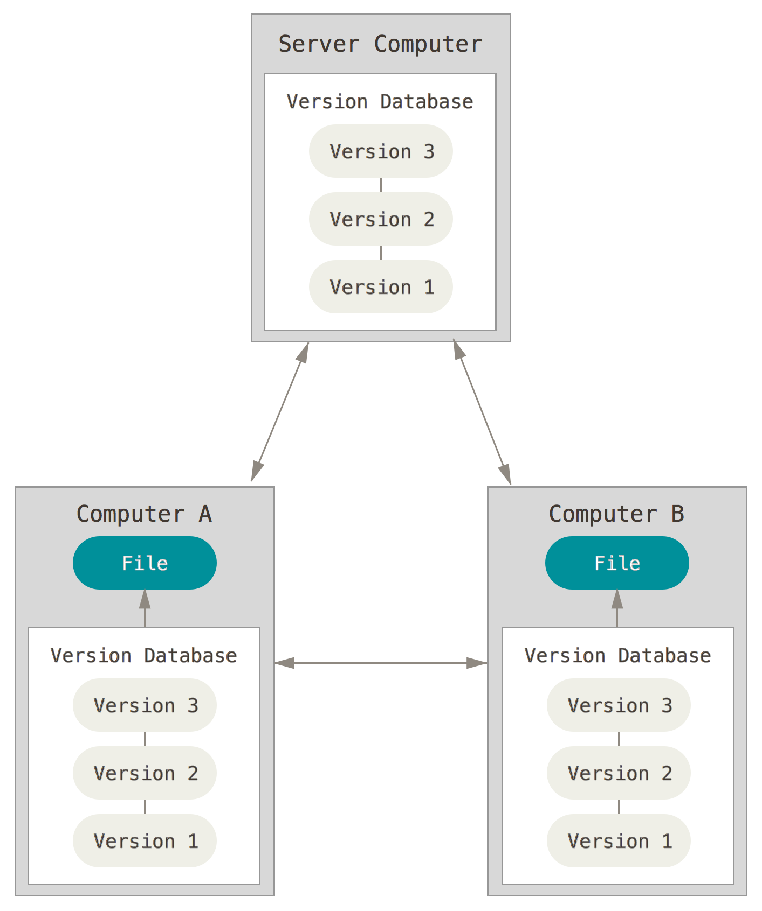
Distributed Git
Picture Courtesy: git-scm.org

Slide 16
Branching – Gits collaboration mech
Create branches when you want to work on a feature, but don’t want to risk ruining the master.
There are two main commands you would want to use:
git branch <branchName>
git checkout <branchName>
For lazy people like me, git checkout –b <branchName>

Slide 17
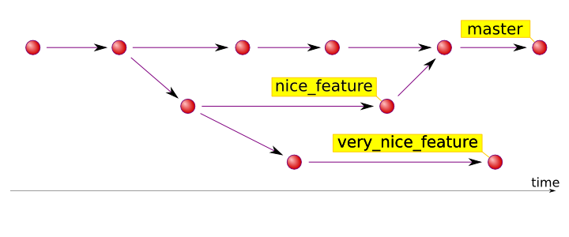
So what does creating a branch do?
Picture Courtesy: hades.github.io

Slide 18
The real fun in branches
Let’s say you created a branch, and continued working on it.
Now, the other guy doesn’t have to wait for working on his feature and goes ahead.
You both merge when each of you want, you can test your changes in your separate branch, and if it didn't work, well, you always have master.
And the master can be updated when you are confident that your branch isn't bringing down an apocalypse. :D

Slide 19
But wait, there is more..
Merging files to master is easy, just run
git merge <branchName> while on master
What happens when two people are working on different branches, but editing the same files, and try to merge these into master at the same time?
Tadum-Teedum => Merge Conflict

Slide 20
Merge Conflicts are scary, boo!
Not really. A merge conflict means that you cannot merge the changes yet, cause the same lines were edited by another person in the other branch, and he beat you to the chase.
Resolving a merge conflict is pretty simple, just open the conflict files in a text editor, edit them to either keep yours or theirs or both.
Then do this:
git add <fileNames>
commit and push.

Slide 21
Ok, but what about rebasing?
Good Question. Rebasing happens when someone merged their changes on to master, after you had pulled from master and were working on your branch. (Master is only an eg, it can be any branch)
Rebasing allows you to apply your changes on top of the current master (or any other branch), instead of the stale copy you had.
Doesn’t rebasing cause merge conflicts too? It sure does. Sometimes. Nah, most times.
Live example (draw the diagram, Sai).

Slide 22
Rebasing
You first need to switch to master, and pull the latest.
git checkout master && git pull origin master
Now, switch back to your branch, and start rebasing
git checkout <branchName>
git rebase <branchToBeRebasedAgainst>
If all was well, and you had no merge conflicts, it will successfully replay your changes on top of the latest.

Slide 23
What if, not?
If you ran into merge conflicts, then you do the same as before. Well, almost.
Instead of committing after changing the files and adding them, do this:
git add <files>
git rebase –continue
Assuming that this was a success, we can then successfully push upstream.

Slide 24
Ok, how do you push stuff?
The best practice when it comes to pushing to a remote, especially when you are working in a team is to make a Pull Request (PR)
Make a PR whenever you want to add changes to master
The benefits are multifold:
It lets others review your code before merging, and so can prevent contamination with bad code.
It gives a clean way to ensure that your changes are self-documented (if such a thing even exists).
It lets you know if there are merge conflicts before you even try merging :O
Live example

Slide 25
Exploiting the most out of GitHub
Issues and PR’s
Issue system on GitHub is awesome.
Lets you keep track of what is pending, what is getting fixed and what needs to be done.
PR’s can be automatically connected to Issues by just specifying their number, and GitHub will auto-close an issue when the corresponding PR gets merged. Yay!
Live example.
Example of a good team collaborated project with guidelines.

Slide 26
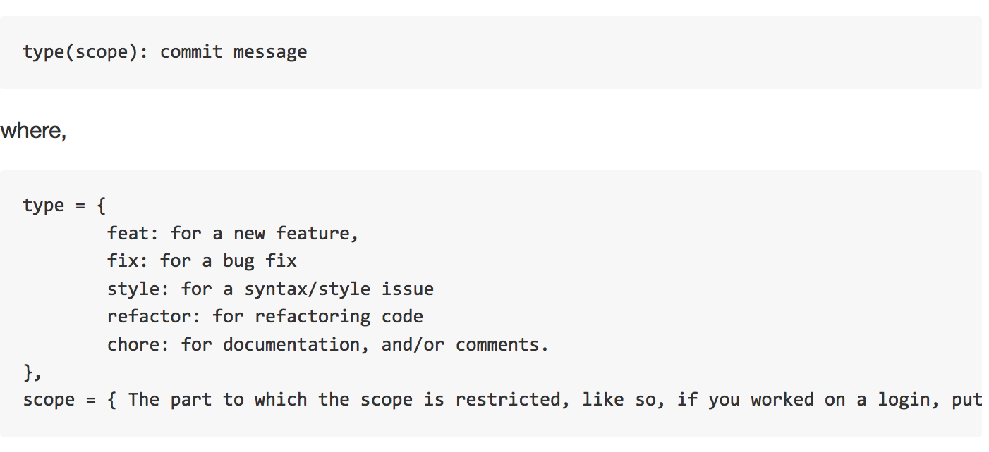
Examples of good Commit messages
Eg: fix(login): prevents xss

Slide 27
Advanced Git – Not kidding
Git has some pretty advanced features, lets start with something small:
git log
Not kidding, this is one powerful feature of git. It gives you the ability to check who did what, and when.
It lists the hashes of each commit in the branch so far, and you can use this info to rollback to some earlier commit.

Slide 28
Creating aliases
Now that you have some experience about git, lets make it easier to type those commands.
Git lets you set aliases to every command it has, so you are free to shorten them down, depending on how lazy you are.
To do this,
git config –global alias.<aliasName> <actualCommand>
Examples on my computer:
git a – git add .
git b – git branch
git c – git commit -m
git d – git diff master

Slide 29
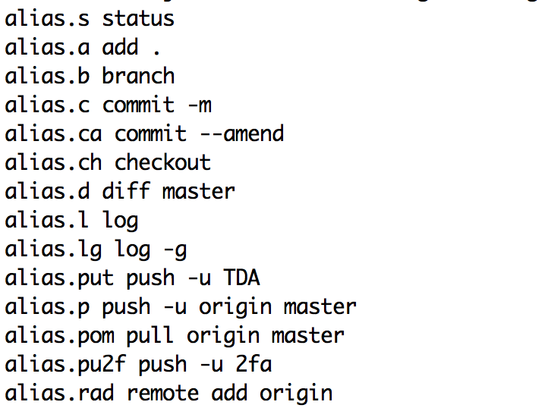
List of aliases I have done:

Slide 30
(Really) Advanced Git – Proceed with caution
Warning: This section might cause you to lose data, land up in limbo, or corrupt your repo.

Slide 31
I don’t like my changes
So, lets say you worked on something, and saved the files on disk.
Now, you havent committed yet, and don’t want these changes for some reason.
You can safely tell git to do that for you.
git stash
If you want the changes to be applied back
git stash apply
Check for a list of changes you have stashed?
git stash list

Slide 32
Total Re(call)set – even after you get committed ☹
Suppose you want to rollback to a particular snapshot in history, all you gotta do is:
git reset <commithash/branch>
Use the –hard option to erase all local changes on disk.
Live Example

Slide 33
iRebase – Not an Apple product
We learnt about rebasing. Well, meet its buffed-up brother – Interactive Rebase.
If you only want certain commits in your repo, and want to remove others, or you want to merge multiple commits together, iRebase is your man.
Lets start up iRebase, like so:
git rebase -i HEAD~n
Where n is the number of commits you want to go back and change :O
Live example (Dangerous example too)

Slide 34
iRebase – Continued
Interactive rebase lets you pick the commits you want.
Squash multiple commits together.
Delete commits altogether.
Change the order of your commits (definitely not a great move, and not at all recommended).

Slide 35
So what? Not really dangerous
Say `hi` to the venomous force push.
git push -f (aka) git push –force
This one command, in addition to reset or iRebase, can single(well, double) handedly delete all your data and send you back to the dark ages (at least back to the initial commit).

