Slide 1
JavaScript: The Beginning
Sai Prashanth Chandramouli
Masters Grad, ASU
Github: TDA
E-mail: schand31@asu.edu

Slide 2
Disclaimer
I assume that all of you have experience with programming, and will not be covering super basic stuff like what a variable is, or what functions do.
I also will be using an IDE called WebStorm to show code, I love it, but do not expect you to have it.
I make obscure references to filmography and some computer fields. Ask if it is unclear.
All code that I show, is either written by me, or is open-source.
All JS discussed here is ES5, unless specified otherwise.
Any resources, or links that I add in these slides are NOT sponsored, and only reflect my personal opinion. Don’t like it? Don’t use it. Simple.

Slide 3
What do you need to follow this?
A Text Editor (Eg: SublimeText3 <3 or if you are a masochist, notepad++ or gedit).
A Terminal (Git Bash or Powershell if you are on Windows, iTerm2 or Terminal if on Mac OSX, and … well, terminal on linux).
An internet connection to download code, or at least look at it.
Ability to put up with my rambling for an hour or so without getting bored/angry/irritated or whatever.

Slide 4
Why JavaScript?
“SOME CLAIM THAT JAVASCRIPT is now the most popular programming language in the world, running any number of complex web applications that the world relies on to do business, make purchases, manage processes, and more. “ - Nicholas Zakas, JavaScript Guru
JavaScript is present everywhere, if you have ever used a browser to go to a website, you have used JavaScript.
Also, it was the first language I ever learnt, so hey, its important all right?

Slide 5
Misconceptions about JavaScript
JavaScript !== Java
JavaScript !== DOM
JavaScript is not “weakly typed”
JavaScript is not a beginners language
JavaScript is not *just* a scripting language

Slide 6
The JavaScript you know
document.alert(‘hi’);
document.forms[0];
element.onclick = function(){}
target.addEventListener(type, listener[, useCapture]);
$(‘.class’).click(function(e) {});
This is NOT what we will see today. Well, at least not completely.

Slide 7
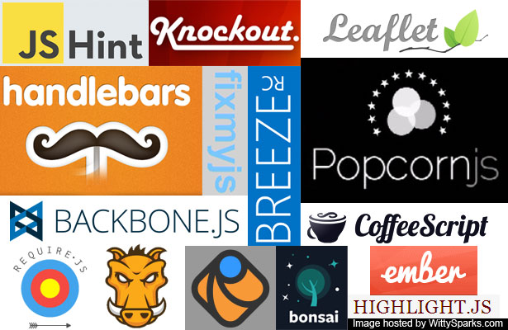
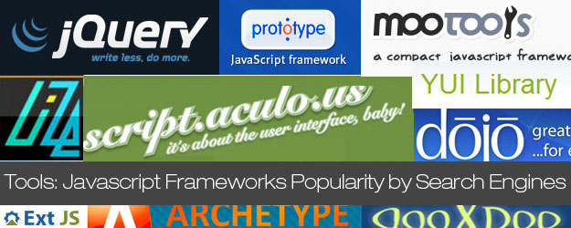
The JavaScript universe

Slide 8
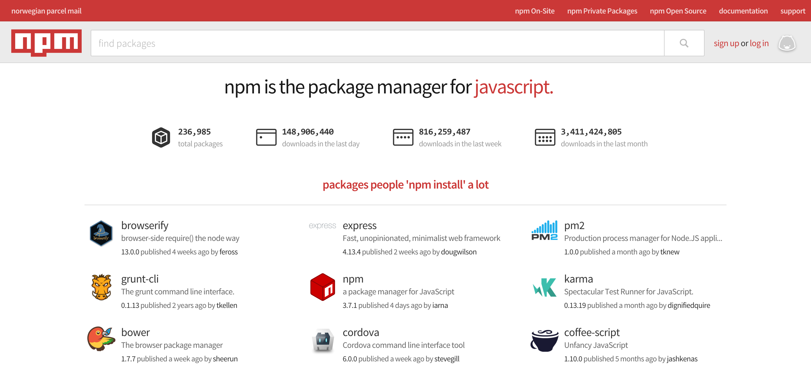
The JavaScript universe

Slide 9
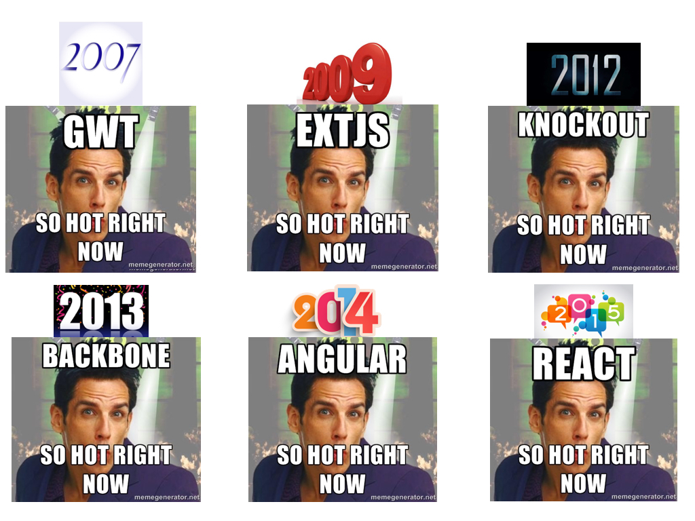
But y u no teach us frameworks?

Slide 10
But I wannnt frameworks!!
Hey, no one said anything about not using them, in fact, I advise that you learn and use at least one major framework.
Vanilla JS and Node.js: http://nodeschool.io/
Pro JS for Web developers : http://www.amazon.com/Professional-JavaScript-Developers-Nicholas-Zakas/dp/1118026691
JS: The Definitive Guide - http://tinyurl.com/zwsg5ku
JS: The Good Parts - http://tinyurl.com/hmu4zfb
AngularJS: https://thinkster.io/a-better-way-to-learn-angularjs
Jquery: http://jqexercise.droppages.com/ → Super fun.

Slide 11
JavaScript Basics – Breeze through
Types:
Integer
String
Boolean
Object
Functions

Slide 12
Functions - Basics
Functions in JS can be declared in four ways:
Regular
Function Expressions
Function Literals
Anonymous Functions

Slide 13
Objects - Basics
Objects in JS are weird.
Objects are like classes.
They are NOT classes.
Inheritance is not really there, but is doable.

Slide 14
Objects - Advanced
Inheritance is possible.
Adding methods and properties at runtime to ”Classes” is very much possible, and is in many cases, needed.
Only add methods/properties to objects you create, and NOT built-in objects, be responsible!!

Slide 15
Functions – Advanced Closures
What are closures?
Closures are very very similar to inner classes, but are vastly different.
Closures allow you to emulate private variables, and maintain state, like real classes and objects :)
Closures are super useful, they are used in almost EVERY *decent* library ever written in JS.
Do NOT claim you know JavaScript *until* you have a firm grasp of Closures.

Slide 16
Mozilla Codebase
Lets look at something I wrote over last summer at Mozilla:
https://github.com/mozilla/fxa-password-strength-checker/blob/master/src/passwordcheck.js
The copy I am using to demo right now(moz-pwsc.js) is in our home repo:
https://github.com/TDA/JavaScript-Presentation

Slide 17
Code Break: Lets build a Selector Engine
This will emulate a “light” version of “Sizzle” which is the engine behind both Jquery and D3. (Kinda)
What do we need to do?
Question break

Slide 18
So why need these constructs at all?
JavaScript is asynchronous in nature.
What this means to you as a developer is that, you can never be sure about when a particular line of code is going to execute.
Example

Slide 19
Asynchronous Javascript
AJAX is a method of using JavaScript with XML and getting smaller packets of data from the server.
Why do we need it? It reduces turnaround time.
Showcase: Old way. Client → Server, Server → Client.

Slide 20
AJAX
Showcase: New way

Slide 21
Code Break: Lets build a simple AJAX Library
What do we need?
Question Break
Lets do it!

Slide 22
Roadmap for JavaScript
https://developer.mozilla.org/en-US/docs/Web/JavaScript - The MDN, even Googlers use it, so why not you?
When stuck, always consult the manual.
https://www.npmjs.com/ → Contains almost every JS library out there.
Once you are on the road to becoming a rockstar JS dev, consider using Linters → JSHint and ESLint are amazing pieces of software.
http://jshint.com/
http://eslint.org/

Slide 23
Roadmap for JavaScript - Continued
Once that is done, and you have been made lazy already, consider using build tools, to make sure you don’t have to run tests everytime → Grunt and Gulp are both amazing as well.
http://gruntjs.com/
http://gulpjs.com/
Of course, you NEED to know whether the code you write is actually working or not right? Build systems build and automate stuff for you, but you need a Test system to know that your code works.

Slide 24
Roadmap for JavaScript - Continued
I personally am biased towards MochaJS, cause its awesome, and also very easy to learn.
https://mochajs.org/
Mocha uses assertions, and a very good assertion Library is Chai. (Not cuz it rhymes with my name)
http://chaijs.com/
Obviously any test system needs to be able to mock and stub actual functions, or else you might end up sending a million emails to real users right? That’s where Sinon comes in.
http://sinonjs.org/

Slide 25
Final Words
JavaScript is a quirky language, with many inherent flaws, and is pretty much a badly hacked together language.
But! It is quite literally the language of the web, and there hasn’t been a better substitute yet.
It is universal, on the client, as middleware, on the server etc.
The roadmap to becoming a JS Guru is a long long list of things, but once you master the base language, its pretty smooth sailing :D
Good Luck! Happy Coding! :D

