Slide 1
Email Header Injection Vulnerabilities
Sai Prashanth Chandramouli
Software Development Engineer
Samsite team – Pyramid Org – TRMS
Notes:
I am Sai Pc, working with the Samsite team on a product called Noir, which helps in Compliance for Suspicious Activity Monitoring.

Slide 2
Agenda
What is it?
How does it occur?
Potential Impact – What can it result in?
How widespread is it?
How can we mitigate it?
Takeaways
Notes:
Discuss “What is it” right here in this slide.
Email header injection is a security vulnerability that can occur in Internet applications that are used to send email messages constructed using user supplied data, e.g. Contact_us forms, subscribe forms, etc.
CVE (Common vulnerabilities and exposures) DB lists 12 such vulnerabilities discovered in popular frameworks in the last 3 years.
Not a new vulnerability, has existed forever, with no research or major patch for vulnerable languages
First documented over a decade ago, in a late 2004 Article on phpsecure.info by user ‘tobozo’
Since this vulnerability was initially found in the mail() function of PHP, E-Mail Header Injection can be traced to as early as the beginning of the 2000’s (release of mail function in PHP 4)

Slide 3
How does it occur?
Sample HTML form
<form action="{mailing-script}” method="post"> <input type="text" name="email" id="email">
<textarea name="msg"></textarea> <input type="submit" value="Email Me! "> </form>
Notes:
When a mailing script fails to properly sanitize user input
Failure to check for the presence of newlines and/or email headers in the form fields that take in email addresses can result in this vulnerability
Can result in e-mails sent with additional and/or spoofed headers
Newlines = \n \r
Encoded = %0a, %0d
Headers include cc, bcc, to, from, subject etc

Slide 4
Sample PHP e-mail script
$from = $_REQUEST['email']; $subject = "Hello Sai Pc"; $message = "We need you to reset your password on …";
$to = ”csai@amazon.com";
// attack string => 'sai@sai.com\nBCC:sss@sss.com\nSubject:Pwned'
mail($to, $subject , $message, "From: $from");
// E−Mail gets sent to both csai@amazon.com AND sss@sss.com
Notes:
$from is the vulnerable variable, as we directly use user input to construct the message
Explain that this is a normal way of constructing emails and is widely taught in tutorials and blogposts

Slide 5
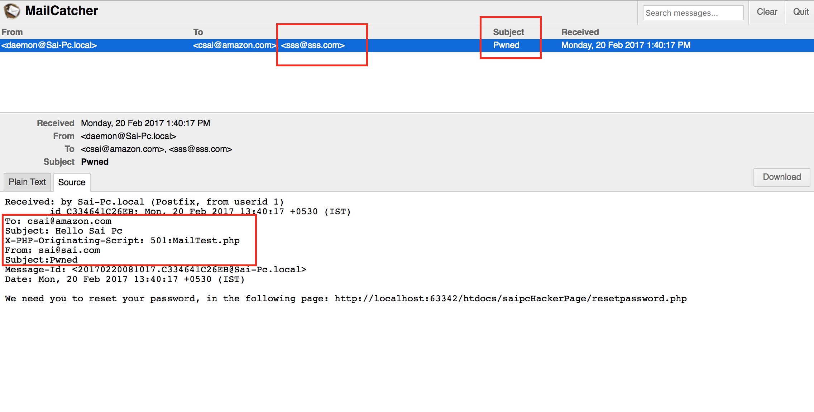
Output of injection
Notes:
Point out the following:
Overwritten subject header
bcc’ed email
Absence of any trace that a bcc was added

Slide 6
Potential Impact - What can it result in?
Email Header Injection can potentially lead to any of the following:
Phishing and spoofing attacks
Spam networks
Denial of service by attacking the underlying mail server
Payloads with malicious attachments
Notes:
Can spoof any e-mail header like cc, bcc, subject, etc.
Present in default mail implementations of popular languages like PHP, Java, Python, Rails, Perl, ASP.Net.
Can add malicious attachments to emails.
PHP – mail() function
Java – JavaMail API
Python – email.parser library
Ruby – Net::SMTP Library
ASP.Net
Together, these languages account for over 90% of server side code on the World Wide Web.

Slide 7
Business Impact at Amazon
What does this mean to us as devs?
Loss of trust
Denial of Service
Notes:
Loss of trust
Phishing emails from a legitimate Amazon server and legitimate @amazon.com email address that mail clients will not flag as spam.
DoS
Underlying mail servers can be overloaded with spam, leading to a DoS attack.

Slide 8
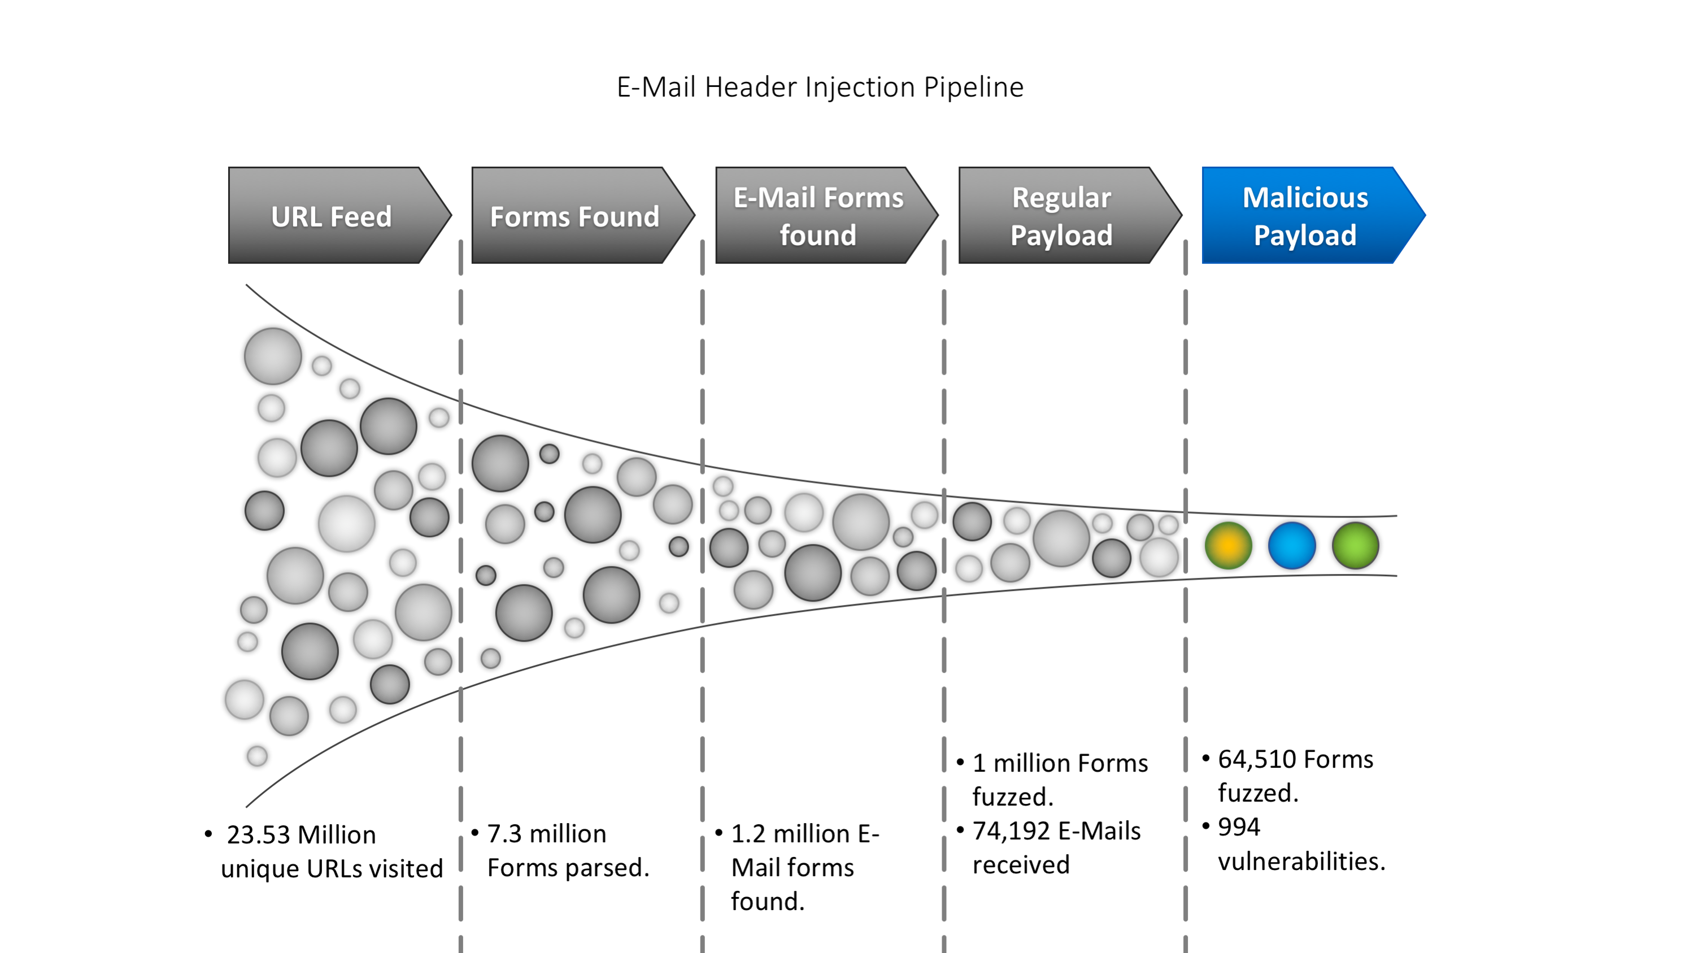
How widespread is it?
Notes:
135 Domains in the Alexa top 1,000,000 ranked websites affected by the vulnerability.
Most of these have SPF (Sender Policy Framework), DKIM (DomainKeys Identified Mail), and DMARC(Domain-based Message Authentication, Reporting and Conformance) protection. So spoofing them manually is very hard, but EHI lets us spoof them easily using their own website and mailing service.
53 of these domains being used in active Spam networks already ➔ spamhaus, uceprotect, other spam blacklists

Slide 9
Breakdown of exploits
We were able to exploit the vulnerable domains in the following ways:
Type of Exploit/Injection | No. of vulnerable urls
E-Mail Header Injections with any header | 583
Malicious attachments possible | 443
Only `To`, `cc`, `bcc` header injections | 229
Notes:
Any header like subject, etc
Ability to inject malicious code as an attachment
E-Mail Header Injections with ‘bcc’ , cc, to headers

Slide 10
Mitigation Strategies
Do not trust user input, Use E-Mail libraries that are verified to prevent such attacks
LANGUAGE | VERIFIED MAIL LIBRARIES
PHP | PEAR Mail, PHPMailer, Swiftmailer
Python | SMTPLib with email.header.Header
Java | Apache Commons E-Mail
Ruby | Ruby Mail >= 2.6

Slide 11
Mitigation Strategies – Contd.
Input validation
Going back to our example from before, we can add input sanitization like so, $from = ($_REQUEST['email']); $sanitized = filter_var($from,FILTER_SANITIZE_EMAIL); if (filter_var($sanitized,FILTER_VALIDATE_EMAIL)) { // do the rest of the e-mail code } where ‘filter_var’ is a built-in PHP function.
Notes:
A word of caution though, do use tested methods for input validation and avoid writing your own.
Talk about the different types of newlines that the RFC describes and the total number of cases/combinations (8) we need to test for.

Slide 12
Takeaways
E-Mail Header Injection vulnerability is just about as dangerous as any other command injection vulnerability, and is present on the WWW.
Its not just email input fields that are vulnerable, any field that is used as part of emails could be potentially vulnerable, including message, feedback, etc.
Do not trust user input, sanitize/pre-process/reject user input using well-tested libraries.
Do not try to perform user input validation by yourself, even the simplest attacks have tricky edge-cases to cover.
Notes:
Can result in loss of trust, malicious attachments
Not just email inputs, all inputs
DO NOT TRUST USER INPUT
Edge cases:
Newlines = \n \r
Encoded = %0a, %0d

Slide 13
Acknowledgements
Dr. Adam Doupé, this project is his brain child, and without him this project wouldn’t have been possible

Slide 14
Questions?
Please feel free to ask any questions.

