Slide 1
Zoncon 2017
Email Header Injection Vulnerabilities
An Analysis of the Wild Wild Web
Sai Prashanth Chandramouli

Slide 2
Introduction
“Email injection is a security vulnerability that can occur in Internet applications that are used to send email messages.”
- Wikipedia

Slide 3
Problem Background
Email Header Injection is possible when the mailing script fails to properly sanitize user input
Failure to check for the presence of newlines and/or email headers in the form fields that take in email addresses can result in this vulnerability
Can result in e-mails sent with additional and/or spoofed headers
Notes:
Newlines = \n \r
Encoded = %0a, %0d
Headers include cc, bcc, to, from, subject etc

Slide 4
Sample HTML page
<!doctype html> <html lang="en"> <head> <meta name="author" content="Sai Pc">
<title>Mock Email</title></head> <body> <form action="{path to back−end}” method="post"> <input type="text" placeholder="Email" name="email" id="e−mail"><br> <textarea name="msg" rows="20" cols="120"></textarea> <input type="submit" value="Email Me! "> </form> </body> </html>

Slide 5
Sample PHP e-mail script
$from = $_REQUEST['email']; $subject = "Hello Sai Pc"; $message = "We need you to reset your password on …";
$to = ”csai@amazon.com";
// attack string => 'sai@sai.com\nBCC:sss@sss.com'
$retValue = mail($to, $subject , $message, "From: $from");
// E−Mail gets sent to both csai@amazon.com AND sss@sss.com

Slide 6
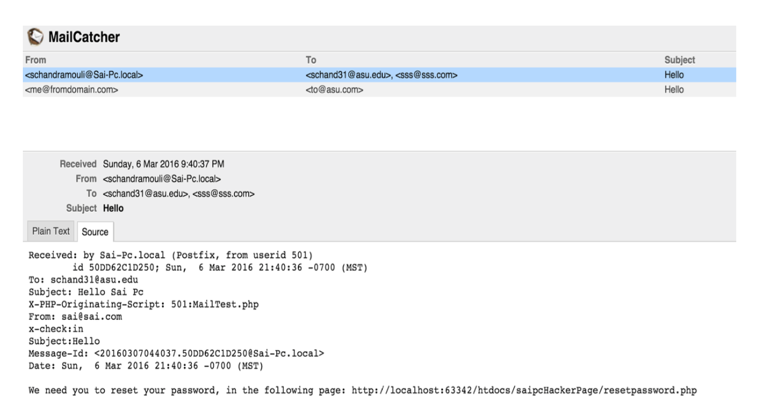
Output of injection

Slide 7
E-Mail Headers
Headers can include:
Cc – Carbon Copy
Bcc – Blind Carbon Copy
To – Recipient of the e-mail
From – Sender of the e-mail
Subject – Subject field of the e-mail
X-Spam-Score, etc.

Slide 8
History
First documented over a decade ago, in a late 2004 Article on phpsecure.info by user ‘tobozo’
Since this vulnerability was initially found in the mail() function of PHP, E-Mail Header Injection can be traced to as early as the beginning of the 2000’s (release of mail function in PHP 4)
Notes:
Not a new vulnerability

Slide 9
Popular Languages Affected
PHP – mail() function
Java – JavaMail API
Python – email.parser library
Ruby – Net::SMTP Library
Notes:
.net’s mail functionality provides inbuilt sanitization for header injections

Slide 10
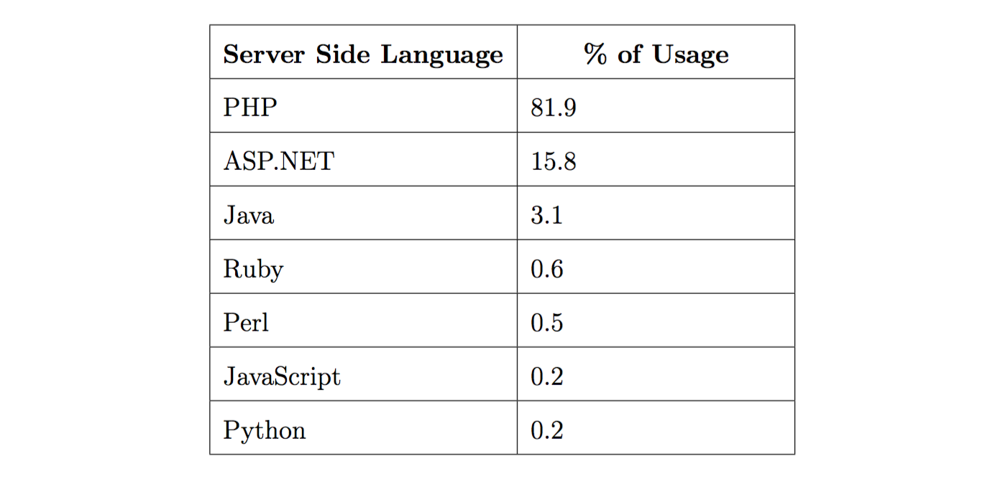
Usage Statistics
Language usage statistics compiled from w3techs
Notes:
Usage is great, but what is the actual harm that ehi can cause?

Slide 11
Potential Impact - What can it do?
Email Header Injection can potentially lead to any of the following:
Phishing and spoofing attacks
Spam networks
Denial of service by attacking the underlying mail server
Information extraction of legitimate users
Payloads with viruses
Notes:
What is the actual harm that it can lead to?
trusted attachments

Slide 12
Contributions of Thesis Project
A black-box approach to detecting the presence of E-Mail header injection vulnerability in a web application
A detection and classification tool based on the above approach, which will automatically detect such E-Mail Header Injection vulnerabilities in a web application
A quantification of the presence of such vulnerabilities on the World Wide Web, based on an expansive crawl across the Web, including 17,686,161 URLs and 5,562,533 forms

Slide 13
System Architecture
Our system can be logically divided into two major modules:
Data Gathering
Crawler
Form Parser
E-Mail Field Checker
Payload Injection
E-Mail Form Retriever
Fuzzer
E-Mail Analyzer
Notes:
One is the We go out there, gather data,
Other is the PI, which injects different payloads into the websites/forms that we gathered

Slide 14
System Architecture - Functions
Data Gathering - Functions
Interface with the Crawler and receive the URLs
Parse the HTML for the corresponding URL, and store the relevant form data
Check for the presence of forms that allow the user to send/receive E-Mail, and store references to these forms

Slide 15
Data Gathering
Crawler
Crawler Feed
Data-base
Form Parser
URLs with forms
Forms found
Email Field Checker
Forms with E-Mail fields

Slide 16
System Architecture – Contd.
Payload Injection - Functions
Retrieve the forms that allow users of a website to send/receive E-Mail and reconstruct these forms.
Inject these forms with benign data (non-malicious payloads), and generate an HTTP request to the corresponding URL.
Analyze the E-Mails, extracting the header fields, and checking for the presence of the injected payloads.
Inject the forms that sent us E-Mails, with malicious payloads, and generate an HTTP request to the corresponding URL to check if E-Mail Header Injection vulnerability exists in that form.

Slide 17
Payload Injection - Fuzzer System
E-Mail Form Retriever
(reconstructs the form)
Fuzzer
(Non-Malicious Payload)
Reconstructed forms
HTTP Request with Payload
Database
E-Mail Analyzer
(Checks for injected payload)
Mails with injected payloads
URL’s that sent back E-Mails
HTTP Request - Malicious Payload
Fuzzer
(Malicious Payload)
External Website
Received E-Mails
E-Mail from website
Postfix Mail Server
Notes:
Unlike the data gathering module which is linear, PI is slightly cyclic in nature

Slide 18
System Components
Crawler
Form Parser
E-Mail Field Checker
E-Mail Form Retriever
Fuzzer
E-Mail Analyzer

Slide 19
Crawler
We used an open-source Apache Nutch based Crawler
The Crawler provides us with a continuous feed of URLs and the HTML contained in those pages

Slide 20
Form Parser
Parses the HTML found on the page, extracting form attributes, such as method, action, etc.
Data about the input fields, such as their attributes, names, and default values
Presence of the <base> element
Notes:
1. These dictate where we send the HTTP Request, and what kind of request it is (GET or POST).
2. The default values are essential for fields like <input type="hidden"> as these fields are usually used to check for the submission of forms by bots.
3. As this affects the final URL to which the form is to be submitted.

Slide 21
Email Field Checker
The email field checker complements the form parser
It takes the output of the form parser and checks if the forms actually have an email input field (or any field with ‘email’ as the name or id)
If such a form is found, we store a reference to the form so that we can test it using the fuzzer
Notes:
words ‘e-mail’, ‘mail’ or ‘email’
2. Compared to searching for explicit E-Mail fields, by searching for the presence of the words ‘e-mail’, ‘mail’ or ‘email’ in the form, not only are we assured zero false negatives — as our system is bound to find an E-Mail field if it is present — but the system is also substantially faster as we do not have to parse the individual form fields at this point in the pipeline.
3. Final stage in the data gathering module

Slide 22
Email Form Retriever
Retrieve the newly inserted forms in the ‘email_forms’ table, checking to ensure no duplication occurs before the fuzzing stage
Reconstruct each form, using the data stored in the ‘form’ table, complete with input fields and their values
Construct the URL for the ‘action’ attribute of the form so that we can send the HTTP Request to the right URL
Notes:
Base tag, self-referencing form, relative paths, etc

Slide 23
Fuzzer
The fuzzer interfaces directly with the websites.
We use two types of payloads, namely,
Non-Malicious Payload – Used to verify that the website sends us an e-mail. ‘reguser@example.com’
Malicious Payload – Used to check for the presence of e-mail header injection vulnerability ‘nuser@example.com\nbcc:maluser@example.com’
Notes:
This is because making HTTP Requests is a very expensive process and is usually the cause of bottlenecks in a Crawler-Fuzzer system

Slide 24
Fuzzer Flow Diagram
Fuzzer
Website
E-Mail Analyzer

Slide 25
Fuzzer – Contd.
Once the data (including the payload) for the form is ready, the Fuzzer constructs the appropriate HTTP Request (GET or POST)
It sends the HTTP Request to the URL that was generated by the E-Mail form retriever

Slide 26
Special Case - Python
This is due to Python’s exhibited behavior when attaching headers: instead of overwriting a header if it is already present, it ignores duplicate headers
Hence, we inject our own unique header ‘x-check’ to ensure we can get results if the injection was successful
nuser@example.com\nbcc:maluser@example.com\nx−check:in
Notes:
So, in case the ‘bcc’ field is already present as part of the headers, our injected ‘bcc’ header would be ignored. In order to overcome this, we need to inject a new header that has not been seen before.

Slide 27
Email Analyzer
The email analyzer will check for the emails that we received after the fuzzer injected the non-malicious payloads onto the forms
It checks for the presence of any injected data in the emails received
For each such field found, we call the fuzzer again, to inject the malicious payload
This is a cyclic process
Notes:
1. E-Mails received by ‘maluser’ account directly indicate the presence of the injected ‘bcc’ field
2. E-Mails not received by the ‘maluser’ account but by the ‘nuser’ account constitute a special category of E-Mails
a. The websites performed some sanitization routines and stripped out the ‘bcc’ part of the payload
b. A more conducive scenario for us is when the ‘bcc’ header was ignored for some reason

Slide 28
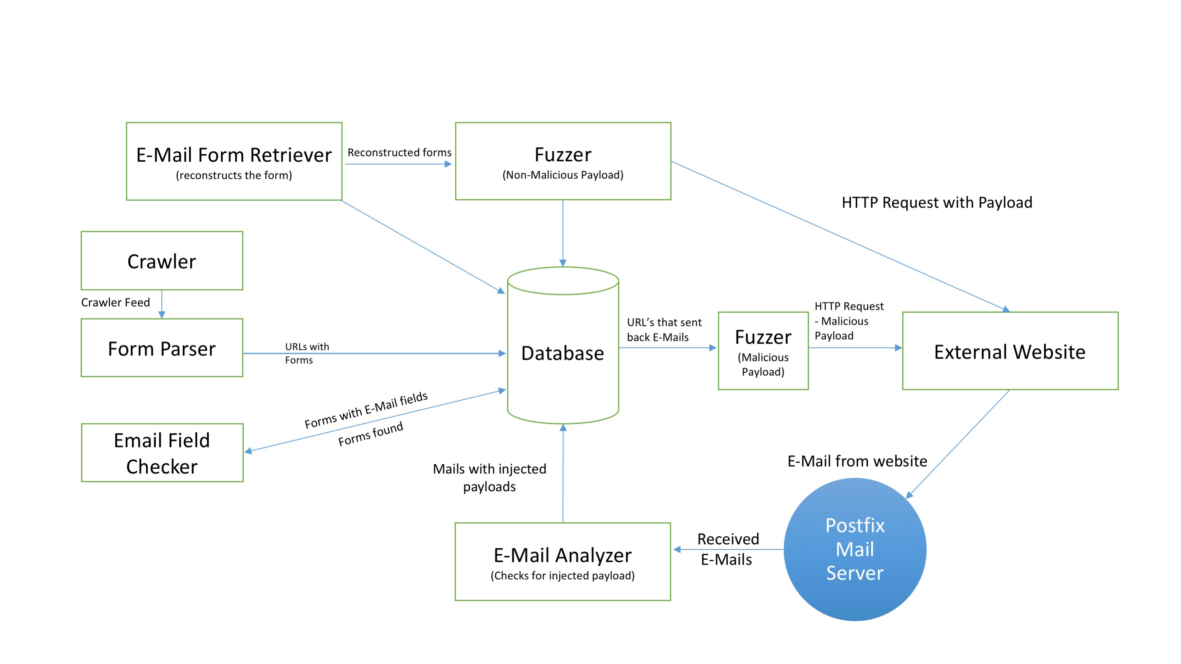
Overall Architecture

Slide 29
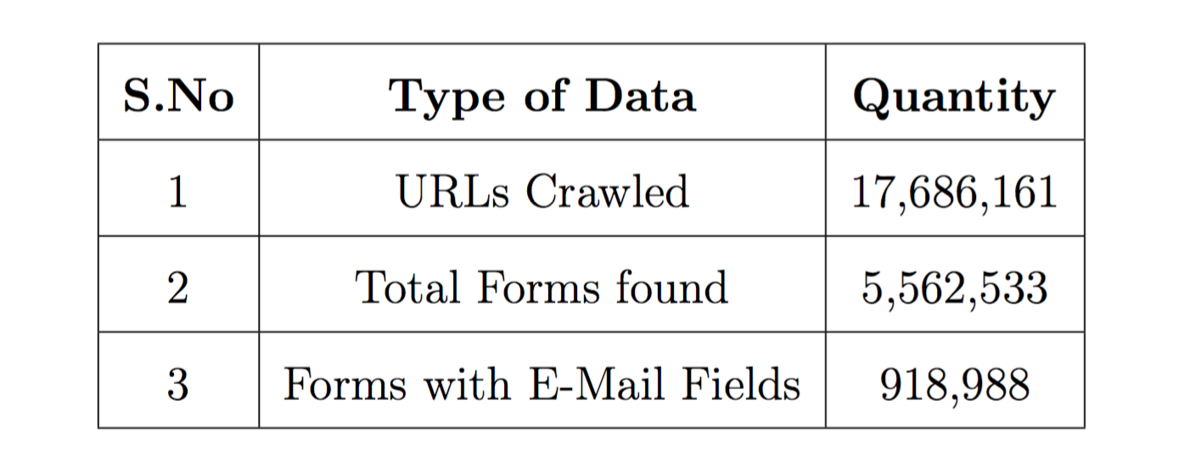
Results – Data Gathered
Over a period of 46 days (Feb 26, 2016 – Today), we were able to gather the data shown in the table below:

Slide 30
Results – Data Fuzzed
Type of fuzzing | Forms fuzzed | E-Mails received
Regular payload | 756,588 | 44,735
Malicious payload | 38,989 | 433

Slide 31
Results – E-Mails Received
The e-mails we received can be classified into the following major injection types (shown in the table below):
Type of Injection | No. of e-mails received
E-Mail Header Injections with bcc header | 265
To header injections alone | 142
Unique x-check headers found in nuser e-mails | 26
Total successful injections | 433
Notes:
E-Mail Header Injections with ‘bcc’ and ‘x-check’ headers These represent the perfect attack scenario where we are able to inject multiple headers into the e-mails. We can see that over 75% of the received ‘bcc’ header injected e-mails are also susceptible to other header injections.
4. Unique ‘x-check’ headers found in ‘nuser’ e-mails These represent the e-mails with form_ids that were not already found in the ‘maluser’ account. We attribute these e-mails to (probably) having a backend that was built with Python or another language having a similar behavior with respect to constructing headers.

Slide 32
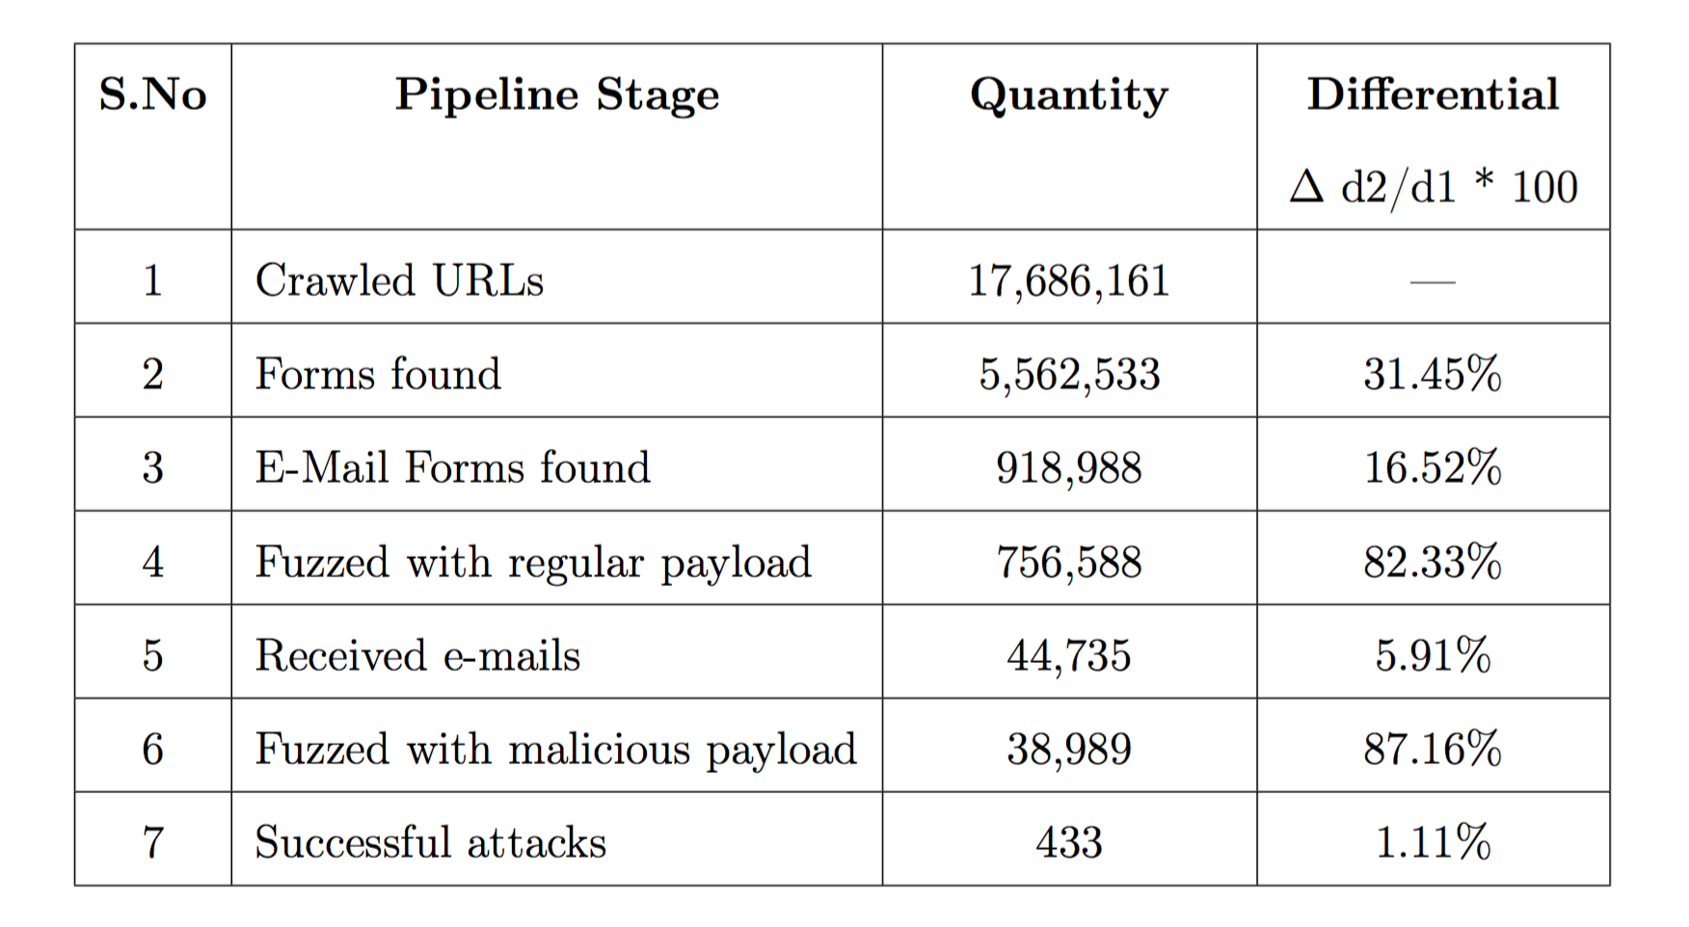
Results – Data Pipeline
Notes:
explain each %

Slide 33
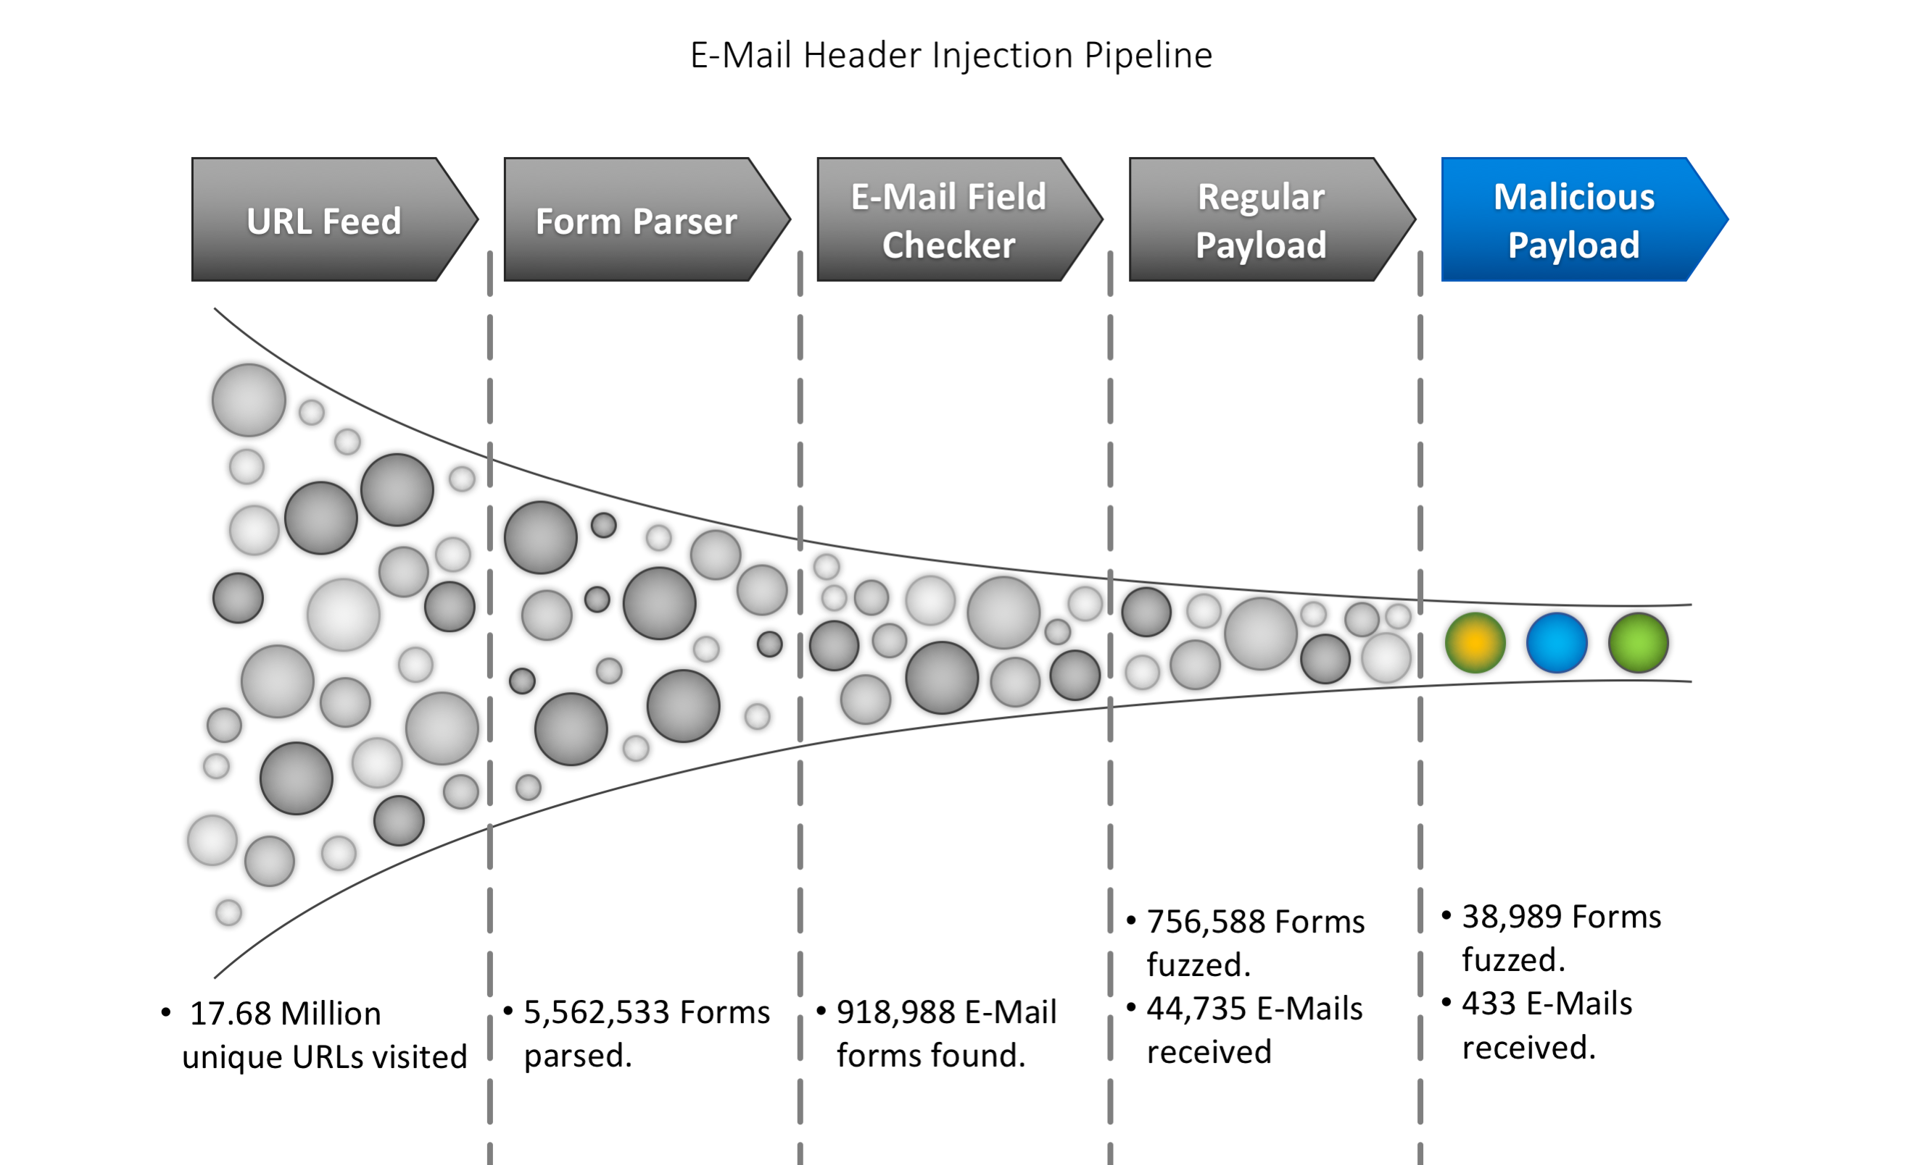
Data Pipeline
Visual Representation of the Data Pipeline:

Slide 34
Distribution across WWW
Successfully Injected E-Mails | Domains | IP Addresses
433 | 188 | 241

Slide 35
Responsible Disclosure of discovered vulnerabilities
Have e-mailed 188 websites about the discovered vulnerabilities
We sent e-mails to the following addresses (as described in RFC2142):
security@domain.com
admin@domain.com
webmaster@domain.com
Only 33 of these mailboxes were found
We received 7 responses, confirming 4 discovered vulnerabilities. Two of the developers fixed the vulnerability on their site

Slide 36
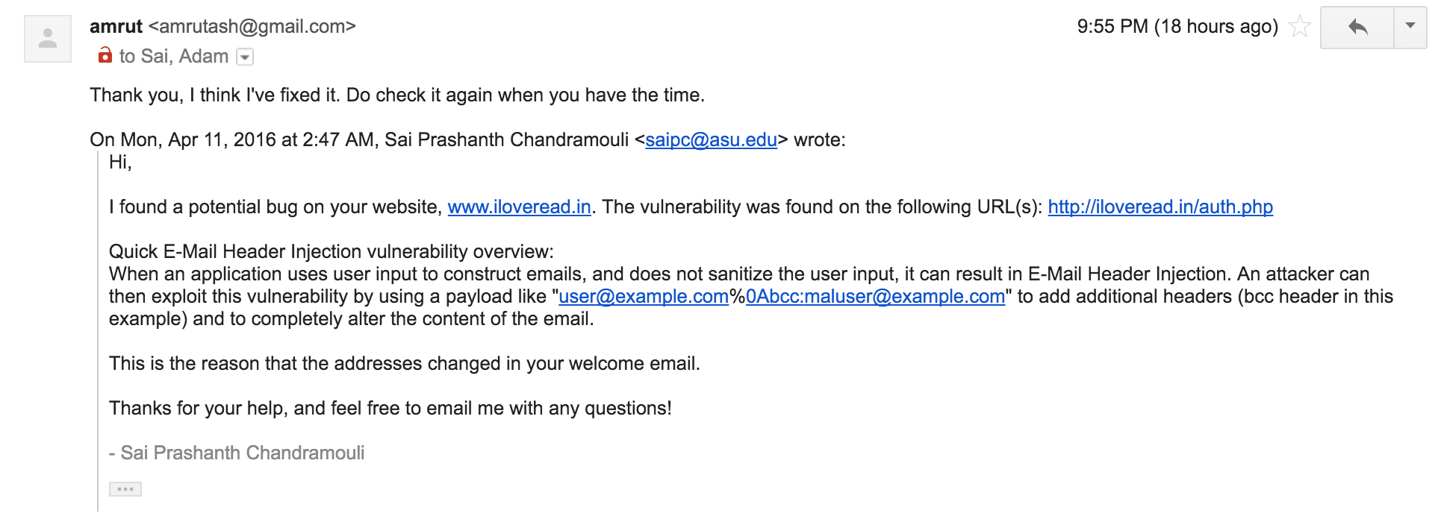
Developer response

Slide 37
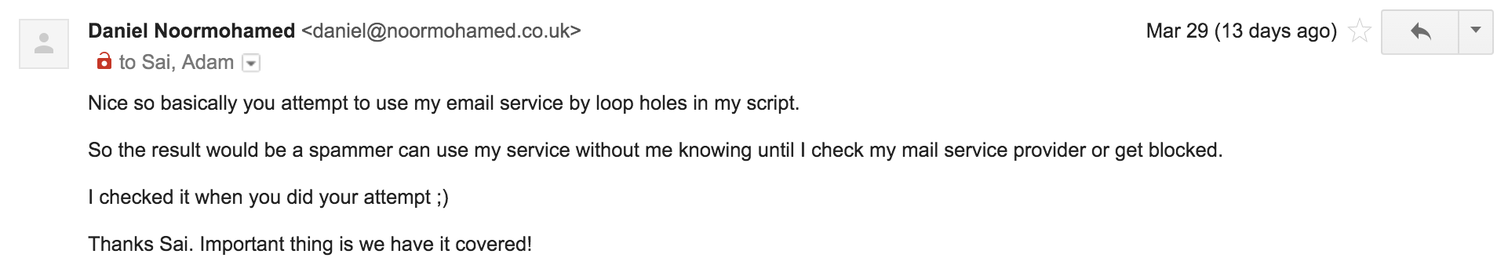
Developer response

Slide 38
Limitations
CAPTCHAs
JavaScript Apps
Blogs powered by WordPress/Drupal
Blacklisting by websites and ISPs
E-Mail libraries
Notes:
Bot blocking
Dynamic insertion of forms into web pages that do not appear in the source code
Plugins to sanitize input
Generation of thousands of requests blacklists our system
Many email libs provide builtin sanitization routines

Slide 39
Mitigation Strategies
Use E-Mail libraries
Language | Mail Libraries
PHP | PEAR Mail, PHPMailer, Swiftmailer
Python | SMTPLib with email.header.Header
Java | Apache Commons E-Mail
Ruby | Ruby Mail >= 2.6
WordPress | Contact Form 7

Slide 40
Mitigation Strategies – Contd.
Use a Content Management System (CMS)
Wordpress, Drupal, etc. with plugins to sanitize user input
Verify that the plugins work as intended
Notes:
add the example, here

Slide 41
Mitigation Strategies – Contd.
Input validation
Going back to our example from before, we can add input sanitization like so, $from = ($_REQUEST['email']); $sanitized = filter_var($from,FILTER_SANITIZE_EMAIL); if (filter_var($sanitized,FILTER_VALIDATE_EMAIL)) { // do the rest of the e-mail code } where ‘filter_var’ is a built-in PHP function.
Notes:
add the example, here

Slide 42
Conclusion
To the best of our knowledge, no other research has been conducted to determine the prevalence of this vulnerability across the World Wide Web.
We have designed and implemented an architecture to identify the existence of this vulnerability and fuzz websites in scale without causing any ostensible harm to the website.
Our work serves to not only prove the existence of the vulnerability on the World Wide Web but to quantify it.
Our work proves that E-Mail Header Injection vulnerability is widespread on the internet, found on 0.0025% of the 17,686,161 websites we crawled.

Slide 43
Acknowledgements
Dr. Adam Doupé, this project is his brain child, and without him this project wouldn’t have been possible
Dr. Gail-Joon Ahn, for all the support in the weekly meetings
Dr. Ziming Zhao, for feedback during the weekly meetings
Michael “Mike” Mabey, for helping set up the infrastructure for this project
Marthony Taguinod, for helping me document this project
SEFCOM members for providing valuable input during the weekly meetings, and ideas for the title of the paper

Slide 44
Questions?
Please feel free to ask any questions.

