Slide 1
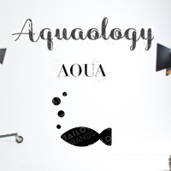
Aquaology
What are we planning for the features?
Our goals
The technologies we use are
Team slide

Slide 2
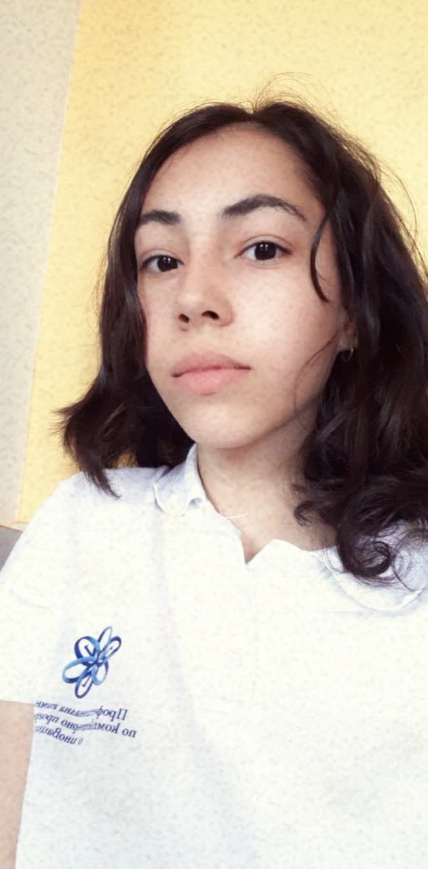
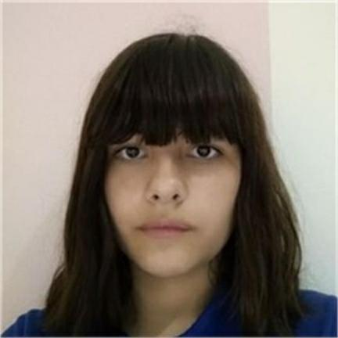

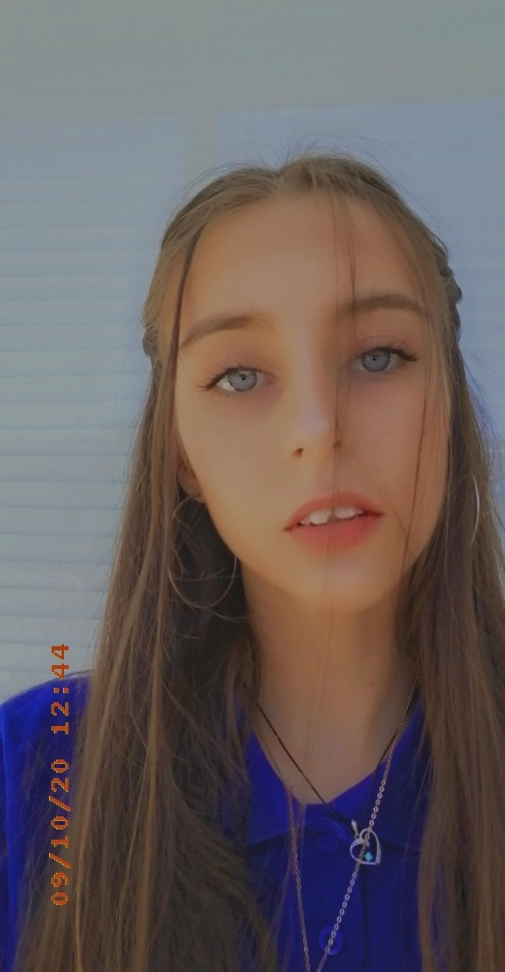
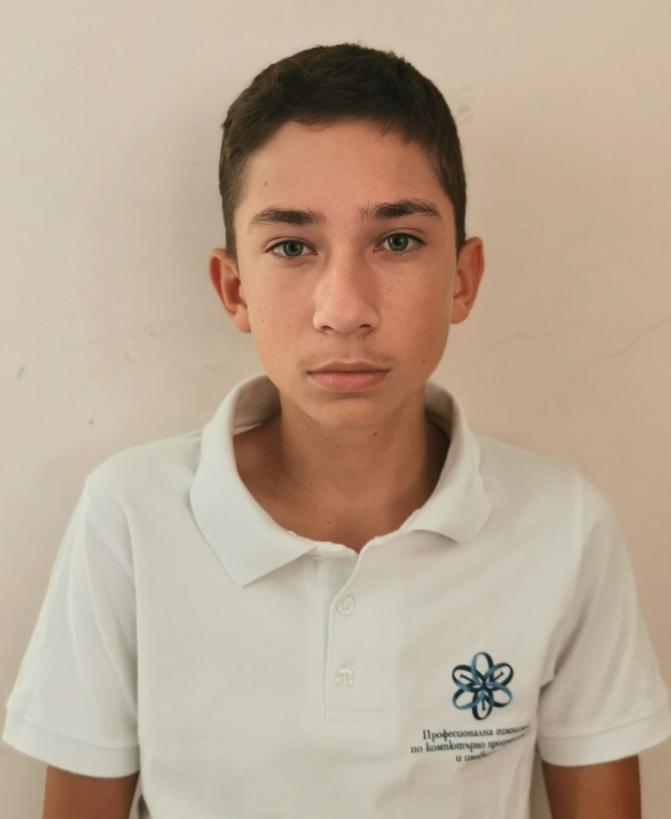
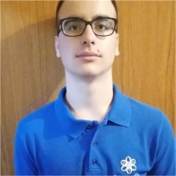
Team slide

Slide 3

Our goals:
To create a site that motivates people to protect water
To create an application that provides information about the moat how water can be protected
To show you that being friends with nature is not difficult at all

Slide 4




The technologies we use are:

Slide 5



What are we planning for the feature?
Let's add a working register form
To improve the application, which is made with C ++
To improve the quality of the project by eliminating errors

Slide 6


