Slide 1
Virtual Machine and Online Model
Definitions:
Virtual Machine: Refers to a copy of control system of VELA-CLARA which that is not connected to the actual machine(s).
Online Model: The simulation (guts) that computes ‘realistic’ values the Virtual Machine. It replace the physical machine for the Virtual Machine.

Slide 2
Goals:
To write coded procedures for VELA-CLARA so we can automate certain tasks.
To test production code offline in a safe environment
Develop and simulate experimental processes before using them on real Machine.

Slide 3
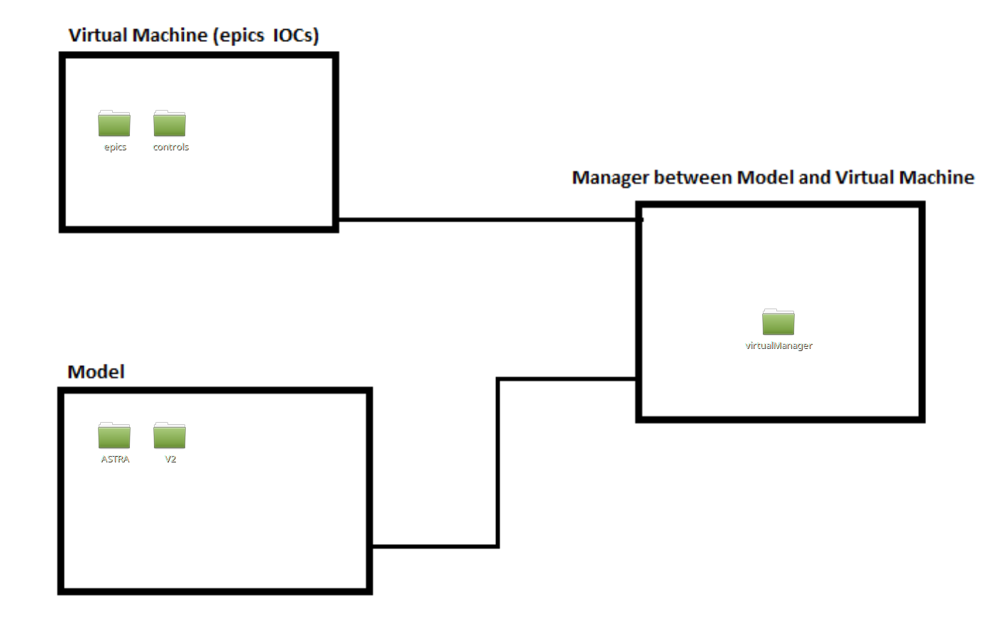
Structure

Slide 4
Demonstration
(TIM)

Slide 5
Where we are:
Version 1 and updates are completed and distributed.
Several users have it installed and are using it to develop code
Can simulate to 20m down VELA INJ line.
Can control a number of magnets and gun parameters
Can observe simulated particles on YAG screens and BPMs

Slide 6
Goals (Version 2)
More Controls: Incorporate CLARA PH1 controls into Virtual Machine
Add more VELA screens and Dipoles correctors
Make Flexible: Re-work the ‘Virtual Manager’ so can flexibly and easily run different simulations of selected sections to the beam line. The user can decided what to include
Speed: Optimise simulations where we can

