Slide 1
VM Simulation with EPICS PV Naming VM Version Control and Internet

Slide 2
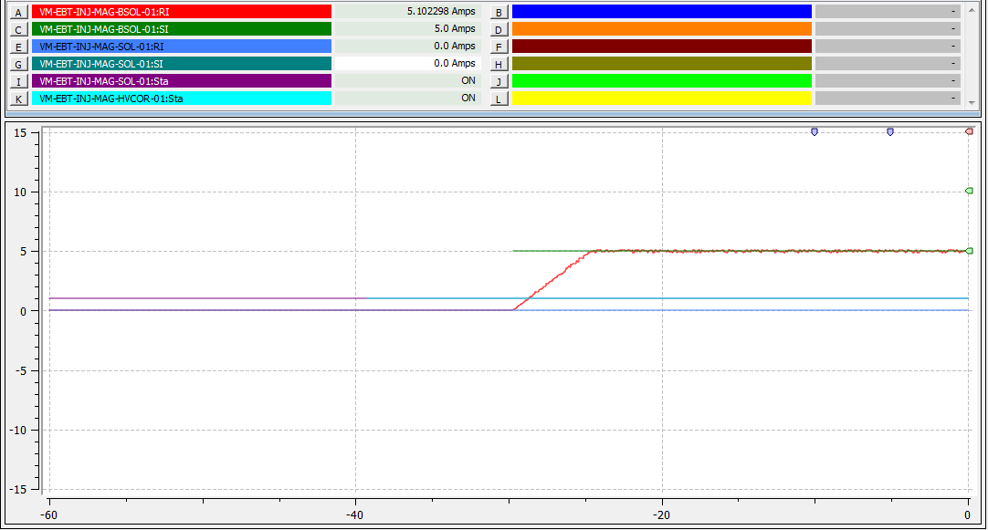
VM PV example:BSOL at 5A with noise
Amps
Noise and ramping current have been added to the simulation of the virtual magnets.
Noise is adjustable. Here it is about 5%
Time
We can currently simulate VELA:
Magnets ➔ Polarity and interlocks
Camera
Screens
BPM
User PVs

Slide 3
PV naming
EPICS provides a common control interface and interlocks between the hardware and the user. Its communication layer is via Process Variables (PVs). The user can set and read to these PVs
For ALICE and VELA there are hundreds (thousands?) of PVs. Only a handful of these are useful to the end user. Before these were named “organically”
For CLARA we are developing a consistent naming model. The VM has helped a collaboration with the AP group that is useful for this goal
As we develop the VM the goal is to document changes and map the PV naming for CLARA/VELA in a consistent way

Slide 4
Version control and network
It is important that the VM names do not clash with the real machine or other users machines. However EPICS IOCs makes pervasive use of the network connection to communicate with clients. We do not want problems with rouge IOCs in the future if the VM becomes prevalent. This could affect IOCs operating on the real machine
Allowing the VM onto the internet would allow parallel Astra simulations and the use of a Git repository for updates
With an upgrade to the EPICE version it is be possible to contain EPICS to the users machine and avoid these PV naming conflicts
Also, tag “VM_” has been added to the controls document for virtual PVs so their should be no conflicts with real PVs

