Slide 1
MED MOBI MANUAL
This is the manual showing all the screens and features

Slide 2

Table of Content
Login screen
Help page
Sign-up page
Sign-up as a doctor page
Forgot password page
Chat area page
Pick a date button screen
Calendar screen
Time picker screen
Doctor logged in screen
Check appointments screen
Add working days screen
Reschedule appointments screen

Slide 3
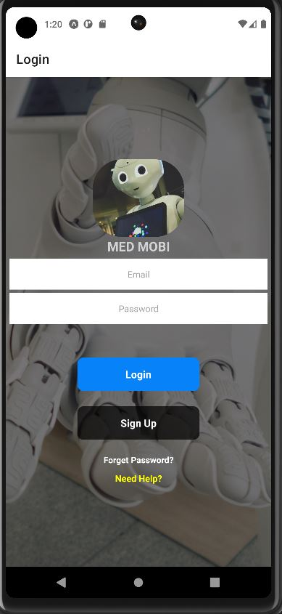
1. Login Screen
Email Input
Login Button
Password Input
Sign Up Button
Forgot Password
Help Button

Slide 4
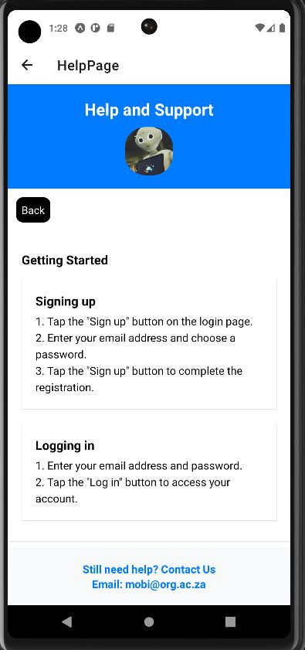
2. Help Page
Back Button
This is the help screen, it provides helpful information on how to navigate and do certain things such as:
Signing up
Logging in
Booking appointments
Cancelling appointment
Reschedule appointments
Searching about a medical condition
Having a conversation with Mobi

Slide 5
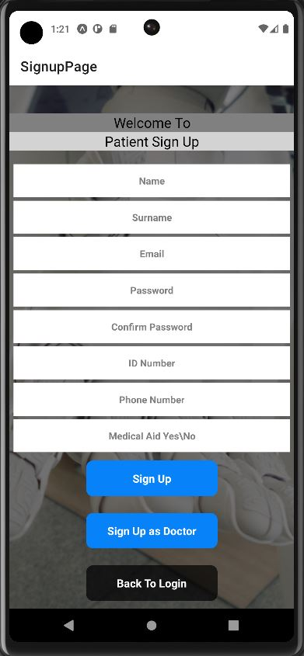
3. Sign-up Page
The signup page is for creating a new account, the following details are required:
The users name
The users surname
The users email
A password for the account
Re-enter the password for confirmation
The users ID number
The users phone number
Yes/No confirmation whether the user has medical aid or not
After all data has been entered correctly a button will appear written “sign up”

Slide 6
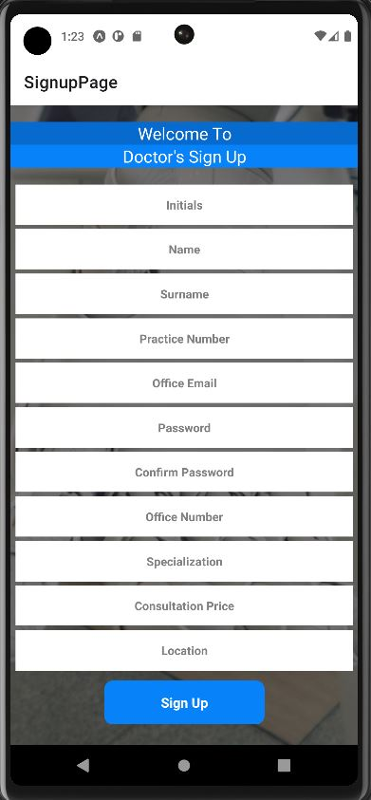
4. Sign-up as Doctor Page
The signup as a doctor page is for creating a new account for medical practitioners, the following details are required:
The doctors initials
The doctors name
The doctors surname
The doctors office email
A password for the account
Re-enter the password for confirmation
The doctor office phone/Tel number
The doctors practice number
The doctors specialization
The doctors office location
The doctors consultation price
After the all details have been entered the doctor press the button written “sign up” and he/she will be logged in to the doctors portal.

Slide 7
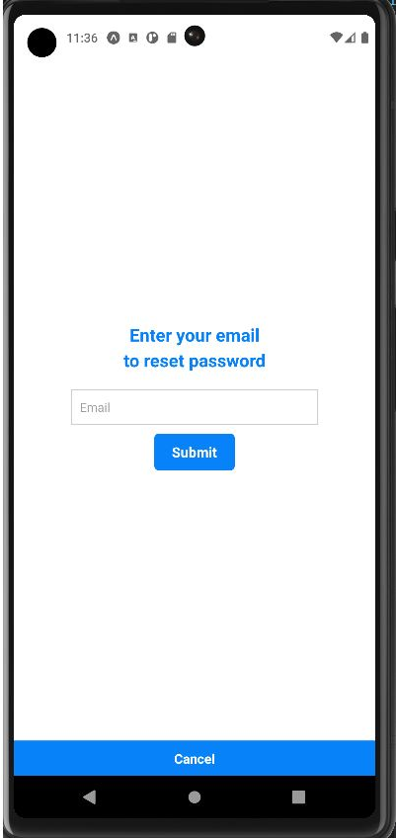
5. Forgot Password Page
The forgot password page is a page for all users who forgot their password for logging in. The user enters their registered email address and presses “submit” after that an email containing user’s password will be sent.

Slide 8
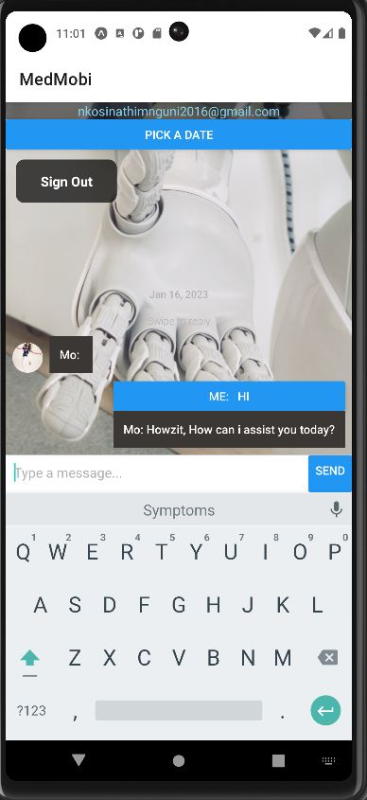
6. Chat Area Page

Slide 9
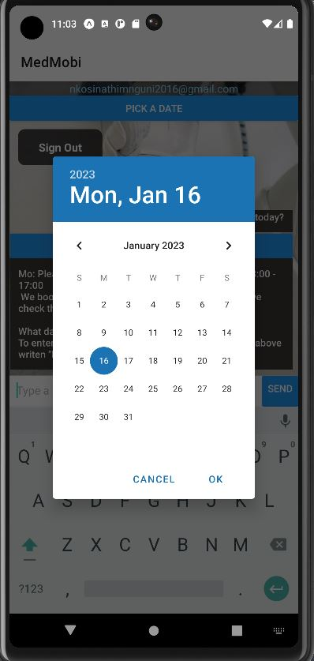
7. Pick A Date Button
7.1. Calendar Screen
The pick a date button is used when a user is booking or rescheduling an appointment, the first screen is the date screen whereby the user picks the date at which they would like to book for, then press “ok” to move on to the next screen which is the time screen

Slide 10
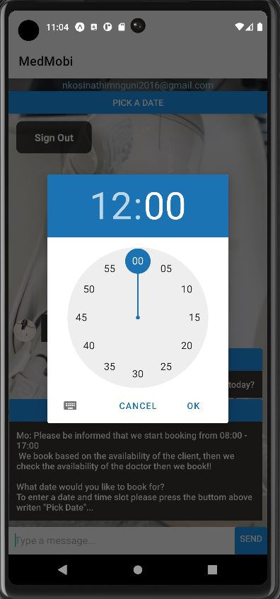
7. Pick A Date Button
7.2. Time Screen
This screen is the time picker screen, this where the user picks the time they would like to book for with the date selected in the previous screen the press “ok” the continue with booking or rescheduling an appointment.

Slide 11
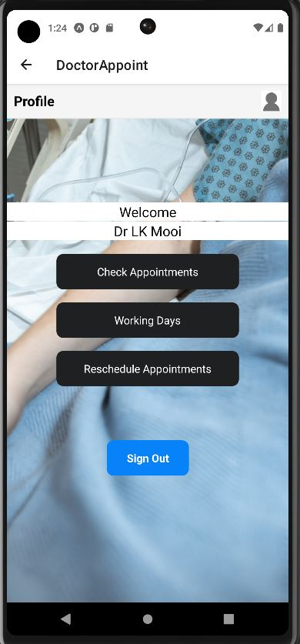
8. Doctors Logged in Screen
This is the page that appears if you are logged in as a doctor which contains:
Check Appointments button - This button allows doctors to view all their up coming appointments.
Working Days button – This will allow the doctors to add the days whereby they will be available and working, add the date and the time they’ll start working and the time they’ll be leaving the office by.
Reschedule Appointments button – This button allows doctors to delete or rather prompt the user to change he's/her appointment date, in results of the doctor having an emergency or any situations that would allow the doctor to cancel the appointment

Slide 12
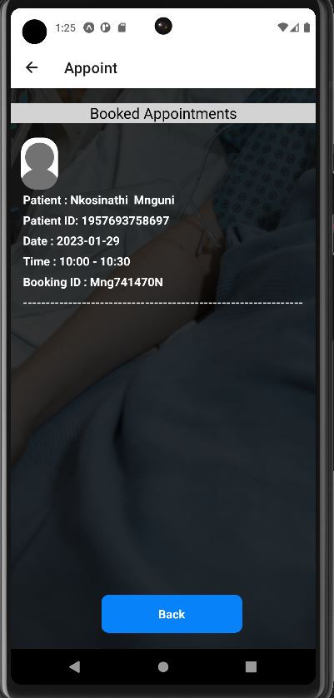
8.1. Check Appointments Screen
This is the Check Appointment Button
This button displays all the appointments the doctor has in ascending order. The information that must be displayed is the patients ID, the patients name and surname, the date and time of the appointments, and the booking id.

Slide 13
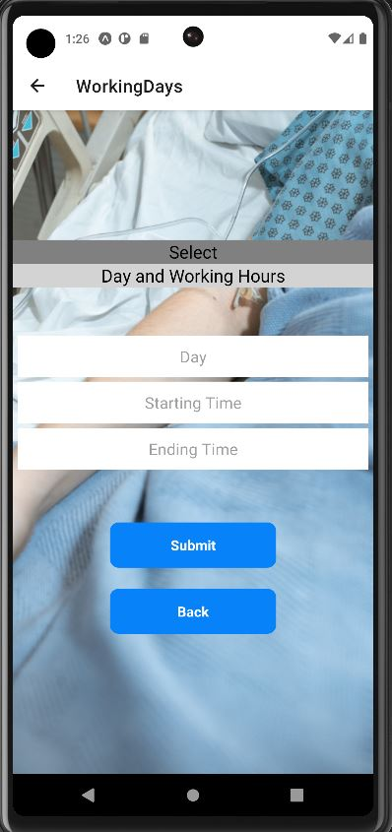
8.2. Add Working days Screen
This is the working day button, this button allows doctors to add the days they will be working on and from what time they’ll be in the office(start time) until what times(ending time), after selecting all that the submit button adds the day.
The Day input will display a calendar and require the user to pick the day they want to add
The Starting time input will require one to have selected the day prior then it will display the time input that looks like s clock in 24H input and will require the doctor to pick the time they’ll start working by’
The Ending time input will require the prior input of the starting time, then it will display a clock in the same format as the starting time input and will require the doctors to pick their end time of the day
Note user cant pick ending time without picking the starting time and ending time cannot be less than or equals to the start time only greater and the starting time cannot be picking without picking the day first and days before today will not be accessible

Slide 14
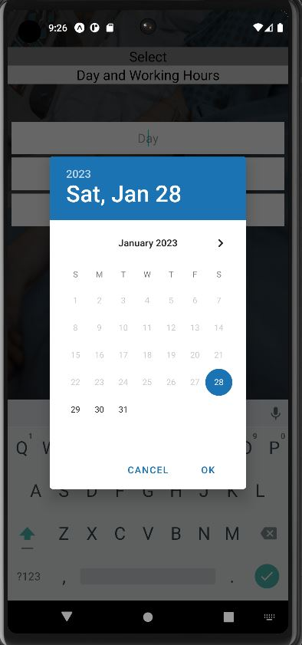
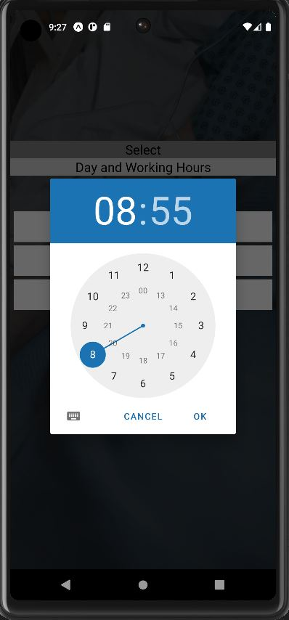
8.2.2. Starting and Ending Time picker
8.2.1. Day Picker
8.2.1. Shows the pop up of the calendar screen that shows after the doctor clicks the Day input inside the working day screen
8.2.2. Shows the time picker after the doctor presses either the starting time input or ending time input in the working days screen

Slide 15
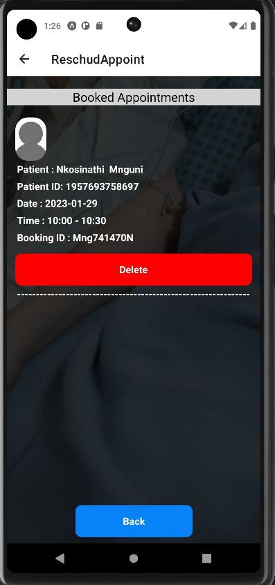
8.3. Reschedule Appointments Screen
This is the Reschedule appointments button, it allows doctors to view all their appointments and delete or rather cancel that appointment, resulting in an email being sent to the user telling him or her to reschedule the appointment.
The information that must be displayed is the patients ID, the patients name and surname, the date and time of the appointments, and the booking id.

Slide 16
9. Possible Errors to encounter

Slide 17
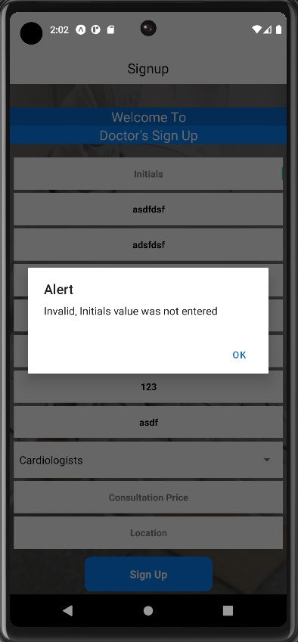
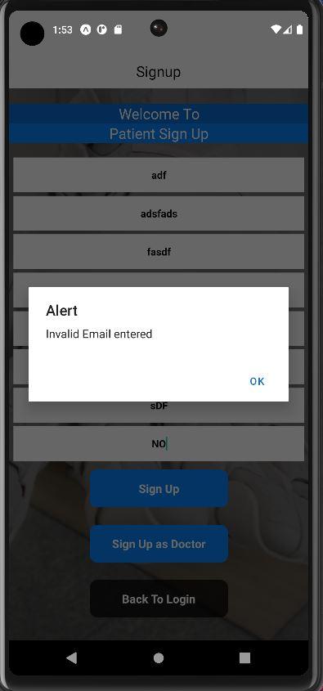

Slide 18
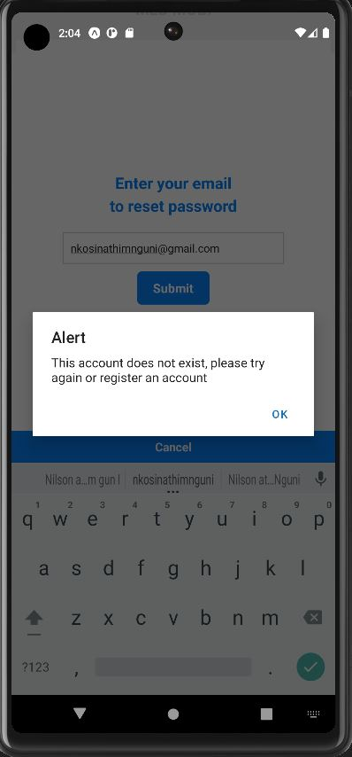
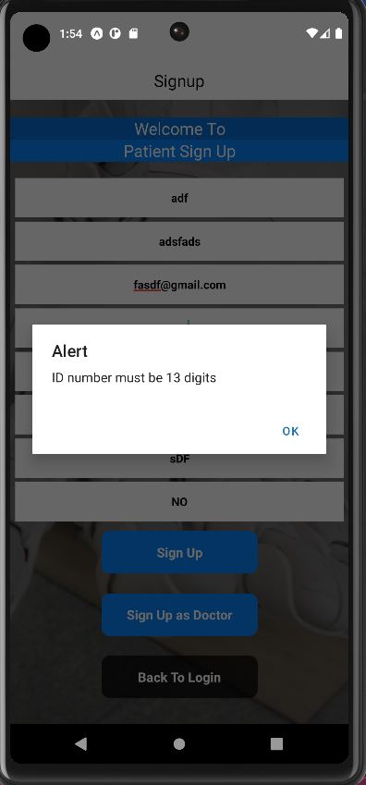

Slide 19
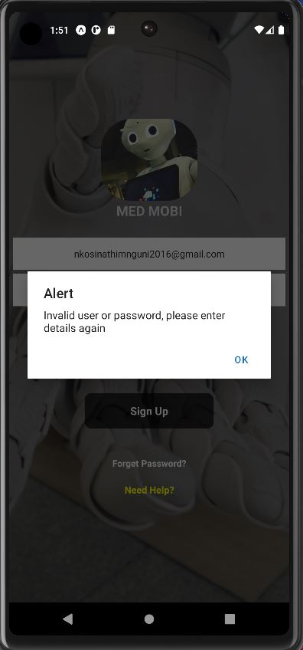
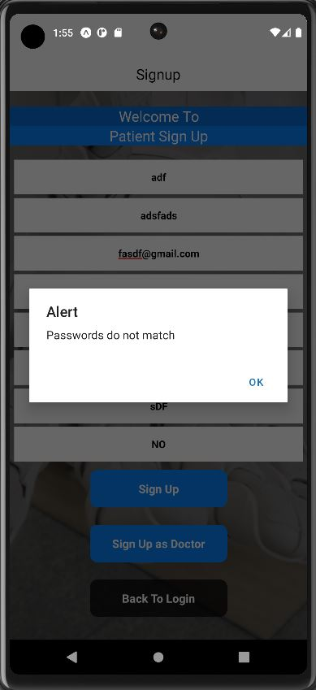

Slide 20
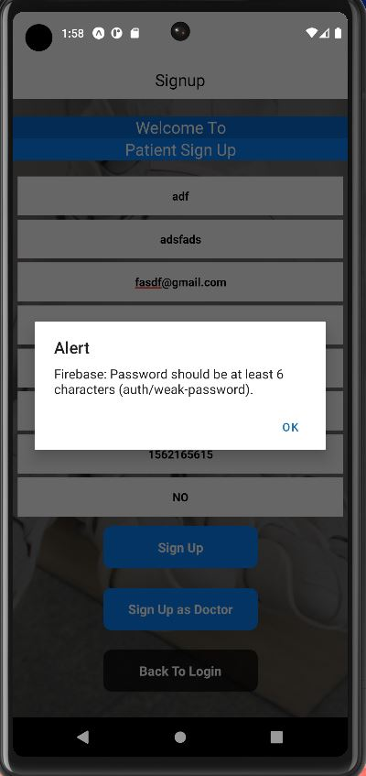
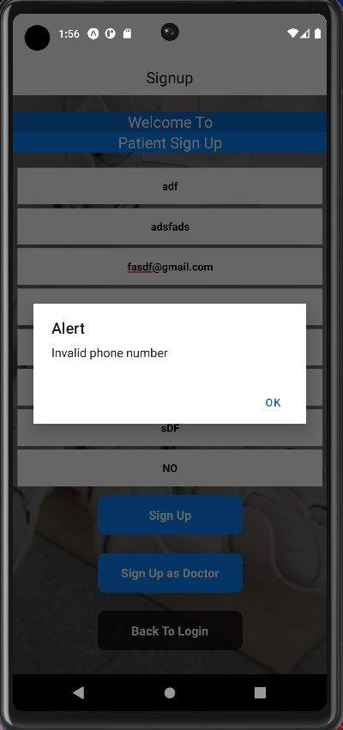

Slide 21
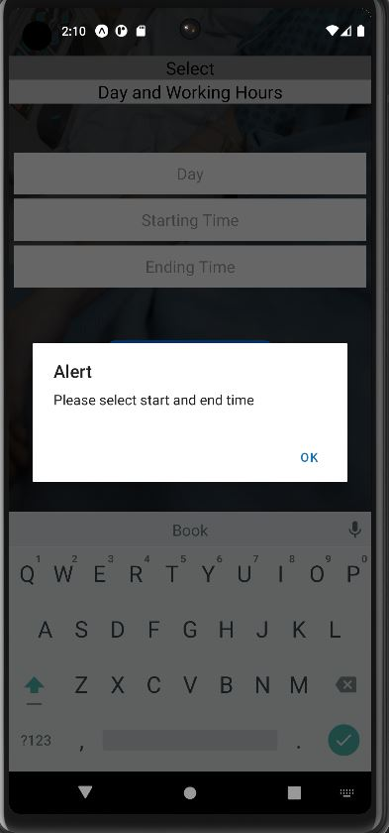
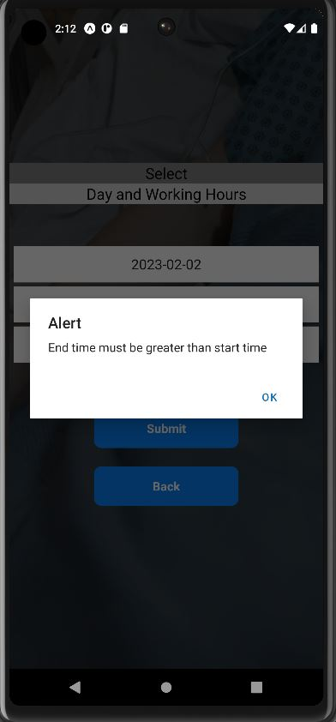

Slide 22
