Slide 1


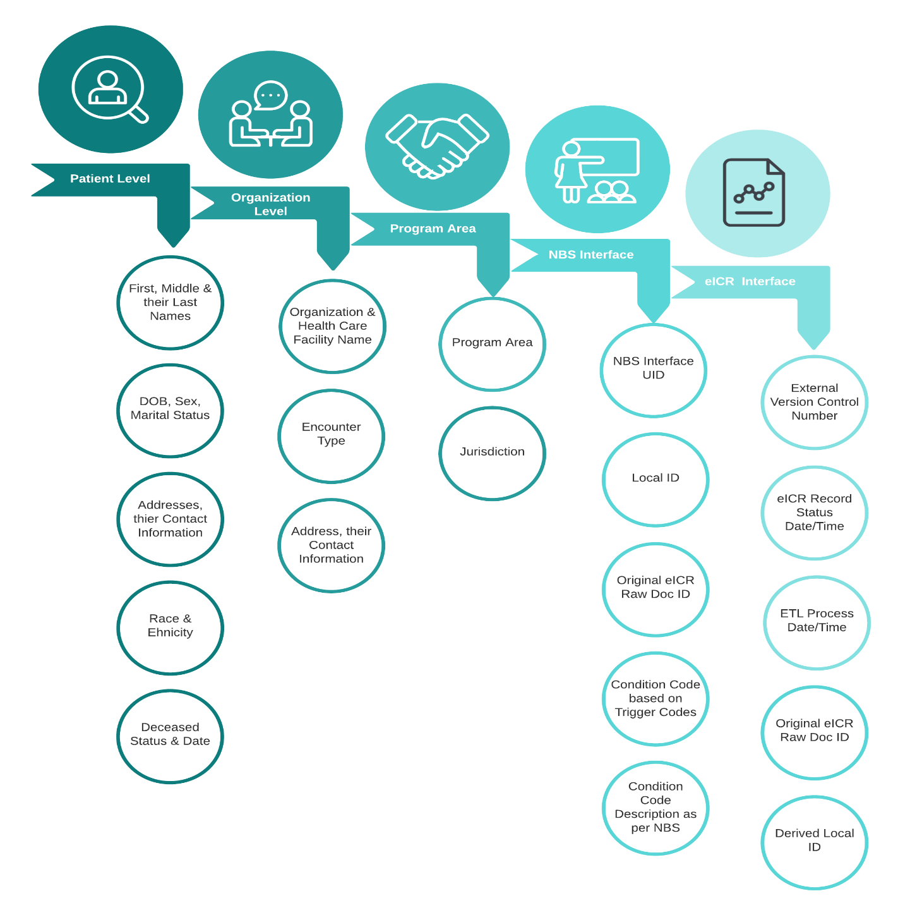
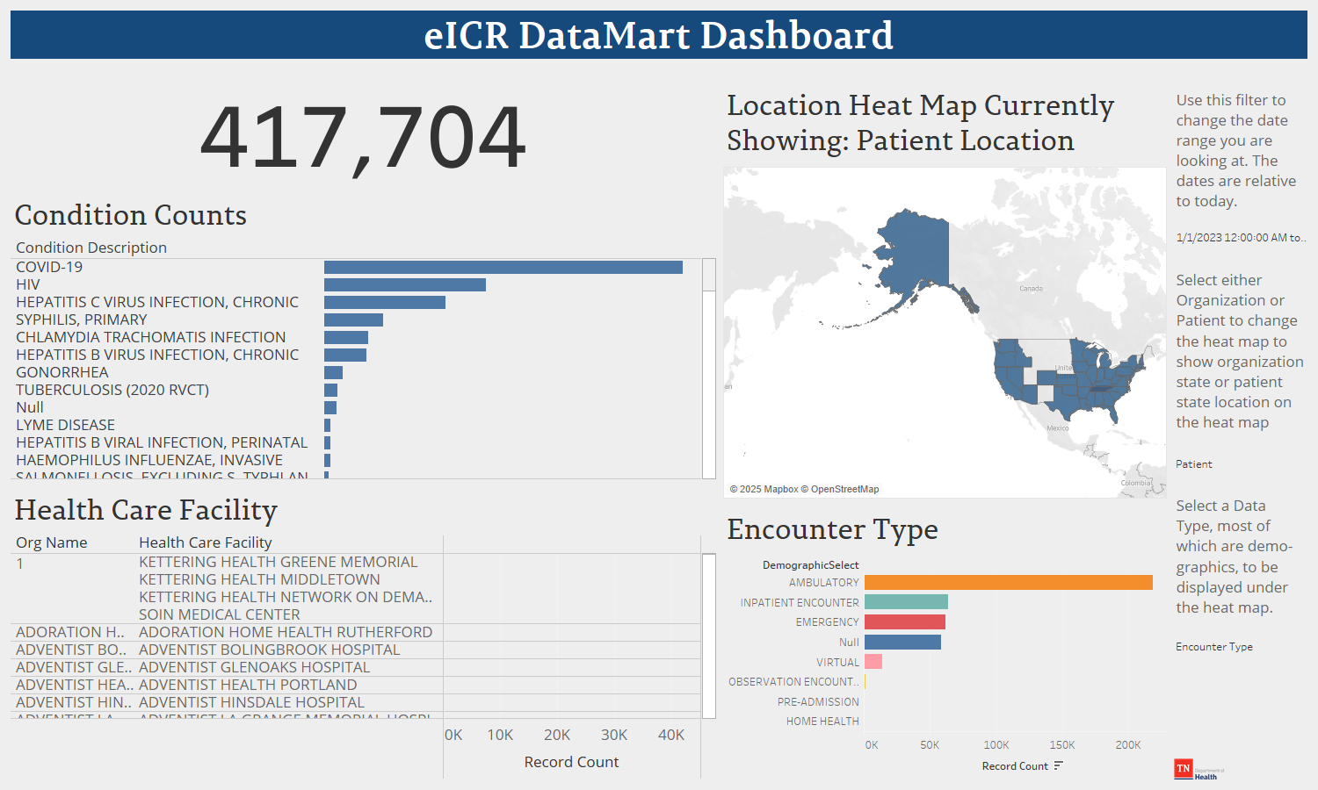
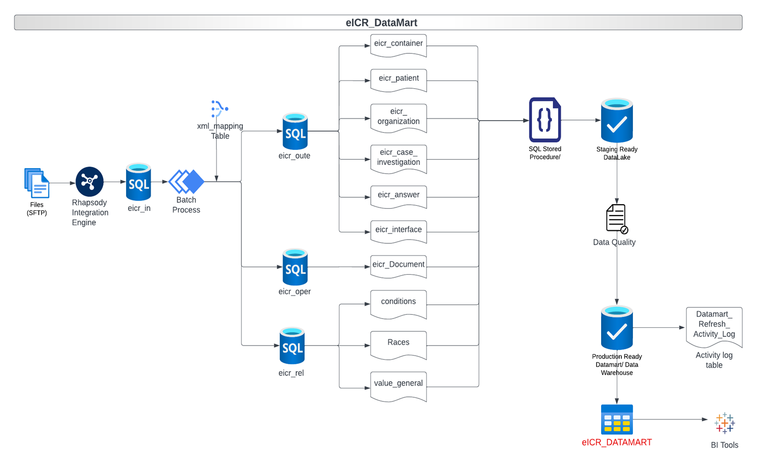

When Field Epis Don’t Have Access to Data, Build a Datamart!
H. Patel, N. Williams
Background
Results
Conclusions
Tennessee is one of 20 states that use the National Electronic Disease Surveillance System Base System (NBS), a CDC-developed integrated information system.
NBS manages various types of data critical for public health reporting and surveillance.
Many NBS databases and tables are restricted from field epidemiologists at the Tennessee Department of Health due to system security and health data protection.
As a result, field epidemiologists often rely on time-consuming manual processes to complete their work.
Comprehensive Data Consolidation:
Integrated patient, organization, and healthcare facility data.
Included reportable conditions, jurisdiction, and program area information in one accessible table.
Daily Refresh for Real-Time Insights:
Up-to-date information for informed decision-making
Stay ahead of emerging trends and critical situations
Timestamps for Effective Analysis:
Track chronology and analyze trends over time
Facilitates early pattern detection for proactive interventions.
Enhanced Visibility with Update Control:
Display of updated external control numbers for the eICR updates(same patient)
Clear visibility into the evolution of reported condition
Empowering Program Areas:
Efficient access to critical data
Supports informed decision-making, contributing to improved patient care outcomes and overall better public health.
Objective
To streamline epidemiologic workflows by reducing data access barriers through the creation of a consolidated, daily-updated Datamart table containing the necessary data for field epidemiologists
Methods
Needs Assessment:
Conducted interviews and surveys with program areas to identify essential data needs.
Field Identification and Extraction:
Identified which required data elements already existed in the databases and tables in NBS
Determined where in the eCR files the required data elements exist that don’t already exist in the databases and tables in NBS
Updated the MSG_XML_MAPPING table so that the MSG_ANSWER table was populated with fields that didn’t already exist in NBS
Automation:
Developed an SQL stored procedure to automatically update the consolidated Datamart table daily.
Verified that the new process maintained system health and security standards within the NBS backend.
Figure 2. Data elements included in the eCR Datamart
Acknowledgements
This study/report was supported in part by the Data Science Team Training program administered by the Council of State and Territorial Epidemiologists (CSTE).
Contact Information
Hardik Patel, MS & Nathan Williams, MPH
CEDS.informatics@tn.gov
https://github.com/TDH-CEDEP/eCR-Share
Figure 1. Data flow diagram for data entering the eCR Datamart
Figure 3. Example dashboard/report created in Tableau using the eCR Datamart data.

