Slide 1


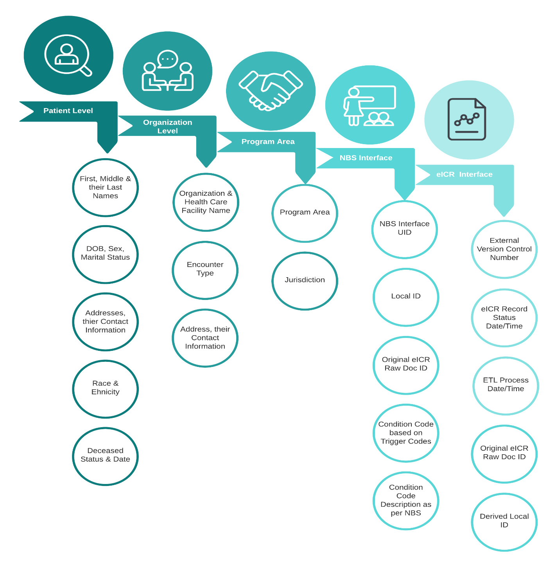
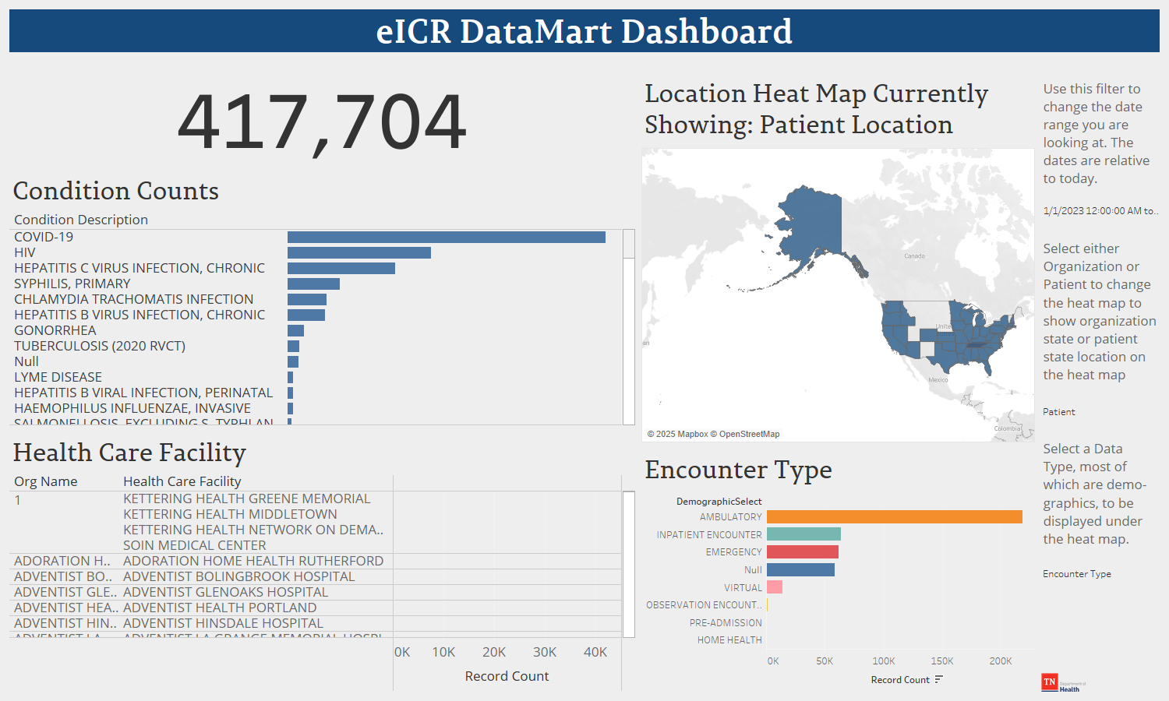
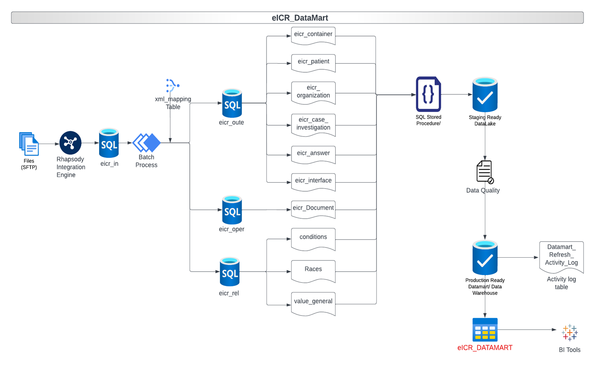

When Field Epis Don’t Have Access to Data, Build a Datamart!
H. Patel, N. Williams
Background
Results
Conclusions
Tennessee is one of 20 states that use the National Electronic Disease Surveillance System Base System (NBS), a CDC-developed integrated information system.
NBS uses many databases and tables to store the data that the system uses.
At the Tennessee Department of Health, many of these tables are unavailable to field epis for system health and security reasons.
Field epis had to perform long manual processes to perform their epidemiologic work
Comprehensive Data Consolidation:
Patient, organization, and health care facility data
reportable conditions, jurisdiction, and program area information
Daily Refresh for Real-Time Insights:
Up-to-date information for informed decision-making
stay ahead of emerging trends and critical situations
Timestamps for Effective Analysis:
Track chronology and analyze trends over time
Identify patterns for proactive intervention
Enhanced Visibility with Update Control:
Display of updated external control numbers for the eICR updates(same patient)
Clear visibility into the evolution of reported condition
Empowering Program Areas:
Efficient access to critical data
Informed decision-making for better patient care outcomes
Objective
Reduce the burden of field epis faced due to data access limitations by consolidating the required for their work into a single Datamart table that is updated daily.
Methods
Needs Assessment:
Interviewed and surveyed program areas for their needs.
Field Identification and Extraction:
Determined which required data elements already existed in the databases and tables in NBS
Determine where in the eCR files the required data elements exist that don’t already exist in the databases and tables in NBS
Update the MSG_XML_MAPPING table so that the MSG_ANSWER table was populated with fields that didn’t already exist in NBS
Automation:
Developed an SQL stored procedure to run daily
Made sure that the new process didn’t impact health or security of our NBS backend
Figure 2. Data elements included in the eCR Datamart
Acknowledgements
This study/report was supported in part by the Data Science Team Training program administered by the Council of State and Territorial Epidemiologists (CSTE).
Contact Information
Hardik Patel, MS & Nathan Williams, MPH
CEDS.informatics@tn.gov
Figure 1. Data flow diagram for data entering the eCR Datamart
Figure 3. Example dashboard/report created in Tableau using the eCR datamart data.

