Slide 1




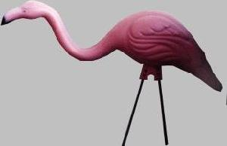



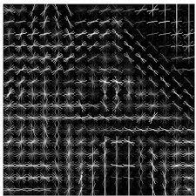
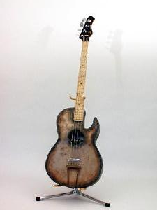
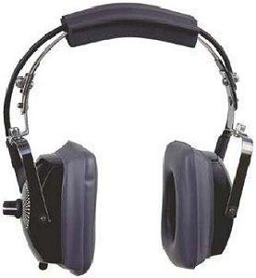
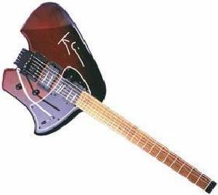
2D-array
Pre-processing
Feature extraction
Embedding
Cluster evaluation
Cluster labels
Color (rgb/gray)
Scale
Resize
PCA
HOG
tSNE
clusteval
Path to file locations

