Slide 1

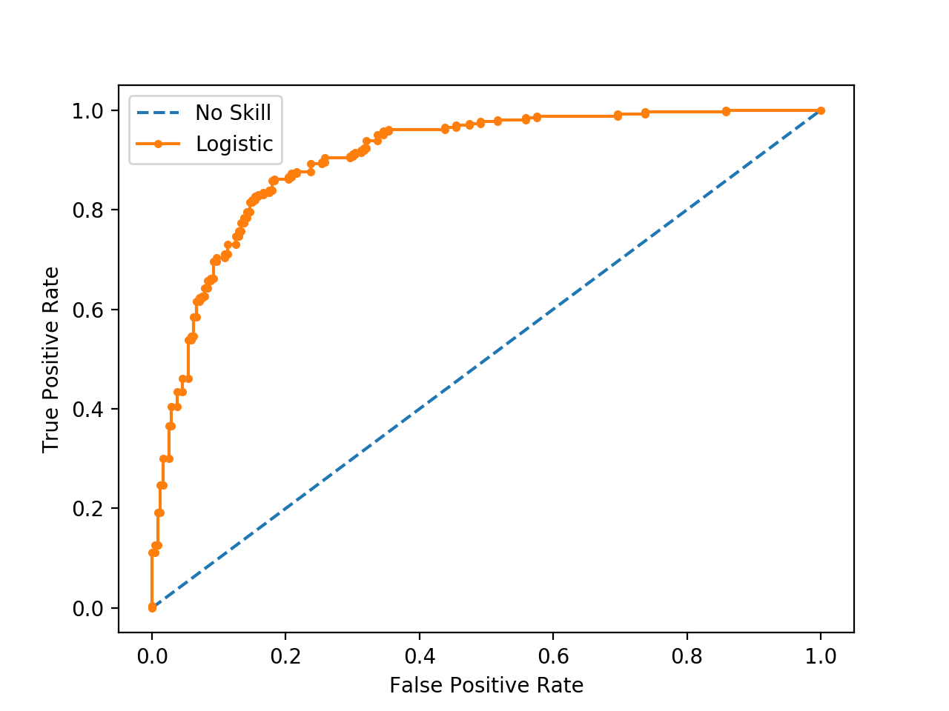
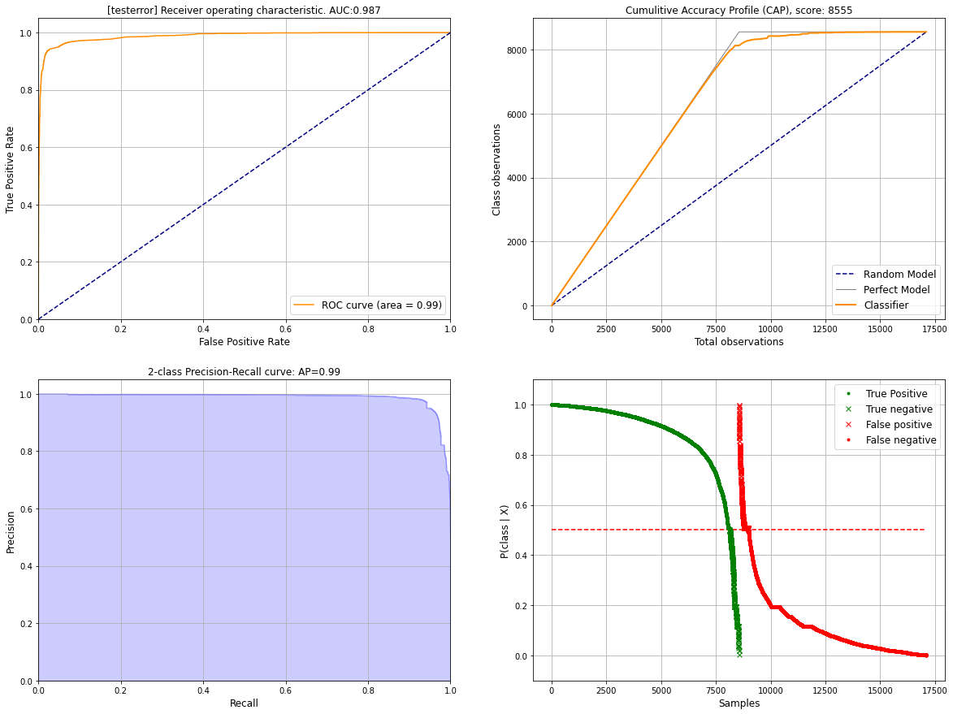
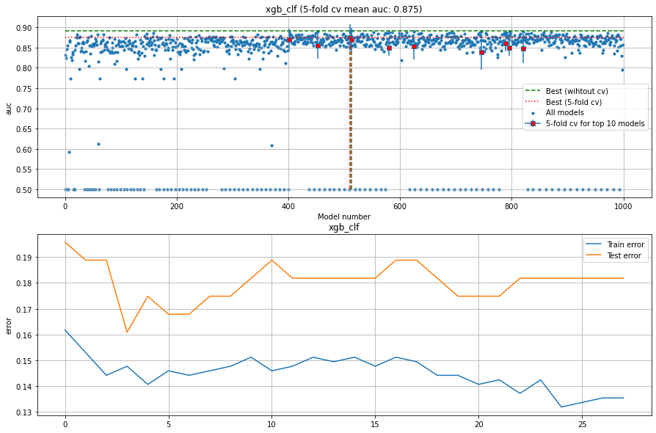
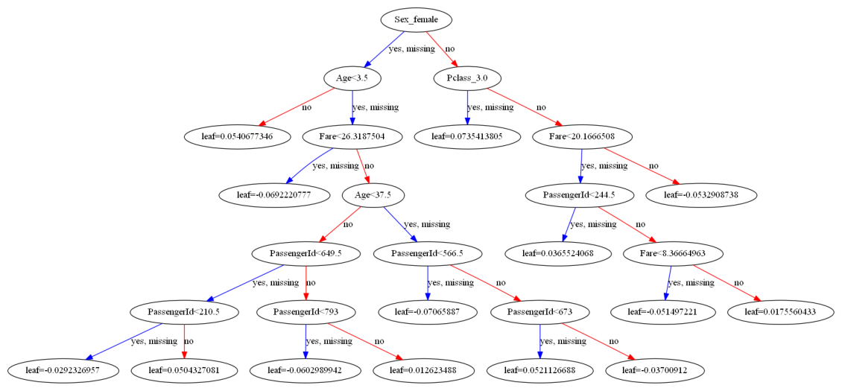
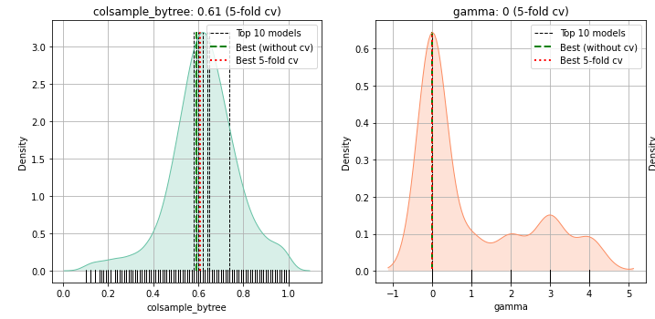
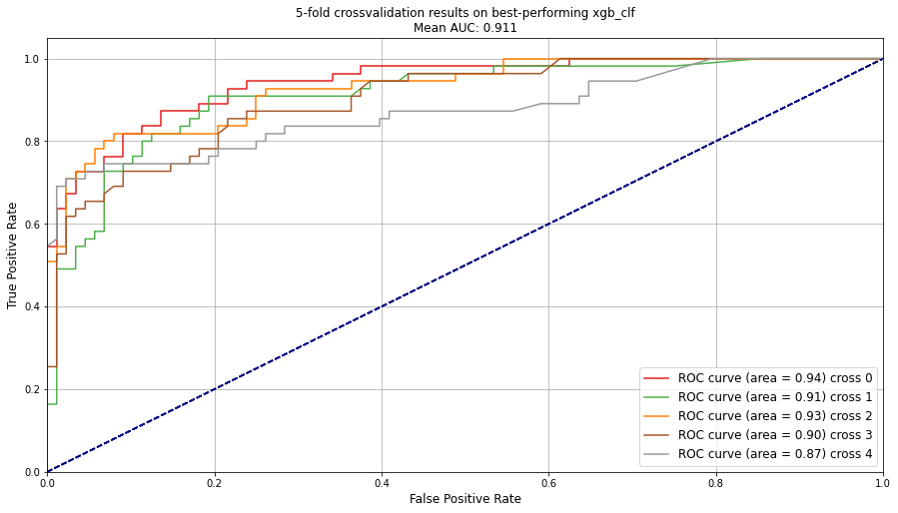
HGBoost
Hyperparameter optimization using HyperOpt
and k-fold cross validation
A
Finding parameters
Train and test set (80%)
Total dataset
Model i
Model i
Model k with hyperparameters
B
Validation set
(20%)
Best model
parameters
Performance on validation set
C
Fit model on entire dataset using optimized parameters
Fitted model
D
Plots to analyse the results

