Slide 1
One Endpoint to Rule them All
Ian Philpot
Sr. Technical Evangelist
@tripdubroot

Slide 2
Session objectives and takeaways
Session objective(s):
Build compelling apps with Microsoft Graph

Slide 3
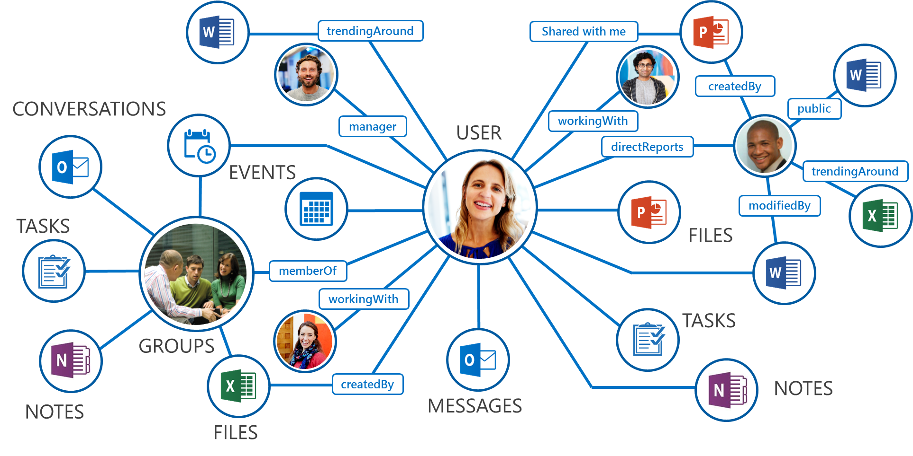
Recap: What is Microsoft Graph?
Single API for:
Accessing data
/me, /users, /groups, /messages, /drive, ….
Traversing data
/drive/items/<id>/lastmodifiedByUser
Accessing insights
/insights/trending
Work/School and Personal
https://graph.microsoft.com/

Slide 4
APIs scattered and inconsistent
Azure Active Directory Graph API
https://graph.windows.net/contoso.com/users
https://graph.windows.net/contoso.com/groups
Windows Live profile API
https://apis.live.net/v5.0/me
SharePoint User Profile API
https://contoso.sharepoint.com/_api/SP.UserProfiles.PeopleManager/GetMyProperties
Exchange HD Picture API
https://graph.microsoft.com/v1.0/me/photo
Outlook REST API
https://outlook.office.com/api/v2.0/me/Messages
https://outlook.office.com/api/v2.0/me/Events
Office Graph in SharePoint Online
https://contoso.sharepoint.com/_api/search/query?Querytext='*'&Properties='GraphQuery:actor(ME,action\:1020,or(action\:1020\,action\:1003,action\:1001,action\:1024,action\:1005,action\:1037,action\:1039,action\:1036)'&SelectProperties='Docid,Title
OneDrive for Business API
https://contoso-my.sharepoint.com/personal
/yina_contoso_com/_api/v2.0/drive
https://contoso.sharepoint.com/sites
/designCouncil/_api/v2./drive
OneDrive API
https://api.onedrive.com/v1.0/drive

Slide 5
APIs centralized and consistent
One endpoint to access it: https://graph.microsoft.com/
Operation | Service endpoint
GET my profile | https://graph.microsoft.com/v1.0/me
GET my files | https://graph.microsoft.com/v1.0/me/drive/root/children
GET my photo | https://graph.microsoft.com/v1.0/me/photo/$value
GET my mail | https://graph.microsoft.com/v1.0/me/messages
GET my calendar | https://graph.microsoft.com/v1.0/me/calendar
GET my manager | https://graph.microsoft.com/v1.0/me/manager
GET last user to modify file foo.txt | https://graph.microsoft.com/v1.0/me/drive/root/children/foo.txt/lastModifiedByUser
GET users in my organization | https://graph.microsoft.com/v1.0/users
GET group conversations | https://graph.microsoft.com/v1.0/groups/<id>/conversations
GET people related to me | https://graph.microsoft.com/beta/me/people
GET my tasks | https://graph.microsoft.com/beta/me/tasks
GET my notes | https://graph.microsoft.com/beta/me/notes/notebooks
GET files trending around me | https://graph.microsoft.com/beta/me/insights/trending

Slide 6
Explorer Demo

Slide 7
Resources for shipping 1.0/beta features
Office Platform Overview https://channel9.msdn.com/Events/Build/2016/B872
Build Smarter Apps by Connecting to Office Services
https://channel9.msdn.com/Events/Build/2016/B820
Build Cool Apps with the Microsoft Graph, Tap into the Intelligence and Reach Millions of Users
https://channel9.msdn.com/Events/Build/2016/T617

Slide 8
Authentication

Slide 9
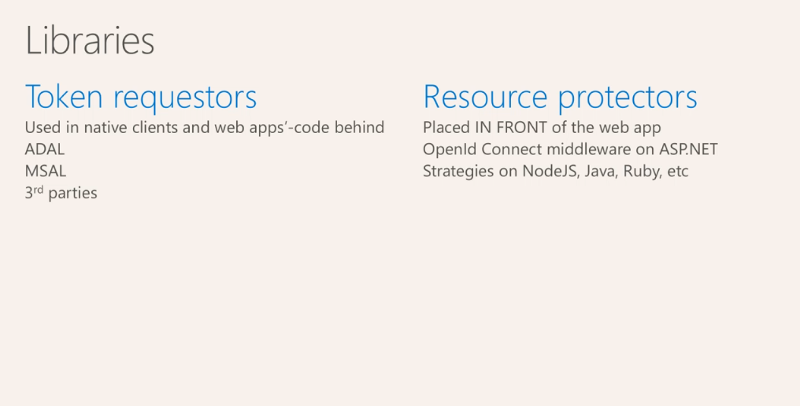

Slide 10
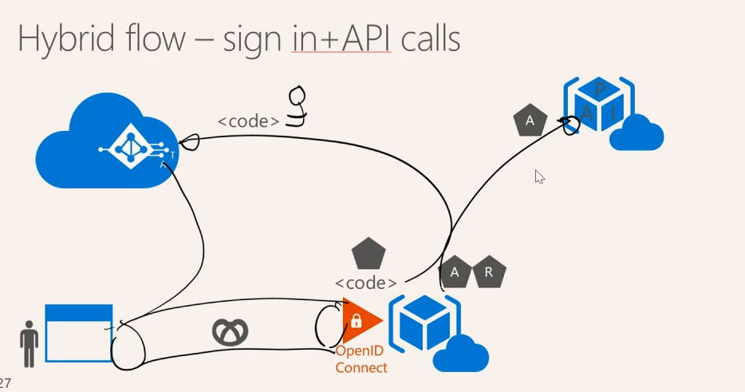

Slide 11
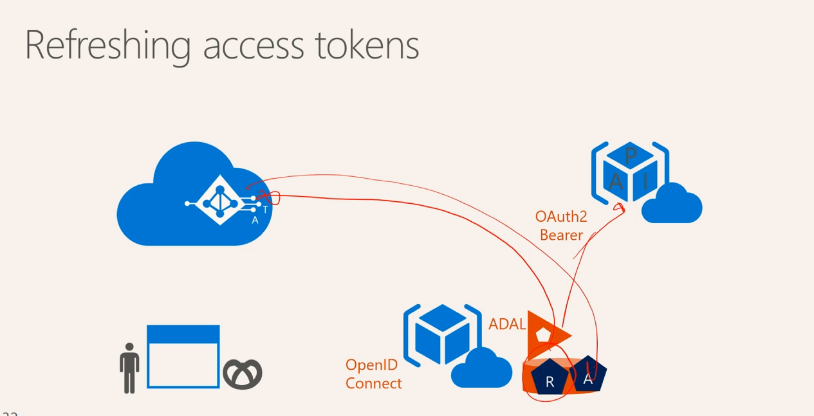

Slide 12
Demo

Slide 13
Calls to Action
Know any potential scenarios/partners for the Intune Admin API via Microsoft Graph?
Email ianphil@Microsoft.com and let us know

Slide 14
Q&A
If you have questions please proceed to the Q&A MICROPHONE located in your session room.

