Slide 1
Tradelab

Slide 2
Introduction
Tradelab is a web-based application developed using Python's Flask framework.
A stock trading platform where users can buy and sell stocks using virtual currency, interacting with real market price data.

Slide 3

How it works
The system fetches real-time stock information from Yahoo Finance using the yfinance API, allowing users to view current stock prices and market information. The application also includes essential features such as user authentication, portfolio, and transaction history.

Slide 4

Tools & Languages
Python
Flask
Backend
Web server
SQLite
Frontend
Database
HTML, CSS, JS, & Bootstrap
yfinance API
Dev Tools
Yahoo Finance
VS Code and browser

Slide 5
Modules
User Authentication
Stock Search
Buy / Sell Stock
Portfolio Management
Transaction History
Database Management

Slide 6
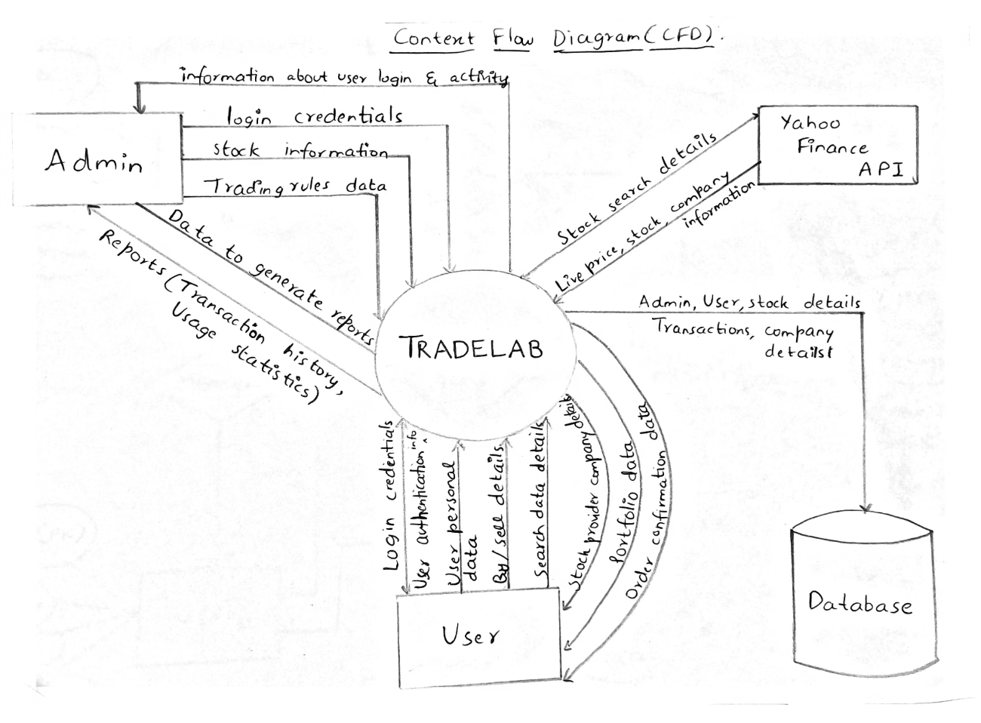
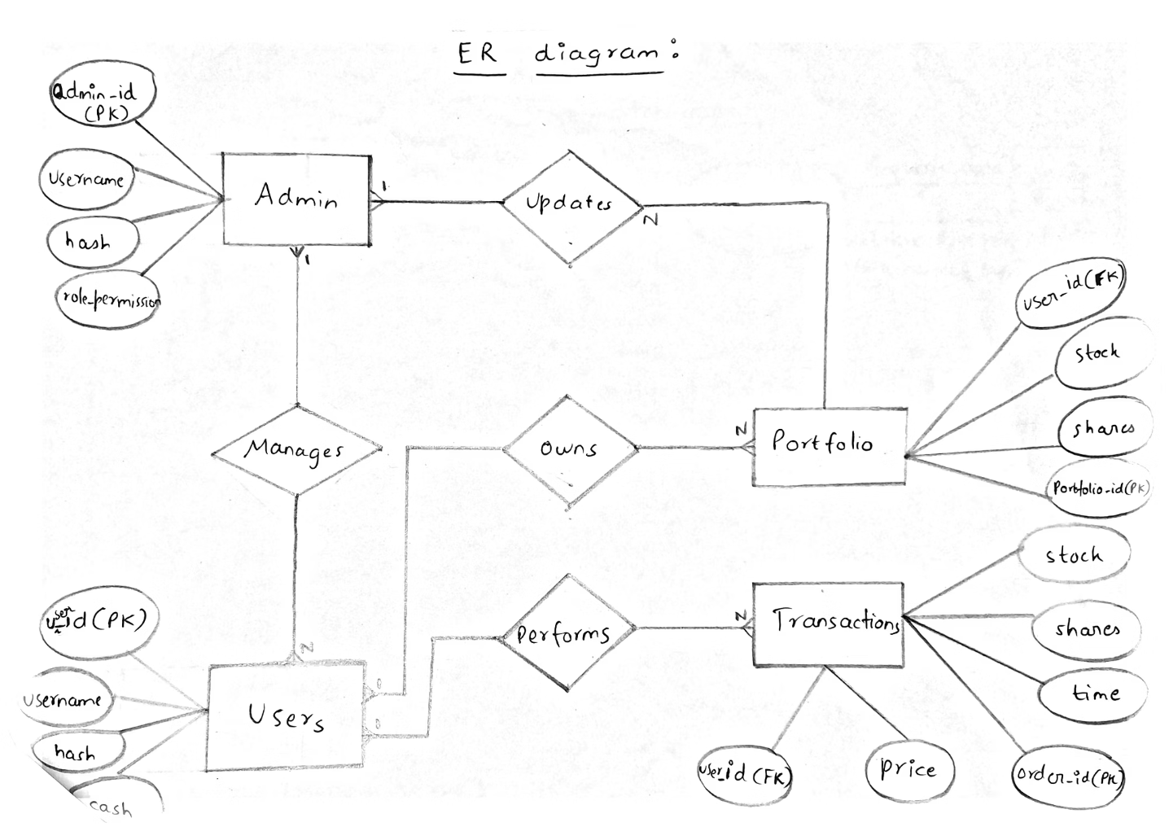
CFD AND ER Diagrams
Context Flow Diagram
Entity Relationship Diagram

Slide 7
Thank you

