Slide 1
Simulation & Physics
2016-2017

Slide 2
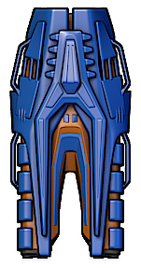

PRACTICAL 3
Steering

Slide 3
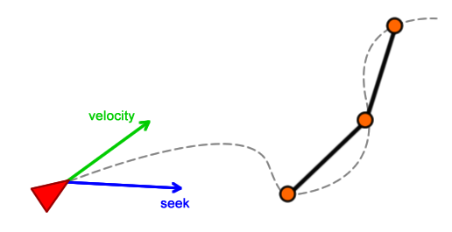
steered objects
Use steering and mass to calculate velocity

Slide 4
Keep within bounds
velocity should not exceed a maximum!
truncate to the rescue
This method is already included in your start project!
private Vector2 Truncate(Vector2 vector, float length)
{
if (vector.LengthSquared() > length * length)
{
vector.Normalize();
vector *= length;
}
return vector;
}

Slide 5
seeking behaviour
Try to move to a specific spot
The target
Control steering and velocity so the object does not jump to the target in one Update
Use Truncate:
Steering vector truncated to a maximum steering speed, then divide by mass
Velocity vector truncated to a maximum speed, after adding the steering velocity

Slide 6
seeking
target
target
desired
velocity
optimal steering force
desired
velocity
normalize
times
max speed
velocity
velocity
position
position

Slide 7
seeking continued
target
steering force adjusted
desired
velocity
normalize
times
max speed
velocity
position

Slide 8
Algorithm
Compute the desired velocity.
Adjust the velocity such that it has a length of maxSpeed.
Compute the steering vector from the velocity and the desired velocity.
Make sure that the length of the steering vector is not larger than maxSteering and divide the vector by the mass of the ship.
Add the steering vector to the current velocity and make sure that the length new velocity is not larger than the maxSpeed.
target
steering force adjusted
desired
velocity
normalize
times
max speed
velocity
position

Slide 9
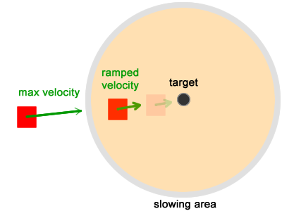
Arriving and stopping
Seek when far away (out of range)
Ease when close by (within range)
Speed proportional to distance
Range is easingRadius
Stop when very close

Slide 10
Arriving algorithm
distance to target outside range
Compute the distance to the target.
If it is less than 5, set velocity to zero.
Else,
If the distance is greater than the arrivingRadius, the value of velocity is defined by the normal seeking behavior.
Else, the value of velocity is adjusted by easing behaviour. That is, the maxSpeed is adjusted proportional to the distance to the target (multiplied by distance/arrivingRadius).
seeking as usual
easing: adjust speed proportional to dist

Slide 11
Practical 3
Download the instructions and the XNA solution for practical 3 from the VLO;
Make both assignments
Seeking
Arriving & Stopping
Hand in your report via VLO group assignments
before May 21st, 23:00

