Slide 1
Simulation & Physics
2016-2017

Slide 2
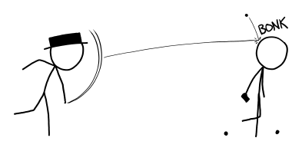
PRACTICAL 4
Collisions

Slide 3
Bouncing on edge of screen: another perspective
Velocity change
velocity = vel.x + vel.y
after
before
velocity = –vel.x + vel.y
velocity = velocity – 2*vel.x

Slide 4
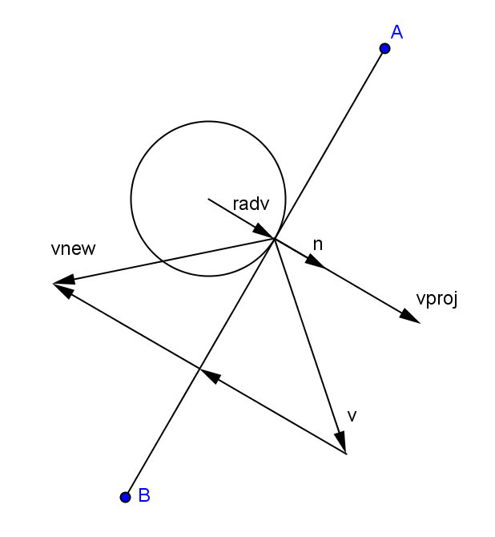
bouncing on any line
v : velocity before bounce
n : normalized normalvector
v_{proj} : projection of v onto n
v_{new} : velocity after bounce
v_{new} = v – 2(v · n) n
velocity change
v_{new} = v – 2v_{proj}
v_{proj} = (v · n) n

Slide 5
Collision between balls: One moving ball
ball1
ball2
velocity
Collision test?
velocity

Slide 6
Collision between balls: Collision test
How do we do that?
Answer: distance between centers is less than sum of radii
length ( ball1.position – ball2.position )
<
ball1.radius + ball2.radius

Slide 7
Collision between balls: Resolve interpenetration
Remember changing the position of the ball when colliding with the edges of the screen?
How do we move both balls?
Collision normal
Calculate difference in position
Normalize that vector and factor it with the distance
ball1.position −= 0.5*resizedDifferenceVector;
ball2.position += 0.5*resizedDifferenceVector;

Slide 8
Collision between balls: After the collision
velocity
ball2.velocity = ball1.velocity
ball1.velocity = Vector2.Zero

Slide 9
Collision between balls: Two moving balls
ball1
ball2
velocity1
velocity2
What are the new velocities?
velocity2
?
?
velocity1

Slide 10
Two moving balls: a different perspective
ball1
ball1
velocity1
−
ball2
ball2
velocity2
Treat as one moving ball
Assume velocity2 = 0
What is the change in velocity
totalChange = 2*(velocity1 – velocity2);
equal mass: apply this change equally, each ball gets half of the totalChange in own direction
After bounce
velocity1 = velocity1 − (velocity1 − velocity2);
velocity2 = velocity2 + (velocity1 − velocity2);
Correct afterwards
Notes:
Compare with slide 7: assume velocity2 = 0

Slide 11
One moving ball: not hitting straight
Now what?
Compute the collision normal
ball2 gets the component of velocity in the direction of the collision normal ‖
ball1 gets the component of the velocity perpendicular to the collision normal ꓕ
ball2
velocity
ball1
It can’t push it in this direction, so…
ball1 can only push ball2 away from itself

Slide 12
collision normal?
The collision normal vector is the normalized difference between the centers (positions) of the balls.

Slide 13
One moving ball: not hitting straight
ball2
Compute the collision normal
ball2 gets the component of velocity in the direction of the collision normal ‖
ball1 gets the component of the velocity perpendicular to the collision normal ꓕ
velocity
ball1
velocity
perpendicular
to normal
ꓕ
velocity
collision
normal
velocity parallel
‖ to normal
collision
normal

Slide 14
Components of velocity
How to compute parallel component of velocity?
v_{new} = v – 2(v · n) n
Dot product!
parallelComponent = dotProduct(velocity,collisionNormal) * collisionNormal;
velocity change
How to compute perpendicular component?
What’s left after substracting other component ;)
perpendicularComponent = velocity – parallelComponent;
v_{proj} = (v · n) n
v_{new} = v – 2v_{proj}
v : velocity before bounce
n : normalized normalvector
vProj : projection of v onto n
vNew : velocity after bounce

Slide 15
One moving ball: not hitting straight
ball2
Compute the collision normal
ball2 gets the component of velocity in the direction of the collision normal ‖
ball1 gets the component of the velocity perpendicular to the collision normal ꓕ
velocity
ball1
Note that both balls change velocity, so the total change in velocity is 2*parallelComponent
velocity
perpendicular
to normal
ꓕ
Put differently:
Calculate TotalChangeInVelocity
and give each ball half
velocity parallel
‖ to normal

Slide 16
different angle, same story
velocity
The collision normal vector is the connection between the centers (positions) of the balls

Slide 17
Two balls moving in different directions
velocity1
velocity2
ball1
ball2
OMG!

Slide 18
Two balls moving in different directions
Same trick: assume
ball2 does not move
velocity1
velocity1
velocity2
− velocity2
velocity1 − velocity2
ball1
ball2
Mental picture: subtract velocity2 from both sides
1. Calculate velocity1 − velocity2
2. Use component of this vector in the direction of collisionNormal to calculate changeVelocity
Note: instead of ball1.velocity

Slide 19
Find coLlision
First resolve interpenetration (this code can be copied)
Step 1 and 2
Step 5
positionDifference = other.Position – this.position
distance = positionDifference.Length() - (other.Radius + this.radius);
if (distance < 0)
{
Vector2 resetVector = collisionNormal;
resetVector *= distance;
this.position += resetVector / 2;
other.Position -= resetVector / 2;

Slide 20
Collision algorithm
Find the collision normalvector
Resolve interpenetration
Compute the velocity component parallel to the collision normal
For two moving balls: use the difference in velocities
Use dot product
Compute the total change in velocity
Use parallelComponent
Change the velocity of both balls
Each ball.velocity changes by 0.5 * totalVelocityChange (we are assuming that balls have equal mass!)

Slide 21
Practical 4
Download the instructions and the XNA solution for practical 4 from the VLO;
Make the assignment
Collision
Hand in your report via VLO group assignments
before May 28th, 23:00

