Slide 1
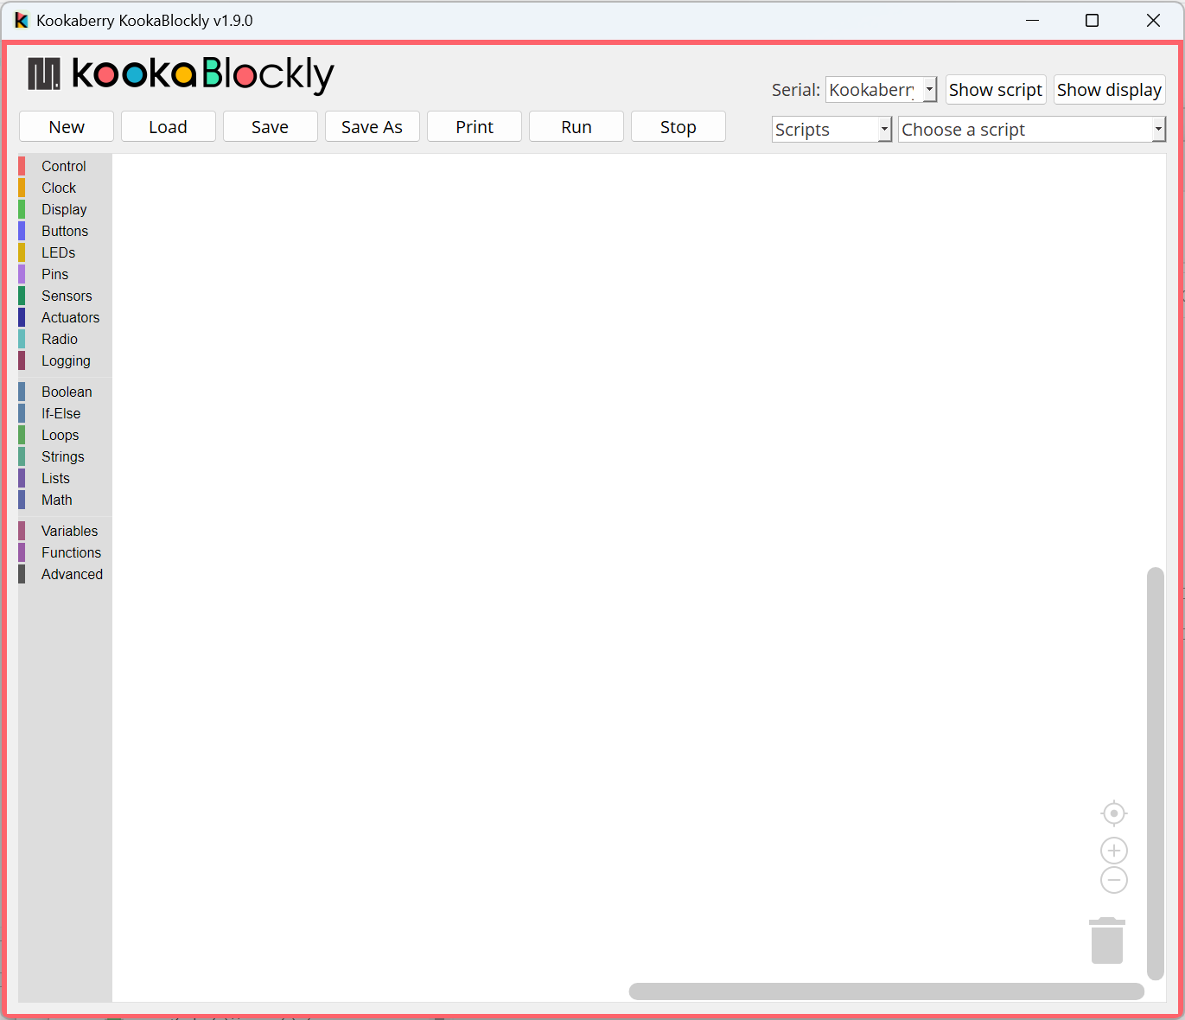
Version
Resize / Exit
Script Controls
Connection
Inspection
Script Selection
Blocks Palette
Workspace
Scroll Bars
Centre Script
Zoom Script
Trash

