Slide 1
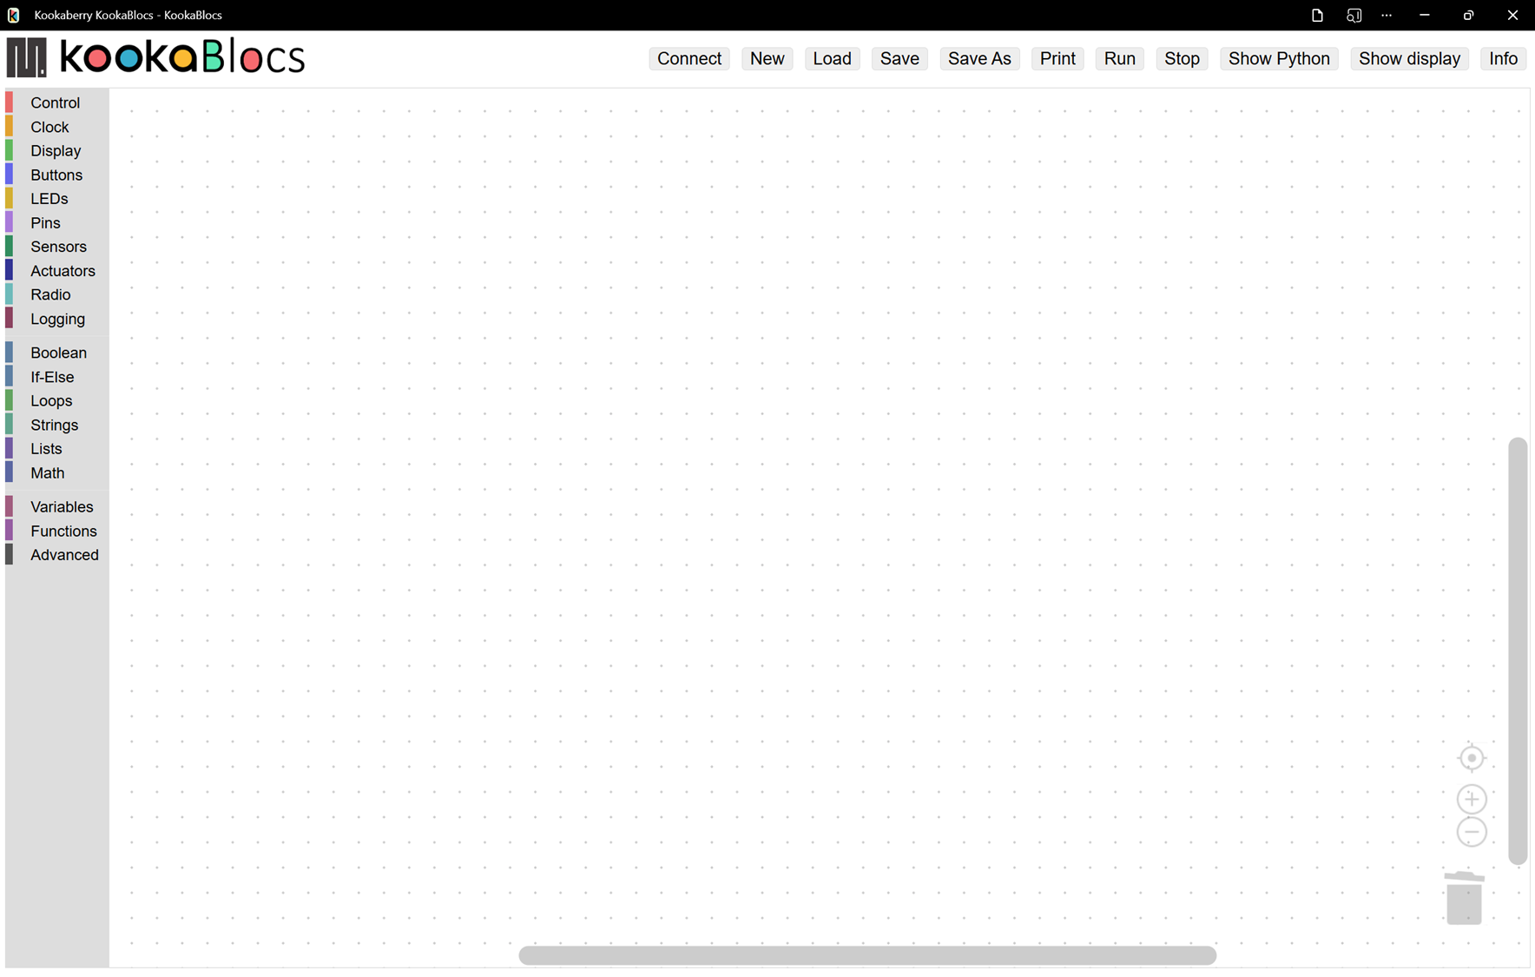
Kookaberry Connection
Script Selection
Script Controls
Inspection
Name
App Controls
Workspace
Blocks Palette
Scroll Bars
Centre Script
Zoom Script
Trash

Slide 2


