Slide 1

10 mm
Layout
10 mm
10 mm
Arial Font
Organization Logo (Or not)
Page
10 mm

Slide 2
Initial Slide

Slide 3

Competition Name
Paper Name / Report Name
Author(s) Name
Affilation
*Correspondence

Slide 4
SAMPLE 1
ASBW: A Frequency-Domain Analysis Approach for
Distinguishing GAN-Generated Images from Real Image
Quang Huy Nguyen¹, Van Huy Pham²
¹ Faculty of Information Technology, Ton Duc Thang University
² School of Technology, University of Management and Technology
* Correspondence: huy.phamvan@umt.edu.vn

Slide 5
SAMPLE 2
NGHIỆM THU ĐỀ TÀI NCKHSV CẤP KHOA
Áp dụng trí tuệ nhân tạo
trong hỗ trợ đầu tư chứng khoán và cảnh báo bất thường
Nguyễn Quang Huy¹, Nguyễn Phúc Toàn¹, Phan Anh Kiệt¹, Trần Lương Quốc Đại²
¹Faculty of Information Technology, Ton Duc Thang University
²NLP & KD Laboratory, Faculty of Information Technology, Ton Duc Thang University

Slide 6
SAMPLE 3
NATURAL LANGUAGE PROCESSING
Large-Scale Vietnamese Financial Diacritic Restoration
using LSTM and Constrained Beam Search Decoding
Nguyễn Quang Huy¹, Nguyễn Trần Nhật An¹
¹Faculty of Information Technology, Ton Duc Thang University

Slide 7
Others Slide

Slide 8
Outline (30px)
5 mm
Introduction (25px)
Related Work
Dataset
Proposed Architecture
Experiments
Conclusion & Future Work

Slide 9
Outline
Introduction
Related Work
Dataset
Proposed Architecture
Experiments
Conclusion & Future Work

Slide 10
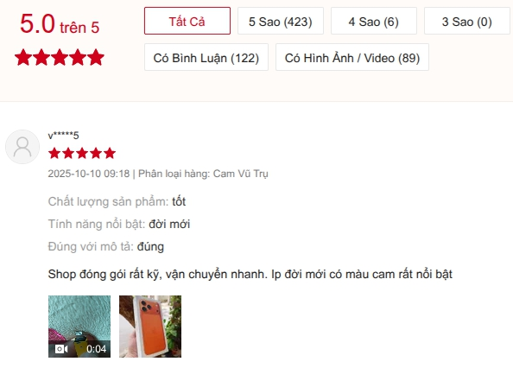
Introduction (30px, Bold, Red)
The Context (25px, Bold)
E-commerce in Vietnam is growing rapidly, making user reviews a valuable resource for business intelligence. (15px)
Current Vietnamese feedback systems (e.g., Shopee, Lazada) mostly use simple star ratings, lacking fine-grained analysis.
Figure 1.1. Product Review Section of Shopee
(15px, Italic)

Slide 11
Introduction
The Context
E-commerce in Vietnam is growing rapidly, making user reviews a valuable resource for business intelligence.
Current Vietnamese feedback systems (e.g., Shopee, Lazada) mostly use simple star ratings, lacking fine-grained analysis.
Figure 1.1. Product Review Section of Shopee

