Slide 1

Data Structures and Algorithms
List ADT & Linked Lists

Slide 2
Acknowledgement
The contents of these slides have origin from School of Computing, National University of Singapore.
We greatly appreciate support from Mr. Aaron Tan Tuck Choy, and Dr. Low Kok Lim for kindly sharing these materials.

Slide 3
Policies for students
These contents are only used for students PERSONALLY.
Students are NOT allowed to modify or deliver these contents to anywhere or anyone for any purpose.

Slide 4
Objectives
1
Able to define a List ADT
2
Able to implement a List ADT with array
3
Able to implement a List ADT with linked list
4
Able to use Java API LinkedList class

Slide 5
References
Book
List ADT: Chapter 4, pages 227 to 233
Linked Lists: Chapter 5, pages 265 to 325
An array-based implementation: Chapter 4, pages 250 to 257
[501043 Lecture 8: List ADT & Linked Lists]

Slide 6
Outline
Use of a List (Motivation)
List ADT
List ADT Implementation via Array
Adding and removing elements in an array
Time and space efficiency
List ADT Implementation via Linked Lists
Linked list approach
ListNode class: forming a linked list with ListNode
BasicLinkedList
More Linked Lists
EnhancedLinkedList, TailedLinkedList
Other Variants
CircularLinkedList, DoublyLinkedList
Java API: LinkedList class
Summary
[501043 Lecture 8: List ADT & Linked Lists]

Slide 7
1 Use of a List
Motivation

Slide 8


Motivation
1. Use of a List
List is one of the most basic types of data collection
For example, list of groceries, list of modules, list of friends, etc.
In general, we keep items of the same type (class) in one list
Typical Operations on a data collection
Add data
Remove data
Query data
The details of the operations vary from application to application. The overall theme is the management of data
[501043 Lecture 8: List ADT & Linked Lists]

Slide 9
ADT of a List (1/3)
1. Use of a List
A list ADT is a dynamic linear data structure
A collection of data items, accessible one after another starting from the beginning (head) of the list
Examples of List ADT operations:
Create an empty list
Determine whether a list is empty
Determine number of items in the list
Add an item at a given position
Remove an item at a position
Remove all items
Read an item from the list at a position
The next slide on the basic list interface does not have all the above operations… we will slowly build up these operations in list beyond the basic list.
You will learn non-linear data structures such as trees and graphs in 502043.
[501043 Lecture 8: List ADT & Linked Lists]

Slide 10
ADT of a List (2/3)
ListInterface.java
1. Use of a List
import java.util.*;
public interface ListInterface <E> {
public boolean isEmpty();
public int size();
public E getFirst() throws NoSuchElementException;
public boolean contains(E item);
public void addFirst(E item);
public E removeFirst()
throws NoSuchElementException;
public void print();
}
The ListInterface above defines the operations (methods) we would like to have in a List ADT
The operations shown here are just a small sample. An actual List ADT usually contains more operations.
[501043 Lecture 8: List ADT & Linked Lists]

Slide 11
ADT of a List (3/3)
1. Use of a List
We will examine 2 implementations of list ADT, both using the ListInterface shown in the previous slide
To be discussed in section 2.
Contractual
obligations:
List ADT
Create empty list
Determine …
Add an item
…
Java Arrays
Linked Lists
To be discussed in section 3: Basic Linked List
ADT
Implementations
[501043 Lecture 8: List ADT & Linked Lists]

Slide 12
2 List Implementation via Array
Fixed-size list

Slide 13
2. List Implementation: Array (1/9)
This is a straight-forward approach
Use Java array of a sequence of n elements
num_nodes
arr : array[0..m] of locations
n
a₀
a₁
a₂
………
a_{n-1}
unused
0
1
2
n-1
m
[501043 Lecture 8: List ADT & Linked Lists]

Slide 14
2. List Implementation: Array (2/9)
We now create a class ListUsingArray as an implementation of the interface ListInterface (a user-defined interface, as defined in slide 10)
<<interface>>
ListInterface
ListUsingArray
implements
Representing an interface in UML diagrams
- MAXSIZE
- num_nodes
- arr
+ isEmpty()
+ size()
+ getFirst()
+ contains(E item)
+ addFirst(E item)
+ removeFirst()
+ print()
Legend:
implements
[501043 Lecture 8: List ADT & Linked Lists]

Slide 15
2. List Implementation: Array (3/9)
ListUsingArray.java
import java.util.*;
class ListUsingArray <E> implements ListInterface <E> {
private static final int MAXSIZE = 1000;
private int num_nodes = 0;
private E[] arr = (E[]) new Object[MAXSIZE];
public boolean isEmpty() { return num_nodes==0; }
public int size() { return num_nodes; }
public E getFirst() throws NoSuchElementException {
if (num_nodes == 0)
throw new NoSuchElementException("can't get from an empty list");
else return arr[0];
}
public boolean contains(E item) {
for (int i = 0; i < num_nodes; i++)
if (arr[i].equals(item)) return true;
return false;
}
Code continued in slide 17
[501043 Lecture 8: List ADT & Linked Lists]
Notes:
Trong Java, Object class là parent class của tất cả các class
Đối với data type mà chưa xác định thì tốt nhất nên để là Object cho an toàn vì nó là class cao nhất, chứa được tất cả
Đối với mảng Object có thể chứa được nhiều thứ; có thể vừa chứa String vừa chứa Integer,…

Slide 16
2. List Implementation: Array (4/9)
For insertion into first position, need to shift “right” (starting from the last element) to create room
Example: addFirst(“it”)
num_nodes
arr
8
a₀
a₁
a₂
a₃
a₄
a₅
a₆
a₇
Step 2 : Write into gap
Step 1 : Shift right
num_nodes
8
9
a₀
a₀
a₁
a₂
a₃
a₄
a₅
a₆
a₇
it
Step 3 : Update num_nodes
[501043 Lecture 8: List ADT & Linked Lists]

Slide 17
2. List Implementation: Array (5/9)
For deletion of first element, need to shift “left” (starting from the first element) to close gap
Example: removeFirst()
num_nodes
arr
8
a₀
a₁
a₂
a₃
a₄
a₅
a₆
a₇
Step 1 : Close Gap
num_nodes
8
7
a₁
a₂
a₃
a₄
a₅
a₆
a₇
a₇
Step 2 : Update num_nodes
unused
Need to maintain num_nodes so that program would not access beyond the valid data.
[501043 Lecture 8: List ADT & Linked Lists]

Slide 18
2. List Implementation: Array (6/9)
public void addFirst(E item) throws IndexOutOfBoundsException {
if (num_nodes == MAXSIZE)
throw new IndexOutOfBoundsException("insufficient space for add");
for (int i = num_nodes-1; i >= 0; i--)
arr[i+1] = arr[i]; // to shift elements to the right
arr[0] = item;
num_nodes++; // update num_nodes
}
public E removeFirst() throws NoSuchElementException {
if (num_nodes == 0)
throw new NoSuchElementException("can't remove from an empty list");
else {
E tmp = arr[0];
for (int i = 0; i<num_nodes-1; i++)
arr[i] = arr[i+1]; // to shift elements to the left
num_nodes--; // update num_nodes
return tmp;
}
}
print() method not shown here. Refer to program.
ListUsingArray.java
[501043 Lecture 8: List ADT & Linked Lists]
Notes:
Đặc điểm đối với các data structure, khi thực hiện thao tác xóa phải trả về data bị xóa cho user

Slide 19
2. Testing Array Implementation (7/9)
import java.util.*;
public class TestListUsingArray {
public static void main(String [] args)
throws NoSuchElementException {
ListUsingArray <String> list = new ListUsingArray <String>();
list.addFirst("aaa");
list.addFirst("bbb");
list.addFirst("ccc");
list.print();
System.out.println("Testing removal");
list.removeFirst();
list.print();
if (list.contains("aaa"))
list.addFirst("xxxx");
list.print();
}
}
TestListUsingArray.java

[501043 Lecture 8: List ADT & Linked Lists]

Slide 20
2. Analysis of Array Impl^{n} of List (8/9)
Question: Time Efficiency?
Retrieval: getFirst()
Always fast with 1 read operation
Insertion: addFirst(E item)
Shifting of all n items – bad!
Insertion: add(int index, E item)
Inserting into the specified position (not shown in ListUsingArray.java)
Best case: No shifting of items (add to the last place)
Worst case: Shifting of all items (add to the first place)
Deletion: removeFirst(E item)
Shifting of all n items – bad!
Deletion: remove(int index)
Delete the item at the specified position (not shown in ListUsingArray.java)
Best case: No shifting of items (delete the last item)
Worst case: Shifting of all items (delete the first item)
[501043 Lecture 8: List ADT & Linked Lists]
Notes:
Thao tác thêm, xóa tốn nhiều thời gian

Slide 21
2. Analysis of Array Impl^{n} of List (9/9)
Question: What is the Space Efficiency?
Size of array collection limited by MAXSIZE
Problems
We don’t always know the maximum size ahead of time
If MAXSIZE is too liberal, unused space is wasted
If MAXSIZE is too conservative, easy to run out of space
Idea: make MAXSIZE a variable, and create/copy to a larger array whenever the array runs out of space
No more limits on size
But copying overhead is still a problem
When to use such a list?
For a fixed-size list, an array is good enough!
For a variable-size list, where dynamic operations such as insertion/deletion are common, an array is a poor choice; better alternative – Linked List
[501043 Lecture 8: List ADT & Linked Lists]

Slide 22
3 List Implementation via Linked List
Variable-size list

Slide 23
3.1 List Implementation: Linked List (1/3)
Recap when using an array...
X, A, B are elements of an array
Y is new element to be added
Unused spaces
X
A
B
I want to add Y after A.
I want to remove A.
Y
[501043 Lecture 8: List ADT & Linked Lists]

Slide 24
3.1 List Implementation: Linked List (2/3)
Now, we see the (add) action with linked list…
X, A, B are nodes of a linked list
Y is new node to be added
X
A
B
I want to add Y after A.
Y
?
[501043 Lecture 8: List ADT & Linked Lists]

Slide 25
3.1 List Implementation: Linked List (3/3)
Now, we see the (remove) action with linked list…
X
A
B
I want to remove A ….
Node A becomes a garbage. To be removed during garbage collection.
[501043 Lecture 8: List ADT & Linked Lists]
Notes:
Xóa Node A (Link Node X với Node B) thì Node A sẽ không có cái nào giữ nữa (tức là không còn cách nào để có thể truy xuất Node A được nữa) mà khi một phần nào đó trong vùng nhớ của mình không có cách nào để truy xuất nữa thì Java nó sẽ tự động thu gom rác
Chỉ cần Link Node trước với Node sau thì Node giữa sẽ biến mất

Slide 26
3.2 Linked List Approach (1/4)
Idea
Each element in the list is stored in a node, which also contains a next pointer
Allow elements in the list to occupy non-contiguous memory
Order the nodes by associating each with its neighbour(s)
element
next
element
next
…
a_{i}
a_{i+1}
This is one node
of the collection…
… and this one comes after it in the collection (most likely not occupying contiguous memory that is next to the previous node).
element
next
a_{k}
Next pointer of this node is “null”, i.e. it has no next neighbour.
[501043 Lecture 8: List ADT & Linked Lists]
Notes:
Note: Explain explicitly the differences between a list and a linked list.

Slide 27
3.2 Linked List Approach (2/4)
Recap: Object References (1/2)
Note the difference between primitive data types and reference data types
x
20
int x = 20;
y
20
Integer y = new Integer(20);
Integer
String z = new String("hi th");
z
h
i
t
h
String
An instance (object) of a class only comes into existence (constructed) when the new operator is applied
A reference variable only contains a reference or pointer to an object.
[501043 Lecture 8: List ADT & Linked Lists]
Notes:
- Primitive type: lưu data trực tiếp trên ô nhớ
int, double, float, boolean, char,… (chữ thường)
- Reference type: pointer trỏ đến ô nhớ lưu data đó
Integer, Double, Float, Boolean, Char,… (Wrapper Classes)
Construct an object: new operator + Constructor()
Example: y is a reference (pointer) variable that means y contains the address of ô nhớ lưu data hoặc object đó

Slide 28
3.2 Linked List Approach (3/4)
Recap: Object References (2/2)
Look at it in more details:
Integer y
=
new Integer(20);
y
20
Integer w;
Integer
w
=
new Integer(20);
if (w == y)
System.out.println("1. w == y");
w
w = y;
Integer
if (w == y)
System.out.println("2. w == y");
Output:

[501043 Lecture 8: List ADT & Linked Lists]
Notes:
Output: 2. w == y
Explanation:
When we construct an object, it will be stored in RAM so it will have an address and each object will have different address
y and w are reference variables that store different address
w == y compare the address of two reference variables store => False
If we want to compare the value of an object use equals() method
w = y means we will assign the value of y to w
Value of a reference variable (pointer) is the address which it refer (point) to
=> w == y => True

Slide 29
3.2 Linked List Approach (4/4)
Quiz: Which is the right representation of e?
class Employee {
private String name;
private int salary;
// etc.
}
Employee e = new Employee("Alan", 2000);
(A)
e
(B)
e
Alan
2000
Alan
2000
(C)
e
(D)
e
2000
Alan
Alan
2000

[501043 Lecture 8: List ADT & Linked Lists]
Notes:
C
Explanation:
- Employee is reference type
- Employee e is reference variable that means it will contains the address of an object (or point to the memory cell which stores that object)
- The data type of name is String which is a reference type so it will point to the memory cell which stores text
- The data type of salary is int which is a primitive type so the data will be stored directly in the memory cell

Slide 30

3.3 ListNode (using generic)
ListNode.java
class ListNode <E> {
/* data attributes */
private E element;
private ListNode <E> next;
/* constructors */
public ListNode(E item) { this(item, null); }
/*{
Element = item;
Next = null;
}*/
public ListNode(E item, ListNode <E> n) {
element = item;
next = n;
}
/* get the next ListNode */
public ListNode <E> getNext() { return next; }
/* get the element of the ListNode */
public E getElement() { return element; }
/* set the next reference */
public void setNext(ListNode <E> n) { next = n };
}
element
next
Mark this slide – You may need to refer to it later when we study the different variants of linked list.
[501043 Lecture 8: List ADT & Linked Lists]
Notes:
Định nghĩa Generic => Lưu trữ được nhiều loại data khác nhau (Ex: số nguyên, sinh viên, phân số,…)

Slide 31
3.4 Forming a Linked List (1/3)
For a sequence of 4 items < a₀, a₁, a₂, a₃ >
head
represents null
a₀
a₁
a₂
a₃
We need a head to indicate where the first node is. From the head we can get to the rest.
[501043 Lecture 8: List ADT & Linked Lists]

Slide 32
3.4 Forming a Linked List (2/3)
For a sequence of 4 items < a₀, a₁, a₂, a₃ >
ListNode <String> node3 = new ListNode <String>("a3", null);
ListNode <String> node2 = new ListNode <String>("a2", node3);
ListNode <String> node1 = new ListNode <String>("a1", node2);
ListNode <String> head = new ListNode <String>("a0", node1);
Can the code be rewritten without using these object references node1, node2, node3?
No longer needed after list is built.
node1
node2
node3
head
a0
a1
a2
a3
[501043 Lecture 8: List ADT & Linked Lists]

Slide 33
3.4 Forming a Linked List (3/3)
Alternatively we can form the linked list as follows:
For a sequence of 4 items < a₀, a₁, a₂, a₃ >, we can build as follows:
LinkedList <String> list = new LinkedList <String>();
list.addFirst(“a3”);
list.addFirst(“a2”);
list.addFirst(“a1”);
list.addFirst(“a0”);
I don’t care how addFirst() is implemented
list
Is this better than the code in previous slide?
head
a₀
a₁
a₂
a₃
[501043 Lecture 8: List ADT & Linked Lists]

Slide 34
3.5 Basic Linked List (1/7)
Using ListNode to define BasicLinkedList
BasicLinkedList.java
import java.util.*;
class BasicLinkedList <E> implements ListInterface <E> {
private ListNode <E> head = null;
private int num_nodes = 0;
public boolean isEmpty() { return (num_nodes == 0); }
public int size() { return num_nodes; }
public E getFirst() throws NoSuchElementException {
if (head == null)
throw new NoSuchElementException("can't get from an empty list");
else return head.getElement();
}
public boolean contains(E item) {
for (ListNode <E> n = head; n != null; n = n.getNext())
if (n.getElement().equals(item)) return true;
return false;
}
getElement() and getNext() are methods in ListNode class (slide 30)
[501043 Lecture 8: List ADT & Linked Lists]

Slide 35
3.5 Basic Linked List (2/7)
The adding and removal of first element
BasicLinkedList.java
public void addFirst(E item) {
head = new ListNode <E> (item, head);
//ListNode p = new ListNode (item);
//p.setNext(head);
//head = p;
num_nodes++;
}
public E removeFirst() throws NoSuchElementException {
ListNode <E> ln;
if (head == null)
throw new NoSuchElementException("can't remove from empty list");
else {
ln = head;
head = head.getNext();
num_nodes--;
return ln.getElement();
}
}
[501043 Lecture 8: List ADT & Linked Lists]
Notes:
NullPointerException: Lỗi khi cố gắng truy xuất vào phần tử reference type là null

Slide 36
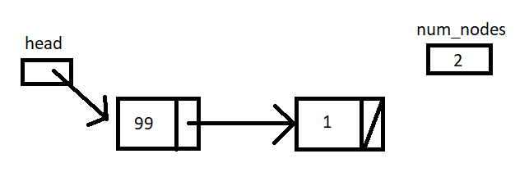
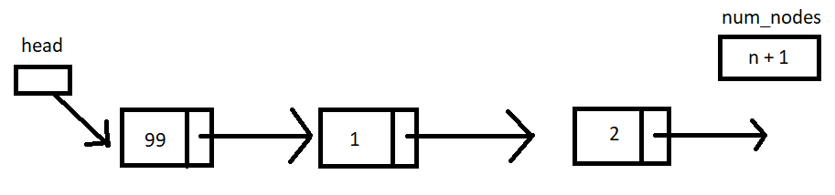
3.5 Basic Linked List (3/7)
public void addFirst(E item) {
head = new ListNode <E> (item, head);
num_nodes++;
}
The addFirst() method
Case | Before: list | After: list.addFirst(99)
0 item
1 item
2 or more items
head
num_nodes
head
num_nodes
0
1
99
0
head
num_nodes
1
1
head
num_nodes
n
1
2

[501043 Lecture 8: List ADT & Linked Lists]
Notes:
Case 0 item:
- Step 1: Create new Node and store data into it
- Step 2: Set next Node for the new Node which is the Node head (to specify the position of the new Node). In this case Node head is null so next Node of this new Node is null
- Step 3: Assign new Node to Node head

Slide 37
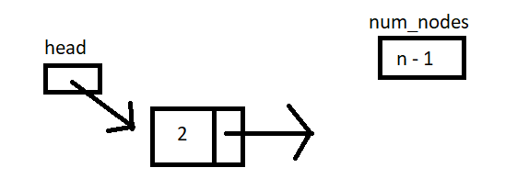
3.5 Basic Linked List (4/7)
The removeFirst() method
Case | Before: list | After: list.removeFirst()
0 item
1 item
2 or more items
head
num_nodes
0
can’t remove
head
num_nodes
head
ln
num_nodes
0
1
1
1
1
head
num_nodes
n
1
2
public E removeFirst() throws NoSuchElementException {
ListNode <E> ln;
if (head == null)
throw new NoSuchElementException("can't remove");
else {
ln = head; head = head.getNext(); num_nodes--;
return ln.getElement();
}
}

[501043 Lecture 8: List ADT & Linked Lists]

Slide 38
3.5 Basic Linked List (5/7)
Printing of the linked list
BasicLinkedList.java
public void print() throws NoSuchElementException {
if (head == null)
throw new NoSuchElementException("Nothing to print...");
ListNode <E> ln = head;
System.out.print("List is: " + ln.getElement());
for (int i=1; i < num_nodes; i++) {
ln = ln.getNext();
System.out.print(", " + ln.getElement());
}
System.out.println(".");
}
[501043 Lecture 8: List ADT & Linked Lists]

Slide 39
3.5 Test Basic Linked List #1 (6/7)
Example use #1
TestBasicLinkedList1.java
import java.util.*;
public class TestBasicLinkedList1 {
public static void main(String [] args)
throws NoSuchElementException {
BasicLinkedList <String> list = new BasicLinkedList <String>();
list.addFirst("aaa");
list.addFirst("bbb");
list.addFirst("ccc");
list.print();
System.out.println("Testing removal");
list.removeFirst();
list.print();
if (list.contains("aaa"))
list.addFirst("xxxx");
list.print();
}
}

[501043 Lecture 8: List ADT & Linked Lists]

Slide 40
3.5 Test Basic Linked List #2 (7/7)
Example use #2
TestBasicLinkedList2.java
import java.util.*;
public class TestBasicLinkedList2 {
public static void main(String [] args)
throws NoSuchElementException {
BasicLinkedList <Integer> list = new BasicLinkedList <Integer>();
list.addFirst(34);
list.addFirst(12);
list.addFirst(9);
list.print();
System.out.println("Testing removal");
list.removeFirst();
list.print();
}
}

[501043 Lecture 8: List ADT & Linked Lists]

Slide 41
Revision
1. Trong trường hợp nào nên dùng DSLK thay vì mảng?
=> Answer: Slide 20, 21
2. DSLK được cấu tạo thành từ những thành phần, thuộc tính nào?
=> Answer: Thành phần của Linked List là Node. Thuộc tính của Node là data và next

Slide 42
4 More Linked Lists
Exploring variants of linked list

Slide 43
4. Linked Lists: Variants
OVERVIEW!
BasicLinkedList
implements
<<interface>>
ListInterface
- head
- num_nodes
has-a
+ isEmpty()
+ size()
+ getFirst()
+ contains(E item)
+ addFirst(E item)
+ removeFirst()
+ print()
ListNode
- element
- next
has-a
EnhancedLinkedList
implements
+ getNext()
+ getElement()
+ setNext(ListNode <E> curr)
- head
- num_nodes
has-a
<<interface>>
EnhancedListInterface
implements
+ isEmpty()
+ size()
+ getFirst()
+ contains(E item)
+ addFirst(E item)
+ removeFirst()
+ print()
+ getHead()
+ addAfter(ListNode <E> curr, E item)
+ removeAfter(ListNode <E> curr)
+ remove( E item)
TailedLinkedList
- head
- tail
- num_nodes
[501043 Lecture 8: List ADT & Linked Lists]

Slide 44
4.1 Enhanced Linked List (1/11)
We explore different implementations of Linked List
Basic Linked List, Tailed Linked List, Circular Linked List, Doubly Linked List, etc.
When nodes are to be inserted to the middle of the linked list, BasicLinkedList (BLL) is not good enough.
For example, BLL offers only insertion at the front of the list. If the items in the list must always be sorted according to some key values, then we must be able to insert at the right place.
We will enhance BLL to include some additional methods. We shall call this Enhanced Linked List (ELL).
(Note: We could have made ELL a subclass of BLL, but here we will create ELL from scratch instead.)
[501043 Lecture 8: List ADT & Linked Lists]

Slide 45
4.1 Enhanced Linked List (2/11)
We use a new interface file:
EnhancedListInterface.java
import java.util.*;
public interface EnhancedListInterface <E> {
public boolean isEmpty();
public int size();
public E getFirst() throws NoSuchElementException;
public boolean contains(E item);
public void addFirst(E item);
public E removeFirst() throws NoSuchElementException;
public void print();
public ListNode <E> getHead();
public void addAfter(ListNode <E> current, E item);
public E removeAfter(ListNode <E> current)
throws NoSuchElementException;
public E remove(E item) throws NoSuchElementException;
}
New
[501043 Lecture 8: List ADT & Linked Lists]

Slide 46
4.1 Enhanced Linked List (3/11)
EnhancedLinkedList.java
import java.util.*;
class EnhancedLinkedList <E>
implements EnhancedListInterface <E> {
private ListNode <E> head = null;
private int num_nodes = 0;
public boolean isEmpty() { return (num_nodes == 0); }
public int size() { return num_nodes; }
public E getFirst() { ... }
public boolean contains(E item) { ... }
public void addFirst(E item) { ... }
public E removeFirst() throws NoSuchElementException { ... };
public void print() throws NoSuchElementException { ... };
public ListNode <E> getHead() { return head; }
public void addAfter(ListNode <E> current, E item) {
if (current != null)
//current.setNext(new ListNode <E> (item, //current.getNext()));
{
ListNode<E> p = new ListNode<E>(item);
p.setNext(current.getNext()));
current.setNext(p);
}
else // insert item at front
// head = new ListNode <E> (item, head);
addFirst(item);
num_nodes++;
}
Same as in BasicLinkedList.java
To continue on next slide

Slide 47
4.1 Enhanced Linked List (4/11)
public void addAfter(ListNode <E> current, E item) {
if (current != null) {
// current.setNext(new ListNode <E>(item,current.getNext()));
ListNode<E> p = new ListNode<E>(item);
p.setNext(current.getNext());
current.setNext(p);
} else { // insert item at front
head = new ListNode <E> (item, head);
}
num_nodes++;
}
current
item
head
num_nodes
4
5
a₀
a₁
a₂
a₃
[501043 Lecture 8: List ADT & Linked Lists]
Notes:
current == null means the list is empty

Slide 48
4.1 Enhanced Linked List (5/11)
EnhancedLinkedList.java
public E removeAfter(ListNode <E> current)
throws NoSuchElementException {
E temp;
if (current != null) {
ListNode <E> nextPtr = current.getNext();
if (nextPtr != null) {
temp = nextPtr.getElement();
current.setNext(nextPtr.getNext());
num_nodes--;
return temp;
} else throw new NoSuchElementException("No next node to remove");
} else { // if current is null, assume we want to remove head
if (head != null) {
temp = head.getElement();
head = head.getNext();
num_nodes--;
return temp;
} else throw new NoSuchElementException("No next node to remove");
}
}
[501043 Lecture 8: List ADT & Linked Lists]
Notes:
if (nextPtr == null) means current is the last node of the list

Slide 49
4.1 Enhanced Linked List (6/11)
public E removeAfter(ListNode <E> current) throws ... {
E temp;
if (current != null) {
ListNode<E> nextPtr = current.getNext();
if (nextPtr != null) {
temp = nextPtr.getElement();
current.setNext(nextPtr.getNext());
num_nodes--;
return temp;
} else throw new NoSuchElementException("...");
} else { ... }
}
current
temp
nextPtr
head
a₂
num_nodes
4
3
a₀
a₁
a₂
a₃
[501043 Lecture 8: List ADT & Linked Lists]

Slide 50
4.1 Enhanced Linked List (7/11)
public E removeAfter(ListNode <E> current) throws ... {
E temp;
if (current != null) {
...
} else { // if current is null, we want to remove head
if (head != null) {
temp = head.getElement();
head = head.getNext();
num_nodes--;
return temp;
} else throw new NoSuchElementException("...");
}
current
null
temp
head
a₀
num_nodes
4
3
a₀
a₁
a₂
a₃
[501043 Lecture 8: List ADT & Linked Lists]

Slide 51
4.1 Enhanced Linked List (8/11)
remove(E item)
Search for item in list
Re-using removeAfter() method
EnhancedLinkedList.java
public E remove(E item)
throws NoSuchElementException {
// Write your code below...
// Should make use of removeAfter() method.
}
}
[501043 Lecture 8: List ADT & Linked Lists]
Notes:
public E remove(E item)
throws NoSuchElementException {
if (head == null) {
throw new NoSuchElementException(“can’ t remove from empty list”);
} else {
Node < E > pre = null;
Node < E > curr = head;
if (curr.getValue().equals(item)) {
return removeFirst();
} else {
for (int i = 0; i < num_nodes – 1; i++) {
pre = curr;
curr = curr.getNext();
if (curr.getValue().equals(item)) {
return removeAfter(pre);
}
}
}
throw new NoSuchElementException(“no element to remove”);
}
}

Slide 52
4.1 Enhanced Linked List (9/11)
public E remove(E item) throws ... {
}
item
prev
curr
a₂
head
num_nodes
4
3
a₀
a₁
a₂
a₃
[501043 Lecture 8: List ADT & Linked Lists]

Slide 53
4.1 Test Enhanced Linked List (10/11)
TestEnhancedLinkedList.java
import java.util.*;
public class TestEnhancedLinkedList {
public static void main(String [] args) throws NoSuchElementException {
EnhancedLinkedList <String> list = new EnhancedLinkedList <String>();
System.out.println("Part 1");
list.addFirst("aaa");
list.addFirst("bbb");
list.addFirst("ccc");
list.print();
System.out.println();
System.out.println("Part 2");
ListNode <String> current = list.getHead();
list.addAfter(current, "xxx");
list.addAfter(current, "yyy");
list.print();

[501043 Lecture 8: List ADT & Linked Lists]
Notes:
Part 1
List is: ccc, bbb, aaa.
Part 2
List is: ccc, yyy, xxx, bbb, aaa.

Slide 54
4.1 Test Enhanced Linked List (11/11)
TestEnhancedLinkedList.java
// (continue from previous slide)
System.out.println();
System.out.println("Part 3");
current = list.getHead();
if (current != null) {
current = current.getNext();
list.removeAfter(current);
}
list.print();
System.out.println();
System.out.println("Part 4");
list.removeAfter(null);
list.print();
}
}

[501043 Lecture 8: List ADT & Linked Lists]
Notes:
Part 3
List is: ccc, yyy, bbb, aaa.
Part 4
List is: yyy, bbb, aaa.

Slide 55
4. Linked Lists: Variants
OVERVIEW!
BasicLinkedList
implements
<<interface>>
ListInterface
- head
- num_nodes
has-a
+ isEmpty()
+ size()
+ getFirst()
+ contains(E item)
+ addFirst(E item)
+ removeFirst()
+ print()
ListNode
- element
- next
has-a
EnhancedLinkedList
implements
+ getNext()
+ getElement()
+ setNext(ListNode <E> curr)
- head
- num_nodes
has-a
<<interface>>
EnhancedListInterface
implements
+ isEmpty()
+ size()
+ getFirst()
+ contains(E item)
+ addFirst(E item)
+ removeFirst()
+ print()
+ getHead()
+ addAfter(ListNode <E> curr, E item)
+ removeAfter(ListNode <E> curr)
+ remove( E item)
TailedLinkedList
- head
- tail
- num_nodes
[501043 Lecture 8: List ADT & Linked Lists]

Slide 56
4.2 Tailed Linked List (1/10)
We further improve on Enhanced Linked List
To address the issue that adding to the end is slow
Add an extra data member called tail
Extra data member means extra maintenance too – no free lunch!
(Note: We could have created this Tailed Linked List as a subclass of Enhanced Linked List, but here we will create it from scratch.)
Difficulty: Learn to take care of ALL cases of updating...
tail
head
num_nodes
4
a₀
a₁
a₂
a₃
[501043 Lecture 8: List ADT & Linked Lists]
Notes:
Vấn đề: Thực hiện thao tác thêm vào cuối danh sách nhiều
Thao tác thêm vào cuối danh sách:
Đi từ đầu đến cuối danh sách
Xác định phần từ nào đang là phần tử cuối => Thêm đằng sau nó
=> Lúc nào thêm vào cuối danh sách cũng phải xuất phát từ đầu

Slide 57
4.2 Tailed Linked List (2/10)
A new data member: tail
Extra maintenance needed, eg: see addFirst()
TailedLinkedList.java
import java.util.*;
class TailedLinkedList <E> implements EnhancedListInterface <E> {
private ListNode <E> head = null;
private ListNode <E> tail = null;
private int num_nodes = 0;
public ListNode <E> getTail() { return tail; }
public void addFirst(E item) {
head = new ListNode <E> (item, head);
num_nodes++;
if (num_nodes == 1)
tail = head;
}
New code
[501043 Lecture 8: List ADT & Linked Lists]
Notes:
private ListNode <E> head;
private ListNode <E> tail;
private int num_nodes;
public TailLinkedList() {
head = null;
tail = null;
num_nodes = 0;
}
public void addFirst(E item) {
head = new Node<E>(item, head);
num_nodes++;
if (tail == null) {
tail = head;
}
}

Slide 58
4.2 Tailed Linked List (3/10)
With the new member tail, can add to the end of the list directly by creating a new method addLast()
Remember to update tail
TailedLinkedList.java
public void addLast(E item) {
if (head != null) {
tail.setNext(new ListNode <E> (item));
tail = tail.getNext();
} else {
tail = new ListNode <E> (item);
head = tail;
}
num_nodes++;
}
[501043 Lecture 8: List ADT & Linked Lists]

Slide 59
4.2 Tailed Linked List (4/10)
TailedLinkedList.java
public void addLast(E item) {
if (head != null) {
tail.setNext(new ListNode <E> (item));
tail = tail.getNext();
} else {
tail = new ListNode <E> (item);
head = tail;
}
num_nodes++;
}
Case 1: head != null
Case 2: head == null
head
tail
head
tail
a
b
…
g
y
y
New node
New node
[501043 Lecture 8: List ADT & Linked Lists]
Notes:
public void addLast(E item) {
if (head == null) {
addFirst(item);
} else {
tail.setNext(new Node<E>(item));
tail = tail.getNext();
num_nodes++;
}
}

Slide 60
Revision
1. Tailed Linked List là gì? Ưu điểm và nhược điểm của Tailed Linked List.
Notes:
Tailed Linked List có thêm cái tail
Ưu điểm: dễ thêm cuối, xóa cuối
Nhược điểm: phải xử lý thêm cái tail

Slide 61
4.2 Tailed Linked List (5/10)
addAfter() method
TailedLinkedList.java
public void addAfter(ListNode <E> current, E item) {
if (current != null) {
current.setNext(new ListNode <E> (item, current.getNext()));
if (current == tail)
tail = current.getNext();
} else { // add to the front of the list
head = new ListNode <E> (item, head);
if (tail == null)
tail = head;
}
num_nodes++;
}
We may replace our earlier addFirst() method (in slide 55) with a simpler one that merely calls addAfter(). How?
Hint: Study the removeFirst() method (slide 62).
[501043 Lecture 8: List ADT & Linked Lists]
Notes:
public void addAfter(Node<E> current, E item) {
if (current != null) {
if (current == tail) {
current.setNext(new Node<E>(item));
tail = current.getNext(); // Update tail
} else {
current.setNext(new Node<E>(item, current.getNext()));
}
num_nodes++;
} else { // current is null, assume we want to add first
addFirst(item);
}
}

Slide 62
4.2 Tailed Linked List (6/10)
TailedLinkedList.java
public void addAfter(ListNode <E> current, E item) {
if (current != null) {
current.setNext(new ListNode <E> (item, current.getNext()));
if (current == tail)
tail = current.getNext();
} else {
. . .
}
num_nodes++;
}
Case 1A
current != null; current != tail
Case 1B
current != null; current == tail
current
current
tail
…
p
q
…
…
p
q
y
y
New node
New node
[501043 Lecture 8: List ADT & Linked Lists]

Slide 63
4.2 Tailed Linked List (7/10)
TailedLinkedList.java
public void addAfter(ListNode <E> current, E item) {
if (current != null) {
. . .
} else { // add to the front of the list
head = new ListNode <E> (item, head);
if (tail == null)
tail = head;
}
num_nodes++;
}
Case 2A
current == null; tail != null
Case 2B
current == null; tail == null
head
current
head
tail
current
a
b
…
y
y
New node
New node
[501043 Lecture 8: List ADT & Linked Lists]

Slide 64
4.2 Tailed Linked List (8/10)
removeAfter() method
TailedLinkedList.java
public E removeAfter(ListNode <E> current)
throws NoSuchElementException {
E temp;
if (current != null) {
ListNode <E> nextPtr = current.getNext();
if (nextPtr != null) {
temp = nextPtr.getElement();
current.setNext(nextPtr.getNext());
num_nodes--;
if (nextPtr.getNext() == null) // last node is removed
tail = current;
return temp;
else throw new NoSuchElementException("...");
else { // if current == null, we want to remove head
if (head != null) {
temp = head.getElement();
head = head.getNext();
num_nodes--;
if (head == null) tail = null;
return temp;
} else throw new NoSuchElementException("...");
}
}
[501043 Lecture 8: List ADT & Linked Lists]

Slide 65
4.2 Tailed Linked List (9/10)
removeFirst() method
removeFirst() is a special case in removeAfter()
public E removeFirst() throws NoSuchElementException {
return removeAfter(null);
}
TailedLinkedList.java
Study the full program TailedLinkedList.java on the module website on your own.
[501043 Lecture 8: List ADT & Linked Lists]
Notes:
public void addFirst(E item) {
addAfter(null);
}

Slide 66
4.2 Test Tailed Linked List (10/10)
TestTailedLinkedList.java
import java.util.*;
public class TestTailedLinkedList {
public static void main(String [] args) throws NoSuchElementException {
TailedLinkedList <String> list = new TailedLinkedList <String>();
System.out.println("Part 1");
list.addFirst("aaa");
list.addFirst("bbb");
list.addFirst("ccc");
list.print();
System.out.println("Part 2");
list.addLast("xxx");
list.print();
System.out.println("Part 3");
list.removeAfter(null);
list.print();
}
}

[501043 Lecture 8: List ADT & Linked Lists]

Slide 67
4. Linked Lists: Variants
OVERVIEW!
BasicLinkedList
implements
<<interface>>
ListInterface
- head
- num_nodes
has-a
+ isEmpty()
+ size()
+ getFirst()
+ contains(E item)
+ addFirst(E item)
+ removeFirst()
+ print()
ListNode
- element
- next
has-a
EnhancedLinkedList
implements
+ getNext()
+ getElement()
+ setNext(ListNode <E> curr)
- head
- num_nodes
has-a
<<interface>>
EnhancedListInterface
implements
+ isEmpty()
+ size()
+ getFirst()
+ contains(E item)
+ addFirst(E item)
+ removeFirst()
+ print()
+ getHead()
+ addAfter(ListNode <E> curr, E item)
+ removeAfter(ListNode <E> curr)
+ remove( E item)
Difficulty: (Boundary cases)
Take care of all cases of update
0 element
1 element
2 elements
3 or more elements, etc.
TailedLinkedList
- head
- tail
- num_nodes
[501043 Lecture 8: List ADT & Linked Lists]

Slide 68

5 Other Variants
Other variants of linked lists

Slide 69
5.1 Circular Linked List
There are many other possible enhancements of linked list
Example: Circular Linked List
To allow cycling through the list repeatedly, e.g. in a round robin system to assign shared resource
Add a link from tail node of the TailedLinkedList to point back to head node
Different in linking need different maintenance – no free lunch!
Difficulty: Learn to take care of ALL cases of updating, such as inserting/deleting the first/last node in a Circular Linked List
Explore this on your own; write a class CircularLinkedList
tail
head
num_nodes
4
a₀
a₁
a₂
a₃
[501043 Lecture 8: List ADT & Linked Lists]
Notes:
Thay vì tail link với null thì bây giờ tail sẽ link với head

Slide 70
5.2 Doubly Linked List (1/3)
In the preceding discussion, we have a “next” pointer to move forward
Often, we need to move backward as well
Use a “prev” pointer to allow backward traversal
Once again, no free lunch – need to maintain “prev” in all updating methods
Instead of ListNode class, need to create a DListNode class that includes the additional “prev” pointer
prev
next
x₂
node
[501043 Lecture 8: List ADT & Linked Lists]
Notes:
Singly Linked List: danh sách liên kết đơn, 1 Node chỉ có thể xác định được Node đằng sau nó (next)
Doubly Linked List: danh sách liên kết đôi, 1 Node có thể xác định được Node đằng trước (prev) và Node đằng sau nó (next)

Slide 71
5.2 Doubly Linked List: DListNode (2/3)
DListNode.java
class DListNode <E> {
/* data attributes */
private E element;
private DListNode <E> prev;
private DListNode <E> next;
/* constructors */
public DListNode(E item) { this(item, null, null); }
public DListNode(E item, DListNode <E> p, DListNode <E> n) {
element = item; prev = p; next = n;
}
/* get the prev DListNode */
public DListNode <E> getPrev() { return this.prev; }
/* get the next DListNode */
public DListNode <E> getNext() { return this.next; }
/* get the element of the ListNode */
public E getElement() { return this.element; }
/* set the prev reference */
public void setPrev(DListNode <E> p) { prev = p };
/* set the next reference */
public void setNext(DListNode <E> n) { next = n };
}
[501043 Lecture 8: List ADT & Linked Lists]

Slide 72
5.2 Doubly Linked List (3/3)
An example of a doubly linked list
head
tail
num_nodes
4
x₁
x₂
x₃
x₄
Explore this on your own.
Write a class DoublyLinkedList to implement the various linked list operations for a doubly linked list.
[501043 Lecture 8: List ADT & Linked Lists]

Slide 73
6 Java API: LinkedList class
Using the LinkedList class

Slide 74
6 Java Class: LinkedList <E>
This is the class provided by Java library
This is the linked list implementation of the List interface
It has many more methods than what we have discussed so far of our versions of linked lists. On the other hand, we created some methods not available in the Java library class too.
Please do not confuse this library class from our class illustrated here. In a way, we open up the Java library to show you the inside working.
For purposes of sit-in labs or exam, please use whichever one as you are told if stated.
[501043 Lecture 8: List ADT & Linked Lists]
Notes:
List interface chứa các method chung để xử lý danh sách
ArrayList implements List interface
ArrayList vs LinkedList
ArrayList bị giới hạn về số lượng
ArrayList tốt cho việc truy xuất, có thể truy xuất phần tử ở vị trí ngẫu nhiên nhờ vào index (vì mảng được cấp phát vùng nhớ liên tục) vs LinkedList muốn xác định phần tử nào trong danh sách luôn phải đi từ đầu danh sách (vì vùng nhớ không liên tục)
Sử dụng ArrayList khi quản lý việc truy xuất nhiều
Sử dụng LinkedList khi quản lý việc thêm, xóa nhiều
Tại sao có thể thêm phần tử vào ArrayList khi đã vượt quá size của array?
=> When we try to add an object to the ArrayList, Java checks to ensure that there is enough capacity in the existing array to hold the new object. If not, a new array of a greater size is created, the old array is copied to new array and the new array is assigned to the existing array

Slide 75
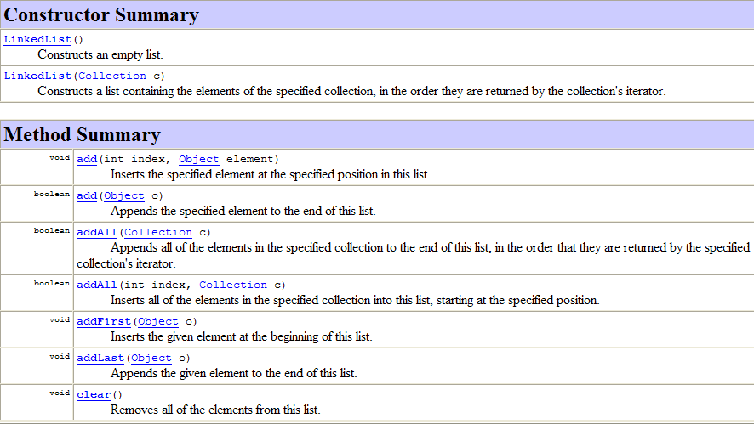
6.1 Class LinkedList: API (1/3)
[501043 Lecture 8: List ADT & Linked Lists]
Notes:
LinkedList được định nghĩa sẵn trong Java là danh sách liên kết đôi Doubly Linked List

Slide 76
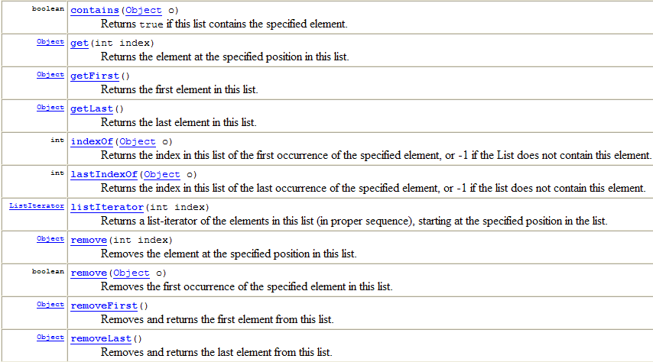
6.1 Class LinkedList: API (2/3)
[501043 Lecture 8: List ADT & Linked Lists]

Slide 77
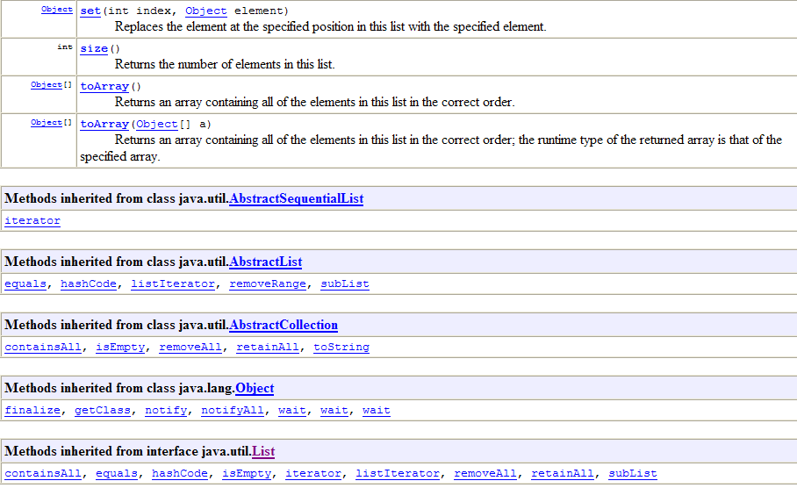
6.1 Class LinkedList: API (3/3)
[501043 Lecture 8: List ADT & Linked Lists]

Slide 78
6.2 Class LinkedList (1/2)
An example use (Page 1 of 2)
TestLinkedListAPI.java
import java.util.*;
public class TestLinkedListAPI {
static void printList(LinkedList <Integer> alist) {
System.out.print("List is: ");
for (int i = 0; i < alist.size(); i++)
System.out.print(alist.get(i) + "\t");
System.out.println();
}
// Print elements in the list and also delete them
static void printListv2(LinkedList <Integer> alist) {
System.out.print("List is: ");
while (alist.size() != 0) {
System.out.print(alist.element() + "\t");
alist.removeFirst();
}
System.out.println();
}
[501043 Lecture 8: List ADT & Linked Lists]

Slide 79
6.2 Class LinkedList (2/2)
An example use (Page 2 of 2)
TestLinkedListAPI.java
public static void main(String [] args) {
LinkedList <Integer> alist = new LinkedList <Integer> ();
for (int i = 1; i <= 5; i++)
alist.add(new Integer(i));
printList(alist);
System.out.println("First element: " + alist.getFirst());
System.out.println("Last element: " + alist.getLast());
alist.addFirst(888);
alist.addLast(999);
printListv2(alist);
printList(alist);
}
}

[501043 Lecture 8: List ADT & Linked Lists]

Slide 80
Why “reinvent the wheel”?
In a data structures course, students are often asked to implement well-known data structures.
A question we sometimes hear from students: “Since there is the API, why do we need to learn to write our own code to implement a data structure like linked list?”
Writing the code allows you to gain an indepth understanding of the data structures and their operations
The understanding will allow you to appreciate their complexity analysis (to be covered later) and use the API effectively
[501043 Lecture 8: List ADT & Linked Lists]

Slide 81
7 Summary (1/2)
We learn to create our own data structure
In creating our own data structure, we face 3 difficulties:
Re-use of codes (inheritance confusion)
Manipulation of pointers/references (The sequence of statements is important! With the wrong sequence, the result will be wrong.)
Careful with all the boundary cases
Drawings are very helpful in understanding the cases (point 3), which then can help in knowing what can be used/manipulated (points 1 and 2)
[501043 Lecture 8: List ADT & Linked Lists]

Slide 82
7 Summary (2/2)
Once we can get through this lecture, the rest should be smooth sailing as all the rest are similar in nature
You should try to add more methods to our versions of LinkedList, or to extend ListNode to other type of node
Please do not forget that the Java Library class is much more comprehensive than our own – for sit-in labs and exam, please use whichever one as you are told if stated.
[501043 Lecture 8: List ADT & Linked Lists]

Slide 83
8 Homework
Doubly Linked List
Single Sorted Linked List
[501043 Lecture 8: List ADT & Linked Lists]

Slide 84
9 Visualising Data Structures
See http://visualgo.net
Click on “Linked List, Stack, Queue”
(Non-linear data structures such as trees and graphs will be covered in 502043.)
See http://www.cs.usfca.edu/~galles/visualization/Algorithms.html
[501043 Lecture 8: List ADT & Linked Lists]

Slide 85
End of file

