Slide 1

Data Structures and Algorithms
Recursion
The mirrors

Slide 2
Acknowledgement
The contents of these slides have origin from School of Computing, National University of Singapore.
We greatly appreciate support from Mr. Aaron Tan Tuck Choy, and Dr. Low Kok Lim for kindly sharing these materials.

Slide 3
Policies for students
These contents are only used for students PERSONALLY.
Students are NOT allowed to modify or deliver these contents to anywhere or anyone for any purpose.

Slide 4
Objectives
1
Strengthening the concept of recursion learned in 501042 (or equivalent)
2
Demonstrating the application of recursion on some classic computer science problems
3
Applying recursion on data structures
4
Understanding recursion as a problem-solving technique known as divide-and-conquer paradigm

Slide 5
References
Book
Chapter 3: Recursion: The Mirrors
Chapter 6: Recursion as a Problem-Solving Technique, pages 337 to 345.
[501043 Lecture 10: Recursion]

Slide 6
Outline
Basic Idea
How Recursion Works?
Examples
Count down
Display an integer in base b
Printing a Linked List
Printing a Linked List in reverse order
Inserting an element into a Sorted Linked List
Towers of Hanoi
Combinations: n choose k
Binary Search in a Sorted Array
K^{th} Smallest Number
Permutations of a string
The 8 Queens Problem
[501043 Lecture 10: Recursion]

Slide 7
1 Basic Idea
Also known as a central idea in CS
Notes:
CS = Computer Science

Slide 8
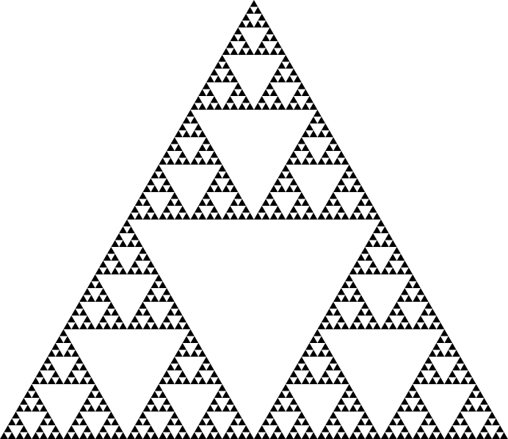
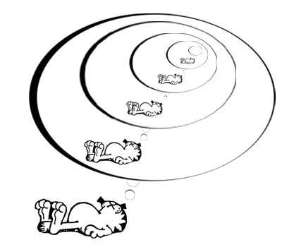

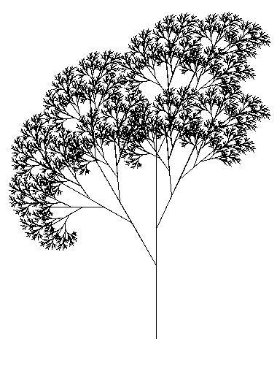
1.1 Pictorial examples
Some examples of recursion (inside and outside CS):
Garfield dreaming recursively.
Sierpinksi triangle
Droste effect
Recursive tree
Recursion is the process of repeating items in a self-similar way but with smaller size.
[501043 Lecture 10: Recursion]

Slide 9

1.2 Textual examples
Definitions based on recursion:
Dictionary entry:
Recursion: See recursion.
Recursive definitions:
A person is a descendant of another if
the former is the latter’s child, or
the former is one of the descendants of the latter’s child.
A list of numbers is
a number, or
a number followed by a list of numbers.
To understand recursion, you must first understand recursion.
Recursive acronyms:
GNU = GNU’s Not Unix
PHP = PHP: Hypertext Preprocessor
[501043 Lecture 10: Recursion]
Notes:
Mình là hậu duệ của cha, cha là hậu duệ của ông => Mình là hậu duệ của ông
listOfNumbers = [2]
listOfNumbers = 2, [1, 5, 7, 9]

Slide 10
1.3 Divide-and-Conquer
Divide: In top-down design (for program design or problem solving), break up a problem into sub-problems of the same type.
Conquer: Solve the problem with the use of a function that calls itself to solve each sub-problem
one or more of these sub-problems are so simple that they can be solved directly without calling the function
A paradigm where the solution to a problem depends on solutions to smaller instances of the same problem.
[501043 Lecture 10: Recursion]
Notes:
Conquer: chinh phục, chiến thắng
paradigm : mô hình

Slide 11
1.4 Why recursion?
Many algorithms can be expressed naturally in recursive form
Problems that are complex or extremely difficult to solve using linear techniques may have simple recursive solutions
It usually takes the following form:
SolveIt (problem) {
if (problem is trivial) return result;
else {
simplify problem;
return SolveIt (simplified problem) ;
}
}
Calls itself!
[501043 Lecture 10: Recursion]

Slide 12
2 How Recursion Works
Understanding Recursion

Slide 13
2.1 Recursion in 501042
In 501042, you learned simple recursion
No recursion on data structures
Code consists of ‘if’ statement, no loop
How to trace recursive codes
Examples covered in 501042
Factorial (classic example)
Fibonacci (classic example)
Greatest Common Divisor (classic example)
Other examples
[501043 Lecture 10: Recursion]

Slide 14
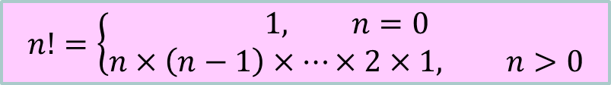
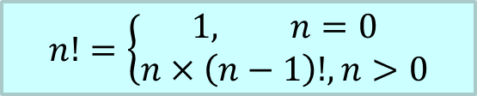
2.1 Recursion in 501042: Factorial (1/2)
$$n!=\left\{\begin{aligned}1, n=0 \\ &n×\left(n−1\right)×⋯×2×1, n>0\end{aligned}\right.$$
$$n!=\left\{\begin{aligned}1, n=0 \\ &n×\left(n−1\right)!, n>0\end{aligned}\right.$$
Recurrence relation
Iterative solution
// Precond: n >= 0
int fact(int n) {
int result = 1;
for (int i=1;i<=n;i++)
result *= i;
return result;
}
// Precond: n >= 0
int fact(int n) {
if (n == 0)
return 1;
else
return n * fact(n-1);
}
Remember to document pre-conditions, which are common for recursive codes.
Base case
Recursive call
[501043 Lecture 10: Recursion]

Slide 15
2.1 Recursion in 501042: Factorial (2/2)
120
Tracing recursion
fact(5)
5*
fact(4)
24
fact(n):
if (n == 0) return 1;
else return n * fact(n-1);
4*
fact(3)
6
3*
fact(2)
2
2*
fact(1)
1
1*
fact(0)
1
1
[501043 Lecture 10: Recursion]

Slide 16
2.1 Recursion in 501042: Fibonacci (1/4)
Fibonacci numbers: 1, 1, 2, 3, 5, 8, 13, 21, …
The first two Fibonacci numbers are both 1 (arbitrary numbers)
The rest are obtained by adding the previous two together.
Calculating the n^{th} Fibonacci number recursively:
Fib(n) = 1 for n=1, 2
= Fib(n-1) + Fib(n-2) for n > 2
Elegant but extremely inefficient. Which is correct?
Recursion doesn’t reach base case
A lot of repeated work
Should put recursive case above base case
// Precond: n > 0
int fib(int n) {
if (n <= 2)
return 1;
else
return fib(n-1) + fib(n-2);
}

[501043 Lecture 10: Recursion]
Notes:
Answer: 2. A lot of repeated work

Slide 17
2.1 Recursion in 501042: Fibonacci (2/4)
Tracing recursive Fibonacci:
Three duplicate calls to fib(3)!
fib(6)
fib(5)
fib(4)
fib(4)
fib(3)
fib(3)
fib(2)
fib(3)
fib(2)
fib(2)
fib(1)
fib(2)
fib(1)
fib(2)
fib(1)
Note the many duplicated fib()’s!
The same computations are done over and over again!
[501043 Lecture 10: Recursion]

Slide 18
2.1 Recursion in 501042: Fibonacci (3/4)
Iterative Fibonacci
int fib(int n) {
if (n <= 2)
return 1;
else {
int prev1=1, prev2=1, curr;
for (int i=3; i<=n; i++) {
curr = prev1 + prev2;
prev2 = prev1;
prev1 = curr;
}
return curr;
}
}
Q: Which part of the code is the key to the improved efficiency?
(1) Part A (red)
(2) Part B (blue)

[501043 Lecture 10: Recursion]
Notes:
Answer: Part B

Slide 19
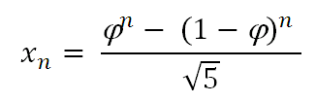
2.1 Recursion in 501042: Fibonacci (4/4)
Closed-form formula for Fibonacci numbers
Take the ratio of 2 successive Fibonacci numbers (say A and B). The bigger the pair of numbers, the closer their ratio is to the Golden ratio ϕ which is ≈ 1.618034…
A | 2 | 3 | 5 | 8 | … | 144 | 233
B | 3 | 5 | 8 | 13 | … | 233 | 377
B/A | 1.5 | 1.666… | 1.6 | 1.625 | … | 1.61805… | 1.61802…
Using ϕ to compute the Fibonacci number x_{n}:
See
http://www.maths.surrey.ac.uk/hosted-sites/R.Knott/Fibonacci/fibFormula.html
[501043 Lecture 10: Recursion]

Slide 20
2.1 Recursion in 501042: GCD (1/2)
Greatest Common Divisor of two integers a and b, where a and b are non-negative and not both zeroes
Iterative method given in Practice Exercise 11
// Precond: a, b non-negative,
// not both zeroes
int gcd(int a, int b) {
int rem;
while (b > 0) {
rem = a % b;
a = b;
b = rem;
}
return a;
}
[501043 Lecture 10: Recursion]

Slide 21
2.1 Recursion in 501042: GCD (2/2)
Recurrence relation:
a, if b = 0
gcd(b, a%b), if b > 0
gcd(a, b) =
// Precond: a, b non-negative,
// not both zeroes
int gcd(int a, int b) {
if (b == 0)
return a;
else
return gcd(b, a % b);
}
[501043 Lecture 10: Recursion]

Slide 22

2.2 Visualizing Recursion
Artwork credit: ollie.olarte
It’s easy to visualize the execution of non-recursive programs by stepping through the source code.
However, this can be confusing for programs containing recursion.
Have to imagine each call of a method generating a copy of the method (including all local variables), so that if the same method is called several times, several copies are present.
[501043 Lecture 10: Recursion]

Slide 23
2.2 Stacks for recursion visualization
int j = fact(5)
Use
push() for new recursive call
pop() to return a value from a call to the caller.
Example: fact (n)
if (n == 0) return 1;
else return n * fact (n-1);
fact(0)
1
fact(1)
1
× 1
fact(2)
2
× 1
fact(3)
3
× 2
fact(4)
4
× 6
fact(5)
5
× 24
j =120
[501043 Lecture 10: Recursion]

Slide 24
2.3 Recipe for Recursion
Sometimes we call #1 the “inductive step”
To formulate a recursive solution:
General (recursive) case: Identify “simpler” instances of the same problem (so that we can make recursive calls to solve them)
Base case: Identify the “simplest” instance (so that we can solve it without recursion)
Be sure we are able to reach the “simplest” instance (so that we will not end up with infinite recursion)
[501043 Lecture 10: Recursion]
Notes:
Recipe : công thức

Slide 25
2.4 Bad Recursion
funct(n) = 1 if (n==0)
= funct(n – 2)/n if (n>0)
Q: What principle does the above code violate?
1. Doesn’t have a simpler step.
2. No base case.
3. Can’t reach the base case.
4. All’s good. It’s a ~trick~!

[501043 Lecture 10: Recursion]
Notes:
Answer: 3. Can’t reach the base case
Explain: nếu như n là số lẻ thì thay vì nó bằng 0 thì nó sẽ giảm xuống nữa => nó không vào được base case

Slide 26
Revision
1. Thành phần của đệ quy bao gồm những gì? Cho ví dụ một bài toán giải bằng đệ quy và chỉ ra các thành phần này.
2. Trong trường hợp nào thuật toán đệ quy lặp vô tận? Chỉ ra ưu điểm và nhược điểm của thuật toán đệ quy.
Notes:
Answer:
Thành phần của đệ quy bao gồm: base case, recursive case (Slide 24)
Ví dụ: Slide 14,…
2. Thuật toán đệ quy lặp vô tận khi can’t reach base case
Ưu điểm: chương trình ngắn gọn, dễ hiểu (Slide 11)
Nhược điểm: chậm, tốn nhiều bộ nhớ

Slide 27
3 Examples
How recursion can be used

Slide 28
3.1 Countdown
Example 1
CountDown.java
public class CountDown {
public static void countDown(int n) {
if (n <= 0) // don’t use == (why?)
System.out.println (“BLAST OFF!!!!”);
else {
System.out.println("Count down at time " + n);
countDown(n-1);
}
}
public static void main(String[] args) {
countDown(10);
}
}

[501043 Lecture 10: Recursion]
Notes:
Nếu sử dụng == thì trong trường hợp ta truyền vào n < 0 => Chương trình sẽ lặp vô tận (do không vào được dk dừng)
Precondition

Slide 29
3.2 Display an integer in base b
Example 2
See ConvertBase.java
E.g. One hundred twenty three is 123 in base 10; 173 in base 8
public static void displayInBase(int n, int base) {
if (n > 0) {
displayInBase(n / base, base);
System.out.print(n % base);
}
}
What is the precondition for parameter base?
Example 1:
n = 123, base = 10
123/10 =12 123 % 10 = 3
12/10 = 1 12 % 10 = 2
1/10 = 0 1 % 10 = 1
Answer: 123
Example 2:
n = 123, base = 8
123/8 = 15 123 % 8 = 3
15/8 = 1 15 % 8 = 7
1/8 = 0 1 % 8 = 1
Answer: 173
[501043 Lecture 10: Recursion]
Notes:
Answer: base > 1

Slide 30
3.3 Printing a Linked List recursively
Example 3
See SortedLinkedList.java and TestSortedList.java
public static void printLL(ListNode n) {
if (n != null) {
System.out.print(n.value);
printLL(n.next);
}
}
Q: What is the base case?
Q: How about printing in reverse order?
head
printLL (head) →
printLL
5
printLL
Output:
8
5
8
9
printLL
9
printLL
[501043 Lecture 10: Recursion]
Notes:
base case: n == null

Slide 31
3.4 Printing a Linked List recursively in reverse order
Example 4
See SortedLinkedList.java and TestSortedList.java
public static void printLL (ListNode n) {
if (n!=null) {
System.out.print(n.value);
printLL (n.next);
}
}
printRev
printRev(n.next);
Just change the name!
… Sure, right!
System.out.print(n.value);
printRev
head
printRev(head) →
printRev
5
printRev
Output:
8
9
8
5
printRev
9
printRev
[501043 Lecture 10: Recursion]

Slide 32
3.5 Sorted Linked List Insertion (1/2)
Example 5
Insert an item v into the sorted linked list with head p
Case 1: Tail insertion
p == null
v
Case 2: Insert before p
v < p.element
insert(p,v)
v
p.element
v >= p.element
Case 3: Insert after p (recursion)
p.element
p.next
insert ( p.next ,v)
p.element
[501043 Lecture 10: Recursion]

Slide 33
3.5 Sorted Linked List Insertion (2/2)
Example 5
public static ListNode insert(ListNode p, int v) {
// Find the first node whose value is bigger than v
// and insert before it.
// p is the “head” of the current recursion.
// Returns the “head” after the current recursion.
if (p == null || v < p.element)
return new ListNode(v, p);
else {
p.next = insert(p.next, v);
return p;
}
}
To call this method: head = insert(head, newItem);
[501043 Lecture 10: Recursion]

Slide 34
3.6 Towers of Hanoi
Example 6
Given a stack of discs on peg A, move them to peg B, one disc at a time, with the help of peg C.
A larger disc cannot be stacked onto a smaller one.
Only the first 3 steps shown.
initial state
A
B
C
final state
A
B
C
[501043 Lecture 10: Recursion]

Slide 35
3.6 Towers of Hanoi – Quiz
Example 6
What’s the base case?
A: 1 disc
B: 0 disc
What’s the inductive step?
A: Move the top n-1 disks to another peg
B: Move the bottom n-1 disks to another peg
How many times do I need to call the inductive step?
A: Once
B: Twice
C: Three times
From en.wikipedia.org

[501043 Lecture 10: Recursion]

Slide 36
3.6 Tower of Hanoi solution
Example 6
public static void Towers(int numDisks, char src, char dest, char temp) {
if (numDisks == 1) {
System.out.println("Move top disk from pole " + src + " to pole " + dest);
} else {
Towers(numDisks – 1, src, temp, dest); // first recursive call
Towers(1, src, dest, temp);
Towers(numDisks – 1, temp, dest, src); // second recursive call
}
}
[501043 Lecture 10: Recursion]

Slide 37
3.6 Tower of Hanoi iterative solution (1/2)
Example 6
public static void LinearTowers(int orig_numDisks, char orig_src,
char orig_dest, char orig_temp) {
int numDisksStack[] = new int[100]; // Maintain the stacks manually!
char srcStack[] = new char[100];
char destStack[] = new char[100];
char tempStack[] = new char[100];
int stacktop = 0;
numDisksStack[0] = orig_numDisks; // Init the stack with the 1st call
srcStack[0] = orig_src;
destStack[0] = orig_dest;
tempStack[0] = orig_temp;
stacktop++;
Complex!
This and the next slide are only for your reference.
[501043 Lecture 10: Recursion]

Slide 38
3.6 Tower of Hanoi iterative solution (2/2)
Example 6
while (stacktop>0) {
stacktop--; // pop current off stack
int numDisks = numDisksStack[stacktop];
char src = srcStack[stacktop]; char dest = destStack[stacktop];
char temp = tempStack[stacktop];
if (numDisks == 1) {
System.out.println("Move top disk from pole "+src+" to pole "+dest);
} else {
/* Towers(numDisks-1,temp,dest,src); */ // second recursive call
numDisksStack[stacktop] = numDisks -1;
srcStack[stacktop] = temp;
destStack[stacktop] = dest;
tempStack[stacktop++] = src;
/* Towers(1,src,dest,temp); */
numDisksStack[stacktop] =1;
srcStack[stacktop] = src; destStack[stacktop] = dest;
tempStack[stacktop++] = temp;
/* Towers(numDisks-1,src,temp,dest); */ // first recursive call
numDisksStack[stacktop] = numDisks -1;
srcStack[stacktop] = src; destStack[stacktop] = temp;
tempStack[stacktop++] = dest;
}
}
Q: Which version runs faster?
A: Recursive
B: Iterative (this version)
[501043 Lecture 10: Recursion]

Slide 39
3.6 Towers of Hanoi
Example 6
Towers(4, src, dest, temp)
3
1
3
src
src
temp
temp
dest
dest
dest
temp
src
numDiskStack srcStack destStack tempStack
[501043 Lecture 10: Recursion]

Slide 40
3.6 Time Efficiency of Towers()
Example 6
Num of discs, n | Num of moves, f(n) | Time (1 sec per move)
1 | 1 | 1 sec
2 | 3 | 3 sec
3 | 3+1+3 = 7 | 7 sec
4 | 7+1+7 = 15 | 15 sec
5 | 15+1+15 = 31 | 31 sec
6 | 31+1+31 = 63 | 1 min
… | … | …
16 | 65,536 | 18 hours
32 | 4.295 billion | 136 years
64 | 1.8 × 10¹⁰ billion | 584 billion years
N | 2^{N} – 1
[501043 Lecture 10: Recursion]

Slide 41

3.7 Being choosy…
Example 7
Suppose you visit an ice cream store with your parents.
You’ve been good so they let you choose 2 flavors of ice cream.
The ice cream store stocks 10 flavors today. How many different ways can you choose your ice creams?
“Photo” credits: Torley (this pic is from 2nd life)
[501043 Lecture 10: Recursion]

Slide 42
3.7 n choose k
Example 7
See Combination.java
X selected
choose k-1 out of n-1
choose k out of n
or
X not selected
choose k out of n-1
k==n
k==0
public static int choose(int n, int k) {
if (k>n) return 0;
if (k==n || k==0) return 1;
return choose(n-1, k-1) + choose(n-1, k);
}
1
1
[501043 Lecture 10: Recursion]

Slide 43
3.7 Compute c(4,2)
Example 7
c(4,2)
Return c(3,1) + c(3,2)
c(3,1)
Return c(2,0) + c(2,1)
c(3,2)
Return c(2,1) + c(2,2)
c(2,0)
Return 1
c(2,1)
Return c(1,0) + c(1,1)
c(2,1)
Return c(1,0) + c(1,1)
c(2,2)
Return 1
c(1,0)
Return 1
c(1,1)
Return 1
c(1,0)
Return 1
c(1,1)
Return 1

[501043 Lecture 10: Recursion]

Slide 44
3.8 Searching within a sorted array
Example 8
Idea: narrow the search space by half at every iteration until a single element is reached.
Problem: Given a sorted int array a of n elements and int x, determine if x is in a.
a =
1
5
6
13
14
19
21
24
32
x = 15
[501043 Lecture 10: Recursion]

Slide 45
3.8 Binary Search by Recursion
Example 8
public static int binarySearch(int [] a, int x, int low, int high)
throws ItemNotFound {
// low: index of the low value in the subarray
// high: index of the highest value in the subarray
if (low > high) // Base case 1: item not found
throw new ItemNotFound("Not Found");
int mid = (low + high) / 2;
if (x > a[mid])
return binarySearch(a, x, mid + 1, high);
else if (x < a[mid])
return binarySearch(a, x, low, mid - 1);
else
return mid; // Base case 2: item found
}
Q: Here, do we assume that the array is sorted in ascending or descending order?
A: Ascending
B: Descending
[501043 Lecture 10: Recursion]
Notes:
Answer: A

Slide 46
Revision
Trình bày các bước của thuật toán đệ quy tìm kiếm nhị phân bằng ngôn ngữ tự nhiên

Slide 47
3.8 Auxiliary functions for recursion
Example 8
Hard to use this function as it is.
Users just want to find something in an array. They don’t want to (or may not know how to) specify the low and high indices.
Write an auxiliary function to call the recursive function
Using overloading, the auxiliary function can have the same name as the actual recursive function it calls
boolean binarySearch(int[] a, int x) {
return binarySearch(a, x, 0, a.length-1);
}
Auxiliary function
Recursive function
[501043 Lecture 10: Recursion]

Slide 48
3.9 Find k^{th} smallest (unsorted array)
Example 9
public static int kthSmallest(int k, int[] a) { // k >= 1
// Choose a pivot element p from a[]
// and partition (how?) the array into 2 parts where
// left = elements that are <= p
// right = elements that are > p
…
int numLeft = sizeOf(left);
if (1_________) 3__________;
if (2_________) {
return 4_________;
else
return 5_________;
}
Map the lines to the slots
A: 1i, 2ii, 3iii, 4iv, 5v
B: 1i, 2ii, 3v, 4iii, 5iv
C: 1ii, 2i, 3v, 4iii, 5iv
D: 1i, 2ii, 3v, 4iv, 5iii
where
i. k == numLeft
ii. k < numLeft
iii. return kthSmallest(k, left);
iv. return kthSmallest(k – numLeft, right);
v. return p;
left
right
p

[501043 Lecture 10: Recursion]

Slide 49
3.10 Find all Permutations of a String (1/3)
Example 10
For example, if the user types a word say east, the program should print all 24 permutations (anagrams), including eats, etas, teas, and non-words like tsae.
Idea to generate all permutation:
Given east, we would place the first character i.e. e in front of all 6 permutations of the other 3 characters ast — ast, ats, sat, sta, tas, and tsa — to arrive at east, eats, esat, esta, etas, and etsa, then
we would place the second character, i.e. a in front of all 6 permutations of est, then
the third character i.e. s in front of all 6 permutations of eat, and
finally the last character i.e. t in front of all 6 permutations of eas.
Thus, there will be 4 (the size of the word) recursive calls to display all permutations of a four-letter word.
Of course, when we’re going through the permutations of the 3-character string e.g. ast, we would follow the same procedure.
[501043 Lecture 10: Recursion]
Notes:
Permutations: hoán vị

Slide 50
3.10 Find all Permutations of a String (2/3)
Example 10
Recall overloaded substring() methods in String class
String | substring(int beginIndex) Returns a new string that is a substring of this string. The substring begins with the character at beginIndex and extends to the end of this string.
String | substring(int beginIndex, int endIndex) Returns a new string that is a substring of this string. The substring begins at beginIndex and extends to the character at index endIndex - 1. Thus the length of the substring is endIndex – beginIndex.
[501043 Lecture 10: Recursion]

Slide 51
3.10 Find all Permutations of a String (3/3)
Example 10
public class Permutations { public static void main(String args[]) { permuteString("", "String"); } public static void permuteString(String beginningString, String endingString) { if (endingString.length() <= 1) System.out.println(beginningString + endingString); else for (int i = 0; i < endingString.length(); i++) { try { String newString = endingString.substring(0,i) + endingString.substring(i+1);
// newString is the endingString but without character at index i permuteString(beginningString + endingString.charAt(i), newString); } catch (StringIndexOutOfBoundsException exception) { exception.printStackTrace(); } } } }
[501043 Lecture 10: Recursion]

Slide 52
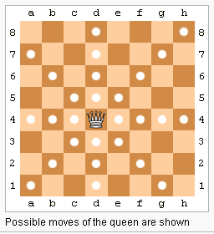
Exercise: Eight Queens Problem
Place eight Queens on the chess board so that they cannot attack one another
Q: How do you formulate this as a recursion problem?
Work with a partner on this.
http://en.wikipedia.org/wiki/Eight_queens_puzzle
[501043 Lecture 10: Recursion]

Slide 53
Backtracking
Recursion and stacks illustrate a key concept in search: backtracking
We can show that the recursion technique can exhaustively search all possible results in a systematic manner
Learn more about searching spaces in other CS classes.
[501043 Lecture 10: Recursion]

Slide 54
More Recursion later
You will see more examples of recursion later when we cover more advanced sorting algorithms
Examples: Quick Sort, Merge Sort
[501043 Lecture 10: Recursion]

Slide 55
5 Summary
Recursion – The Mirrors
Base Case:
Simplest possible version of the problem which can be solved easily
Inductive Step:
Must simplify
Must arrive at some base case
Easily visualized by a Stack
Operations before and after the recursive calls come in FIFO and LIFO order, respectively
Elegant, but not always the best (most efficient) way to solve a problem
[501043 Lecture 10: Recursion]

Slide 56
End of file

