Slide 1

Data Structures and Algorithms
Census Problem

Slide 2
Acknowledgement
The contents of these slides have origin from School of Computing, National University of Singapore.
We greatly appreciate support from Dr. Steven Halim for kindly sharing these materials.

Slide 3
Policies for students
These contents are only used for students PERSONALLY.
Students are NOT allowed to modify or deliver these contents to anywhere or anyone for any purpose.

Slide 4
Recording of modifications
Currently, there are no modification on these contents.

Slide 5

CS2010 – Data Structures and Algorithms II
Lecture 03 – Census Problem stevenhalim@gmail.com

Slide 6
Outline
Motivation: Census Problem
Abstract Data Type (ADT) Table
Solving Census Problem with CS1020 Knowledge
The “performance issue”
Binary Search Tree (BST)
Heavy usage of VisuAlgo Binary Search Tree Visualization
Simple analysis of BST operations
Java Implementation
PS2 Preview

Slide 7
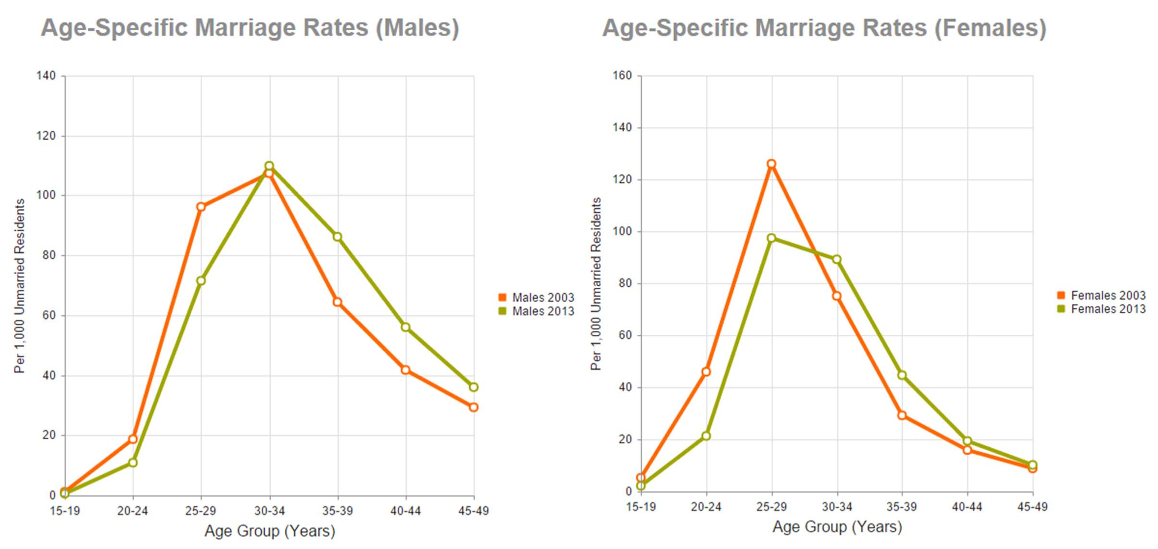
Census is Important!
Source: http://www.singstat.gov.sg

Slide 8

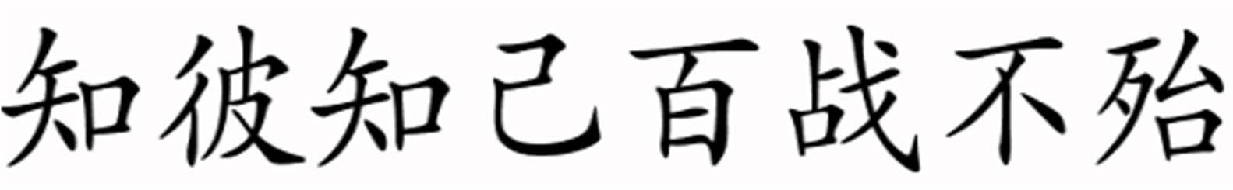
Sun Tzu’s Art of War
Chapter 1 “The Calculations”
zhī bǐ zhī jǐ bǎi zhàn bù dài
(If you know your enemies and know yourself, you will not be imperiled in a hundred battles)

Slide 9


Your Age (2013 data)
‘[‘ (or ‘]’) means that endpoint is included (closed)
1. [24 … ∞)
2. [23 … 24)
3. [22 … 23)
4. [21 … 22)
5. [20 … 21)
6. [19 … 20)
7. [18 … 19)
8. [17 … 18)
9. [0 … 17)
6
‘(‘ (or ‘)‘) means that endpoint is not included (open)
5
4
3
3
3
2
0
0
Mean = 3.¹961²5
3
4
5
6
7
8
9

Slide 10
Your Major (2013 data)
1. Computer Science (CS) 2.
Communications and
15
Media (C&M)
Computer Engineering (CEG/CEC)
Comp. Biology (CB)
Information System (IS)
Science Maths (SCI)
None of the above :O
11
3
0
0
0
0
1
2
3
4
5
6
7

Slide 11
Your Nationality (2013 data)
70% according to MOE rules)
Chinese
Indian
Indonesian
Vietnamese
Malaysian
European
None of the above
1. Singaporean (should be ≥
15
3
3
2
2
1
1
0
1
2
3
4
5
6
7
8

Slide 12
Your CAP (2013 data)
1. [4.5 … 5.0]
2. [4.25 … 4.5)
3. [4.0 … 4.25)
4. [3.75 … 4.0)
5. [3.5 … 3.75)
6. [3.25 … 3.5)
7. [3.0 … 3.25)
8. [0.0 … 3.00)
9. I do not want to tell
7
6
5
4
3
1
1
1
1
1
2
3
4
5
6
7
8
9

Slide 13

What Happen After Census?
Data Mining
Statistical Analysis

Slide 14
Abstract Data Type (ADT) Table
Let’s deal with one aspect of our census: Age
To simplify this lecture, we assume that students’ age ranges from [0 … 100), all integers, and distinct
Required operations:
Search whether there is a student with a certain age?
Insert a new student (that is, insert his/her age)
Determine the youngest and oldest student
List down the ages of students in sorted order
Find a student slightly older than a certain age!
Delete existing student (that is, remove his/her age)
Determine the median age of students
How many students are younger than a certain age?

Slide 15
CS1020: Unsorted Array
Index | 0 | 1 | 2 | 3 | 4 | 5 | 6 | 7
A | 5 | 7 | 71 | 50 | 23 | 4 | 6 | 15
No | Operation | Time Complexity
1 | Search(age) | O(n)
2 | Insert(age) | O(1)
3 | FindOldest() | O(n)
4 | ListSortedAges() | O(n log n)
5 | NextOlder(age) | O(n)
6 | Remove(age) | O(n)
7 | GetMedian() | O(n log n)/O(n)
8 | NumYounger(age) | O(n log n)

Slide 16
CS1020: Sorted Array
Index | 0 | 1 | 2 | 3 | 4 | 5 | 6 | 7
A | 4 | 5 | 6 | 7 | 15 | 23 | 50 | 71
No | Operation | Time Complexity
1 | Search(age) | O(log n)
2 | Insert(age) | O(n)
3 | FindOldest() | O(1)
4 | ListSortedAges() | O(n)
5 | NextOlder(age) | O(log n)
6 | Remove(age) | O(n)
7 | GetMedian() | O(1)
8 | NumYounger(age) | O(log n)

Slide 17

With Just CS1020 Knowledge
No | Operation |  | Unsorted Array |  | Sorted Array
1 | Search(age) |  | O(n) |  | O(log n)
2 | Insert(age) |  | O(1) |  | O(n)
3 |  |  |  |  | O(1)
 | FindOldest() Dynamic O(n)
4 | ListSortedAge | data s structure |  | (n log n) | O(n)
5 | NextOlder(ag ^{operations} O(n) |  |  |  | O(log n)
6 | Remove(age) |  | O(n) |  | O(n)
7 | GetMedian() |  | O(n log n) / O(n) |  | O(1)
8 | NumYounger(age) |  | O(n log n) |  | O(log n)
() O
e)
If n is large, our queries are slow…

Slide 18
O(n) versus O(log n): A Perspective
n = 8 log₂ n = 3
n = 16
log₂ n = 4
n = 32
log₂ n = 5
Try larger n, e.g. n = 1000000…

Slide 19
A Versatile, Non‐Linear Data Structure
BINARY SEARCH TREE (BST)

Slide 20
Binary Search Tree (BST) Vertex
For every vertex x, we define:
x.left = the left child of x
x.right = the right child of x
x.parent = the parent of x
x.key (or x.value, x.data) = the value stored at x
BST Property:
x.key
x.left.key < x.key ≤ x.right.key
For simplicity, we assume that the keys are unique
so that we can change ≥ to >
<
x.key
≥
x.key

Slide 21
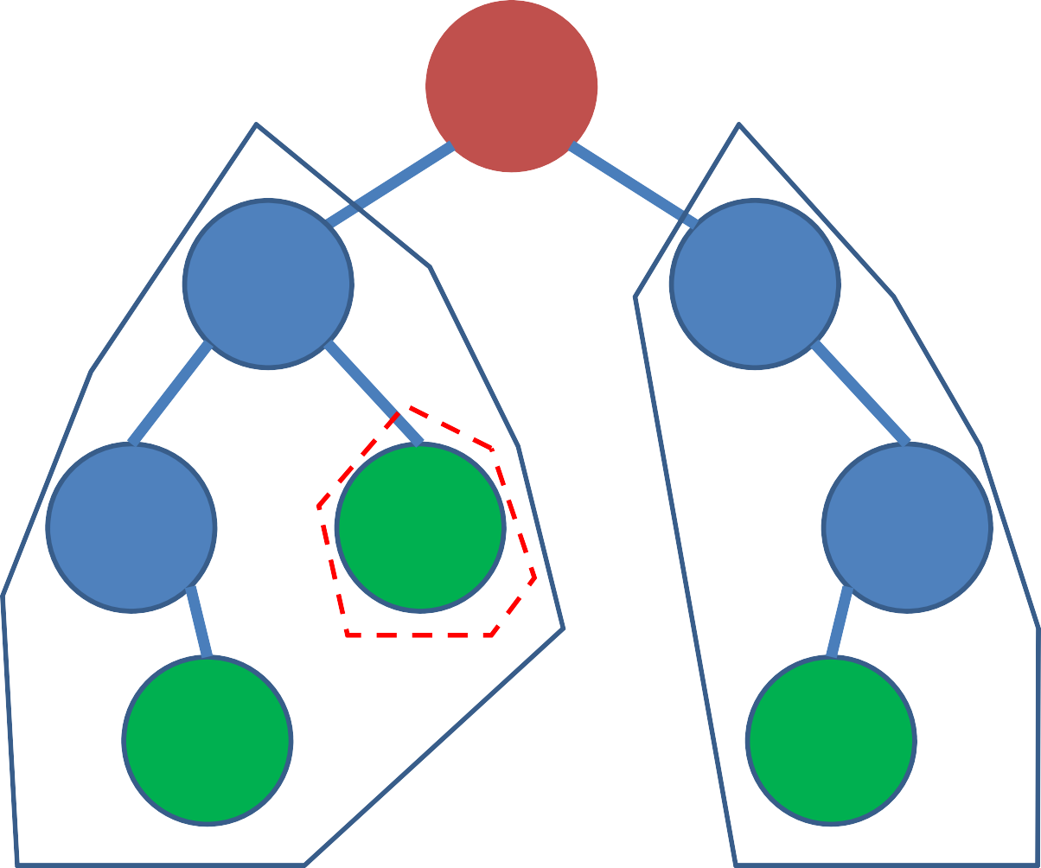
BST: An Example, Keys = Ages
x.key
Recursive definition
Root
15
<
x.key
≥
x.key
6
23
All other vertices other than 15, 5, 7,
and 50 are
Internal vertices
4
7
71
5
50
Leaves

Slide 22
Revision
Cho dãy số: 9, 8, 10, 20, 23, 21, 1, 5, 3. Hãy biểu diễn từng bước thêm lần lượt dãy số trên vào cây nhị phân tìm kiếm (Binary Search Tree).

Slide 23
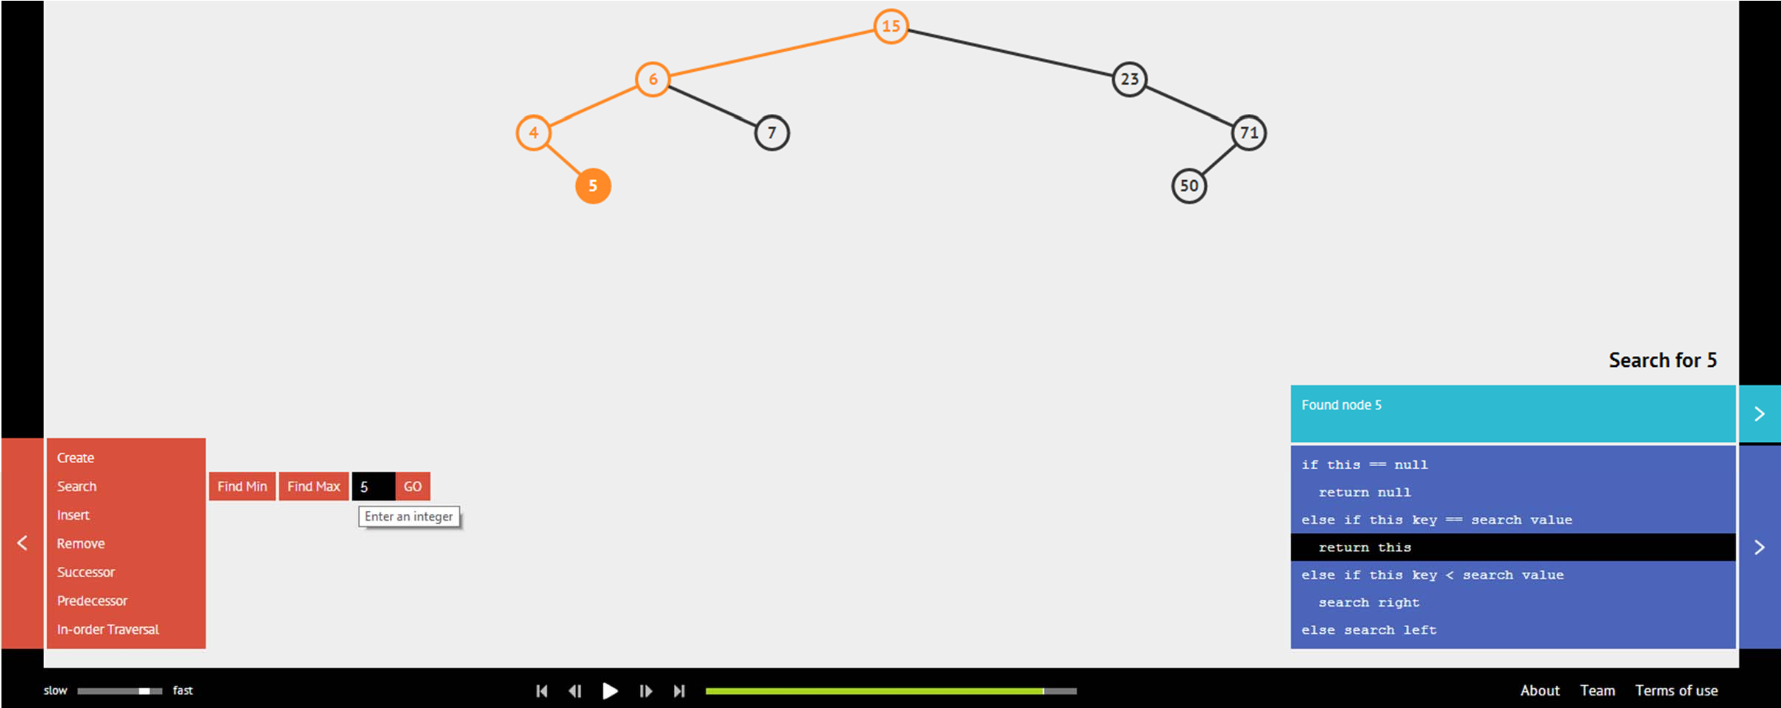
BST: Search/Min/Max Operations
Ask VisuAlgo to perform various search operations on the sample BST, including find min and find max
In the screen shot below, we show search(5)

Slide 24
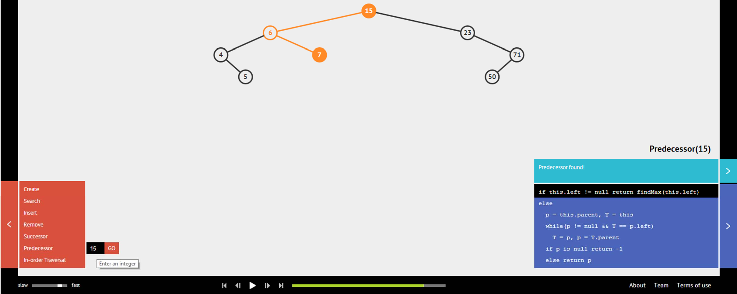
BST: Succ/Predec‐essor Operations
Ask VisuAlgo to perform Succ/Pred operations on the sample BST
In the screen shot below, we show pred(15)

Slide 25
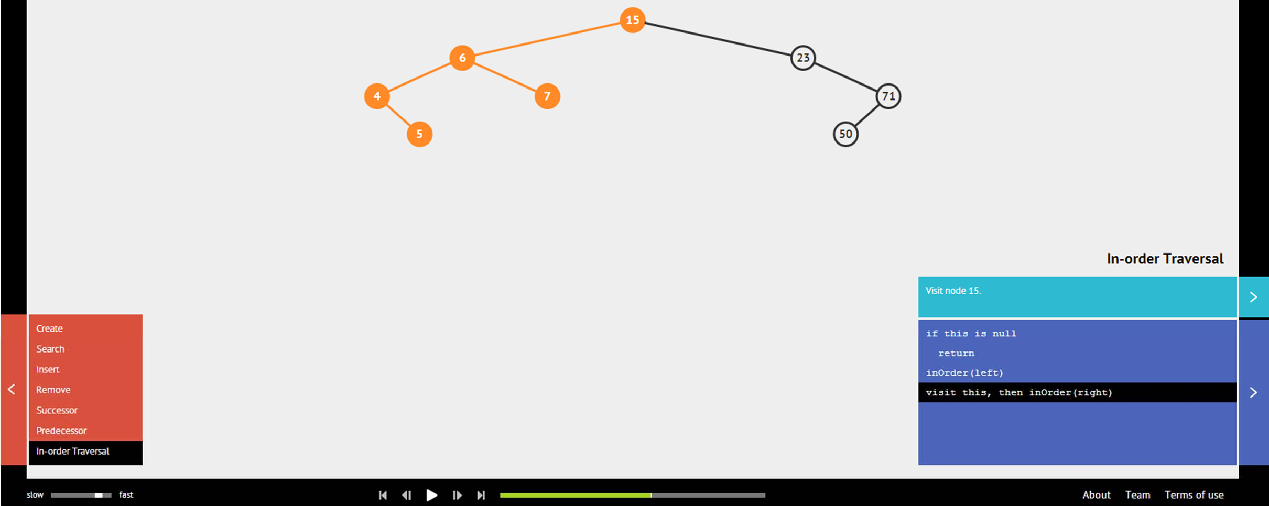
BST: Inorder Traversal Operation
Ask VisuAlgo to perform inorder traversal operation on the sample BST
In the screen shot below, we partial inorder traversal

Slide 26
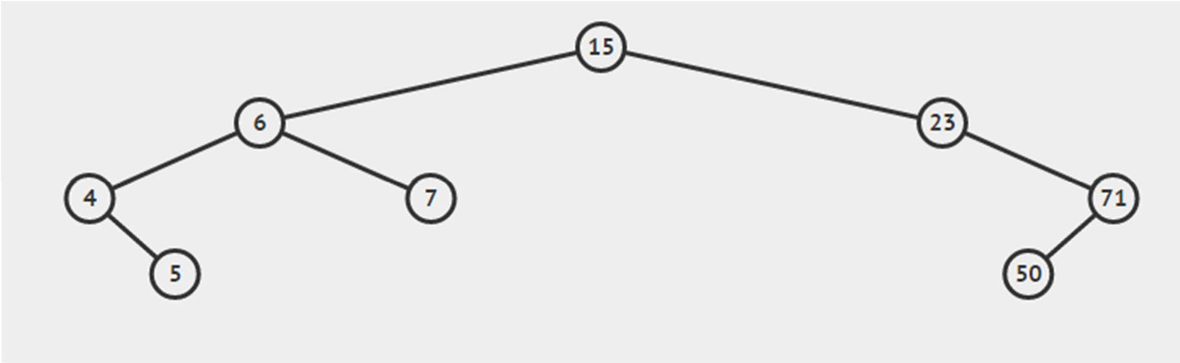
BST: Select/Rank Operations
These 2 operations will be added to VisuAlgo BST visualization soon; for now, here are the concepts:
Select(k) – Return the value v of k‐th smallest* element
Examples: Select(1) = 4, Select(3) = 6, Select(8) = 71, etc (1‐based index)
Rank(v) – Return the ranking* k of element v
Examples: Rank(4) = 1, Rank(6) = 3, Rank(71) = 8, etc
Details will be discussed in the next lecture
1
2
3
4
5
6
7
8

Slide 27
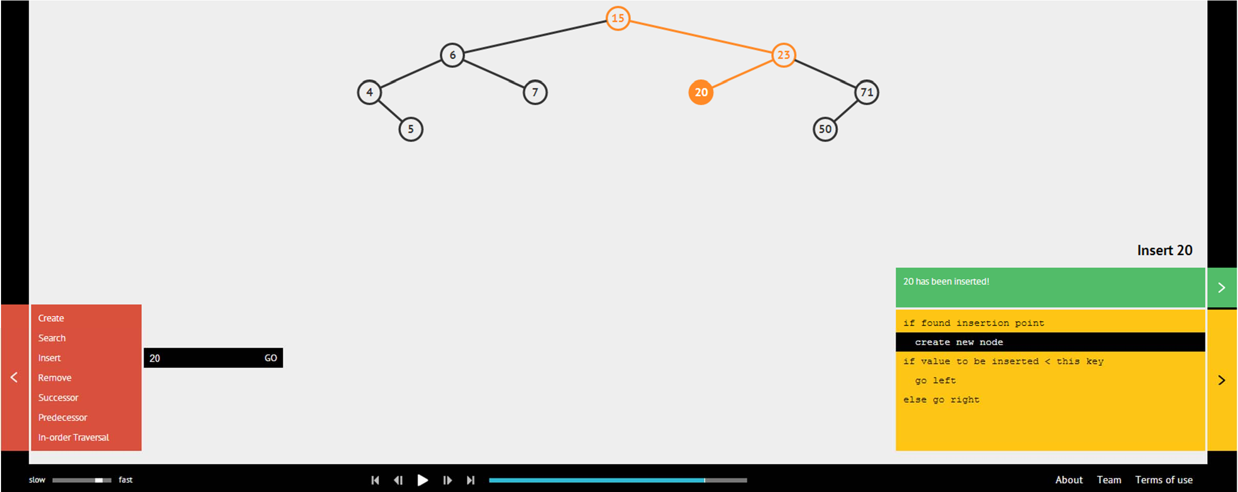
BST: Insert Operation
Ask VisuAlgo to perform various insert operations on the sample BST
In the screen shot below, we show insert(20)

Slide 28
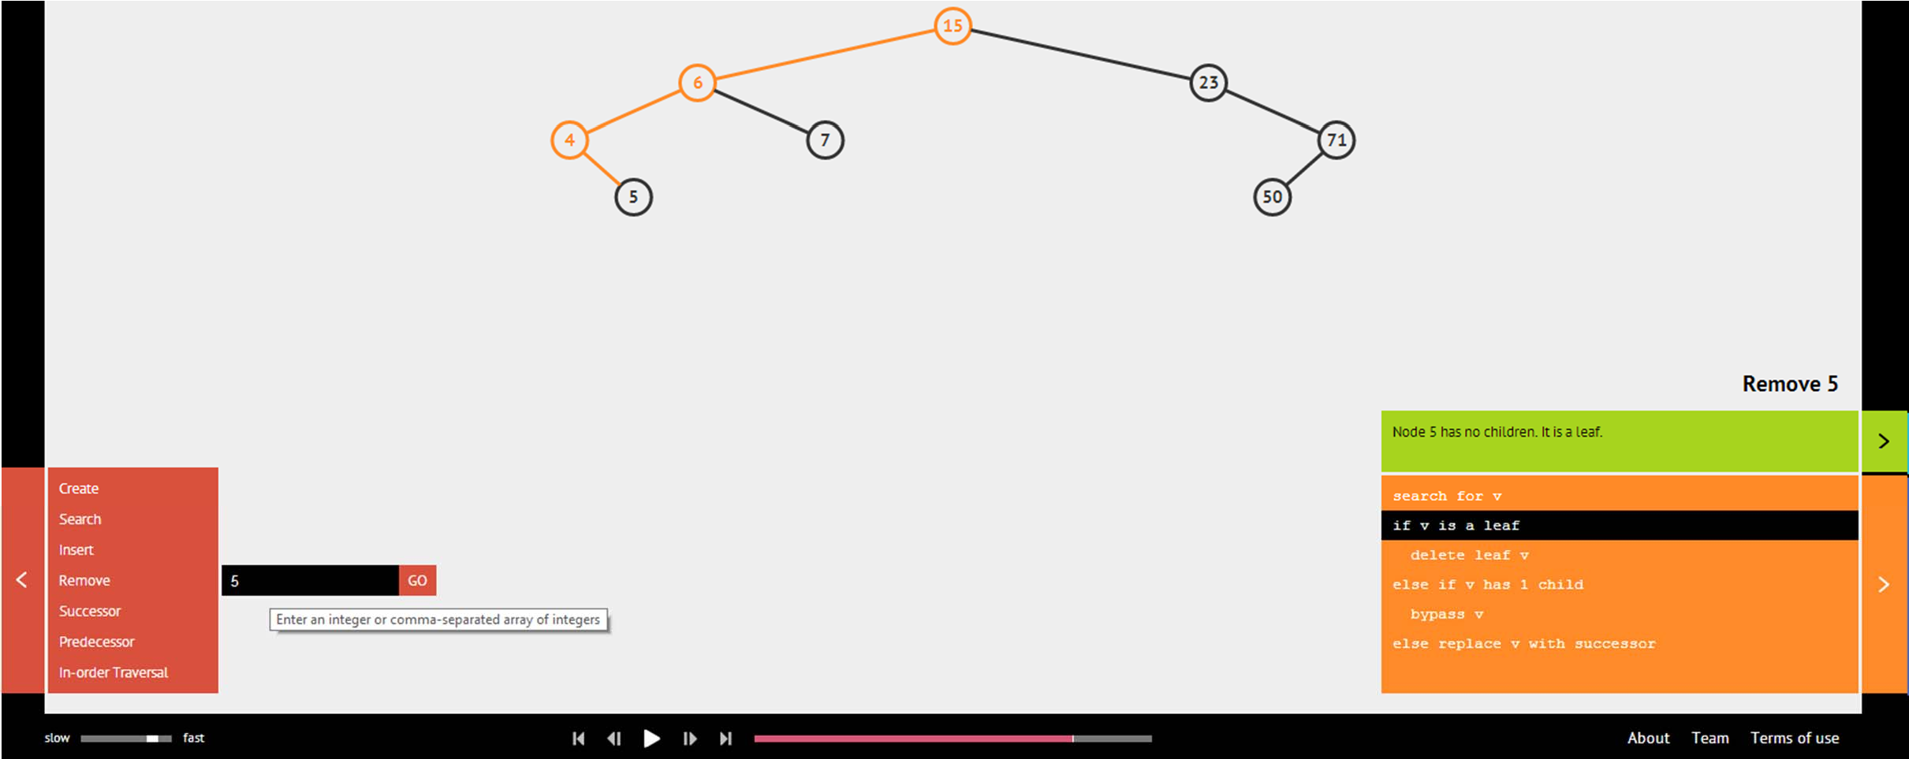
BST: Delete/Remove Operation (1)
Ask VisuAlgo to perform various delete operations on the sample BST (3 cases, this is delete leaf)
In the screen shot below, we show remove(5) before deletion

Slide 29
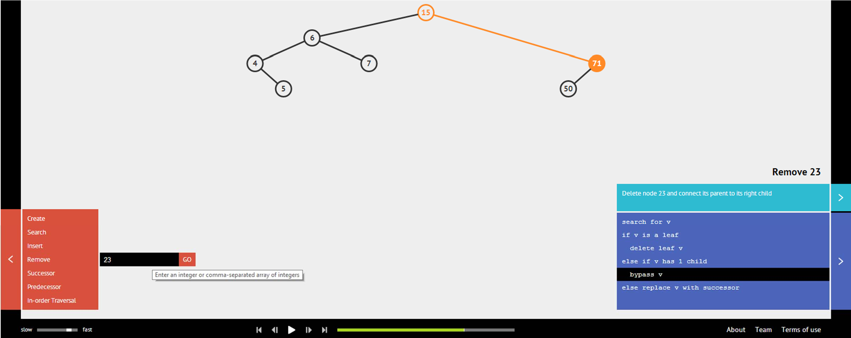
BST: Delete/Remove Operation (2)
Ask VisuAlgo to perform various delete operations on the sample BST (this is delete vertex with one child)
In the screen shot below, we show remove(23) before relayout

Slide 30
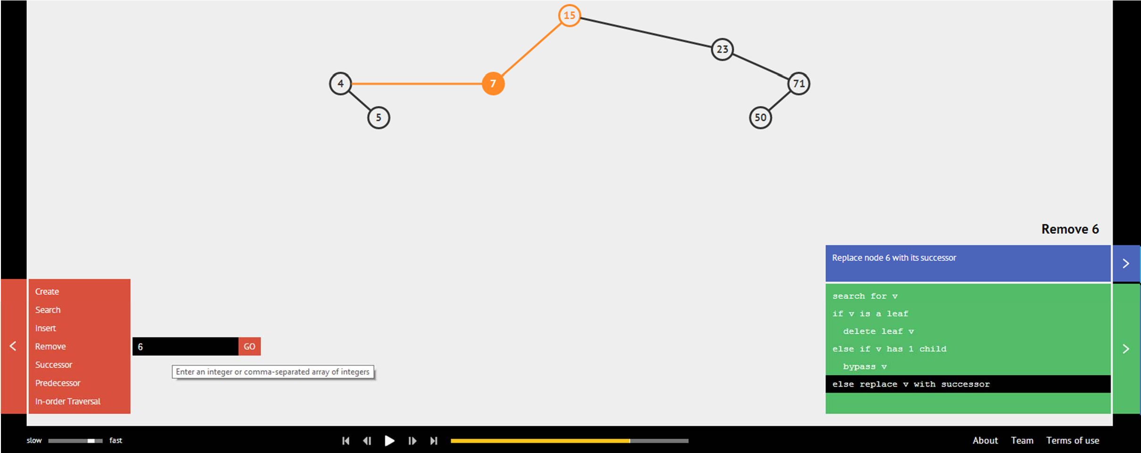
BST: Delete/Remove Operation (3)
Ask VisuAlgo to perform various delete operations on the sample BST (delete vertex with two children)
In the screen shot below, we show remove(6) before relayout
Later, we will analyze on why replacing the deleted item with it’s successor (and delete the old successor works

Slide 31
ANALYSIS OF BST OPERATIONS

Slide 32
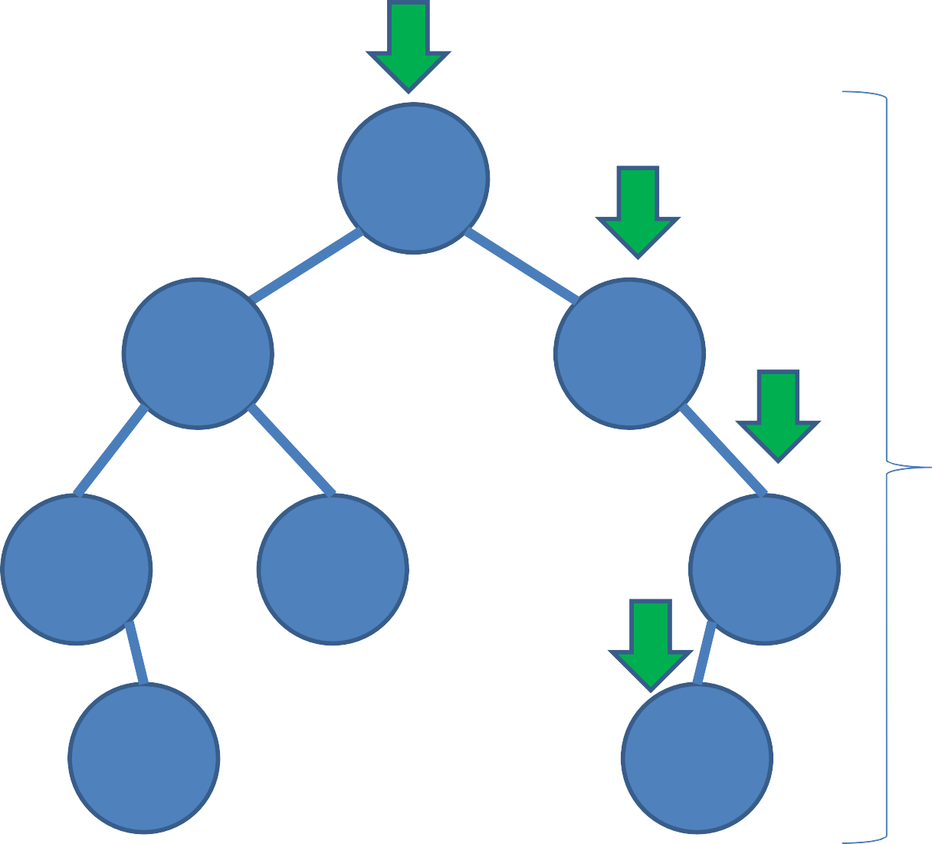
BST: Search Analysis
search(51)
Quick analysis: search runs in O(h)
15
6
23
h = Height of BST
4
7
71
5
50
51 is not found ☹

Slide 33
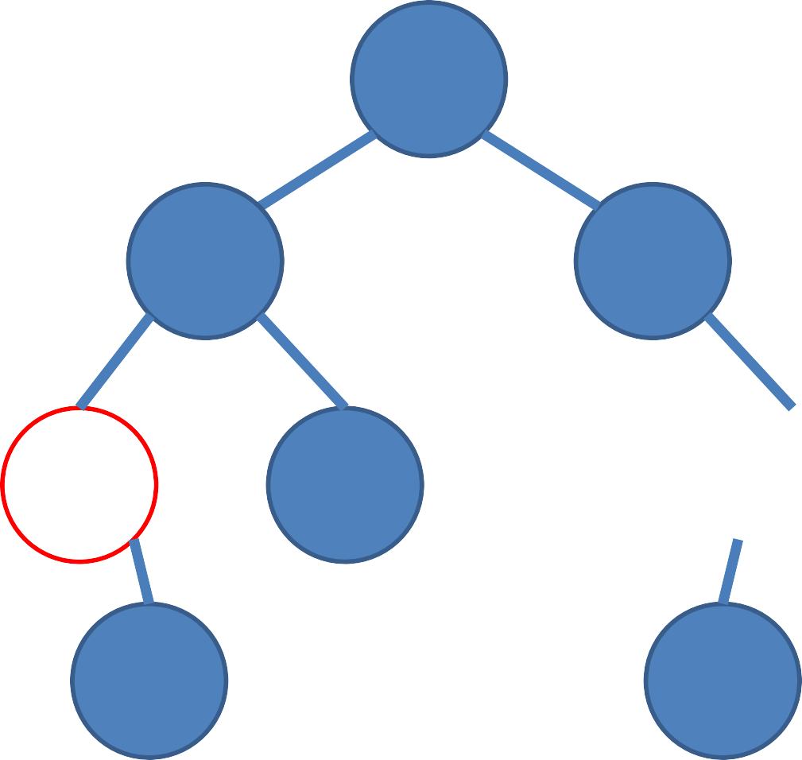
BST: Find Min/Max Analysis
Quick analysis:
findMin/findMax
also runs in O(h)
15
6
23
4
7
71
5
50

Slide 34
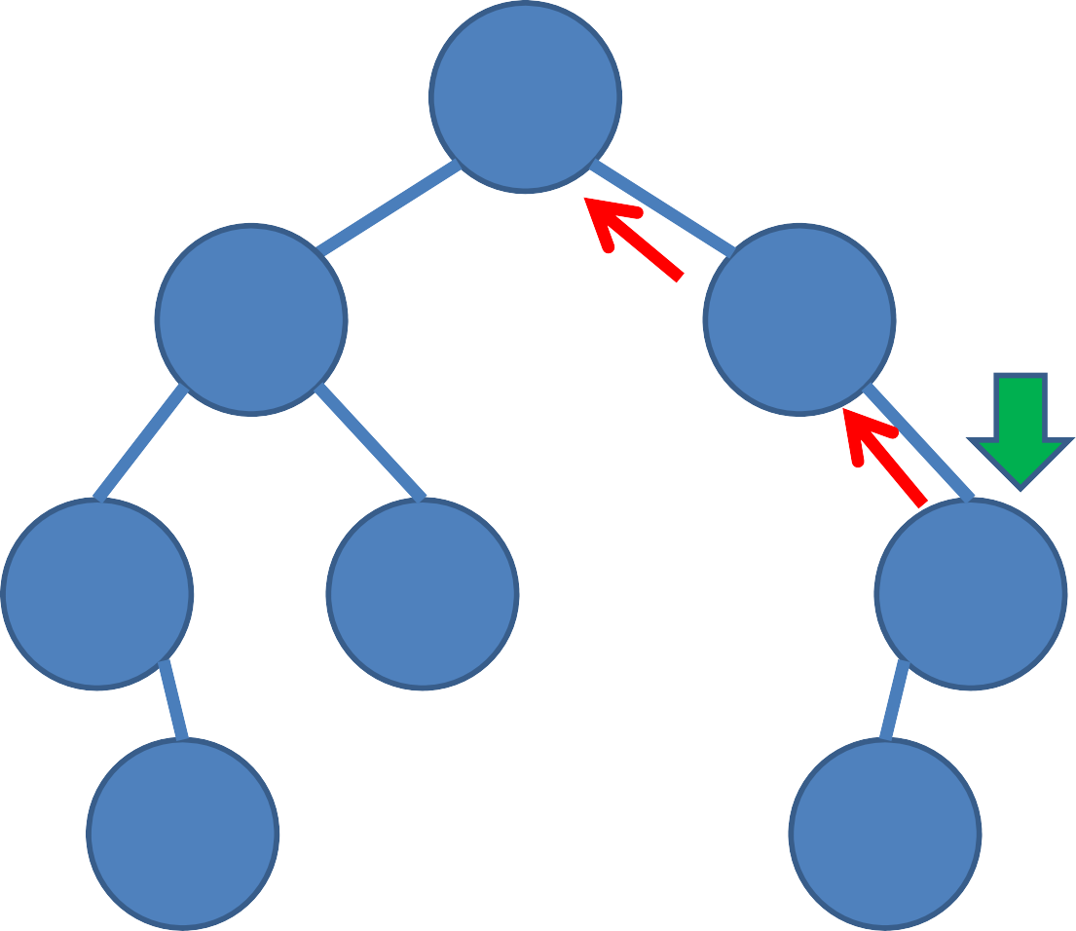
BST: Successor/Predecessor Analysis
Assumption, we already done an O(h) search(71) before
successor(71)
Keep going up until we make a ‘right turn’, but here we do not find such vertex, so there is no successor for 71
Quick analysis: O(h) again, similarly for predecessor
15
6
23
4
7
71
No right child
5
50

Slide 35
BST: Inorder Traversal Analysis
Using a new analysis technique
Ask this question:
How many times a vertex is touched during inorder traversal from the start until the end?
Answer:
Three times: from parent and from left + right children (even if one or both of them is/are empty/NULL)
• O(3n) = O(n)

Slide 36
BST: Select/Rank Analysis
We have not explored the operations in detail yet
This will be discussed in more details in the next lecture

Slide 37
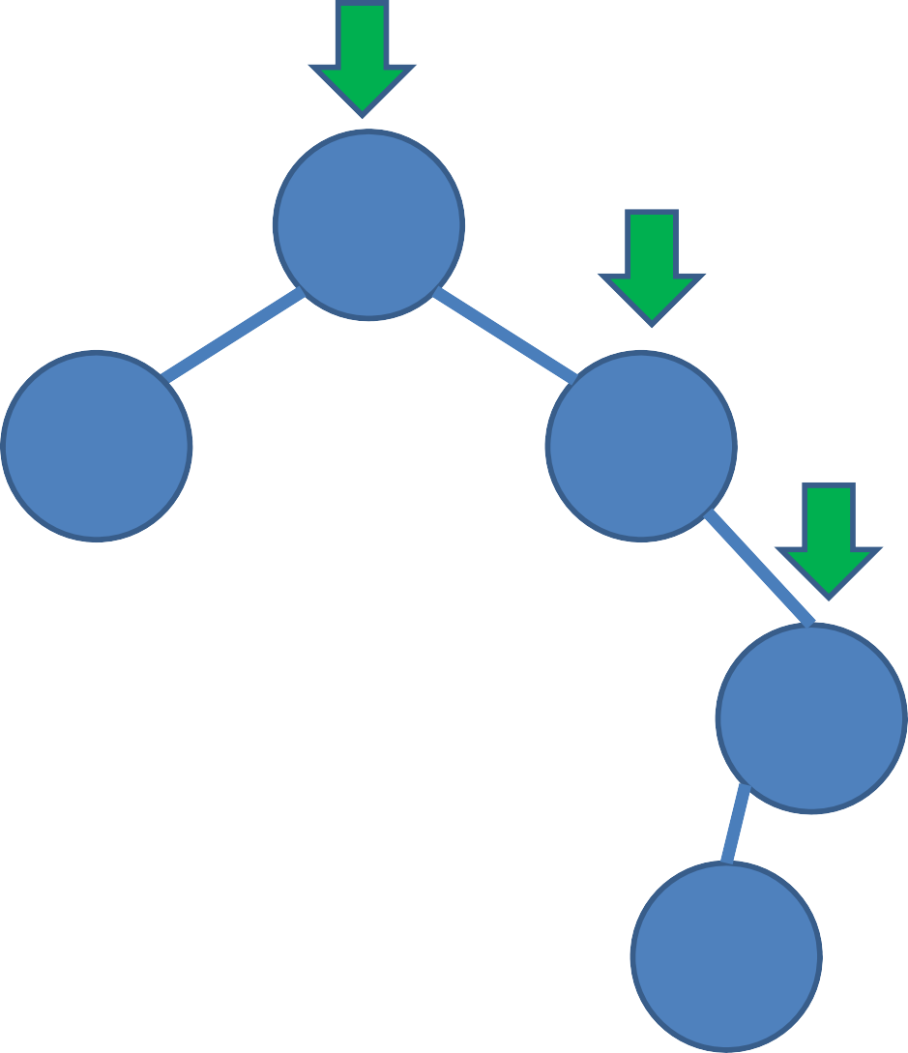
BST: Insertion Analysis
insert(50)
15 < 50, go right
Quick analysis: insert also runs in O(h)
15
23 < 50, go right
6
23
71 > 50,
go left
h
71
50
Insert 50 here

Slide 38
Why successor of x can be used for deletion of a BST vertex x with 2 children?
Claim: Successor of x has at most 1 child!
Easier to delete and will not violate BST property
Proof:
Vertex x has two children
Therefore, vertex x must have a right child
Successor of x must then be the minimum of the right subtree
A minimum element of a BST has no left child!!
So, successor of x has at most 1 child! ☺

Slide 39
BST: Deletion Analysis
Delete a BST vertex v, find v in O(h), then three cases:
Vertex v has no children:
Just remove the corresponding BST vertex v → O(1)
Vertex v has 1 child (either left or right):
Connect v.left (or v.right) to v.parent and vice versa → O(1)
Then remove v → O(1)
Vertex v has 2 children:
Find x = successor(v) → O(h)
Replace v.key with x.key → O(1)
Then delete x in v.right (otherwise we have duplicate) → O(h)
Running time: O(h)

Slide 40
Now, after we learn BST…
No | Operation | Unsorted Array | Sorted Array | BST
1 | Search(age) | O(n) | O(log n) | O(h)
2 | Insert(age) | O(1) | O(n) | O(h)
3 | FindOldest() | O(n) | O(1) | O(h)
4 | ListSortedAges() | O(n log n) | O(n) | O(n)
5 | NextOlder(age) | O(n) | O(log n) | O(h)
6 | Remove(age) | O(n) | O(n) | O(h)
7 | GetMedian() | O(n log n) | O(1) | O(h)
8 | Rank(age) | O(n log n) | O(log n) | ?
It is all now depends on ‘h’… → next lecture ☺

Slide 41
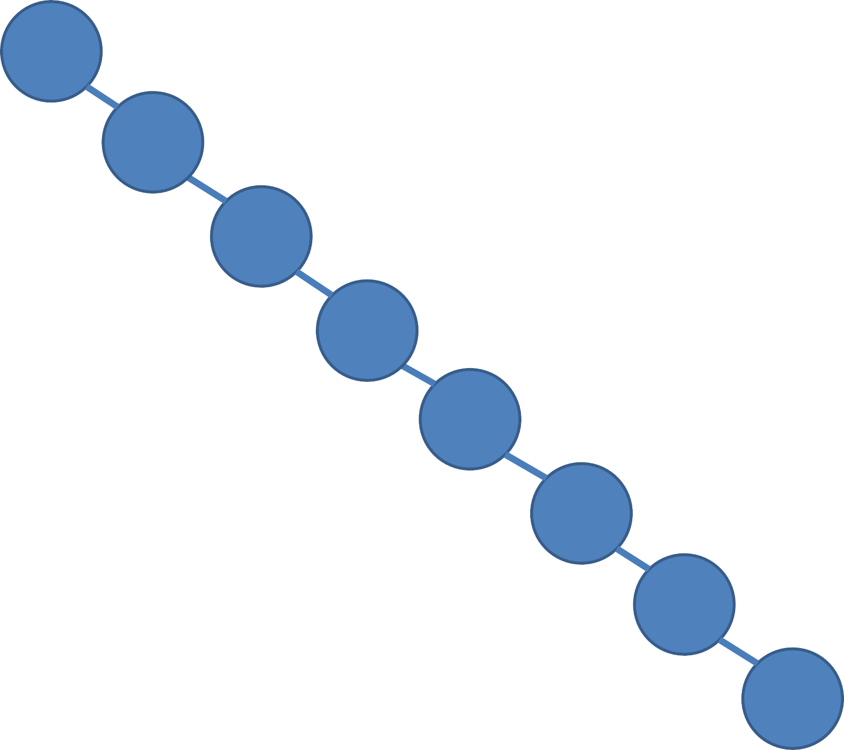
Worst case height of a BST
h = O(n)… ☹
4
5
6
7
15
23
50
Can you spot one more worst case scenario using the same set of numbers?
71

Slide 42
Java Implementation
See BSTDemo.java (you can use this for PS2)
Concepts covered:
Java Object Oriented Programming (OOP) implementation of BST data structure
Java Error Handling: Throw & Catch Exception

Slide 43

The Baby Names Problem (PS2)
Given a list of male and female baby names suggestions (from your parents, in‐laws, friends, yourself, Internet, etc), your task is to answer some queries (see the next slide)
This problem is always encountered by every parents with new baby
(Including the search for baby Joshua name, born on 16 July 2014)

Slide 44
PS2 Queries
(Note: Unlike this lecture with integer keys, the keys in PS1 are strings)
Easy: How many names start with a certain letter?
Medium: How many names start with a certain prefix?
Definition: A prefix of a string T = T₀T₁…T_{n‐1} with length n is string P = T₀T₁…T_{m} where m < n.
Hard: Can you do it without Java API library code?
CS2010R: How many names have a certain substring?
Definition: A substring of a string T = T₀T₁…T_{n‐1} with length n is string S = T_{i}T_{i+1}…T_{j‐1}T_{j} where 0 ≤ i ≤ j < n.
You need efficient DS(es) to answer those queries

Slide 45
End of Lecture Quiz ☺
After Lecture 03, I will set a random test mode @ VisuAlgo to see if you understand BST
Go to:
http://visualgo.net/test.html
Use your CS2010 account to try the 5 BST questions (medium difficulty, 5 minutes)
Meanwhile, train first ☺
http://visualgo.net/training.html

