Slide 1

Data Structures and Algorithms
Balancing Act

Slide 2
Acknowledgement
The contents of these slides have origin from School of Computing, National University of Singapore.
We greatly appreciate support from Dr. Steven Halim for kindly sharing these materials.

Slide 3
Policies for students
These contents are only used for students PERSONALLY.
Students are NOT allowed to modify or deliver these contents to anywhere or anyone for any purpose.

Slide 4
Recording of modifications
Currently, there are no modification on these contents.

Slide 5

CS2010 – Data Structures and Algorithms II
Lecture 04 – Balancing Act
stevenhalim@gmail.com

Slide 6

Outline
Binary Search Tree (BST): A Quick Revision
The Importance of a Balanced BST
To keep h = O(log n)
Adelson‐Velskii Landis (AVL) Tree
Principle of “Height‐Balanced”
Keeping AVL Tree balanced via rotations
Code is shown but not given (try this during PS2)
Relation with CS2010 PS2: “The Baby Names Problem” Reference in CP3 book: Page 43‐47 + 380‐382

Slide 7
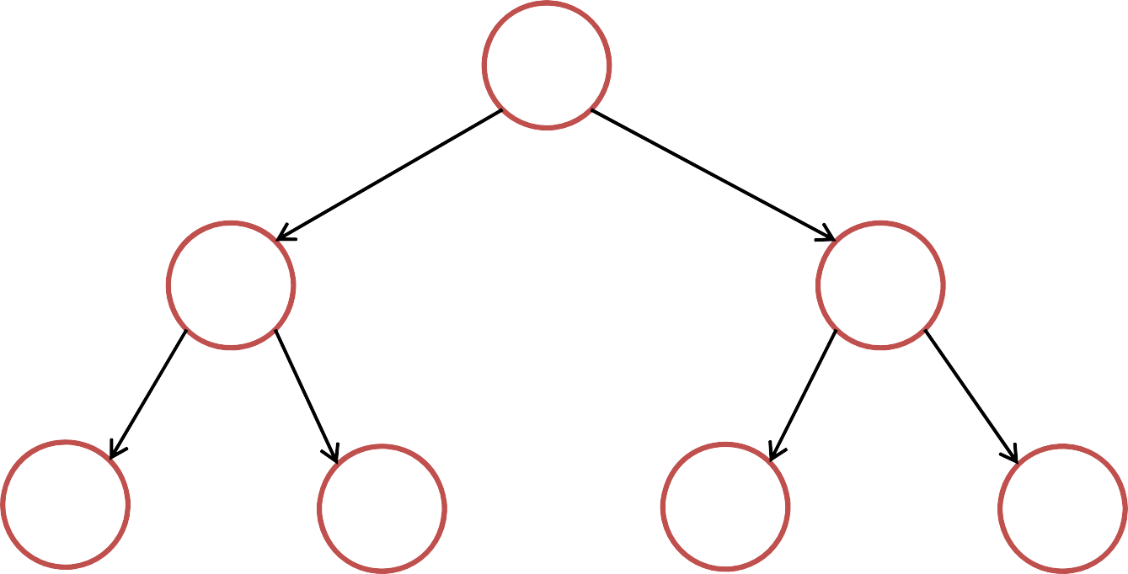
Binary Search Trees: Quick Review
41
20
65
11 29 50
91
Vertex x has two children: x.left, x.right and one parent: x.parent
x.left/x.right/x.parent can be null for some vertices
Vertex x has a key: x.key
BST Property: all keys in left sub‐tree < x.key < all keys in right sub‐tree

Slide 8
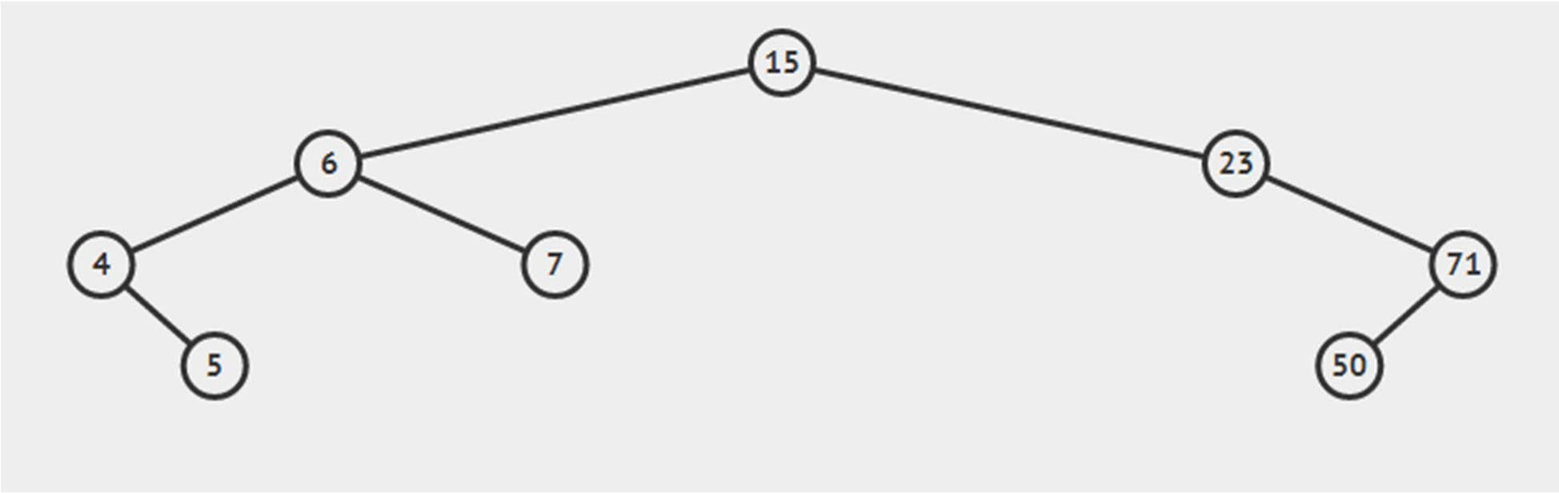
BST Web‐based Review
http://visualgo.net/bst.html
root
internal vertices
leaves

Slide 9
More BST Attributes: Height and Size
Two more attributes at each BST vertex: Height and Size Height: #edges on the path from this vertex to deepest leaf Size: #vertices of the subtree rooted at this vertex
These values can be computed recursively:
x.height = ‐1 (if x is an empty tree)
x.height = max(x.left.height, x.right.height) + 1 (all other cases) x.size = 0 (if x is an empty tree)
x.size = x.left.size + x.right.size + 1 (all other cases)
The height of the BST is thus: root.height The size of the BST is thus: root.size

Slide 10
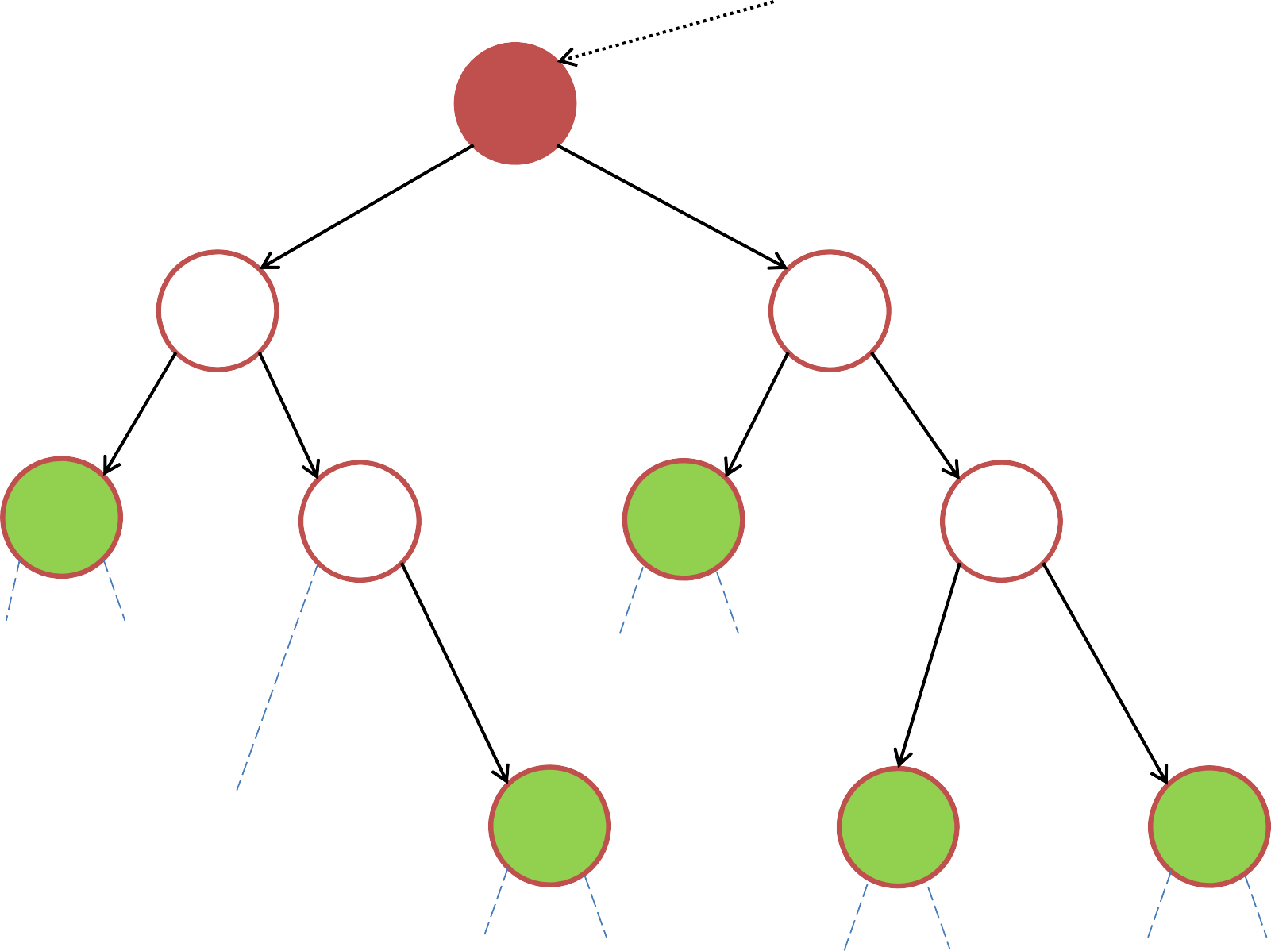
Binary Search Trees: Height (h)
root
h=3
41
h=2
20
65
h=2
h=0
11
29
h=0
50
h=1
91
h=1
h=‐1
h=‐1
h=‐1
h=‐1
h=‐1
h=0
32
h=0
72
h=0
99
h=‐1
h=‐1
h=‐1
h=‐1
h=‐1
h=‐1

Slide 11

Binary Search Trees: Size (s)
root
s=10
41
s=4
20
65
s=5
s=1
11
29
s=1
50
s=3
91
s=2
s=0 s=0
s=0 s=0
s=0
s=1
32
s=1
72
s=1
99
s=0
s=0
s=0 s=0
s=0 s=0

Slide 12
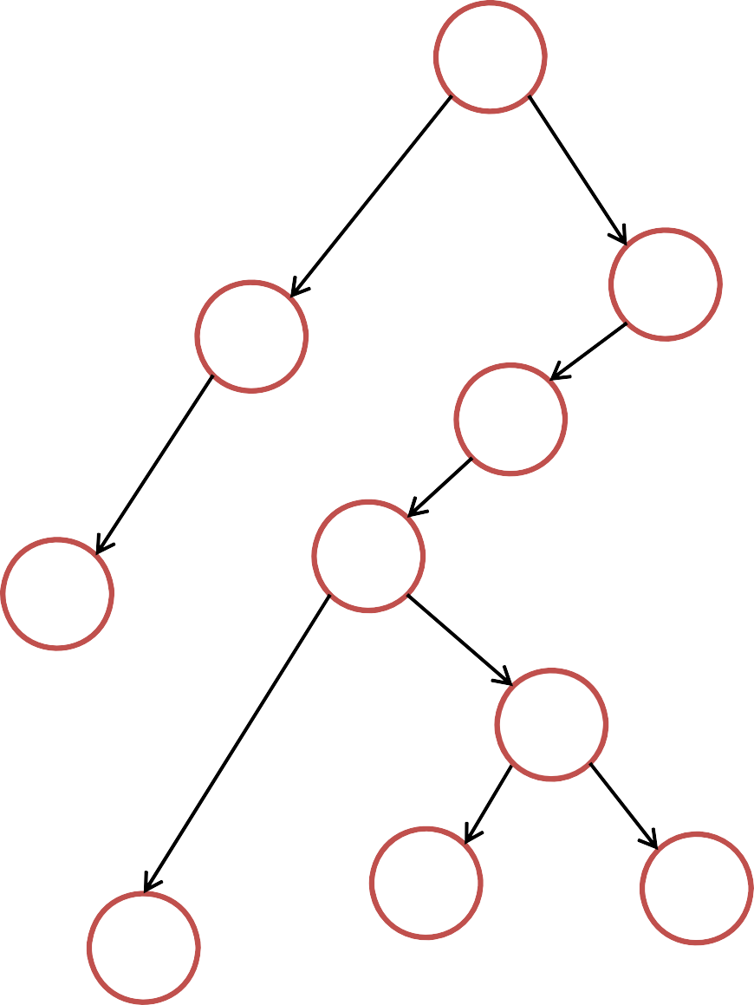
The height of this tree is?
1. 2
2. 4
3. 5
4. 6
5. 7
6. 42
41
65
20
50
91
11
99
11
29
32
72
Notes:
5

Slide 13
The size of this tree is?
1. 10
2. 11
3. 12
4. 13
5. 14
6. 15
41
65
20
50
91
11
99
11
29
32
72
Notes:
11

Slide 14
Binary Search Tree: Summary
Operations that modify the BST (dynamic data structure):
insert: O(h)
delete: O(h)
Query operations (the BST structure remains the same):
search: O(h)
findMin, findMax: O(h)
predecessor, successor: O(h)
inorder traversal: O(n) – the only one that does not depend on h
PS: We also have preorder and postorder traversals for tree structure (discussed in tutorial)
select/rank: ? (we have not discuss this yet)

Slide 15
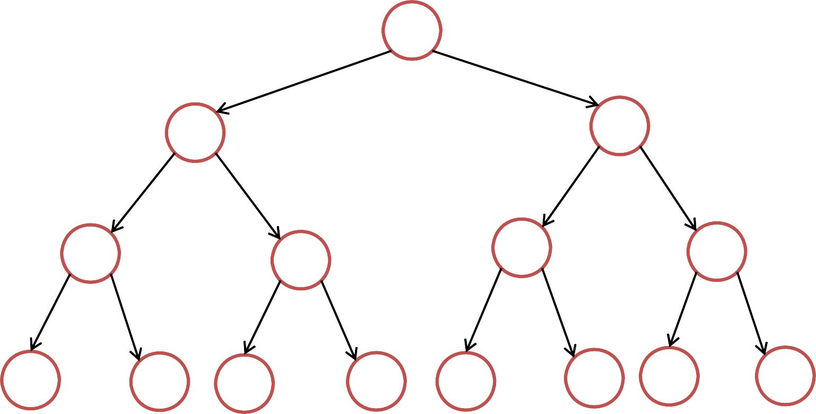
The Importance of Being Balanced
Most operations take O(h) time Lower bound: h > log₂(n)
20
41
2⁰=1
65
2¹=2
11
29
50
91
2²=4
5
13
22
32
49
52
72
99
2³=8
n ≤ 1 + 2 + 4 + … + 2^{h}
≤ 2⁰ + 2¹ + 2² + … + 2^{h} < 2^{h+1} (sum of geometric progression)
log₂ (n) < log₂(2^{h+1}) ➔ log₂ (n) < (h + 1) * log₂ (2) ➔ h > log₂ (n) – 1
➔ h > log₂ (n)

Slide 16
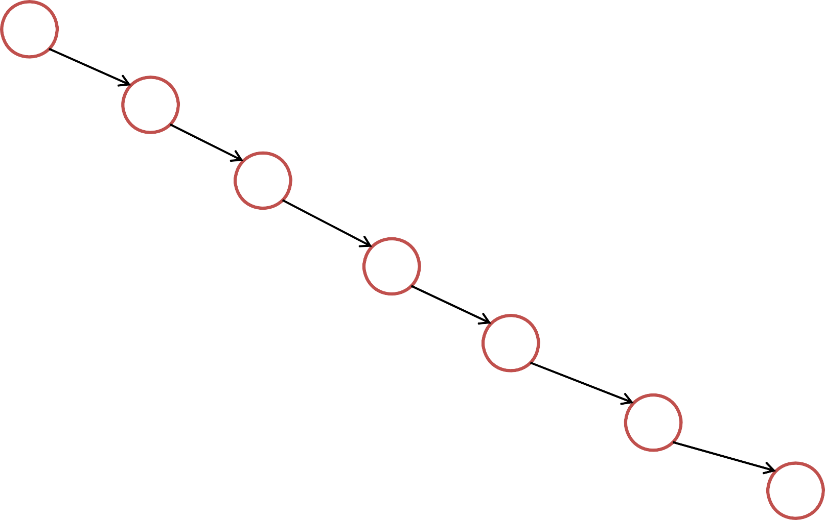
The Importance of Being Balanced
Most operations take O(h) time Upper bound: h ≤ n‐1 ➔ h < n
41
65
91
93
95
96
97

Slide 17
The Importance of Being Balanced
Most operations take O(h) time Combined bound: log₂(n) < h < n
log₂(n) versus n in picture (revisited with larger numbers):
n = 500
log₂(n) ~ 9
n = 1000
log₂(n) ~ 10
If we just stop at CS1020
After learning CS2010 ☺
If we just stop at CS1020
After learning CS2010 ☺
We say a BST is balanced if h = O(log n), i.e. O(c * log n)
On a balanced BST, all operations run in O(log n) time

Slide 18

The Importance of Being Balanced
Example of a perfectly balanced BST: This is hard to achieve though…
41
20
65
11
29
50
91
5
13
22
32
49
52
72
99

Slide 19
The Importance of Being Balanced
How to get a balanced tree:
Define a good property of a tree
Show that if the good property holds, then the tree is balanced
After every insert/delete, make sure the good property still holds
If not, fix it!

Slide 20
Adelson‐Velskii & Landis, 1962 (~53 years ago… :O)
Can be a little bit frustrating if you are not comfortable with recursion Hang on…
AVL TREES

Slide 21
AVL Trees [Adelson‐Velskii & Landis 1962]
Step 1: Augment (i.e. add more information)
In every vertex x, we also store its height: x.height
(Note that x already has: x.left, x.right, x.parent, and x.key)
During insertion and deletion, we also update height:
insert(x, v)
// ... same as before ... x.height = max(x.left.height,
x.right.height) + 1
// update
height
during
deletion
too (same
as above)

Slide 22
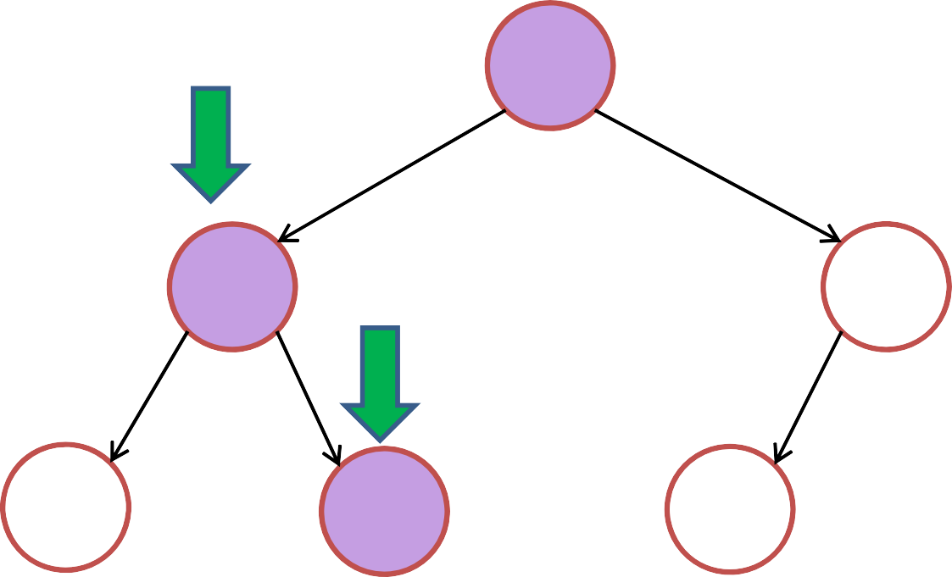
Binary Search Trees
Height of empty trees are ignored in this illustration (all ‐1)
insert(27)
41
h=2
20
h=1
65
h=1
11
h=0
29
h=0
50
h=0
Height information during insertion/deletion is not shown in VisuAlgo (yet)

Slide 23
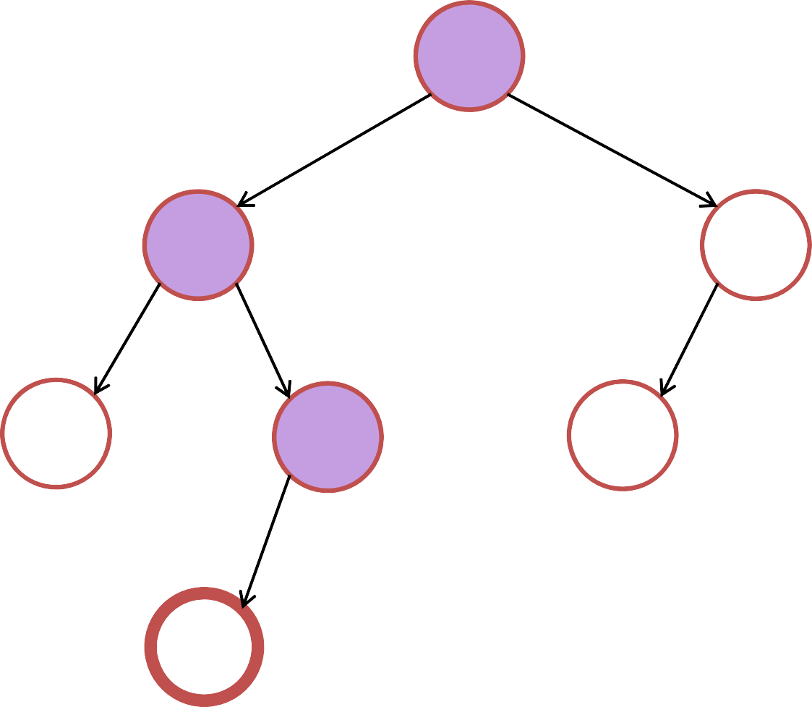
Binary Search Trees
insert(27)
41
h=2
20
h=1
65
h=1
11
h=0
29
h=0
50
h=0
27
h=0

Slide 24
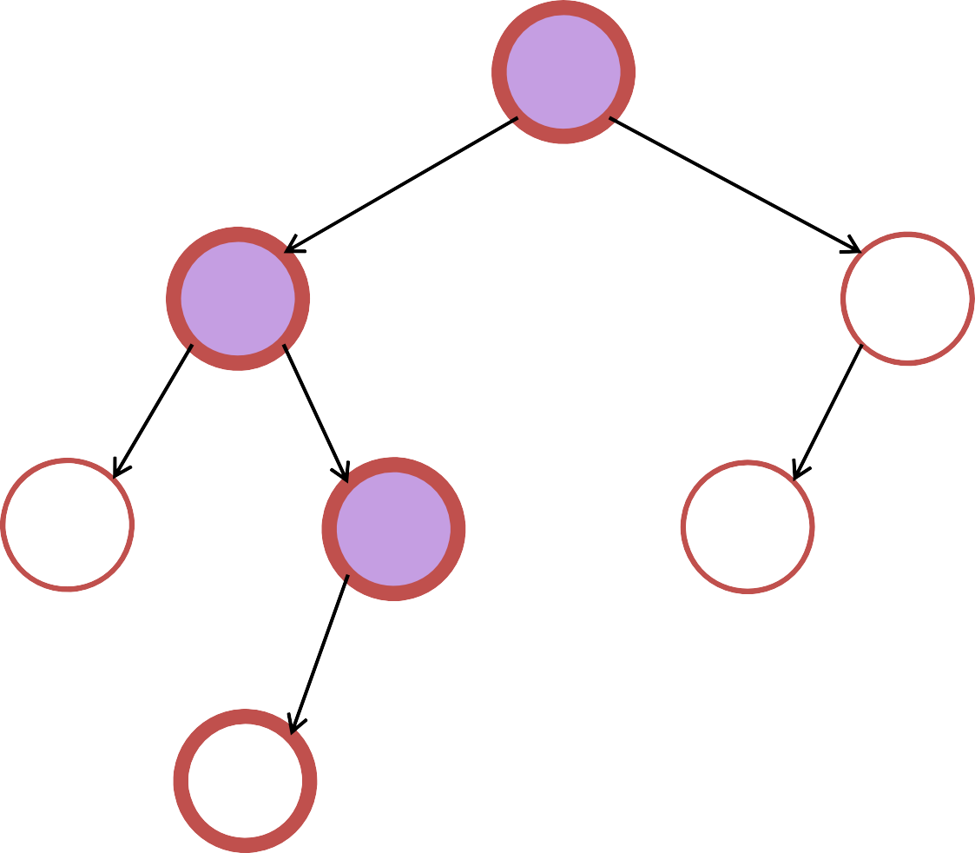
Binary Search Trees
Notice that only vertices along the insertion path may have their height attribute updated...
insert(27)
41
h=3
20
h=2
65
h=1
11
h=0
29
h=1
50
h=0
27
h=0

Slide 25
AVL Trees [Adelson‐Velskii & Landis 1962]
Step 2: Define Invariant (something that will not change)
A vertex x is said to be height‐balanced if:
|x.left.height ‐ x.right.height| ≤ 1
An binary search tree is said to be height balanced if:
every vertex in the tree is height‐balanced
x
h
h‐1

Slide 26
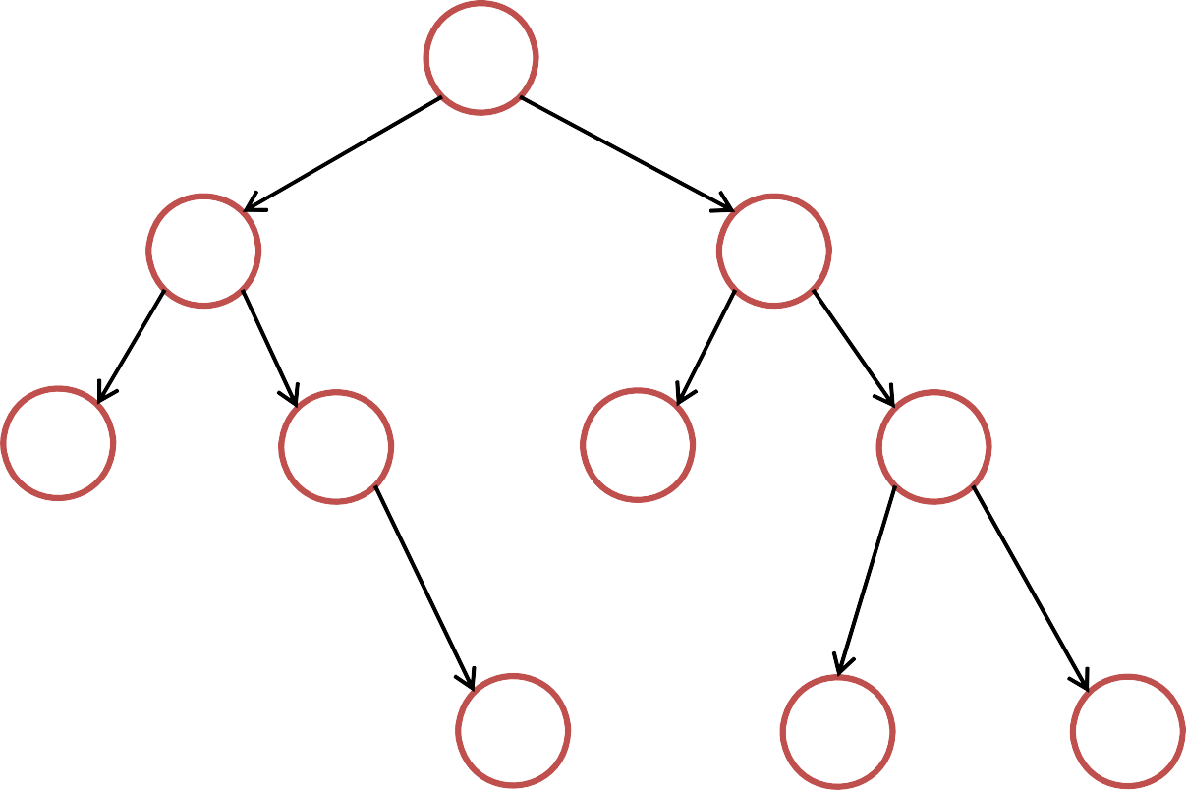
Is this tree height‐balanced according to AVL?
Yes
No
I am confused… ☹
41
20
65
11
29
50
91
32
72
99

Slide 27
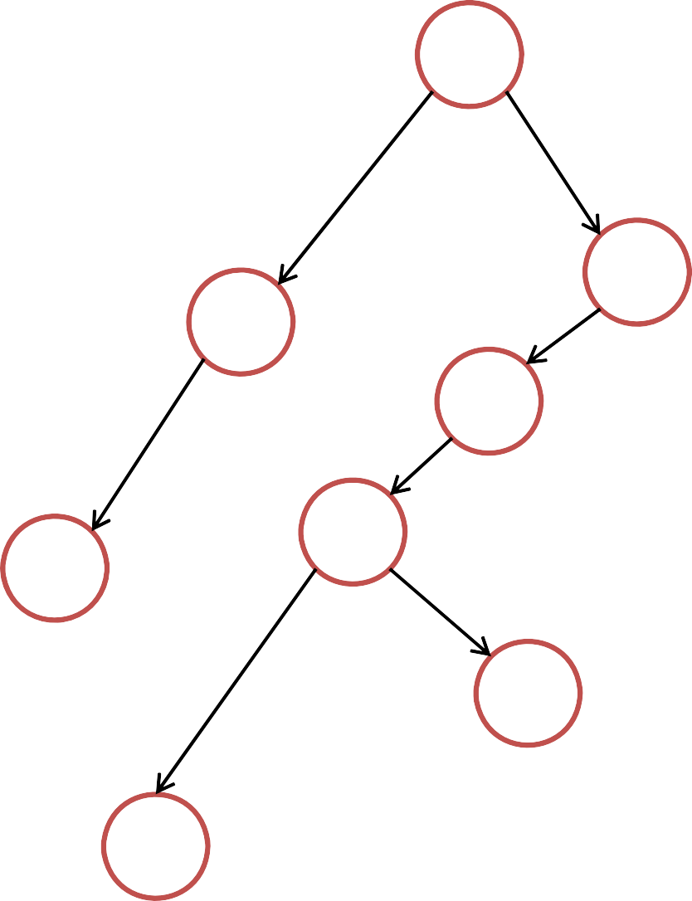
Is this tree height‐balanced according to AVL?
Yes
No
I am confused… ☹
41
65
20
50
45
11
48
91
42
72

Slide 28
Height‐Balanced Trees
Claim:
A height‐balanced tree with n vertices has height h < 2 * log₂(n)
Proof (do not be scared):
Let n_{h} be the minimum number of vertices in a height‐balanced tree of height h
h
≥n_{h}
vertices

Slide 29
Height‐Balanced Trees
Proof:
Let n_{h} be the minimum number of vertices in a height‐balanced tree of height h
n_{h} = 1 + n_{h‐1} + n_{h‐2}
n_{h} > 1 + 2n_{h‐2} (as n_{h‐1} > n_{h‐2}) n_{h} > 2n_{h‐2} (obvious)
= 4n_{h‐4} (recursive)
= 8n_{h‐6}
= …
h‐1 h
h‐2
Base case: n = 1
^{≥n}h‐2
0
≥n
h‐1

Slide 30
Height‐Balanced Trees
Proof:
Let n_{h} be the minimum number of vertices in a height‐balanced tree of height h
n_{h} = 1 + n_{h‐1} + n_{h‐2} n_{h} > 1 + 2n_{h‐2}
n_{h} > 2n_{h‐2}
As each step we reduce h by 2,
Then we need to do this step h/2 times to reduce h (assume h is even) to 0
n_{h} > 2^{h/2} n_{0 nh > 2}h/2
= 4n_{h‐4}
= 8n_{h‐6}
= …
Base case: n = 1
0

Slide 31
Height‐Balanced Trees
Claim:
A height‐balanced tree is balanced,
i.e. has height h = O(log(n))
We have shown that: n_{h} > 2^{h/2} and n ≥ n_{h} n ≥ n_{h} > 2^{h/2}
_{n > 2}h/2
log₂(n) > log₂(2^{h/2}) (log₂ on both side) log₂(n) > h/2 (formula simplification) 2 * log₂(n) > h or h < 2 * log₂(n)
h = O(log(n))
h
>
₂h/2
vertices

Slide 32
AVL Trees [Adelson‐Velskii & Landis 1962]
Step 3: Show how to maintain height‐balance
h
h‐1

Slide 33
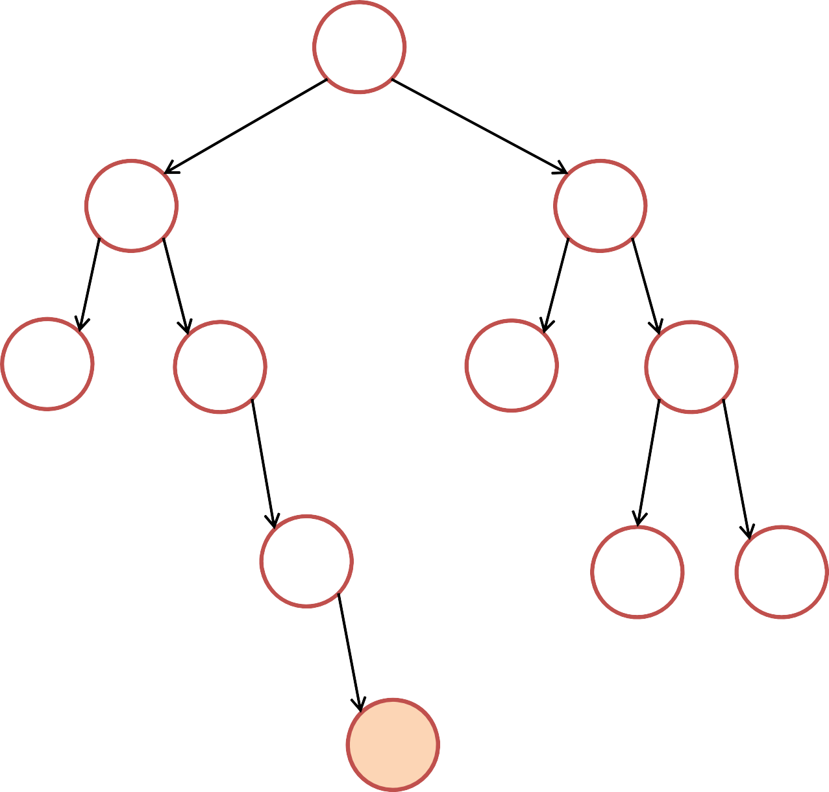
Insertion to an AVL Tree
insert(37)
41
Initially balanced
20
65
But no longer balanced after Inserting 37
11
29
50
91
Need to rebalance!
32
72 99
But how?
37
“Infinite more” examples in VisuAlgo…

Slide 34
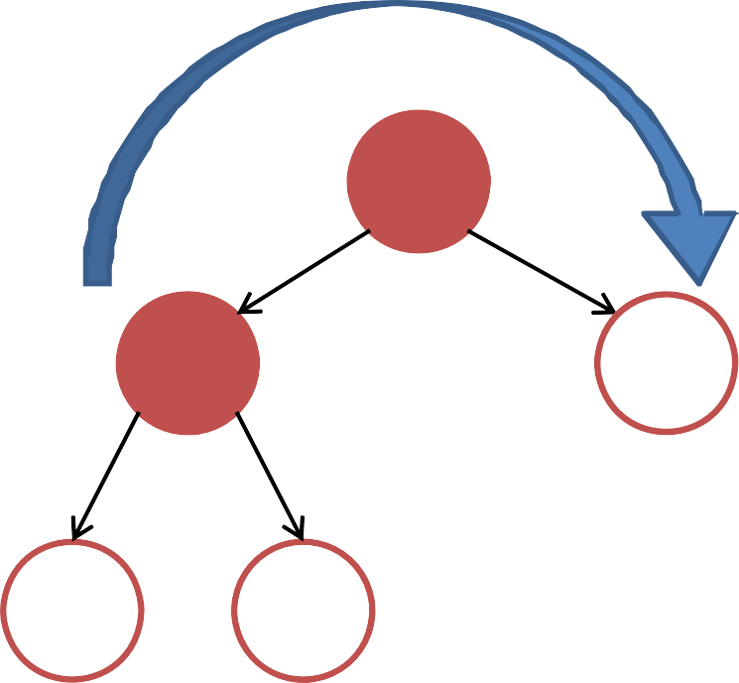
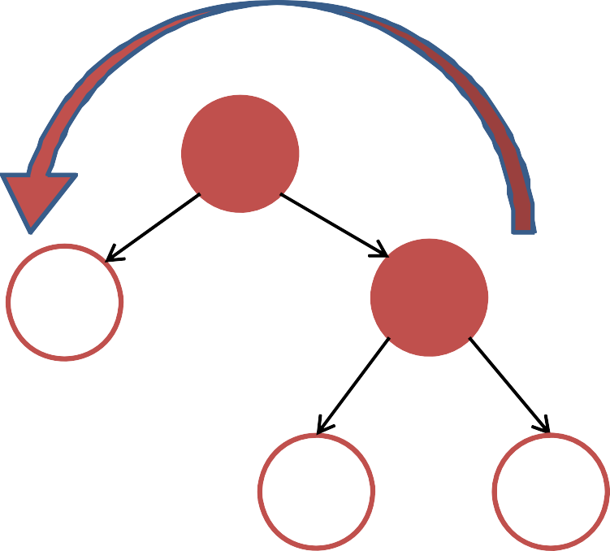
Tree Rotations
Right Rotation
Q
P
P
C
A
Q
Left Rotation
B C
A B
Rotations maintain ordering of keys
⇒ Maintains BST property (see vertex B where P ≤ B ≤ Q)
rotateRight requires a left child rotateLeft requires a right child

Slide 35
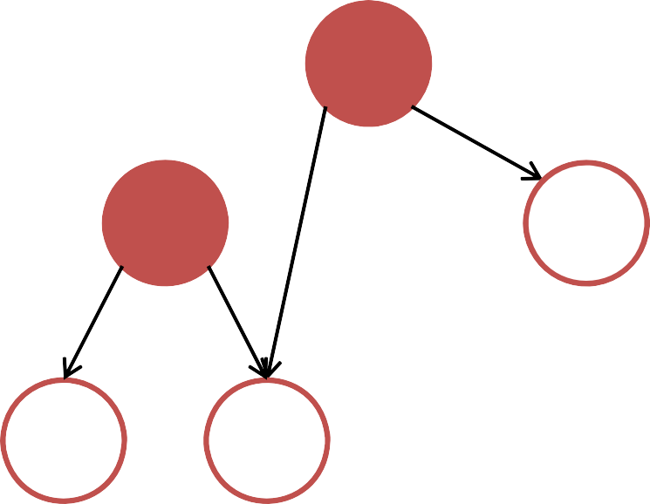
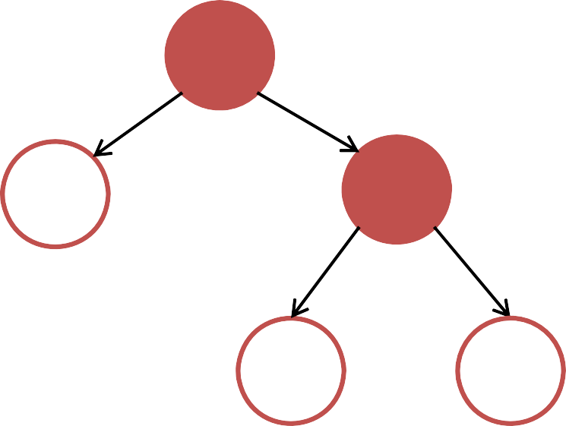
Tree Rotations Pseudo Code → O(1)
BSTVertex rotateLeft(BSTVertex T) // BSTVertex w = T.right
w.parent = T.parent T.parent = w T.right = w.left
if (w.left != null) w.left.parent = T
w.left = T
pre-req: T.right != null
rotateRight is the mirrored version of this pseudocode
T
// Update the return w
height of T
w
and then w
Q
P
w
T
P
C A
Q
This slide is can be confusing without the animation
A
B
B
C

Slide 36
Balance Factor (bf(x))
bf(x) =
x.left.height ‐ x.right.height
41
From the insertion point, check the balance factor
of each vertex up to the root
20
65
‐2, need rebalancing
29
11
50
91
‐1
32
72 99
Once we have vertex with balance factor +2 or ‐2, we have to rebalance it
0
37

Slide 37
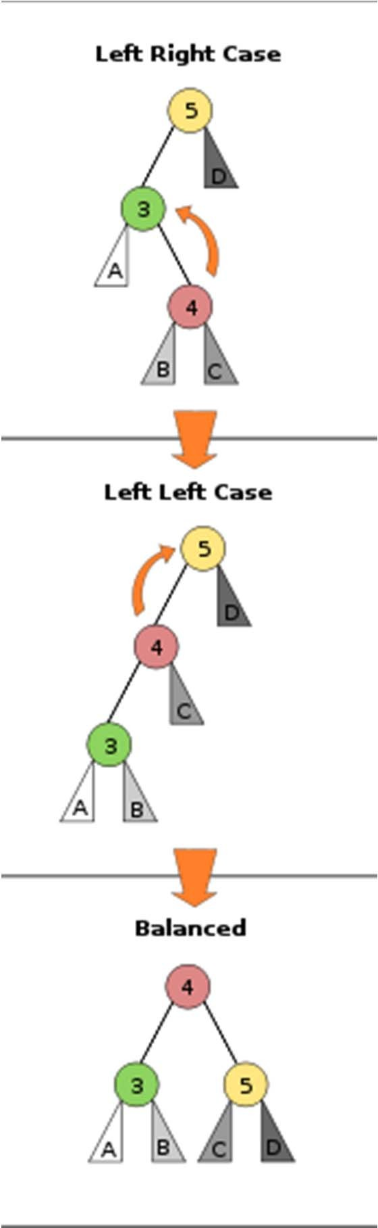
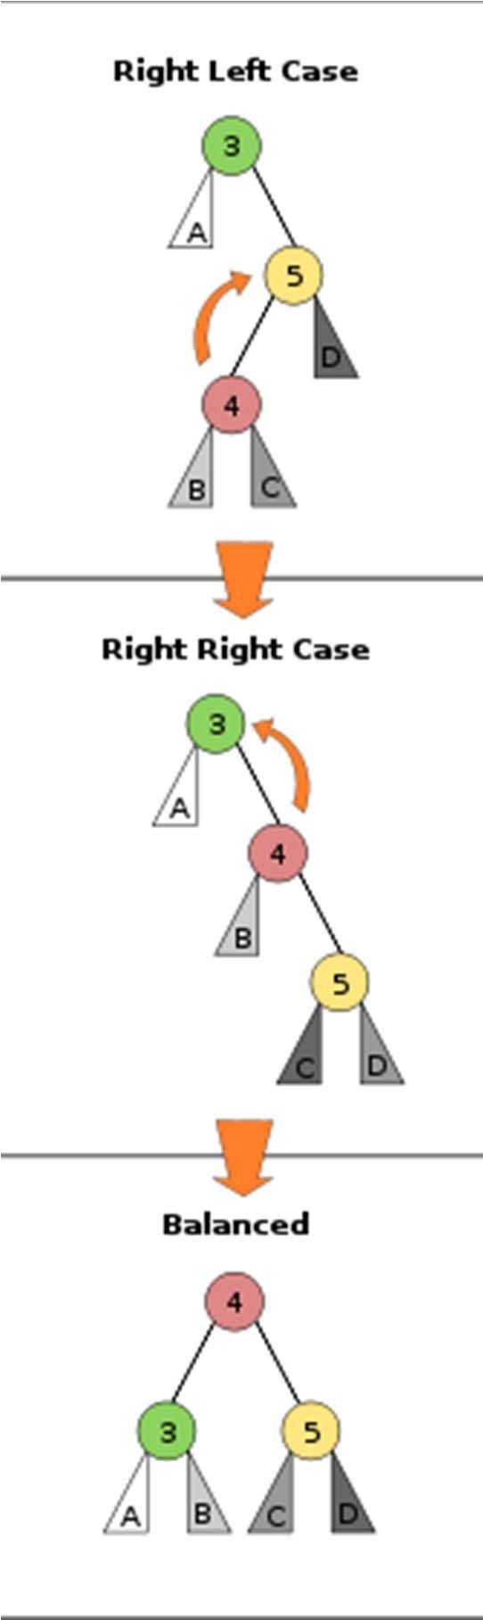
Four Possible Cases
2
‐2
‐1
1
bf(x) = +2 and bf(x.left) = 1 rightRotate(x)
bf(x) = +2 and bf(x.left) = ‐1
leftRotate(x.left)
2
‐2
rightRotate(x)
bf(x) = ‐2 and bf(x.right) = ‐1 leftRotate(x)
bf(x) = ‐2 and bf(x.right) = 1 rightRotate(x.right) leftRotate(x)
1
‐1
Pictures from Wikipedia

Slide 38
Rebalancing (1)
This is a case of ‐2, ‐1 Do left rotate on 29
41
20
65
‐2, need rebalancing
29
11
50
91
‐1
32
72 99
0
37
“Infinite more” examples in VisuAlgo…

Slide 39
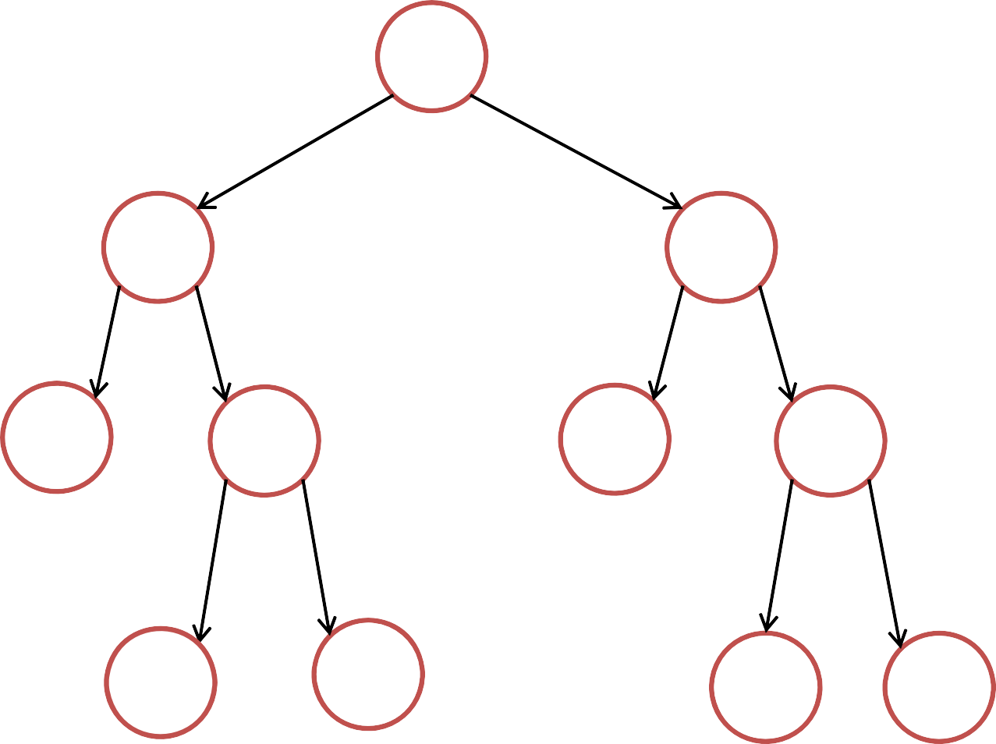
Rebalancing (2)
Now all vertices are balanced again
41
20
65
11
32
50
91
29
37
72 99
“Infinite more” examples in VisuAlgo AVL Tree Visualization

Slide 40
Insertion to an AVL Tree
Summary:
Just insert the key as in normal BST
Walk up the AVL tree from the insertion point to root:
At every step, update height & check balance factor
If a certain vertex is out‐of‐balance (+2 or ‐2), use rotations to rebalance
– During insertion to an AVL tree, you can only trigger
one of the four possible rebalancing cases as shown earlier

Slide 41
Revision
Cho dãy số: 28, 18, 8, 13, 3, 38, 33, 9, 23, 6. Trình bày các bước xây dựng cây AVL

Slide 42
Deletion from an AVL Tree
Deletion is quite similar to Insertion:
Just delete the key as in normal BST
Walk up the AVL tree from the deletion point to root:
At every step, update height & check balance factor
If a certain vertex is out‐of‐balance (+2 or ‐2), use rotations to rebalance
– The main difference compared to insertion into AVL tree is that you may trigger one of the four possible rebalancing cases several times, up to h = log n times :O, see this example (next slide)

Slide 43
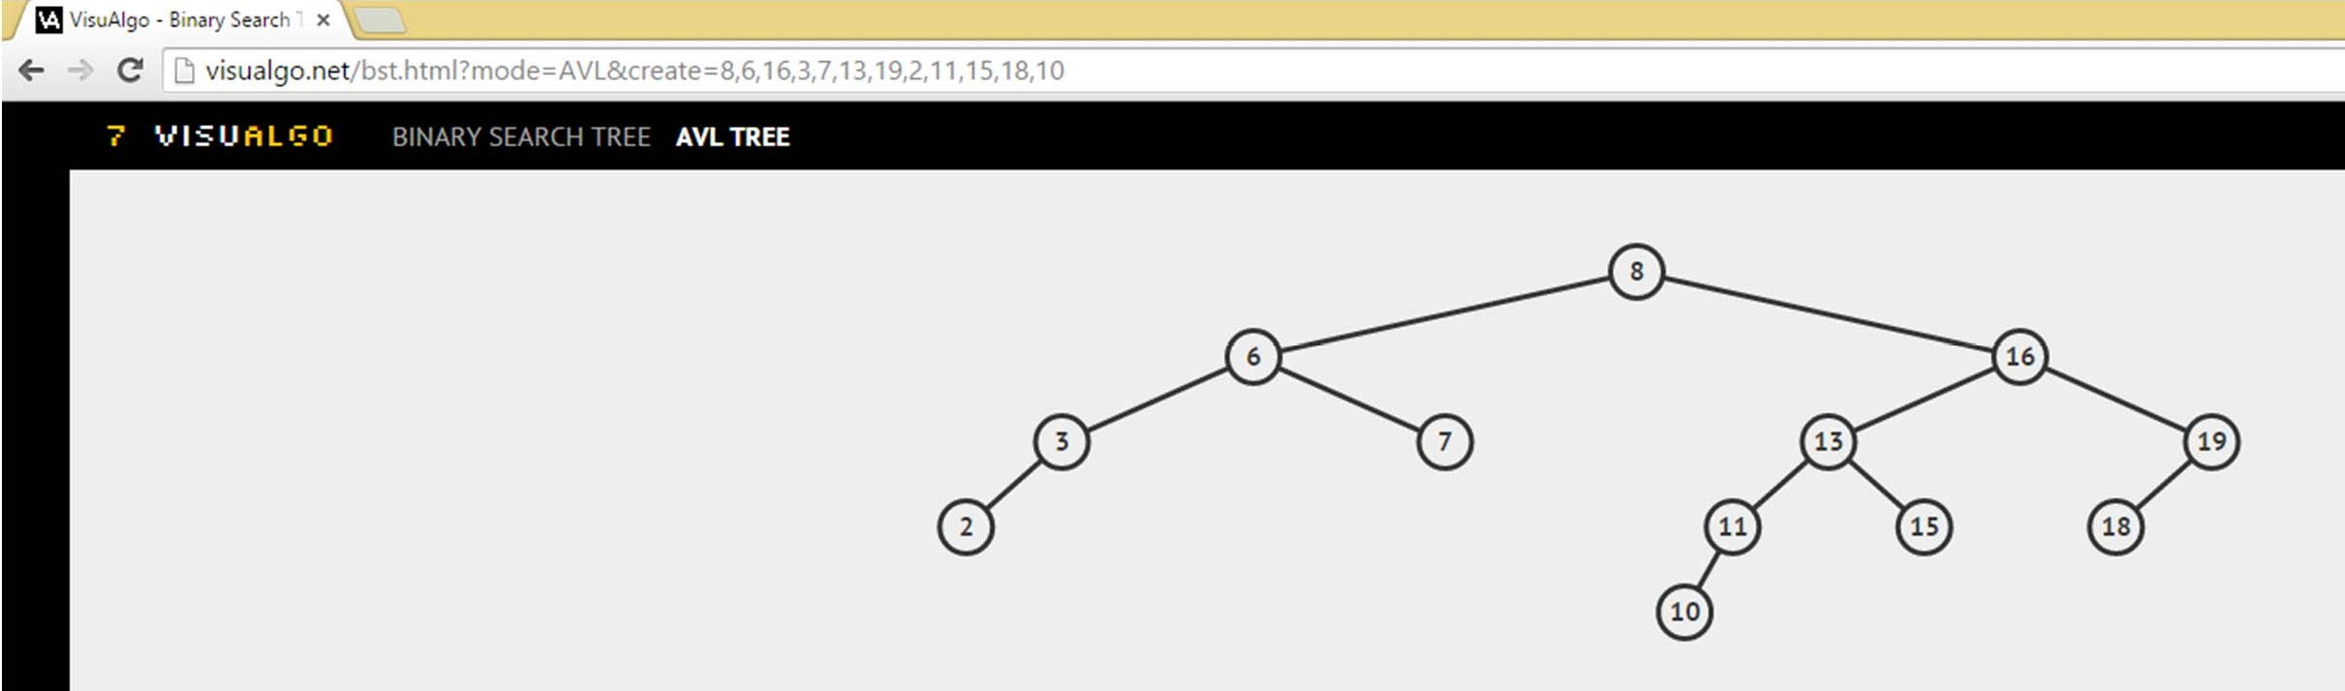
AVL Tree Web‐based Review
Try: http://visualgo.net/bst.html?mode=AVL&create=8,6,16,3,7,13,19,2,11,15,18,10
Try Remove (Delete) vertex 7, it triggers two (more than one)
rebalancing actions
Then try various Insert operations and notice that at most it will only trigger one (out of the four cases) of rebalancing actions

Slide 44
The Implementation
Let’s look briefly at AVLDemo.java
The code is NOT given, it is asked in PS2 ☺
So, I will only flash them
Introducing Java Inheritance and Polymorphism
Q: Do we have to use such long code every time we need a balanced BST ☹?
A: Fortunately no ☺, we can use Java API Details during your lab demo on Week 04

Slide 45
Balanced Search Trees
Many different flavors of balanced search trees
AVL trees (Adelson‐Velsii & Landis, 1962)
Discussed in this lecture…
B‐trees / 2‐3‐4 trees (Bayer & McCreight, 1972)
BB[α] trees (Nievergelt & Reingold 1973)
Red‐black trees (see CLRS 13)
Splay trees (Sleator and Tarjan 1985)
Treaps (Seidel and Aragon 1996)
Skip Lists (Pugh 1989)

Slide 46
Balanced Search Trees
Red‐Black Trees
Every vertex is colored red or black
All leaves are black
A red vertex has only black children
Every path from a vertex to any leaf contains the same number of black vertices.
Rebalance using rotations on insert/delete

Slide 47
Balanced Search Trees
Skip Lists and Treaps
Randomized data structures
Random insertions → balanced tree
Use randomness on insertion to maintain balance

Slide 48
Balanced Search Trees
Splay Trees
On access (search or insert),
move vertex to root (via rotations)
Height can be linear!
On average, O(log n) per operation (amortized)
Optimality?
Cannot do better than O(log n) worst‐case
What about for specific access patterns (e.g., 10 searches in a row for value x)?

Slide 49
Now, after we learn balanced BST
No | Operation | Unsorted Array | Sorted Array | bBST
1 | Search(age) | O(n) | O(log n) | O(log n)
2 | Insert(age) | O(1) | O(n) | O(log n)
3 | FindOldest() | O(n) | O(1) | O(log n)
4 | ListSortedAges() | O(n log n) | O(n) | O(n)
5 | NextOlder(age) | O(n) | O(log n) | O(log n)
6 | Remove(age) | O(n) | O(n) | O(log n)
7 | GetMedian() | O(n log n) | O(1) | O(log n)
8 | NumYounger(age) | O(n log n) | O(log n) | ????

Slide 50
NumYounger(age) = rank(age)‐1
Now, how to get rank(v) efficiently?
This has not been discussed before
and will be revealed during the live lecture
–

Slide 51
Balanced BST
Summary:
The Importance of Being Balanced
Height Balanced Trees
Tree Rotations
AVL trees
Next Lecture:
ADT Priority Queues
Binary Heaps

Slide 52
CS2010R first meeting
Tomorrow, Thu, 03 Sep 15, 6.00‐6.30pm
Note: venue TBA
All R students must come
Those who wants to get PS2E AC can also come ☺
TA: Myself ☺

