Slide 1

Data Structures and Algorithms
Heaps

Slide 2
Acknowledgement
The contents of these slides have origin from School of Computing, National University of Singapore.
We greatly appreciate support from Dr. Steven Halim for kindly sharing these materials.

Slide 3
Policies for students
These contents are only used for students PERSONALLY.
Students are NOT allowed to modify or deliver these contents to anywhere or anyone for any purpose.

Slide 4
Recording of modifications
Currently, there are no modification on these contents.

Slide 5

CS2010 – Data Structures and Algorithms II
Lecture 02 – Heaps of Fun
stevenhalim@gmail.com

Slide 6
Admins
Topics to be discussed:
Class Status (Tutorial, Lab, CS2010 Account Issues?)
Plan for Help Session?
This slide will be updated on the lecture day itself

Slide 7
Class Status
See Steven’s private IVLE tutorial and lab section for Tutorial and Lab status
See Steven’s private IVLE leaderboard section to see if your CS2010 account is in order
You should be able to see your VisuAlgo Online Quiz 0 scores (most people will score 1% or near 1%, after practice)
Remember that you will use CS2010 account to check your class score in private IVLE leaderboard section, login to VisuAlgo Online Quiz, and login to Mooshak for all Pses (PS1 will be out soon)

Slide 8
Outline
What are you going to learn in this lecture?
Motivation: Abstract Data Type: PriorityQueue
With major help from VisuAlgo Binary Heap Visualization
Binary Heap data structure and it’s operations
Building Heap from a set of n numbers in O(n)
Heap Sort in O(n log n)
CS2010 PS1 Overview: “Scheduling Deliveries, v2015”
Reference in CP3 book: Page 43‐47 + 148‐150

Slide 9
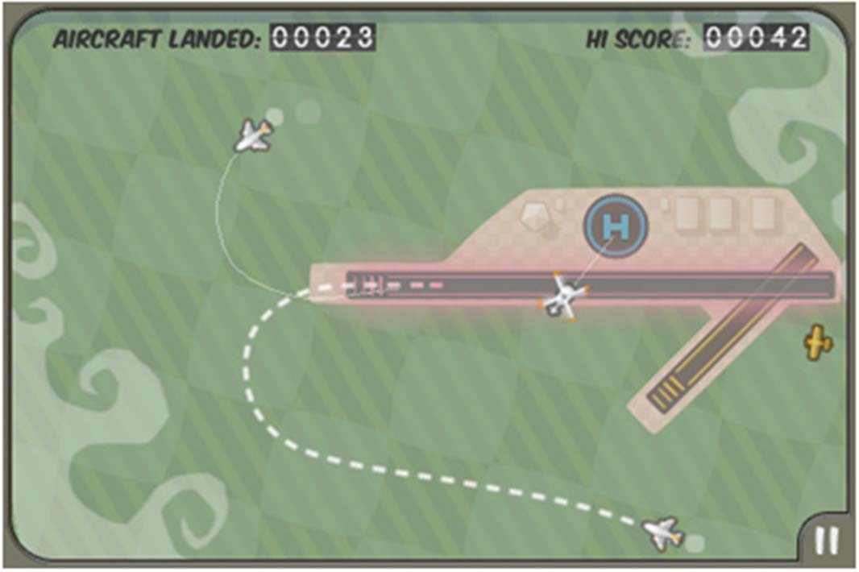



Abstract Data Type: PriorityQueue (1)
Imagine that you are the Air Traffic Controller:
You have scheduled the next aircraft X to land in the next 3 minutes, and aircraft Y to land in the next 6 minutes
Both have enough fuel for at least the next 15 minutes and both
are just 2 minutes away from your airport
Y
X

Slide 10
The next two slides are hidden…
Attend the lecture to figure out

Slide 11
Abstract Data Type: PriorityQueue
Important Basic Operations:
Enqueue(x)
Put a new item x in the priority queue PQ (in some order)
y ← Dequeue()
Return an item y that has the highest priority (key) in the PQ
If there are more than one item with highest priority, return the one that is inserted first (FIFO)
Note: We can always define highest priority = higher number or it’s opposite: highest priority = lower number

Slide 12
A Few Points To Remember
Data Structure (DS) is…
A way to store and organize data in order to support efficient insertions, searches, deletions, queries, and/or updates
Most data structures have propert(ies)
Each operation on that data structure has to maintain
that propert(ies)

Slide 13
PriorityQueue Implementation (1)
The array is circular: We just manipulate front+back pointers to define the active part of array
(Circular) Array‐Based Implementation (Strategy 1)
Property: The content of array is always in correct order
Enqueue(x)
Find the correct insertion point, O(n) – recall insertion sort
y ← Dequeue()
Return the front‐most item which has the highest priority, O(1)
Index | 0 (front) | 1 (back)
Key | Aircraft X* | Aircraft Y*
Aircraft Z**
We do not need to close the gap, just advance the front pointer, O(1)
Index | 0 (front) | 1 | 2 (back)
Key | Aircraft Z** | Aircraft X* | Aircraft Y*

Slide 14
PriorityQueue Implementation (2)
(Circular) Array‐Based Implementation (Strategy 2)
Property: dequeue() operation returns the correct item
Enqueue(x)
Put the new item at the back of the queue, O(1)
y ← Dequeue()
Scan the whole queue, return first item with highest priority, O(n)
Index | 0 (front) | 1 (back)
Key | Aircraft X* | Aircraft Y*
We may need to close the gap if this operation causes it, also O(n)
Aircraft Z**
Index
0 (front)
1
2 (back)
Key
Aircraft X*
Aircraft Y*
Aircraft Z**

Slide 15

PriorityQueue Implementation (3)
If we just stop at CS1020 knowledge level:
Strategy | Enqueue | Dequeue
Circular‐Array‐Based PQ (1) | O(n) | O(1)
Circular‐Array‐Based PQ (2) | O(1) | O(n)
Can we do better? | O(?) | O(?)
If n is large, our queries are slow…

Slide 16
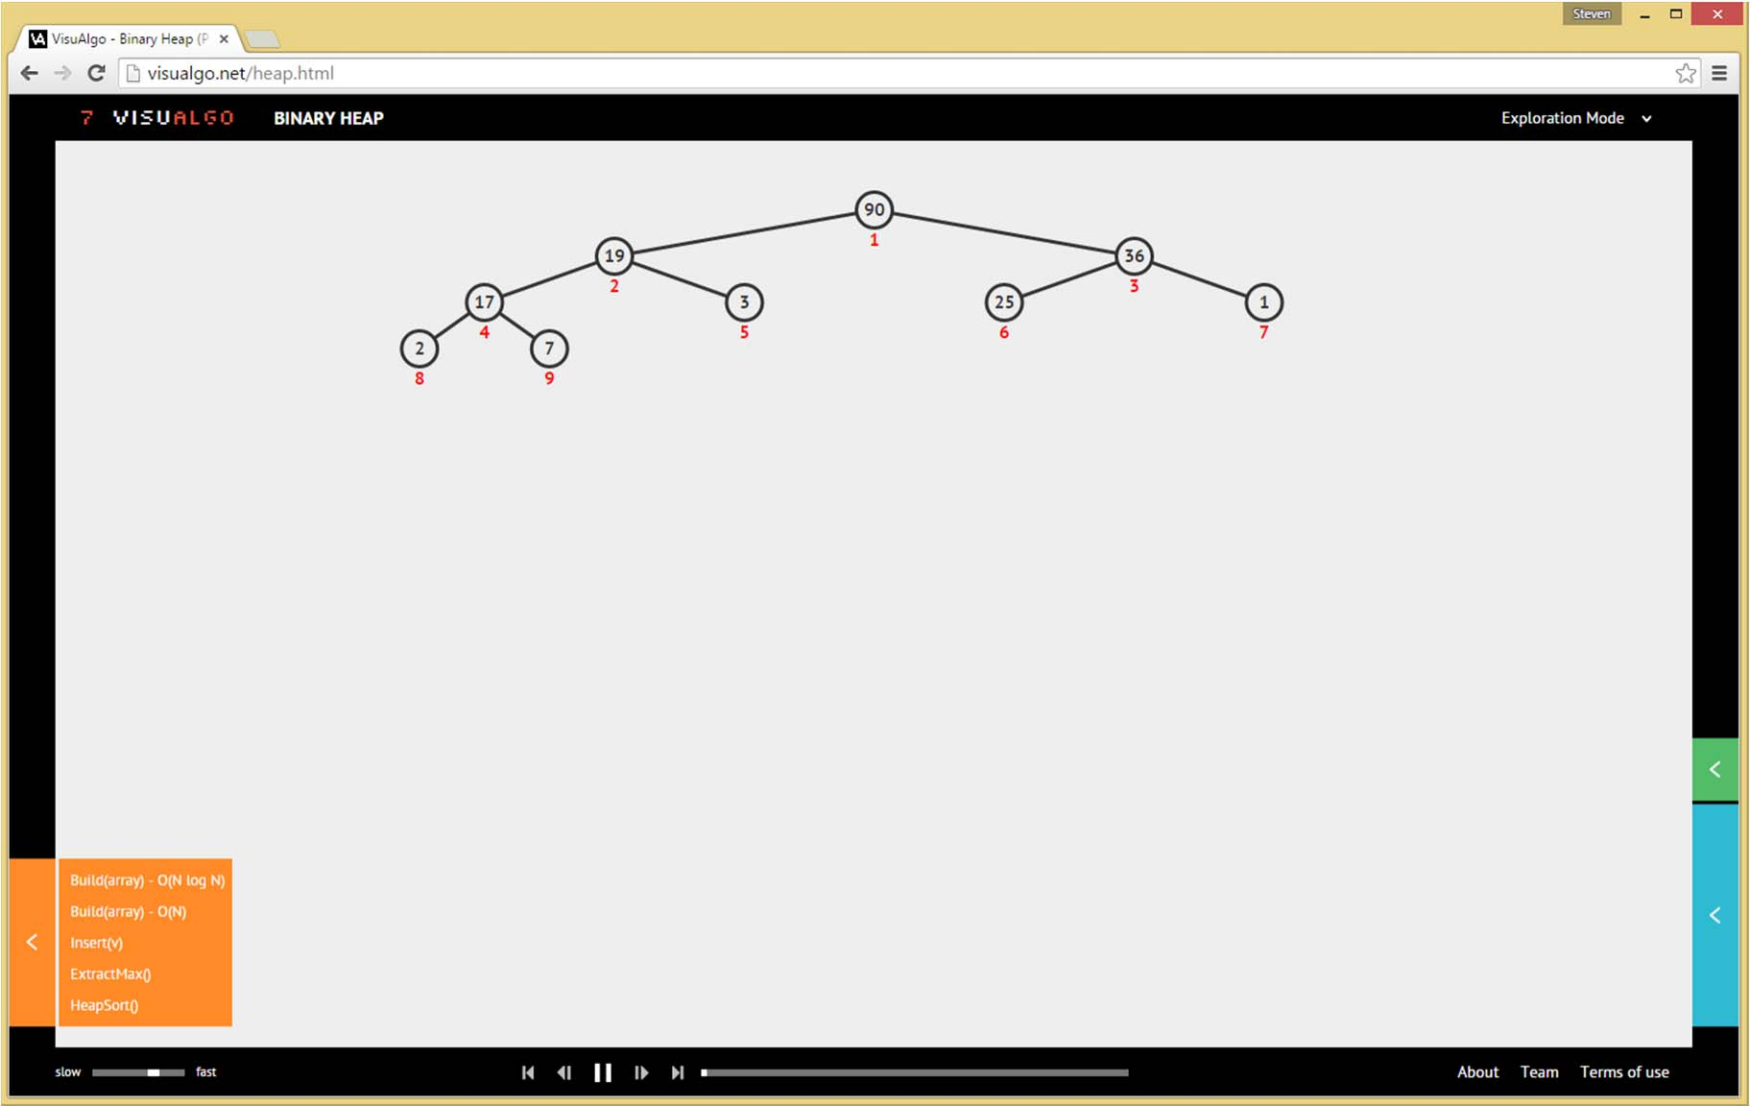
http://visualgo.net/heap.html
INTRODUCING BINARY HEAP DATA STRUCTURE

Slide 17
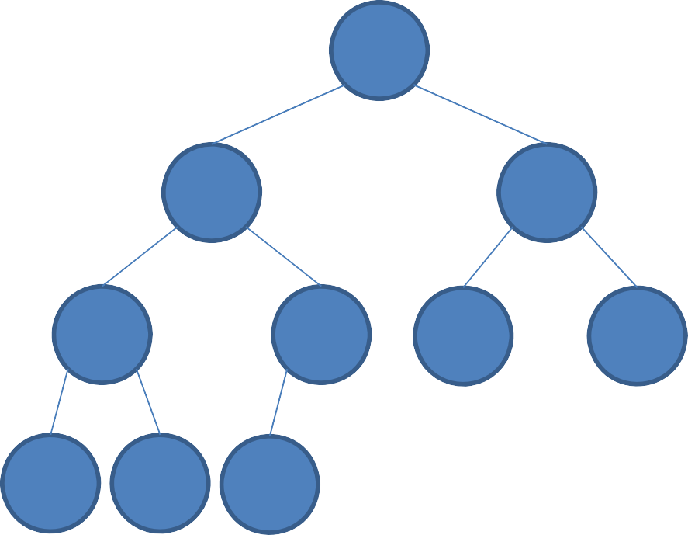
Complete Binary Tree
Introducing a few concepts:
Complete Binary Tree
– Binary tree in which every level, except possibly the last,
is completely filled, and all nodes are as far left as possible
Important Q:
If you have a complete binary tree of N items, what will be the height of it?
– Height = number of levels‐1 =
?
?
?
max edges from root to deepest leaf
?
?
?
?
?
?
?

Slide 18
The Height of a
Complete Binary Tree of N Items is...
O(N)
O(sqrt(N))
O(log N) 4. O(1)
Memorize this answer!
We will need that for nearly all time complexity analysis of binary heap operations
23
0 0 ¹
1 2 3 4

Slide 19
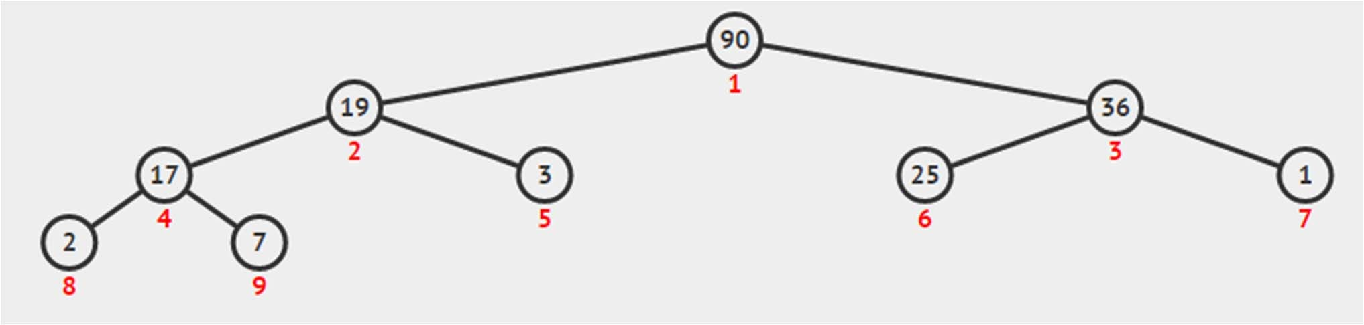
Storing a Complete Binary Tree
Q: Why not 0‐based?
As a 1‐based compact array: A[1..size(A)]
size(A)
0 | 1 | 2 | 3 | 4 | 5 | 6 | 7 | 8 | 9 | 10 | 11
NIL | 90 | 19 | 36 | 17 | 3 | 25 | 1 | 2 | 7 | ‐ | ‐
heapsize ≤
size(A)
Navigation operations:
parent(i) = floor(i/2),
•
•
except for i
= 1 (root)
left(i) = right(i)
2*i, No left child when: left(i) >
heapsize
= 2*i+1, No right child when: right(i)
> heapsize

Slide 20
Binary Heap Property
Q: Can we write Binary Max Heap property as:
Binary Heap property (except root)
A[i] | ≥ | A[left(i)]
&&
A[i] ? | ≥ | A[right(i)]
A[parent(i)]
A[parent(i)]
≥ A[i] (Max Heap)
≤ A[i] (Min Heap)
Without loss of generality, we will use (Binary Max) Heap for all examples in this lecture and we ensure that the numbers are distinct

Slide 21
The largest element
in a Binary Max Heap is stored at…
17
4
3
0
1 2 3 4
One of the leaves
One of the internal vertices
Can be anywhere in the heap
The root

Slide 22
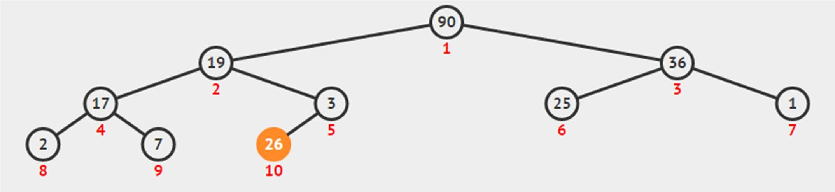
Insertion to an Existing B Max Heap
The most appropriate insertion point into an existing Binary Max Heap is at A[heapsize]
Q: Why?
A:
But Binary Max Heap property can still be violated?
– No problem, we use ShiftUp(i) to fix the heap property

Slide 23
Insert(v) – Pseudo Code
Insert(v)
heapsize = heapsize+1; // extend, O(1) A[heapsize] = v // insert at the back, O(1)
ShiftUp(heapsize) | // | fix | the | heap | property
 | // | in | O(?)
// Preliminary
//
analysis:
Insert(v)
depends on
ShiftUp(i)

Slide 24
ShiftUp – Pseudo Code
This name is not unique, the alternative names are: ShiftUp/BubbleUp/IncreaseKey/etc
ShiftUp(i) while i >
“not root” “violates max heap property”
1 and A[parent(i)] < A[i] // don't swap
swap(A[i], A[parent(i)]) i = parent(i)
// Analysis: ShiftUp() runs in

Slide 25
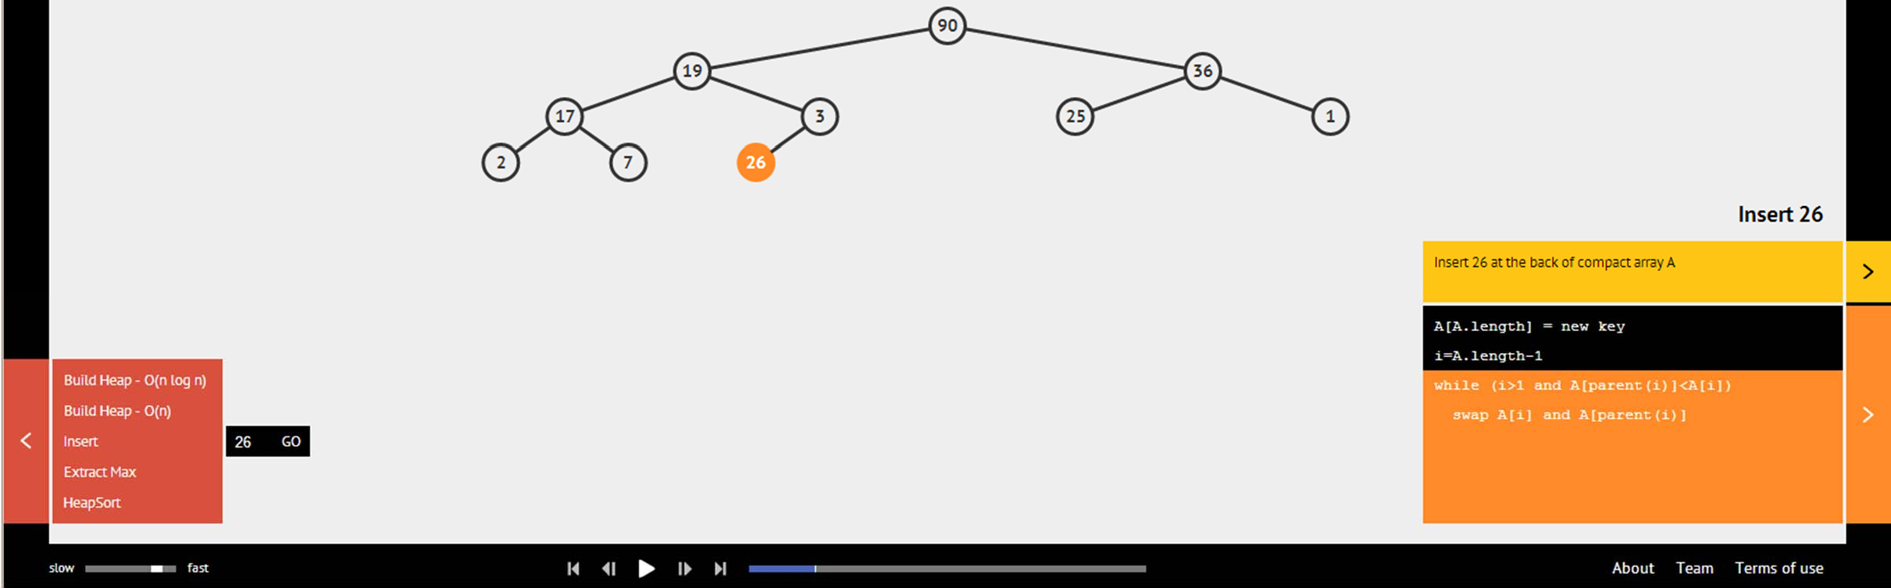
Binary Heap: Insert(v)
Ask VisuAlgo to perform various insert operations on the sample Binary (Max) Heap
In the screen shot below, we show the first step of
Insert(26)

Slide 26
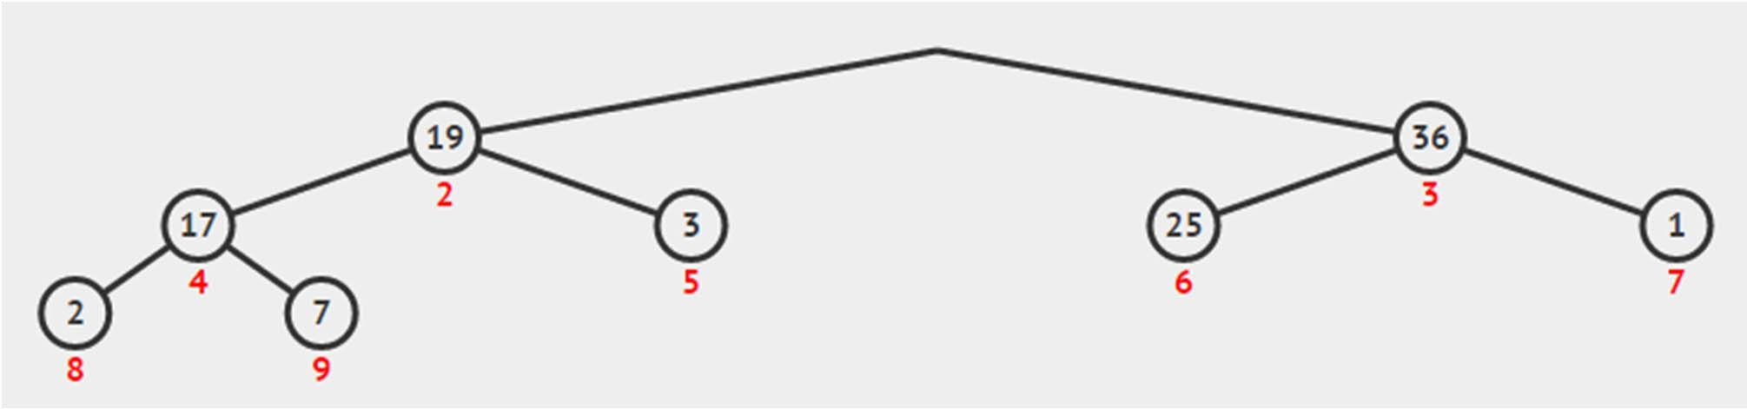
Deleting Max Element (1)
The max element of a Binary Max Heap is at the root
But simply taking the root out from a Binary Max Heap will disconnect the complete binary tree ☹
– We do not want that…
Q: Which node is the best candidate to replace the root yet still maintain the complete binary tree property?

Slide 27

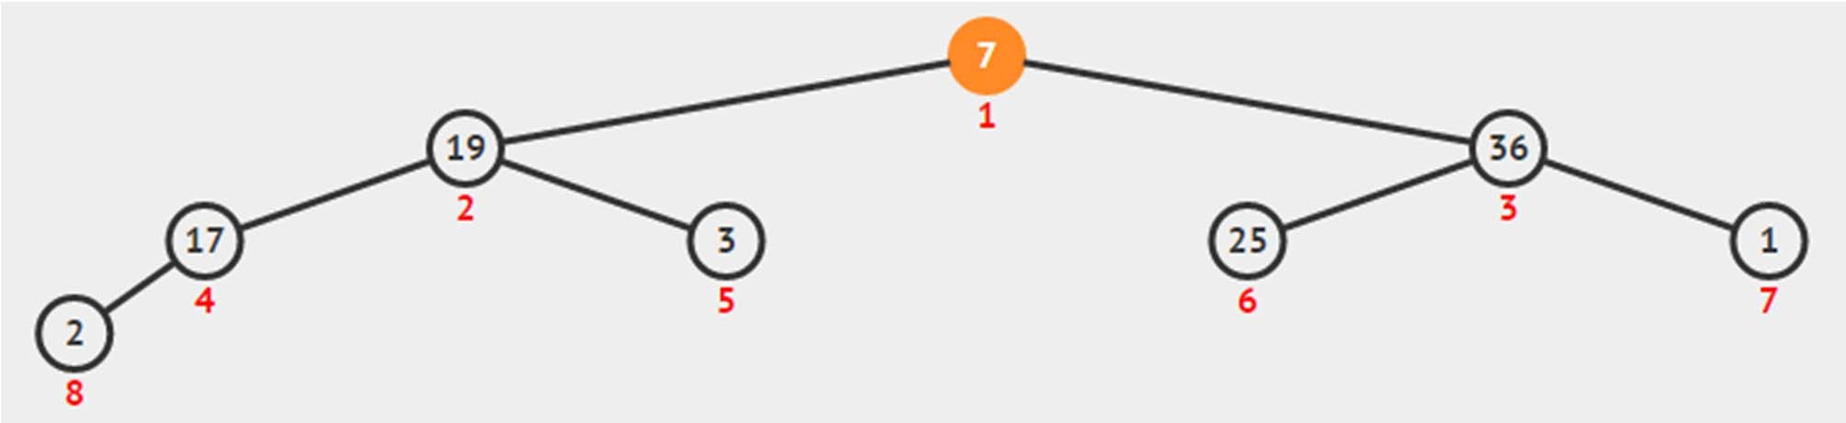
Deleting Max Element (2)
A: The leaf
Which is the last element in the compact array
But the heap property can still be violated?
No problem, this time we call ShiftDown(1)

Slide 28
ExtractMax ‐ Pseudocode
ExtractMax()
maxV ←
A[1] ←
A[1] // O(1)
A[heapsize] //
O(1)
heapsize = heapsize-1 ShiftDown(1) // O(?) return maxV
// O(1)
// Preliminary
// ExtractMax()
analysis:
depends on
ShiftDown()

Slide 29
ShiftDown – Pseudo Code
Again, the name is not unique:
ShiftDown(i)
ShiftDown/BubbleDown/Heapify/etc
while i <= heapsize
maxV ←
A[i]; max_id
← i;
and maxV
if left(i)
<= heapsize
< A[left(i)]
maxV ←
A[left(i)];
max_id ←
left(i)
if right(i) <= heapsize and maxV
< A[right(i)]
maxV ←
A[right(i)]; max_id ←
right(i)
// be
if (max_id
careful
with the
!= i)
implementation
swap(A[i],
A[max_id])
i ←
else
break;
max_id;
// Analysis:
ShiftDown()
runs in

Slide 30
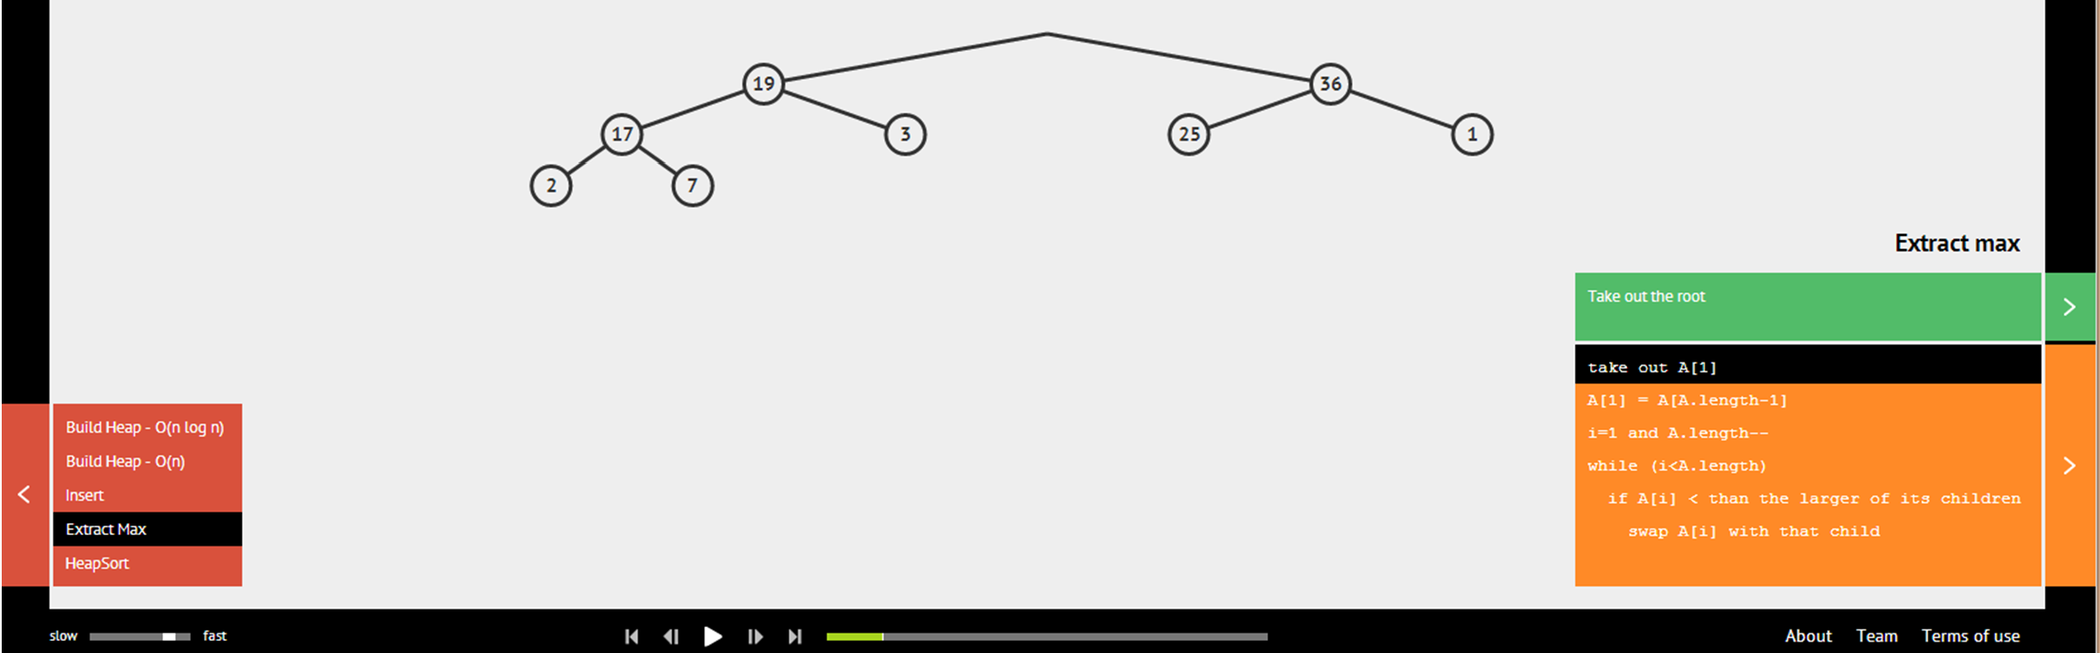
Binary Heap: ExtractMax()
Ask VisuAlgo to perform various ExtractMax() operations on the sample Binary (Max) Heap
In the screen shot below, we show the first step of
ExtractMax() from the sample Binary (Max) Heap

Slide 31
PriorityQueue Implementation (4)
Now, with knowledge of non linear DS from CS2010:
Strategy | Enqueue | Dequeue
Array‐Based PQ (1) | O(n) | O(1)
Array‐Based PQ (2) | O(1) | O(n)
Binary‐Heap (actually uses array too) | Insert(key) O(log n) | ExtractMax() O(log n)
Summary so far:
Heap data structure is an efficient data structure ‐‐ O(log n) enqueue/dequeue operations ‐‐ to implement ADT priority queue where the ‘key’ represent the ‘priority’ of each item

Slide 32
Next Items:
Building Binary Max Heap from an ordinary Array, the O(n log n) version
And the faster O(n) version
Heap Sort, O(n log n)
Java Implementation of Binary Max Heap
PS1 overview and introduction of one more Binary Max Heap operation: UpdateKey that has been purposely left out from this lecture
LECTURE BREAK

Slide 33
Review: We have seen MergeSort in
CS1020. It can sort n items in…
1. O(n²)
O(n log n)
O(n)
O(log n)
20
4
0 0
1 2 3 4

Slide 34
HeapSort Pseudo Code
With a max heap, we can do sorting too ☺
Just call ExtractMax() n times
If we do not have a max heap yet, simply build one!
HeapSort(array) BuildHeap(array)
// O(?)
n ← size(array) for
i from
1 to n // O(n)
← ExtractMax()
A[n–i+1]
// O(log n)
return A
// Preliminary
//
analysis:
HeapSort
runs in O(?
+ n log n)

Slide 35
BuildHeap, O(n log n) Version
BuildHeapSlow(array) // n ← size(array)
naïve
version
A[0] ← 0 // dummy for i = 1 to n //
entry O(n)
Insert(array[i-1])
// O(log n)
// Analysis:
//
This clearly
runs
in O(n log n)
So HeapSort
in previous
slide
is O(n log n) ☺
Can we do better?

Slide 36
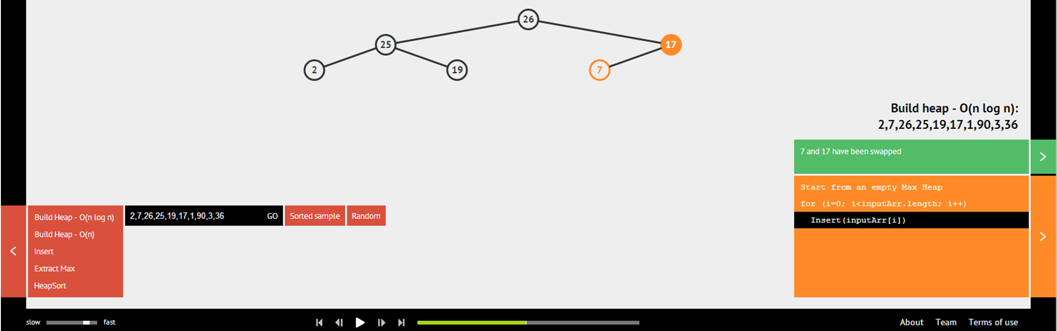
Build Binary Heap in O(n log n)
Ask VisuAlgo to build Binary (Max) Heap from an array in O(n log n) time by inserting each number one by one
In the screen shot below, the partial state of the O(n log n) Build Heap of the sample Binary (Max) Heap

Slide 37
BuildHeap, the Faster One
BuildHeap(array)
heapsize ←
size(array)
A[0] ← 0
for i = 1 A[i] ←
// dummy entry to heapsize // array[i-1]
copy
the content
O(n)
for i =
parent(heapsize)
down
to 1 // O(n/2)
ShiftDown(i) // O(log n)
// Analysis:
//
Is this
also
O(n log n) ??
is
No...
soon,
we will see
that this
just
O(n)

Slide 38
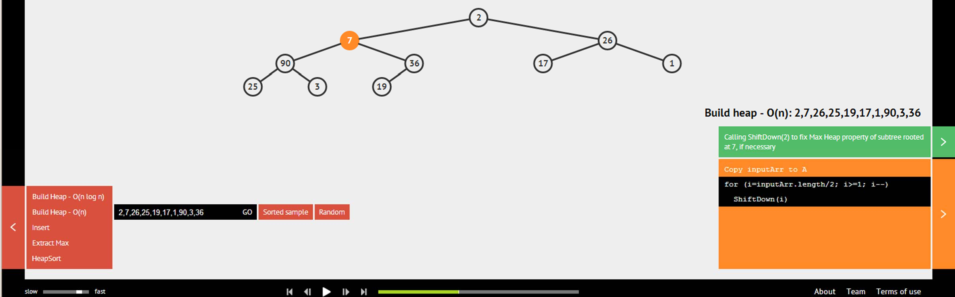
Build Binary Heap in O(n)
Ask VisuAlgo to build Binary (Max) Heap from an array in O(n) time by calling ShiftDown strategically
In the screen shot below, the partial state of the O(n) Build Heap of the sample Binary (Max) Heap

Slide 39
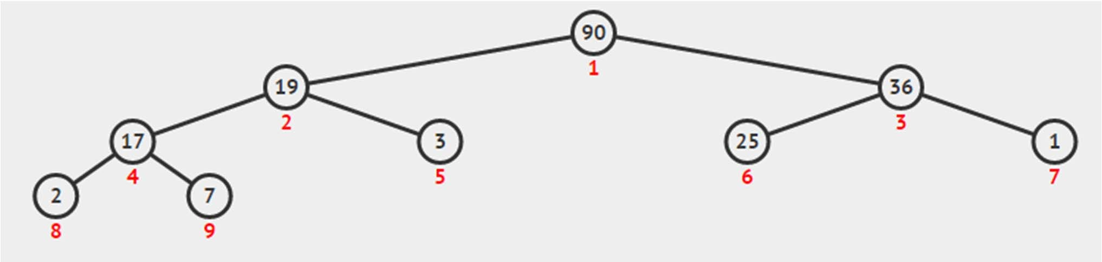
BuildHeap() Analysis… (1)
Recall: How many levels (height) are there in a complete binary tree (heap) of size n?
Recall: What is the cost to run shiftDown(i)?
Q: How many nodes are there at height h of a full binary tree?
h = 3
h = 2
h = 1
h = 0
n = 9

Slide 40
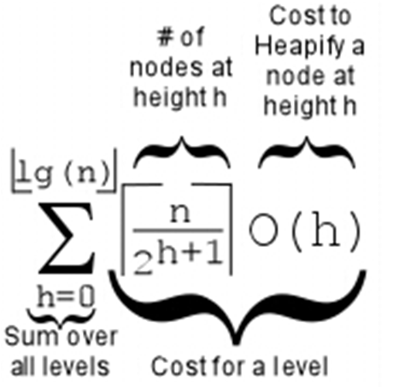
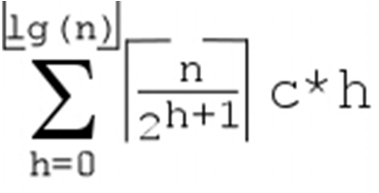
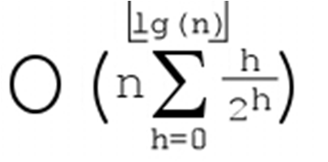
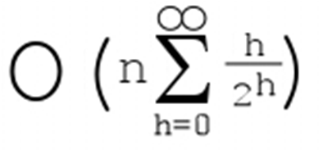
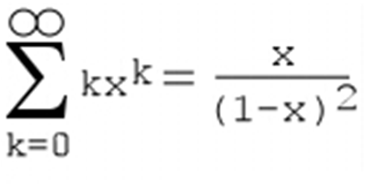
BuildHeap() Analysis… (2)
Cost of BuildHeap() is thus:
=
=
=
= O(2n) = O(n)
=2
x = 1/2
0 1 2 3 4
- + - + - + - + - ₂0 ₂1 ₂2 ₂3 ₂4
0 + 0.5 + 0.5
0 1 2 3 4
- + - + - + - + - + ...= 1 2 4 8 16
0.09375 + ... < 2
+ ... =
+ 0.375 +
0.25 + 0.15625 +

Slide 41
HeapSort Analysis
HeapSort(array)
BuildHeap(array) // The best we can do is
n ←
for i from
size(array)
1 to n // O(n)
← ExtractMax()
A[n–i+1]
return A
// O(log n)
// Analysis: Thus HeapSort
//
//
//
//
//
runs in O( ) not need extra array
Do you notice that we do
like merge sort to Thus heap sort is This
But
perform sorting?
more memory friendly.
is called "in-place
sorting"
HeapSort is not
"cache
friendly"

Slide 42
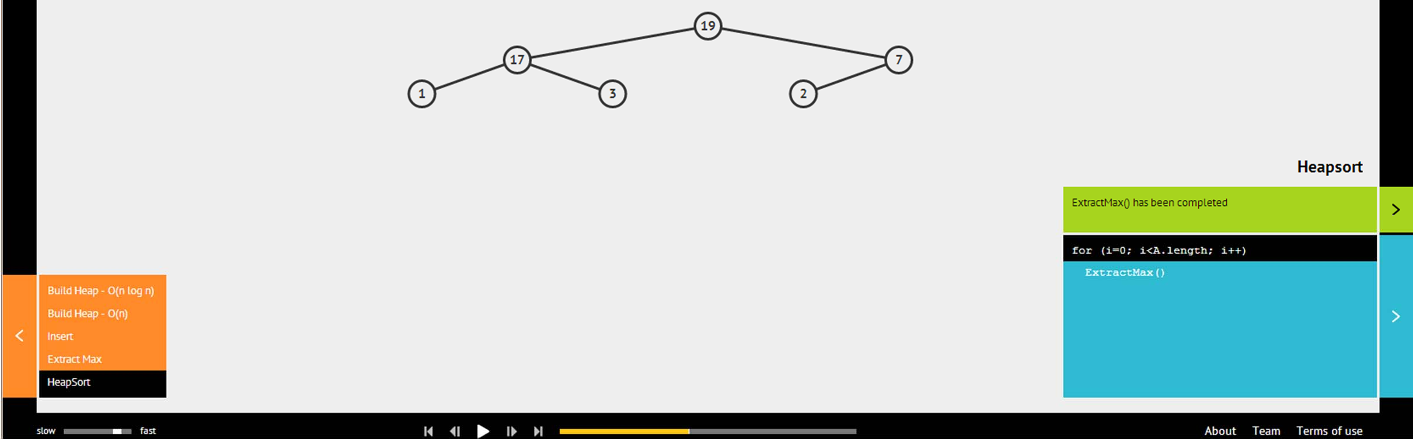
Binary Heap: HeapSort()
Ask VisuAlgo to run HeapSort() on the sample Binary (Max) Heap
In the screen shot below, the partial state of the O(n log n) HeapSort() of the sample Binary (Max) Heap

Slide 43
Java Implementation
Priority Queue ADT
Heap Class (Java file given, you can use it for PS1)
ShiftUp(i)
Insert(v)
ShiftDown(i)
ExtractMax()
BuildHeapSlow(array) and BuildHeap(array)
HeapSort()
In OOP Style ☺

Slide 44

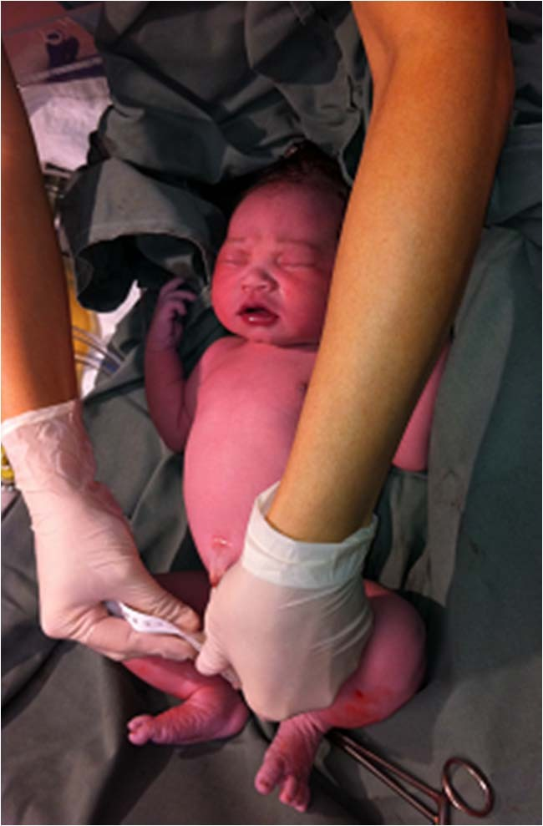
Scheduling Deliveries, v2015 (PS1)
This happens in the delivery suite (or surgery room for Caesarean section) of a hospital

Slide 45
PS1, the task
Given a list of (“insanely” many) pregnant women, prioritize the one who will give birth sooner
over the one who will give birth later…
Open on Wed, 19 Aug 2015, 11.45am, right after this lecture
Clearly involving some kind of PriorityQueue ☺
PS1 Subtask A should be very easy
PS1 Subtask B may need Lab Demo 01 on Week 03 PS1 Subtask C is the challenge
Introducing UpdateKey operation of a PriorityQueue

Slide 46
End of Lecture Quiz ☺
After Lecture 02, I will set a random test mode @ VisuAlgo to see if you understand Binary Heap
Go to:
http://visualgo.net/test.html
Use your CS2010 account to try the 5 Binary Heap questions (medium difficulty, 5 minutes)
Meanwhile, train first ☺
http://visualgo.net/training.html

Slide 47
Summary
In this lecture, we have looked at:
Heap DS and its application as efficient PriorityQueue
Storing heap as a compact array and its operations
– Remember how we always try to maintain complete binary tree and heap property in all our operations!
Building a heap from a set of numbers in O(n) time
Simple application of Heap DS: O(n log n) HeapSort
We will use PriorityQueue in the 2nd part of CS2010
If some concepts are still unclear, ask your personal tutor: http://visualgo.net/heap.html

Slide 48
Revision
Cho dãy số: 2, 7, 26, 25, 19, 17, 1, 90, 3, 36
Trình bày các bước xây dựng min heap từ dãy số trên
Trình bày các bước xây dựng max heap từ dãy số trên
Lưu ý: trình bày từng bước bằng cấu trúc mảng

