Slide 1

Data Structures and Algorithms
Maze Exploration

Slide 2
Acknowledgement
The contents of these slides have origin from School of Computing, National University of Singapore.
We greatly appreciate support from Dr. Steven Halim for kindly sharing these materials.

Slide 3
Policies for students
These contents are only used for students PERSONALLY.
Students are NOT allowed to modify or deliver these contents to anywhere or anyone for any purpose.

Slide 4
Recording of modifications
Currently, there are no modification on these contents.

Slide 5

CS2010 – Data Structures and Algorithms II
Lecture 06 – Maze Exploration
stevenhalim@gmail.com

Slide 6
Outline
Continue Week 05 stuffs (Graph DS Applications) Two algorithms to traverse a graph
Depth First Search (DFS) and Breadth First Search (BFS)
Plus some of their interesting applications
visualgo.net/dfsbfs.html
Reference: Mostly from CP3 Section 4.2
Not all sections in CP3 chapter 4 are used in CS2010!
– Some are quite advanced :O

Slide 7
SOME GRAPH DATA STRUCTURE APPLICATIONS

Slide 8
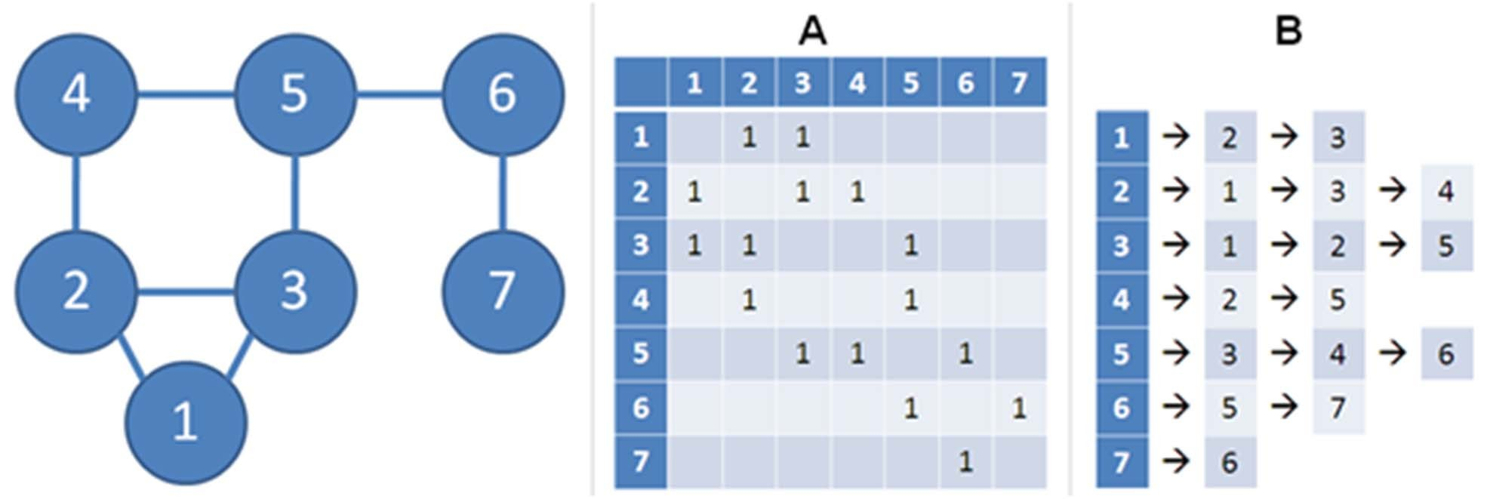
So, what can we do so far? (1)
With just graph DS, not much that we can do… But here are some:
Counting V (the number of vertices)
Very trivial for both AdjMatrix and AdjList: V = number of rows!
Sometimes this number is stored in separate variable so that we do not have to re‐compute every time, that is, O(1), especially if the graph never changes

Slide 9
So, what can we do so far? (2)
Enumerating neighbors of a vertex v
O(V) for AdjMatrix: scan AdjMatrix[v][j], ∀j ∈ [0..V‐1]
O(k) for AdjList, scan AdjList[v]
k is the number of neighbors of vertex v (output‐sensitive algorithm)
This is an important difference between AdjMatrix versus AdjList
It affects the performance of many graph algorithms. Remember this!

Slide 10
So, what can we do so far? (3)
Counting E (the number of edges)
O(V²) for AdjMatrix: count non zero entries in AdjMatrix
O(V+E) for AdjList: sum the length of all V lists
Sometimes this number is stored in separate variable so that we do not have to re‐compute every time, i.e. O(1), especially if the graph never changes

Slide 11
So, what can we do so far? (4)
Checking the existence of edge(u, v)
O(1) for AdjMatrix: see if AdjMatrix[u][v] is non zero
O(k) for AdjList: see if AdjList[u] contains v
There are a few others,
but let’s reserve them for PSes or even for test questions ☺

Slide 12
Trade‐Off
Adjacency Matrix
Pros:
Existence of edge i‐j can be found in O(1)
Good for dense graph/
Floyd Warshall’s (Lecture 12)
Cons:
O(V) to enumerate neighbors of a vertex
O(V²) space
Adjacency List
O(k) to enumerate k neighbors of a vertex
Good for sparse graph/Dijkstra’s/ DFS/BFS, O(V+E) space
Pros:
Cons:
O(k) to check the existence of edge i‐j
A small overhead in maintaining the list (for sparse graph)

Slide 13
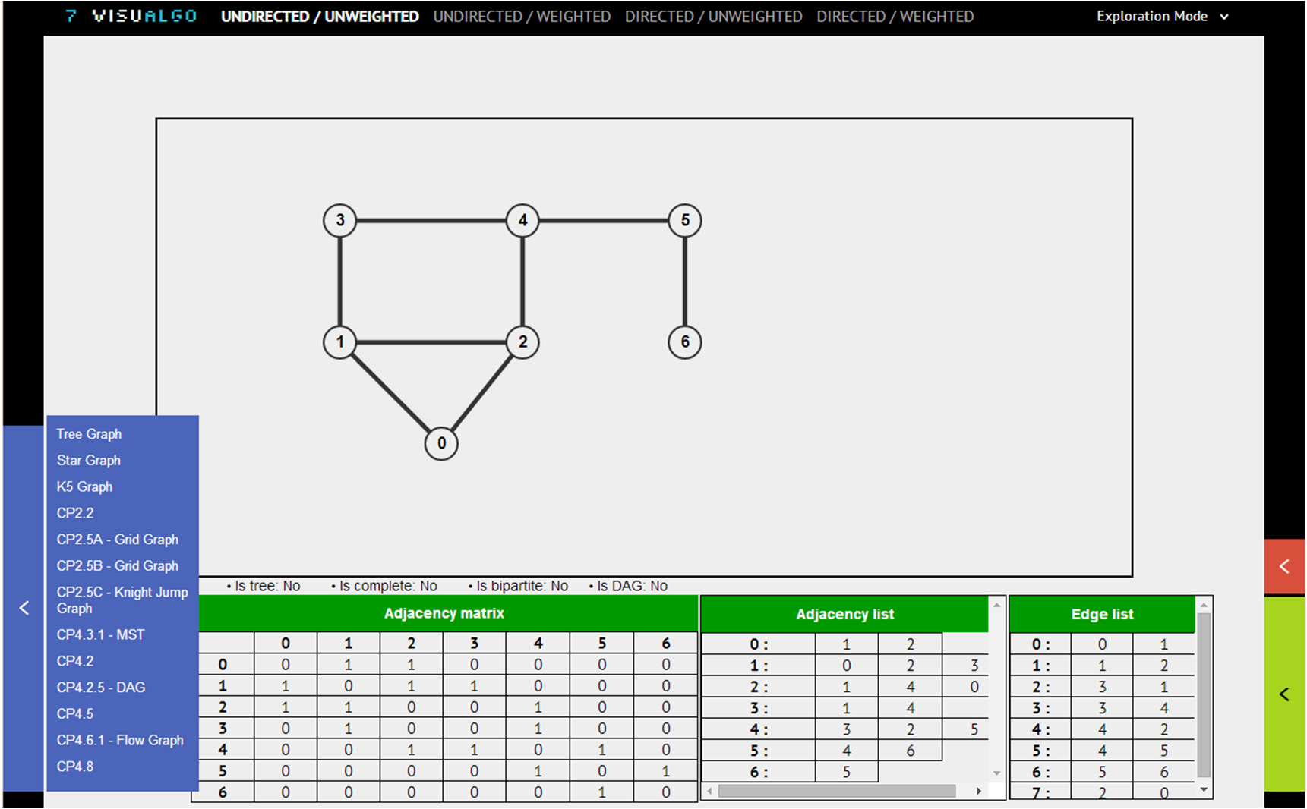
VisuAlgo Graph DS Exploration (1)
Click each of the sample graphs one by one and verify the content of the corresponding Adjacency Matrix, Adjacency List, and Edge List

Slide 14
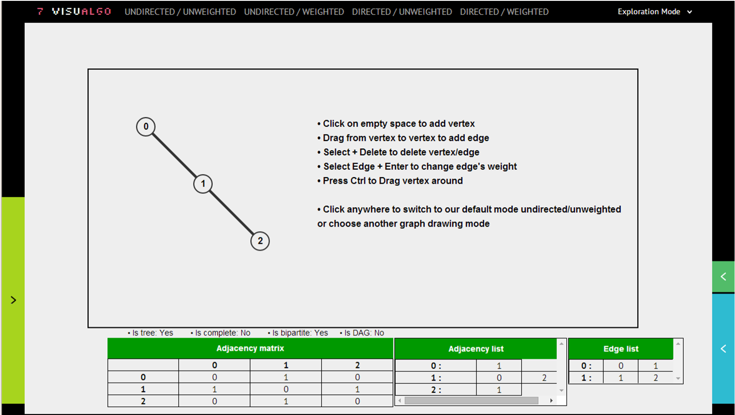
VisuAlgo Graph DS Exploration (2)
Now, use your mouse over the currently displayed graph and start drawing some new vertices and/or edges and see the updates in AdjMatrix/AdjList/EdgeList structures

Slide 15
GRAPH TRAVERSAL ALGORITHMS

Slide 16
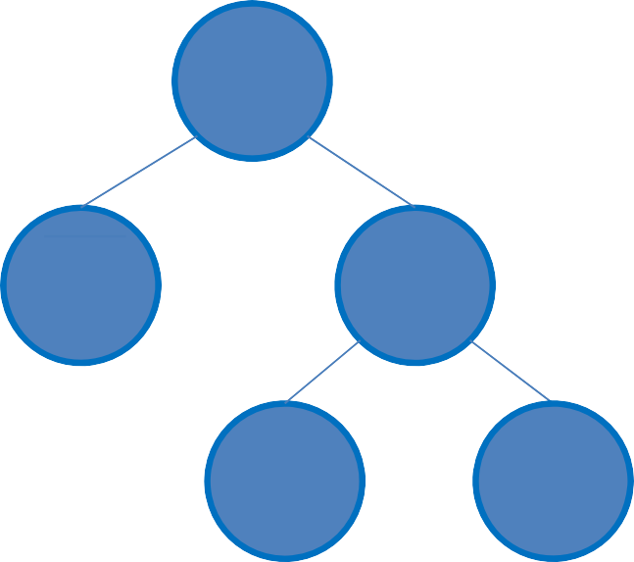
Review – Binary Tree Traversal
In a binary tree, there are three standard traversal:
Preorder
Inorder
Postorder
•
pre(u)
visit(u);
pre(u->left); pre(u->right);
in(u)
in(u->left);
visit(u);
in(u->right);
post(u)
post(u->left); post(u->right); visit(u);
(Note: “level order” is just BFS which we will see next)
We start binary tree traversal from root:
0
pre(root)/in(root)/post(root)
– pre = 0, 1, 2, 3, 4
– in = 1, 0, 3, 2, 4
– post = 1, 3, 4, 2, 0
1
2
3
4

Slide 17
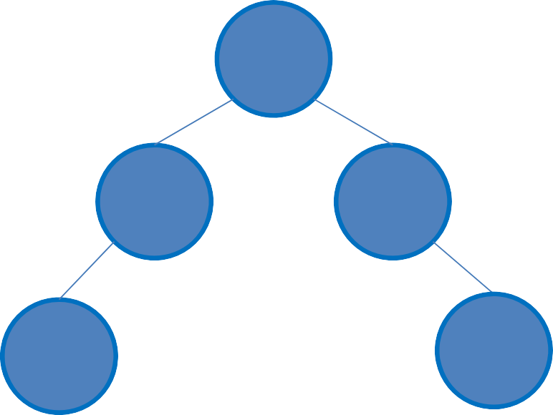
What is the PostOrder Traversal of this Binary Tree?
1. 0 1 2 3 4
2. 0 1 3 2 4
3. 3 4 1 2 0
4. 3 1 4 2 0
0
17
4
1
0
1 2 3 4
1
2
3
4

Slide 18
Traversing a Graph (1)
Two ingredients are needed for a traversal:
The start
The movement
Defining the start (“source”)
In tree, we normally start from root
Note: Not all tree are rooted though!
In that case, we have to select one vertex as the “source”, see below
In general graph, we do not have the notion of root
Instead, we start from a distinguished vertex
We call this vertex as the “source” s

Slide 19
Traversing a Graph (2)
Defining the movement:
In (binary) tree, we only have (at most) two choices:
Go to the left subtree or to the right subtree
In general graph, we can have more choices:
If vertex u and vertex v are adjacent/connected with edge (u, v); and we are now in vertex u;
then we can also go to vertex v by traversing that edge (u, v)
In (binary) tree, there is no cycle
In general graph, we may have (trivial/non trivial) cycles
We need a way to avoid revisiting u → v → u → u → … indefinitely
Solution: BFS and DFS ☺

Slide 20

Breadth First Search (BFS) – Ideas
Start from s
If a vertex v is reachable from s, then all neighbors of v will also be reachable from s (recursive definition)
BFS visits vertices of G in breadth‐first manner (when viewed from source vertex s)
Q: How to maintain such order?
A: Use queue Q, initially, it contains only s
Q: How to differentiate visited vs unvisited vertices (to avoid cycle)?
A: 1D array/Vector visited of size V,
visited[v] = 0 initially, and visited[v] = 1 when v is visited
Q: How to memorize the path?
A: 1D array/Vector p of size V,
p[v] denotes the predecessor (or parent) of v

Slide 21
BFS Pseudo Code
for all v in V visited[v] ← 0
p[v] ← -1
Q ← {s} // start from s visited[s] ← 1
Initialization phase
while Q is not empty u ← Q.dequeue()
for all v adjacent to u // order of neighbor
if visited[v] = visited[v] ←
p[v] ← u Q.enqueue(v)
0 // influences BFS
true // visitation sequence
Main loop
// after BFS stops,
we can use info stored in visited/p

Slide 22
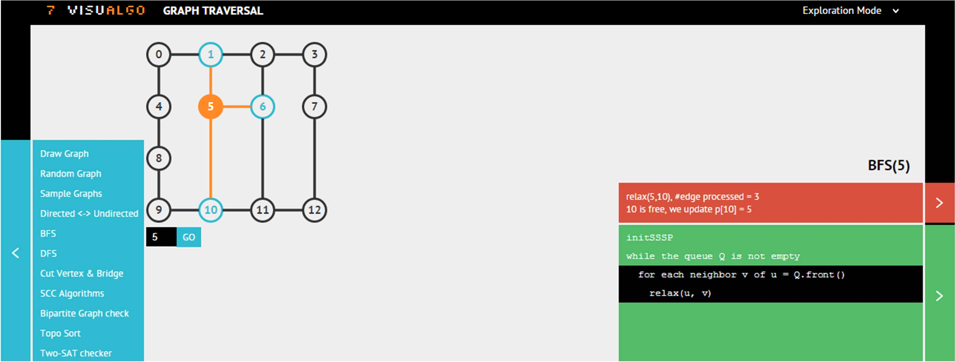
Graph Traversal: BFS(s)
Ask VisuAlgo to perform various Breadth‐First Search operations on the sample Graph (CP3 4.3, Undirected)
In the screen shot below, we show the start of BFS(5)

Slide 23
BFS Analysis
Time Complexity: O(V+E)
Each vertex is only in the queue once ~ O(V)
Every time a vertex is dequeued, all its k
neighbors are scanned; After all vertices are
for all v in V visited[v] ← 0
p[v] ← -1
Q ← {s} // start visited[s] ← 1
from s
dequeued, all E edges are examined ~ O(E)
→ assuming that we use Adjacency List!
Overall: O(V+E)
while Q is not empty u ← Q.dequeue()
for all v adjacent to u // order of neighbor if visited[v] = 0 // influences BFS
visited[v] ← true // visitation sequence p[v] ← u
Q.enqueue(v)
// we can then use information stored in visited/p

Slide 24

Depth First Search (DFS) – Ideas
Start from s
If a vertex v is reachable from s, then all neighbors of v will also be reachable from s (recursive definition)
DFS visits vertices of G in depth‐first manner (when viewed from source vertex s)
Q: How to maintain such order?
A: Stack S, but we will simply use recursion (an implicit stack)
Q: How to differentiate visited vs unvisited vertices (to avoid cycle)?
A: 1D array/Vector visited of size V,
visited[v] = 0 initially, and visited[v] = 1 when v is visited
Q: How to memorize the path?
A: 1D array/Vector p of size V,
p[v] denotes the predecessor (or parent) of v

Slide 25
DFS Pseudo Code
DFSrec(u) visited[u] ←
1 // to avoid
cycle order
for all v if
adjacent to u //
of neighbor
visited[v] = 0 //
influences DFS
Recursive phase
p[v] ←
u // visitation
sequence (implicit
DFSrec(v) // recursive
stack)
// in the
for all v in V
←
main
method
visited[v]
0
Initialization phase, same as with BFS
p[v] ← -1 DFSrec(s) // recursive
start the
s
call
from

Slide 26
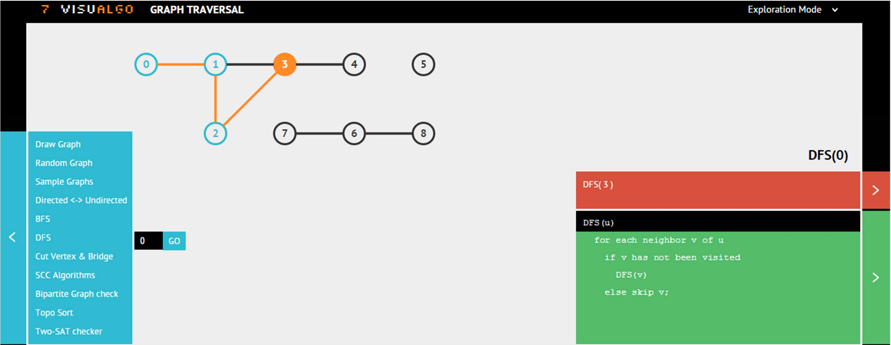
Graph Traversal: DFS(s)
Ask VisuAlgo to perform various Breadth‐First Search operations on the sample Graph (CP3 4.1, Undirected)
In the screen shot below, we show the start of DFS(0)

Slide 27
DFS Analysis
DFSrec(u) visited[u] ←
1 // to avoid
cycle order
for all v if
adjacent to u //
of neighbor
visited[v] = 0 //
influences DFS
p[v] ←
u // visitation
sequence (implicit stack)
Time Complexity: O(V+E)
Each vertex is only visited once O(V), then it is flagged to avoid cycle
Every time a vertex is visited, all its k neighbors are scanned; Thus after all vertices are visited, we have
examined all E edges ~ O(E) →
assuming that we use Adjacency List!
Overall: O(V+E)
DFSrec(v) // recursive
// in the
for all v in V
←
main
method
visited[v]
0
p[v] ← -1 DFSrec(s) // recursive
start the
s
call
from

Slide 28
Path Reconstruction Algorithm (1)
// iterative version
(will
produce
reversed
output)
Output "(Reversed) Path:"
i ← t // start from end of
path:
suppose
vertex t
while i != s Output i i ← p[i]
Output s
// go back
to predecessor of i
//
//
try
it
on
this
array
p,
t
=
4
p
=
{-1,
0,
1,
2,
3,
-1,
-1,
-1}

Slide 29
Path Reconstruction Algorithm (2)
void backtrack(u) if (u == -1) //
stop backtrack(p[u])
recall:
predecessor
of s is -1
// go
back like
to predecessor
of u the order
Output u // recursion
this reverses
// in main
//
method
recursive
version
(normal
path)
Output "Path:" backtrack(t); //
start
from
end of path
(vertex t)
//
//
try
it
on
this
array
p,
t
=
4
p
=
{-1,
0,
1,
2,
3,
-1,
-1,
-1}

Slide 30
SOME GRAPH TRAVERSAL APPLICATIONS

Slide 31
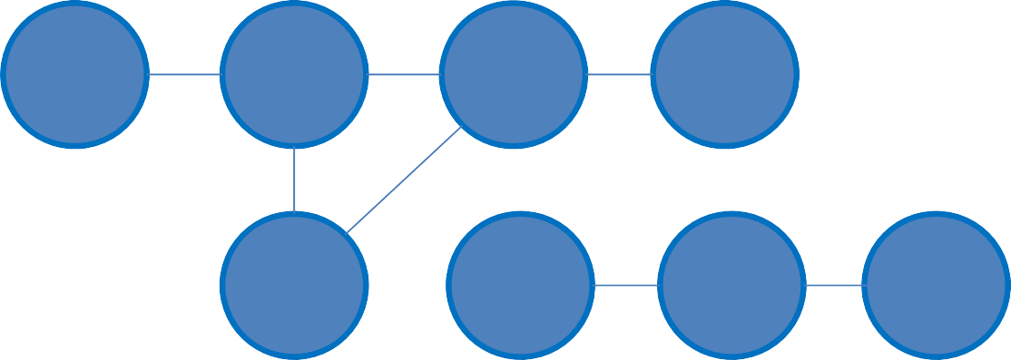
What can we do with BFS/DFS? (1)
Several stuffs, let’s see some of them:
Reachability test
Test whether vertex v is reachable from vertex u?
Start BFS/DFS from s = u
If visited[v] = 1 after BFS/DFS terminates,
then v is reachable from u; otherwise, v is not reachable from u
BFS(u) // DFSrec(u) if visited[v] == 1
Output else
Output
"Yes"
0 1 3 4
5
"No"
2
7
6
8

Slide 32
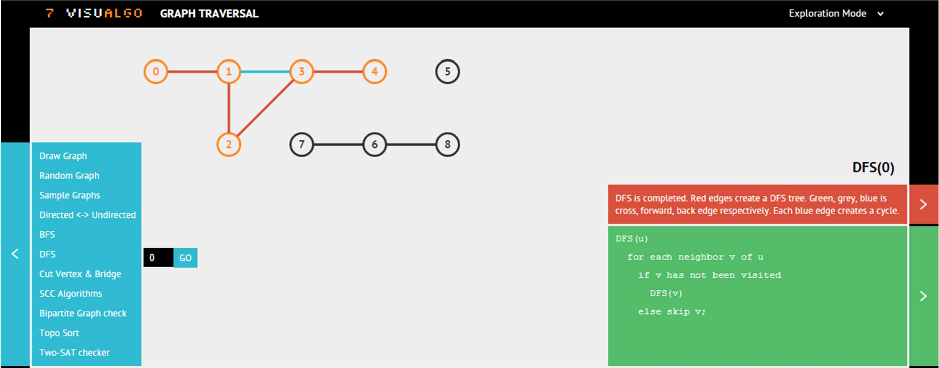
Reachability Test
Ask VisuAlgo to perform various DFS (or BFS) operations on the sample Graph (CP3 4.1, Undirected)
Below, we show vertices that are reachable from vertex 0

Slide 33
What can we do with BFS/DFS? (2)
Identifying component(s)
Component is sub graph in which any 2 vertices are connected to each other by at least one path, and is connected to no additional vertices
With BFS/DFS, we can identify/label/count components in graph G
Solution:
CC ← 0
for all v in V visited[v] ← 0
for all v in V // O(V)?
if visited[v] == 0 CC ← CC + 1
0 1 3 4 5
DFSrec(v)//O(V+E)?
// BFS from v
// is also OK

Slide 34
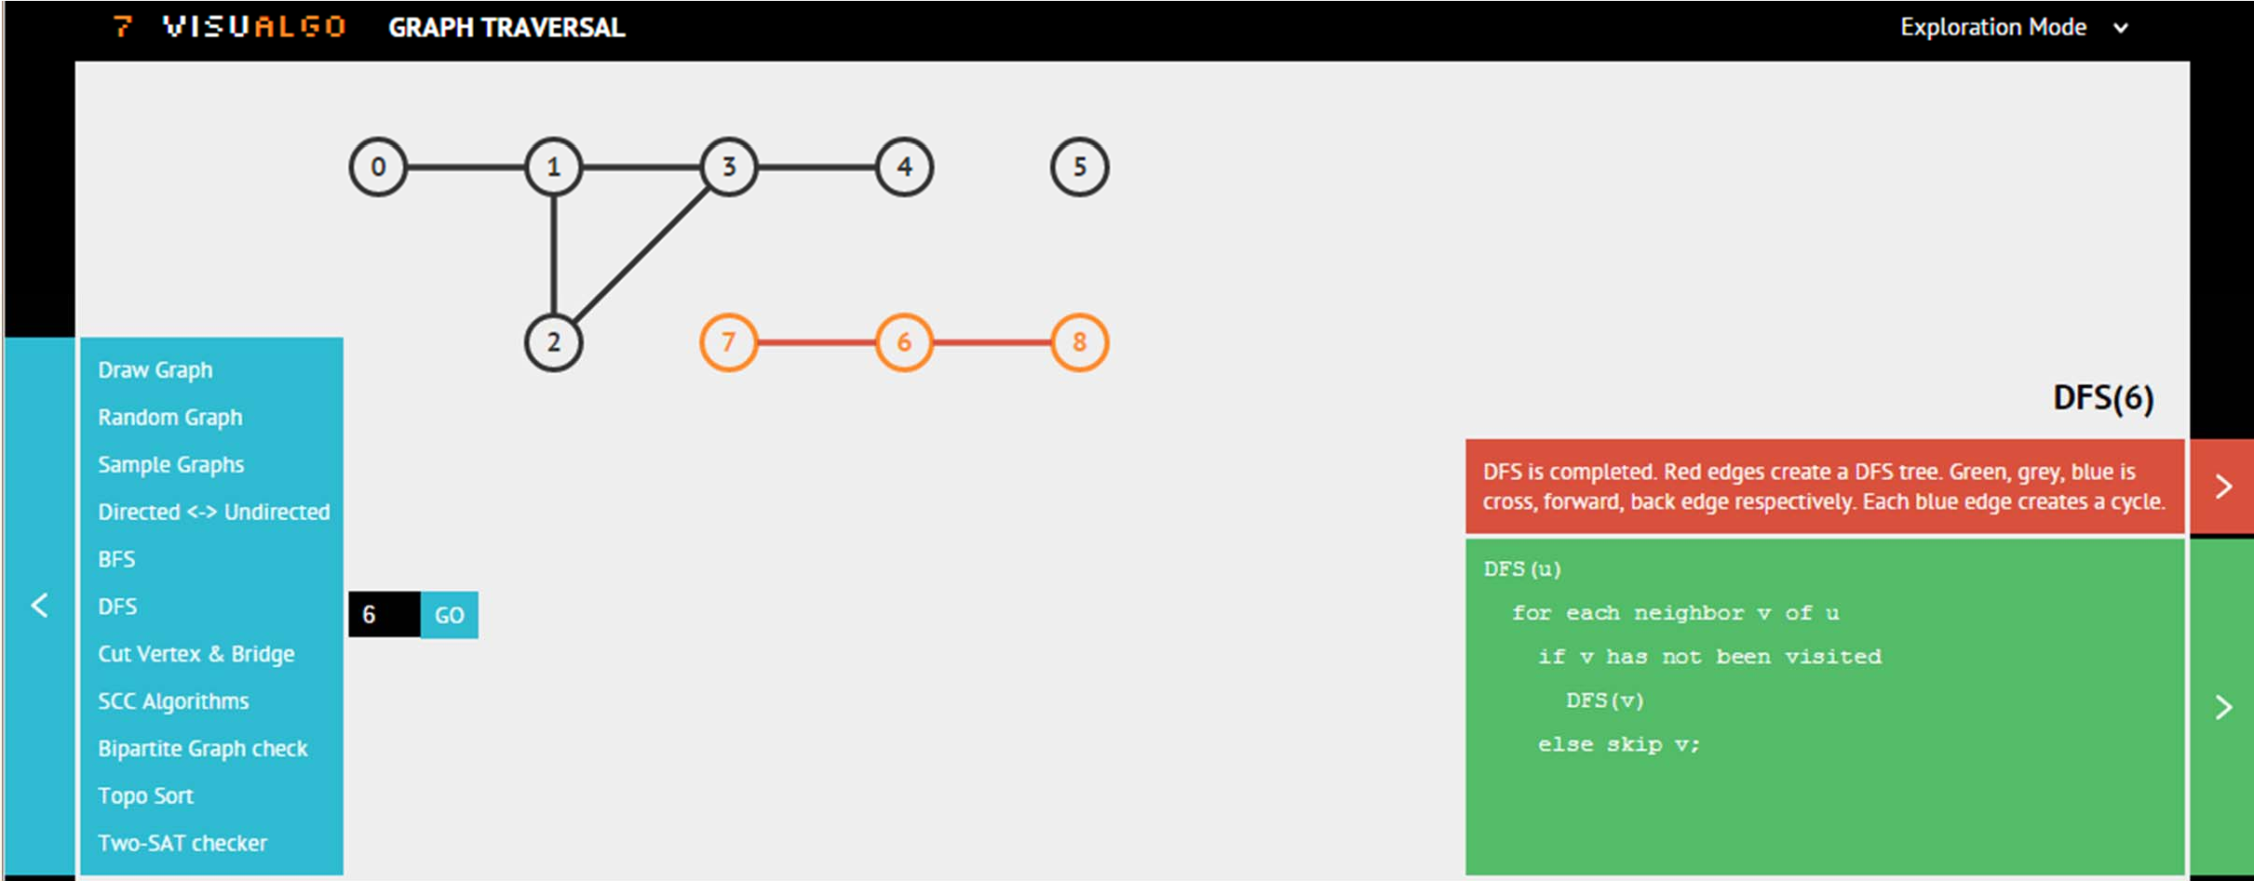
Reachability Test
Ask VisuAlgo to perform various DFS (or BFS) operations on the sample Graph (CP3 4.1, Undirected)
Call DFS(0)/BFS(0), DFS(5)/BFS(5), then DFS(6)/BFS(6)

Slide 35

What is the time complexity for “counting connected component”?
Hm… you can call O(V+E) DFS/BFS up to V times… I think it is O(V*(V+E)) = O(V^2 + VE)
It is O(V+E)...
Maybe some other time complexity, it is O( )

Slide 36
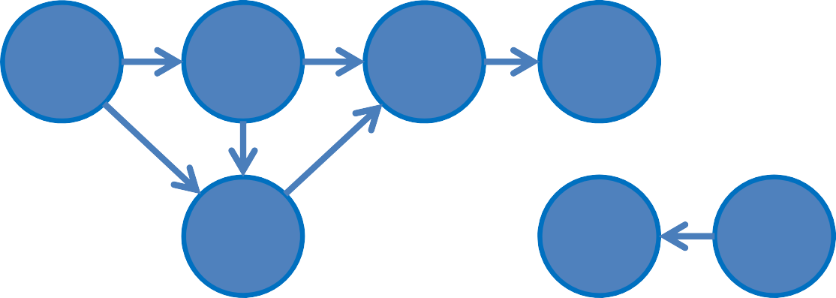
What can we do with BFS/DFS? (3)
Topological Sort
Topological sort of a DAG is a linear ordering of its vertices in which each vertex comes before all vertices to which it has outbound edges
Every DAG has one or more topological sorts
One of the main purpose of finding topological sort: for Dynamic Programming (DP) on DAG (will be discussed a few weeks later…)
0 | 1 | 3 | 4 | 5
 | 2 |  | 6 | 7
Reminder to myself: slow down here

Slide 37
What can we do with BFS/DFS? (4)
Topological Sort
If the graph is a DAG, then simply running DFS on it (and at the same time record the vertices in “post‐order” manner) will give us one valid topological order
“Post‐order” = process vertex u after all children of u have been visited
See pseudo code in the next slide
0 | 1 | 3 | 4 | 5
 | 2 |  | 6 | 7

Slide 38
DFS for TopoSort – Pseudo Code
Simply look at the codes in red/underlined
DFSrec(u)
visited[u] ← 1 // to avoid cycle
for all v adjacent to u // order of neighbor if visited[v] = 0 // influences DFS
p[v] ← u // visitation sequence DFSrec(v) // recursive (implicit stack)
append u to the back of toposort // "post-order"
// in the main method for all v in V
visited[v] ← 0
p[v] ← -1 clear toposort for all v in V
if visited[v] == 0
toposort is a kind of List (Vector)
DFSrec(s) // start the recursive call from s reverse toposort and output it

Slide 39
What can we do with BFS/DFS? (5)
Topological Sort
Suppose we have visited all neighbors of 0 recursively with DFS
toposort list = [list of vertices reachable from 0] ‐ vertex 0
Suppose we have visited all neighbors of 1 recursively with DFS
toposort list = [[list of vertices reachable from 1] ‐ vertex 1] ‐ vertex 0
and so on…
We will eventually have = [4, 3, 5, 2, 1, 0, 6, 7]
Reversing it, we will have = [7, 6, 0, 1, 2, 5, 3, 4]
0 | 1 | 3 | 4 | 5
 | 2 |  | 6 | 7

Slide 40
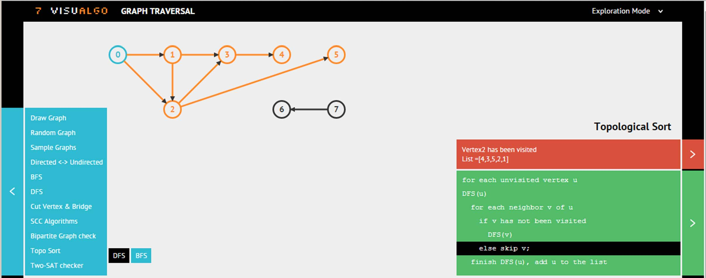
Topological Sort
Ask VisuAlgo to perform Topo Sort (DFS) operation on the sample Graph (CP3 4.4, Directed)
Below, we show partial execution of the DFS variant

Slide 41
Trade‐Off
O(V+E) DFS
Pros:
Slightly easier? to code (this one depends)
Use less memory
Has some extra features (not in CS2010 syllabus but useful for your PS3)
Cons:
Cannot solve SSSP on unweighted graphs
O(V+E) BFS
Pros:
Can solve SSSP on unweighted graphs (revisited in latter lectures)
Cons:
Slightly longer? to code (this one depends)
Use more memory (especially for the queue)

Slide 42
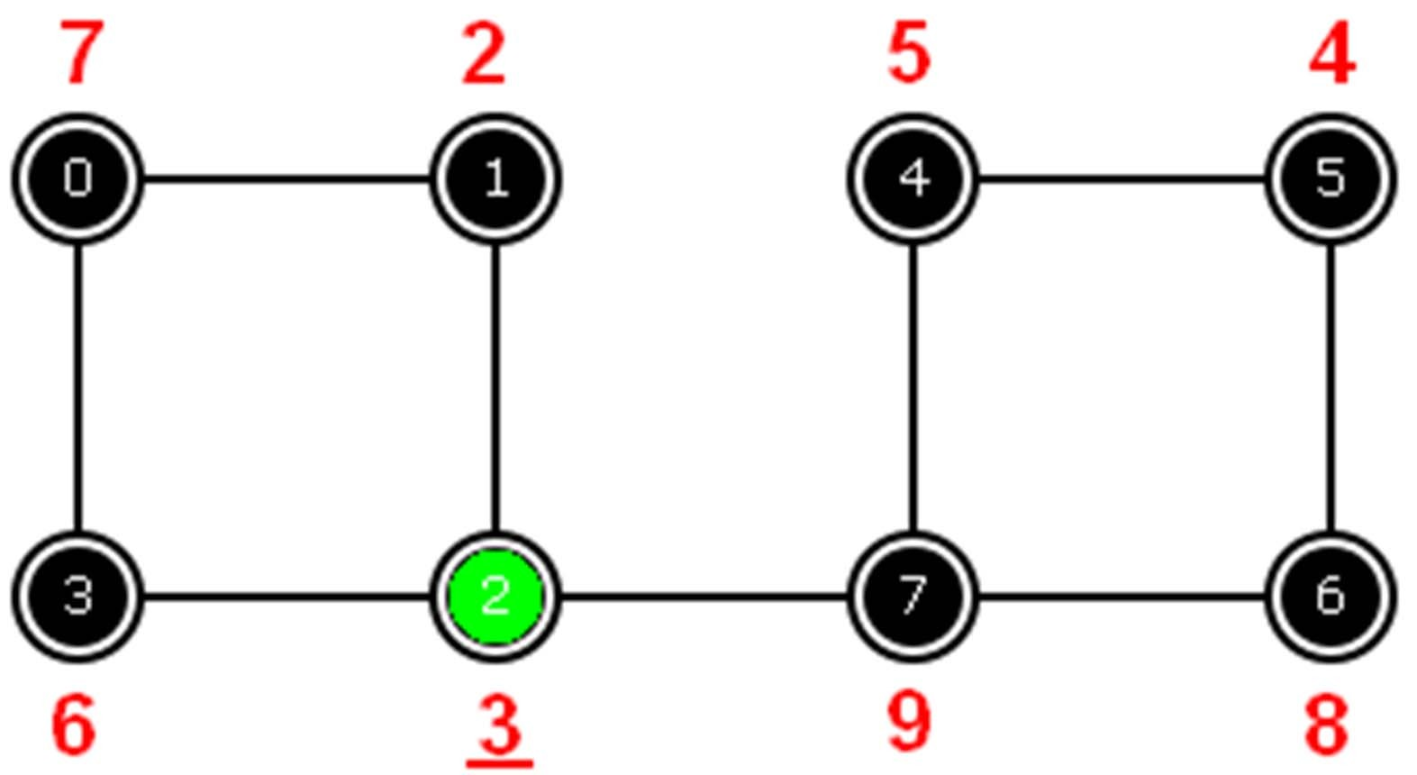
Hospital Tour Problem (PS3)
Given a layout of a hospital…
Determine which room(s) is/are the ‘important room(s)’
Among those room(s), pick one with the lowest rating score

Slide 43
Online Quiz 1 (Tomorrow)
(Thu, 17 Sep 2015, during your lab session)
Try OQ1 Preview (test ID: 31) if you have not done so
http://visualgo.net/test.html
You can always challenge yourself more with this:
http://visualgo.net/training.html?diff=Hard&n=20&tl=40& module=heap,bst,avl,ufds,bitmask,graphds

Slide 44
Written Quiz 1 (This Saturday)
(Sat, 19 Sep 2015, LT19, SR@LT19, TR9)
3 Sections only, 90 minutes:
Most basic questions about Binary Heap/BST/AVL/UFDS/ Bitmask/Graph Data Structures have been automated in the Online Quiz 1
So this one is definitely (much) harder than Online Quiz 1…
Disclaimer: Doing well in OQ1 may not correlate with doing well in WQ1
Material:
• Lecture 1‐2‐3‐4‐5, Tutorial 1‐2‐3‐4, Lab Demos 1‐2‐3‐4, PS1‐2
IMPORTANT: UFDS, bitmask, and Graph DSes are included
Lecture 06 (DFS/BFS) is excluded
• CP3: page 36‐54 ☺

Slide 45
Summary
In this lecture, we have looked at:
Some applications of Graph Data Structures
Continuation from Lecture 05
Graph Traversal Algorithms: Start + Movement
Breadth‐First Search: uses queue, breadth‐first
Depth‐First Search: uses stack/recursion, depth‐first
Both BFS/DFS uses “flag” technique to avoid cycling
Both BFS/DFS generates BFS/DFS “Spanning Tree”
Some applications: Reachability, CC, Toposort

Slide 46
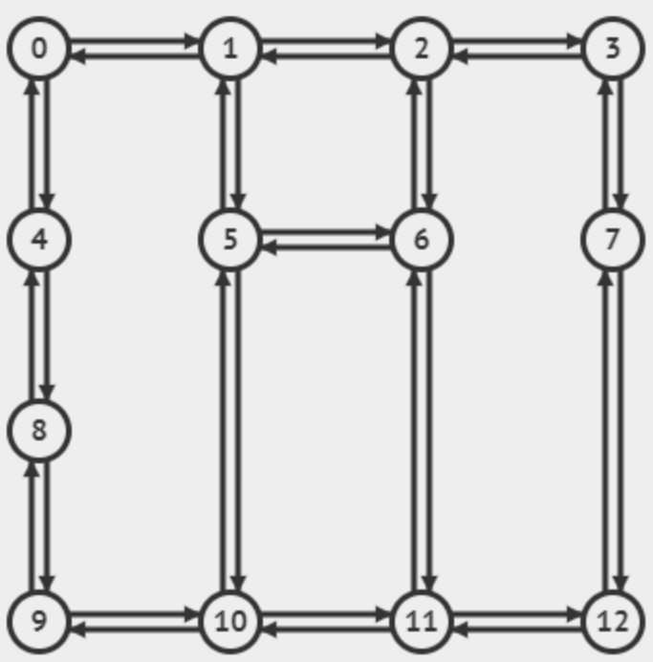
Revision
Duyệt BFS, DFS đồ thị sau, xuất phát từ đỉnh 0, ưu tiên đỉnh có số thứ tự bé hơn
Trình bày theo dạng:
BFS:
DFS:
Notes:
BFS: 0 1 4 2 5 8 3 6 10 9 7 11 12
DFS: 0 1 2 3 7 12 11 6 5 10 9 8 4

