Slide 1

Data Structures and Algorithms
Connecting People

Slide 2
Acknowledgement
The contents of these slides have origin from School of Computing, National University of Singapore.
We greatly appreciate support from Dr. Steven Halim for kindly sharing these materials.

Slide 3
Policies for students
These contents are only used for students PERSONALLY.
Students are NOT allowed to modify or deliver these contents to anywhere or anyone for any purpose.

Slide 4
Recording of modifications
Currently, there are no modification on these contents.

Slide 5

CS2010 – Data Structures and Algorithms II
Lecture 07 – Connecting People
stevenhalim@gmail.com

Slide 6
Outline
Minimum Spanning Tree (MST), CP3 Section 4.3
Motivating Example & Some Definitions
Two Algorithms to solve MST (you have a choice!)
Prim’s (greedy algorithm with PriorityQueue)
PriorityQueue is discussed in Lecture 03‐04 (not just Lecture 02)
Kruskal’s (greedy algorithm, uses sorting and UFDS)
UFDS is discussed in Lecture 05

Slide 7
Review
Definitions that we have learned before
Tree T
T is a connected graph that has V vertices and V‐1 edges
Important: One unique path between any two pair of vertices in T
Spanning Tree ST of connected graph G
ST is a tree that spans (covers) every vertices in G
Recall the BFS and DFS Spanning Tree
Sorting problem & several sorting algorithms
Rearrange set of objects so that every pair of objects (a, b; a < b)
in the final arrangement satisfies that a is before b

Slide 8
Is This A Tree?
Yes, why
No, why
20
0
1 2
1
4
3
2
0

Slide 9
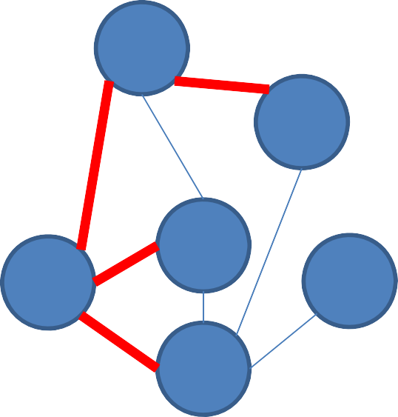
Are the edges highlighted in red part of a spanning tree of the original graph?
15
5
1 2
Yes, why
No, why
1
4
3
2
0
5

Slide 10
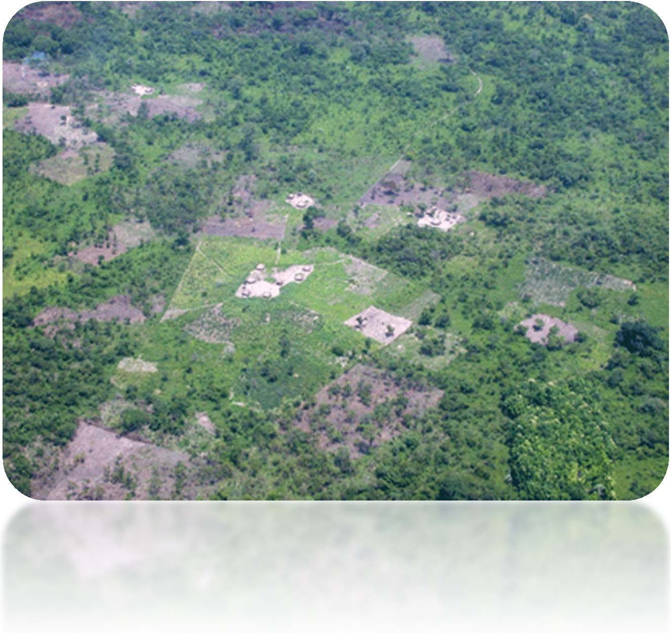
Motivating Example
Government Project
Want to link rural villages with roads
The cost to build
a road depends on the terrain, etc
You only have limited budget
How are you going to build the roads?

Slide 11
More Definitions (1)
Vertex set V (e.g. street intersections, houses, etc)
Edge set E (e.g. streets, roads, avenues, etc)
Generally undirected (e.g. bidirectional road, etc)
Weighted (e.g. distance, time, toll, etc)
Weight function w(a, b): E→R
Sets the weight of edge from a to b
Weighted Graph: G(V, E), w(a, b): E→R
Connected undirected graph G
There is a path from any vertex a to any other vertex b in G

Slide 12
More Definitions (2)
Spanning Tree ST of G
Let w(ST) denotes the total weight of edges in ST
w(ST ) = ∑ w(a, b)
(a,b)∈ST
Minimum Spanning Tree (MST) of connected undirected weighted graph G
MST of G is an ST of G with the minimum possible w(ST)

Slide 13
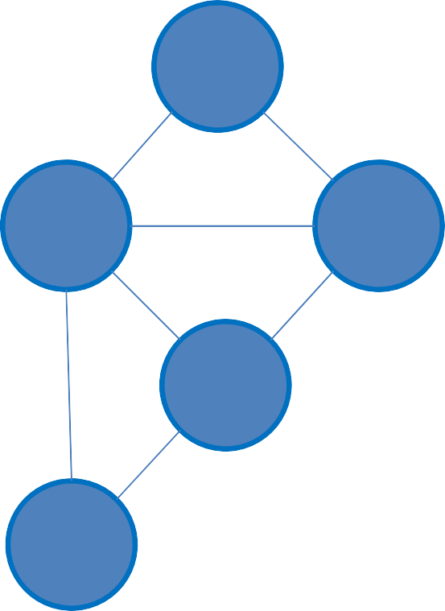
More Definitions (3)
The (standard) MST Problem
Input: A connected undirected weighted graph G(V, E)
Select some edges of G such that the graph is still connected,
1
5
but with minimum total weight
4
2
– Output: Minimum Spanning Tree
(MST) of G
0
2
5
8
6
3
9
4

Slide 14

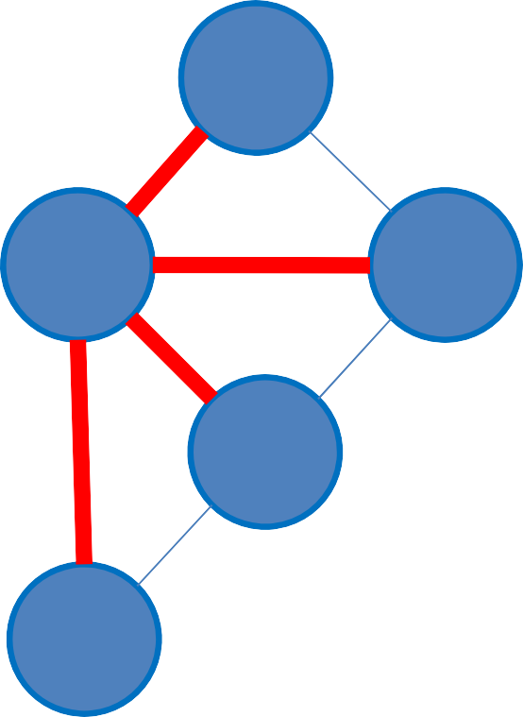
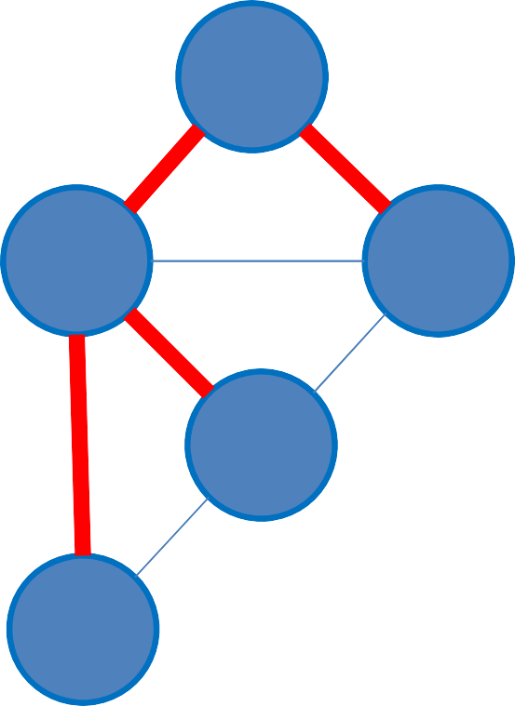
Example
The Original Graph
A Spanning Tree Cost: 4+4+6+6 = 20
An MST
Cost: 4+6+6+2 = 18
1
4
1
4
1
4
4
2
4
2
4
2
0
2
0
2
0
2
6
6
6
8
8
8
6
3
6
3
6
3
9
9
9
4
4
4

Slide 15

Are the edges highlighted in red part of an MST of the original graph?
20
₀ 1
1 2 3
No, we must replace edge 0‐3 with edge 2‐3
No, we must replace edge 1‐2 with 0‐2
1
4
5
3.
Yes
3
2
0
2
1
6
3
7
4

Slide 16
MST Algorithms
MST is a well‐known Computer Science problem Several efficient (polynomial) algorithms:
Jarnik’s/Prim’s greedy algorithm
Uses PriorityQueue Data Structure taught in Lecture 02‐04
Kruskal’s greedy algorithm
Uses Union‐Find Data Structure taught in Lecture 05
Boruvka’s greedy algorithm (not discussed here)
And a few more advanced variants/special cases…

Slide 17
Do you still remember Prim’s/Kruskal’s algorithms from CS1231?
Yes and I also know how to
implement them
Yes, but I have not try implementing them yet
I forgot that particular CS1231 material…
but I know it exists
Eh?? These two algorithms were covered before in CS1231??
I haven’t took CS1231 ☹
9
7
3
2 2
1 2 3 4 5

Slide 18
Grid MST, ICPC SG Prelim 2015
https://open.kattis.com/problems/gridmst/ https://open.kattis.com/problems/gridmst/statistics
If you know basic MST algorithm…, you still canNOT solve this problem
But you can solve the simplified form when N
is small (1 ≤ N ≤ 1000)

Slide 19
Prim’s Algorithm
Very simple pseudo code
T ← {s}, a starting vertex
s (usually vertex to s (only the other
0)
ending
enqueue edges connected
vertex and edge
weight)
into a priority
queue PQ
that orders elements
based
on increasing
weight
while there are take out the
unprocessed
edges left
in PQ
front
most with
edge this this
e
edge e is edge e)
if vertex v linked
not taken yet
T ⬅ T ∪
v (including
enqueue edges
T is an MST
connected
to v (as
above)

Slide 20
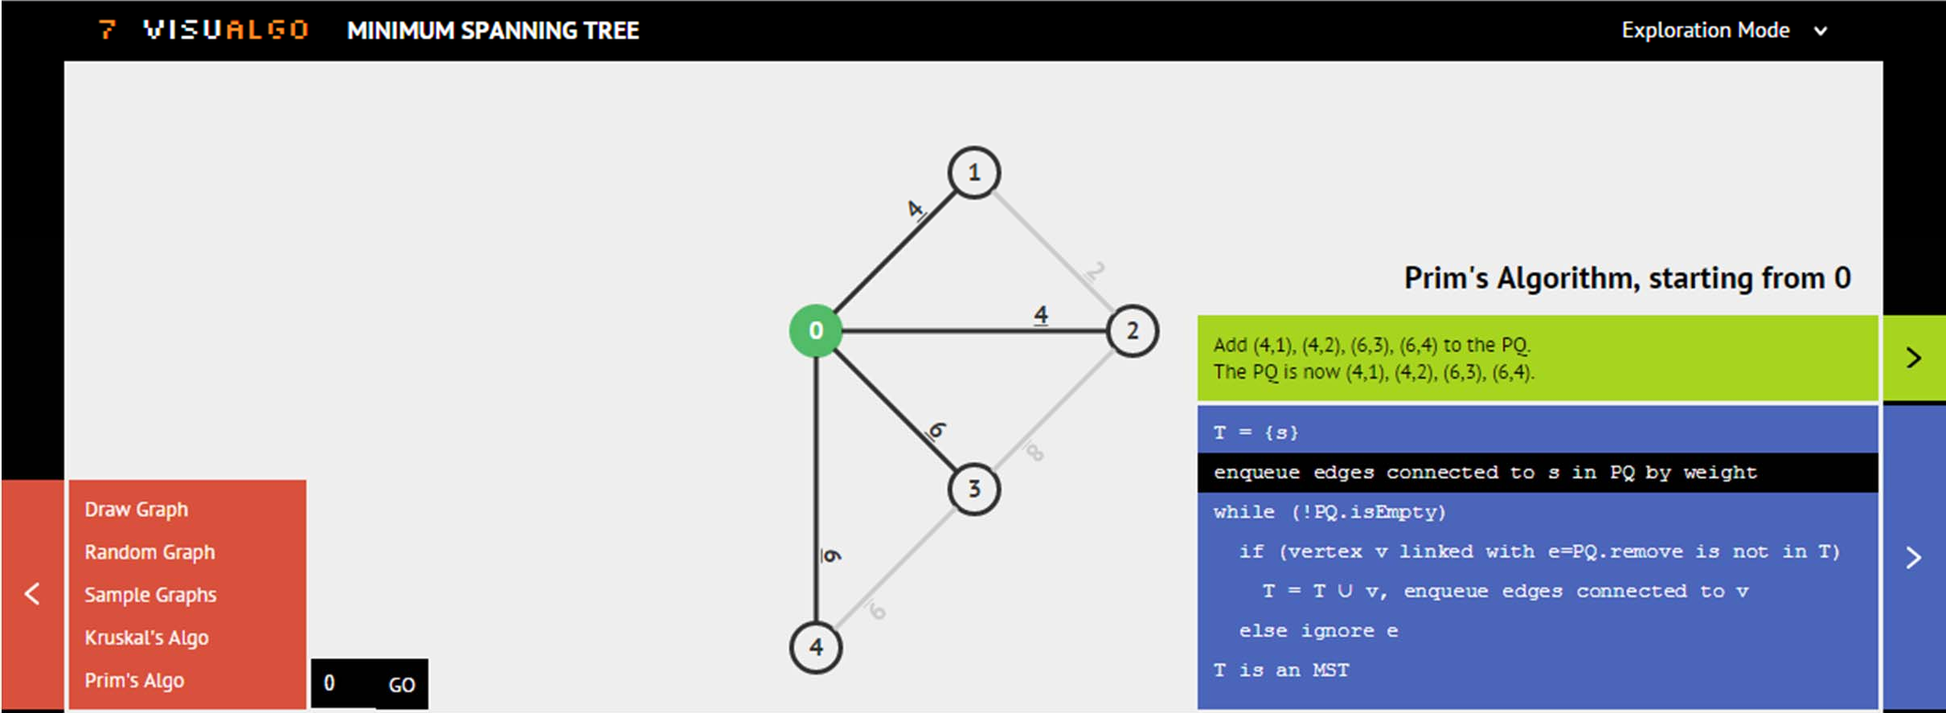
MST Algorithm: Prim’s
Ask VisuAlgo to perform Prim’s from various sources
on the sample Graph (CP3 4.12), then try other graphs
In the screen shot below, we show the start of Prim(0)

Slide 21
Easy Java Implementation
You just need to use two known Data Structures to be able to implement Prim’s algorithm:
A priority queue (we can use Java PriorityQueue), and
A Boolean array (to decide if a vertex has been taken or not)
With these DSes, we can run Prim’s in O(E log V)
We process each edge once, O(E)
Each time, we Insert/ExtractMax from a PQ in O(log E)
As E = O(V²), we have O(log E) = O(log V²) = O(2 log V) = O(log V)
Let’s have a quick look at PrimDemo.java

Slide 22
Why Prim’s Works? (1)
First, we have to realize that Prim’s algorithm
is a greedy algorithm
This is because at each step, it always try to select the next valid edge e with minimal weight (greedy!)
Greedy algorithm is usually simple to implement
However, it usually requires “proof of correctness”
You will see such proof like this again in CS3230
Here, we will just see a quick proof

Slide 23
Why Prim’s Works? (2)
see visual explanation in the next two slides
Let T be the spanning tree of graph G generated by Prim’s algorithm and T* be the spanning tree of G that is known to have minimal cost
If T == T*, we are done
If T != T*
Let e_{k} = (u, v) be the first edge chosen by Prim’s algorithm at the k‐th iteration that is not in T*
Let P be the path from u to v in T*, and let e* be an edge in P such that one endpoint is in the tree generated at the (k−1)‐th iteration of Prim's algorithm and the other is not
i.e. one endpoint of e* is u or one endpoint is v, but the endpoints are not u and v

Slide 24
Why Prim’s Works? (3)
see visual explanation in the next slide
If T != T* (continued)
If the weight of e* is less than the weight of e_{k}, then Prim's algorithm would have chosen e* on its k‐th iteration
So, it is certain that w(e*) ≥ w(e_{k})
When e* has weight equal to that of e_{k}, the choice between the e* or e_{k} is arbitrary
Whether the weight of e* is greater than or equal to e_{k}, e* can be substituted with e_{k} while preserving minimal total weight of T*
This process can be repeated until T* is equal to T
Thus we can show that the spanning tree generated by any instance of Prim's algorithm is a minimal spanning tree

Slide 25

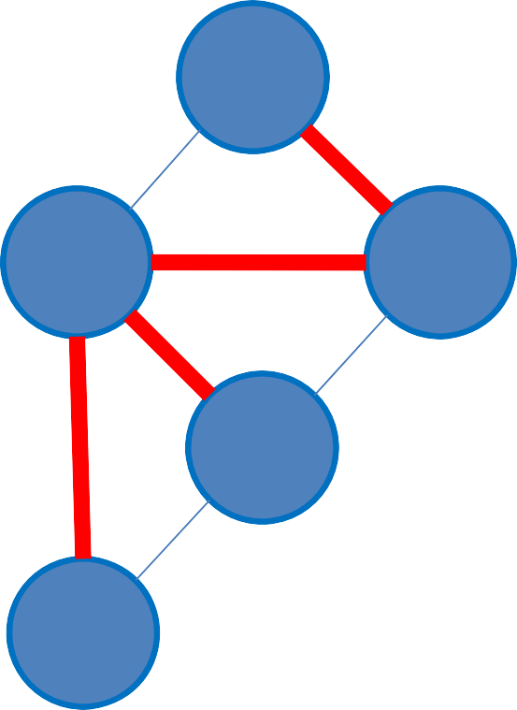
Visual Explanation
Our Prim’s algorithm reports this MST T
Suppose that this is the optimal MST T*
1
4
1
4
4
2
4
2
0
2
0
2
6
6
8
8
6
3
6
3
9
9
4
4
e₁ = (0‐1) at iteration 1 P = 0‐2‐1 in T*
e* is (0‐2)
If we substitute e₁ with e*, we can transform T to T*

Slide 26
Coming up next: Kruskal’s algorithm
5 MINUTES BREAK

Slide 27

Kruskal’s Algorithm
Very simple pseudo code
sort the set of E edges by increasing weight T ← {}
while there are unprocessed edges pick an unprocessed edge e with
left
min cost
if adding e to T does not form a
cycle
add e to T T is an MST

Slide 28
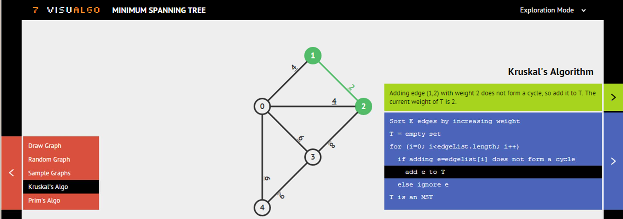
MST Algorithm: Kruskal’s
Ask VisuAlgo to perform Kruskal’s on the sample Graph (CP3 4.11), then try other graphs
In the screen shot below, we show the start of Kruskal
(there is no parameter for this algorithm)

Slide 29
Why Kruskal’s Works? (1)
Kruskal’s algorithm is also a greedy algorithm
Because at each step, it always try to select the next unprocessed edge e with minimal weight (greedy!)
Simple proof on how this greedy strategy works
Let’s define a loop invariant: Every edge e that is added into T
by Kruskal’s algorithm is part of the MST

Slide 30
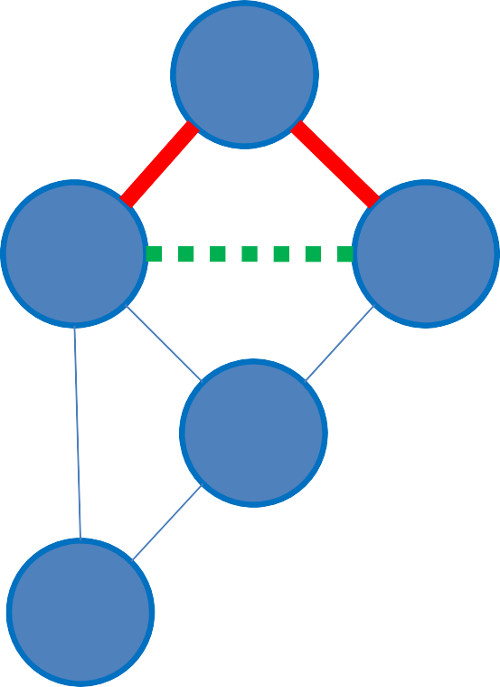
Why Kruskal’s Works? (2)
Cannot connect 0 and 2 As it will form a cycle
Loop invariant: Every edge e that is added into T
by Kruskal’s algorithm is part of the MST.
sort E edges by increasing weight T ← {}
while there are unprocessed edges left
pick an unprocessed edge e with min cost
if adding e to T does not form a cycle add e to T
T is an MST
1
4
4
2
0
2
6
8
Kruskal’s algorithm has a special cycle check before adding an edge e into T. Edge e will never form a cycle.
6
3
9
At the start of every loop, T is always part of MST.
4
At the end of the loop, we have selected V‐1 edges from a connected weighted graph G without having any cycle. This implies that we have a Spanning Tree.

Slide 31
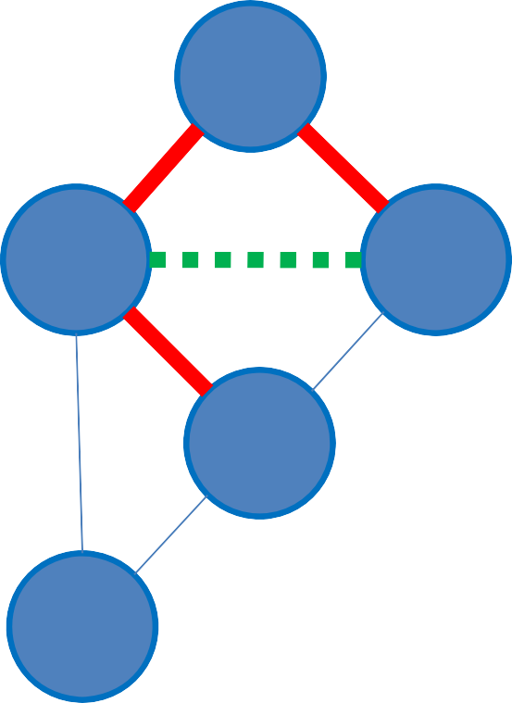
Why Kruskal’s Works? (3)
Connect 0 and 3 The next smallest edge
Loop invariant: Every edge e that is added into T
by Kruskal’s algorithm is part of the MST.
sort E edges by increasing weight T ← {}
while there are unprocessed edges left
pick an unprocessed edge e with min cost
if adding e to T does not form a cycle add e to T
T is an MST
1
4
4
2
0
2
6
8
By keep adding the next unprocessed edge e with min cost, w(T U e) ≤ w(T U any other unprocessed edge that does not form cycle).
6
3
9
4
At the start of every loop, T is always part of MST.
At the end of the loop, the Spanning Tree T must have minimal weight w(T), so T is the final MST.

Slide 32
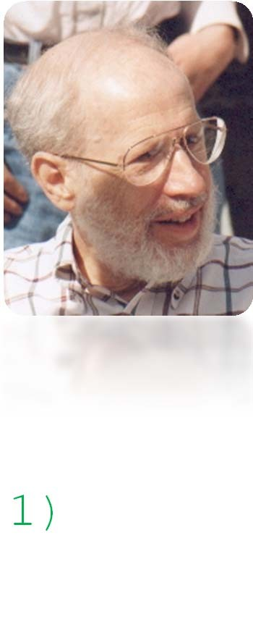
Kruskal’s Implementation (1)
(1)
sort E
edges
by increasing
weight
// O(E log E)
T ← {}
while
pick
there
are unprocessed
edges
left // O(E) min // O
an unprocessed
edge
e with
cost
if adding
e to T does not form T
a cycle
// O(?)
add e to T is an MST
the // O(1)
To sort the edges:
We use EdgeList to store graph information
Then use “any” sorting algorithm that we have seen before
To test for cycles:
We use Union‐Find Disjoint Sets

Slide 33

Sorting Edges in Edge List
Adjacency Matrix/List that we have learned previously are not suitable for edge‐sorting task!
To sort EdgeList, we use one liner Java Collections.sort :O
Yeah, you don’t have to use merge/quick sort in CS1020… :O
1
4
i | w | u | v
0 | 2 | 1 | 2
1 | 4 | 0 | 1
2 | 4 | 0 | 2
3 | 6 | 0 | 3
4 | 6 | 0 | 4
5 | 8 | 2 | 3
6 | 9 | 3 | 4
4
2
0
2
6
8
6
3
9
4

Slide 34

Kruskal’s Implementation (2)
) = O(1)
sort E
edges
by increasing
weight
// O(E log E)
T ← {}
while
pick
there
are unprocessed
edges
left // O(E) min
an unprocessed
edge
e with
cost // O(1)
if adding
e to T does
T //
not form
a cycle
// O(α(V)
add e
to the
O(1)
T is an MST
To sort the edges, we need O(E log E)
To test for cycles, we need O(α(V)) – small, assume constant O(1) In overall
Kruskal’s runs in O(E log E + E α(V)) // E log E dominates!
•
As E = O(V²), thus Kruskal’s runs in O(E log V²) = O(E log V)
Let’s have a quick look at KruskalDemo.java

Slide 35
If given an MST problem, I will…
Use/code Kruskal’s algorithm
Use/code Prim’s algorithm
No preference…
7 7 7
1 2 3

Slide 36
Summary
Re‐introducing the MST problem (covered in CS1231) Discussing the implementation of Prim’s algorithm
Revisiting the PriorityQueue ADT
Discussing the implementation of Kruskal’s algorithm
Revisiting the EdgeList and showing technique to sort edges
Revisiting the Union‐Find Disjoint Sets DS
You may learn MST/Prim’s/Kruskal’s again in CS3230

Slide 37
PS4 should now be doable ☺
It will not due until Sat, 17 Oct 2015, 8am, because I want to give you time off from CS2010 in Week 07
But it is always better to attempt it earlier than later
Reminder to self (re‐discuss TopoSort if still have time)

Slide 38
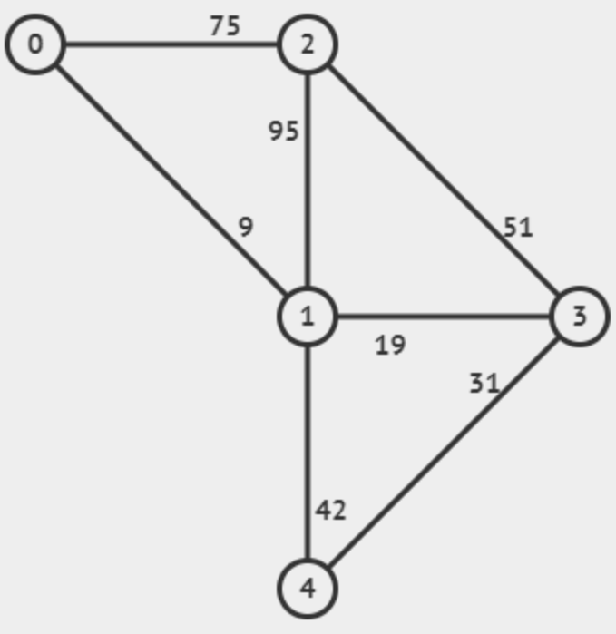
Revision
Trình bày giải thuật Kruskal tìm MST trên đồ thị sau

Slide 39
Answer
Edge | Selected? | Vertices of MST
9,0-1 | Yes | {0, 1}
19,1-3 | Yes | {0, 1, 3}
31,3-4 | Yes | {0, 1, 3,4}
42,1-4 | No | {0, 1, 3,4}
51,2-3 | Yes | {0, 1, 2, 3,4}
75,0-2 | No | {0, 1, 2, 3,4}
95,1-2 | No | {0, 1, 2, 3,4}

Slide 40
Answer
Notes:
W = 9 + 19 + 31 + 51 = 110

