Slide 1

Data Structures and Algorithms
Finding Shortest Way
From Here to There, Part I

Slide 2
Acknowledgement
The contents of these slides have origin from School of Computing, National University of Singapore.
We greatly appreciate support from Dr. Steven Halim for kindly sharing these materials.

Slide 3
Policies for students
These contents are only used for students PERSONALLY.
Students are NOT allowed to modify or deliver these contents to anywhere or anyone for any purpose.

Slide 4
Recording of modifications
Currently, there are no modification on these contents.

Slide 5

Lecture 08 – Finding Shortest Way
CS2010 – Data Structures and Algorithms II
from Here to There, Part I
stevenhalim@gmail.com

Slide 6
Outline
Single‐Source Shortest Paths (SSSP) Problem
Motivating example
Some more definitions
Discussion of negative weight edges and cycles
Algorithms to Solve SSSP Problem (CP3 Section 4.4)
BFS algorithm cannot be used for the general SSSP problem
Bellman Ford’s algorithm
Pseudo code, example animation, and later: Java implementation
Theorem, proof, and corollary about Bellman Ford’s algorithm

Slide 7
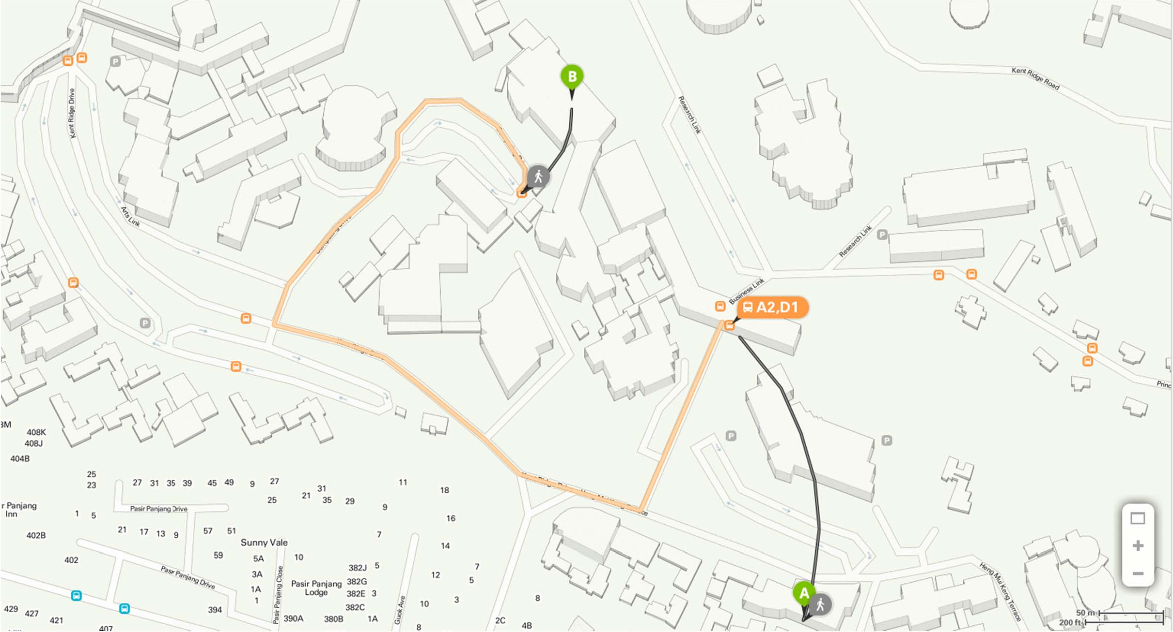
Motivating Example

Slide 8
Review: Definitions that you know (1)
Vertex set V (e.g. street intersections, houses, etc)
Edge set E (e.g. streets, roads, avenues, etc)
Directed (e.g. one way road, etc)
Note that we can simply use 2 edges (bi‐directional) to model 1 undirected edge (e.g. two ways road, etc)
Recall that for the MST problem discussed in the previous lecture, we generally deal with a connected undirected weighted graph
Weighted (e.g. distance, time, toll, etc)
Weight function w(a, b): E→R, sets the weight of edge from a to b
Weighted Graph: G(V, E), w(a, b): E→R

Slide 9
Review: Definitions that you know (2)
(Simple) Path
p = ⟨v₀ , v₁, v₂ ,😐, v_{k} ⟩
– Where
^{(v}i ^{, v}i+1 ^{) ∈ E,∀}0≤i≤( k −1)
– Simple = No repeated vertex!
Shortcut notation: v₀ v_{k}
p
– Means that p is a path from v₀ to v_{k}
k −1
Path weight: PW ( p) = ∑w(v_{i} , v_{i+1} )
i=0

Slide 10
More Definitions (1)
Shortest Path weight from vertex a to b: δ(a, b)
– δ is pronounced as ‘delta’
If there exists such path
p
⎧min(PW ( p))
δ (a, b) = ⎨
⎩
a b
If b is unreachable from a
∞
Single‐Source Shortest Paths (SSSP) Problem:
Given G(V, E), w(a, b): E‐>R, and a source vertex s
Find δ(s, b) (+best paths) from vertex s to each vertex b ∈ V
i.e. From one source to the rest

Slide 11
More Definitions (2)
Additional Data Structures to solve the SSSP Problem:
An array/Vector D of size V (D stands for ‘distance’)
Initially, D[v] = 0 if v = s; otherwise D[v] = ∝ (a large number)
D[v] decreases as we find better paths
D[v] ≥ δ(s, v) throughout the execution of SSSP algorithm
D[v] = δ(s, v) at the end of SSSP algorithm
An array/Vector p of size V
p[v] = the predecessor on best path from source s to v
p[s] = NULL (not defined, we can use a value like ‐1 for this)
Recall: The usage of this array/Vector p is already discussed
in BFS/DFS Spanning Tree (and also in PS4, Min Spanning Tree)

Slide 12
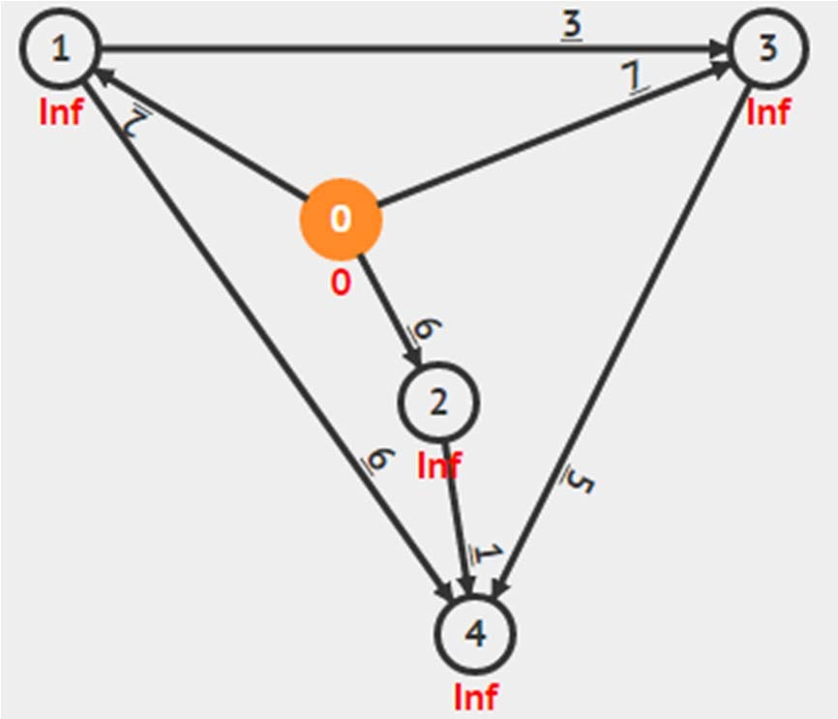
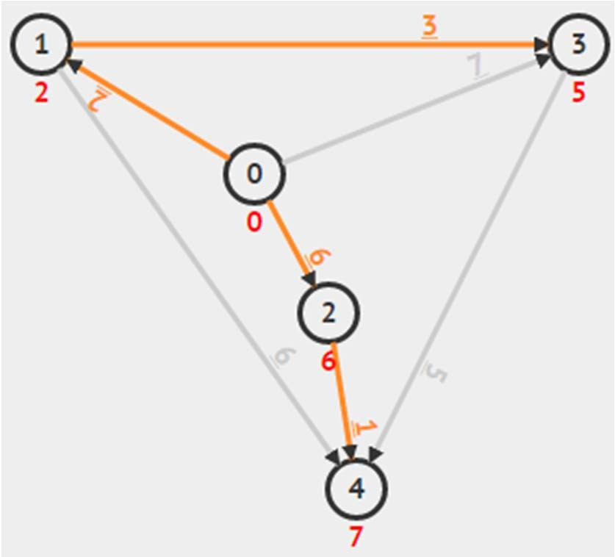
Example
s = 0 Initially:
D[s] = D[0] = 0
D[v]= ∝ for the rest
Denoted as values in red font/vertex p[s] = ‐1 (to say ‘no predecessor’) p[v] = ‐1 for the rest
Denoted as orange edges (none initially)
s = 0
At the end of algorithm: D[s] = D[0] = 0 (unchanged)
D[v] = δ(s, v) for the rest e.g. D[2] = 6, D[4] = 7
p[s] = ‐1 (source has no predecessor)
p[v] = the origin of orange edges for the rest e.g. p[0] = 2, p[4] = 0

Slide 13
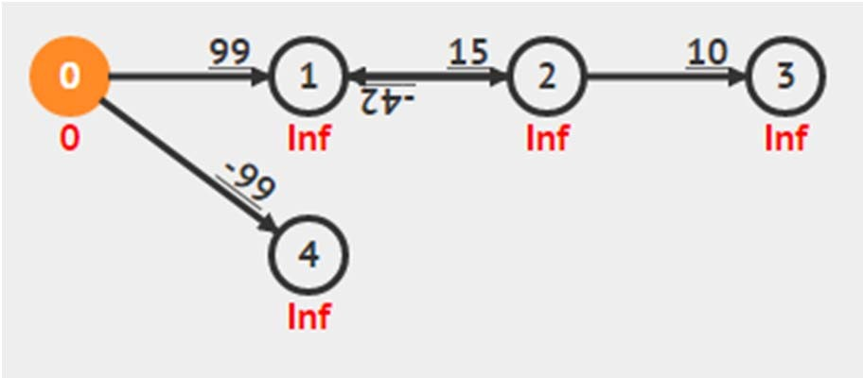
Negative Weight Edges and Cycles
They exist in some applications
Fictional application: Suppose you can travel back in time by passing through time tunnel (edges with negative weight)
Shortest paths from 0 to {1, 2, 3} are undefined
1→2→1 is a negative cycle as it has negative total path (cycle) weight
One can take 0→1→2→1→2→1→… indefinitely to get ‐∝
Shortest path from 0 to 4 is ok, with δ(0, 4) = ‐99

Slide 14
SSSP Algorithms
This SSSP problem is a(nother) well‐known CS problem We will discuss three algorithms in this lecture:
O(V+E) BFS fails on general case of SSSP problem
Introducing the “initSSSP” and “Relax” operations
O(VE) Bellman Ford’s SSSP algorithm
General idea of SSSP algorithm
Trick to ensure termination of the algorithm
Bonus: Detecting negative weight cycle

Slide 15
Initialization Step
We will use this initialization step for all our SSSP algorithms
initSSSP(s)
for each D[v] ←
p[v] ←
v ∈ V // initialization phase
1000000000 // use 1B
to represent INF
-1 // use -1 to
0 // this is what
represent NULL
so far
D[s] ←
we know

Slide 16
“Relax” Operation
(abbreviated name of these actions)
relax(u,
v, w_u_v)
> D[u]+w_u_v // if
if D[v]
be shortened this edge
the predecessor
SP can
D[v] ←
p[v] ←
D[u]+w_u_v // relax
u // remember/update
// if
necessary, update
some
data structure
u
4
4
4
p[u] = x
9
v
x
9
0
p[v] = x
8
p[v] = u

Slide 17
Review: BFS
When the graph is unweighted*, the SSSP can be viewed as a problem of finding the least number of edges traversed from source s to other vertices
* We can view each edge as having weight 1 or constant weight
The O(V+E) Breadth First Search (BFS) traversal algorithm precisely measures such thing
BFS Spanning Tree = Shortest Paths Spanning Tree

Slide 18
Modified BFS
Do these three simple modifications:
Rename visited to D ☺
At the start of BFS, set D[v] = INF (say, 1B) for all v in G, except D[s] = 0 ☺
Change this part (in the BFS loop) from:
if visited[v] = 0 visited[v] = 1;
into:
// if v is
// set v
not visited
before
as reachable
from u
if D[v] = INF // D[v] = D[u]+1;
if v is not visited
// v is
before
1 step away
from u ☺

Slide 19
Modified BFS Pseudo Code (1)
for all v in V D[v] ← INF
p[v] ← -1
Initialization phase
Q ← {s} // start from s D[s] ← 0
while Q is not empty u ← Q.dequeue() for all v adjacent
to u // order of neighbor influences BFS
// visitation sequence
if D[v] = D[v] ←
p[v] ←
INF // D[u]+1
u
Main loop
Q.enqueue(v)
// we can then use information stored in D/p

Slide 20
Modified BFS Pseudo Code (2)
simpler form
initSSSP(s)
Q ← {s} // start from s
Initialization phase
while Q is not empty u ← Q.dequeue()
for all v adjacent to u // order of neighbor relax(u, v, 1); // the weight is 1
Main loop
// we can then use information stored in D/p

Slide 21
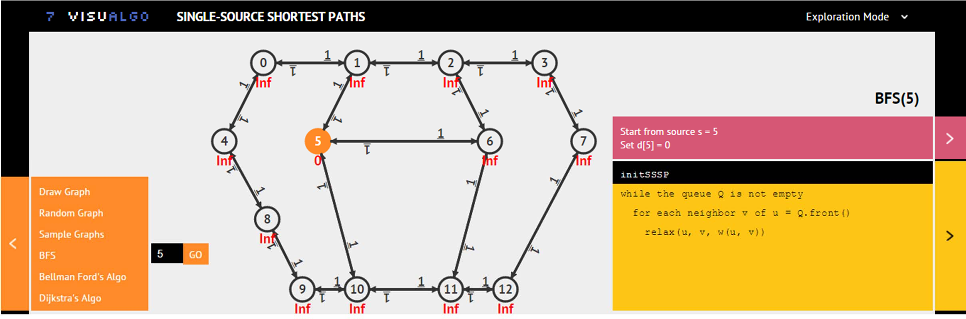
SSSP: BFS on Unweighted Graph
Ask VisuAlgo to perform BFS from various sources
on the sample Graph (CP3 4.3)
In the screen shot below, we show the start of BFS from source vertex 5 (the same example as in Lecture 06,
it just looks messier due to bidirectional edges)

Slide 22
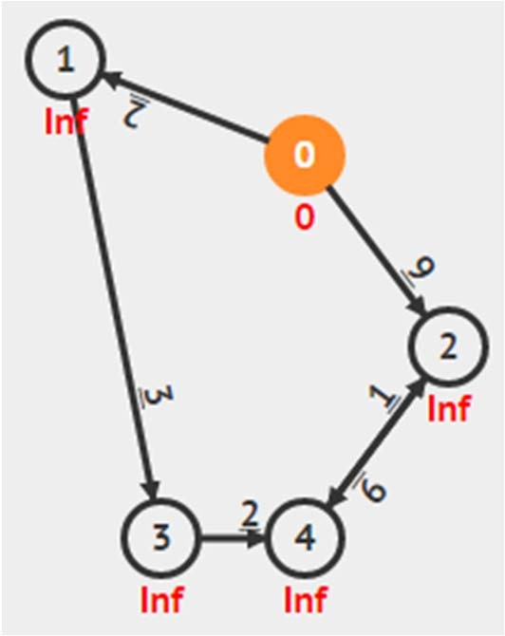
But BFS will not work on general cases
The shortest path from 0 to 2 is not path 0→2 with weight 9, but a “detour” path 0→1→3→4→2 with weight 2+3+2+1= 8
BFS cannot detect this and will only report path 0→2 (wrong answer)
You can draw this graph @ VisuAlgo and try it for yourself
Rule of Thumb:
If you know for sure that your graph is unweighted (all edges have weight 1 or all edges have the same constant weight), then solve SSSP problem on it using the more efficient O(V+E) BFS algorithm

Slide 23
Reference: CP3 Section 4.4 (especially Section 4.4.4) visualgo.net/sssp.html
BELLMAN FORD’S SSSP ALGORITHM

Slide 24
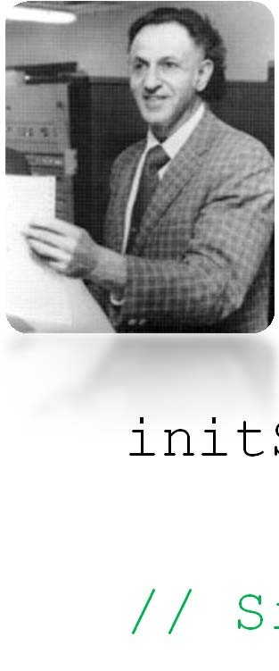

Bellman Ford’s Algorithm
init
// S
SSSP(s)
imple for i = 1
Bellman
Ford's
algorithm
runs
in O(VE)
to |V|-1
// O(V) here v)
for each
edge(u,
∈ E //
O(E)
here
relax(u,
v, w_u_v)
// O(1)
here
//
// D[v]
algorithm, weight cycle
At the end of Bellman Ford's
= δ(s, v) if no negative
exist
// Q: Why "relaxing
all edges
V–1 times"
works?

Slide 25
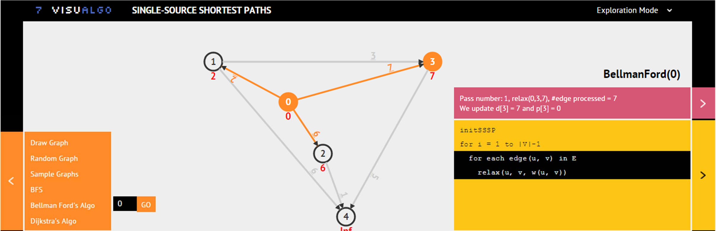
SSSP: Bellman Ford’s
Ask VisuAlgo to perform Bellman Ford’s algorithm
from various sources on the sample Graph (CP3 4.17)
The screen shot below is the first pass of all E edges of BellmanFord(0)

Slide 26
Theorem: If G = (V, E) contains no negative weight cycle, then the shortest path p from s to v is a simple path
4
Suppose the shortest path p is not a simple path
Then p contains one (or more) cycle(s)
Suppose there is a cycle c in p with positive weight
If we remove c from p,
then we have a shorter ‘shortest path’ than p
This contradicts the fact that p is a shortest path
Let’s do a Proof by Contradiction!
1 2
3

Slide 27
Theorem: If G = (V, E) contains no negative weight cycle, then the shortest path p from s to v is a simple path
0
6. Even if c is a cycle with zero total
1 0 3
weight (it is possible!), we can still remove c from p
without increasing the shortest path weight of p
7. So, p is a simple path (from point 5) or can always be made into a simple path (from point 6)
In another word, path p has at most |V|‐1 edges from the source s to the “furthest possible” vertex v in G (in terms of number of edges in the shortest path)

Slide 28
Theorem: If G = (V, E) contains no negative weight cycle, then after Bellman Ford’s terminates D[v] = δ(s, v), ∀v ∈ V
Let’s do a Proof by Induction!
Consider the shortest path p from s to v_{i}
(p will have minimum number of edges)
– v_{i} is defined as a vertex which shortest path requires i hops (number of edges) from s
Initially D[v₀] = δ(s, v₀) = 0, as v₀ is just s
After 1 pass through E, we have D[v₁] = δ(s, v₁)

Slide 29
Theorem: If G = (V, E) contains no negative weight cycle, then after Bellman Ford’s terminates D[v] = δ(s, v), ∀v ∈ V
After 2 passes through E, we have D[v₂] = δ(s, v2), ...
After k passes through E, we have D[v_{k}] = δ(s, v_{k})
When there is no negative weight cycle, the shortest path p will be simple (see the previous proof)
Thus, after |V|‐1 iterations, the “furthest” vertex
v_{|V|‐1} from s has D[v_{|V|‐1}] = δ(s, v_{|V|‐1})
– Even if edges in E are in worst possible order
3
1 2 3
2
1

Slide 30
“Side Effect” of Bellman Ford’s
Corollary: If a value D[v] fails to converge after |V|‐1 passes, then there exists a negative‐weight cycle reachable from s
Additional check after running Bellman Ford’s:
for each edge(u,
v) ∈ E
if D[v] > D[u]+w(u, v)
report negative weight
cycle
exists in G

Slide 31
Java Implementation (2)
See BellmanFordDemo.java
Now implemented using AdjacencyList ☺
AdjacencyList or EdgeList can be used to have an O(VE) Bellman Ford’s
Show performance on:
Small graph without negative weight cycle → OK, in O(VE)
Small graph with negative weight cycle → terminate in O(VE)
Plus we can report that negative weight cycle exists
Small graph; some negative edges; no negative cycle → OK

Slide 32
Summary
Introducing the SSSP problem
Revisiting BFS algorithm for unweighted SSSP problem
But it fails on general case
Introducing Bellman Ford’s algorithm
This one solves SSSP for general weighted graph in O(VE)
Can also be used to detect the presence of ‐ve weight cycle

Slide 33
PS5* should now be doable ☺
* The first Subtask of PS5…
(but I will only open it on Saturday, 17 Oct 2015, 8am)
Subtask B (easy), Subtask C (medium‐hard), and Subtask E (R‐option, also medium‐hard) require something else ☺
Train first to check basic understanding of the past two lectures on graph algorithms:
http://visualgo.net/training.html?diff=Medium&n=5&tl=0&module=mst,sssp

Slide 34
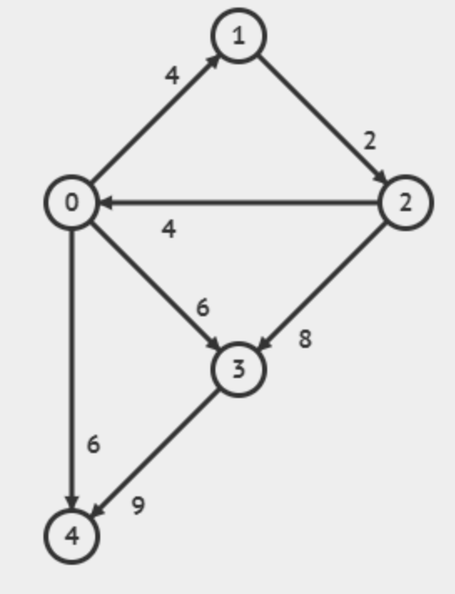
Revision
Dùng giải thuật Bellman Ford bắt đầu từ đỉnh 1, tìm đường đi ngắn nhất trong đồ thị sau:

